Slide 1
Carcinoma of prostate
Renal Module
4th Year MBBS
Dr Kiran Fatima
Pathology Department
Rawalpindi Medical University

Slide 2
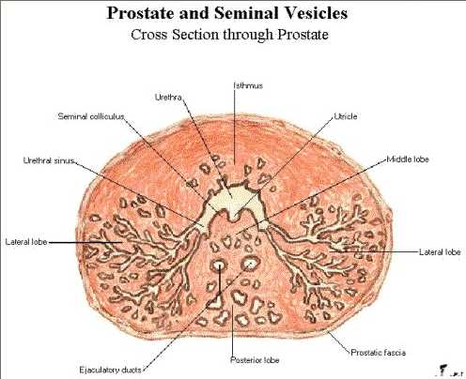
MOTTO OF RMU
Wisdom
Truth
Service

Slide 3
VISION OF RMU
THE DREAM/ TOMORROW
To impart evidence based research oriented medical education
To provide best possible patient care
To inculcate the values of mutual respect and ethical practice of medicine

Slide 4
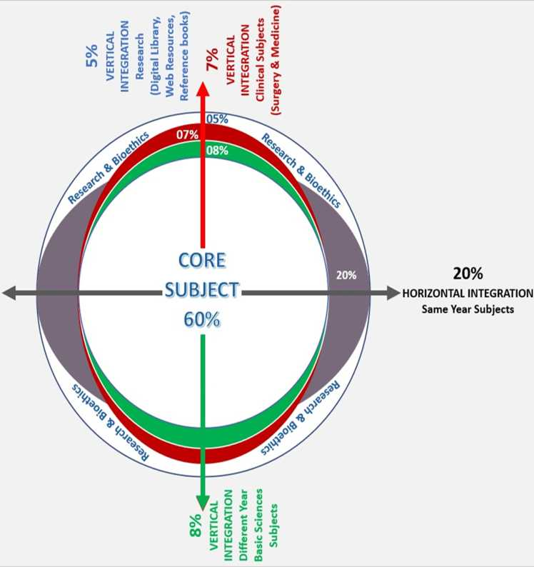

Slide 5
How to use HEC Digital Library
Steps to Access HEC Digital Library
Go to the website of HEC National Digital Library.
On Home Page, click on the INSTITUTES.
A page will appear showing the universities from Public and Private Sector and other Institutes which have access to HEC National Digital Library (HNDL).

Slide 6
4. Select your desired Institute.
5. A page will appear showing the resources of the institution
6. Journals and Researches will appear
7. You can find a Journal by clicking on JOURNALS AND DATABASE and enter a keyword to search for your desired journal.

Slide 7
Objectives
Implement effective screening programs to detect prostate cancer early, when treatment is most effective.
Utilize advanced diagnostic techniques like MRI and targeted biopsies for accurate staging and grading.
Develop individualized treatment plans based on patient-specific factors.
Offer curative options like surgery or radiation for localized prostate cancer.
Provide palliative care and systemic therapies for advanced or metastatic disease.

Slide 8
Introduction
Spiral Anatomy
Zonal anatomy
CA Prostate :
Incidence
Risk Factors
Presentation
Diagnosis
Investigations
Treatment :
Organ confined
Locally advanced
Metastatic

Slide 9
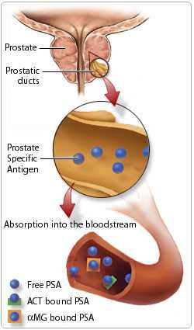
Spiral Anatomy

Slide 10
Zonal anatomy
Spiral Anatomy
Three zones:
  Peripheral zone (60-70% of CaP origin)
  Central zone (5 –10% of CaP origin)
  Transition zone (10-20% of CaP origin)

Slide 11
Prostate cancer (Ca P)
Spiral
Incidence:
  Men >65 Yrs
  Increases with age
  Directly proportional to life Expectancy

Slide 12
Risk factors for Ca P
Core Content
Increased risks
  Old Age
  Viable Testis
  First Degree Relative with CaP – 5 to11 fold risk
  Low levels of Vitamin D
  Saturated Fatty Acids
  Multiple Sexual Partners (infection)
  Cigarette smoking - both + and – results
  Vasectomy? - 1.5 times more risk
  IGF 1 (taller men)

Slide 13
Risk factors for Ca P
Core Content
Decreased risks
  Vitamin E Supplements
  Lycopene (Tomato sauce)
  Selenium
  Heavy alcohol

Slide 14
Symptoms
Integration Vertical
Early stage
    Asymtomatic
Locally advanced disease
    Obstructive / irritative voiding
    Retention of urine
    Hematuria
    Renal failure
    Pelvic pain

Slide 15
Symptoms
Integration Vertical
Metastatic disease
    Bone pain
    Spinal cord compression symptoms
    Paraparesis
    Paraplegia

Slide 16
Signs
Integration Vertical
  Distended bladder
  Nodes-iliac, inguinal, supraclavicular
  Lower limb edema
  Paraperisis
  Paraplegia

Slide 17
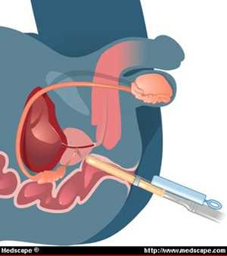
Signs
Integration Vertical
Digital rectal examination
  Nodular
  Indurated
  Asymmetrical
  Hard in consistency
  Median Sulcus Obliterated
  Rectal Mucosal Mobility

Slide 18
Laboratory investigations
Core Content
Routine investigations
Blood urea, S .Creatinine
Serum acid phosphatase
Serum alkaline phosphatase (Bone metastasis,liver metastasis)

Slide 19
Laboratory investigations
Core Content
Prostate specific antigen
  Glycoprotein secreted by prostatic epithelium,aids in semen liquefaction
  Normal up to 4 ng/ml
  Mild elevation 4-10 ng/ml
  Significant elevation more than 10 ng/ml
  Suggestive of bone metastasis
  Dre does not raise psa levels significantly
  Prostate biopsy raises psa
  Turp significantly raises psA

Slide 20
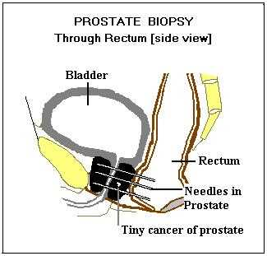
Prostate specific antigen (PSA)
Core Content
Prostate specific antigen (PSA) is an enzyme produced in the ducts of the prostate and absorbed into the bloodstream. Here it may become bound to two proteins: anti-chymotrypsin (ACT) and alpha macroglobulin (aMG) . The "PSA test" measures the level of free and bound PSA in the blood. With benign prostate conditions, there is more free PSA, while cancer produces more of the attached form.
PSA test results show the level of PSA detected in the blood. The PSA level that is considered normal for an average man ranges from 0 to 4 nanograms per milliliter (ng/ml). A PSA level of 4 to 10 ng/ml is considered slightly elevated; levels between 10 and 20 ng/ml are considered moderately elevated; and anything greater is considered highly elevated. But because various factors can cause PSA levels to fluctuate, one abnormal PSA test does not necessarily indicate that cancer is present.
Combined, the digital rectal exam (DRE) and the PSA test are the most accurate guide to early detection of prostate cancer. You may also have heard of the prostatic acid phosphatase (PAP) blood test. This test is rarely performed, as it is less accurate than the PSA test.

Slide 21
Importance of PSA testing
Core Content
Diagnosis
Pre-operative staging
Monitoring response to therapy
Detecting recurrence after therapy

Slide 22
Trans rectal ultrasound
Core Content
More sensitive than DRE
Hypoechoic lesions
Local staging
Sextant biopsy
Brachytherapy,cryosurgery

Slide 23
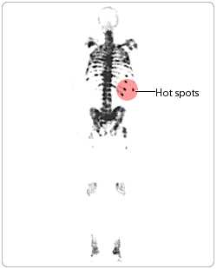
Core Content

Slide 24
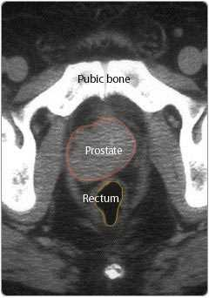
Core Content

Slide 25
Role of X- ray
Core Content
Axial skeleton
Osteoblastic secondaries
Chest X- ray
  Pulmonary metastasis
  Miliary pattern

Slide 26
CT scan & MRI
Integration vertical
Not routinely done
When radical prostatectomy is being planned
CT - Nodes
MRI -Perivesical extension

Slide 27
Bone scan
Integration vertical
Radionuclide bone scan for secondaries
PSA > 20 ng / ml
Bone pain
More sensitive than X-ray
False +ve results
  Fractures,arthritis etc

Slide 28
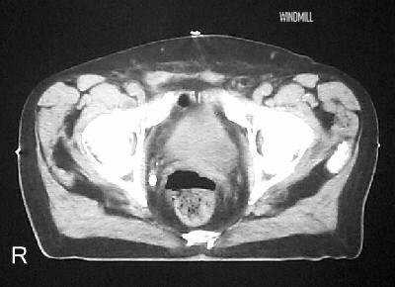
Bone scan
Integration vertical
This may include a bone scan. A bone scan (shown at left) is an imaging technique used to identify the presence of cancer in the bones. A tiny amount of radioactive substance is injected into your bloodstream and absorbed by your bones. If prostate cancer has spread to the bones, it most often shows up on the scan as a series of hot spots (darker areas) along the spine and ribs.

Slide 29
CT scan
Integration vertical
As part of the process of diagnosing prostate cancer you may be expected to undergo additional tests to determine if cancer has spread beyond the prostate. This may include a CT scan.
CT scan, also called CAT scan, stands for Computerized Axial Tomography. It is a form of computerized X-ray that allows doctors to view your internal organs. A machine revolves around you generating a series of images that are then translated by a computer. These images look like cross-sections of your body.

Slide 30
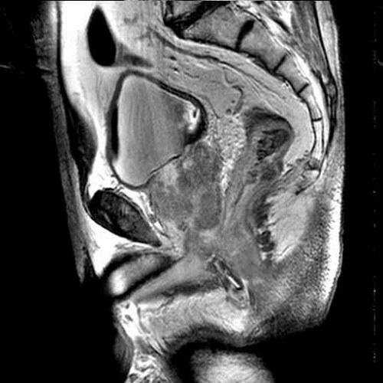

Slide 31
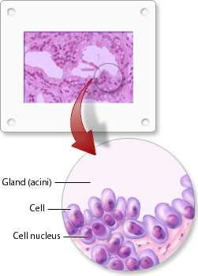

Slide 32
Differential diagnosis of hard prostate
Integration vertical
Chronic granulomatous prostatitis
Prostatic calculi
Prostatic infarction

Slide 33
Pathology of Ca P
Core Content
95% of Ca P - Adenocarcinoma
Other 5% :
  90% - Transitional cell carcinoma
  Remaining - Neuroendocrine sarcomas
- Squamous cell carcinoma

Slide 34
Pathology
Core Content
PERIPHERAL ZONE
  60- 70% of Ca P origin
TRANSITIONAL ZONE
  10-20% of Ca P origin
CENTRAL ZONE
  5-10% of Ca P origin
TURP / open prostatectomy does not eliminate risk of Ca P

Slide 35
Gleason grading system
Core Content
Most commonly used
Glandular architecture on low power microscope
Prognosis and progression correlates well

Slide 36
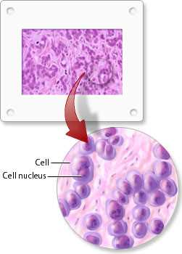
Gleason grade: low grade
Core Content
Normal prostate tissue consists of a structured arrangement of small glands (acini) and ducts.
Low grade cancer is the least aggressive and most resembles normal tissue.

Slide 37
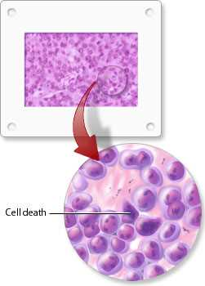
Gleason grade: medium grade
Core Content
As the cancer cells multiply and spread both the appearance and arrangement of the cells will change. The cells change shape and begin to look less like typical prostate cells. As well, this increase in activity causes the cell nucleus (it contains the genetic material for the maintenance, growth and reproduction of each cell) to become larger than normal.
All of these changes also cause the ducts and glands (acini) of the prostate to take on an irregular appearance.

Slide 38
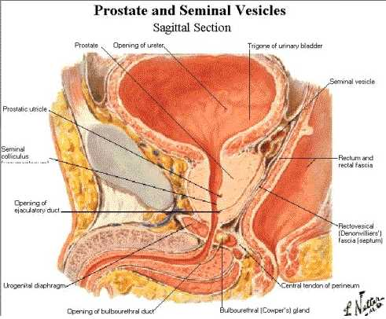
Gleason grade: high grade
Core Content
High grade cancer cells tend to behave very aggressively. Normal cells die off as they compete against the cancer cells for nutrients. As High Grade cancer cells continue to spread, the ducts and glands (acini) of the prostate disappear also.

Slide 39
TNM Staging
Core Content
T1a - Less than 5% of resected tissue has Ca P, normal DRE
T2a - More than 5% of resected tissue has Ca P, normal DRE
T2 - Palpable tumor confined to prostate
T3 - Tumor extends beyond prostate & seminal vesicle
T4 - Tumor fixed or invades other structures like
bladder neck,rectum

Slide 40
TNM Staging…
Core Content
Nx - Regional nodes not assessed
N 0 - No nodes
N 1 - Single node 2cm or smaller
N 2 - Node 2-5cm or multiple nodes
N 3 - Node more than 5cms
Mx - Not assessed
M 0 - No distant metastasis
M 2 - Non regional nodes , bones& viscera

Slide 41
Staging
Core Content
Organ confined disease
    T1 AND T2 (TNM)
Locally advanced
    T3,T4,N1 (TNM)
Metastatic disease
    STAGE M (TNM)

Slide 42
Treatment
Integration Vertical
Early prostatic carcinoma t1&t2(tnm)
Watchful waiting
  >70yrs
  Small well differentiated tumors

Slide 43
Treatment…
IntegrationHorizontal
Radical Prostatectomy
    Less than 60 yrs
    Good general health
    Life expectancy >10yrs
    No life threatening ancillary disease
    Removal of entire prostate and seminal vesicle
    Pelvic lymphadenectomy for staging
    Preservation of distal sphincter
    Preservation of cavernosal nerves-to prevent impotence

Slide 44
Radical prostatectomy…
Integration Horizontal
Retropubic route
Laproscopic
Survival >10yrs
Complications
  Bleeding
  Incontinence
  Erectile dysfunction (nerve sparing technique)

Slide 45
Radical radiotherapy
Integration Horizontal
External beam therapy
6500-7500 Gy to prostate and nodes
Brachytherapy
  Placement of radioactive seeds inside tumor under TRUS guidance
Advantages
  As good as surgery
  No incontinence
Disadvantages
  Radiation cystitis
  Radiation prostatitis

Slide 46
Treatment…
Integration Horizontal
Locally Advanced Disease
  > 70 YRS ASYMTOMATIC WATCHFUL WAITING
  EXTERNAL BEAM RT
  BRACHYTHERAPY

Slide 47
Treatment metastatic disease
Integration Horizontal
Bilateral orchidectomy
    Gold standard
    Done under local anesthesia
    Rapid lowering of serum testosterone level
    Side effects less
    Testicular prosthesis –cosmetic result

Slide 48
Treatment metastatic disease
Integration Horizontal
LHRH agonists
  Causes pitutary desensitisation by altering pulsatile release of LHRH
  Diminished LH
  Fall in testosterone-<50ng/ml
Advantages
  Less CVS complications
  Less gynecomastia

Slide 49
Treatment metastatic disease
Integration Horizontal
Disadvantages
    Flare phenomenon due to initial rise of testosterone.
    Might worsen symptoms
Give anti androgen before starting therapy

Slide 50
Treatment metastatic disease
Integration Horizontal
Anti-androgens
    Competitively inhibits dht receptors
    Flutamide (250mg) 3times
    Bicalutamide 50mg od
    With hormonal abalation complete androgen blockage

Slide 51
Treatment metastatic disease
Integration Horizontal
Chemotherapy
    Very limited role
Radiotherapy
    Local RT for isolated bone secondaries
    Hemibody RT –multiple secondaries
    Strontium 89-painful bone metastasis

Slide 52
Family medicine
A 60-year-old male smoker presents with painless hematuria. He also reports flank pain and has a palpable mass in his left abdomen. A CT scan reveals a 5 cm solid mass in his left kidney.
Which of the following is the most likely diagnosis?
A) Renal cell carcinoma
B) Renal cyst
C) Kidney stone
D) Pyelonephritis

Slide 53
Take home message
Prostate cancer is the most common cancer in men, typically affecting older individuals.
It often presents with no early symptoms, making screening crucial for early detection.
Risk factors include age, family history, and race, with African American men at higher risk.
Treatment options vary depending on the stage and aggressiveness of the cancer, including surgery, radiation, and hormone therapy.

Slide 54
Research
https://www.ncbi.nlm.nih.gov/books/NBK470550/
Prostate Cancer
Stephen W. Leslie; Taylor L. Soon-Sutton; William P. Skelton.
Author Information and Affiliations
Last Update: October 4, 2024.
Go to:
Continuing Education Activity
Prostate cancer is the most commonly diagnosed malignancy worldwide and the sixth leading cause of cancer-related death in men. Diagnosis is primarily based on prostate-specific antigen testing, magnetic resonance imaging scans, and prostate tissue biopsies, although prostate-specific antigen testing for screening remains controversial. New diagnostic technologies are now available, including risk stratification bioassay tests, germline testing, and various positron emission tomography scans. When confined to the prostate, the disease is considered localized and potentially curable. If the disease has spread outside the prostate, bisphosphonates, rank ligand inhibitors, hormonal treatment, chemotherapy, radiopharmaceuticals, immunotherapy, focused radiation, and other targeted therapies can be used. This activity provides a comprehensive review of the current evaluation and management of prostate cancer, highlighting the role of the interprofessional team in improving care for affected patients.

Slide 55


