Slide 1
CANCERS
Module III (Endocrinology)
DR Narjis Zaidi

Slide 3
Prof Umar Model

Slide 4
LEARNING OUTCOMES
Differentiate categories of cancers
Identify epidemiology of cancers
recommend the approaches for prevention of cancers in the community

Slide 5
LECTURE SEQUENCE
Core Content 15
HORIZONTAL INTEGRATION 02
VERTICAL INTEGRATION 06
FAMILY MEDICINE 02
BIOETHICS 01
ARTIFICIAL INTELLIGENCE 01
EOLA 01

Slide 6
TOP CANCERS RELATED DEATHS AMONG MEN
CORE SUBJECT

Slide 7
TOP CANCERS RELATED DEATHS AMONG WOMEN
Core subject

Slide 8
INFECTIONS INDICATED IN CERTAIN CANCERS
Core subject
INFECTION | CANCER
Hepatitis B And C | Hepatocellular Carcinoma
HIV | Kaposi's Sarcoma, Non-hodgkin's Lymphoma
The Epstein-barr Virus (EBV) | Burkett's Lymphoma And Nasopharyngeal Carcinoma.
Cytomegalovirus (CMV) | Kaposi's Sarcoma
Human Papilloma Virus | Cancer Cervix
The Human T -Cell Leukemia Virus | Adult T-cell Leukemia /Lymphoma
Chistosomiasis | Carcinoma Of Bladder

Slide 9
DIETARY FACTORS AS ETIOLOGY
Core subject
Evidence suggest association between certain cancers colorectal , breasts lung prostate cancers etc
Fruits and vegetables have protective effects
Fist meat consumption is also protective
Process red meat intake with colo-rectal cancers
Smoked fish is related to stomach cancer
Dietary fiber to intestinal cancer
Beef consumption to bowel cancer
high fat diet to breast cancer

Slide 10
OCCUPATIONAL EXPOSURES
Core subject
WHO Estimates Every Year 200,000 Cancers Deaths Related To Workplace Exposure
Lung Cancer, Mesothelioma, And Bladder Cancer Are Most Common
Every Tenth Lung Cancer Death Is Closely Related To Risks In The Workplace.
125 Million People Around The World Are Exposed To Asbestos At Work
Leukemia Caused By Exposure To Benzene, An Organic Solvent Widely Used By Workers, Including In The Chemical And Diamond Industries.

Slide 11
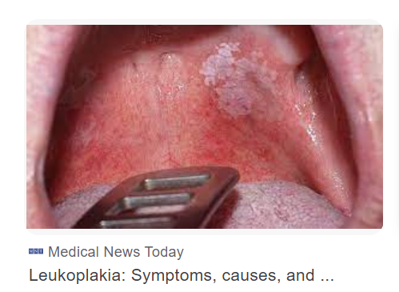
ORAL CANCER
Vertical Integration
Tobacco
Alcohol
Pre-cancerous stage
High risk group
Cultural patterns

Slide 12
Core subject
CANCER OF CERVIX
AGENT : Human papilloma virus (HPV) - sexually transmitted
AGE : age of 25 to 45.
WARTS : Past and/or present occurrence of clinical genital warts
MARITAL STATUS :
Increases with multiple sexual partners
Common in prostitutes
EARLY MARRIAGE : Early marriage, early coitus, early childbearing and repeated childbirth have been associated with increasing risk.
ORAL CONTRACEPTIVE PILLS : possible link between OCP and ca cervix high estrogen content
SOCIO-ECONOMIC CLASS : more common in the lower socio-economic groups reflecting probably poor genital hygiene

Slide 13
PAP SMEAR
Vertical integration
Can Detect Prolonged Early Phase Of Cancer
Requires Excessive Resources Laboratories, Equipment's And Trained Personnel.
Visual Inspection Based Screening Tests Are Alternative
Via With Magnification (Viam), And Visual Inspection Post Application Of Lugol's Iodine (Vili)

Slide 14
SCREENING CANCER
Vertical Integration

Slide 15
BREASTS CANCER
Core subject
AGE :
Uncommon below the age of 35
incidence increasing rapidly between the ages of 35 and 50.
Slight dip in incidence at the time of menopause.
A secondary rise in frequency often occurs after the age of 65
Women who developed their first breast cancer under the age of 40, had three times the risk of developing a second breast cancer than did those who developed their first cancer after the age of 40

Slide 16
BREAST CANCER
Horizontal integration

Slide 17
RISK FACTORS BREAST CANCERS
Core subject
FAMILY HISTORY
High in those with a positive family history especially if a mother or sister developed breast cancer when premenopausal.
PARITY
Directly related to the age at which women bear the first child.
An early first, full-term pregnancy seems to have a protective effect.
Risk increases with delayed first pregnancy
Unmarried women tend to have more breast tumors

Slide 18
RISK FACTORS BREASTS CANCERS
Core subject
AGE OF MENARCHE AND MENOPAUSE
Early menarche and late menopause are established risk factors
The risk is reduced for those with a surgically induced menopause
HORMONAL FACTORS
Elevated estrogen as well as progesterone are important risk factors
Prior breasts biopsy
Diet: High fat diet and obesity
Socio-economic status : more in high groups

Slide 19
SCREENING FOR BREASTS CANCER
Vertical Integration
Breasts self examination
Palpation by surgeon
Thermography
Mammography

Slide 20
LUNG CANCERS: SMOKING
Core subject
Smoking :
Tobacco smoking was first suggested as a cause of lung cancer in the 1920s.
Smoking practices such as
Number of cigarettes smoked
Age of starting to smoke
Smoking habits, such as inhalation and the number of puffs and the nicotine, the tar content and the length of cigarettes.
Risk of cancer who exposed to passive smoking
strongest evidence suggesting incidence reduction in cancer after cessation of smoking

Slide 21
OVERVIEW LUNG ANATOMY
vertical integration

Slide 22
DIAGNOSIS
Vertical integration

Slide 23
SMOKING CONTENTS
Core subject
The Most Noxious Components
Tar Carbon Monoxide And Nicotine
Nicotine And Carbon Monoxide, Particularly, Contribute To Increased Risk Of Cardiovascular Diseases Through Enhancement Of Blood Coagulation In The Vessels
Interference With Myocardial Oxygen Delivery, And Reduction Of The Threshold For Ventricular Fibrillation
The Carcinogenic Role Of Tar Is Well Established

Slide 24
PRIMARY PREVENTION
Core subject
Control Of Tobacco And Alcohol Consumption
Radiation
Personal Hygiene
Occupational Exposure
Immunization
Treatment Pre-cancerous Stages

Slide 25
SECONDARY PREVENTION
Core subject
CANCER REGISTRATION
Active by Collection at source by registry staff
Passive by Notification by health-care workers.
Early Detection of cases
Treatment
Surgery
Chemotherapy
Radiotherapy
Palliative treatment

Slide 26
CANCER EDUCATION
Family medicine
Lump Or Hard Area In The Breast
Change In A Wart Or Mole
Persistent Change In Digestive And Bowel Habits
Persistent Cough Or Hoarseness E.
Excessive Loss Of Blood At The Monthly Period Or Loss Of Blood Outside The Usual Dates
Blood Loss From Any Natural Orifice
A Swelling Or Sore That Does Not Get Better
Unexplained Loss Of Weight

Slide 27
PREVENTION
Core subject
PRIMARY PREVENTION
The most promising approach is to control the "smoking epidemic
METHODS OF CONTROLLING THE SMOKING EPIDEMIC
Public information and education
Legislative and restrictive measures
Smoking cessation activities
National and international coordination

Slide 28
SECONDARY PREVENTION
Core subject
Early detection of cases and their treatment.
procedures capable of detecting pre-symptomatic, early-stage lung cancer.
Chest X-ray
Sputum cytology.
Screening for early- stage lung cancer is less attractive, more expensive and appears to have less potential for reducing mortality than primary prevention.
Mass screening for lung cancer is not recommended as a routine public health

Slide 29
FAMILY MEDICINE
Identifying and monitoring risk factors
Early disease screening, diagnosis, staging, treatment
Shared care (between referring physicians and cancer specialists) follow up monitoring
Advanced disease management
Continuity of care
Comprehensive care
CORE CONTENT

Slide 30
UBAGO-GUISADO, ESTHER, ET AL. "EVIDENCE UPDATE ON THE RELATIONSHIP BETWEEN DIET AND THE MOST COMMON CANCERS FROM THE EUROPEAN PROSPECTIVE INVESTIGATION INTO CANCER AND NUTRITION (EPIC) STUDY: A SYSTEMATIC REVIEW." NUTRIENTS 13.10 (2021): 3582.
RESEARCH

Slide 31
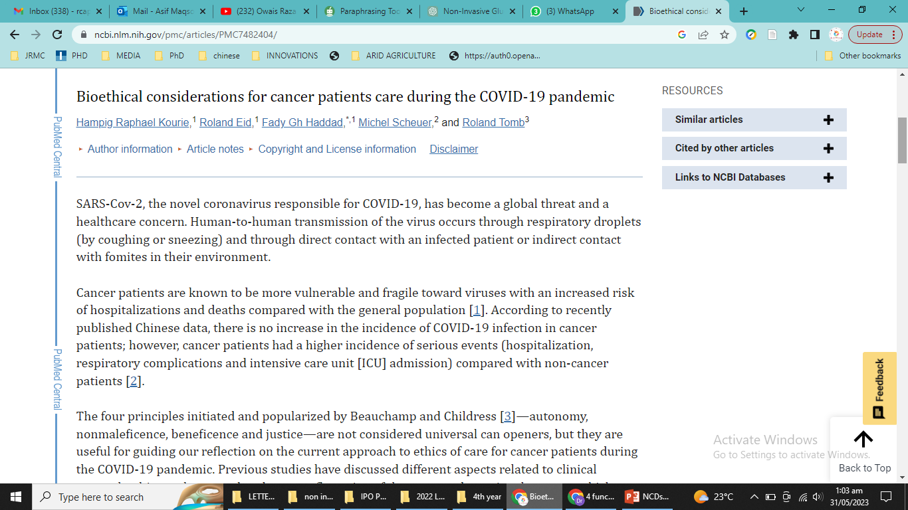
BIOETHICS
https://www.ncbi.nlm.nih.gov/pmc/articles/PMC7482404/
CORE CONTENT

Slide 32
ARTIFICIAL INTELLIGENCE
https://www.nature.com/articles/s41416-021-01633-1
CORE CONTENT

Slide 33
END OF LECTURE ASSESSMENT
Which of the screening method is no recommended as a public health intervention
Breasts self examination for breast cancer
Mammography for breasts cancer
Pap smear for cervix cancer
X-ray chest for lung cancers
VIA methods for cervix cancer

Slide 34
LEARNING MATERIAL
K .park
Park text book of preventive and social medicine
25th edition
Chapter 6 . Epidemiology of chronic non-communicable diseases and conditions

