Slide 2
SURGICAL MANAGMENT
OF BONE TUMORS
DR. OBAID UR RAHMAN
FCPS [Ortho] , Fellowship in Arthroplasty [PAS]
CHPE,MHPE
HEAD OF ORTHOPAEDICS
RAWALPINDI MEDICAL UNIVERSITY

Slide 3
LEARNING OBJECTIVES
Identify clinical features [history ,examination] of bone tumors
RECOGNISE THE RADIOLOGICAL FINDINGS OF BONE TUMORS
APPRECIATE THE RELEVANT LABORATORY INVESTIGATIONS
CLASSIFY BONE TUMORS
UNDER STAND THE BIOPSY TECHNIQUES
ROLE OF ADJUVANT THERAPY
UNDERSTAND THE PRINCIPLES OF SURGERY
ORGANIZE A MANGEMENT PLAN FOR BONE TUMOR PATIENT
Notes:
at the end of this 1hour LGIS session, fourth year MBBS the student will be able to

Slide 4
HISTORY
PAIN
SWELLING
C
CHARACTER
L
LOCATION
E
ERADICATING
A
AGGRAVATING
R
RADIATION
T R
TIME RELATION
A P
ASSOCIATED PHENOMENA[WT LOSS,FEVER..]
Notes:
ding detected during
the evaluation of an unrelated problem. Patients with bone
tumors most frequently present with pain. The pain initially
may be activity related, but a patient with a malignancy of
bone often complains of progressive pain at rest and at night.
Patients with benign bone tumors also may have activity_x0002_related pain if the lesion is large enough to weaken the bone.
Other benign lesions, most notably osteoid osteoma, may
cause night pain initially. Conversely, patients with soft-tissue
tumors rarely complain of pain but more often complain of a
mass. Exceptions to this rule are patients with nerve sheath
tumors who have pain or neurologic sign

Slide 5
PHYSICAL EXAMINATION
General health
A mass should be measured, and its location, shape, consistency, mobility, tenderness, local temperature, and change with position should be noted.
Atrophy of the surrounding musculature
Neuro Vascular status
Café-au-lait spots or cutaneous hemangiomas also may provide diagnostic clues.
Potential sites of lymph node metastases should be palpated.
Notes:
neurologic deficits and adequacy of circulation. Although lymph node metastases are rare with most sarcomas, they often are present with rhabdomyosarcomas, epithelioid sarcomas, and synovial sarcomas.

Slide 6
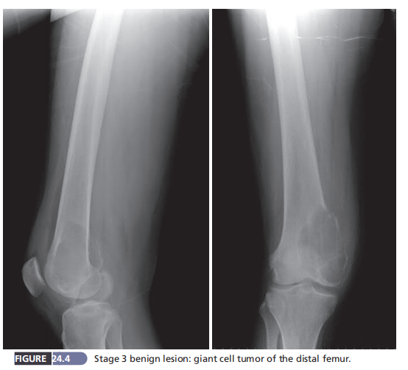
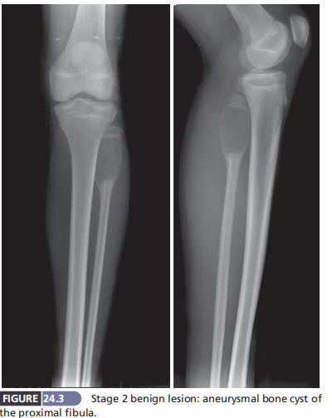
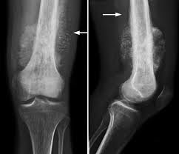
RADIOGRAPHY
SITE EPI,META,DIA
CONSISTENSY -RADIO LUCENT, DENSE ,
GROUND GLASS,MIXED
EXPANSILE/NON EXPANSILE
MARGINS GEOGRAPHICAL/WELL DEFINED, PERMEATIVE,MOTH EATEN
PERIOSTEAL REACTION
COD MANS TRIANGLE,SUNBURST
CORTICAL BREAK
SOFT TISSUE EXTNSION

Slide 7
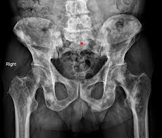
METASTASES OF UNKNOWN ORIGIN
> age 40 with a new, painful bone lesion--- multiple myeloma and metastatic carcinoma
Prostate cancer and breast cancer are the two most common primary sources for bone metastases.
If a patient has no known primary tumor, however, the most likely sources are lung cancer and renal cell carcinoma.
Notes:
In a patient older than age 40 with a new, painful bone lesion, multiple myeloma and metastatic carcinoma are the most likely diagnoses even if the patient has no known history of carcinoma. Prostate cancer and breast cancer are the two most common primary sources for bone metastases. If a patient has no known primary tumor, however, the most likely sources are lung cancer and renal cell carcinoma.
Rougraff et al. described the proper evaluation of a patient with suspected metastases of unknown origin.
The evaluation begins with a history focusing on any previous malignancies, even in the remote past, followed by a physical examination that includes
not only the involved extremity but also the thyroid, lungs, abdomen, prostate in men, and breasts in women.
Laboratory analysis should include complete blood cell count, erythrocyte sedimentation rate, electrolytes, liver enzymes, alkaline
phosphatase, serum protein electrophoresis, and possibly prostate-specific antigen. Plain radiographs of the involved bone and the chest should be obtained.
A whole-body bone scan should be ordered to evaluate other possible areas of skeletal involvement, and a CT scan of the chest, abdomen, and pelvis should be obtained

Slide 8
METASTASES
Notes:
They listed six reasons why the
biopsy should not be done until the evaluation is complete:
(1) The lesion may be a primary sarcoma of bone that may
require a biopsy technique that allows for future limb salvage
surgery; (2) another, more accessible lesion may be found; (3)
if renal cell carcinoma is considered likely, the surgeon may
wish to consider preoperative embolization to avoid excessive
bleeding; (4) if the diagnosis of multiple myeloma is made by
laboratory studies, an unnecessary biopsy can be avoided; (5)
the pathologic diagnosis is more accurate if aided by appro_x0002_priate imaging studies; and (6) the pathologist and surgeon
may be more assured of a diagnosis of metastasis made on
frozen section analysis if supported by the preoperative eval_x0002_uation. This is important if stabilization of an impending frac_x0002_ture is planned for the same procedure.

Slide 9
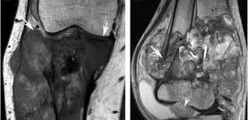
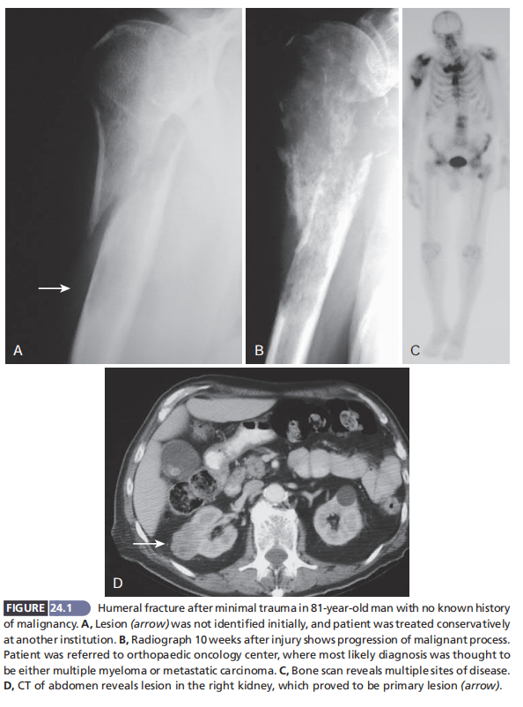
OTHER IMAGING
CT CHEST & UPPER ABD
MRI
BONE SCAN
US
ANGIOGRAPHY
Notes:
MRI has replaced CT as the study of choice to determine
the size, extent, and anatomic relationships of bone and softtissue tumors. It is the most accurate technique for determining the extent of intramedullary and extraosseous disease and the relationship to neurovascular structures. MRI may yield a specific diagnosis with tumors such as lipoma, hemangioma, hematoma, or pigmented villonodular synovitis, all of which have characteristic appearances. With regard to most neoplasms, however, the MRI appearance is nonspecific.
Likewise, MRI frequently cannot differentiate benign from malignant lesions.
Angiography still is useful, however, to rule out nonneoplastic conditions, such as pseudoaneurysms or
arteriovenous malformations, and for preoperative embolization of highly vascular lesions, such as renal cell carcinoma
and aneurysmal bone cysts

Slide 10
LABS
NUTRITIONAL STATUS
Serum Albumin < 3.5 g/dL
Total Lymphocyte count < 1500/mL
CBC
ESR
Protein Eectrophoresis
Prostate-Specific Antigen
Alkaline Phosphatase
Blood urea nitrogen and creatinine
Serum Calcium and parathyroid hormone
Notes:
Risks of
wound healing problems and infection have been shown to be
significantly greater in patients whose serum albumin value is
less than 3.5 g/dL or whose total lymphocyte count is less than
1500/mL. A complete blood cell count may be helpful to rule
out infection and leukemia. The erythrocyte sedimentation
rate usually is elevated in infection, metastatic carcinoma, and
small “blue cell” tumors, such as Ewing sarcoma, lymphoma,
leukemia, and histiocytosis. Serum protein electrophoresis
should be ordered if multiple myeloma is part of the differential diagnosis.
Likewise, a prostate-specific antigen test should
be ordered if prostate carcinoma is a possibility. Hypercalcemia
may be present with metastatic disease, multiple myeloma, and
hyperparathyroidism. Alkaline phosphatase may be elevated
in metabolic bone disease, metastatic disease, osteosarcoma,
Ewing sarcoma, or lymphoma. Blood urea nitrogen and creatinine may be elevated with renal tumors, and a urinalysis may
reveal hematuria in this setting. Brown tumors of hyperparathyroidism sometimes can look like giant cell tumors and can
be evaluated with serum calcium and parathyroid hormone
levels. Finally, Paget disease may be in the differential diagnosis
and can be evaluated by serum alkaline phosphatase and urinary pyridinium cross-links.

Slide 11
ENNEKING CLASSIIFICATION BENIGN BONE LESION
Notes:
Benign tumors are staged as follows: stage 1, latent;
stage 2, active; and stage 3, aggressive. Stage 1 lesions are
intracapsular, usually asymptomatic, and frequently inci_x0002_dental findings. Radiographic features include a well_x0002_defined margin with a thick rim of reactive bone. There
is no cortical destruction or expansion. These lesions do
not require treatment because they do not compromise
the strength of the bone and usually resolve spontane_x0002_ously. An example is a small asymptomatic nonossifying
fibroma discovered incidentally on radiographs taken to
evaluate an unrelated injury (Fig. 24.2). Stage 2 lesions also
are intracapsular but are actively growing and can cause
symptoms or lead to pathologic fracture. They have well_x0002_defined margins on radiographs but may expand and thin
the cortex. Usually they have only a thin rim of reactive
bone. Treatment usually consists of extended curettage
(Fig. 24.3). Stage 3 lesions are extracapsular. Their aggres_x0002_sive nature is apparent clinically and radiographically.
They do not respect natural anatomic barriers and usu_x0002_ally have broken through the reactive bone and possibly
the cortex (Fig. 24.4). MRI may show a soft-tissue mass,
and metastases may be present in 1% to 5% of patients
with these lesions (e.g., giant cell tumor). Treatment con_x0002_sists of extended curettage, marginal resection, or pos_x0002_sibly wide resection, and local recurrences are common.

Slide 12
ENNEKING CLASSIIFICATION MALIGNANT BONE LESION
Notes:
stages that helps to guide surgical and adjuvant treatments.
The system is based on the histologic grade of the tumor,
its local extent, and the presence or absence of metastases.
Low-grade lesions are designated as stage I. These lesions
are well-differentiated, have few mitoses, and exhibit only
moderate cytologic atypia. The risk for metastases is low
(<25%). High-grade lesions are designated as stage II. They
are poorly differentiated with a high mitotic rate and a high
cell-to-matrix ratio. Stage I and II lesions are subdivided
according to the extent of local growth. Stage IA and IIA
lesions are contained within well-defined anatomic com_x0002_partments (Fig. 24.5). Anatomic compartments are deter_x0002_mined by the natural anatomic barriers to tumor growth,
such as cortical bone, articular cartilage, fascial septa, or
joint capsules. Stage IB and IIB lesions extend beyond the
compartment of origin (Fig. 24.6). Stage III refers to any
lesion that has metastasized regardless of the size or grade of
the primary tumor. No distinction is made between lymph
node metastases or distant metastases because both circum_x0002_stances are associated with a poor prognosis.

Slide 13
AJCC BONE SARCOMAS
Notes:
The AJCC system for bone sarcomas (Table 24.3) is based on tumor grade, size, and presence and location of metastases.
Stage I tumors, which are low grade, and stage II tumors, which
are high grade, are subdivided based on tumor size.
Stage I-A and II-A tumors are 8 cm or less in their greatest linear measurement; stage I-B and II-B tumors are larger than 8 cm.
Stage III tumors have “skip metastases,” which are defined as discontinuous lesions within the same bone.
Stage IV-A involves pulmonary metastases, whereas stage IV-B involves nonpul_x0002_monary metastases. The subdivision of stage IV was made
because it has been shown that patients with nonpulmonary metastases from osteosarcoma and Ewing sarcoma have worse
prognoses than patients with only pulmonary metastases.
BIOPSY
In 1982, Mankin et al. reported 18.2% major errors in diagno_x0002_sis, 10.3% nonrepresentative or technically poor biopsy speci_x0002_mens, and 17.3% wound complications associated with biopsy
of musculoskeletal sarcomas. As a result of these complica_x0002_tions, the optimal treatment plan had to be altered in 18.2%,
including unnecessary amputations in 4.5%. These complica_x0002_tions occurred three to five times more frequently when the
biopsy was done by a surgeon at a referring institution, rather
than by a member of the Musculoskeletal Tumor Society. A
series of recommendations were made regarding the technical
aspects of the biopsy, stating that whenever possible a patient
with a suspected primary musculoskeletal malignancy should
be referred before biopsy to the institution where definitive
treatment will take place. The study was repeated 10 years later,
and the results were essentially unchanged.
A biopsy should be planned as carefully as the definitive
procedure. Biopsy should be done only after clinical, labora_x0002_tory, and radiographic examinations are complete. As stated
previously, completion of the evaluation before biopsy aids in
planning the placement of the biopsy incision, helps provide
more information leading to a more accurate pathologic diag_x0002_nosis, and avoids artifacts on imaging studies. If the results
of the evaluation suggest that a primary malignancy is in the
differential diagnosis, the patient should be referred to a mus_x0002_culoskeletal oncologist before biopsy.
pulmonary metastases, whereas stage IV-B involves nonpul_x0002_monary metastases. The subdivision of stage IV was made
because it has been shown that patients with nonpulmonary
metastases from osteosarcoma and Ewing sarcoma have worse
prognoses than patients with only pulmonary metastases.

Slide 14
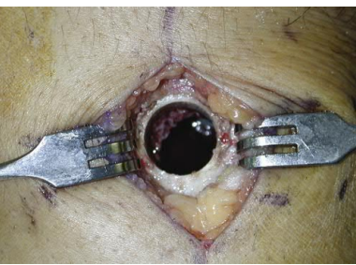
BIOPSY
Notes:
A biopsy can be done by fine-needle aspiration, core needle biopsy, or an open incisional procedure (Table 24.4). Most musculoskeletal neoplasms can be diagnosed with a well-done needle biopsy.
Fine-needle aspiration may be 90% accurate at determining malignancy; however, its accuracy at determin_ing specific tumor type is much lower because only cells rather than tissue architecture are evaluated. This technique may be best applied when there is a high probability that the diagno_sis is known such as metastases or infection and when evaluating lymph nodes. An experienced pathologist is helpful in determining the diagnosis because of the limited sample size obtained.
A core needle biopsy uses a larger-gauge needle than a fine-needle aspiration, providing for tissue and preservation of the tissue architecture. The limited amount of tissue obtained may not be adequate, however, for accurate grading or for any additional studies that may dictate subsequent treatment. The few dedicated series that have analyzed outpatient core needle biopsies have reported an overall diagnostic accuracy ranging from 84% to 98%. A study of 252 outpatient core needle biop_x0002_sies of malignant bone and soft-tissue neoplasms reported an accuracy rate of 97% for determining whether or not a lesion is malignant; core needle biopsy was accurate for a specific histo_x0002_pathologic diagnosis and grade in 81%.
Open biopsy is the gold standard for biopsy of bone and soft-tissue tumors, but complications are greater with incisional biopsy when compared with needle biopsy (e.g., bleeding, infec_tion, tissue contamination). However, this procedure is least likely to be associated with a sampling error, and it provides the
most tissue for additional diagnostic studies, such as cytogenetics and flow cytometry. If the administration of chemotherapy is
anticipated before further surgery, a central venous access catheter may be placed at the same setting as the biopsy if the frozen
section is confirmatory. The definitive procedure can be done immediately after biopsy only if the frozen section diagnosis con_x0002_firms the clinical and radiographic diagnosis. In cases of discrep_x0002_ancy or doubt, the definitive procedure should be delayed until a firm diagnosis is established. If a giant cell tumor is suspected on clinical and radiographic grounds, definitive curettage can proceed immediately after confirmation of the diagnosis on fro_x0002_zen section. Likewise, if the suspicion of an impending fracture from metastatic carcinoma is confirmed on frozen section, pro_x0002_phylactic fixation can be applied immediately. Conversely, if the
frozen section in either of these scenarios exhibited any atypical cells that might represent a sarcoma, definitive surgery should be delayed until the final pathologic evaluation is complete.
Rarely, a primary resection (i.e., excisional biopsy) should be done instead of a biopsy. A small (<3 cm) subcutaneous mass that is unlikely to be malignant may be marginally resected primarily

Slide 15
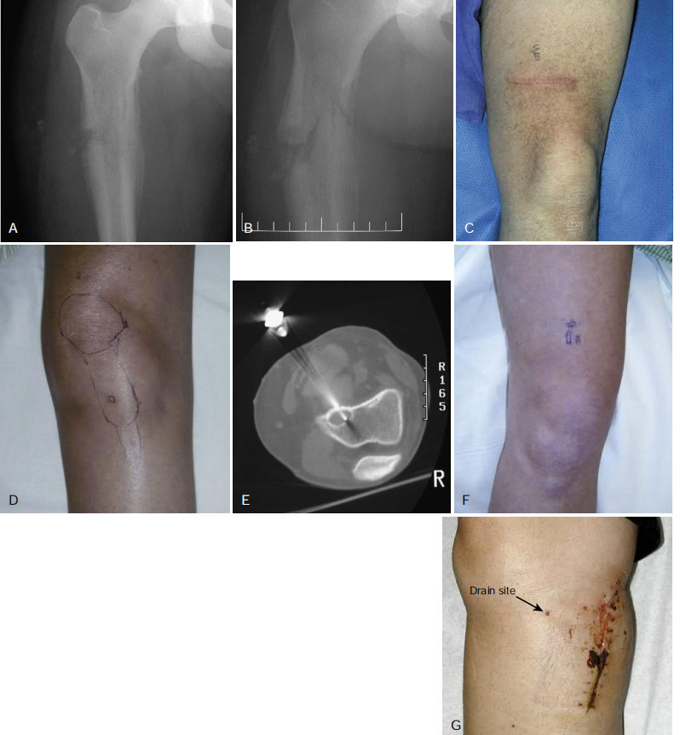
BIOPSY : GOING WRONG
Notes:
oskeletal oncologist before biopsy.
Regardless of whether a needle biopsy or an open biopsy is
done, the biopsy track should be considered contaminated with
tumor cells. Placement of the biopsy is a crucial decision because
the biopsy track needs to be excised en bloc with the tumor. The
surgeon performing the biopsy should be familiar with incisions
for limb salvage surgery and standard and nonstandard ampu_x0002_tation flaps. If a tourniquet is used, the limb can be elevated
before inflation but should not be exsanguinated by compres_x0002_sion to prevent “squeezing” the tumor’s cells into the systemic
circulation. Care should be taken to contaminate as little tissue
as possible. Transverse incisions should be avoided because they
are extremely difficult or impossible to excise with the speci_x0002_men (Fig. 24.7). The deep incision should go through a single
muscle compartment rather than contaminating an intermus_x0002_cular plane. Major neurovascular structures should be avoided.
Soft-tissue extension of a bone lesion should be sampled because
this leading edge contains the most viable tumor for making the
diagnosis. Care should be taken, however, to sample more than
just the pseudocapsule surrounding the lesion. A frozen section
should be sent intraoperatively to ensure that diagnostic tissue
has been obtained. If a hole must be made in the bone, it should
be round or oval to minimize stress concentration and prevent
a subsequent fracture, which could preclude limb salvage sur_x0002_gery (Fig. 24.8). The hole should be plugged with methacrylate
to limit hematoma formation. Only the minimal amount of
methacrylate needed to plug the hole should be used because
excessive amounts push the tumor up and down the bone. If a
tourniquet has been used, it should be deflated and meticulous
hemostasis ensured before closure, because a hematoma would
be contaminated with tumor cells. If a drain is used, it should exit

Slide 16
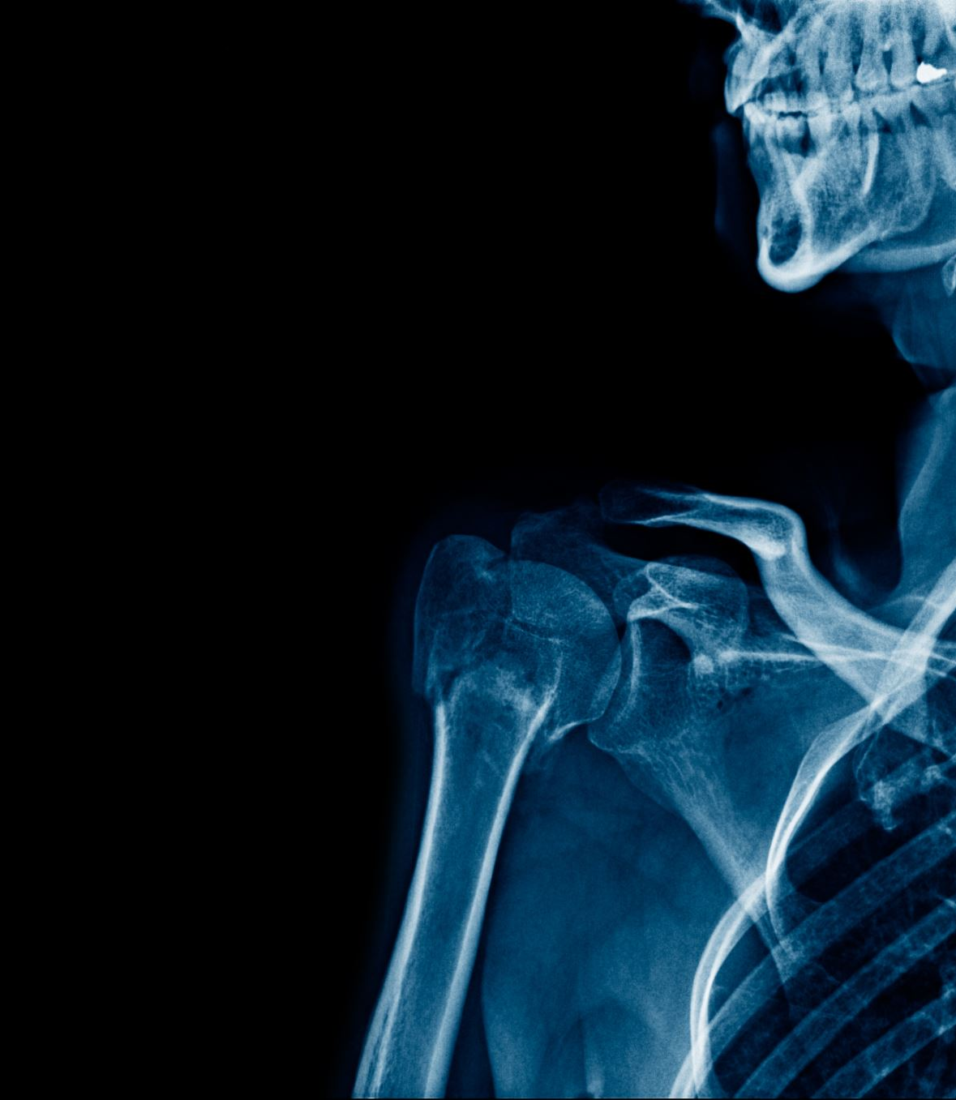
ADJUVANT THERAPY
The primary goal of treatment in a patient with a primary malignancy of the musculoskeletal system is to make the patient disease free.
The goal of treatment of a patient with metastatic carcinoma to bone is to minimize pain and to preserve function.
The optimal treatment of the tumor often requires a combination of radiation therapy, chemotherapy, and surgery

Slide 17
RADIATION THERAPY
Radiation causes cell death by inducing the formation of intracellular free radicals that subsequently cause DNA damage.
Most primary bone malignancies are relatively radioresistant.
Exceptions are the small blue cell tumors, including multiple myeloma, lymphoma, and Ewing sarcoma, which are each exquisitely sensitive.
Carcinomas metastatic to bone,with the exception of renal cell carcinoma, also frequently are sensitive to radiation treatment
Notes:
The sensitivity of a cell to radiation depends on several fac_x0002_tors, including (1) the cell’s position in the cell cycle (actively
mitotic cells are most sensitive), (2) tissue oxygenation (local
hypoxia provides a protective effect because oxygen-free radicals cannot be formed in hypoxic tissue), and (3) the cell’s
ability to repair DNA damage or its inability to undergo apop_x0002_tosis (programmed cell death) in response to this damage.
The dose of radiation is measured in Gray (Gy): 1 Gy
is equal to 1 joule of absorbed energy per kilogram; 1 rad
is equal to 1 centigray (cGy). The goal of radiation treat_x0002_ment is to deliver the highest possible dose of radiation to
the tumor cells while minimizing toxicity to normal tissues.
This is accomplished by using linear accelerators that deliver
a high dose to the target tissues with sharp lateral field edges
that limit the dose to nontarget tissues. Therapeutic advan_x0002_tage also is gained by fractionation of the dose. After a single
treatment of 200 cGy, all cells in the most sensitive phase of
the cell cycle are killed. Delivering another dose at a specified
interval allows additional cells to enter this phase of the cell
cycle. In addition, with progressive tumor cell death, previ_x0002_ously hypoxic areas of the tumor may become reoxygenated
and may become more sensitive to radiation. The interval also
allows time for normal cells to repair damage. Most radia_x0002_tion treatment protocols deliver 150 to 200 cGy/day until the
target dose is achieved. This dose ranges from 30 to 40 Gy for
myeloma to 60 Gy for treatment of a soft-tissue sarcoma.

Slide 18
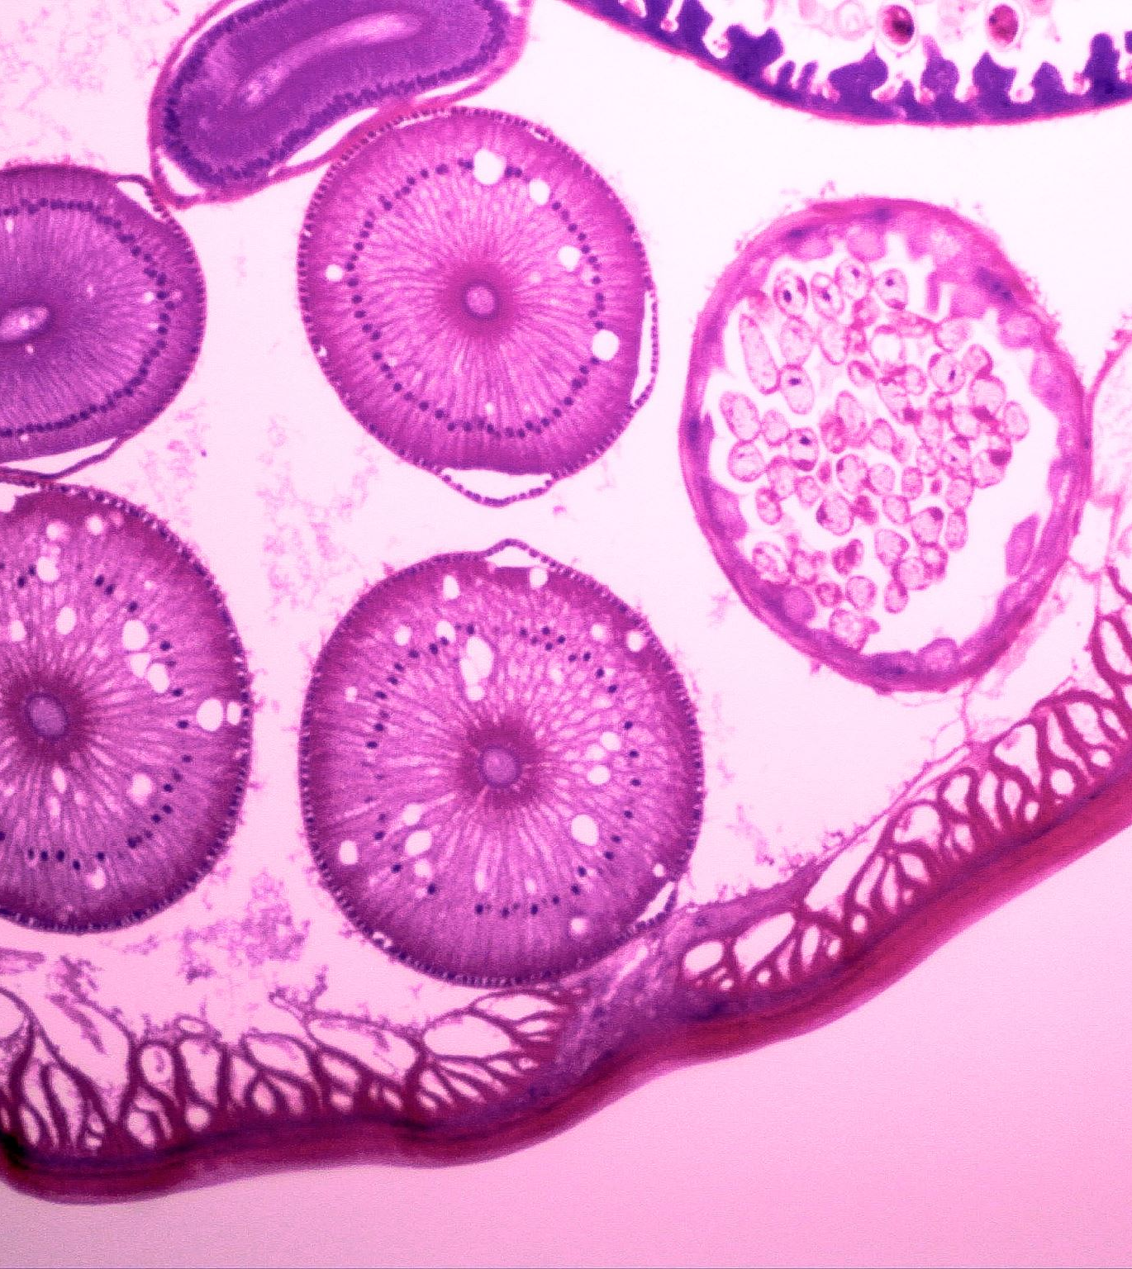
CHEMOTHERAPY
With the use of multimodal treatment including surgery and chemotherapy, long-term survival for patients with osteosarcoma has improved from approximately 20% to approximately 70% in most series.
Ewing sarcoma
Malignant fibrous histiocytoma,
High-grade soft-tissue malignancies of childhood, such as rhabdomyosarcoma
Adjuvant chemotherapy refers to chemotherapy administered postoperatively to treat presumed micrometastases.
Neoadjuvant chemotherapy refers to chemotherapy administered before surgical resection of the primary tumor
Notes:
Similar numbers are available regarding the treatment of Ewing sarcoma. Similarly, chemotherapy has a
well-defined role in the treatment of other high-grade malignancies of bone, such as malignant fibrous histiocytoma, and high-grade soft-tissue malignancies of childhood, such as rhabdomyosarcoma
preoperative chemotherapy with the definitive procedure
performed 3 to 4 weeks after the last dose has been admin_x0002_istered. Chemotherapy is restarted 2 weeks postoperatively if
the wound has healed.

Slide 19
MALIGNANT BONE TUMORS NEO ADJUVANT CHEMOTHERAPY
PREOP CHEMOTHERAPY
4 CYCLES
3 WEEKS APART
DEFINITIVE SURGERY
4-6 WEEKS AFTER PRE OP CHEMO
POST OP CHEMOTHERAPY
2-4 WEEKS AFTER SURGERY
10 CYCLES 3 WEEKS APART
Notes:
PREOP CHEMOTHERAPY
4 CYCLES 3 WEEKS APART

Slide 21
MARGINS
Enneking classification
Intralesional
Marginal
Wide
Radical

Slide 22
Amputations and limb-sparing resections may be associated with any of the four types of margins, and the margin must be specifically defined with each procedure
Notes:
An intralesional margin is one in which the plane of sur_gical dissection is within the tumor. This type of procedure is often described as “debulking” because it leaves behind
gross residual tumor. This procedure may be appropriate for symptomatic benign lesions when the only surgical alternative would be to sacrifice important anatomic structures. This
also may be appropriate as a palliative procedure in the setting of metastatic disease.
As musculoskeletal tumors grow, they compress the surrounding tissues and appear to become encapsulated. This surrounding reactive tissue often is referred to as the pseudocapsule.
A marginal margin is achieved when the closest plane of dissection passes through the pseudocapsule. This type of margin usually is adequate to treat most benign lesions and
some low-grade malignancies. In high-grade malignancy, however, the pseudocapsule often contains microscopic foci of disease, or “satellite” lesions. A marginal resection often
leaves behind microscopic disease that may lead to local recurrence if the remaining tumor cells do not respond to adjuvant chemotherapy or radiation therapy. Despite an increased risk
of local recurrence, a marginal resection may be preferable if the alternative is a more mutilating procedure. Improvements in preoperative radiation therapy and neoadjuvant chemo__therapy have made marginal resections an acceptable alternative to amputation in some selective circumstances.
Wide margins are achieved when the plane of dissection is in normal tissue. Although no specific distance is defined, the entire tumor remains completely surrounded by a cuff
of normal tissue. The quality of a margin is more important than the quantity (thickness) of the margin. For instance, a fascial margin provides a better plane for containing tumor
spread than does a similar or thicker plane of subcutaneous tissue. If the plane of dissection touches the pseudocapsule at any point, the margin should be defined as being marginal
and not wide. Although sometimes impossible to achieve,wide margins are the goal of most procedures for high-grade malignancies.
Radical margins are achieved when all the compartments that contain tumor are removed en bloc. For deep soft-tissue tumors, this involves removing the entire compartment (or
multiple compartments) of any involved muscles. For bone tumors, this involves removing the entire bone and the compartments of any involved muscles. Radical operations were
previously the procedures of choice for most high-grade neo_x0002_plasms; however, with improvements in imaging studies, radical procedures now are rarely performed because equivalent
oncologic results usually can be obtained with wide margins.

Slide 23
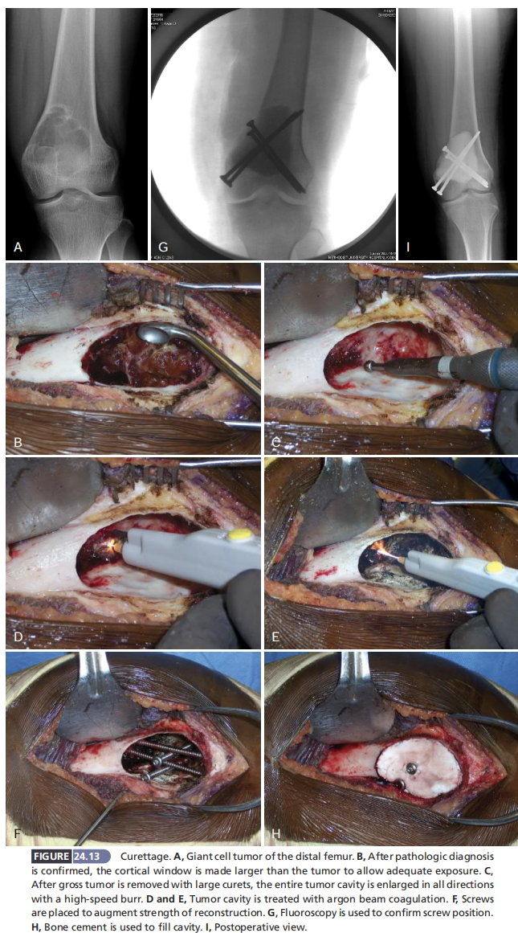
INTRALESIONAL EXCISION

Slide 24
WIDE MARGIN EXCISION

Slide 25
Definitive Surgery
Limb Salvage
Biological
Non-Biological
Amputation
Notes:
More often, however, the choice between limb salvage and amputation must be made on the basis of the expectations and desires of the individual

Slide 26
Location of theTumor & Limb Salvage ?
With regard to function, location of the tumor is the most important issue.
Resection of an upper extremity lesion with limb salvage, even with the sacrifice of one or two major nerves, generally provides better function than amputation and subsequent prosthetic fitting.
Similarly, resection of a proximal femoral or pelvic lesion with local construction generally provides better function than would be possible after a hip disarticulation or hemipelvectomy.
Around the ankle and foot, however, large sarcomas frequently are treated with amputation followed by prosthetic fitting.
Treatment of sarcomas around the knee must be individualized.
Notes:
patients who had amputations had difficulty
walking on steep, rough, or slippery surfaces but were active
and were the least worried about damaging the affected limb.
Patients with an arthrodesis performed the most demanding
physical work and recreational activities but had difficulty
with sitting, especially in the back seats of cars, theaters, or
sports arenas. Patients who had an arthroplasty generally led
more sedentary lives and were more protective of the limb but
had little difficulty with activities of daily living. These patients
also were the least self-conscious about the limb.
In patients who are long-term survivors after resection
of an extremity sarcoma, the probability of limb survival is
associated with the type of reconstruction and the location
of the tumor. A successful arthrodesis is more durable in
the long term than a mobile joint reconstruction. Regarding
prosthetic or allograft-prosthetic composite reconstructions,
location is the most important issue, with proximal recon_x0002_structions generally outlasting more distal reconstructions.
(This is the inverse of the prognosis for overall patient sur_x0002_vival, with distal sarcomas having a better prognosis than
proximal sarcomas.) Proximal femoral reconstructions gen_x0002_erally outlast distal femoral reconstructions, which generally
outlast proximal tibial reconstructions

Slide 27
LIMB SALVAGE
BIOLOGICAL
NON BIOLOGICAL
AUTO GRAFT
ALLO GRAFT
ARTHRODESIS
ENDOPROSTHESIS

Slide 28
Allograft-Prosthesis Composites [ BIOLOGICAL ]
Notes:
Allograft-prosthesis composites may provide a long-term
solution for some patients. They avoid the complications of
degenerative joint disease and articular collapse while still
preserving the ability to attach soft-tissue structures directly,
such as the patellar tendon or the hip abductors. They are
associated, however, with fatigue fracture, infection, and non_x0002_union at the graft-host junction. Although many surgeons use
allograft-prosthesis composite as their primary method of
reconstruction, our main indication is an inadequate length
of remaining host bone to secure the stem of an endopros_x0002_thesis

Slide 29
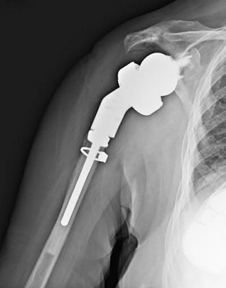
Endoprosthetic Reconstruction [ NON BIOLOGICAL ]
Notes:
Endoprosthetic reconstruction also may provide long_x0002_term function for some patients and is associated with its
own complications. Endoprosthetic reconstruction provides
the advantage of predictable immediate stability that allows
for quicker rehabilitation with immediate full weight bear_x0002_ing. Most endoprostheses are modular, allowing for incre_x0002_mental limb lengthening as an immature patient grows.
Improvements in implant materials have greatly increased the
durability of modern endoprostheses; however, all are asso_x0002_ciated with long-term complications if a patient is cured of
disease. Polyethylene wear is still a limiting factor for articu_x0002_lating surfaces, but the inserts are easily replaceable in most
prostheses. Fatigue fracture can occur at the rotating hinge,
but this, too, is easily replaceable. Fatigue fracture at the base
of the intramedullary stem where it attaches to the body of
the prosthesis is more problematic. In this location, extrac_x0002_tion of the remaining stem can be extremely difficult.

Slide 30
CONSIDERATIONS FOR PEDIATRIC
Notes:
We have been able to gain 0.5 to 1.5 cm during each scheduled expansion session. Expansion sessions can be scheduled 4 weeks
apart if needed to allow the operated leg to “catch up.” After the expansion sessions, patients usually are able to ambulate immediately without an assistive device. Although this device is not as durable and mechanical problems are com_x0002_mon, complications are usually relatively easy to address.
Moreover, skeletally immature patients treated for bone sarcomas are allowed to maintain limb-length equality at the
completion of growth.
PATIENTS
For pediatric patients, future limb-length inequality must be
considered. For patients who are near skeletal maturity, the
reconstructed limb can be lengthened 1 cm at the initial pro_x0002_cedure. Also, epiphysiodesis of the contralateral limb can be

Slide 32
RESECTION AND RECONSTRUCTION - LIMB SALVAGE
Currently, most musculoskeletal malignancies are treated with local resection and reconstruction.
Aggressive benign neoplasms also can be treated in this manner.
The goal of resection of a malignancy is to achieve wide surgical margins if possible. If this is impossible because of anatomic constraints, a marginal resection combined with adjuvant or neoadjuvant treatment (e.g., radiation for a soft-tissue sarcoma) may be preferable to an amputation, although this decision must be made on an individual basis in conjunction with the patient and family.
A marginal resection usually is adequate for most benign neoplasms.

Slide 33
Take Home Message TUMOR WORK UP
CLINICAL
HISTORY
EXAMINATION
XRAYS
LOCAL
[ CHEST ]
LABS
CBC,ESR
RFT,LFT
PSA, ALK PHOSPHATASE
S ELECTROPHORESIS
RADIOLOGY
MRI
CT CHEST & UPPER ABDOMEN
US
BONE SCAN
BIOPSY
FNAC
CORE NEEDLE
INCISIONAL
EXCISIONAL
Rx
+Adjuvant therapy Chemo/Radio
Surgery

