Slide 2
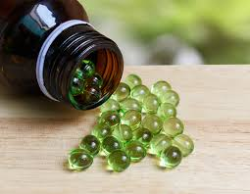
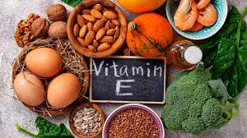
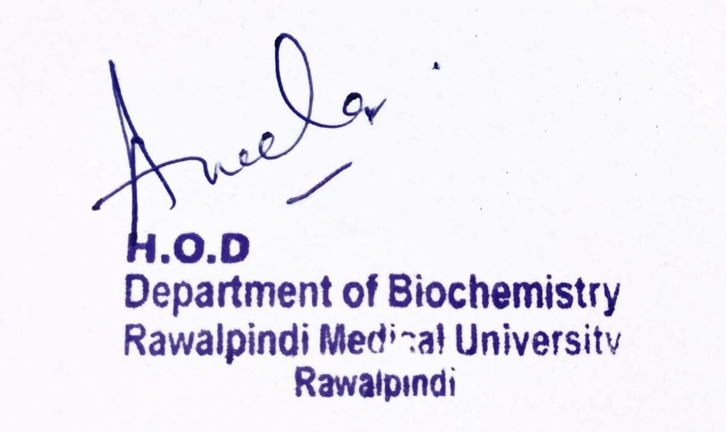
Musculoskeletal-I Module 1st Year MBBS(SGD) Vitamin E
Presenter: Dr. Sana Latif Date: 18-02-2025
(Senior Demonstrator)

Slide 3
Motto, Vision, Dream
To impart evidence based research oriented medical education
To provide best possible patient care
To inculcate the values of mutual respect and ethical practice of medicine
Wisdom
Truth
Service

Slide 4
Professor Umar Model of Integrated Lecture

Slide 5
Learning Objectives
At the end of the SGD, students will be able to:
Understand the role of vitamin E in human health.
Recognize dietary sources and recommended intake of vitamin E
Functions of Vitamin E

Slide 6
Interactive Session
A 32-year-old male with a history of Crohn’s disease presents to the clinic with progressive muscle weakness, difficulty walking, and numbness in his hands and feet over the past six months. He also reports occasional difficulty with coordination and frequent tripping while walking.
His medical history includes multiple episodes of diarrhea and unintentional weight loss over the past year.
He follows a strict low-fat diet due to concerns about worsening his gastrointestinal symptoms.
Examination:
Neurological findings:
Decreased deep tendon reflexes (DTRs)
Impaired vibratory sensation and proprioception in the lower limbs
Mild ataxia on tandem walking
Laboratory tests :
Low serum α-tocopherol levels
Normal B12 and folate levels

Slide 7
Introduction to Vitamins
Core Knowledge
Vitamins are essential organic compounds required in small amounts for normal metabolism and good health.
They are not a source of energy
Classified into:
Water-Soluble (Vitamin C and B Class)
Fat-Soluble (A,D,E and K)

Slide 8
Classification Of Vitamins
Core Knowledge
Type | Vitamin | Other Names | Functions | Sources
Fat-Soluble | A | Retinol, Retinal, Retinoic Acid | Vision, growth, immunity | Carrots, liver, dairy
 | D | Cholecalciferol (D3), Ergocalciferol (D2) | Bone health, calcium balance | Sunlight, fish, milk
 | E | Tocopherols, Tocotrienols | Antioxidant, cell protection | Nuts, seeds, oils
 | K | Phylloquinone (K1), Menaquinone (K2) | Blood clotting, bone health | Leafy greens, liver
Water-Soluble | B1 | Thiamine | Carbohydrate metabolism | Whole grains, pork
 | B2 | Riboflavin | Energy production | Dairy, eggs, greens
 | B3 | Niacin, Nicotinamide | NAD+/NADP+ coenzyme | Meat, fish, grains
 | B5 | Pantothenic Acid | Coenzyme A synthesis | Meat, eggs, grains
 | B6 | Pyridoxine | Amino acid metabolism | Bananas, poultry, fish
 | B7 | Biotin | Fat & carbohydrate metabolism | Nuts, eggs, liver
 | B9 | Folate | DNA synthesis, RBC formation | Leafy greens, beans
 | B12 | Cobalamin | Nerve function, RBC production | Meat, fish, dairy
 | C | Ascorbic Acid | Antioxidant, collagen synthesis | Citrus fruits, peppers

Slide 9
Chemistry of VITAMIN E
Core Knowledge
Structure – Vitamin E consists of tocopherols and tocotrienols, both having a chromanol ring (antioxidant site) and a hydrophobic side chain for membrane incorporation.
Forms – The most active form is α-tocopherol, followed by β, γ, and δ-tocopherols, each differing in methylation on the chromanol ring.
Antioxidant Property – Acts as a lipid-soluble antioxidant, scavenging free radicals and preventing lipid peroxidation in cell membranes.
Solubility & Stability – It is fat-soluble, stable to heat but sensitive to light, oxygen, and alkaline conditions, which degrade its activity.
Absorption & Transport – Absorbed in the intestine with dietary fats, transported in chylomicrons, and stored in adipose tissue and liver.

Slide 10
Sources of Vitamin-E
Core Knowledge

Slide 11
RDA of Vitamin-E
Core Knowledge
Age Group | RDA (mg/day of α-Tocopherol)
Infants (0-6 months) | 4 mg (AI*)
Infants (7-12 months) | 5 mg (AI*)
Children (1-3 years) | 6 mg
Children (4-8 years) | 7 mg
Children (9-13 years) | 11 mg
Adolescents (14-18 years) | 15 mg
Adults (19+ years) | 15 mg
Pregnant Women | 15 mg
Lactating Women | 19 mg
AI (Adequate Intake) is given for infants as RDAs are not established for this group.
These values are based on Dietary Reference Intakes (DRIs) by the Institute of Medicine (IOM).

Slide 12
Biochemical Role Of Vitamin-E
Core Knowledge
Antioxidant Role – Neutralizes free radicals and prevents lipid peroxidation, protecting cell membranes from oxidative damage.
Membrane Stability – Maintains integrity of phospholipid bilayers, especially in red blood cells, neurons, and muscle tissues.
Immune Function – Enhances T-cell function and modulates immune response, reducing inflammation.
Gene Expression – Regulates gene transcription involved in cell signaling, growth, and apoptosis.
Cardiovascular Protection – Prevents oxidation of LDL cholesterol, reducing the risk of atherosclerosis and cardiovascular diseases.

Slide 13
Biochemical Role Of Vitamin-E
Core Knowledge
Neurological Function – Supports nerve conduction and prevents neurodegenerative diseases by protecting neurons from oxidative damage.
Reproductive Health – Essential for sperm motility and normal fetal development during pregnancy.
Skin Protection – Promotes wound healing, reduces UV-induced skin damage, and prevents premature aging by maintaining skin integrity.
Platelet Regulation – Inhibits platelet aggregation, reducing the risk of thrombus formation and improving blood circulation.
Enzyme Activity Modulation – Influences the activity of protein kinase C (PKC), which regulates smooth muscle growth and immune cell function

Slide 14
Bio-physiological & Anatomical Aspects of Vitamin E
Absorption & Transport – Absorbed in the small intestine with dietary fats, transported via chylomicrons, and distributed through lipoproteins (LDL, HDL, VLDL).
Storage Sites – Primarily stored in adipose tissue, with smaller amounts in the liver, skeletal muscles, and brain
Neurological Role – Maintains myelin sheath integrity, ensuring proper nerve conduction and preventing neurodegeneration.
Skin & Hair Health – Helps maintain skin elasticity, wound healing, and hair growth by preventing oxidative stress in epidermal cells.

Slide 15
Bio-physiological & Anatomical Aspects of Vitamin E
Eye Protection – Prevents oxidative damage in the retina, reducing the risk of age-related macular degeneration (AMD).
Aging & Longevity – Delays cellular aging by protecting tissues from oxidative damage, especially in the brain and skin.
Muscle Function – Supports muscle strength and endurance, reducing oxidative stress during physical activity.
Bone Health – Plays a role in bone remodeling by influencing osteoblast and osteoclast activity, helping maintain bone density.

Slide 16
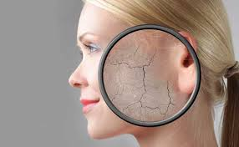
Clinical Correlates
Vertical Integration

Slide 17
Vertical Integration

Slide 18
Management of Vit –E Deficiency
Spiral Integration
Essential nutritional counseling to families, emphasizing the importance of a balanced diet that includes adequate amounts of fat-soluble vitamins (A, D, E, and K).
Patients with certain chronic conditions, such as malabsorption disorders, liver diseases, or pancreatic disorders, may be prone to fat-soluble vitamin deficiencies. Family physicians can monitor these patients closely, recommend appropriate supplementation, and adjust treatments as needed.
Community education initiatives, raising awareness about the importance of fat-soluble vitamins and promoting healthy nutrition practices for all age groups.

Slide 19
Role of AI in Management
Spiral Integration
Personalized Nutrition Guidance
Early Deficiency Detection
Remote Monitoring
Drug-Nutrient Interaction Analysis

Slide 20
Ethical Considerations
Spiral Integration
Bioethics
Equitable Access to Supplements.
Ethical practices in nutritional genomics when utilizing genetic testing.
Cultural Sensitivity in Dietary Recommendations:
Transparent Communication on Supplementation: discussions about the risks and benefits

Slide 21
Fat-Soluble Vitamins A, D, E, and K: Review of the Literature and Points of Interest for the Clinician Andrès, E.; Lorenzo-Villalba, N.; Terrade, J.-E.; Méndez-Bailon, M. J. Clin. Med. 2024, 13(13), 3641; https://doi.org/10.3390/jcm13133641
Spiral Integration
Fat-soluble vitamins, including vitamins A, D, E, and K, are energy-free molecules that are essential to the body’s functioning and life. Their intake is almost exclusively exogenous, i.e., dietary. As a result, fat-soluble vitamin deficiencies are rarer in industrialized countries than in countries with limited resources. Certain groups of people are particularly affected, such as newborns or growing children, pregnant or breastfeeding women, and elderly or isolated individuals. Deficiencies in vitamins A, D, E, and K are also relatively frequent in subjects with digestive tract disorders, liver diseases, chronic pathologies, or in intensive care patients. Deficiencies or excesses of fat-soluble vitamins are responsible for a variety of more or less specific clinical pictures. Certain syndromes are typical of fat-soluble vitamin deficiency, such as the combination of ophthalmological and immunity impairments in the case of vitamin A deficiency or hemorrhagic syndrome and osteopenia in the case of vitamin E deficiency. This is also the case for osteomalacia, muscular weakness, even falls, and rickets in the case of vitamin D deficiency. Diagnosis of a deficiency in one of the fat-soluble vitamins relies on blood tests, which are not always essential for routine use. In this context, a therapeutic test may be proposed. Treatment of deficiencies requires vitamin supplementation, a well-balanced diet, and treatment of the cause.

Slide 22
How To Access Digital Library
Steps to Access HEC Digital Library
Go to the website of HEC National Digital Library
On Home Page, click on the INSTITUTES
A page will appear showing the universities from Public and Private Sector and other Institutes which have access to HEC National Digital Library HNDL
Select your desired Institute
A page will appear showing the resources of the institution
Journals and Researches will appear
You can find a Journal by clicking on JOURNALS AND DATABASE and enter a keyword to search for your desired journal

Slide 23
Learning Resources
Textbook of Biochemistry, Lippincott 8th edition, chapter no.28 , pages no. 441-444
Google scholar
Google images

