Slide 1


Slide 2


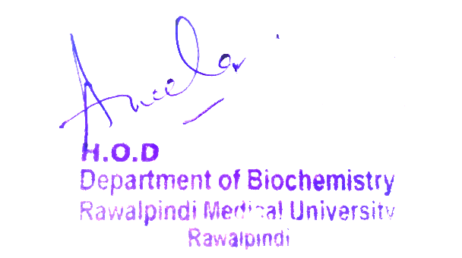
2nd Year MBBS Gastrointestinal Tract Module Large Group Interactive Session (LGIS) Vitamin A
Presenter: Dr. Almas Ajaz

Slide 3
Motto, Vision, Dream
To impart evidence based research oriented medical education
To provide best possible patient care
To inculcate the values of mutual respect and ethical practice of medicine
Wisdom
Truth
Service

Slide 4
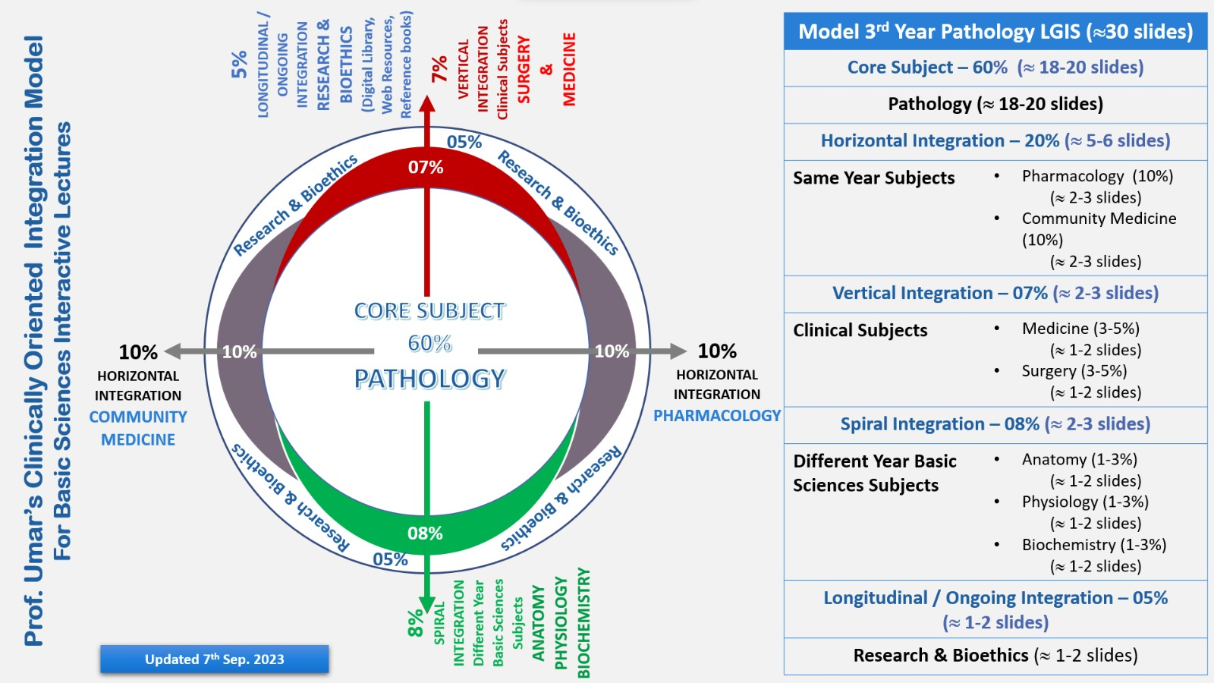
Professor Umar Model of Integrated Lecture

Slide 5
Learning Objectives
At the end of this session students should be able to
Understanding the Role of Vitamin A:
Identifying Dietary Sources and Requirements
Recognizing Deficiency and at-Risk Groups
Exploring Health Impacts and Safety Considerations related to Vitamin A

Slide 6
Interactive Session
Name: Maria Gonzalez
Age: 32 years old
Gender: Female
Medical History: Maria has a history of poor dietary habits, primarily consuming processed foods with low nutritional value. She has been experiencing night blindness and dry eyes for the past few months.
Presentation: Maria visits her primary care physician complaining of difficulty seeing in low light and persistent dry eyes. She mentions that these symptoms have been progressively getting worse.

Slide 7
HORIZONTAL INTEGRATION (ANATOMY AND PHYSIOLOGY )
Vitamins are essential organic compounds required in small amounts for normal metabolism and good health.
They are not a source of energy
They are classified into Water-Soluble (Example; vitC and vitB) and Fat-Soluble (Example; A,D,E,K)
Vitamin A is essential for vision as it plays a crucial role in the formation of rhodopsin which helps in vision.It also supports the immune system and skin health.
Vitamin D facilitates the absorption of calcium and phosphorus, promoting bone health and mineralization.
Vitamin E acts as an antioxidant, protecting cell membranes from oxidative damage.
Vitamin K essential for blood clotting, as it is a cofactor for several proteins involved in the coagulation process

Slide 8
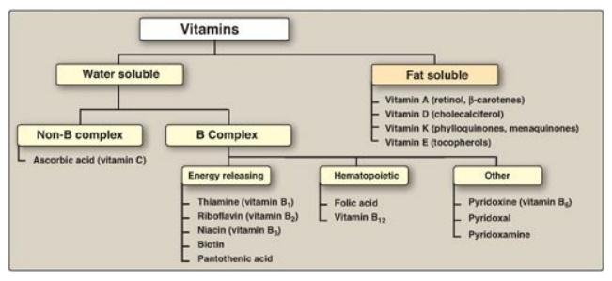
INTRODUCTION OF VITAMINS
Vitamins are essential organic compounds required in small amounts for normal metabolism and good health.
They are not a source of energy
They are classified into Water-Soluble (Example; vitC and vitB) and Fat-Soluble (Example; A,D,E,K)

Slide 9
Vitamin A
Vitamin A is an essential nutrient needed in small amounts for normal functioning of visual system, maintenance of cell growth, epithelial integrity, red blood cell production and immunity and reproduction
Vitamin A deficiency (VAD) is a nutritional concern in poor countries.

Slide 10
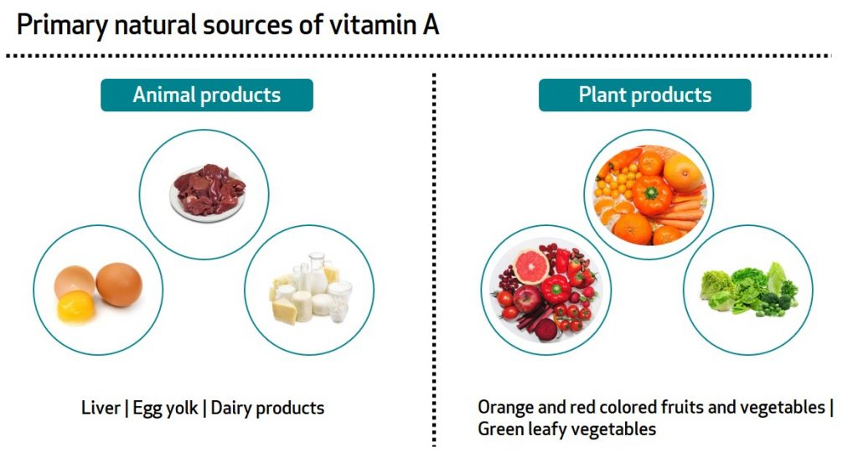
SOURCES OF VITAMIN A
It is present in foods of animal origin as well as plants.
In plants it is in the form of carotenes and provitamin

Slide 11
FORMS OF VITAMIN A
RETINOID: Natural and synthetic forms of vitamin A
RETINOL: Alcohol form , present in animal tissue as retinyl ester.
RETINAL: aldehyde form, obtained by oxidation of retinol
RETINOIC ACID: acid form, produced by oxidation of retinal

Slide 12
PROVITAMINS
PROVITAMINS: Carotenoids ( beta-carotene) can yield 2 retinols when metabolized in the body.
Β-CAROTENE: found in plants

Slide 13
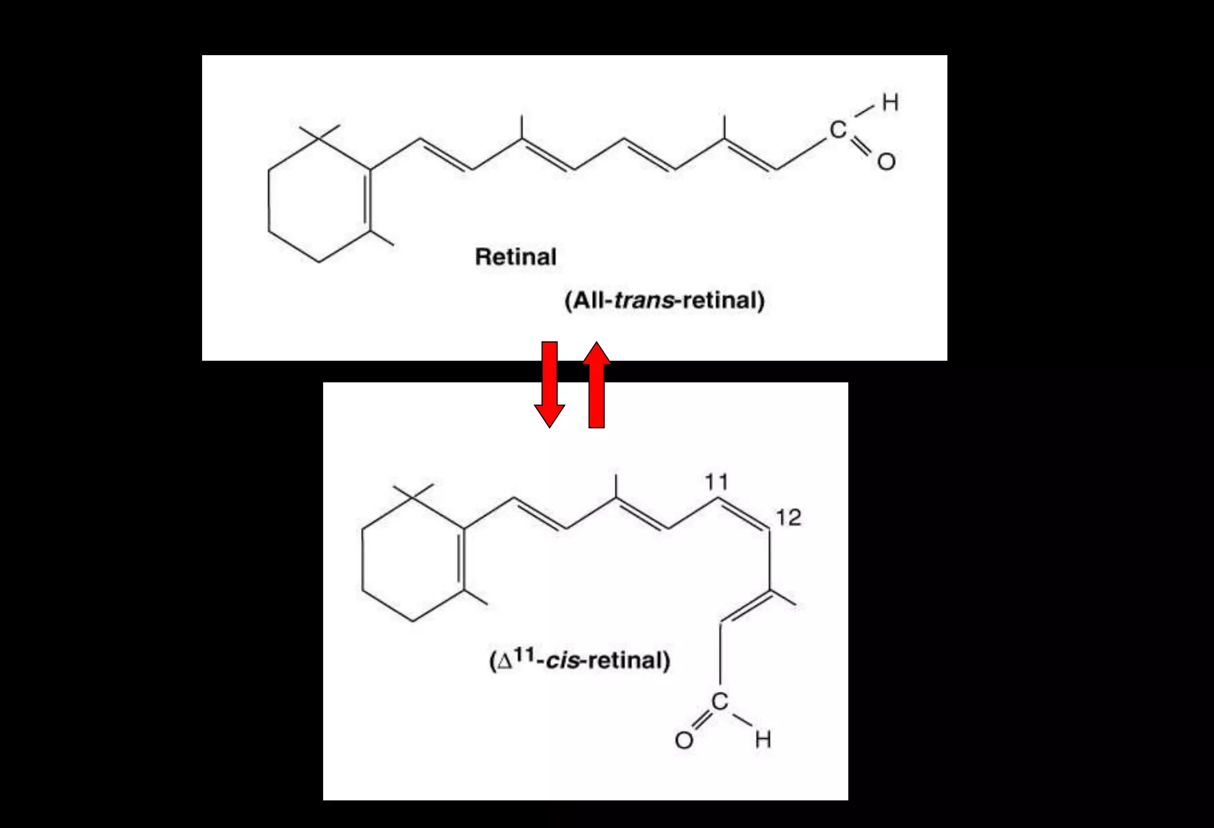

Slide 14
ABSORPTION
RETINOIDS: Retinyl esters are broken down into free retinal and fatty acids and absorbed in small intestine with the help of bile and digestive enzymes.
Once absorbed retinyl esters are reformed, 90% of retinol can be absorbed.
CAROTENOIDS: absorbed intact, absorption rate is much lower
Intestinal cells can convert carotenoids into retinoids

Slide 15
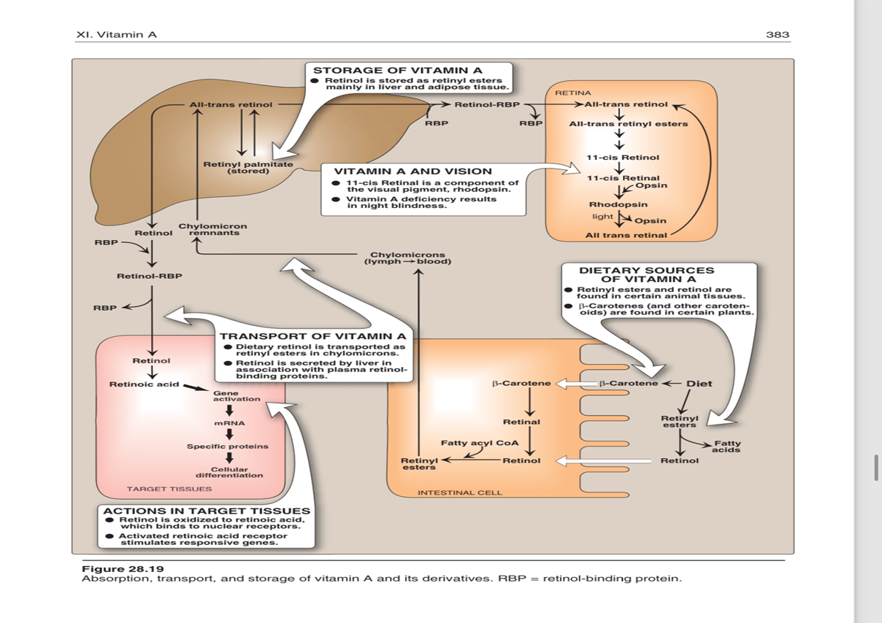
TRANSPORT OF VITAMIN A

Slide 16
STORAGE
Liver stores vitamin A in the form of RETINOL PALMITATE
Under normal conditions, a well-fed person has sufficient vitamin A reserves for 6-9 months.

Slide 17
Core Knowledge
EXCRETION
Not readily excreted
Kidney Disease and aging will increase toxicity because excretion is impaired

Slide 18
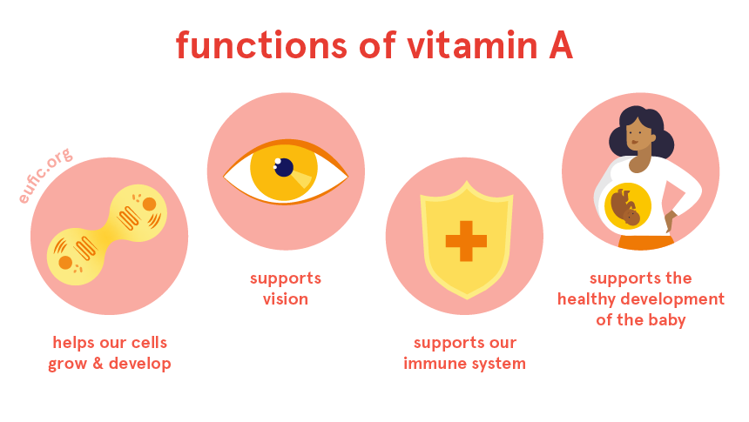
Core Knowledge

Slide 19
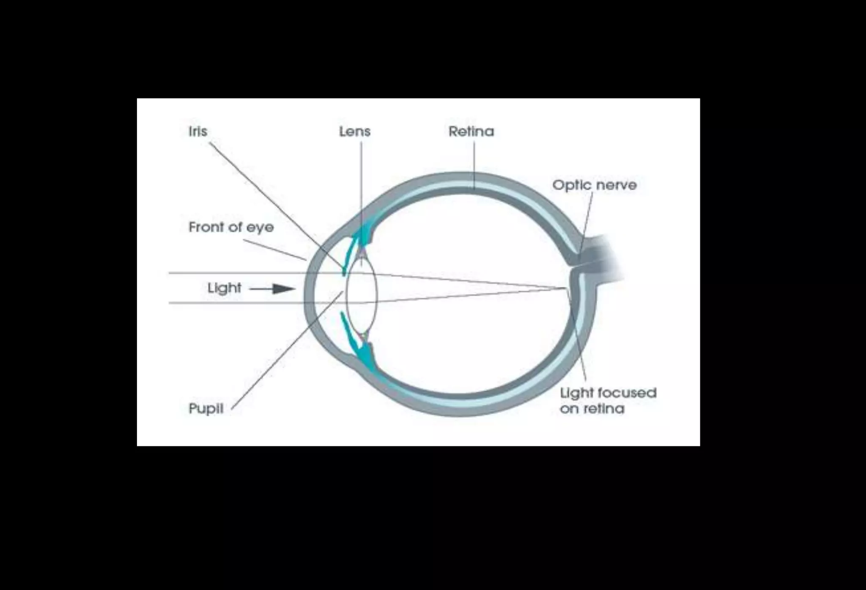
Core Knowledge
ROLE IN VISION
Retina is a light-sensitive layer of cells at the back of retina.
It consists of rod and cone cells (photochemical cells)
Rod cells process white and black image
Cone cells process colour image

Slide 20
WALDS VISUAL CYCLE
Core Knowledge
Normal Vision depends on retina and on adequate Vitamin A.
In retina, Vitamin A in the form of Retinal binds to protein called opsin and makes rhodopsin
Rhodopsin is light-sensitive pigment.
When stimulated by light, vitamin A isomerizes and transforms from cis into trans form

Slide 21
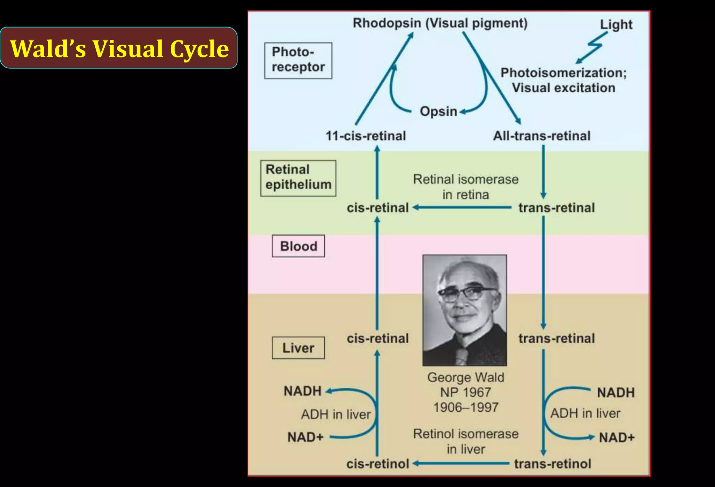

Slide 22
DARK ADAPTATION TIME
Bright light depletes rhodopsin (photobleaching)
Sudden shift from bright light to darkness causes difficulty in seeing
Rhodopsin is synthesized in a few minutes and vision is improved in dark.
THE TIME REQUIRED TO SYNTHESIZE RHODOPSIN IN DARK IS CALLED DARK ADAPTATION TIME.
It is increased in Vitamin A deficiency.

Slide 23
OTHER FUNCTIONS OF VITAMIN A
Retinoic acid is necessary for cell differentiation
Important for embryo development and gene expression
Many epithelial cells require Vitamin A for proper differentiation and maintenance
Lack of vitamin A leads to dysfunction of epithelia.
Skin becomes scaly and keratinized and mucous secretion is suppressed.

Slide 24
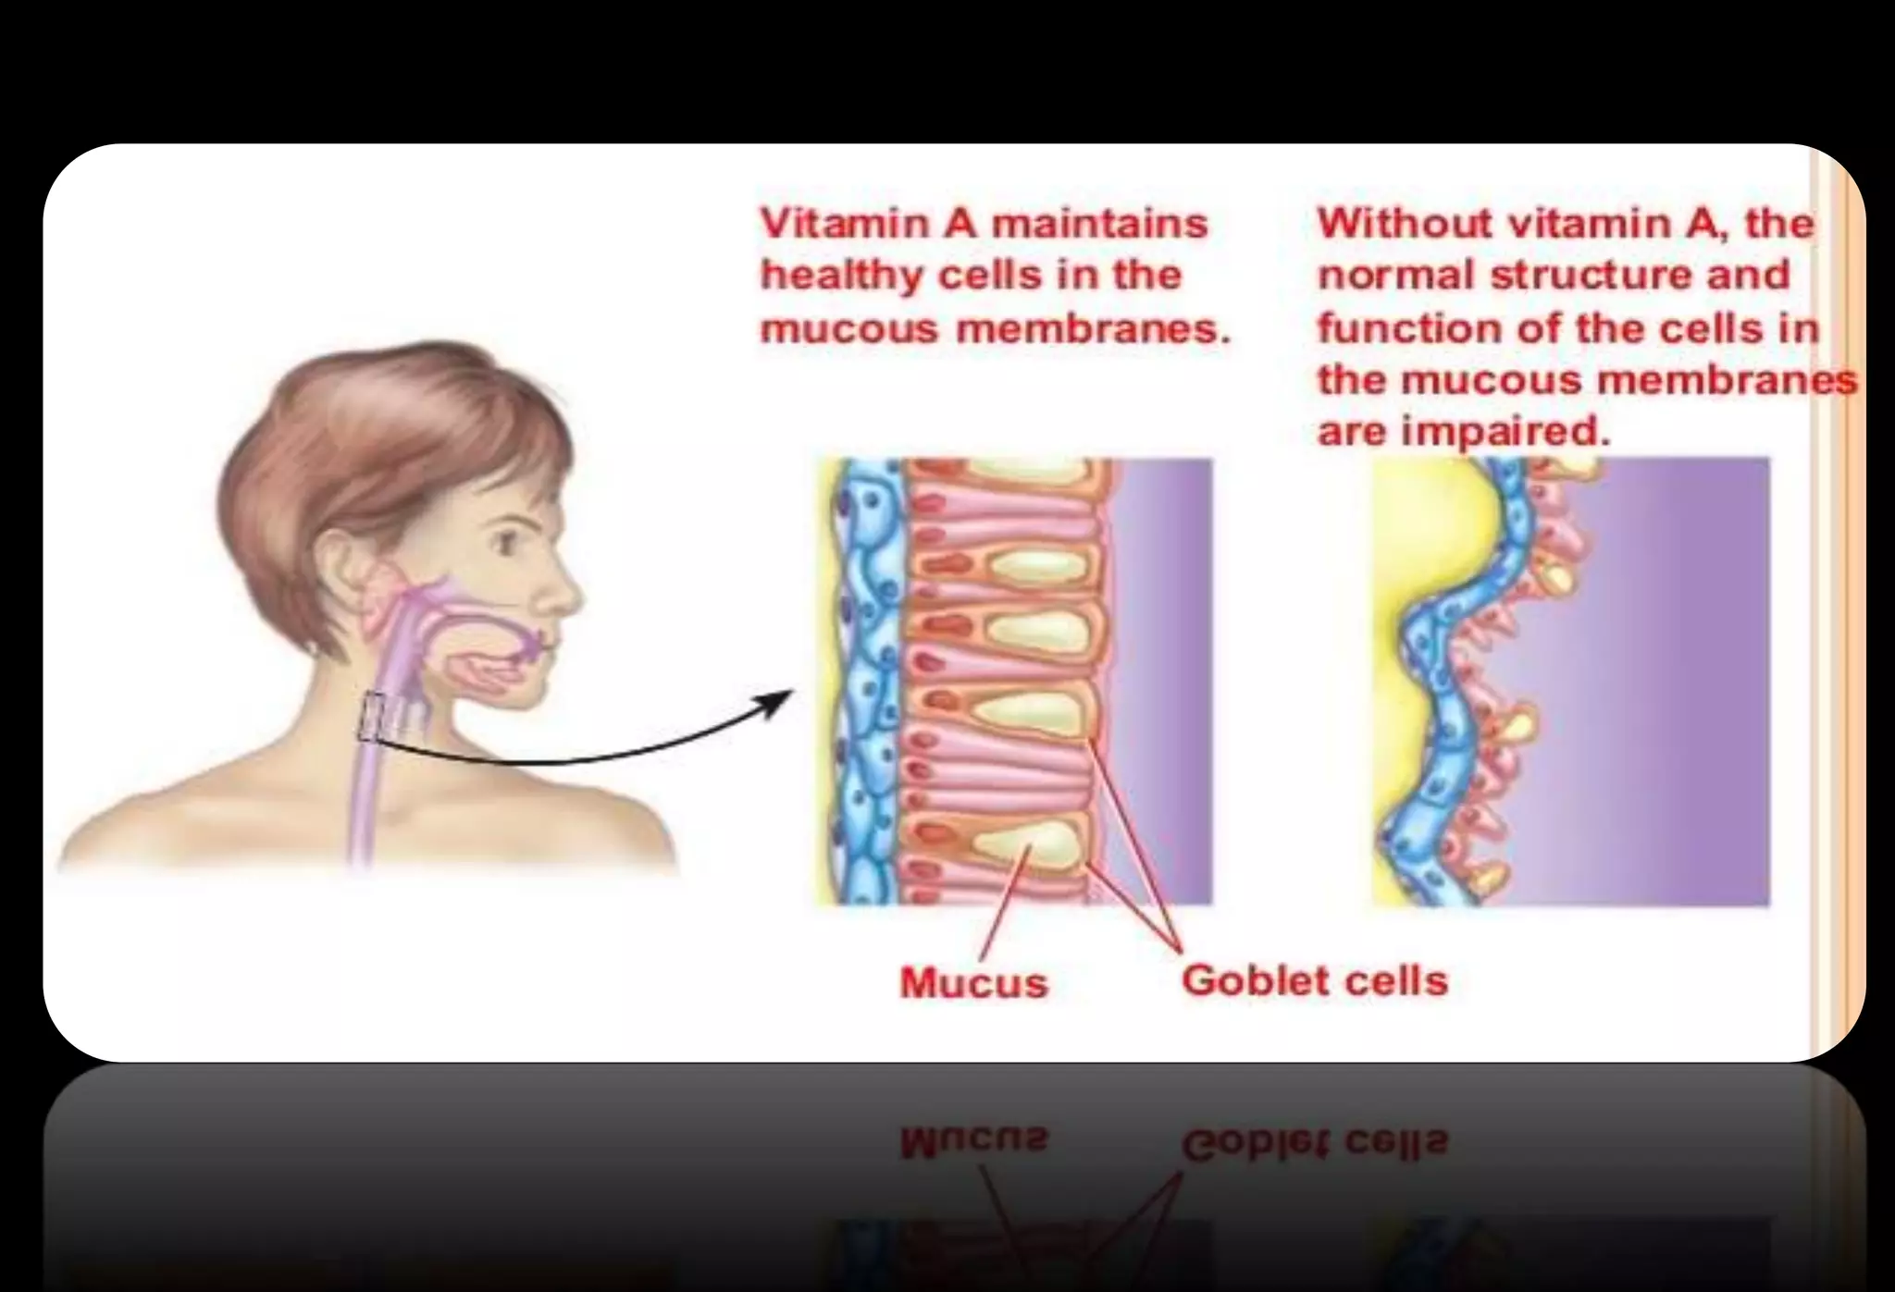

Slide 25
IMMUNE FUNCTIONS
Deficiency leads to decreased resistance to infections
Supplementation may lead to decrease in severity of infections in deficient person

Slide 26
RECOMMENDED DIETARY ALLOWANCE (RDA)
These are suggested levels of essential nutrients required to meet nutritional needs of healthy indivivuals.
The Recommended Dietary Allowance (RDA) for men and women is 900 and 700 μg retinol activity equivalents respectively

Slide 27
VERTICAL INTEGRATION
Deficiency leads to:
Night Blindness
Xerophthalmia
Keratomalacia
Bitot Spots
Complete Blindness (if severe)

Slide 28
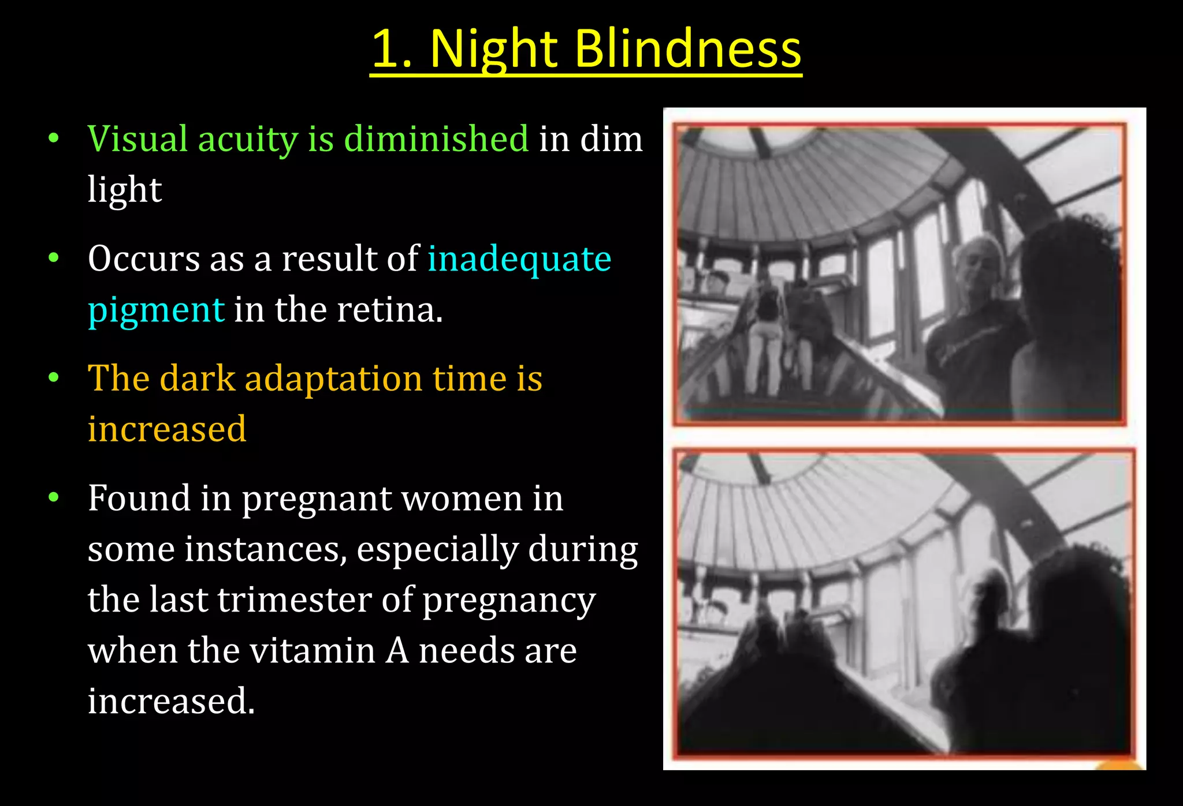
Night Blindness
Visual acuity is diminished in dim light
Occurs as a result of inadequate pigment in the retina.
The dark adaptation time is increased
Found in pregnant women in some instances, especially during the last trimester of pregnancy when the vitamin A needs are increased.

Slide 29
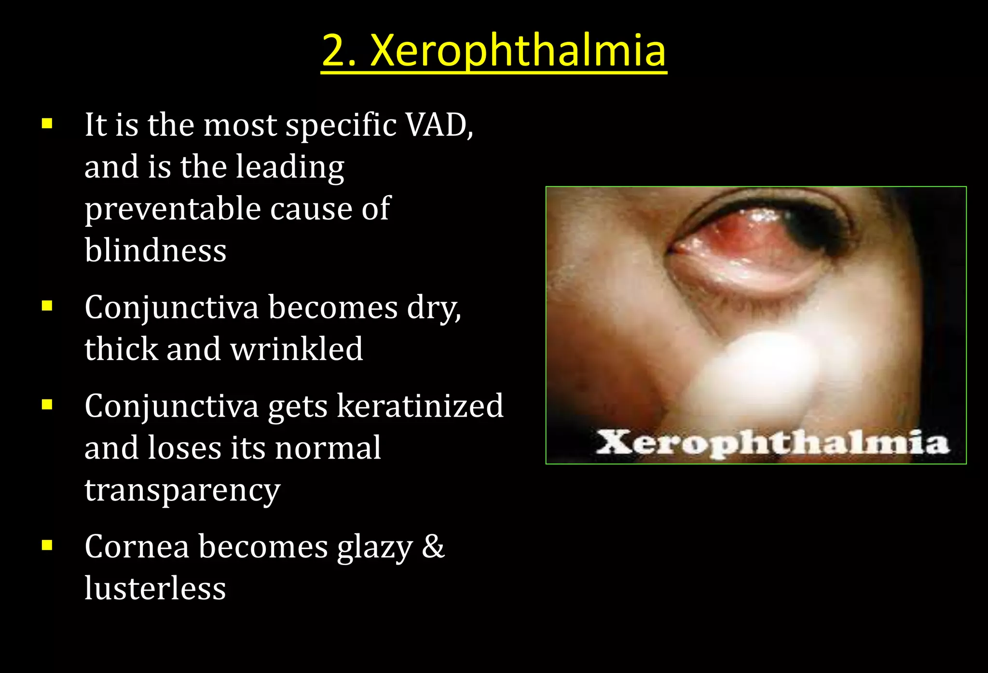
Xerophthalmia
It is the most specific VAD, and is the leading preventable cause of blindness
Conjunctiva becomes dry, thick and wrinkled
Conjunctiva gets keratinized and loses its normal transparency
Cornea becomes glazy & lusterless

Slide 30
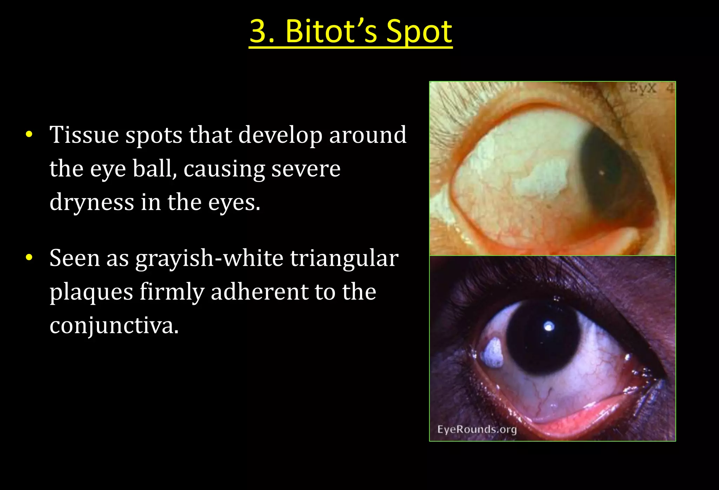
. Bitot's Spot
Tissue spots that develop around the eye ball, causing severe dryness in the eyes.
Seen as grayish-white triangular plaques firmly adherent to the conjunctiva.

Slide 31
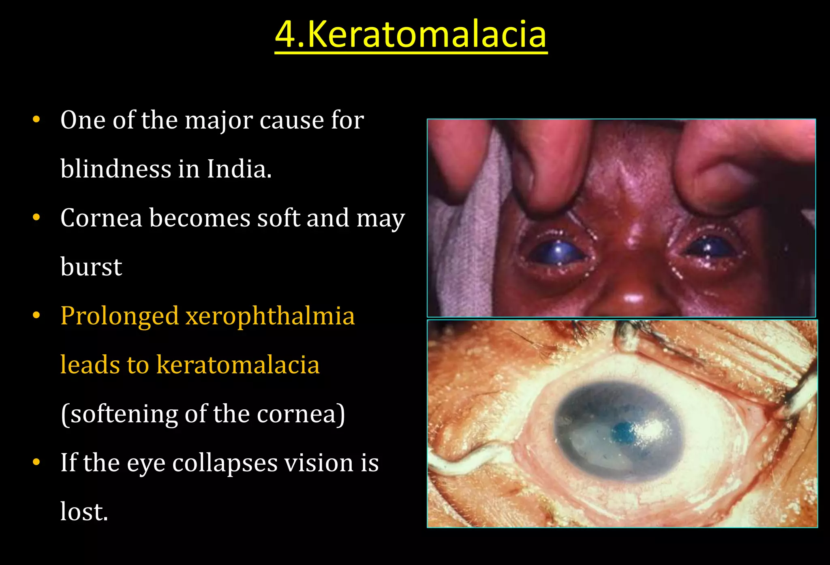
Keratomalacia
One of the major cause for blindness.
Cornea becomes soft and may burst
Prolonged xerophthalmia leads to keratomalacia (softening of the cornea)
If the eye collapses vision is lost.

Slide 32
Family Medicine
Preventive Care: Understanding genetic predispositions and biochemical markers for early detection and preventive strategies in at-risk families.
Personalized Treatment: Tailoring treatments based on the patient's genetic profile, considering familial patterns of cancer to optimize outcomes.
Holistic Management: Addressing not just the biological aspects of cancer but also the psychological, social, and lifestyle impacts on patients and their families, providing comprehensive car

Slide 33
Artificial Intelligence
Predictive Analytics: AI models predict cancer progression and patient outcomes by analyzing genetic mutations and biochemical markers, enhancing personalized medicine approaches.
Diagnostic Support: AI algorithms improve the accuracy of diagnosing cancers through pattern recognition in genetic data and imaging, facilitating early detection.
Treatment Optimization: AI helps in developing targeted therapies by analyzing vast biochemical datasets, identifying potential drug targets, and predicting treatment responses, improving efficacy and reducing side effects.

Slide 34
Bioethics
Consent and Confidentiality: Addressing ethical concerns in genetic testing for hereditary cancers, ensuring patient consent, and maintaining confidentiality of genetic information.
Equity in Access: Ensuring equitable access to cancer diagnostic tools, treatments, and new technologies across different populations to prevent disparities in cancer care.
Ethical Implications of Research: Considering the ethical implications of cancer research, including the use of human subjects, and balancing the potential benefits against the risks and ethical concerns.

Slide 35
Suggested Research Article
Link: Mini-Review: Electrochemical Sensors Used for the Determination of Water- and Fat-Soluble Vitamins: B, D, K: Critical Reviews in Analytical Chemistry: Vol 54, No 1 (tandfonline.com)
Title:Mini-Review: Electrochemical Sensors Used for the Determination of Water- and Fat-Soluble Vitamins: B, D , K
Author Name: Damaris-Crisitna Gheorghe
Abstract: Vitamins are one of the most essential organic compounds that are necessary for the human body, in order to develop and grow in a healthy way. The aim of this mini-review is to bring together a series of electrochemical sensors (voltametric and amperometric) developed for the determination of vitamins from the families of B, D and K in biological, pharmaceutical or food-related samples. For this mini-review, 16 articles published between 2016 and 2021 were taken into consideration.

Slide 36
Learning Resources
Textbook of Biochemistry, Lippincott 10th edition, chapter no.28 , pages no. 432-436
Google scholar
Google images

Slide 37
Assessment
Which of the following is NOT a function of Vitamin A?
a) Vision
b) Immune function
c) Bone growth
d) Cell differentiation
e) Reproduction
2. What is the precursor form of Vitamin A found in plants?
a) Retinol
b) Retinal
c) Retinoic acid
d) Beta-carotene
e) Lycopene

Slide 38
Which of the following is a symptom of Vitamin A deficiency?
a) Night blindness
b) Excessive tearing
c) Yellowing of the skin
d) Hyperpigmentation
e) Increased blood clotting
4. Which organ primarily stores Vitamin A in the body?
a) Liver
b) Kidneys
c) Spleen
d) Pancreas
e) Adrenal glands

Slide 39
5- What is the recommended dietary allowance (RDA) of Vitamin A for adult males?
a) 300 mcg
b) 600 mcg
c) 900 mcg
d) 1200 mcg
e) 1500 mcg

Slide 40
Answers
c) Bone growth
d) Beta-carotene
a) Night blindness
a) Liver
b) 600 mcg

Slide 41

How to access Digital Library
Open PC.
Open Internet.
Search HEC library.
Access public universities
Click on RMU
Read your desired article.

Slide 42


