Slide 1
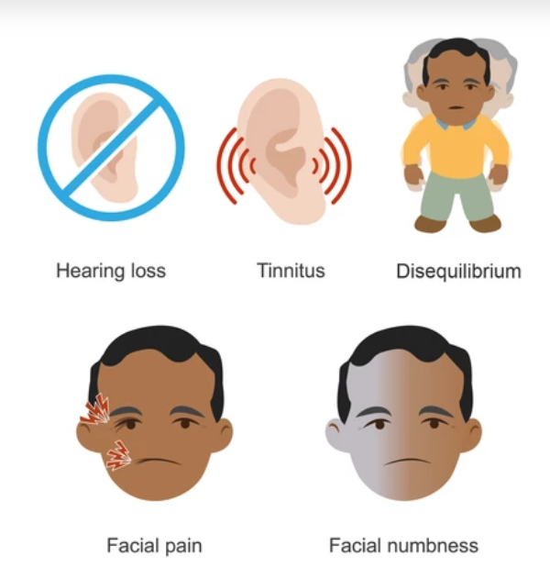
Vestibular Schwannoma

Slide 2
University Motto, Vision, Values & Goals
Mission Statement
To impart evidence-based research-oriented health professional education
Best possible patient care
Mutual respect, ethical practice of healthcare and social accountability.
Vision and Values
Highly recognized and accredited centre of excellence in Medical Education, using evidence-based training techniques for development of highly competent health professionals, who are lifelong experiential learner and are socially accountable.
Goals
The Undergraduate Integrated Learning Program is geared to provide you with quality medical education in an environment designed to:

Slide 3
Sequence of LGIS
Learning objectives
Development (core concept = 60%)
Anatomy, physiology, biochemistry (spiral integration 8%)
Pathology and community medicine (horizontal integration 20%)
Related clinical medical surgical (vertical integration – 7%)
Research, family medicine, bioethics, artificial intelligence (5%)

Slide 4
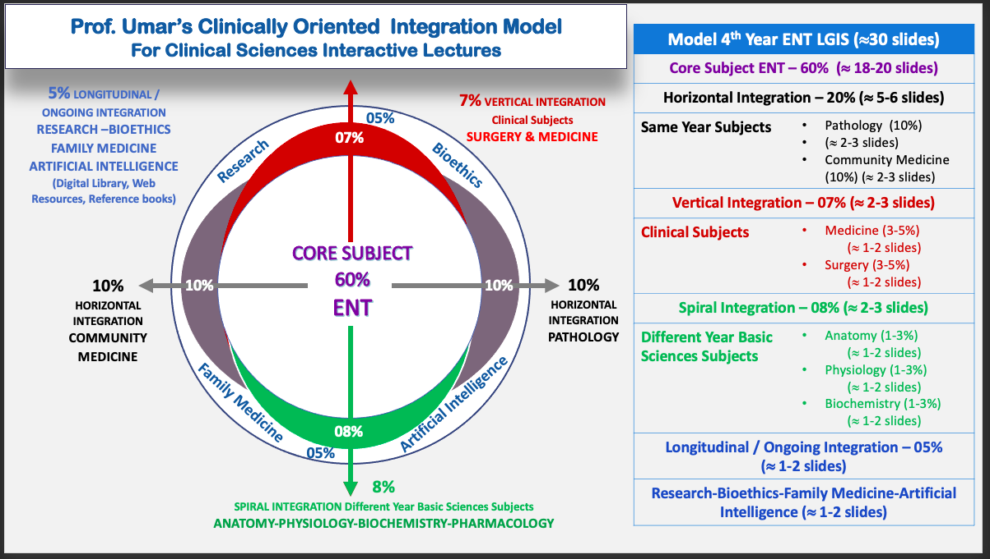
Prof Umer Model Of Integrated Lecture

Slide 5
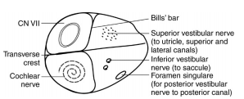
Definition
Benign tumor arising from abnormally proliferative schwann cell enveloping lateral portion of vestibular nerve in internal acoustic meatus
Represent ~80% of cerebellopontine angle (CPA) masses.
Bilateral vestibular schwannomas are strongly suggestive of neurofibromatosis type 2 (NF2).
Notes:
. They were classically described as originating near the transition zone between glial and Schwann cells but contemporary data suggests they can originate at any point along the nerve
In over 90% of cases, these tumors arise from the inferior division of the vestibular nerve 8. Less than 5% cases arise from the cochlear component of the vestibulocochlear nerve (CN VIII)

Slide 6
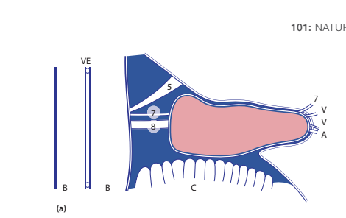
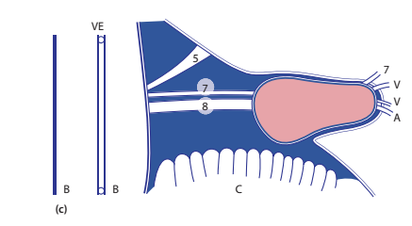
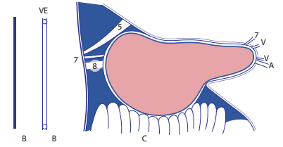
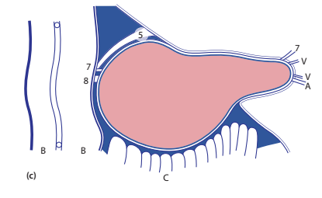
GROWTH

Slide 7
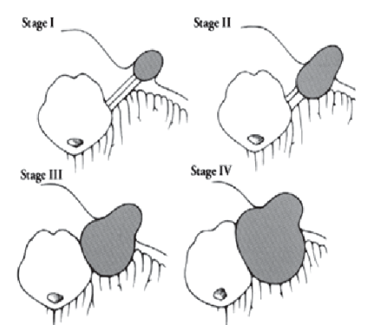
KOOS CLASSIFICATION

Slide 8
Fundus empty or not
tumor cystic or not

Slide 9
DIAGNOSIS
AUDIOLOGICAL TEST
PTA Shows Sensorineural Hearing loss)
Speech Discrimination Score (Poor)
BERA
1) interpeak latency (IPL) between waves I and III >2.5 ms,
2) IPL between waves I and V >4ms,
3) wave V interaural latency difference >0.2 ms

Slide 11
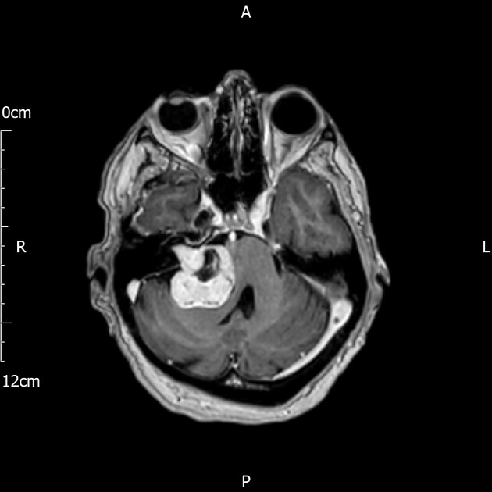
Radiological tests MRI with gadolinium contrast gold standard for diagnosis of acoustic neuroma
On imaging, they classically present as a solid nodular mass with an intracanalicular component
They usually show intense contrast enhancement and, when larger, cystic degeneration can be present. Hemorrhagic areas may also be seen, but calcification is typically not present.

Slide 12
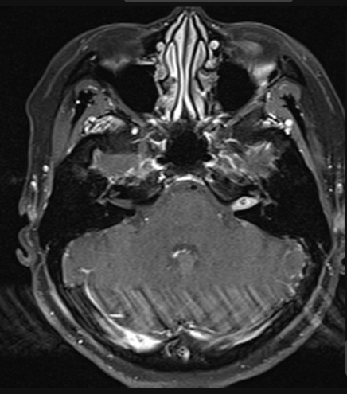
Tumor limited to Intracannalicular segment
Large tumor with brainstem displacement

Slide 13
TREATMENT STRATEGY
Unilateral <15-20mm
Yearly MRI for 5 years
MRI every 4 year
Tumor >15-20mm
Primary Treatment (surgery/ radiosurgery)
Cystic VS
Surgical treatment

Slide 14
RadioSURGERY
Gamma knife surgery: radiation energy is converged on the tumour, thus minimizing its effect on the surrounding normal tissue.
Cyber knife It is more accurate. It uses real-time image guidance technology through computer-controlled robotics.

Slide 15
Translabyrinthine Approach
Pros
Avoidance of cerebellar retraction
Any size can be removed
Early identification of CNVII
Excellent exposure of the tumour and brainstem
Cons
Destruction of the inner ear
higher incidence of cerebrospinal fluid (CSF) fistula
Not an option for hearing preservation surgery

Slide 16
Translabyrinthine Approach

Slide 17
Middle cranial Fossa Approach
Pros
Hearing Preservation
IAC lateral extent visualization
Cons
Risk of epilepsy
maximum size of tumor that can be removed is 1-1.5cm
Limited view of posterior fossa

Slide 18
Middle cranial Fossa Approach

Slide 19
Retrolabyrinthine
Pros
Hearing preservation surgery in small tumors (1.5-3cm)
Larger tumors can be removed
Cons
Post-operative headache is more common
Cerebellar retraction

Slide 20
Retrolabyrinthine

Slide 21
COMPLICATIONS
Death 1%
Arterial Bleeding(AICA, PICA, SCA)
Venous Bleeding(Mastoid Emissary Vein, Petrosal Vein)
Postop Hematoma

Slide 22
Brain Injury
Cerebellum(Retrosigmoid Approach Prolonged retraction)
Brain Stem: Large tumor Malacia of brainstem Breach of pia matter
Temporal Lobe Seizures( middle fossa approach)

Slide 23
Cranial Neuropathies
Facial Nerve increased risk of injury in tumor>4cm
Nervus Intermedius
Trigeminal Nerve >2cm tumor
Abducent & trochlear uncommon
Lower Cranial Nerves(Translabyrinthine approach/ during removal of inferior pole of tumor)
CSF Leakage(most common)
CSF otorrhea
CSF Rhinorrhea(translabyrinthine approach)
Meningitis, Encephalitis, Cerebritis: 1-5% risk (vancomycin and ceftriaxone 1st line)

Slide 25
VESTIBULAR NEURITIS VS LABYRINTHITIS

Slide 26
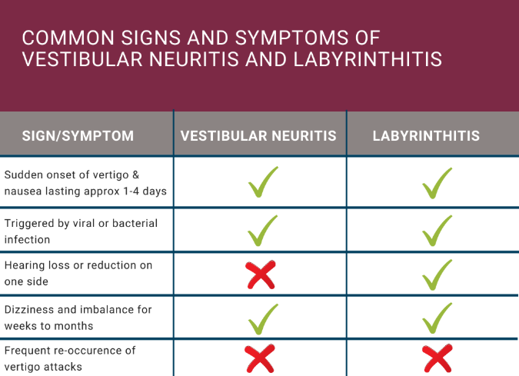

Slide 27
TREATMENT
In the initial stages of the illness, medications for nausea and dizziness may be prescribed. Sometimes corticosteroids are also given to reduce the inflammation.
These medications include anti emetics, betahistine,labyrinthine sedatives.
In case of labyrinthitis ,intravenous antibiotics are also required
Vestibular rehabilitation exercises can help to re-train the brain and create new connections from the inner ear to the brain to re-route around the damaged area of the nerve.

Slide 29
Biomedical Ethics
Before doing any medical and surgical treatment, informed consent must be taken
Prognosis should be explained to patients and attendants.

Slide 30
Family Medicine
Any patient who presents with progressive hearing loss in middle age should be referred to ENT specialist and tested for audiological assessment.

Slide 31
Artificial Intelligence
Cyber Knife is a new technique in the treatment of Acoustic Neuroma as it utitlises Computer controlled robotics and real time image guidance technology.

Slide 32
REFERENCES
SCOTT BROWN OTOLARYNGOLOGY 8th edition
PL Dhingra, 7th edition

