Slide 1
Urinary Incontinence Renal Module 4th Year MBBS
Dr Kiran Fatima
Pathology Department
Rawalpindi Medical University

Slide 2
MOTTO OF RMU
Wisdom
Truth
Service

Slide 3
VISION OF RMU THE DREAM/ TOMORROW
To impart evidence based research oriented medical education
To provide best possible patient care
To inculcate the values of mutual respect and ethical practice of medicine

Slide 4
PROF UMAR’S LGIS MODEL

Slide 5
How to use HEC Digital Library
Steps to Access HEC Digital Library
Go to the website of HEC National Digital Library.
On Home Page, click on the INSTITUTES.
A page will appear showing the universities from Public and Private Sector and other Institutes which have access to HEC National Digital Library (HNDL).

Slide 6
4. Select your desired Institute.
5. A page will appear showing the resources of the institution
6. Journals and Researches will appear
7. You can find a Journal by clicking on JOURNALS AND DATABASE and enter a keyword to search for your desired journal.

Slide 7
Learning outcomes
Types of Incontinence: Differentiate between the various types of urinary incontinence (e.g., stress, urge, overflow, functional, mixed).
Risk Factors: Identify risk factors associated with urinary incontinence, including age, gender, pregnancy, childbirth, obesity, neurological disorders, medications, and other medical conditions.
Pathophysiology: Explain the underlying physiological mechanisms contributing to different types of incontinence.
Assessment & Diagnosis: Describe appropriate methods for assessing and diagnosing urinary incontinence, including patient history, physical examination, and diagnostic tests (e.g., urinalysis, urodynamic studies).

Slide 8
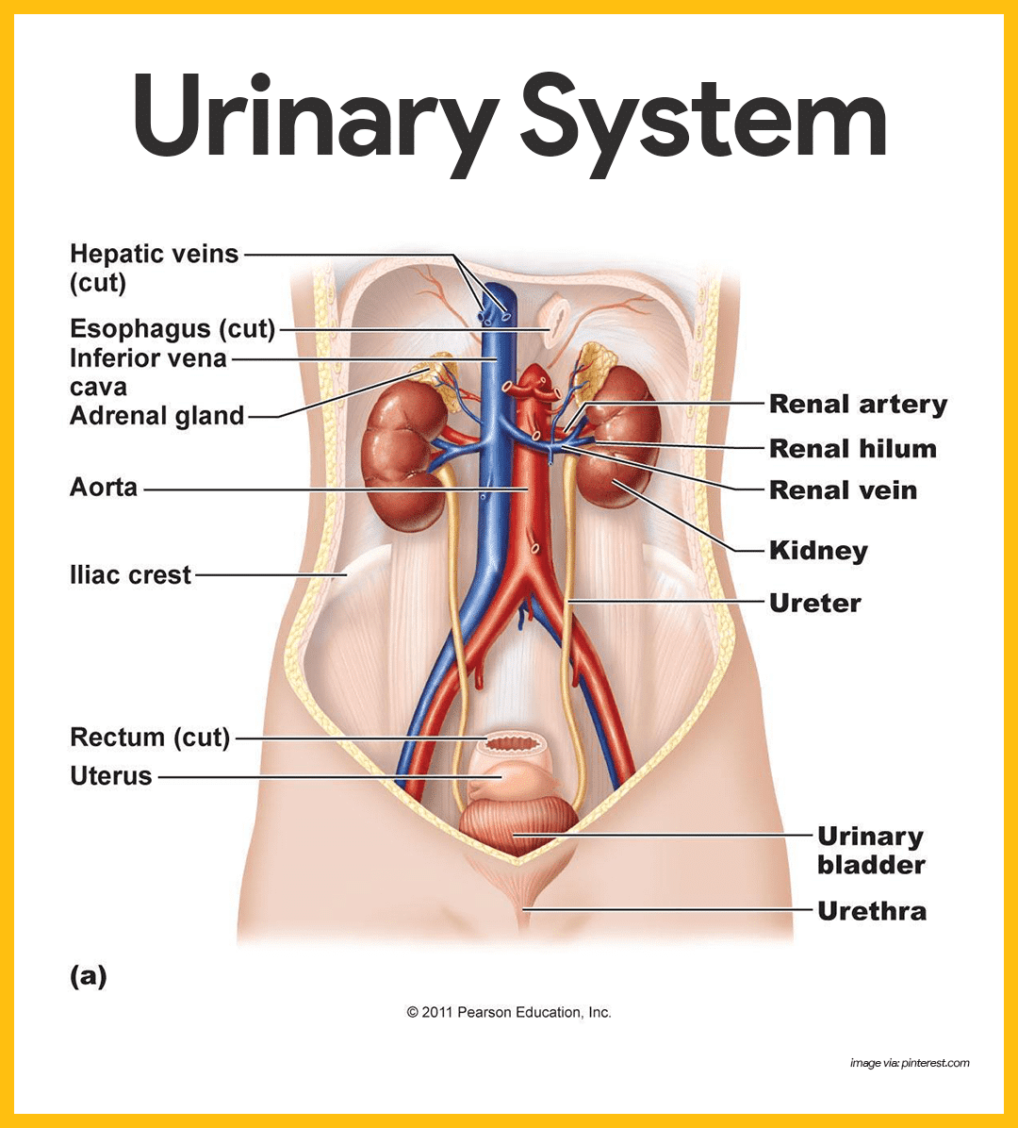
Spiral Anatomy

Slide 9
Prevalence
Core Content
Increases with age
Affects women more than men (2:1) until age 80
15-30% in age 65 and older
60-70% in older adults age 65 and older in long term care
Significantly impairs quality of life

Slide 10
Risk factors
Core Content
Obesity
Functional impairment
Dementia
Medications
Notes:
medications: estrogen blockers; alpha blockers; cholinesterase inhibitors

Slide 11
Core Content

Slide 12
Pathophysiology : age related lower urinary tract changes
Core Content
Bladder contractility decreases
Uninhibited bladder contractions increase
Diurnal urine output occurse later in day
Bladder capacity decreases
Sphincteric striated muscle attenuates
PVR increases

Slide 13
Age related lower urinary tract changes- women
Core Content
In addition to the physiologic changes already discussed:
Urethral closure pressure decreases
Vaginal mucosal atrophy

Slide 14
Age related lower urinary tract changes- men
Core Content
In addition to the physiologic changes already discussed:
Benign prostatic hyperplasia
Prostate hypertrophy

Slide 15
Urge urinary incontinence
Core Content
Urge Urinary incontinence with detrusor overactivity (uninhibited bladder contractions)
40% on urodynamic testing
Suggest detrusor overactivity PLUS impaired compensatory mechanisms.
Idiopathic, age-related, secondary to lesions in cerebral and spinal pathways.
Due to bladder outlet obstruction or bladder irritation (infection, stones, tumor)
Notes:
Research emphasizes the role of afferent stimulation from the bladder urothelium and impaired CNS control of urgency in DO and overactive bladder.
Occurs with urgency, a compelling and often sudden need to void; most common in both men and women.

Slide 16
Stress urinary incontinence
Core Content
Etiology
Damage to the pelvic floor supports
Sphincter failure
Leakage associated with coughing, sneezing, laughing, physical activity
Second most common form in women
Seen in men after prostectomy
Notes:
Damage to pelvic floor supports (levator ani, CT) which compress the urethra when intrabdominal pressure increases.
Sphincter failure- surgical damage, severe atrophy, or (rare) subsacral SCI.

Slide 17
Mixed urinary incontinence with both detrusor overactivity and impaired sphincter support
Core Content
Leakage occurs with both urgency and activity
Seen in women

Slide 18
Medications associated with urinary incontinence
Core Content
Alcohol
Alpha-adrenergic agonists
Alpha-adrenergic blockers
ACE Inhibitors
Anticholinergic
Antipsychotics
CCB
Cholinesterase inhibitors
Estrogen
Gabapentin
Loop diuretics
Narcotics
NSAIDs
Sedative hypnotics
Thiazolidinediones
TCA

Slide 19
Physical examination
Core Content
Rectal Exam
Masses, fecal loading, prostate nodules or firmness
Neuro Exam
Sacral cord integrity (sensory)
Anal tone and contraction (motor)
Pelvic Exam
Labial and vaginal lesions
Pelvic organ prolapse
Psychological Exam
Association between depression and Urinary incontinence

Slide 20
Diagnostic testing
Vertical Integration
Urinalysis
Hematuria, glycosuria
Bladder diaries (time, volume & Urinary incontinence episode in 48 hr)
Urodynamics
Only in uncertain diagnosis

Slide 21
Urinary incontinence treatment and management
Vertical Integration
Lifestyle Management
Weight loss
Extreme fluid intake
Limit caffinated beverages
Limit evening fluid intake
Quit smoking

Slide 22
Urinary incontinence treatment and management
Vertical Integration
Behavioral therapies
A. Bladder training and pelvic muscle exercises
B. Prompt timed voiding

Slide 23
Medications : anti muscarinics
Vertical Integration
Mechanism of action :
Increase bladder capacity by decreasing basal excretion of Ach from urothelium
Contraindicated
Narrow angle glaucoma
Impaired gastric emptying
Known urinary retention
Patient taking cholinesterase inhibitor
Drugs
Oxybutynin
Tolterodine
Fesoterodine
Trospium
Darifenacin
Solifenacin

Slide 24
Medications urinary incontinence and overactive bladder
Vertical Integration
Mechanism of action
Stimulation of beta 3 receptors in the detrusor mediates bladder relaxation:
Mirabegron 25-50mg QD
Adverse effects :
Increase blood pressure
Prescribe carefully in patient with renal and hepatic impairment

Slide 25
Other treatments
Vertical Integration
Intravesical injection of botulinum toxin
Sacral nerve neuromodulation

Slide 26
Surgical treatment
Horizontal Integration
Surgery (stress urinary incontinence)
Colposuspension (burch operation)
Slings (synthetic mesh, autologus or cadaveric fascia)

Slide 27
Research https://www.ncbi.nlm.nih.gov/books/NBK559095/
Urinary Incontinence
Stephen W. Leslie; Linh N. Tran; Yana Puckett.
Author Information and Affiliations
Last Update: August 11, 2024.
Go to:
Continuing Education Activity
Urinary incontinence is the involuntary leakage of urine. This condition is prevalent in older adults but can also affect younger adults and significantly impacts both health and quality of life. The 5 main types include stress, urge, mixed, overflow, and functional incontinence. Possible treatments include lifestyle adjustments, physical therapy, pelvic floor exercises, fluid management strategies, prompted voiding, biofeedback, catheters (intermittent or permanent), pads, pharmaceuticals, botulinum toxin injections, sacral neuromodulation, bedside suction devices, and numerous procedures, including male and female slings, artificial sphincters, and prostate surgery.
This activity reviews the different types of urinary incontinence, effective screening practices, and evidence-based management strategies. Participants gain comprehensive knowledge of the latest diagnostic techniques and treatment modalities, enabling them to provide improved patient care. Clinicians also learn about the psychosocial aspects of the condition and how to address them, enhancing their ability to support patients holistically. This activity also highlights the role of the interprofessional team in the care of patients with urinary incontinence, leading to better clinical outcomes and improved quality of life for individuals affected by urinary incontinence.

Slide 28
Family Medicine
A 70-year-old woman, Mrs. Smith, reports to her doctor that she experiences involuntary leakage of urine when she coughs, laughs, or sneezes. She denies any other urinary symptoms such as frequency, urgency, or burning. She is otherwise healthy and takes no medications known to affect urinary function.
Question:
What is the MOST likely type of urinary incontinence Mrs. Smith is experiencing?
A) Urge incontinence B) Overflow incontinence C) Functional incontinence D) Stress incontinence
Correct Answer: D) Stress incontinence

Slide 29
Take home message
Urinary incontinence is the involuntary leakage of urine, affecting millions worldwide. It can range from occasional drips to complete loss of bladder control, impacting quality of life. Various types exist, each with different causes and treatment approaches.

Slide 30
Thank You

