Slide 1
THEME:ULCERATED LESION OF FACE
DR. Usman Qureshi
M.B.B.S F.C.P.S
HEAD OF THE DEPARTMENT
SURGERY UNIT–II, BBH
RAWALPINDI MEDICAL UNIVERSITY

Slide 2
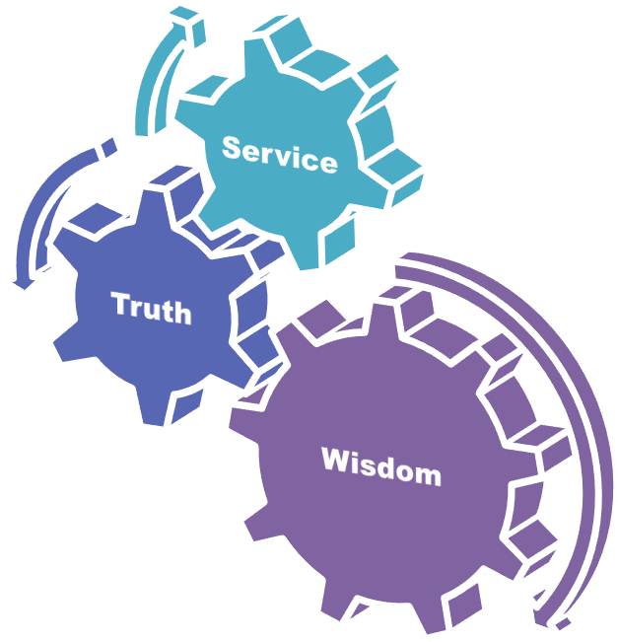
University Motto, Vision, Values & Goals
Mission Statement To impart evidence-based research-oriented health professional education .Best possible patient care Mutual respect, ethical practice of healthcare and social accountability. Vision and Values Highly recognized and accredited centre of excellence in Medical Education, using evidence-based training techniques for development of highly competent health professionals, who are lifelong experiential learner and are socially accountable. Goals The Undergraduate Integrated Learning Program is geared to provide you with quality medical education in an environment designed to:

Slide 3
PROF UMER MODEL OF INTEGRATED LECTURE

Slide 4
Clinical Scenario
A 70-year-old man presents with a slowly enlarging, non-healing ulcerated lesion on his right cheek that has been present for several months. The lesion has a rolled border and some areas of crusting. He reports a history of significant sun exposure. What is the most likely diagnosis?
A. Basal cell carcinoma
B. Squamous cell carcinoma
C. Melanoma
D. Actinic keratosis
E. Pyogenic granuloma

Slide 5
Answer:
Basal cell carcinoma
Explanation
Basal Cell Carcinoma (BCC) is the most common type of skin cancer, often linked to prolonged sun exposure. It typically presents as a non-healing ulcerated lesion with rolled edges and can have a central depression. BCCs are usually found on sun-exposed areas of the skin, such as the face, and are more common in older adults with significant sun exposure history, as seen in this patient.

Slide 6
Clinical Scenario
A 48-year-old woman presents with an ulcerated lesion on her lower lip that has been present for several months. The lesion is painful and occasionally bleeds. She reports a long history of smoking and frequent sun exposure. Physical examination reveals a 1.5 cm ulcerated lesion with indurated borders on the vermilion border of the lower lip. What is the most likely diagnosis?
A. Basal cell carcinoma B. Squamous cell carcinoma C. Melanoma D. Actinic keratosis E. Aphthous ulcer

Slide 7
Answer: B. Squamous cell carcinoma
Explanation: Squamous cell carcinoma (SCC) is a common malignancy on the lower lip, especially in patients with a history of smoking and sun exposure. It typically presents as a painful, ulcerated lesion with indurated borders. Basal cell carcinoma (A) is less common on the lips and more typically found on the upper face.

Slide 8
LEARNING OBJECTIVES
At The End Of This Lecture Students Shall Be Able To Learn:
To understand the surgical anatomy of the skin
To know different skin diseases that can present with Ulcerated Lesions
To take a biopsy of any ulcerated lesion
To have a concept of primary surgical clearance and role of flaps needed for defect coverage

Slide 9
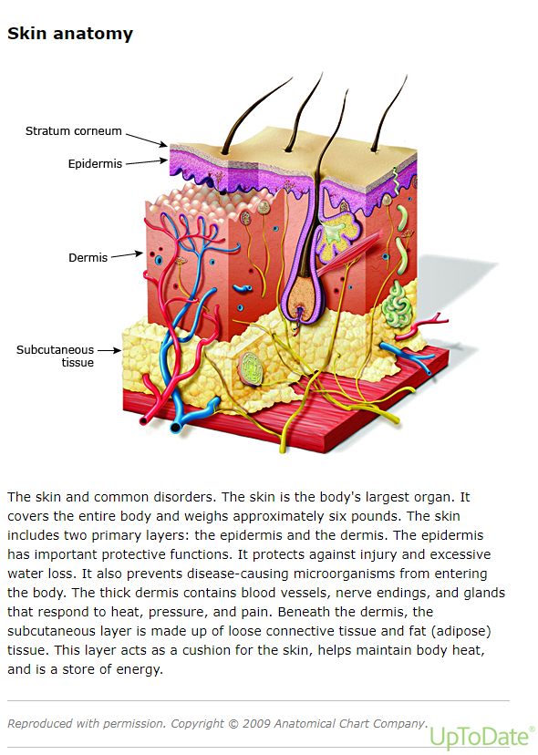

Slide 10
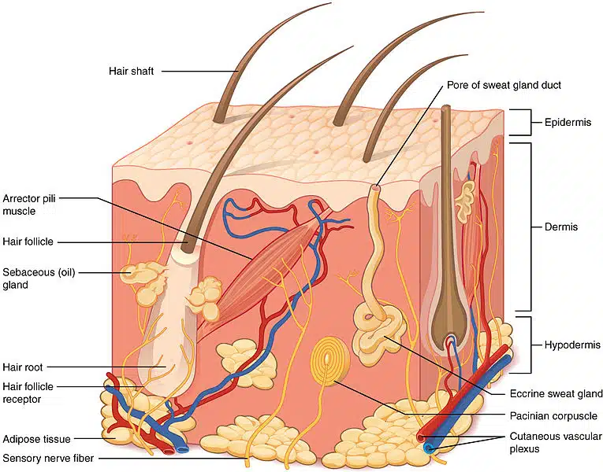
Skin Anatomy

Slide 12
Basal Cell Carcinoma
Basal cell carcinoma (BCC) is a common skin cancer arising from the basal layer of epidermis and its appendages. These tumors have been referred to as "epitheliomas" because of their low metastatic potential. However, the term carcinoma is appropriate since they are locally invasive, aggressive, and destructive of skin and the surrounding structures, including bone

Slide 13
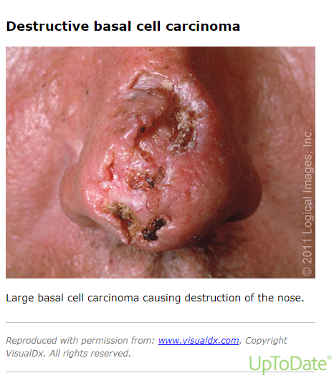

Slide 14
Clinical Presentation
Approximately 70 percent of BCCs occur on the face, consistent with the etiologic role of solar radiation, and 15 percent present on the trunk.
The clinical presentation of BCC can be divided into three groups, based upon lesion histopathology:
nodular
superficial
morpheaform.

Slide 15
Risk Factors
Environmental
Ultraviolet radiation
Sun exposure
Tanning beds
Phototherapy
Photosensitizing agents
Chronic arsenic exposure
Ionizing radiation

Slide 16
Cutaneous squamous cell carcinoma
Cutaneous squamous cell carcinoma (cSCC) is a malignant tumor arising from epidermal keratinocytes. In individuals with lightly pigmented skin, it typically develops in areas of photodamaged skin and presents with a wide variety of cutaneous lesions, including papules, plaques, or nodules, that can be smooth, hyperkeratotic, or ulcerated

Slide 17
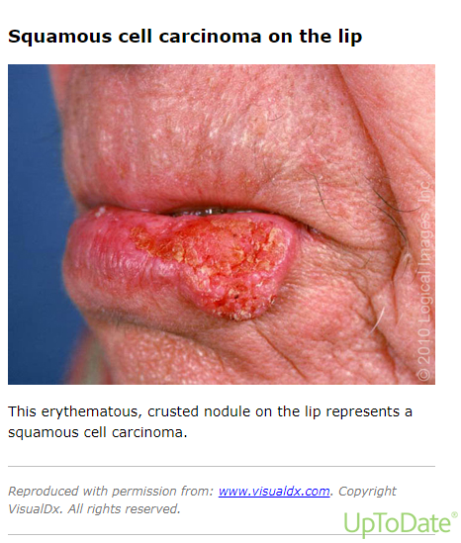

Slide 18
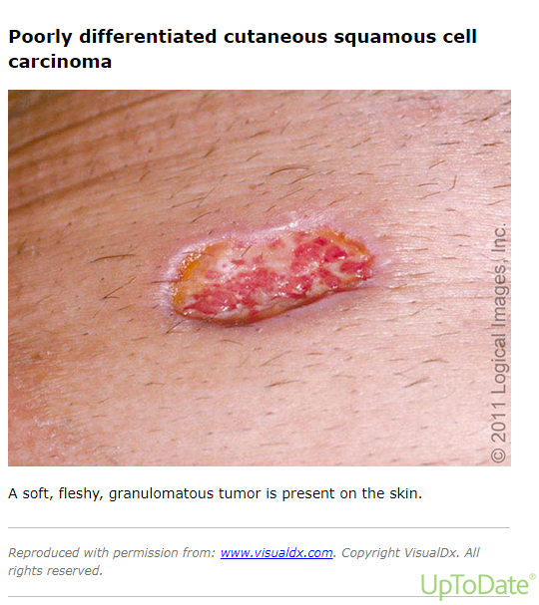

Slide 19
Keratoacanthoma
Keratoacanthomas are keratocytic epithelial tumors that clinically and histologically resemble squamous cell carcinoma (SCC). Keratoacanthomas are usually found on actinically damaged skin. Lesions typically exhibit rapid initial growth, manifesting as dome-shaped or crateriform nodules with a central keratotic core that develop within a few weeks

Slide 21
Biopsy Techniques
Shave biopsy – Shave biopsies are typically used for lesions for which sampling of the full thickness of the dermis and subcutis is not necessary. Shave biopsies are performed with a number 15 scalpel blade or a razor blade. Aluminum chloride or another topical hemostatic agent is used to control bleeding.
Punch biopsy – Punch biopsies involve the removal of a core-shape piece of tissue and allow sampling of the deep dermis. Punch biopsy wounds can be closed with suture or left to heal by secondary intention.
Excisional biopsy – Excisional biopsies are more time consuming than punch or shave biopsies but are useful for biopsies of larger or deeper lesions.

Slide 22
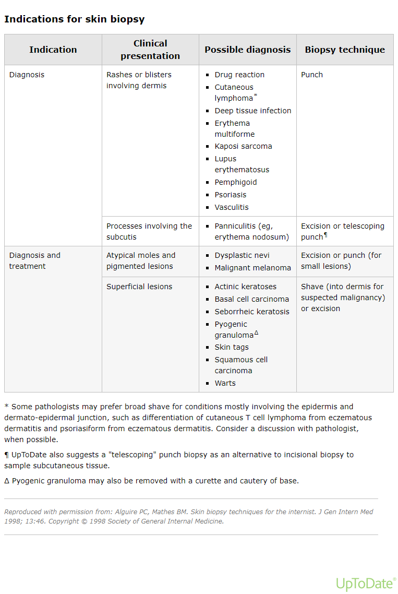

Slide 23
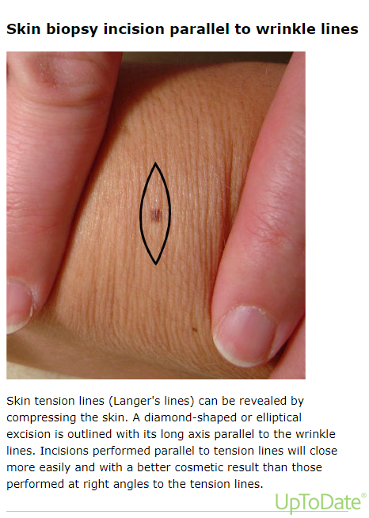

Slide 24
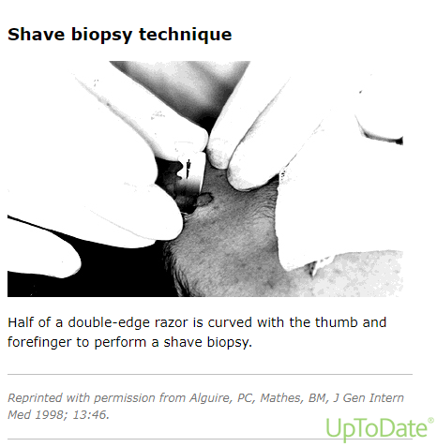

Slide 25
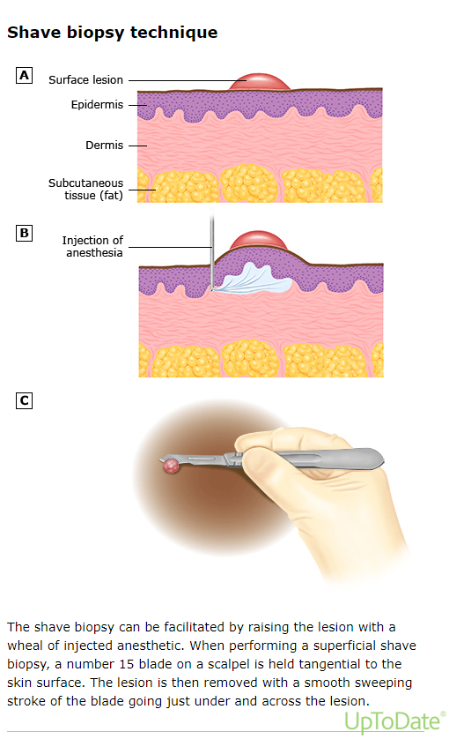

Slide 26
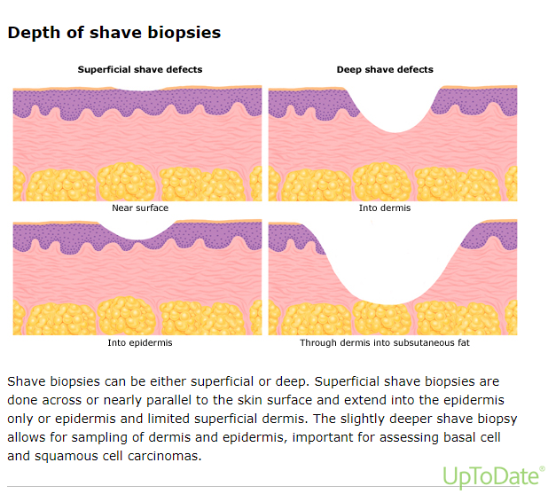

Slide 27
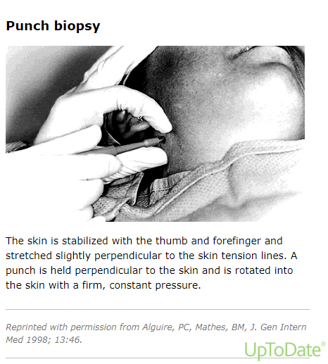

Slide 28
Skin Flaps
Skin-only flaps are most commonly used as local flaps, though microsurgical transfer of skin-only flaps (eg, scapular and parascapular flaps)
Random pattern type – Most commonly, skin flaps are random pattern flaps with no specific named vascular supply.Local skin flaps are often used to cover defects from surgical lesion excision (eg, cutaneous carcinoma. One example is the use of local skin flaps to cover a defect on the face after Mohs surgery.
Axial type – The suprafascial flap contains skin and a fat-containing envelope and is based on vessels that perforate through muscles or through intermuscular septae. With these flaps, the muscle fascia is left behind.

Slide 30
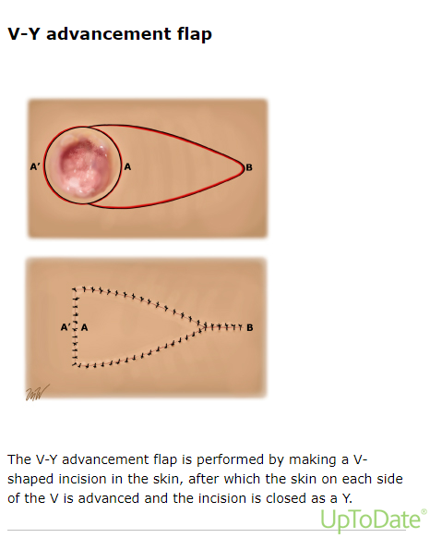

Slide 31
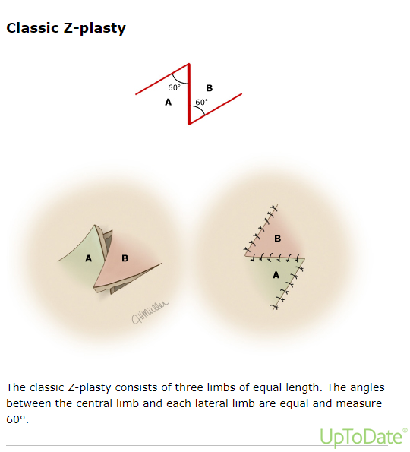

Slide 32
REFERENCES
Ratner D. Skin grafting. Semin Cutan Med Surg 2003; 22:295.
Ogawa R, Hyakusoku H, Ono S. Useful tips for successful skin grafting. J Nippon Med Sch 2007; 74:386.
Harrison CA, MacNeil S. The mechanism of skin graft contraction: an update on current research and potential future therapies. Burns 2008; 34:153.
Lannon DA, Novak CB, Neligan PC. Resurfacing of colour-mismatched free flaps on the face with split-thickness skin grafts from the scalp. J Plast Reconstr Aesthet Surg 2009; 62:1363.
Elston DM, Stratman EJ, Miller SJ. Skin biopsy: Biopsy issues in specific diseases. J Am Acad Dermatol 2016; 74:1.
Harvey NT, Chan J, Wood BA. Skin biopsy in the diagnosis of inflammatory skin disease. Aust Fam Physician 2017; 46:283.

Slide 33
Any Question?
Thankyou

