Slide 1
Urinary Tract infections in adults
DR.ASMARA ASRAR
Assistant Professor of Nephrology
Holy Family Hospital Rawalpindi

Slide 2
MOTTO AND VISION
Mission Statement
To impart evidence-based research-oriented health
professional education
Best possible patient care
Mutual respect, ethical practice of healthcare and social
accountability.
Vision and Values
Highly recognized and accredited centre of excellence in
Medical Education, using evidence-based training
techniques for development of highly competent health
professionals, who are lifelong experiential learner and are
socially accountable.
Goals
The Undergraduate Integrated Learning Program is geared to
provide you with quality medical education in an
environment designed to:

Slide 4
Learning Objectives
AT THE END OF THIS LECTURE STUDENTS SHALLBE ABLE TO LEARN:
ETIOLOGY OF UTI
COMPLICATED AND UNCOMPLICATED UTI
SIGNS AND SYMPTOMS
EXAMINATION
INVESTIGATIONS
MEDICAL AND SURGICAL MANAGEMENT
RECENT ADVANCES

Slide 5
Definition
Urinary tract infection is an infection in any part of the urinary system kidneys ureters bladder or urethra.
Complicated UTI is defined as UTI that increases the risk of serious complications or treatment failure

Slide 6
Pathogenesis
Uncomplicated infection
E coli present in the rectal flora enter the bladder through the urethra after and Interim phase of periureteral and distal ureteral colonization.
Hematogenous seeding staphylococcal aureus is the source of some UTI but most likely to occur in settings of persistent bloodstream infection and urinary tract obstruction
Virulence determinants E coli fimbriated strains adherence properties may stimulate epithelial and other cells to produce pro-inflammatory factors that stimulate the inflammatory response Other variance determinants include
adherence factors
immune invasion iron acquisition
Male determinants
Dry environment
greater length of male urethra
lack of circumcision

Slide 8
Complicated infection
Earlier factors plus new factors like causing obstruction or stasis of urine flow indwelling catheters
Visico ureteric reflux
neutropenia
immune deficiencies
diabetes mellitus associated with renal perianal abscess, cystitis, emphysematous pyelonephritis

Slide 9
EtioloGic agents
Uncomplicated upper and lower UTI E coli 70 to 90%
Staphylococcus saprophyticus 5 to 20%
Healthy non pregnant women
Lactobacillus Group b streptococcus
Coagulase negative staphylococcus other than saprophyticus
Chronic conditions spinal cord injury and neurogenic bladder polymicrobial and multidrug resistant infections

Slide 10
A urinary tract infection (UTI) is an infection in any part of your urinary system — your kidneys, ureters, bladder and urethra.

Slide 11
Upper urinary tract infections
Ascending infections, mostly in association with a lower urinary tract infection and its symptoms
Types:
Acute pyelonephritis
Chronic pyelonephritis

Slide 12
Acute pyelonephritis
Symptoms:
Pyrexia
Loin pain
Rigors
Investigations :
Urine analysis: lecuocytes, bateria, casts
Blood cultures: for septicemic patients
Radiological:
Abdominal xray: calculus
USG: Hydronephrosis
Complications include pyonephrosis and perinephric abscess

Slide 13
treatment
IV antibiotics therapy for uncomplicated UTI.
initial stages to control infection, then shifting to oral regimen.

Slide 14
Chronic pyelonephritis
Pathology:
obstructive or non obstructive
Clinical Features:
Recurrent symptomatic UTIs or subclincal with bacteriuria on routine screening.
Rarley present at advanced stages of chronic renal failure
Complications:
ESRD 15% of adult cases and 30% of childhood cases
Investigations:
USG
IVU
CT scan

Slide 15
treatment
Long term low dose antibiotics should be considered
Parentral therapy:
Ceftiraxone 1000mg to 2000mg OD
Ciprofloxacin 200 to 400mg BD
Levofloxacin 250 to 750mg OD
Oral therapy:
Flouroquinlones ,
Amoxicillin + clavulunate
Levofloxacin

Slide 16
Can be categorised into five groups
Acute uncomplicated cystitis
Women with recurrent cystitis
Women with acute uncomplicated pyelonephritis
Complicated UTI
Asymptomatic bacteriuria

Slide 17
Acute uncomplicated cystitis young women
Signs and symptoms Acute onset of dysuria, frequency, urgency and suprapubic pain.
Pyuria is present in almost all women with acute cystitis.
Hematuria microscopic or gross common in women with UTI but not with urethritis or vaginitis
Definitive diagnosis of UTI requires presence of significant bacteria. Infectious diseases society of America consensus definition of cystitis is 10³cfu/ml or more uropathogens.
Urine cultures are generally not indicated in women with uncomplicated cystitis because of causative organism in a predictable and cultures may become available only after therapeutic decision has been made.

Slide 20
Recurrent acute uncomplicated cystitis in women
Persistence of initial infection strain in fecal flora
If the reocurrance is 1 to 2 weeks of treatment and antimicrobial resistant uropathogens should be considered and urine culture should be performed followed by the treatment with an alternative regimen.

Slide 22
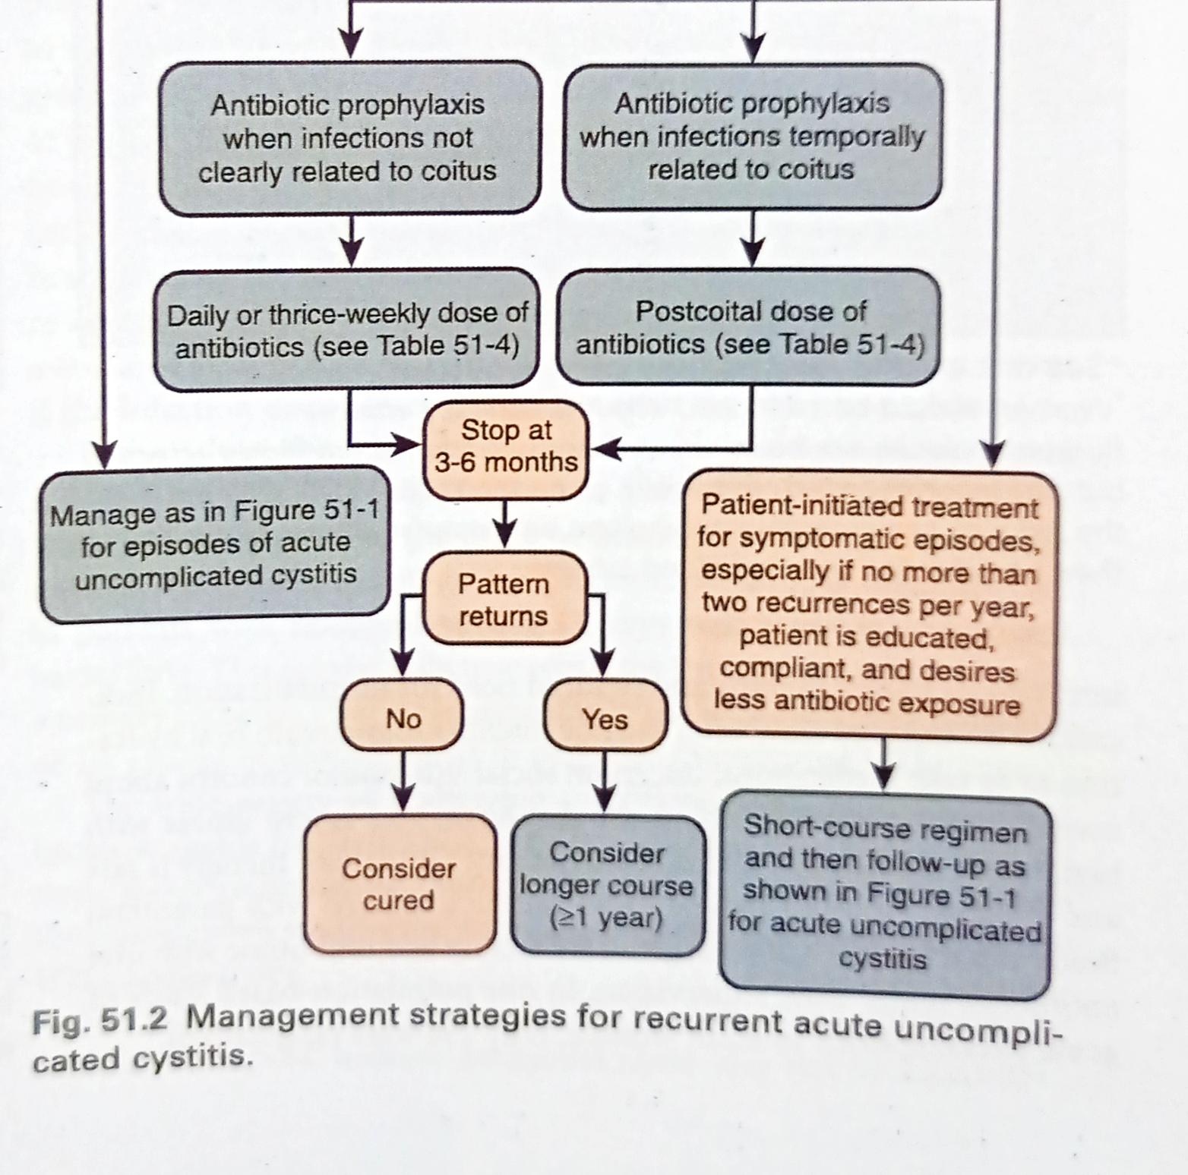

Slide 23
Acute uncomplicated pyelonephritis in women
Signs and symptoms
Fever, chills, flank pain nausea and vomiting and costovertebral angle tenderness Symptoms of cystitis may be present mild illness to sepsis syndrome with or without shock and renal failure
Pyuria is always present
Pathologic examination shows focal in inflammatory reactions with neutrophil and monocyte infiltrates tubal damage and interstitial edema

Slide 27
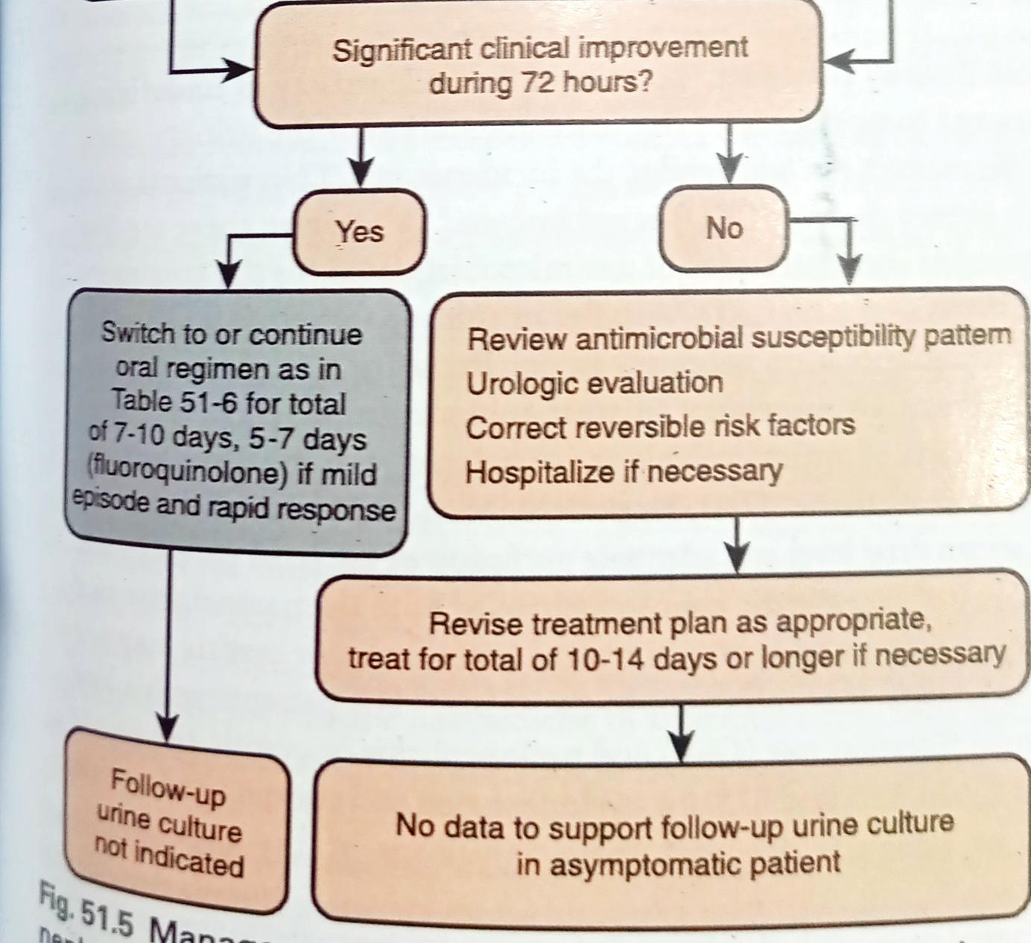

Slide 29
Complicated infections
Complicated UTI may present with classic signs of cystitis and pyelonephritis but also vague and non specific symptoms such as fatigue, irritability, headache and abdominal or back pain.
Diabetes and pregnancy warrant special attention of serious complications of inadequate treatment.
Urine culture should be performed in complicated UTI.
IDSA consensus definition of complicated UTI is
10⁵cfu/ml Or more in women 10⁴ CFU/ml or more in men S. Aureus is more common in complicated UTI

Slide 30
Clinical and microbial microbiological success rates after treatment of patients with acute pyelonephritis and complicated UTI is of 5 days for levofloxacin, and a 10 day course for ciprofloxacin.
A 5 to 10 day regimen is reasonable for most patients with complicated UTI at least 10 to 14 days of therapy is recommended in patients have delayed response.
Routine post-treatment cultures are not indicated unless symptomatic or exception pregnant women.
Prostatic source of infection warrants four to six weeks regimen of either fluoroquinolone TMP-SMX

Slide 31
Chronic kidney disease
For patients with low GFR and pyelonephritis or cystitis agents are: Fluoroquinolones
Levofloxacin
Amoxicillin clavulanate
Trimethoprim-sulfamethoxazole Ceftriaxone
Ampicillin
Piperacillin-tazobactam Meropenem
vancomycin

Slide 32
Catheter associated infections
Incidence of the bacteriuria is 3% to 10% of per day catheterization.
Complications of long term catheterization more than 30 days almost universal often with multiple antibiotic resistant flora.
Frequent febrile episodes catheter obstruction stone formation associated with urease producing uropathogen
Rare complications like fistula formation and bladder cancer
Treatment:
Antimicrobial coated catheters
Antimicrobial therapy at the replacement of catheter
7 days is the recommended duration of antimicrobial treatment but for delayed response 10 to 14 days

Slide 33
Spinal cord injury
Alters the dynamic of Voiding and often requires bladder drainage with catheters
Signs and symptoms include pyuria and significant bacteriuria.
Treatment of asymptomatic bacteriuria in spinal cord injury patients is not proven benefit and increases risk of infection to antimicrobial resistant uropathogens.
Empirical oral agents fluoroquinolones are the drug of choice for mild to moderate infections

Slide 34
Prostatitis
Commonest organisms (gram negative bacilli)
E coli
proteus
klebsiella
pseudomonas aeruginosa and Enterococci less frequently.
Signs and symptoms
Dysuria, frequency, urgency, obstructive voiding of urine, fever and chills
Treatment
Fluoroquinolones the recommendation duration of treatment is 14 to 30 days.
Chronic bacterial prostatitis
Optimal duration of treatment is recommended 4 to 6 weeks whereas some authorities recommended up to 3 months

Slide 35
Renal abscess
Renal cortical and corticomedullary abscesses and perirenal abscesses in 1 to 10 per 10,000 hospital admissions.
Sign symptoms
Fever chills, back or abdominal pain and costovertebral angle tenderness
Investigation of choice
CT is recommended to establish diagnosis and location of renal and peri renal abscess
Treatment
With antimicrobial agents without draining may be effective in small abscess and if underline urinary tract abnormality can be corrected.
Aspiration of abscess may be necessary in some patients and nephrectomy may be occasionally required in patients with diffuse renal involvement or with severe sepsis.

Slide 36
Papillary necrosis
Papillary necrosis half of them have diabetes almost always in conjunction with UTI.
Condition can also complicate:
Sickle cell disease, analgesic abuse,obsruction.
Pathology:
vulnerable to ischemia because of sluggish blood flow in the vasa recta leading to papillary necrosis. Sloughed of papillae can cause ureter obstruction, renal impairment, or failure, or urosepsis.
Signs and symptoms are typical of pyelonephritis.

Slide 37
Emphysematous Pyelonephritis
Emphysematous pyelonephritis is a fulminant, necrotizing, life_x0002_threatening variant of acute pyelonephritis caused by gas-forming organisms, including E. coli, Klebsiella pneumoniae, P. aerugi_x0002_nosa, and Proteus mirabilis.Up to 90% of cases occur in diabeticpatients, and obstruction may be present.
Signs & Symptoms: Symptoms are suggestive of pyelonephritis, and there may be a ank mass. Dehydration and ketoacidosis are common.
Investigation of choice:
CT is the diagnostic modality of choice, however, because it can localize the gas better than ultrasound
Treatment:Parenteral broad-spectrum antibiotics and percutaneous catheter drainage with relief of obstruction may be ade_x0002_quate for less severely ill patients, but nephrectomy is warranted for those who are more severely ill and those less severely ill who do not respond to the preceding steps. Medical treatment is associated with mortality of 60% to 80%, which is lowered to 20% or less with surgical intervention (e.g., nephrectomy, percutaneous drainage).

Slide 38
Emphysematous Pyelonephritis

Slide 39
Kidney Malacoplakia
Definition: Malacoplakia is a chronic granulomatous disorder of unknown etiology involving the genitourinary, gastrointestinal, skin, and pulmonary systems.It is characterized by an unusual inammatory reaction to a variety of infections and is manifested by the accumulation of macrophages containing calcied bacterial debris called Michaelis Gutmann bodies.
Signs and Symptoms: Patients with kidney malacoplakia generally have fever, flank pain, pyuria and hematuria, bacteriuria, and, if both kidneys are involved, impaired renal function.
Investigation of Choice: CT usually shows enlarged kidneys with areas of poor enhancement, and the condition may be indistin guishable from other infectious or neoplastic lesions. On occasion, the malacoplakia may extend through the kidney capsule into the peri nephric space, simulating a renal carcinoma.
Treatment:
Treatment consists of therapy with a broad-spectrum antimicrobial.
Attempted correction of any underlying complicating conditions, and improve_x0002_ment of renal function.
Nephrectomy is recommended for advanced unilateral disease. When the disease is bilateral or occurs in a trans_x0002_planted kidney, the patient’s prognosis is very poor.

Slide 40
Kidney Malacoplakia

Slide 41
Xanthogranulomatous Pyelonephritis
Definition: Xanthogranulomatous pyelonephritis is a poorly understood, uncom_x0002_mon but severe chronic destructive granulomatous inammation of the kidney parenchyma associated with obstruction and infection of the urinary tract.
Signs & Symptoms: Patients with Xanthogranulomatous pyelonephritis are characteristically middle_x0002_aged females and have chronic symptoms such as ank pain, fever,chills, and malaise. Flank tenderness, a palpable mass, and irritative voiding symptoms are common.
Pathology: The renal parenchyma is replaced with a diffuse or segmental cellular inltrate of foam cells, which are lipid-laden macrophages. T process also may extend beyond the kidney capsule to the retroperitoneum. Its pathogenesis appears to be multifactorial, with infection complicating obstruction and leading to ischemia, tissue destruction, and accumulation of lipid deposits.
Investigations: The urine culture is usually posi_x0002_tive with E. coli, other gram-negative bacilli, or S. aureus. CT gener_x0002_ally shows an enlarged nonfunctioning kidney, often the presence of calculi and low-density masses (xanthomatous tissue), and, in some cases, involvement of adjacent structures.
Treatment: Broad-spectrum anti_x0002_microbials are indicated, but total or partial nephrectomy is usually necessary for cure.

Slide 42
XANTHOGRANULOMATOUS PYELONEPHRITIS

Slide 43
Asymptomatic bacteuria
Common and generally begnin.
Pyuria is present mostly in elderly,
Organisms: same as those causing UTIs in the same population.
Screening and treatment:
Generally not warranted.
Unless high risk individuals warrant a more aggressive approach, like undergoing urological surgery, pregnant women

Slide 44
Imaging of urinary tract
USG (size, contour, renal mass or abscess calculi detection, hydronephrosis)
X-ray KUB ( radiopaque calculi, proximal and distal stones missed on USG KUB)
CT contrast and non contrast CT.
Cystoscopy and excretory urography

Slide 45
How to use HEC Digital Library
Steps to Access HEC Digital Library
Go to the website of HEC National Digital Library.
On Home Page, click on the INSTITUTES.
A page will appear showing the universities from Public and Private Sector and other Institutes which have access to HEC National Digital Library (HNDL).
4. Select your desired Institute.
A page will appear showing the resources of the institution
6. Journals and Researches will appear
7. You can find a Journal by clicking on JOURNALS AND DATABASE and enter a keyword to search for your desired journal.

Slide 46
Questions
Question 1: A 30-year-old pregnant woman in her second trimester presents with a UTI. What
antibiotic should be avoided during her treatment?
A) Nitrofurantoin
B) Cefalexin
C) Amoxicillin
D) Ciprofloxacin

Slide 47
Questions
Question 2 A 22-year-old female presents with dysuria, increased frequency, and urgency for the past 48 hours. She denies fever, chills, or back pain. Urinalysis reveals positive nitrites and leukocyte esterase. A culture is pending. She has no history of urinary tract infections (UTIs) but is sexually active. Which of the following organisms is the most likely cause of her symptoms?
A. Staphylococcus epidermidis
B. Klebsiella pneumoniae
C. Escherichia coli
D. Pseudomonas aeruginosa

Slide 48
Questions
Question 3 : A 45-year-old female with a history of recurrent UTIs presents with dysuria, urgency, and cloudy urine. She reports three similar infections in the past year. Urinalysis shows positive nitrites and leukocyte esterase, with 50-100 WBCs/hpf. Which of the following is an appropriate next step in managing her recurrent infections?
A. Avoiding antibiotic treatment due to the risk of resistance
B. Initiating suppressive antibiotic therapy
C. Referral for cystoscopy to rule out bladder lesions
D. Only recommending fluid intake of 2 L/day and hygiene practices

Slide 49
Answers
1 : D - Ciprofloxacin
2 : C - E.coli
3: B - Initatiating Supressive Antibiotic Therapy

Slide 50
Refrences
1 Nicolle LE. A practical guide to the management of complicated urinary tract infection. Drugs. 1997;53(4):583–592.
2. Hooton TM, Scholes D, Hughes JP, et al. A prospective study of risk factors for symptomatic urinary tract infection in young women. N Engl J Med. 1996;335(7):468–474.
3. Hooton TM, Stamm WE. Diagnosis and treatment of uncomplicated urinary tract infection. Infect Dis Clin North Am. 1997;11(3):551–581.
4. Scholes D, Hooton TM, Roberts PL, Gupta K, Stapleton AE, Stamm WE. Risk factors associated with acute pyelonephritis in healthy women. AnnIntern Med. 2005;142(1):20–27.

Slide 51
Thank you.

