Slide 1
Tubulointerstitial Diseases Renal Module 4th Year MBBS
Dr Kiran Fatima
Pathology Department
Rawalpindi Medical University

Slide 2
MOTTO OF RMU
Wisdom
Truth
Service

Slide 3
VISION OF RMU THE DREAM/ TOMORROW
To impart evidence based research oriented medical education
To provide best possible patient care
To inculcate the values of mutual respect and ethical practice of medicine

Slide 4
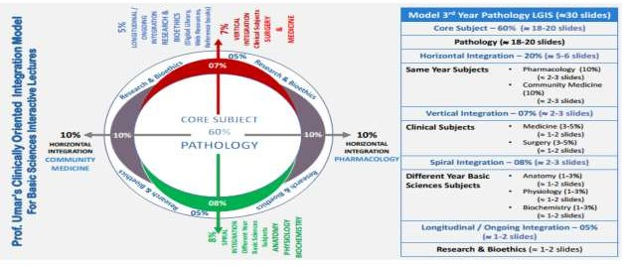

Slide 5
How to use HEC Digital Library
Steps to Access HEC Digital Library
Go to the website of HEC National Digital Library.
On Home Page, click on the INSTITUTES.
A page will appear showing the universities from Public and Private Sector and other Institutes which have access to HEC National Digital Library (HNDL).

Slide 6
4. Select your desired Institute.
5. A page will appear showing the resources of the institution
6. Journals and Researches will appear
7. You can find a Journal by clicking on JOURNALS AND DATABASE and enter a keyword to search for your desired journal.

Slide 7
Learning outcomes
At the end of this lecture, the student should be able to:
What are the main types of Tubulointerstitial diseases?
What is the pathophysiology behind Tubulointerstitial diseases?

Slide 8
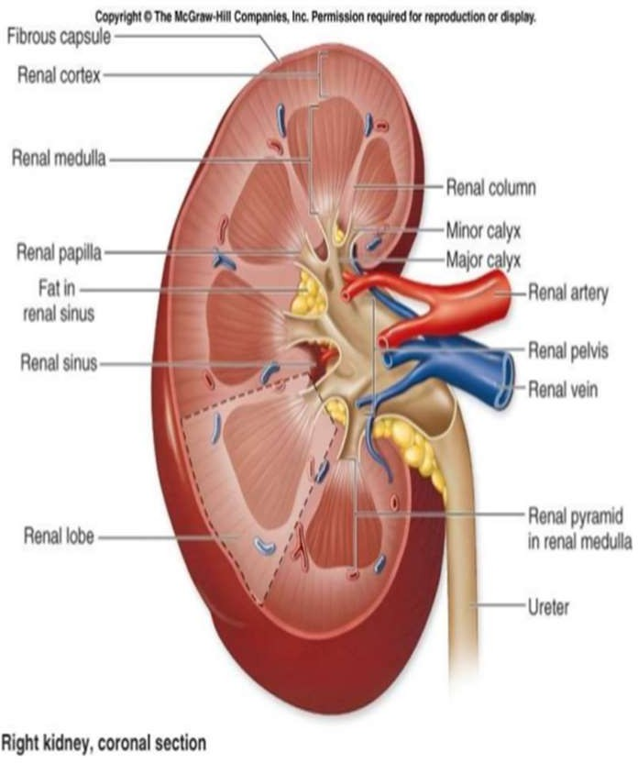
Spiral integration
Anatomy
Dr. anum usman

Slide 9
Diseases affecting tubules and interstitium
Core
Pathology
Tubulointerstitial Nephritis TIN
Acute Tubular Injury ATI
Acute Pyelonephritis
Chronic Pyelonephritis
Ischemic ATI
Nephrotoxic ATI

Slide 10
Acute tubular injury ATI
Core
Pathology
Acute diminution or loss of renal function and
destruction of tubular epithelial cells.
Decreased GFR
Oliguria (defined as urine output of less than 400mL/day)
Granular casts and tubular cells observed in the urine
It is the most common cause of acute renal failure.

Slide 11
Etiology
Core
Pathology
Ischemic ATI
Shock
Burns
Trauma
Sepsis
Blood transfusion reactions
Microscopic polyangitis
Malignant hypertension
RPGN
Urinary obstruction

Slide 12
2. Nephrotoxic ATN
Core
Pathology
Drugs (antibiotics, anti-virals, NSAIDS, mercurial, diuretics)
Radiocontrast dyes
Myoglobin
Hemoglobin
Heavy metals ( mercury )
Organic solvents ( CCl4 )
Radiation

Slide 13
Core
Pathology
Pathogenesis ATI
Effects of tubular injury
Loss of cell polarity
redistribution of membrane proteins
Na+,K+-ATPase integrins
vasoconstriction increased intratubular pressure
Reduced GFR

Slide 14
Pathogenesis ATI
Effects of tubular injury
Core
Pathology
Tubular damage
Release of chemokines,
Fluid leakage
into the interstitium
cytokines
Recruitment of leukocytes
Increased interstitial pressure
Interstitial inflammation
Tubular collapse

Slide 15
Pathogenesis ATI
Disturbances in blood flow
Core Pathology
Characterized by hemodynamic alterations that causes reduced
GFR.
VASOCONSTRICTOR PATHWAYS are activated that results in
reduced GFR and O2 delivery to tubules.
Increased renin angiotensin Increased endothelin Decreased nitric oxide Decreased prostaglandins

Slide 16
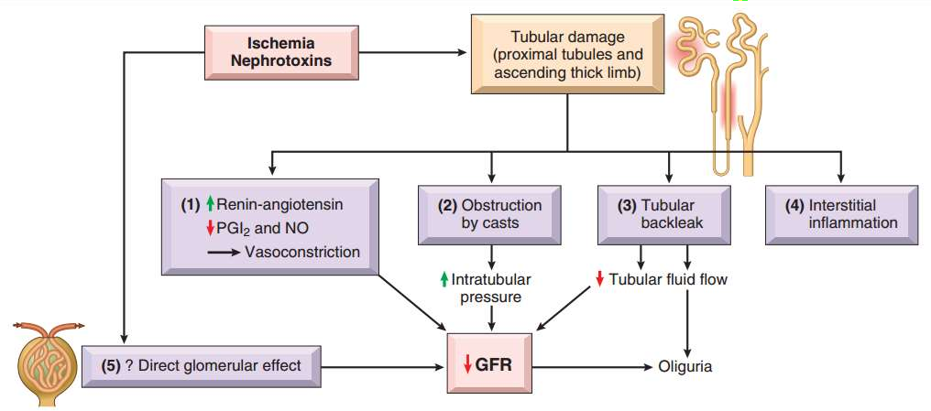
Core
Pathology

Slide 17
Morphology
Core
Pathology
Ischemic ATI
Tubules:
Lesions in the straight portions of the proximal tubule and the ascending thick limbs of loop
Attenuation of proximal tubular brush borders
Blebbing and vacuolization of cells
Detachment of tubular cells from their BM
Sloughing of cells into the urine –-proteinaceous casts in the distal tubules and collecting ducts (Tamm-Horsfall protein)
In crush injuries casts also contain myoglobin

Slide 18
Morphology
Core
Pathology
Ischemic ATI
The interstitium:
Generalized edema
Mild inflammatory infiltrate consisting of polymorphonuclear leukocytes, lymphocytes, and plasma cells.

Slide 19
Morphology
Core
Pathology
Toxic ATI
Similar to ischemic ATI
Differences.
Overt necrosis is most prominent in the proximal tubule, and the tubular basement membranes generally are spared.

Slide 20
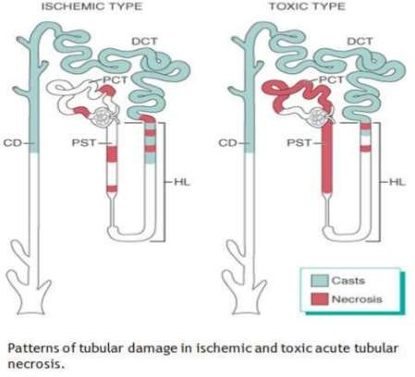
Core
Pathology

Slide 21
Acute drug induced interstitial Nephritis
Horizontal integration Pharmacology
ANTIBIOTICS ( Penicillins, Cephalosporins, Sulfonamide, Tetracycline, Vancomycin, Ciprofloxacin )
NSAIDS ( Salicyclic acid, Ibuprofen, Naproxen, Indomethacin)
DIURETICS ( Thiazide, Furosemide, )

Slide 22
Acute drug induced interstitial
Vertical integration
Medicine
nephritis
Clinical features:
hypersensitivity reaction after a latent period about 15 days (range, 2 to 40 days) after exposure to the drug.
fever, eosinophilia and rash, raised Serum IgE levels .
hematuria, minimal or no proteinuria, and leukocyturia
(sometimes including eosinophils).
A rising serum creatinine or acute kidney injury with oliguria develops in about 50% of cases

Slide 23
Acute drug induced interstitial nephritis
Core
Pathology
Pathogenesis:
Immune mechanism.
Occurs in people having hypersensitivity to a drug .
Type I hypersensitivity. Or T-cell mediated hypersensitivity reaction Type IV

Slide 24
Acute drug induced interstitial nephritis
Core Pathology
Pathogenesis:
The drugs act as haptens
Secreted by tubules
Binds covalently to some cytoplasmic or extracellular component of tubular cells
Stimulates hypersensitivity reaction
IgE- and cell mediated immune reactions to tubular cells or their basement membranes.
Tubulointerstitial injury

Slide 25
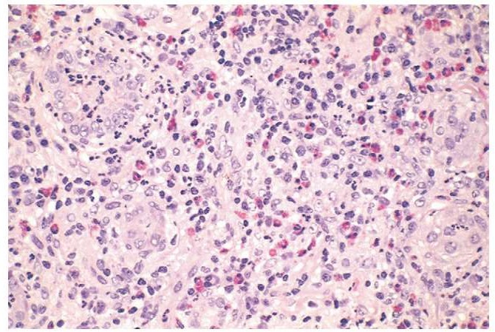

Slide 26
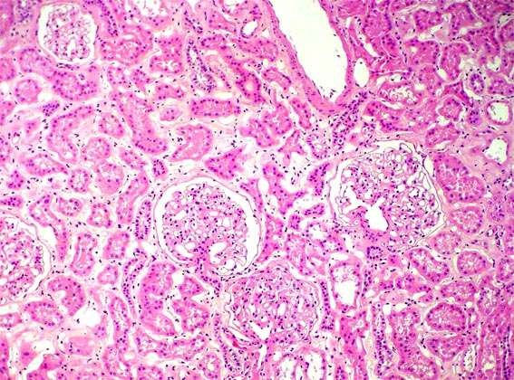

Slide 27
Diseases affecting tubules and interstitium
Core
Pathology
Tubulointerstitial Nephritis TIN
Acute Tubular Injury ATI
Acute Pyelonephritis
Chronic Pyelonephritis
Ischemic ATI
Nephrotoxic ATI

Slide 28
Tubulointerstitial nephritis
Core
Pathology
Group of inflammatory diseases of the kidney that primarily involve the interstitium and tubules
Acute Pyelonephritis: suppurative inflammation by bacterial infection
Chronic Pyelonephritis: interstitial inflammation and scarring
deformity of the pelvicalyceal system.

Slide 29
Acute pyelonephritis
Core
Pathology
Acute infection of upper urinary tract
Commonly associated with infection of the lower urinary tract including cystitis, prostatitis, urethritis.

Slide 30
Pathogens
Core
Pathology
enteric gram-negative rods.
Escherichia coli = the most common
Other important organisms are
Proteus, Klebsiella, Enterobacter, and Pseudomonas

Slide 31
Predisposing conditions
Core Pathology
Acute pyelonephritis can be an ascending
infection or hematogenous infection
Ascending infection can occur in the following settings
Instrumentation - catheterization
Outflow obstruction = benign prostatic hyperplasia and uterine prolapse
Pregnancy—4% to 6% of pregnant women develop bacteriuria sometime during pregnancy
Females in reproductive age
Bladder dysfunction
Diabetes

Slide 32
Predisposing conditions
Core
Pathology
Ascending infection cont…
Incompetence of the vesicoureteral orifice, resulting in vesicoureteral reflux
congenital VUR due to incompetence of the ureterovesical valve.
acquired VUR in persons with a flaccid bladder resulting from
spinal cord injury or
neurogenic bladder dysfunction secondary to diabetes

Slide 33
Predisposing conditions
Core
Pathology
Hematogenous infection
Immunosuppression
Immunodeficiency
Endocarditis

Slide 34
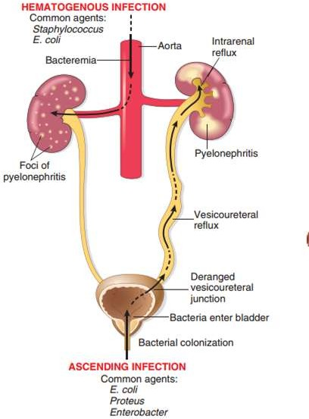
Core
Pathology

Slide 35
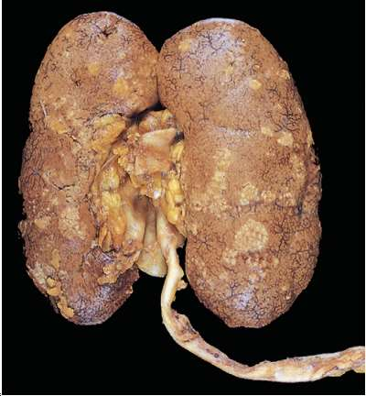
Morphology acute pyelonephritis
Core
Pathology
Gross
discrete, yellowish, raised abscesses are grossly apparent on the renal surface

Slide 36
Morphology acute pyelonephritis
Core
Pathology
Microscopy
liquefactive necrosis with abscess formation within the renal parenchyma.
In the early stages pus formation (suppuration) is limited to the interstitial tissue
later abscesses rupture into tubules.
Large masses of intratubular neutrophils frequently extend within involved nephrons into the collecting ducts, giving rise to white cell casts found in the urine.
The glomeruli are not affected.
When obstruction is prominent, the pus may not drain and then fills the renal pelvis, calyces, and ureter, producing pyonephrosis.

Slide 37
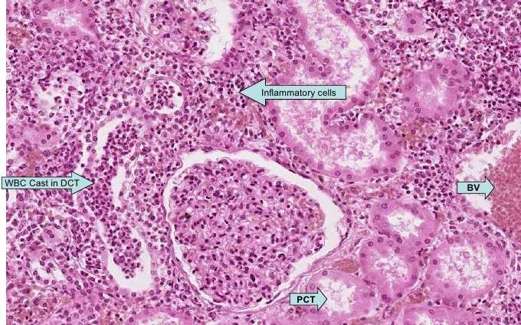
Morphology
Core Pathology
abscess formation within the renal parenchyma.
In the early stages pus formation (suppuration) is limited to the interstitial tissue
later abscesses rupture into tubules.

Slide 38
Special sub type of acute pyelonephritis
Core
Pathology
Papillary necrosis
predisposing conditions: diabetes, urinary tract obstruction, and analgesic abuse.
Ischemic and suppurative necrosis of the tips of the renal pyramids (renal papillae).

Slide 39
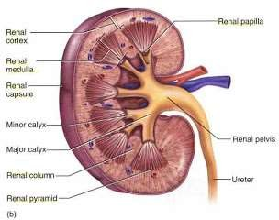
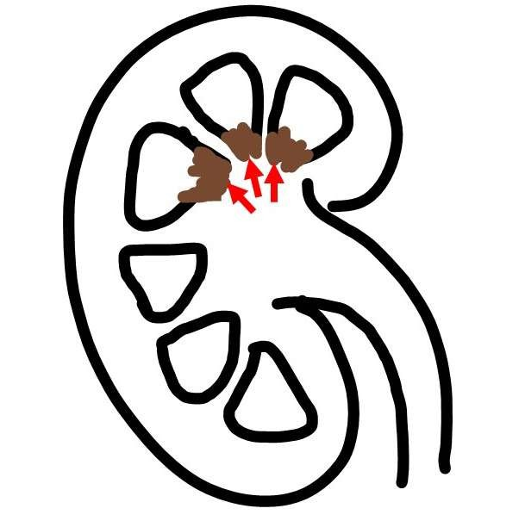
Core
Pathology

Slide 40
Chronic pyelonephritis and reflux nephropathy
Core
Pathology
Interstitial inflammation
grossly visible scarring and deformity of the pelvicalyceal system.
It can be divided into two forms:
Chronic obstructive pyelonephritis
Chronic reflux– associated pyelonephritis.

Slide 41
Chronic obstructive pyelonephritis
Core
Pathology
Obstruction predisposes the kidney to infection.
Recurrent infections recurrent scarring.

Slide 42
Chronic reflux–associated Pyelonephritis (reflux nephropathy)
Core
Pathology
Superimposition of a UTI on congenital vesicoureteral reflux and intrarenal reflux.
Reflux may be unilateral or bilateral;
Scarring and atrophy of one kidney or may involve both

Slide 43
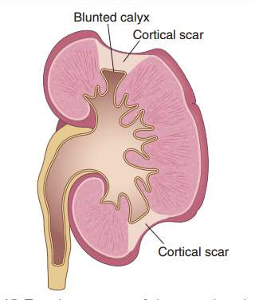
Morphology
Core
Pathology
The hallmark of chronic pyelonephritis is scarring involving the pelvis or calyces, or both, leading to papillary blunting and marked calyceal deformities

Slide 44
Morphology
Core
Pathology
Microscopy
Uneven interstitial fibrosis
Tubular atrophy.
Chronic inflammatory cell infiltration and fibrosis involving the calyceal mucosa and wall

Slide 45
Morphology
Core
Pathology
Intratubular PAS-positive colloid casts, that suggest the appearance of thyroid tissue— hence the descriptive term thyroidization.
Arteriolosclerosis caused by the frequently associated hypertension
Glomerulosclerosis that usually develops as a secondary process caused by nephron loss

Slide 46
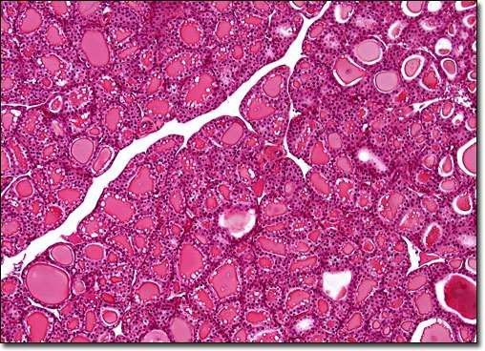

Slide 47
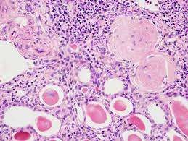
Morphology

Slide 48
Longitudnal integration
Bioethics

Slide 49
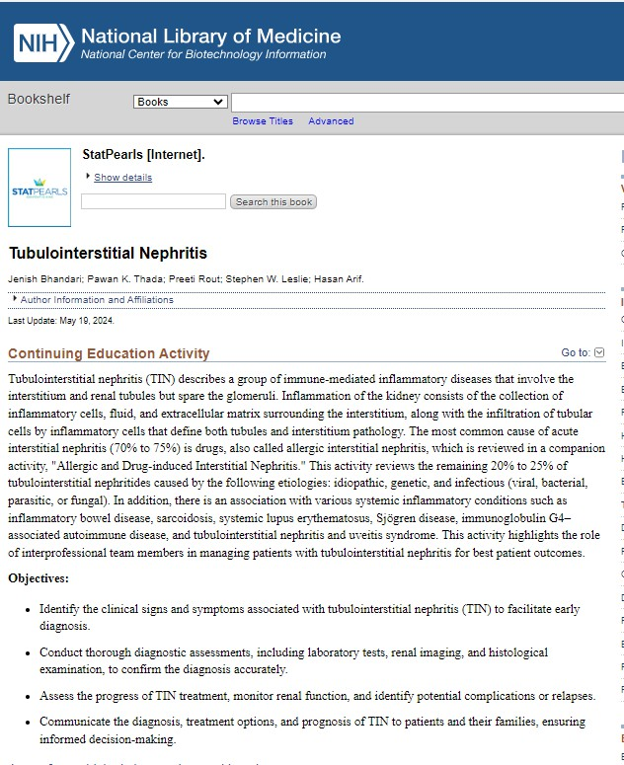
https://www.ncbi.nlm.nih.gov/books/NBK557537/
Research

Slide 50
Take home message
Tubulointerstitial nephritis (TIN) is an inflammation of the kidney's tubules and surrounding interstitial tissue, often caused by medications, infections, or autoimmune diseases. It can lead to acute kidney injury and may present with fever, rash, and changes in urine output. Diagnosis often involves urine analysis, blood tests, and sometimes a kidney biopsy.

Slide 51
Thank you !

