Slide 2
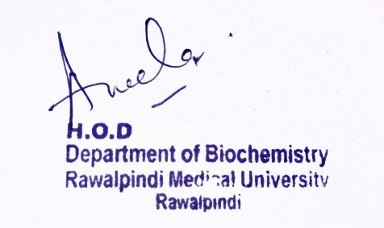
Foundation Module 1st Year MBBS (LGIS) Translation
Presenter: Dr. Aneela Jamil Date: 27-01-25
(Assistant Professor)

Slide 3
Motto, Vision, Dream
To impart evidence based research oriented medical education
To provide best possible patient care
To inculcate the values of mutual respect and ethical practice of medicine
Wisdom
Truth
Service

Slide 4
Professor Umar Model of Integrated Lecture

Slide 5
Learning Objectives
At the end of this lecture students should be able to
Explain process of Translation in prokaryotes and eukaryotes
Describe posttranslational modifications
Discuss related clinical disorders

Slide 6
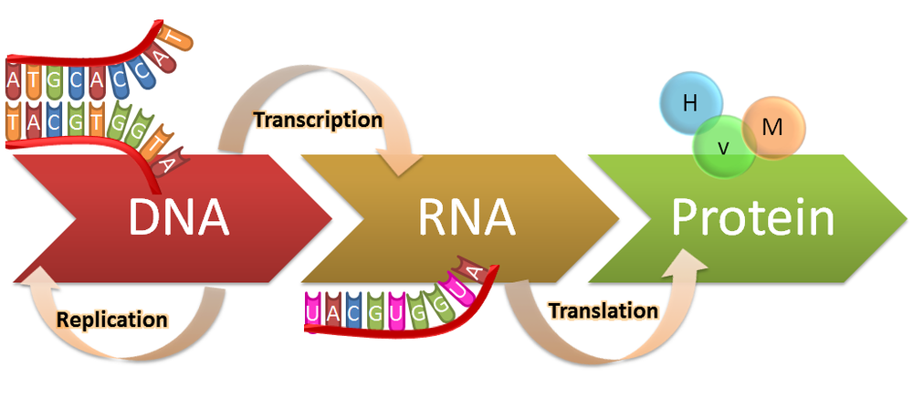
Translation
Core Knowledge

Slide 7
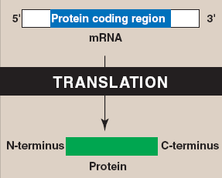
Translation
Core Knowledge
7

Slide 8
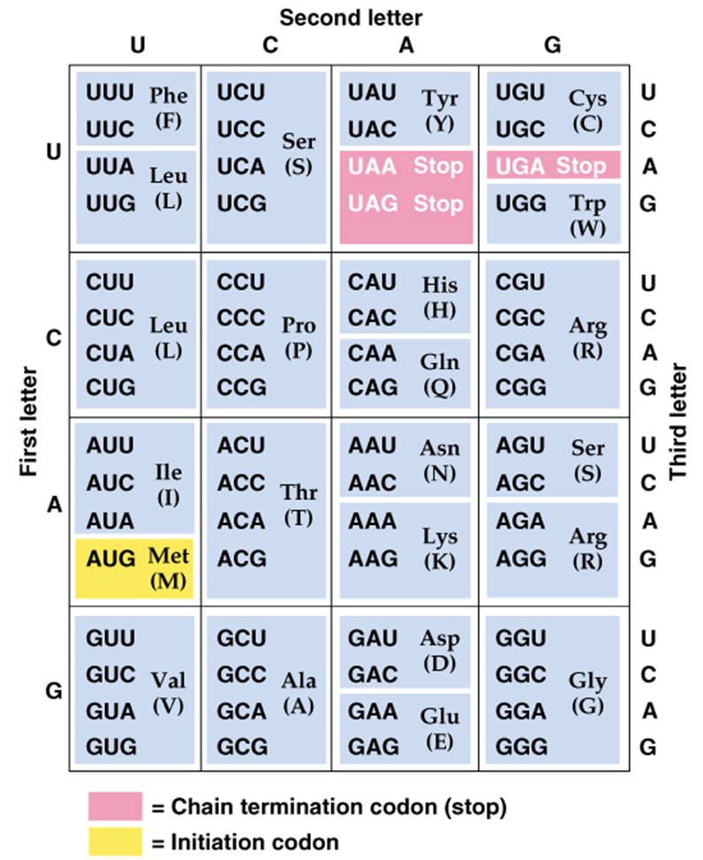
Genetic Code
Core Knowledge
Non-overlapping
Specific
Universal
Degenerate
Core Concept
8

Slide 9
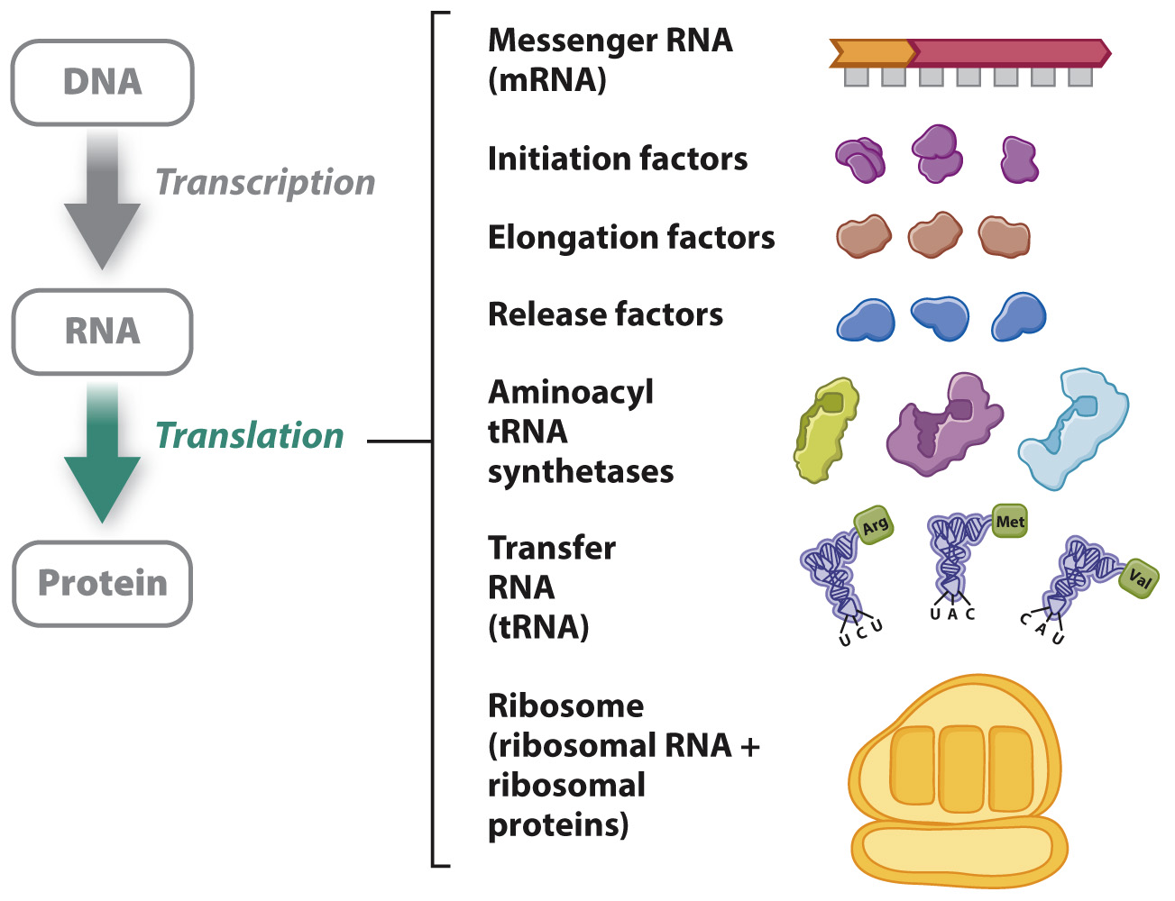
Translation Components Required
Core Knowledge
9

Slide 10
Translation Components Required
Core Knowledge
10

Slide 11
Translation Components Required
Core Knowledge
11

Slide 12
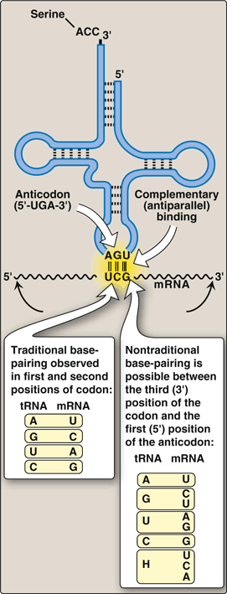
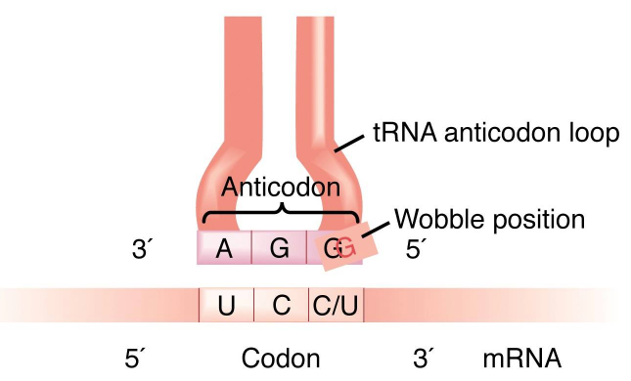
Translation Wobble Hypothesis
Core Knowledge
Core Concept
12

Slide 13
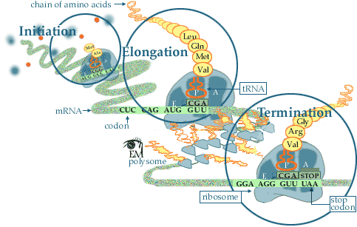
Translation
Core Knowledge
Steps
Initiation
Elongation
Termination
Core Concept
13

Slide 14
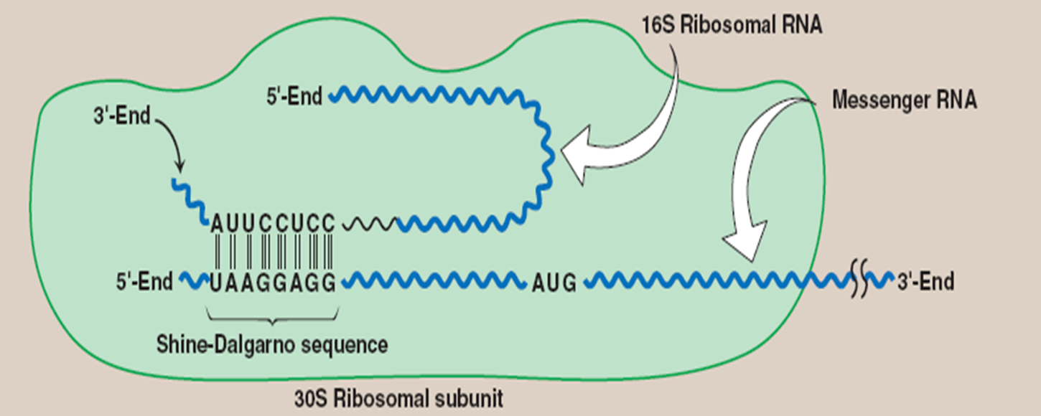
Initiation
Core Knowledge

Slide 15
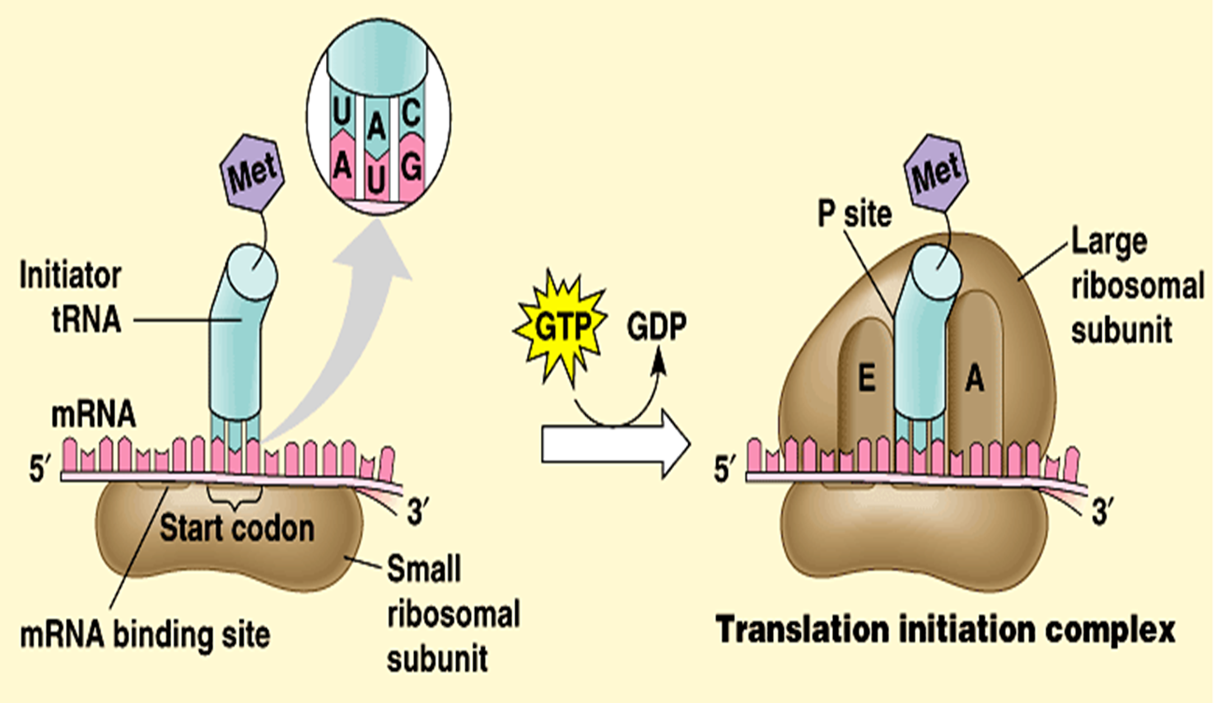
Initiation
Core Knowledge

Slide 16
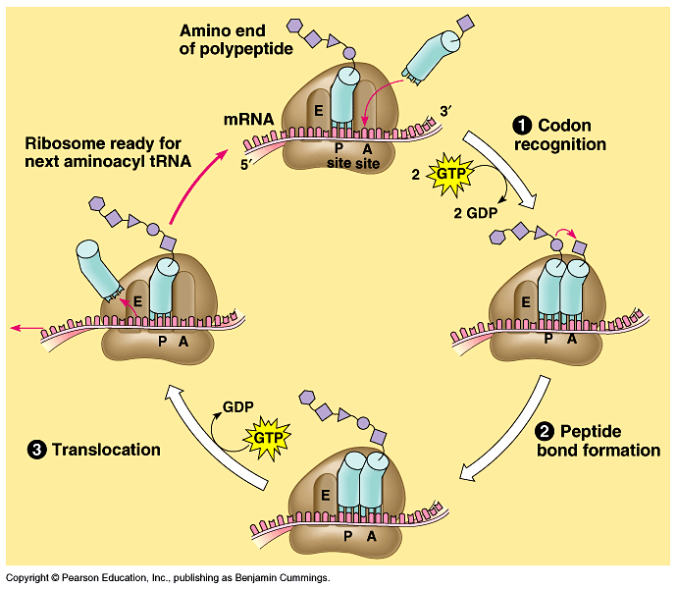
Elongation
Core Knowledge

Slide 17
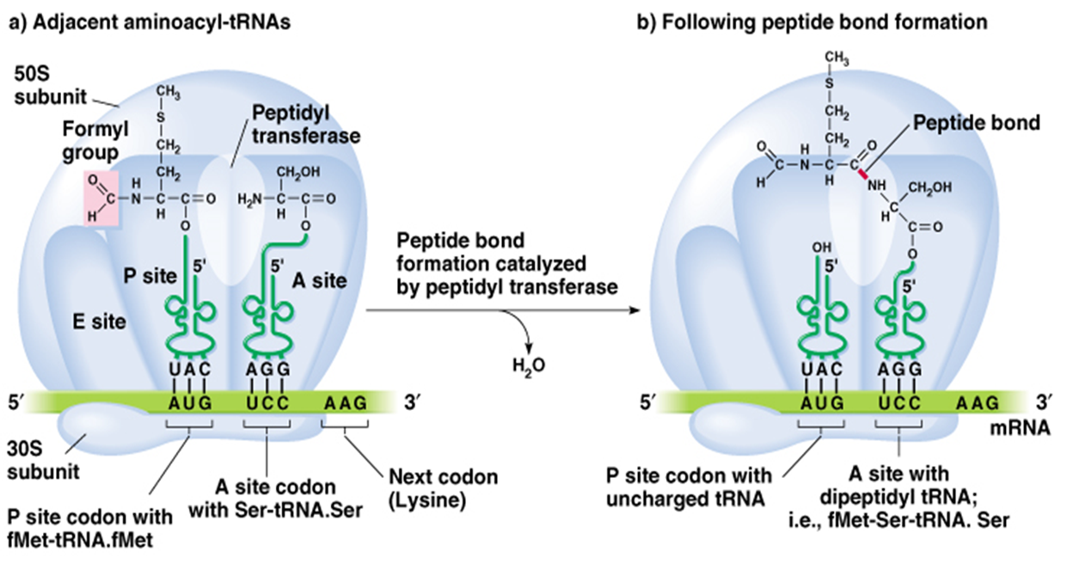
Elongation
Core Knowledge

Slide 18
Elongation
Core Knowledge

Slide 19
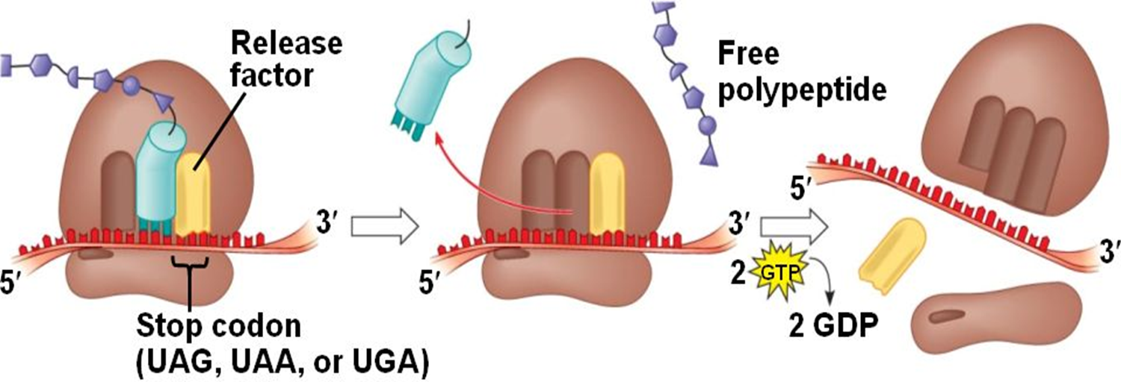
Termination
Core Knowledge

Slide 20
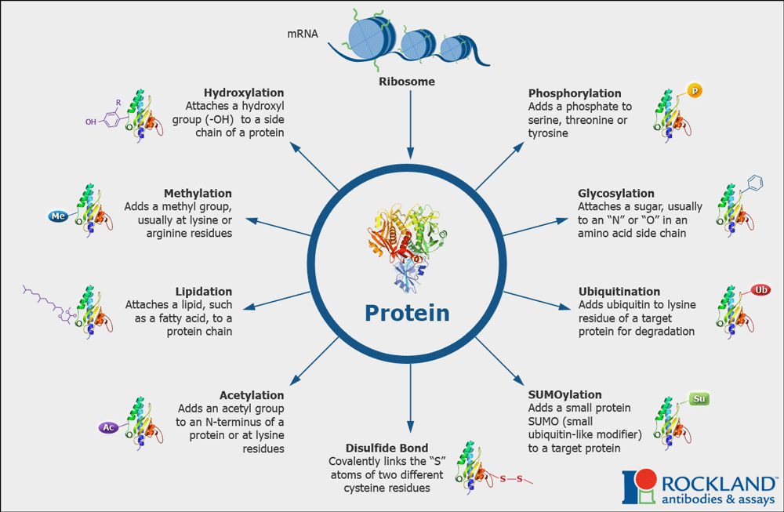
Posttranslational Modification
Core Knowledge

Slide 21
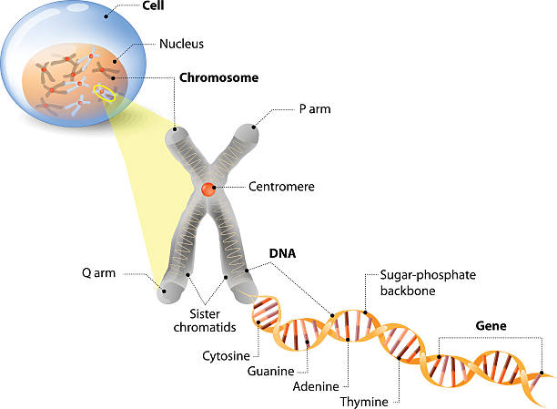
Anatomical & Physiological Aspects
Horizontal Integration

Slide 22
Anatomical & Physiological Aspects
Horizontal Integration
Control center of cell
Contains genetic material
Cell division
Heredity

Slide 23
Action of Antibiotics
Vertical Integration
Erythromycin, Clindamycin | Bind to 50S ribosomal subunit Inhibit translocation
Chloramphenicol | Inhibits prokaryotic peptidyltransferase
Streptomycin | Bind to 30S subunit Inhibits initiation
Tetracycline | Bind to 30S subunit Prevents binding of aminoacyl-tRNA to mRNA ribosome complex
Diphtheria toxin | Inactivates eukaryotic EF-2, prevents translocation

Slide 24
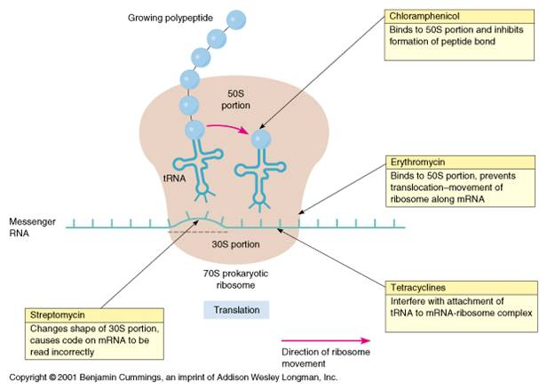
Action of Antibiotics

Slide 25
Family Medicine
Spiral Integration
Family Medicine plays important role in following manner:
Early Diagnosis
Education
Dietary Guidance
Monitoring
Refer to Specialists

Slide 26
Artificial Intelligence
Spiral Integration
Artificial Intelligence plays role in following aspects:
Decoding DNA sequences to
pinpoint genetic variations
identify genetic abnormalities
Utilizes extensive data from patient thereby enhancing prevention, diagnosis & treatment based on individual genetic profiles
Food Recommendations

Slide 27
Suggested Research Article
Spiral Integration
Link: https://www.frontiersin.org/journals/microbiology/articles/10.3389/fmicb.2020.624830/full
Journal Name : Front. Microbiol
Title: Coupled Transcription-Translation in Prokaryotes: An Old Couple With New
Author Name: Mikel Irastortza-Olaziregi, Orna Amster-Choder
Abstract
Coupled transcription-translation (CTT) is a hallmark of prokaryotic gene expression. CTT occurs when ribosomes associate with and initiate translation of mRNAs whose transcription has not yet concluded, therefore forming “RNAP.mRNA.ribosome” complexes. CTT is a well-documented phenomenon that is involved in important gene regulation processes, such as attenuation and operon polarity. Despite the progress in our understanding of the cellular signals that coordinate CTT, certain aspects of its molecular architecture remain controversial. Additionally, new information on the spatial segregation between the transcriptional and the translational machineries in certain species, and on the capability of certain mRNAs to localize translation-independently, questions the unanimous occurrence of CTT. Furthermore, studies where transcription and translation were artificially uncoupled showed that transcription elongation can proceed in a translation-independent manner. Here, we review studies supporting the occurrence of CTT and findings questioning its extent, as well as discuss mechanisms that may explain both coupling and uncoupling, e.g., chromosome relocation and the involvement of cis- or trans-acting elements, such as small RNAs and RNA-binding proteins. These mechanisms impact RNA localization, stability, and translation. Understanding the two options by which genes can be expressed and their consequences should shed light on a new layer of control of bacterial transcripts fate.

Slide 28
Bioethics
Spiral Integration
Appropriate information
Explain to patient or his family the genetic aspects of the condition
Counselling

Slide 29
How To Access Digital Library
Steps to Access HEC Digital Library
Go to the website of HEC National Digital Library
On Home Page, click on the INSTITUTES
A page will appear showing the universities from Public and Private Sector and other Institutes which have access to HEC National Digital Library HNDL
Select your desired Institute
A page will appear showing the resources of the institution
Journals and Researches will appear
You can find a Journal by clicking on JOURNALS AND DATABASE and enter a keyword to search for your desired journal

Slide 30
Learning Resources
Textbook of Biochemistry, Lippincott Illustrated Reviews 8th edition, chapter no. 32, page no. 885-910
Google scholar
Google images

