Slide 2
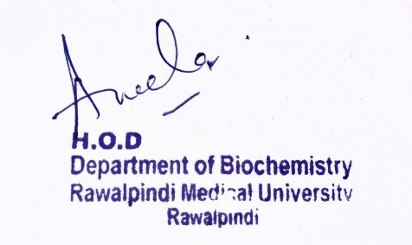
Foundation Module 1st Year MBBS (LGIS) Transcription
Presenter: Dr. Aneela Jamil Date: 27-01-25
(Assistant Professor)

Slide 3
Motto, Vision, Dream
To impart evidence based research oriented medical education
To provide best possible patient care
To inculcate the values of mutual respect and ethical practice of medicine
Wisdom
Truth
Service

Slide 4
Professor Umar Model of Integrated Lecture

Slide 5
Learning Objectives
At the end of this lecture students should be able to
Explain Transcription in prokaryotes and eukaryotes
Discuss related clinical disorders

Slide 6
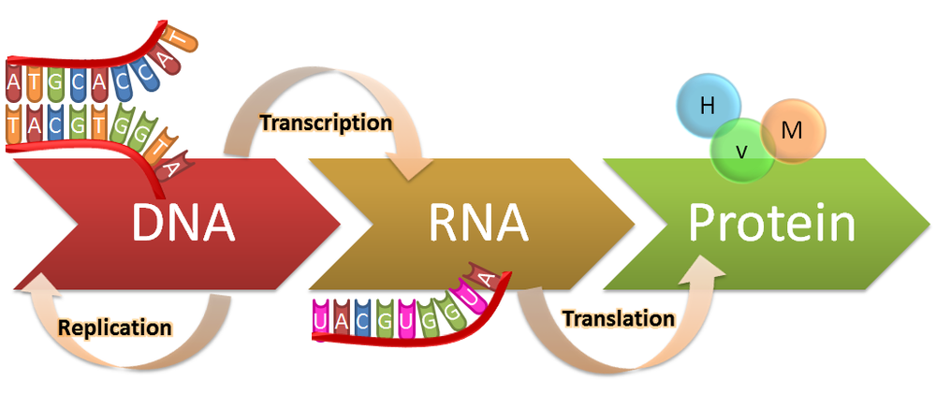
Transcription
Core Knowledge

Slide 7
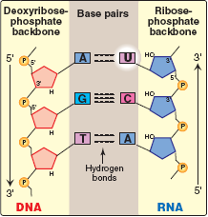
Transcription
Core Knowledge
Process during which a DNA strand serves as a template for the synthesis of RNA, with the help of RNA polymerase is called transcription
7

Slide 8
Transcription
Core Knowledge
One species of RNA polymerase
No role of transcription factors
Steps
Initiation
Elongation
Termination
8

Slide 9
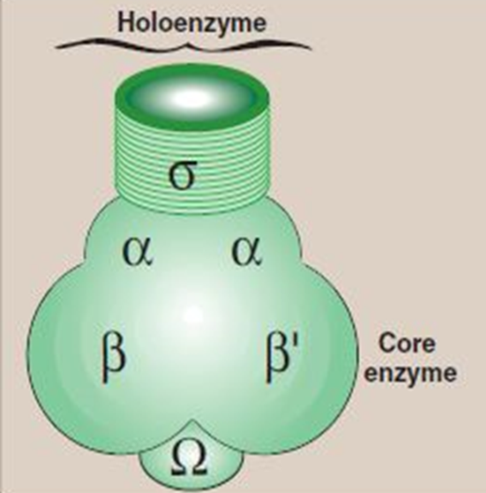
Transcription
Core Knowledge
RNA polymerase
Core enzyme
Holoenzyme
9

Slide 10
Core Knowledge
Transcription unit
Primary transcript

Slide 11
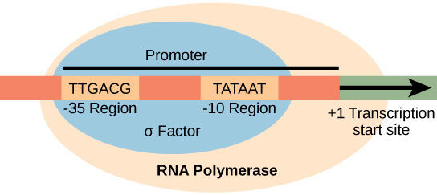
Initiation
Core Knowledge

Slide 12
Core Knowledge
Promoter region
-35 sequence
Pribnow box

Slide 13
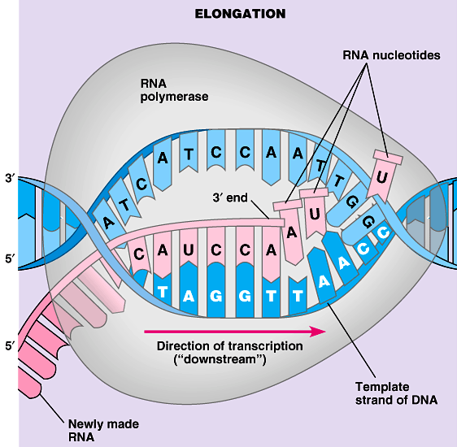
Elongation
Core Knowledge

Slide 14
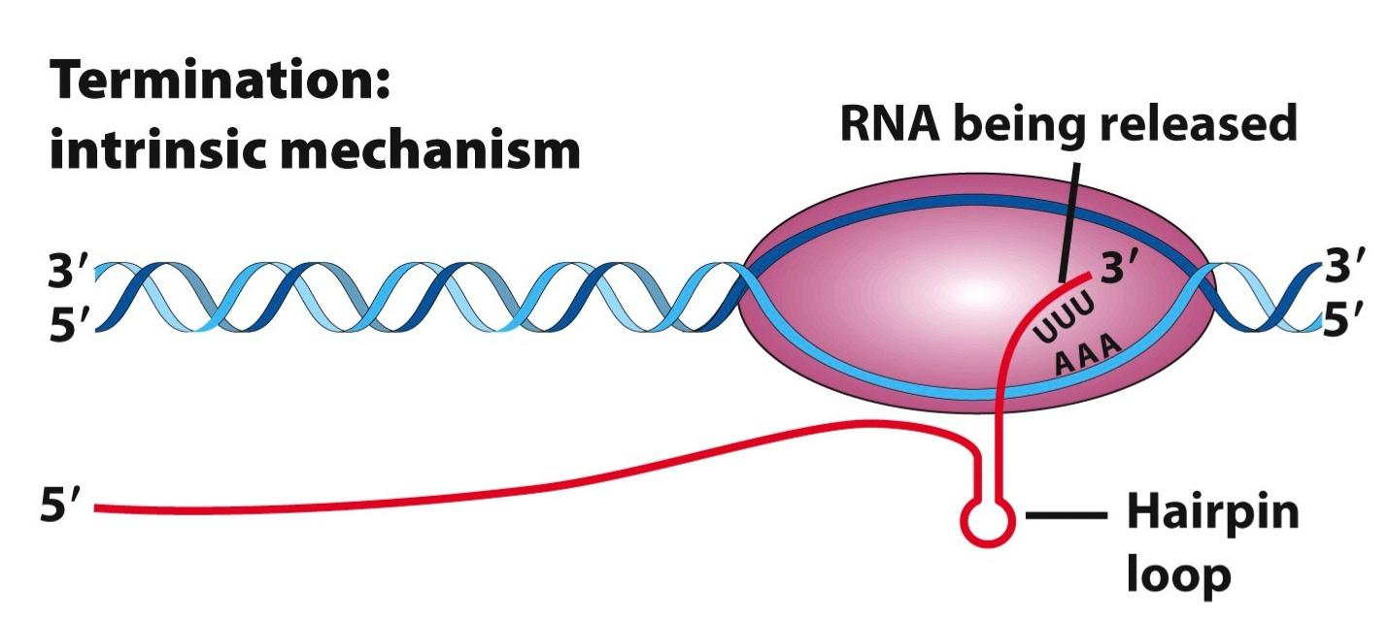
Termination
Core Knowledge
ρ-dependent Termination
ρ-independent Termination

Slide 15
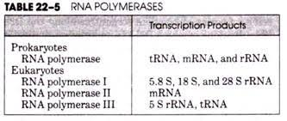
Core Knowledge
Separate RNA polymerases
Role of transcription factors

Slide 16
Core Knowledge
General transcription factors
Required for recognition of the promoter, recruitment of RNA polymerase II to the promoter and initiation of transcription
TFIID recognizes and binds the TATA box,
TFIIF brings the polymerase to the promoter
TFIIH melts the DNA and allows RNA polymerase to clear the promoter

Slide 17
Core Knowledge
Specific transcription factors
Bind to sequences within and outside of the core promoter
Regulate the frequency of initiation and gene expression
Bind other proteins (“coactivators”), recruiting them to the transcription complex

Slide 18
Posttranscriptional Modification
Core Knowledge
Ribosomal RNA

Slide 19
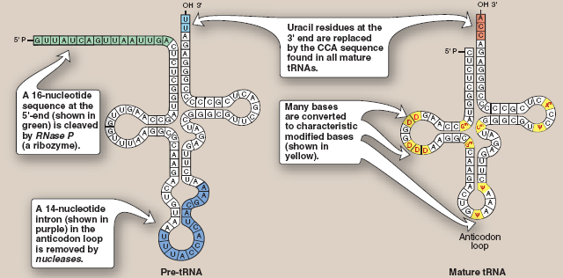
Core Knowledge
Posttranscriptional Modification
Transfer RNA

Slide 20
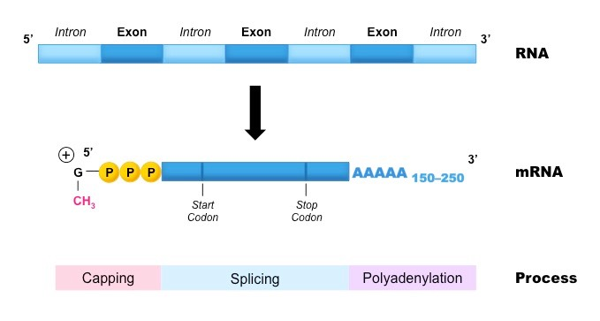
Core Knowledge
Posttranscriptional Modification
Messenger RNA

Slide 21
Core Knowledge
Posttranscriptional Modification

Slide 22
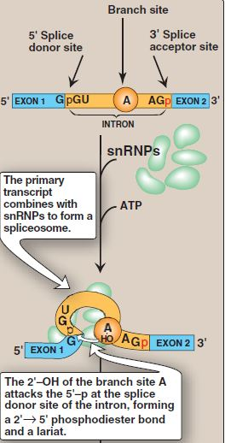
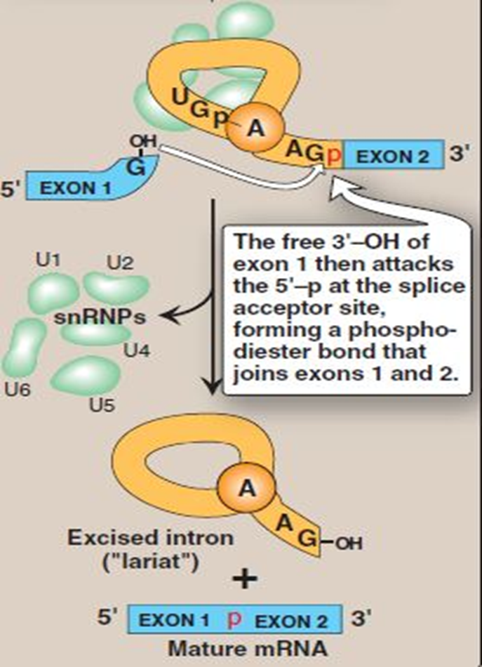
Core Knowledge
Mechanism of Splicing

Slide 23
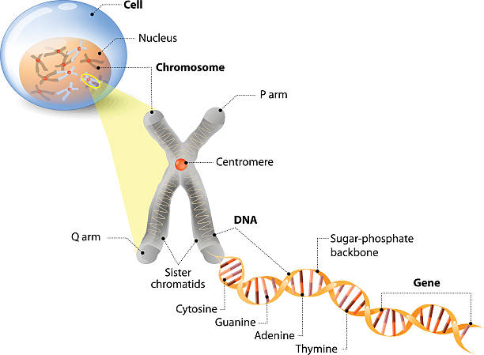
Anatomical & Physiological Aspects
Horizontal Integration

Slide 24
Anatomical & Physiological Aspects
Horizontal Integration
Control center of cell
Contains genetic material
Cell division
Heredity

Slide 25
Action of Antibiotics
Vertical Integration

Slide 26
Family Medicine
Spiral Integration
Family Medicine plays important role in following manner:
Early Diagnosis
Education
Dietary Guidance
Monitoring
Refer to Specialists

Slide 27
Artificial Intelligence
Spiral Integration
Artificial Intelligence plays role in following aspects:
Decoding DNA sequences to
pinpoint genetic variations
identify genetic abnormalities
Utilizes extensive data from patient thereby enhancing prevention, diagnosis & treatment based on individual genetic profiles
Food Recommendations

Slide 28
Suggested Research Article
Spiral Integration
Link: https://pubmed.ncbi.nlm.nih.gov/31213387/
Journal Name : Trends Genet
Title: Transcriptional Control by Premature Termination: A Forgotten Mechanism
Author Name: Kinga Kamieniarz-Gdula, Nick J Proudfoot
Abstract
The concept of early termination as an important means of transcriptional control has long been established. Even so, its role in metazoan gene expression is underappreciated. Recent technological advances provide novel insights into premature transcription termination (PTT). This process is frequent, widespread, and can occur close to the transcription start site (TSS), or within the gene body. Stable prematurely terminated transcripts contribute to the transcriptome as instances of alternative polyadenylation (APA). Independently of transcript stability and function, premature termination opposes the formation of full-length transcripts, thereby negatively regulating gene expression, especially of transcriptional regulators. Premature termination can be beneficial or harmful, depending on its context. As a result, multiple factors have evolved to control this process

Slide 29
Bioethics
Spiral Integration
Appropriate information
Explain to patient or his family the genetic aspects of the condition
Counselling

Slide 30
How To Access Digital Library
Steps to Access HEC Digital Library
Go to the website of HEC National Digital Library
On Home Page, click on the INSTITUTES
A page will appear showing the universities from Public and Private Sector and other Institutes which have access to HEC National Digital Library HNDL
Select your desired Institute
A page will appear showing the resources of the institution
Journals and Researches will appear
You can find a Journal by clicking on JOURNALS AND DATABASE and enter a keyword to search for your desired journal

Slide 31
Learning Resources
Textbook of Biochemistry, Lippincott Illustrated Reviews 8th edition, chapter no. 31, page no. 862-78
Google scholar
Google images

