Slide 2
Anger Management

Slide 3
Motto Vision; The Dream/Tomorrow
Wisdom
Truth
Service
To impart evidence based research oriented medical education
To provide best possible patient care
To inculcate the values of mutual respect and ethical practice of medicine

Slide 4
Prof Umar’s model of clinically oriented integrated Lecture Third year MBBS
Core subject | 90%
Horizontal integration ( Same year subjects) Anatomy, Biochemistry, Physiology | 0%
Vertical Integration (Basic sciences subjects of different years(Forensic Medicine, Pharmacology, Community medicine | 0%
Vertical Integration Clinical Subjects (Medicine, Surgery, Gynae/Obs etc) | 0%
Longitudinal/ ongoing integration ( Bioethics, Research, Artificial Intelligence, Family Medicine | 10%

Slide 5
Learning objectives
At the end of the session students should be able to
Explain the biological, psychological, and social factors influencing anger expression.
Describe the consequences of maladaptive anger and anger-related disorders.
Apply evidence-based strategies for anger management, including de-escalation techniques and psychological interventions

Slide 6
What is Anger ?
Anger is one letter short of
DANGER
So we have to deal with it !
Core Concept

Slide 7
What is Anger?
A basic human emotion experienced by all people
Unpleasant feeling when you think you are injured or mistreated or faced with obstacles to attain personal goals.
Anger can lead to Aggression which is an intentional desire to harm someone.
Core Concept

Slide 8
Core Concept

Slide 9
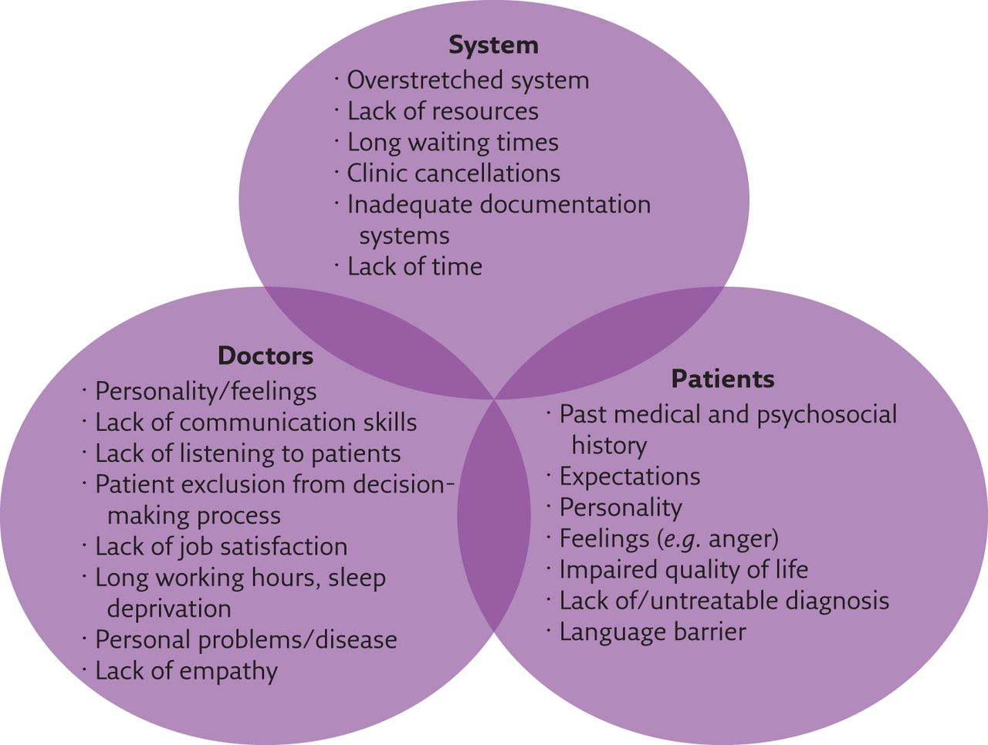
WHY DO WE GET ANGRY ?
Core Concept

Slide 10
Core Concept

Slide 11
Anger Management Techniques
Anger management is NOT about never getting angry rather it is about finding more positive ways to behave.
“Anger is a problem for you if the cost of it is greater than the benefit you get from it”
Core Concept

Slide 12
Anger Management Techniques
Recognize source of anger
Identify situations and the attitudes that lead to anger
Develop empathy
to see with the eyes of others to feel with the heart of others
Respond instead of react
Some people push our buttons so don’t allow them to do so
Core Concept

Slide 13
Anger Management Techniques
Communicate assertively
without getting hostile about it
Adjust expectations
Anger occurs as there is discrepancy between what we expect and what we get
Forgive, but never Forget!
Making a decision to “let go” is a process of forgiveness
Core Concept

Slide 14
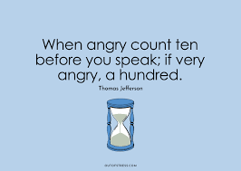
Anger Management Techniques
Retreat and think things over
practice alternative ways of dealing with situations that provoke anger
Delaying their response until anger can be brought under control (‘count to 10’)
Drink water
Core Concept

Slide 15
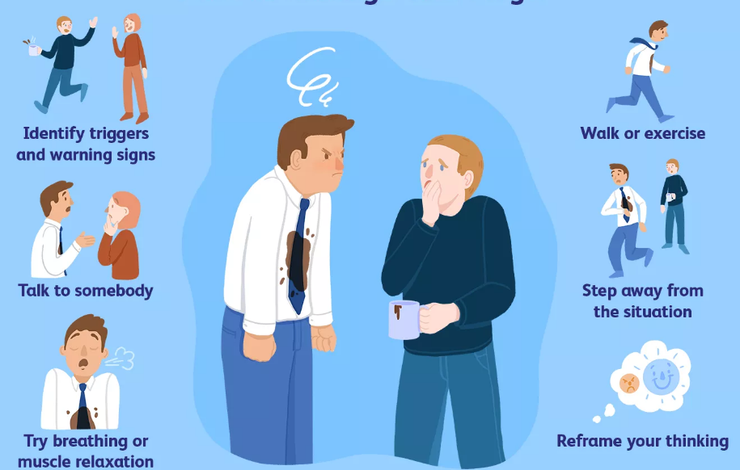
Ways to Relax yourself
Core Concept

Slide 16
Scenario
Dr. Saleem, a senior physician, is working a long shift in a busy emergency department. He is exhausted, and there is a high volume of patients waiting for care. During a particularly hectic moment, Dr. Saleem receives a call from Nurse Sarah, asking him to approve a medication order for a patient who has been waiting for pain relief. Dr. Saleem is frustrated because he has already spoken to Nurse Sarah about prioritizing certain tasks and feels that she is interrupting him unnecessarily. In a moment of anger, he raises his voice, snaps at Nurse Sarah, and tells her she should have figured it out her self. Nurse Sarah, who has been feeling the stress of the shift as well, responds defensively, and tension builds between them. This situation leads to a breakdown in communication and increases stress in the department.
How will you handle this situation?
Core Concept

Slide 17
Steps to Manage
Analyze the Situation
Identify the Anger Triggers
Dr. John is overwhelmed by the stress of the shift and his exhaustion, making him more sensitive to interruptions
Nurse Sarah’s repeated questions may have made him feel like his authority or time was being disrespected.
Lack of clear communication and expectations regarding task prioritization
Core Concept

Slide 18
Consequences
A loss of respect and trust between colleagues, affecting teamwork and collaboration.
Potential delay in patient care because of the emotional breakdown between the two.
Increased tension among other healthcare workers witnessing the interaction.
Core Concept

Slide 19
Immediate Solutions
In the moment, Dr. John should have taken a deep breath before responding to Nurse Sarah.
This simple act of pausing helps clear the mind, allowing a more thoughtful and calm response.
Dr. John could have listened carefully to Nurse Sarah’s concerns without interrupting, acknowledging the pressure she was also facing. This would have made her feel heard and validated.
Conflict De-escalation
Pause and Breathe
Active Listening
Core Concept

Slide 20
After the tension had settled, Dr. John should apologize for raising his voice and explain his stress. He could then ask Nurse Sarah if she needs help with prioritizing tasks or if there’s a better way they can communicate during high-stress moments.
This helps rebuild trust and ensures the same situation doesn’t occur again
Open Communication
Apologize and Clarify Expectations
Core Concept

Slide 21
A team meeting could be scheduled where the department discusses communication protocols, particularly during high-stress situations like busy shifts..
Supportive Team Environment:
Dr. John and Nurse Sarah, along with their colleagues, could discuss stress management techniques or team-building activities that would foster mutual respect and decrease frustration levels.
This way, everyone is clear on expectations, and strategies for managing conflict can be introduced
Conflict Resolution (Team Dynamics)
Core Concept

Slide 22
The healthcare facility could implement more structured well-being programs to prevent burnout and anger from escalating.
This might include counseling sessions, stress management workshops, or meditation programs designed to help staff cope better with the emotional demands of their work.
Supervision and Mentorship:
Junior staff, like Nurse Sarah, could benefit from mentorship programs to help them navigate difficult situations.
Long-Term Anger Management
Core Concept

Slide 23
A meta-analytic review of anger management activities that increase or decrease arousal: What fuels or douses rage?
Sophie L. Kjærvik a , Brad J. Bushman
Clinical Psychology Review, 2024
Anger is an unpleasant emotion that most people want to get rid of. Some anger management activities focus on decreasing arousal.
This meta-analytic review, based on 154 studies including 184 independent samples involving 10,189 participants, tested the effectiveness of both types of activities. The results indicated that arousal-decreasing activities decreased anger and aggression and the results were robust.
Effects were stable over time for participants of different genders, races, ages, and cultures.
Arousaldecreasing activities were effective in students and non-students, in criminal offenders and non-offenders, and in individuals with and without intellectual disabilities.
Arousal-decreasing activities were effective regardless of how they were delivered. A more effective approach for managing anger is “turning down the heat” or calming down by engaging in activities that decrease arousal.
https://www.sciencedirect.com/science/article/pii/S0272735824000357
Longitudinal Integration

Slide 24
Justice
Justice involves treating individuals fairly and equitably, ensuring that everyone receives what is due to them.
It requires impartiality, equality, and fairness in the distribution of benefits, resources, opportunities, and burdens.
Justice also entails addressing systemic inequalities and advocating for the rights of marginalized or disadvantaged groups.
Longitudinal Integration

Slide 25
MCQ
1. A 45-year-old female presents with frequent episodes of irritability and anger, particularly when her children fail to meet expectations. She describes a sense of helplessness and frustration when her children don't follow instructions, and she has difficulty expressing these feelings without becoming angry. What is the most effective non-pharmacological treatment for this patient’s anger?
A) Cognitive-behavioral therapy (CBT) focused on parenting skills B) Psychoanalysis to explore repressed feelings C) Anger management training combined with relaxation techniques D) Couples therapy to improve relationship dynamics
Answer: C

Slide 26
MCQ
1. A 45-year-old female presents with frequent episodes of irritability and anger, particularly when her children fail to meet expectations. She describes a sense of helplessness and frustration when her children don't follow instructions, and she has difficulty expressing these feelings without becoming angry. What is the most effective non-pharmacological treatment for this patient’s anger?
A) Cognitive-behavioral therapy (CBT) focused on parenting skills B) Psychoanalysis to explore repressed feelings C) Anger management training combined with relaxation techniques D) Couples therapy to improve relationship dynamics
Answer: C

Slide 27
MCQ
A 25-year-old male with a history of chronic stress at work presents with difficulty managing anger, particularly during stressful meetings with his supervisor. He finds himself becoming frustrated when his ideas are not acknowledged or accepted, leading to tension and verbal confrontations. What strategy would most help this patient manage his anger during such situations?
A) Practicing problem-solving skills and re-framing negative thoughts
B) Increasing workload to distract from emotional responses C) Avoiding communication with his supervisor D) Using verbal aggression to assert himself in meetings
Answer: A

Slide 28
References
Handbook of Behavioral sciences by Mowadat H.Rana, third edition
Shorter Oxford Textbook of Psychiatry, seventh edition

Slide 29
Thank You
ioprmu@gmail.com

