Slide 2
Use Of Digitalization For Mental Health

Slide 3
Motto Vision; The Dream/Tomorrow
Wisdom
Truth
Service
To impart evidence based research oriented medical education
To provide best possible patient care
To inculcate the values of mutual respect and ethical practice of medicine

Slide 4
Prof Umar’s model of clinically oriented integrated Lecture Third year MBBS
Core subject | 90%
Horizontal integration ( Same year subjects) Anatomy, Biochemistry, Physiology | 0%
Vertical Integration (Basic sciences subjects of different years(Forensic Medicine, Pharmacology, Community medicine | 0%
Vertical Integration Clinical Subjects (Medicine, Surgery, Gynae/Obs etc) | 0%
Longitudinal/ ongoing integration ( Bioethics, Research, Artificial Intelligence, Family Medicine | 10%

Slide 5
Learning objectives
At the end of the session students should be able to
• Understand the Digital Mental Health Resources, including online courses, mobile apps, virtual reality simulations, and telepsychiatry services.
• Evaluating Digital Mental Health Tools: develop the ability to critically evaluate the effectiveness, reliability, and accessibility of digital mental health tools.
• Applying Digital Tools in Practice: Gain practical experience in using digital mental health tools to support individuals experiencing mental health challenges, including crisis intervention, counseling, self-assessment, and self-care strategies

Slide 6
Digital Mental Health
The application of digital technologies in mental healthcare, which can be used for
Mental health promotion, prevention, early intervention and treatment of mental illnesses
For example:
Online video communication technologies
Digital transformation of mental health services Raymond R. Bond, Maurice D. Mulvennanpj Mental Health Research (2023)
Core Concept

Slide 7
Importance
Digital technologies may help to
1. Optimize current services by using technologies to create a better, more fluid, user experience.
2. Generate more useful and actionable data for service providers and therapists which can be used to deliver more data-informed ‘personalised’ services
3. To provide new digital interventions for prevention or to deliver or support treatment.
Digital transformation of mental health services Raymond R. Bond, Maurice D. Mulvennanpj Mental Health Research (2023)
Core Concept

Slide 8
Digital transformation of mental health services Raymond R. Bond, Maurice D. Mulvennanpj Mental Health Research (2023) 13
Core Concept
Notes:
An illustration of the range of digital technologies that can be used in mental health services. a shows a suite of digital mental health technologies with example applications, and b a notional continuum of digital mental health tools/applications that are relatively static (e.g. a psychoeducational app) as well as those tools that are arguably more interactive and dynamic (e.g. chatbots and virtual reality). In (b), the orange labels represent ‘wellbeing support’, the red labels represent ‘monitoring’, the green labels represent ‘treatment’ and the blue labels represent ‘training’

Slide 9
Digital transformation of mental health services Raymond R. Bond, Maurice D. Mulvennanpj Mental Health Research (2023)
Core Concept
Notes:
A visual example of ‘poly-digital’. This is where various digital tools are used to manage different aspects of one’s mental wellbeing which can lead to an aggregation of marginal gains. This figure is an example of the myriad of digital tools that a user could be prescribed to use based on their bespoke needs. These digital tools could be different apps or indeed one app that has these different features enabled whilst other features might be disabled by a service provider.

Slide 10
Digital transformation of mental health services Raymond R. Bond, Maurice D. Mulvennanpj Mental Health Research (2023)
Core Concept

Slide 11
Resources For Online Mental Health Services In Pakistan
Core Concept

Slide 12
Resources For Online Services
Umang
Ruhbaru
Hamraaz mobile app
Counselling Hotline services
Tele-psychiatric services
Core Concept

Slide 13
Umang
Umang is Pakistan’s first 24/7 Mental Health Helpline run by GCP certified Clinical Psychologists , Psychiatrists and active listeners.
Founded in early 2017 by Dr. Kinza Naeem along with her compassionate team.
Umang cares about your well being and want to improve the lives of those with mental illnesses.
We connect those in need with our highly competent team of clinical psychologists who provide therapeutic sessions over the phone. Our mission is to fight the taboo associated with mental health and raise awareness nationwide.
Reference: https://www.umang.com.pk/
Core Concept

Slide 14
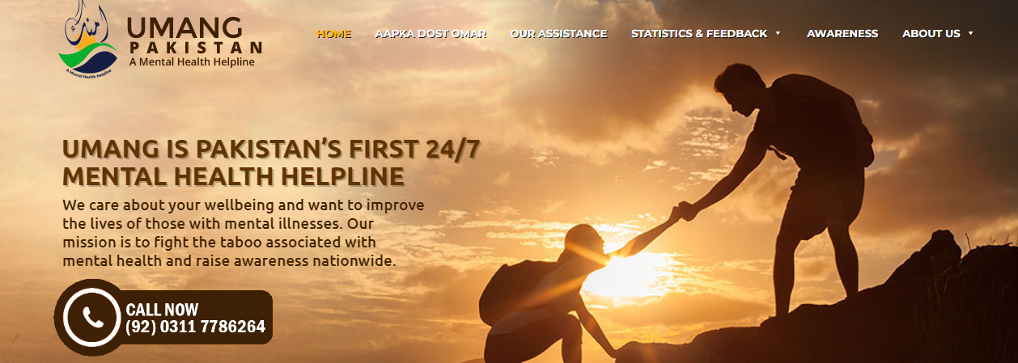
Core Concept
Reference: https://www.umang.com.pk/

Slide 15
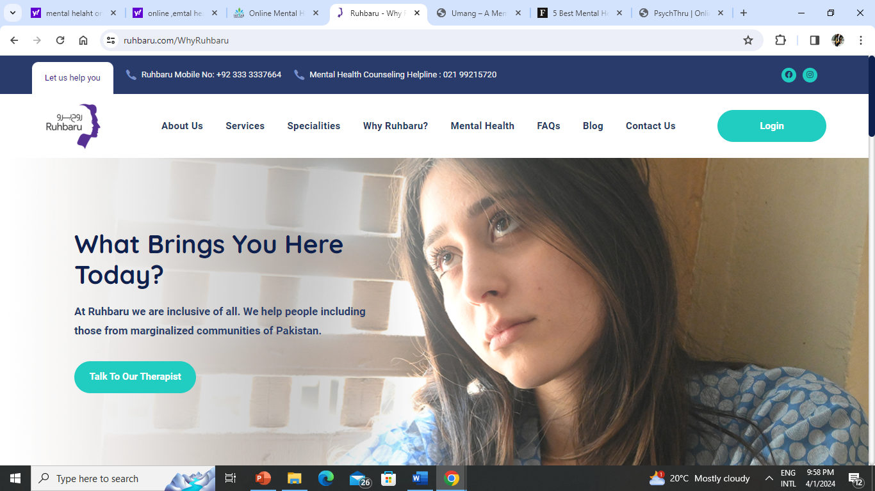
Core Concept

Slide 16
Hamraaz
The Government of Pakistan has taken a major step in promoting mental health by launching its first-ever mental health app named “Humraaz” and a toll-free helpline.
The launch of these initiatives is a recognition of the importance of mental health in the country and a commitment towards addressing the increasing need for mental health services.
The Humraaz app will be available for free on Android and will provide users with information about mental health and mental illnesses, as well as resources for support
https://wow360.pk/govt-of-pakistan-launches-first-ever-mental-health-app-humraaz-toll-free-helpline/
Core Concept

Slide 17
https://wow360.pk/govt-of-pakistan-launches-first-ever-mental-health-app-humraaz-toll-free-helpline/
Core Concept

Slide 18
Free Telephone Counselling Hotlines
in Pakistan

Slide 19
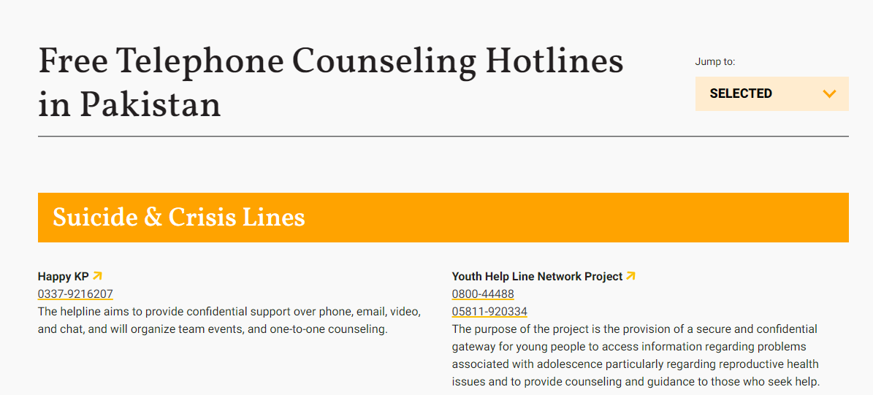
Core Concept

Slide 20
Core Concept

Slide 21
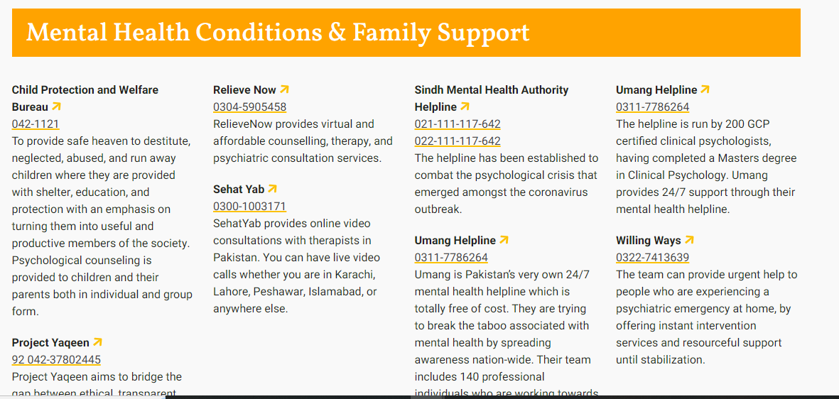
Core Concept

Slide 22
Core Concept

Slide 23
Advantages of Digitalization
Increased Access to Resources:
24/7 Support:
Anonymity and Privacy:
Remote Therapy:
Monitoring and Tracking Tools:
Customization and Personalization:
Educational Resources:
Community Support:
Core Concept
Notes:
Increased Access to Resources: Digital platforms provide easier access to mental health resources such as information, articles, self-help tools, and online support groups. This accessibility can help individuals who may not have access to traditional mental health services due to factors like location, cost, or stigma.
24/7 Support: Digital mental health resources are available 24/7, allowing individuals to seek help and support whenever they need it, even outside of traditional office hours.
Anonymity and Privacy: Online platforms can offer a degree of anonymity, which can reduce the fear of judgment or stigma associated with seeking help for mental health issues. This anonymity can encourage more people to seek support without fear of social repercussions.
Remote Therapy: Digitalization enables the provision of therapy and counseling services remotely through video calls, messaging apps, or online therapy platforms. This is particularly beneficial for individuals who have difficulty accessing traditional in-person therapy due to barriers such as transportation or mobility issues.
Monitoring and Tracking Tools: Digital tools such as mobile apps and wearable devices can help individuals track their mood, behavior patterns, and symptoms over time. This data can provide valuable insights into one's mental health and help identify triggers or warning signs of potential issues.
Customization and Personalization: Digital mental health platforms can offer personalized interventions and recommendations based on individual preferences, needs, and goals. This tailored approach can improve engagement and outcomes for users.
Educational Resources: Digital platforms can provide educational resources on mental health topics, helping to increase awareness, reduce stigma, and promote mental health literacy among the general population.
Community Support: Online forums, social media groups, and virtual support communities allow individuals to connect with others who are experiencing similar challenges. This sense of community and shared understanding can provide valuable emotional support and validation.
Overall, digitalization has the potential to significantly expand access to mental health support, improve convenience and flexibility in accessing services, and empower individuals to take a more active role in managing their mental well-being. However, it's important to recognize that digital mental health interventions should complement rather than replace traditional face-to-face services, and appropriate safeguards must be in place to ensure the quality, safety, and effectiveness of online interventions.

Slide 24
Disadvantages
Lack of Human Connection
Digital Divide
Privacy and Security Concerns
Quality and Regulation
Risk of Misdiagnosis or Harm
Digital Fatigue and Overwhelm
Loss of In-Person Support Networks
Digital Addiction and Dependency
Core Concept
Notes:
lack of Human Connection: Digital platforms may lack the personal connection and rapport that can be established in face-to-face interactions with mental health professionals. This human element is important for building trust and facilitating effective therapeutic relationships.
Digital Divide: Not everyone has access to digital devices or reliable internet connectivity, particularly in rural or low-income areas. This digital divide can exacerbate disparities in access to mental health services, leaving some individuals without adequate support.
Privacy and Security Concerns: Digital mental health platforms may raise concerns about privacy and data security. Users may worry about their personal information being compromised or their sensitive health data being misused, especially with the increasing prevalence of data breaches and cybersecurity threats.
Quality and Regulation: The quality of digital mental health interventions can vary widely, and not all apps or online platforms adhere to evidence-based practices. There is a lack of standardized regulation and oversight in the digital mental health space, which can make it difficult for users to assess the credibility and effectiveness of different options.
Risk of Misdiagnosis or Harm: Without proper oversight and professional guidance, individuals may misinterpret symptoms or receive inaccurate information from digital mental health resources. In some cases, reliance on self-diagnosis or unguided interventions could potentially worsen mental health problems or delay appropriate treatment.
Digital Fatigue and Overwhelm: Constant exposure to digital screens and notifications can contribute to feelings of overwhelm, stress, and anxiety, which may negatively impact mental health. Additionally, the abundance of mental health information online can be overwhelming for some individuals, making it difficult to discern reliable sources from misinformation.
Loss of In-Person Support Networks: Reliance on digital platforms for mental health support may lead to a reduction in face-to-face interactions with friends, family, and community members. This could weaken social support networks, which are crucial for maintaining good mental health and resilience.
Digital Addiction and Dependency: Excessive use of digital devices and online platforms for mental health support may contribute to addictive behaviors and dependency issues. Some individuals may become overly reliant on digital interventions to cope with stress or manage their emotions, which could have negative consequences for their overall well-being.

Slide 25
Improvements
Awareness and Education
Infrastructure Development:
Capacity Building:
Regulation and Standards:
Integration with Healthcare System.
Research and Evaluation:
Public-Private Partnerships:
Affordability and Accessibility
Core Concept
Notes:
Awareness and Education: Increase public awareness and education about mental health issues and available digital mental health resources. This can be done through targeted campaigns, community outreach programs, and collaborations with educational institutions and media outlets.
Infrastructure Development: Invest in improving internet connectivity and technological infrastructure, particularly in rural and underserved areas. This will expand access to digital mental health services for individuals who may not have access to traditional in-person services.
Cultural Sensitivity: Develop culturally sensitive digital mental health resources that take into account the cultural beliefs, values, and norms prevalent in Pakistan. This includes providing content in local languages and addressing cultural stigma associated with mental illness.
Capacity Building: Provide training and capacity building programs for mental health professionals on how to effectively use digital tools and platforms in their practice. This includes training on telepsychiatry, online counseling techniques, and digital therapy modalities.
Regulation and Standards: Establish clear regulations and standards for digital mental health interventions to ensure quality, safety, and effectiveness. This includes guidelines for data privacy and security, as well as standards for evidence-based practice and professional conduct in online therapy.
Integration with Healthcare System: Integrate digital mental health services into the broader healthcare system to ensure continuity of care and collaboration among different providers. This can involve partnerships with government agencies, hospitals, clinics, and community health centers.
Research and Evaluation: Conduct research to evaluate the effectiveness and outcomes of digital mental health interventions in the Pakistani context. This includes studies on user satisfaction, treatment efficacy, and long-term impact on mental health outcomes.
Public-Private Partnerships: Foster partnerships between government agencies, non-profit organizations, private sector companies, and academic institutions to leverage resources and expertise for digital mental health initiatives. This can help scale up existing programs and develop innovative solutions to address unmet needs.
Affordability and Accessibility: Ensure that digital mental health services are affordable and accessible to all segments of the population, including low-income individuals and marginalized communities. This may involve subsidizing costs, offering sliding-scale fees, or integrating digital services into existing healthcare financing mechanisms.

Slide 26
Digital Transformation Of Mental Health Services Raymond R. Bond, Maurice D. Mulvenna, npj Mental Health Research (2023)
Digital technologies can be used to augment existing mental health services without replacing them, and act as a kind of ‘digital glue’ to improve the user experience and future proof services for future generations
Digital mental health interventions can increase the accessibility of support (24/7) and can also be used as a ‘nonstigmatising’ and ‘anonymous’ stepping stone to receiving support.
Be sure to consider all ethical aspects of deploying different kinds of digital technologies in mental health
Longitudinal Integration

Slide 27
Justice
Justice involves treating individuals fairly and equitably, ensuring that everyone receives what is due to them.
It requires impartiality, equality, and fairness in the distribution of benefits, resources, opportunities, and burdens.
Justice also entails addressing systemic inequalities and advocating for the rights of marginalized or disadvantaged groups.
Longitudinal Integration

Slide 28
MCQ
1. Which of the following is NOT a potential challenge in digitalization of mental health services?
Lack of human connection
Cultural sensitivity
Enhanced privacy and security
Digital divide.
Answer: c

Slide 29
MCQ
2. How does digitalization contribute to personalized mental health care?
a) By providing a one-size-fits-all approach
b) By offering tailored interventions based on individual needs
c) By limiting access to certain demographics
d) By increasing wait times for appointments
Answer: b

Slide 30
MCQ
3. What aspect of mental health care does telemedicine primarily address?
a) Physical health assessments
b) Emergency interventions
c) Consultations and therapy sessions at a distance
d) Pharmaceutical treatments
Answer: c

Slide 31
MCQ
4. What is a possible consequence of neglecting to address the digital divide in mental health services?
Increased access to resources
Culturally sensitive interventions
Exacerbation of inequalities
Enhanced user engagement
Answer: c

Slide 32
MCQ
5.Which of the following is an example of a digital mental health intervention?
a) Traditional face-to-face therapy only
b) Smartphone application for guided meditation
c) In-person group therapy sessions
d) Printed self-help booklets
Answer: b

Slide 33
References
Digital Transformation Of Mental Health Services Raymond R. Bond, Maurice D. Mulvenna, npj Mental Health Research (2023)
https://wow360.pk/govt-of-pakistan-launches-first-ever-mental-health-app-humraaz-toll-free-helpline/
https://www.umang.com.pk/

Slide 34
Thank You
ioprmu@gmail.com

