Slide 2
Drug Abuse, Alcohol And Tobacco Use

Slide 3
Motto Vision; The Dream/Tomorrow
Wisdom
Truth
Service
To impart evidence based research oriented medical education
To provide best possible patient care
To inculcate the values of mutual respect and ethical practice of medicine

Slide 4
Prof Umar’s model of clinically oriented integrated Lecture Third year MBBS
Core subject | 48%
Horizontal integration ( Same year subjects) Anatomy, Biochemistry, Physiology | 16%
Vertical Integration (Basic sciences subjects of different years(Forensic Medicine, Pharmacology, Community medicine | 16%
Vertical Integration Clinical Subjects (Medicine, Surgery, Gynae/Obs etc) | 17%
Longitudinal/ ongoing integration ( Bioethics, Research, Artificial Intelligence, Family Medicine | 8%

Slide 5
Learning objectives
At the end of the session students should be able to
Understand the substance use disorders
Different types of substances
Management plan for the substance use disorders

Slide 6
What is Substance and Abuse?
Substance:
“Any drug, medication or toxin that has the potential to abuse”
Abuse:
Self-administration of any drug in a culturally disapproved manner that causes adverse consequences.
Core Concept

Slide 7
Addiction
A behavioral pattern of drug abuse characterized by overwhelming involvement with the use of a drug (compulsive use), the securing of its supply, and a high tendency to relapse after discontinuation.
Dependance
The physiological state of adaptation produced by repeated administration of certain drugs such as alcohol, heroin, and benzodiazepines when they are abruptly discontinued, and are associated with physical drug withdrawal distinct from the motivational changes of acute withdrawal and protracted abstinence, which is part of addiction.
Core Concept

Slide 8
Tolerance:
Tolerance has developed when, after repeated administration, a given dose of a drug produces a decreased effect, or, conversely, when increasingly larger doses must be administered to obtain the effects observed with the original use.
Core Concept

Slide 9
Relapse:
The re-occurrence, upon discontinuation of an effective medical treatment, of the original condition from which the patient suffered.
Withdrawal:
The psychologic and physiologic reactions to abrupt cessation of a dependence producing drug
Core Concept

Slide 10
Psychotropic Substances
Core Concept

Slide 11
Nicotine Withdrawl
Core Concept

Slide 12
Cannabis
Active compound: delta 9 tetra hydrocannabinol
Clinical effects: exaggeration of mood, reddening of conjunctiva, dry mouth, tachycardia, coughing
Withdrawal: irritability, insomnia, nausea, anorexia
Can give rise to Schizophreniform Psychosis
Drugs used: symptomatic treatment
Core Concept

Slide 13
Withdrawal of Alcohol
ALCOHOL:
Withdrawal symptoms: restlessness, tremors, sweating, anxiety, nausea, vomiting, loss of appetite, insomnia, tachycardia, seizures and Delirium tremens
Scales : CAGE, SAWS.
Drugs used: chlordiazepoxide , diazepam
Core Concept

Slide 14
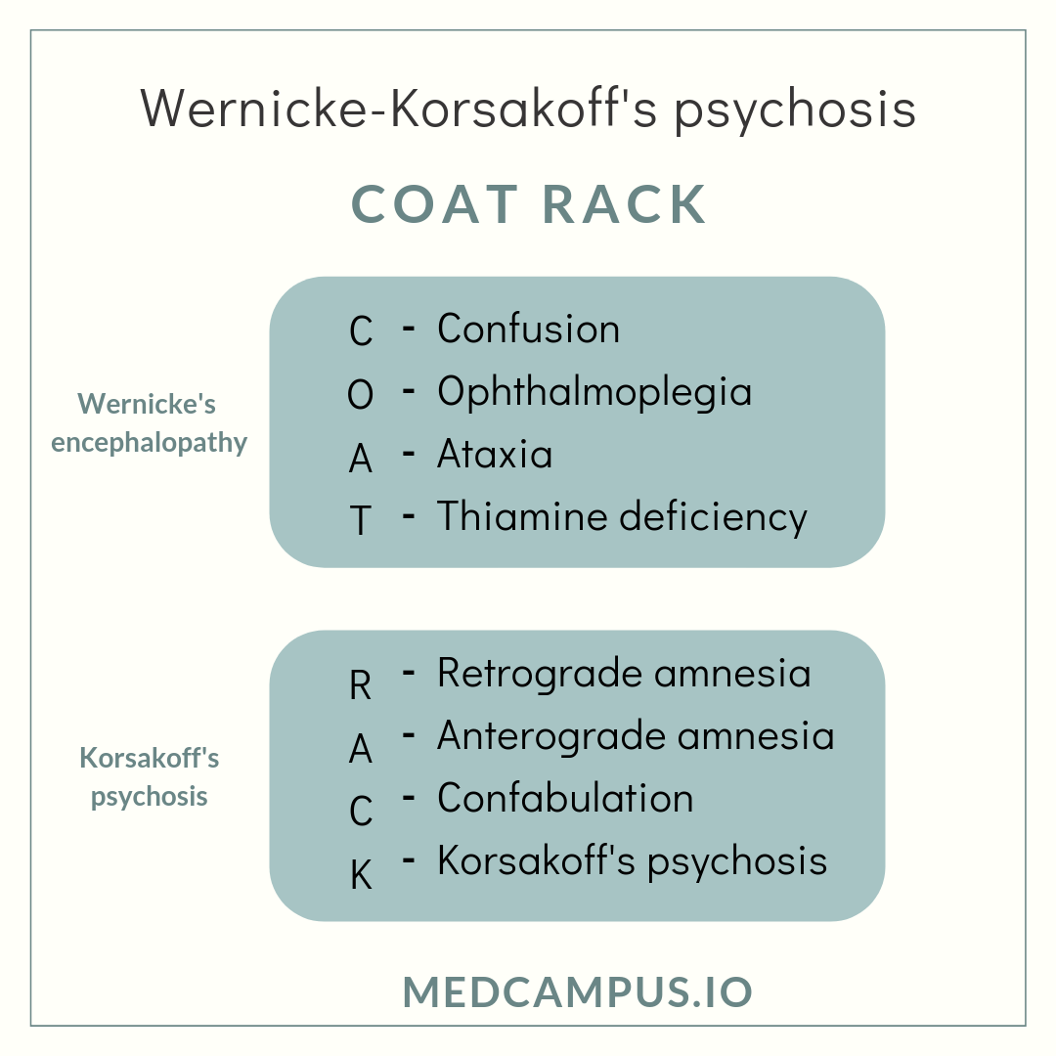
Wernicke- Korsakoff syndrome
Acute neuropsychiatric emergency caused by thiamine deficiency, secondary to chronic alcohol abuse.
Core Concept

Slide 15
Delirium tremens(DTs)
Delirium tremens is an acute confusional state that occurs when alcohol withdrawal symptoms are severe
The classic triad includes clouding of consciousness, vivid hallucinations and marked tremors.
Other features include paranoid delusions, agitation, sleeplessness and autonomic hyperactivity.
Symptoms of DTs peak between 72-96 hours
Core Concept

Slide 16
Opioids
Withdrawal syndrome: lacrimation, rhinorrhea , agitation, perspiration , piloerection , vomiting, shivering, yawning, dilated pupils
Scales: OOWS(objective opioid withdrawal scale)
Drugs used: Methadone, buprenorphine as oral substitution therapy
Symptomatic treatment is also given to reduce severity of symptoms
Core Concept

Slide 17
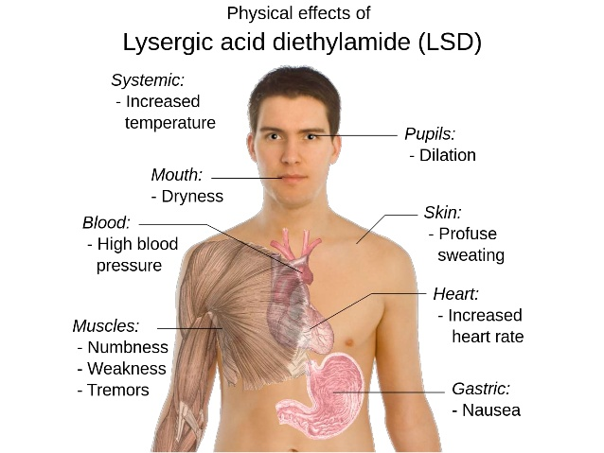
Stimulants
Amphetamines
Cocaine
LSD
Core Concept

Slide 18
Neurobiology of drug abuse
Horizontal Integration

Slide 19
Neurobiology of tolerance & dependence
Addiction can be conceptualised as a three-stage, recurring cycle—binge/intoxication, withdrawal/negative affect, and preoccupation/anticipation (craving)—that worsens over time and involves neuroplastic changes in the brain reward, stress, and executive function systems
Horizontal Integration

Slide 20
History Taking
Drug
In which form
Mode of intake(oral, inhalation, parenteral )
Duration
Amount
Frequency
Reasons (peer pressure etc)
Any attempts to quit
When & what happened
Period of abstinence
Reasons of relapse
Treatment History
History of poly drug abuse
Establish tolerance
What does the patient want?
Social & medical complications
Vertical integration

Slide 21
Adverse effects of drug misuse
Psych. comorbidities
Depression
Anxiety
Anti social personality disorder
Social consequences
Unemployment
Traffic accidents
Relationship problems
Neglect of children
Criminality
Local
Vein thrombosis
Infection at injection site
Damage to arteries
Systemic
Bac. Endocarditis
Hep B& C
HIV
Accidental overdose
Vertical integration

Slide 22
Aims of Management
Explore wether the patient wants:
To quit
Detoxifiy
Treatment of withdrawal or intoxication
Treatment of physical complications
Treatment of psychiatric comorbidity
To deal with social and psychological problems
Vertical integration

Slide 23
Management during acute intoxication
Case of a substance abuse patient starts with assessment- to determine which substance he is using.It varies according to the type of drug
During the Acute phase of Intoxication-
maintain vitals ,ensure safety and ease discomfort
Institute seizure precaution
Maintain IV fluids ,monitor vital signs and urine output
Do all baseline investigations and Urine for TLC ,in case of Alcohol BAC is done
Vertical integration

Slide 24
Psychological treatment
Brief psychiatric interventions
Counseling
Motivational interview
CBT
Family psycho-education
Contingency management
Vertical integration

Slide 25
Motivational interview
Raise awareness about contrast between substance user’s aims and behavior
Express empathy
Avoid confrontation
Detect problems and roll with resistance
Point out discrepancies in history
Vertical integration

Slide 26
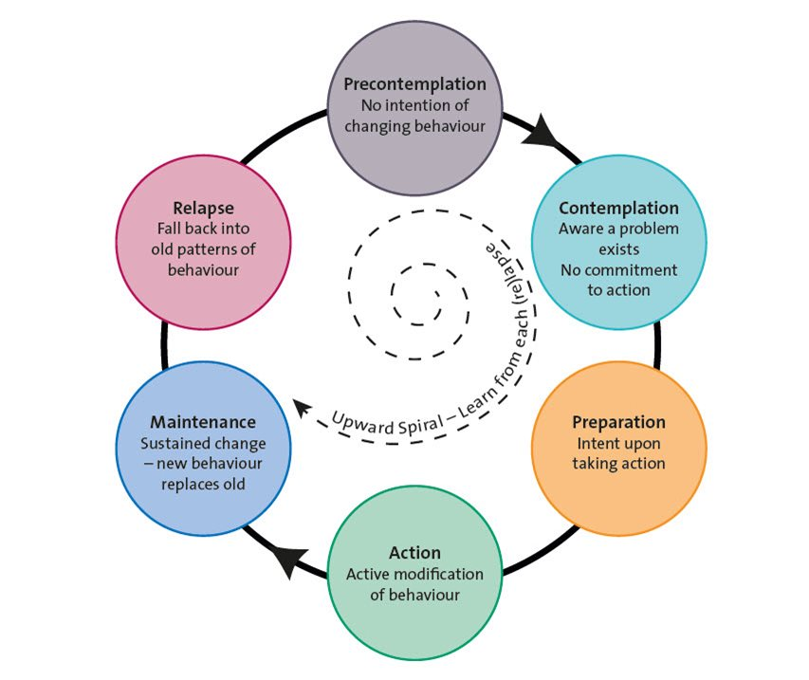
Vertical integration

Slide 27
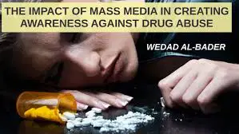
Prevention of Drug use and relapse
Restricting availability
Policies regarding import of drugs
Reducing over prescription of sedative & hypnotics by doctor
Education programs in schools, colleges
Use of media to create awareness
Role of GPs/ LHVs/ Social workers
Vertical integration

Slide 28
Specific Pharmacotherapy
Vertical integration

Slide 29
Ethical Imperatives to Overcome Stigma Against People With Substance Use Disorders
Abstract
Responding to the public health crisis in the United States resulting from untreated opioid use disorder (OUD) requires expanding delivery of effective treatments, including medications, and eliminating stigma against people with OUD and people seeking OUD treatment.
Stigma discourages people with substance use disorders from seeking care and compromises the care they receive when they do seek it.
Stigma against both medication treatments for OUD and harm-reduction approaches like syringe services programs has created additional barriers to these strategies' acceptance and use.
It is ethically incumbent upon everyone in medicine and health care to recognize addiction not as a moral failing but as a treatable disease.
Adams JM, Volkow ND. Ethical Imperatives to Overcome Stigma Against People With Substance Use Disorders. AMA J Ethics. 2020 Aug 1;22(1):E702-708. doi: 10.1001/amajethics.2020.702. PMID: 32880359.
Longitudinal Integration

Slide 30
The principle of confidentiality is the ethical obligation of physician to preserve the information gathered in association with patient care. The patient needs to be able to trust the physicians, will protect the information shared in confidence. It is worth emphasizing that, confidentiality can be breached in few cases, to other healthcare personnels for patient care, patient can harm oneself or others or required by law.
Confidentiality
Longitudinal Integration

Slide 31
MCQ
1. A young 30 year old male is a cannabis user for last 13 years. He has increased the quantity of cannabis and is unable to function without it. Now he has been smoking 10-15 cigarettes per day. He has sweating and palpitations accompanied with nausea vomiting when he is unable to get cannabis. What is the phenomena that has led to increasing dose?
Abuse
Dependance
Tolerance
Withdrawal
Answer: c

Slide 32
MCQ
2. A 29 year old male is a cannabis user for last 13 years. He has been smoking 10-15 cigarettes per day. He is brought to hospital by his family to stop his drug use. He says that cannabis has no harm to him and is actually helping him function better What is the stage of change, patient is at?
Action
Contemplation
Precontemplation
Preparation
Answer: c

Slide 33
MCQ
3. A 25 year old male presented with restlessness, tremors, sweating, nausea, vomiting, and had two episodes of fits in last 24 hours. His family reports he occasionally use drugs. He came back from a friends gathering after which he is in this condition. He took alcohol at the gathering as his friends reported. What do these symptoms suggest?
Alcohol withdrawal
Alcohol intoxication
Alcohol overdose
Harmful use of alcohol
Answer: b

Slide 34
Thank You
ioprmu@gmail.com

