Slide 2
Post Traumatic Stress Disorder

Slide 3
Vision; The Dream/Tomorrow MOTTO
To impart evidence based research oriented medical education
To provide best possible patient care
To inculcate the values of mutual respect and ethical practice of medicine
Wisdom
Truth
Service

Slide 4
Prof Umar’s model of clinically oriented integrated Lecture Third year MBBS
Core subject | 75%
Horizontal integration ( Same year subjects) Anatomy, Biochemistry, Physiology | 13%
Vertical Integration (Basic sciences subjects of different years(Forensic Medicine, Pharmacology, Community medicine | 2%
Vertical Integration Clinical Subjects (Medicine, Surgery, Gynae/Obs etc) | 2%
Longitudinal/ ongoing integration ( Bioethics, Research, Artificial Intelligence, Family Medicine | 8%

Slide 5
LEARNING OBJECTIVES
At the end of the lecture, students will be able to
To understand the epidemiology of PTSD
To understand the etiology of PTSD
To be able to Recognise the symptoms and signs of PTSD
Identify the risk factors of PSD
To be able to understand the role of Psycho education in management of PTSD
To be able to treat the patient keeping in view recent advances and biomedical ethics

Slide 6
Post Traumatic Stress Disorder
Posttraumatic stress disorder (PTSD) is a psychiatric disorder that may occur in people who have experienced or witnessed a traumatic event such as a natural disaster, a serious accident, a terrorist act, war/combat, or rape or who have been threatened with death, sexual violence or serious injury.
Core Concept

Slide 7
ICD-11 Criteria
PTSD is a syndrome that develops following exposure to an extremely threatening or horrific event or series of events that is characterised by all of the following: 1: Re experiencing the traumatic event or events in the present in form of vivid intrusive memories, flashbacks, or nightmares, which are typically accompanied by strong emotions
2: Avoidance of thoughts and memories of the event
3: Persistent perceptions of heightened current threat Symptoms mut persist for at least several weeks and cause significant impairment in functioning.
Core Concept

Slide 8
Symptoms of PTSD
Core Concept

Slide 9
Intrusions
Recurrent, involuntary, and intrusive distressing memories of the traumatic event(s)
Recurrent, distressing dreams related to the traumatic event(s)
Dissociative reactions (e.g., flashbacks)
Intense or prolonged psychological distress at exposure to trauma reminders
Marked physiological reactions to trauma reminders
Core Concept

Slide 10
Persistent avoidance
Effortful avoidance of distressing memories, thoughts, or feelings related to the traumatic event(s)
Effortful avoidance of external reminders (e.g., people, places, conversations, situations) related to the traumatic event(s)
Core Concept

Slide 11
Negative changes in beliefs and feelings
Persistent, exaggerated negative beliefs about oneself, others, and/or the world
Distorted blame of self or others
Persistent negative emotions
Difficulty feeling positive emotions
Feeling detached or cut off from others
Diminished interest or participation in significant activities
Difficulty remembering important aspects of the trauma
Core Concept

Slide 12
Alterations in arousal and reactivity
Irritable behavior and angry outbursts
Reckless or self-destructive behavior
Hypervigilance
Exaggerated startle response
Problems with concentration
Sleep disturbance
Core Concept

Slide 13
Risk factors
Core Concept

Slide 14
Personal Factors
Core Concept

Slide 15
Traumatic Event
Core Concept

Slide 16
Recovery Environment
Core Concept

Slide 17
Differential Diagnosis
Adjustment Disorder
Specific Phobias
Generalised anxiety disorder
Obsessive Compulsive Disorder
Panic Attack
Depression
Core Concept

Slide 18
Epidemiology
Lifetime prevalence of PTSD among adult Americans is estimated to be 6.8% (1).
Current past year PTSD prevalence was estimated at 3.5% (1).
The lifetime prevalence of PTSD among men was 3.6% and among women was 9.7%. The twelve month prevalence was 1.8% among men and 5.2% among women (2).
1. Kessler, R.C., Berglund, P., Delmer, O., Jin, R., Merikangas, K.R., & Walters, E.E. (2005). Lifetime prevalence and age-of-onset distributions of DSM-IV disorders in the National Comorbidity Survey Replication. Archives of General Psychiatry, 62(6): 593-602.
2. National Comorbidity Survey. (2005). NCS-R appendix tables: Table 1. Lifetime prevalence of DSM-IV/WMH-CIDI disorders by sex and cohort. Table 2. Twelve-month prevalence of DSM-IV/WMH-CIDI disorders by sex and cohort. Accessed at: www.hcp.med.harvard.edu/ncs/publications.php
Horizontal Integration

Slide 19
Etiology
Horizontal Integration

Slide 20
Neurobiological basis
Increased central norepinephrine levels with down regulated central adrenergic receptiors
A meta analysis review found a positive association between the diagnosis pf PTSD and basal cardiovascular activity
The HPA axis has been the most extensively studied neuroendocrine system in PTSD
In a large sample of Vietnam veterans, combat-exposed veterans with current PTSD had lower cortisol as compared to non combat exposed veterans without PTSD
Horizontal Integration

Slide 21
Imaging
MRI Scans: Decreased volume of the hippocampus, left amygdala and anterior cingulate cortex in patients with PTSD
F-MRI and PET: Increased reactivity of the amygdala and anterior paralimbic region to trauma- related stimuli
In response to trauma related stimuli, there is decreased reactivity of the anterior cingulate and orbitofrontal areas
Horizontal Integration

Slide 22
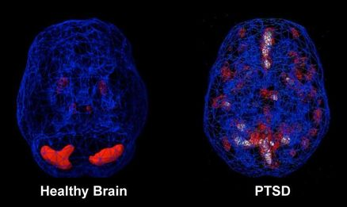
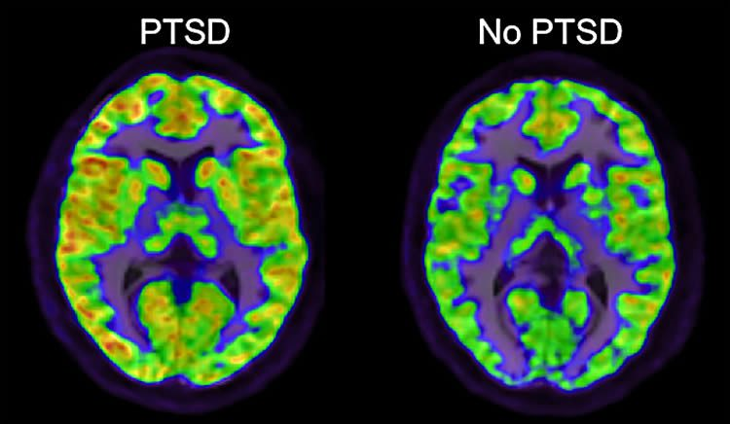
Amygdala, hippocampus, and the
ventromedial prefrontal cortex play
a role in triggering the typical symptoms
of PTSD.
Horizontal Integration

Slide 23
Genetics
Researchers suspect that genetics may contribute to an individual’s susceptibility to PTSD through an interaction with environmental factors
Presence of one of four polymorphisms at the stress related gene FKBP5, increased risk for PTSD in patients with a history of child abuse
Evidence suggests that psychiatric history, both personal or in family members, increaes the likelihood of being exposed to a trauma and developing PTSD once exposed.
Horizontal Integration

Slide 24
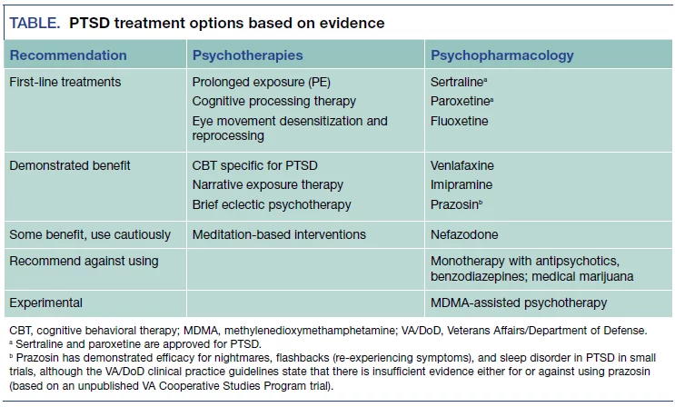
Treatment options
Vertical integration

Slide 25
Evidence-based Psychotherapy Treatments
First line psychotherapies:
A Trauma-focused psychotherapy that includes components of exposure and/or cognitive restructuring, such as:
Prolonged Exposure (PE)
Cognitive Processing Therapy (CPT)
Eye Movement Desensitization and Reprocessing (EMDR)
Vertical integration

Slide 26
Longitudinal Integration

Slide 27
Longitudinal Integration

Slide 28
Longitudinal Integration

Slide 29
Longitudinal Integration

Slide 30
Efficacy of Artificial Intelligence-Assisted Psychotherapy in Patients With Anxiety Disorders: A Prospective, National Multicenter Randomized Controlled Trial Protocol Shanshan Su, ^{1 , †} Yuan Wang, ¹ Abstract The availability of psychotherapy is low due to the limited resources. Artificial intelligence (AI)-assisted psychotherapy offers an opportunity to develop an efficient and standardized psychotherapy model and improve the availability of psychotherapy, which is key to improve the clinical efficacy of anxiety disorder treatments.
Research
Longitudinal Integration

Slide 31
Multiple Choice Questions
A 25-year-old woman, who was sexually assaulted a year ago, reports feeling emotionally detached, unable to connect with her family, and avoiding social interactions. She also experiences nightmares and hyperarousal. What PTSD symptom cluster does this describe?
Intrusion symptoms
Avoidance symptoms
Negative alterations in mood and cognition
Hyperarousal symptoms
Re-experiencing
Answer: C

Slide 32
A 35-year-old man who survived a terrorist attack begins drinking heavily to cope with nightmares and anxiety. Which of the following is the most likely explanation for his substance use?
Social pressure
Maladaptive coping mechanism
Alcohol Dependence without PTSD
Genetic predisposition to addiction
Peer pressure
Answer: B

Slide 33
3. A 29-year-old woman who survived domestic violence reports frequent blackouts where she "loses time" and finds herself in unfamiliar places without memory of how she got there. She also has flashbacks of the abuse. What subtype of PTSD does she likely have?
PTSD with Dissociative Symptoms
Complex PTSD
Dissociative Identity Disorder
Panic Disorder
Genaralized anxiety disorder
Answer: A

Slide 34
References
Handbook of Behavioral sciences by Mowadat H.Rana, Third edition

Slide 35
Thank You
ioprmu@gmail.com

