Slide 1


Slide 2
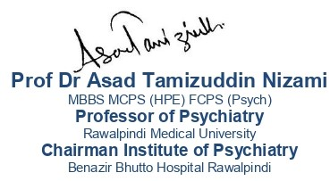
Depressive Disorder

Slide 3
Motto Vision; The Dream/Tomorrow
Wisdom
Truth
Service
To impart evidence based research oriented medical education
To provide best possible patient care
To inculcate the values of mutual respect and ethical practice of medicine

Slide 4
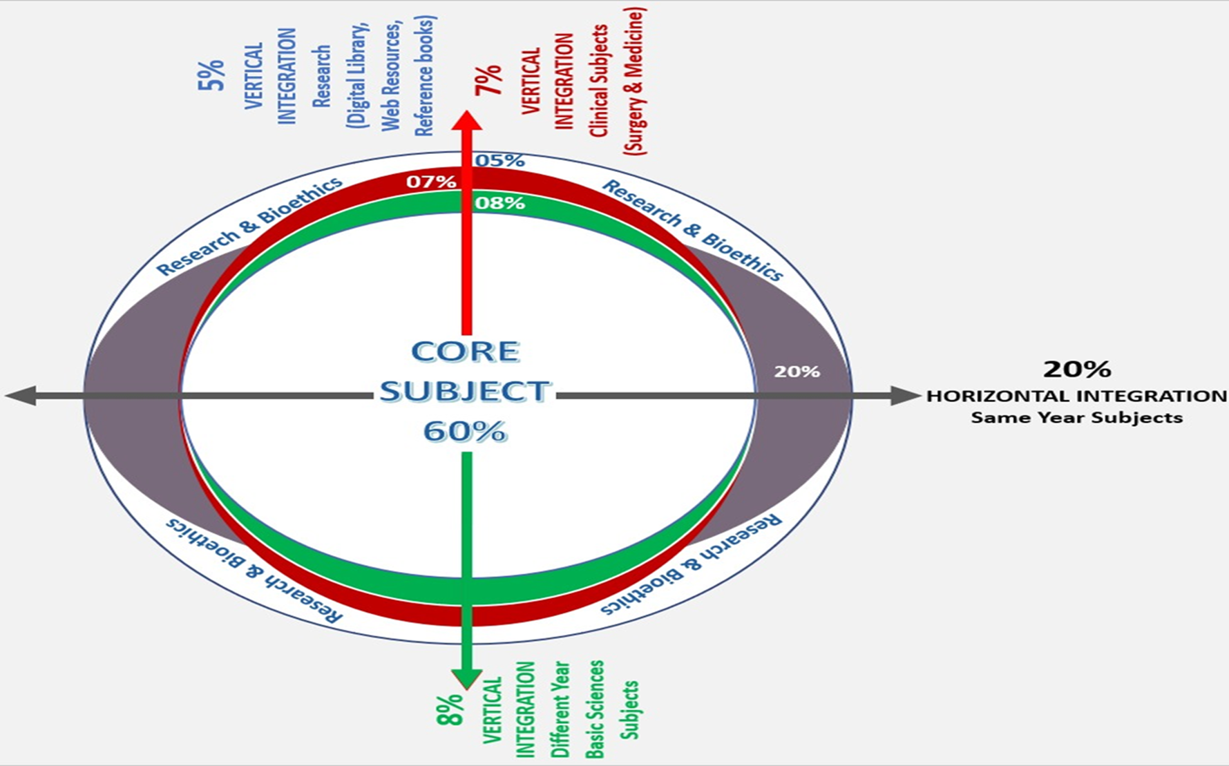
Prof Umar’s model of clinically oriented integrated Lecture Third year MBBS
Core subject | 42%
Horizontal integration ( Same year subjects) Anatomy, Biochemistry, Physiology | 16%
Vertical Integration (Basic sciences subjects of different years(Forensic Medicine, Pharmacology, Community medicine | 17%
Vertical Integration Clinical Subjects (Medicine, Surgery, Gynae/Obs etc) | 17%
Longitudinal/ ongoing integration ( Bioethics, Research, Artificial Intelligence, Family Medicine | 8%

Slide 5
Learning objectives
At the end of the session students should be able to
• Understand depression.
• To list differential diagnosis of diseases
• Elaborate a management plan

Slide 6
Depressive Disorder
It is a mood disorder.
It is an episodic illness.
There are THREE Core symptoms and SEVEN associated symptoms to diagnose it
Core Concept

Slide 7
Symptoms
A | B
Depressed mood Loss of interest and enjoyment Reduced energy and decreased activity | Reduced concentration Reduced self-esteem Ideas of guilt Worthlessness Pessimistic thoughts Ideas of self harm Disturbed sleep Diminished appetite
MILD DEPRESSIVE DISORDER: At least 2 of A and 2 of B MODERATE DEPRESSIVE DISORDER: At least 2 of A and 3 of B SEVERE DEPRESSIVE DISORDER: All 3 of A and 4 of B
Core Concept

Slide 8
Appearance
Dress and grooming is neglected
Turning downwards of corner of mouth
Vertical furrowing center of brow
Rate of blinking is reduced
Shoulders are bent and gaze is downward
Gestures and movements are reduced
Core Concept

Slide 9
Mood
The mood does not improve substantially in circumstances such as hearing a good news or in pleasant company.
Patient sometimes speaks as black cloud pervading all mental activities.
The mood is often WORSE in morning and improves as the day wears on, it is called as DIURNAL VARIATION.
Core Concept

Slide 10
Depressed Cognitions
Negative thoughts are divided into three groups
Worthlessness
Helplessness
Hopelessness
Core Concept

Slide 11
Psychomotor Changes
Psychomotor retardation is frequently seen
The patient walks and acts slowly
Slowing of thought is reflected in speech.
Agitation can also be seen in depressed patients
Anxiety is also seen sometimes in severe depression.
Core Concept

Slide 12
Biological functions
Sleep disturbance
Loss of appetite
Loss of weight
Constipation
Loss of libido
Amenorrhea
Early morning waking
Core Concept

Slide 13
Variants Of Depression
Agitated depression
Retarded depression
Depressive stupor
Atypical depression
Psychotic depression
Core Concept

Slide 14
Epidemiology of Depression
The 12 month prevalence of depression is 2-5%.
The mean .
The age of onset is about 27 years.
The rates of depression are twice as high in women as in men across different countries.
Rates of depression are higher in unemployed and divorced.
Core Concept

Slide 15
Aetiology
Genetic Causes:
The risk is increased about three-fold in first degree relatives
Mode of Inheritance:
Polygenic inheritance
Personality
Parental deprivation
Recent life events
Physical illness
Cognitive theories
Neurobiology
Horizontal Integration

Slide 16
Abnormalities in Monoamine Activity
5 HT | Noradrenaline | Dopamine
Decreased plasma tryptophan Blunted 5-HT neuroendocrine responses Decreased brain 5-HT1A receptor binding Decreased brain 5-HT reuptake sites (SPET and PET) Clinical relapse after tryptophan depletion. | Blunted noradrenaline-mediated growth hormone release Clinical relapse after α-methyl-para-tyrosine (AMPT) | Decreased homovanillic acid (HVA) levels in cerebrospinal flud Clinical relapse after α-methyl-para-tyrosine (AMPT)
Reference: Shorter Oxford Textbook Of Psychiatry, Seventh Edition
Horizontal Integration

Slide 17
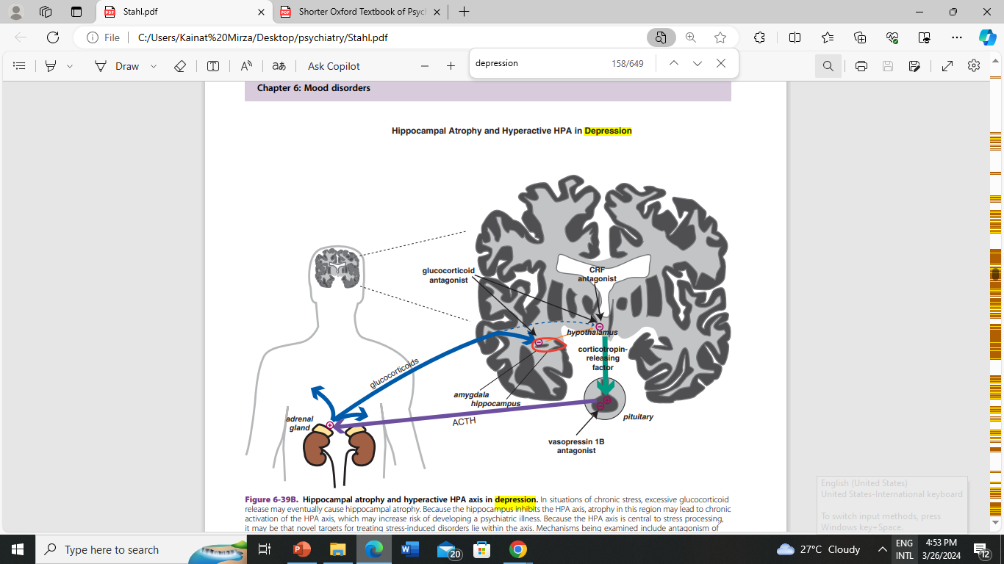
Reference: Stahl Essential psychopharmacology, Stephan M Stahl, fourth edition
Horizontal Integration

Slide 18
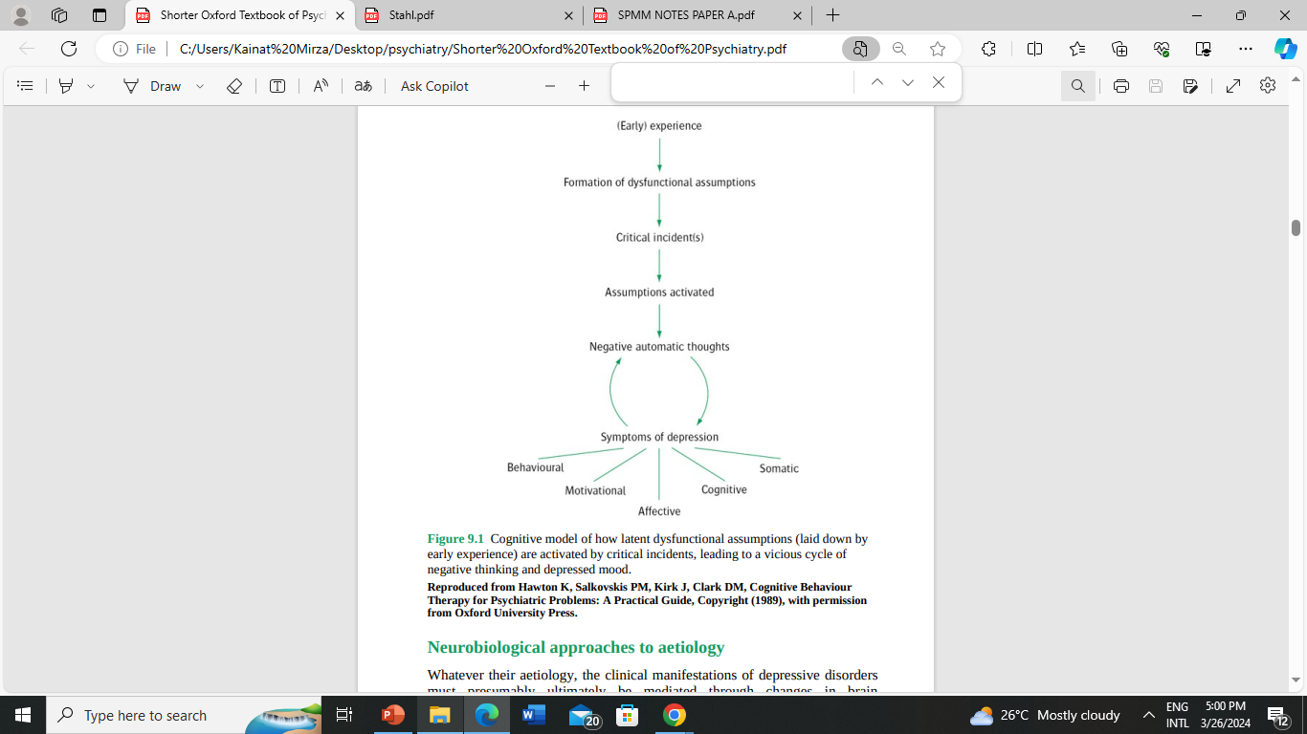
Cognitive Model
Reference: Shorter Oxford Textbook Of Psychiatry, Seventh Edition
Horizontal Integration

Slide 19
Scenario
A 35 years old female presents to you, she has complain of reduced sleep. Upon exploring the history, she has weeping spells and reduced energy. She also reports that she wakes up early and is unable to go to sleep again. Her appetite is reduced to one chapatt per day.
What is your diagnosis?
How would you manage the patient?
Vertical integration

Slide 20
Diagnostic Criteria ICD-10
A | B
Depressed mood Loss of interest and enjoyment Reduced energy and decreased activity | Reduced concentration Reduced self-esteem Ideas of guilt Worthlessness Pessimistic thoughts Ideas of self harm Disturbed sleep Diminished appetite
MILD DEPRESSIVE DISORDER: At least 2 of A and 2 of B MODERATE DEPRESSIVE DISORDER: At least 2 of A and 3 of B SEVERE DEPRESSIVE DISORDER: All 3 of A and 4 of B
Vertical integration

Slide 21
Pharmacological Treatment
Antidepressant Drugs
SSRI: escitalopram, sertraline
SNRI: mirtazapine
Tricyclic antidepressants
Anticonvulsants:
Carbamezpine, valproate and lamotrigine.
Electroconvulsive Therapy
Vertical integration

Slide 22
Psychological Treatment
Cognitive behavioral Therapy
Behavioral activation
Interpersonal psychotherapy
Couple therapy
Vertical integration

Slide 23
NICE guidelines
Antidepressants are not recommended as a first‐line treatment in recent‐onset, mild depression – active monitoring, individual guided self‐help, cognitive behavioural therapy (CBT) or exercise are preferred.
Antidepressants are recommended for the treatment of moderate to severe depression and for dysthymia.
When an antidepressant is prescribed, a generic selective serotonin reuptake inhibitor (SSRI) is recommended.
All patients should be informed about the withdrawal (discontinuation) effects of antidepressants.
Vertical integration

Slide 24
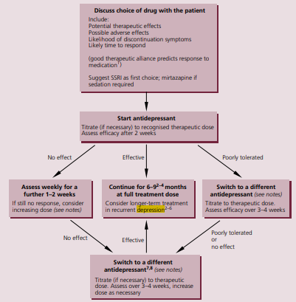
Vertical integration

Slide 25
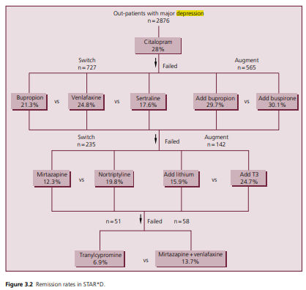
STAR*D
SEQUENCED
TREATMENT ALTERNATIVES TO RELIEVE DEPRESSON
Vertical integration

Slide 26
Ketamine versus ECT for Nonpsychotic Treatment-Resistant
A. Anand, S.J. Mathewn,
The New England Journal of Medicine, June 22, 2023
Major depressive disorder is a leading cause of disability worldwide and is estimated to affect 21 million adults in the United States.
Ketamine was noninferior to ECT as therapy for treatment-resistant major depression without psychosis
https://www.nejm.org/doi/pdf/10.1056/NEJMoa2302399?articleTools=true
Longitudinal Integration

Slide 27
Beneficence
Beneficence refers to the ethical obligation of healthcare providers to act in the best interest of their patients and to promote their well-being.
In the context of depression, beneficence involves providing effective and appropriate treatments, offering support and empathy, and striving to alleviate suffering.
Healthcare providers should seek to maximize the benefits of treatment while minimizing harm, ensuring that interventions are tailored to the individual needs and preferences of patients with depression
Longitudinal Integration

Slide 28
MCQ
1. A 30-year-old woman with a history of recurrent depressive episodes presents to her psychiatrist's office. She reports feeling depressed for the past two weeks, along with increased appetite, hypersomnia, and significant weight gain. She has a history of similar episodes during the winter months. What is the most likely diagnosis?
a) Major depressive disorder with atypical features
b) Bipolar disorder, depressive episode
c) Seasonal affective disorder
d) Bipolar disorder, manic episode
Answer: a

Slide 29
MCQ
2. A 32-year-old female presents to her primary care physician with complaints of persistent low mood, loss of interest in activities she once enjoyed, fatigue, and difficulty sleeping for the past six months. She reports feeling worthless and guilty, she wants to harm herself. She has attempted self harm with the intention to end her life. She was given medication but did not show any improvement. Now she has reduced oral intake and has become mute. How would you treat?
Give antipsychotics to contain the patient
Give lithium as first line drug
Physically restrain the patient
Electroconvulsive therapy
Answer: d

Slide 30
MCQ
3. A 22-year-old college student visits the university health center complaining of poor concentration, fatigue, irritability, and feelings of hopelessness. She reports difficulty sleeping and has lost interest in her studies and social activities. She admits to feeling overwhelmed by academic pressure and relationship issues the patient reported The patient reported that the symptoms appear in every winters for last 3 years. What is the most likely diagnosis?
a) Adjustment disorder
b) Dysthymic disorder
c) Severe depressive disorder
d) Seasonal affective disorder
Answer: d

Slide 31
MCQ
4. A 68-year-old retired man presents to his primary care physician with symptoms of depression. He reports feeling sad, has lost interest in activities he once enjoyed, and has difficulty sleeping. He also complains of chronic pain in his joints due to arthritis. Which of the following treatment options should be considered first for this patient?
a) Cognitive-behavioral therapy
b) Antidepressant medication
c) Physical therapy for pain management
d) Referral to a support group for retirees
Answer: b

Slide 32
MCQ
5. A 29 years old patient has been diagnosed with depression she has been on escitalopram 10mg for two weeks. She reports no improvement. What would you do?
Switch to another antidepressant
Augment with olanzapine for better results
Continue escitalopram for next two weeks
Give ECT to patient
Answer: c

Slide 33
References
Handbook of Behavioral sciences by Mowadat H.Rana, third edition
Shorter Oxford Textbook Of Psychiatry, Seventh Edition

Slide 34
Thank You
ioprmu@gmail.com

