Slide 1


Slide 2

Deliberate Self Harm

Slide 3
Motto Vision; The Dream/Tomorrow
Wisdom
Truth
Service
To impart evidence based research oriented medical education
To provide best possible patient care
To inculcate the values of mutual respect and ethical practice of medicine

Slide 4
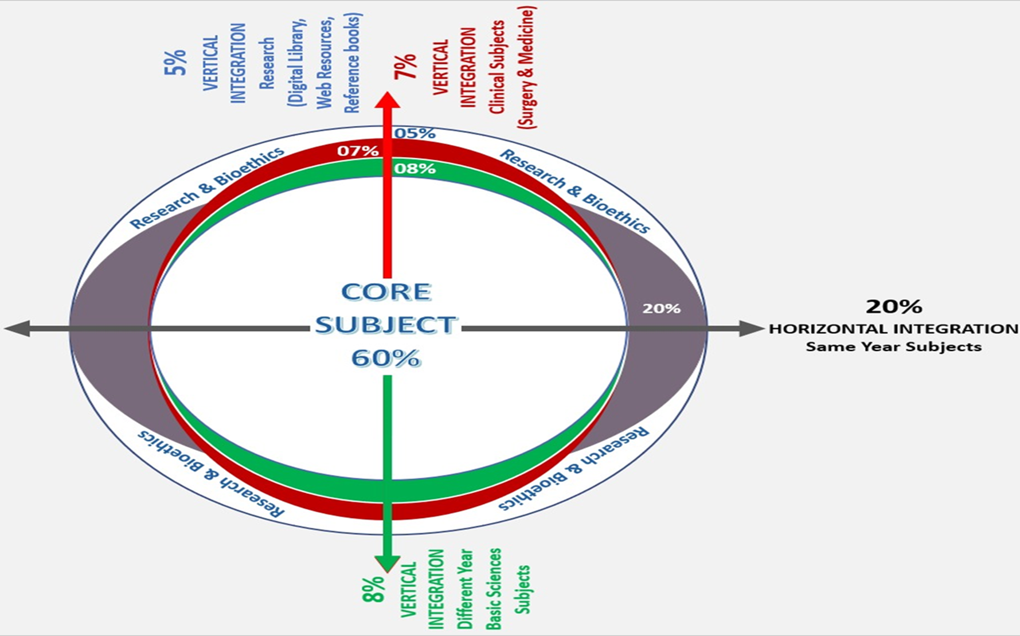
Prof Umar’s model of clinically oriented integrated Lecture Third year MBBS
Core subject | 80%
Horizontal integration ( Same year subjects) Anatomy, Biochemistry, Physiology | 8%
Vertical Integration (Basic sciences subjects of different years(Forensic Medicine, Pharmacology, Community medicine | 2%
Vertical Integration Clinical Subjects (Medicine, Surgery, Gynae/Obs etc) | 2%
Longitudinal/ ongoing integration ( Bioethics, Research, Artificial Intelligence, Family Medicine | 8%

Slide 5
Learning objectives
At the end of the session students should be able to
• Understand suicide and deliberate self harm
• To list differential diagnosis
• Elaborate a management plan

Slide 6
Definitions
Deliberate Self Harm:
An act in which an individually deliberately causes injury or harm to themselves, without the intent to commit suicide.
Self Mutilation
Repetitive superficial bodily harm without suicidal intent.
Core Concept

Slide 7
Suicide
An act in which an individually causes injury or harm to themselves, with the intent to end his/her life.
Parasuicide
Episodes of self harm survived with or without suicidal intent.
Attempted Suicide
For episodes of self harm where there was suicidal intent
Core Concept

Slide 8
Epidemiology of DSH
Lifetime prevalence of deliberate self-harm in Europe and the US is about 3% to 5% of the population, and has been increasing.
Familial, biological, and psychosocial factors may contribute. Risks are higher in women and young adults, in people who are socially isolated or deprived, and in those with psychiatric or personality disorders.
Around a quarter of people will repeat the self-harm within 4 years, and the long-term suicide risk is 3% to 7%.
Younger adults are more likely to repeat non-fatal self-harm, while adults aged over 45 years are more likely to die by suicide, especially if the previous self-harm involved a violent method.
Deliberate self-harm (and attempted suicide), G Mustafa Soomro,Sara kakhi, BMJ clin evid. 2015
Core Concept

Slide 9
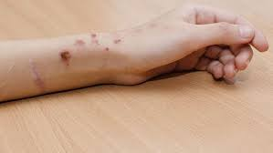
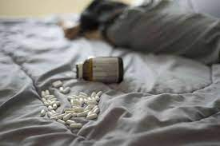
Methods of DSH
Drug overdose
Cutting forearms
Burning/ abrasions
Biting
Head banging
Picking, pulling skin and hair
Hitting
Core Concept

Slide 10
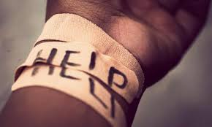
Reasons for DSH
To get help
Physical pain distracts from emotional pain
Physical pain is easier to deal with than emotional pain
Make internal wounds external (visible)
Coping strategy
Core Concept

Slide 11
Suicide
Pakistan does not compile national suicide statistics, but the World Health Organization (WHO) estimates the suicide rate in Pakistan to be 8.9 deaths per 100,000 people, slightly below the global average of nine.
According to police records, there were 113 suicides in 2020 in Tharparkar district where Mithi is located.
The Mystifying Rise of Suicide in Pakistan’s Thar Desert, Al-Jazeera 2022
Core Concept

Slide 12
Every 40 seconds, a person dies by suicide somewhere in the world and many more attempt suicide, according to WHO.
Preventing suicide: A global imperative, World health Organization, 2014
Core Concept

Slide 13
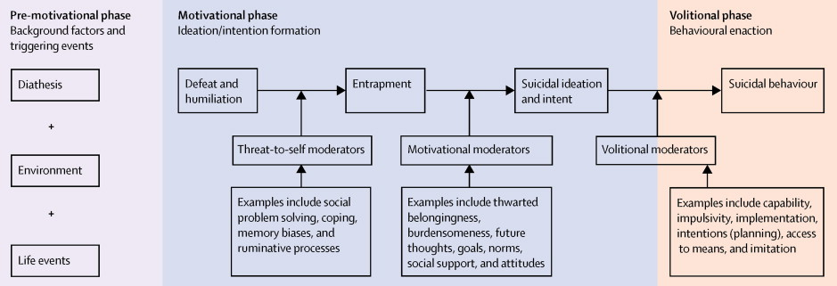
Suicidal Behavior
The Psychology of suicidal behavior, Lancet
Horizontal Integration

Slide 14
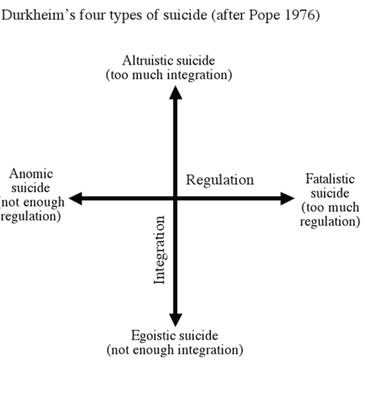
Types of Suicide
Horizontal Integration

Slide 15
Scenario
A 20 year old girl, presented with low mood, weeping spells and disturbed biological functions. She had cut her wrist with intent to end her life. She to that she often told her mother about her thoughts and that she wanted to end her life but she was told that it was all in her head and she is not obeying her religion that is why she has these thought. Patient reported that she was not happy that she was saved and would again attempt to end her life
What would be your management plan?
Vertical integration

Slide 16

Factors Suggesting High Suicidal Intent
Act carried out in isolation
Act timed so intervention is unlikely
Precautions taken to avoid discovery
Precautions made in anticipation of death (will)
Preparations made for act ( purchasing means of suicide/ saving tablets)
Extensive premeditation
Leaving a note
Not alerting potential helpers after act
Communicating intent to others beforehand
Core Concept

Slide 17
ASSESSMENT
Assess if the person has attempted a medically serious act of self-harm
Assess for imminent risk of self-harm/suicide
Assess for any of the psychiatric illness
Assess for chronic pain
Assess for severity of emotional symptoms
Core Concept

Slide 18
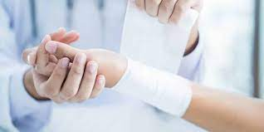
Medically Serious Act Of Self-harm
Signs of poisoning or intoxication
Bleeding from self-inflicted wound
Loss of consciousness
Extreme lethargy
MANAGE ACCORDINGLY
Core Concept

Slide 19
Imminent Risk Of Self-harm/Suicide
Assess for
Current thoughts or plan of self-harm/suicide
History of thoughts or plan of self-harm in the past month or act of self-harm in the past year in a person who is now extremely agitated, violent, distressed or lacks communication
Core Concept

Slide 20
Assess for any of the Psychiatric illness
Depression
Bipolar affective disorder
Disorders due to substance use
Child & adolescent mental and behavioral disorders
Psychoses
Personality disorder
Epilepsy
Manage the concurrent conditions
Core Concept

Slide 21
Care For The Person With Self-harm
Place the person in a secure and supportive environment at a health facility ( do not leave them alone)
ensure safety at all times.
Remove access to means of self-harm.
Mobilize family, friends and available community resources to monitor and support the person during the imminent risk period
Core Concept

Slide 22
Psychosocial Assessment
if possible, the psychosocial assessment should include a one-to-one interview between the person and the health worker, to explore private issues.
Provide emotional support to carers if they need it
Ensure continuity of care.
monitor the person closely to prevent further self-harm in the hospital
Core Concept

Slide 23

Pharmacological Treatment
If prescribing medication:
Use medicines that are the least hazardous, in case of intentional overdose.
Give prescriptions as short courses (e.g. one week at a time).
Core Concept

Slide 24

Psychosocial Interventions
Offer And Activate Psychosocial Support
Offer support to the person
Explore reasons and ways to stay alive.
Focus on the person’s strengths by encouraging them to talk of how earlier problems have been resolved.
Core Concept

Slide 25
Consider problem-solving therapy to help people with acts of self-harm within the last year
Activate psychosocial support
Mobilize family, friends and other available resources to ensure close monitoring of the person as long as the risk of self-harm persists.
Advise the person and carers to restrict access to means of self-harm/suicide (e.g. pesticides/toxic substances, prescription medications, firearms, etc.)
Core Concept

Slide 26
2. Carers Support
Inform carers and family members that asking about suicide will often help the person feel relieved, less anxious, and better understood.
Provide emotional support to them if they need it.
Inform carers that even though they may feel frustrated with the person, they should avoid hostility and severe criticism
Core Concept

Slide 27
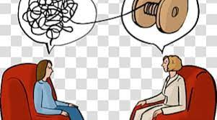
3. Psycho-education
If one has thoughts of self-harm/suicide, seek help immediately from a trusted family member, friend or health care provider.
It is okay to talk about suicide. Talking about suicide does not provoke the act of suicide.
Self-harm/suicide is an indicator of severe emotional distress. The person does not see an alternative or a solution. Therefore, it is important to get the person immediate support for emotional problems and stressors
Core Concept

Slide 28
Suicide and deliberate self-harm in Pakistan: a scoping review
Sualeha S. Shekhani, Shagufta Perveen, BMC Psychiatry (2018)
Suicide is a major global public health problem with more than 800,000 incidents worldwide annually. Seventy-five percent of the global suicides occur in low and middle-income countries (LMICs). Pakistan is a LMIC where information on suicidal behavior is limited
Gender differences and age were predominantly reported, with more males committing suicide. Suicidal behavior was more common among individuals younger than 30 years of age.
The three most common methods for suicides were hanging, poisoning and use of firearm
Longitudinal Integration

Slide 29
Justice
Justice involves treating individuals fairly and equitably, ensuring that everyone receives what is due to them.
It requires impartiality, equality, and fairness in the distribution of benefits, resources, opportunities, and burdens.
Justice also entails addressing systemic inequalities and advocating for the rights of marginalized or disadvantaged groups.
Longitudinal Integration

Slide 30
MCQ
1. A 22-year-old female presents to the emergency department after cutting her wrists with a kitchen knife. She reports feeling overwhelmed by stress from work and personal relationships. She denies any previous suicide attempts but admits to having recurrent thoughts of self-harm. She describes feeling hopeless and unable to cope with her emotions. On examination, she has superficial lacerations on her wrists. She appears tearful and expresses feelings of worthlessness. What is the most appropriate next step in management?
A) Admit her to the psychiatric unit for further evaluation and monitoring.
B) ) Discharge her home with a referral to outpatient therapy.
C) Prescribe antidepressant medication and arrange a follow-up appointment.
D) Provide her with a safety plan and refer her to a community mental health team.
Answer: A

Slide 31
MCQ
2. A 17-year-old male presents to the emergency department with superficial cuts on his arms. He reports feeling overwhelmed by academic pressure and relationship issues. He denies suicidal intent but admits to using self-harm as a coping mechanism. On examination, he appears anxious and distressed. What is the initial step in managing this patient?
A) Immediate psychiatric hospitalization.
B) Prescribing antidepressant medication.
C) Referring to outpatient therapy.
D) Conducting a comprehensive suicide risk assessment.
Answer: D

Slide 32
MCQ
3.Which of the following risk factors is most strongly associated with increased suicide risk?
A) Being in a long-term relationship.
B) Having a strong social support network.
C) A history of previous suicide attempts.
D) Regular exercise routine.
Answer: C

Slide 33
References
Handbook of Behavioral sciences by Mowadat H.Rana, Third edition

Slide 34
Thank You
ioprmu@gmail.com

