Slide 1


Slide 2
Motto Vision; The Dream/Tomorrow
To impart evidence-based research oriented medical education
To provide best possible patient care
To inculcate the values of mutual respect and ethical practice of medicine
Wisdom
Truth
Service

Slide 3
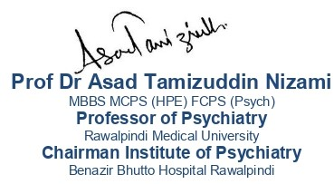
Psychosocial Assessment

Slide 4
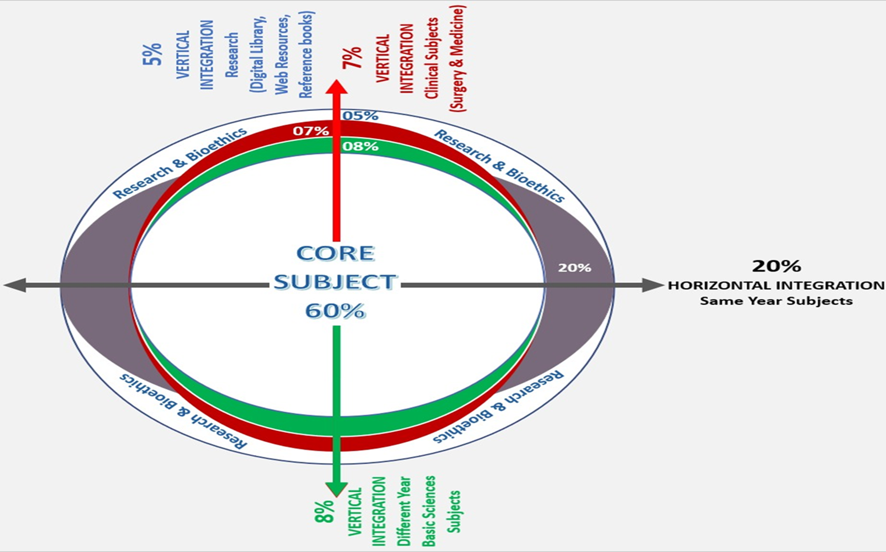
Prof Umar’s model of clinically oriented integrated Lecture Third year MBBS
Core subject | 84%
Vertical Integration (Basic sciences subjects of different years(Forensic Medicine, Pharmacology, Community medicine | 6%
Vertical Integration Clinical Subjects (Medicine, Surgery, Gynae/Obs etc) | 6%
Longitudinal/ ongoing integration ( Bioethics, Research, Artificial Intelligence, Family Medicine | 12%

Slide 5

PSYCHOSOCIAL ASSESSMENT
A psychosocial assessment is an evaluation of an individual's mental health and social well-being
It is the practical application of BioPsychoSocial Model of Healthcare

Slide 6

Case Scenario
Asma is a 30 years old lady, single ,graduate and is currently working as a receptionist in a hotel. She has to support her 4 younger sisters and one brother as her parents passed away in a road traffic accident 10 years back. Lately she came to know that her brother has started abusing drugs and he has been caught by the police. Asma is very caring and sensitive, this event has led to total break-down. She has stopped going to work and has attempted suicide multiple times .Her younger sisters were worried and they took her to a doctor where it was discovered that she has hepatitis B. Due to multiple problems she indulged into drugs and now is abusing Heroin I/V.

Slide 7
Case Scenario
Asma is a 30 years old lady, single ,graduate and is currently working as a receptionist in a hotel. She has to support her 4 younger sisters and one brother as her parents passed away in a road traffic accident 10 years back. Lately she came to know that her brother has started abusing drugs and he has been caught by the police. Asma is very caring and sensitive, this event has led to total break-down. She has stopped going to work and has attempted suicide multiple times .Her younger sisters were worried and they took her to a doctor where it was discovered that she has hepatitis B. Due to multiple problems she indulged into drugs and now is abusing Heroin I/V.

Slide 8
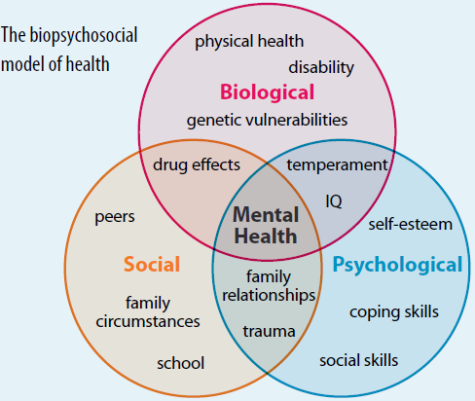

The Medical Support keeps me alive but
it is the psychological and social support that enables me to live

Slide 9
STEPS INVOLVED IN ASSESSMENT
History
Demographics and Presenting Complaints
An introduction is necessary to establish the focus of your case and provide orientation to your reader.
Reason for referral and mode of admission
Referral source
Source of information
Presenting complaints
In patient’s and attendants own words (verbatim)
Duration of each complaint

Slide 10
History of Presenting Illness
This should be a detailed account of the patient's central problem that you have already identified in your opening statement. Put details about the problem and related symptoms in a chronological order.
From the earliest time at which change was noted until admission
precipitating event
Onset: sudden or insidious
Course of illness: continuous or episodic
Behavioral changes
Mood
Biological functions
Functioning

Slide 11
Treatment History: Part of history of present illness
Past Psychiatric History
Details of all psychiatric conditions for which treatment has been received or not received
Dates and duration of illness
Hospital admissions
Nature of treatment
Medical and Surgical History

Slide 12
Family History
Include details of:
Parents
  age or age at death and patient’s age at that time, cause of death and patient’s reaction to death
  Education and occupation
  Relationship with them during childhood
  Periods of separation
Siblings
  Chronological order of birth
  Marital status
  Education
Nature of the relationships between family members
Any family tensions and stresses and family models of coping
Family history of psychiatric illness (incl. drug/alcohol abuse, suicide attempts)

Slide 13
Personal history
This portion covers certain areas; include:
Birth, Early development, Childhood, School, Adolescence
Education
Occupation
Psychosexual history
Marital history
Drug history
Forensic history
Socioeconomic history

Slide 14
Premorbid personality
Description of personality before the illness
Predominant mood
  stable, mood swings
  Optimistic or pessimistic
  Anxious, irritable, worrying, tense, lively, apathetic
  Ability to express and control feelings of anger, sadness, disappointment
Attitude to self
  Egocentric, selfish, vain, indulgent, self dramatizing
  Critical, self conscious
  Attitude to own health, over concerned, neglectful
  Realistic or Unrealistic self appraisal
  Attitude to past achievements and failures

Slide 15
Attitude to others/ interpersonal relationships
  Ability to trust, make and maintain relationships
  Anxious, secure, friendly, warm, reserved, cold, indifferent, dominant, submissive, sensitive, dependant, quarrelsome
Reaction pattern to stress
  Ability to tolerate frustration, losses, disappointment and circumstances arousing anger, anxiety or depression
  Evidence of excessive use of particular defense mechanism such as denial, rationalization etc

Slide 16
Moral and religious attitudes and standards
  Rigid, uncompromising, perfectionist, conforming, rebellious
  Religious beliefs
Fantasy life
  Day dreams, nightmares
Leisure activities
  Books, plays, pictures, music
  Sports and other leisure activities
  Spends leisure time alone, with one or two friends or many friends

Slide 17
Diagnosis (ICD 10 )
Axis 1 :Main diagnosis
Axis 2 : Functionality
Axis 3 : Contextual factors
    Predisposing
    Precipitating
    Perpetuating

Slide 18
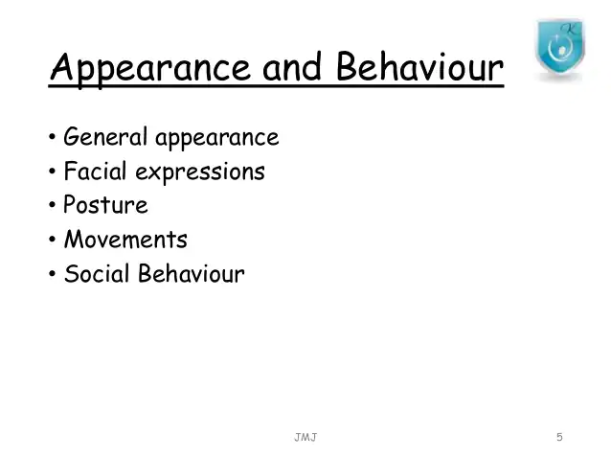
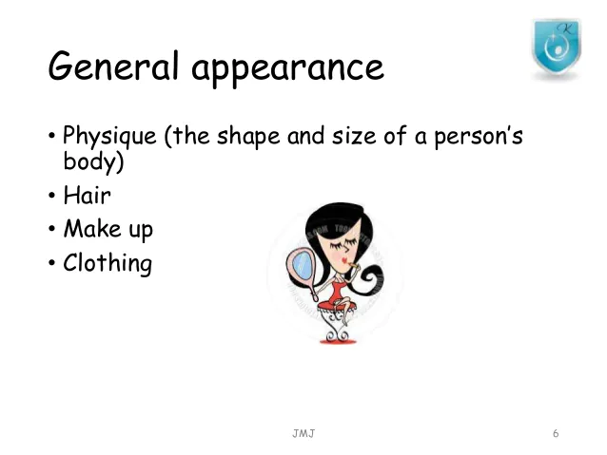
Mental State Examination

Slide 19
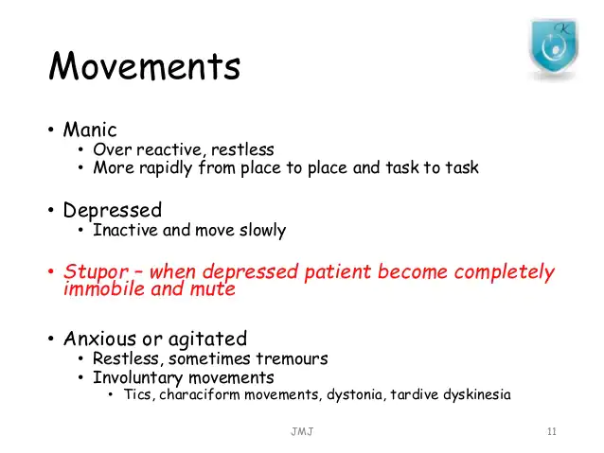
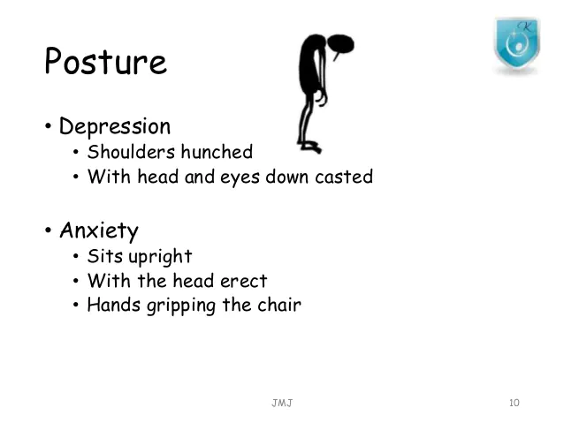
Mental State Examination

Slide 20
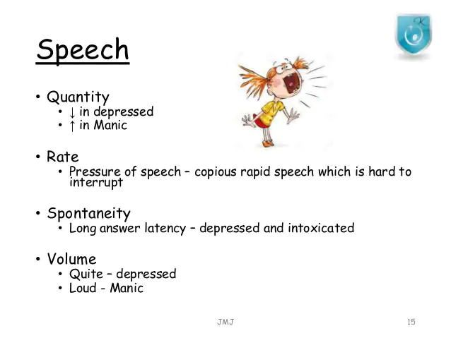
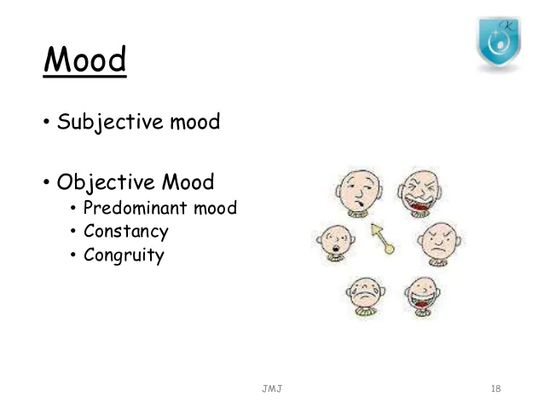
Mental State Examination

Slide 21
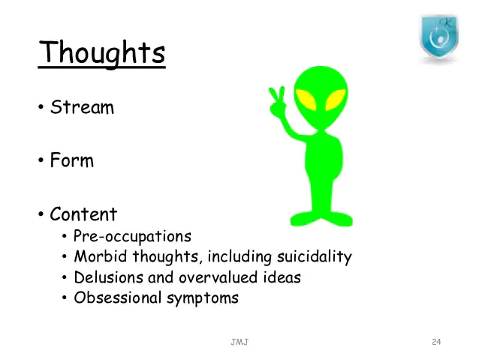

Slide 22
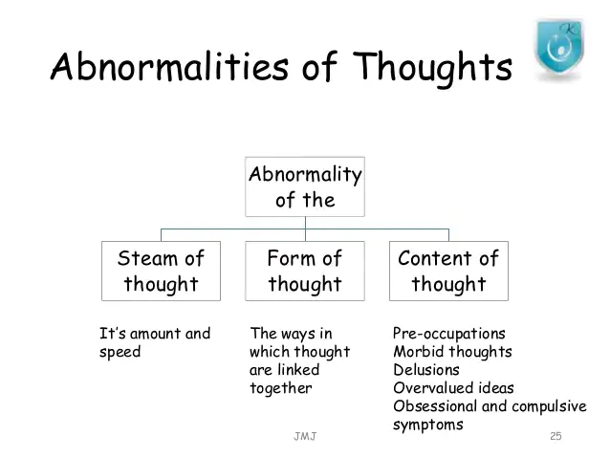

Slide 23
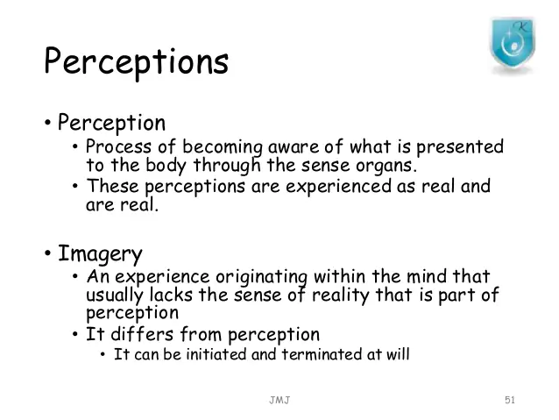
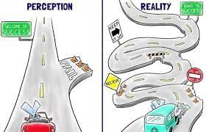
Mental State Examination

Slide 24
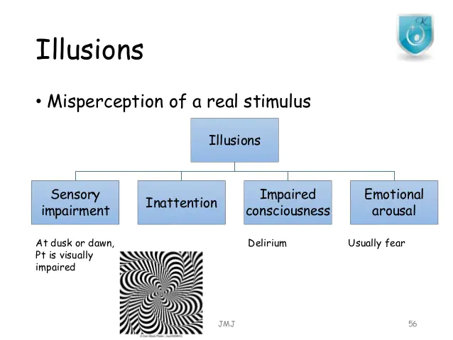

Slide 25
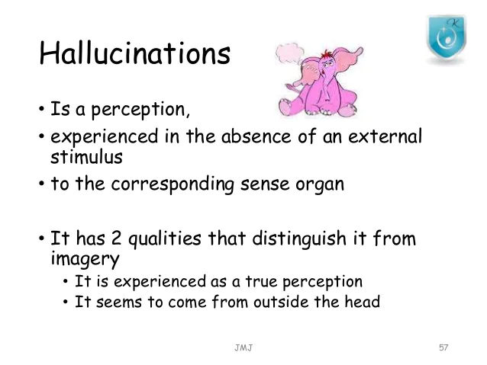
Mental State Examination

Slide 26
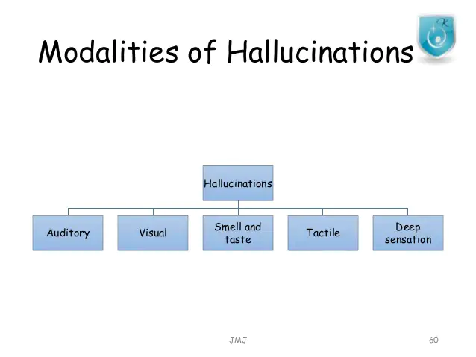
Mental State Examination

Slide 27
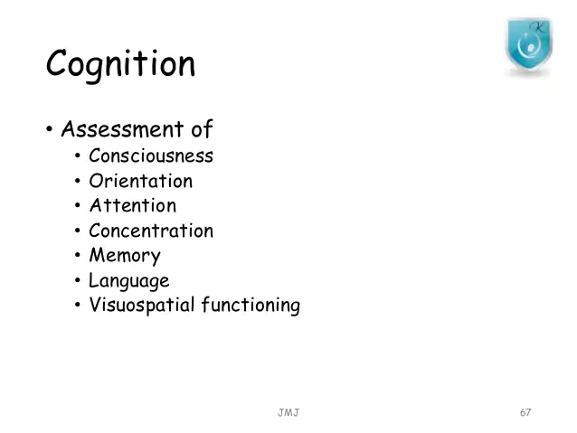
Mental State Examination

Slide 28
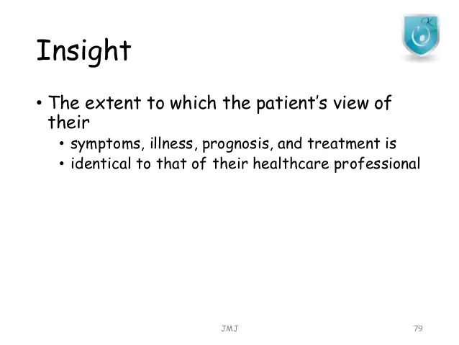
Mental State Examination

Slide 29
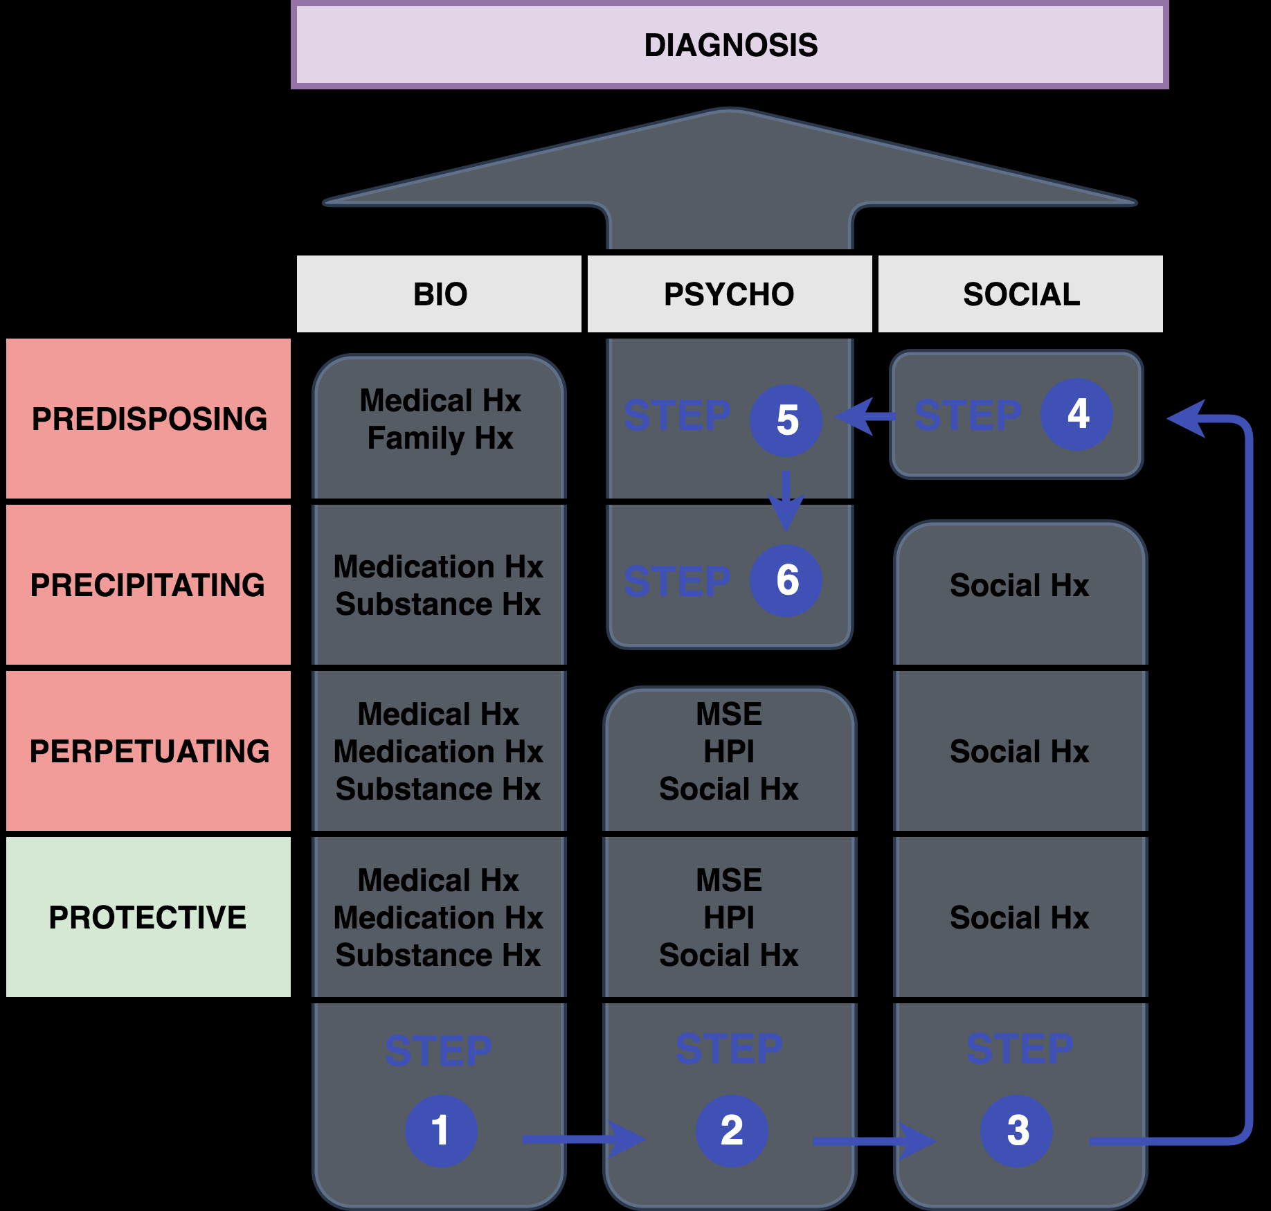

Slide 30
Spiral integration
Cost-effectiveness of psychosocial assessment for individuals who present to hospital following self-harm in England: A model-based retrospective analysis
David McDaid, A-La Park, Apostolos Tsiachristas, Fiona Brand, Deborah Casey Caroline Clements, Galit Geulayov, Nav Kapur, Jennifer Ness, Keith Waters 8, Keith Hawton
European Psychiatry, 2022
This article examines the cost-effectiveness of psychosocial assessments for individuals presenting to hospitals in England following self-harm.
Using a Markov model, it compares outcomes with and without psychosocial assessments over two years, finding the intervention cost-effective, with incremental cost per Quality Adjusted Life Year (QALY) gained falling within acceptable thresholds.
The study highlights the potential for reduced repeat self-harm and enhanced adherence to clinical guidelines, while emphasizing the need for further evidence on long-term impacts on individuals and their families.
https://pmc.ncbi.nlm.nih.gov/articles/PMC3915791/
Longitudnal Integration

Slide 31
Question 1
A 50-year-old woman presents with a complaint of excessive worry, restlessness, and difficulty concentrating. She reports that these symptoms have worsened over the past few months and are affecting her work and family life. She also mentions experiencing significant stress due to caregiving responsibilities for her elderly mother. What should be the next step in the psychosocial assessment?
a) Explore her caregiving role in more detail and the associated stress.
b) Focus only on her anxiety symptoms and assess for an anxiety disorder.
c) Recommend medication to treat her anxiety symptoms immediately.
d) Skip the family dynamics and focus solely on her work-related stress.
Answer: a

Slide 32
Question 2
A 22-years-old male student presents with complaints of feeling low , lack of interest in activities, and difficulty sleeping. He reports a recent breakup with a long-term girlfriend and feeling overwhelmed by the pressure of academic performance. What should be the primary focus during the psychosocial assessment?
a) Assess his recent breakup and explore how it is impacting his emotional well-being.
b) Focus on his academic performance and its impact on his mental health.
c) Recommend medication to improve his sleep without further exploration.
d) Ignore the relationship stress and focus solely on his sleep issues.
Answer: a

Slide 33
Question 3
A 27-year-old male patient presents with complaints of irritability, lack of motivation, and difficulty getting along with colleagues. He reports that his symptoms have been ongoing for several months, and he feels increasingly withdrawn. His medical history includes a recent job change and a history of childhood trauma. Which of the following should be the primary focus during the psychosocial assessment?
a) Assess for any potential personality disorders without considering his trauma history.
b) Focus entirely on his current job-related issues without considering past trauma.
c) Recommend medication for irritability without exploring any further psychological factors.
d) Explore the impact of childhood trauma and its potential influence on his current emotional state.
Answer: d

Slide 34


