Slide 1


Slide 2

Informational Care

Slide 3
Motto Vision; The Dream/Tomorrow
Wisdom
Truth
Service
To impart evidence based research oriented medical education
To provide best possible patient care
To inculcate the values of mutual respect and ethical practice of medicine

Slide 4
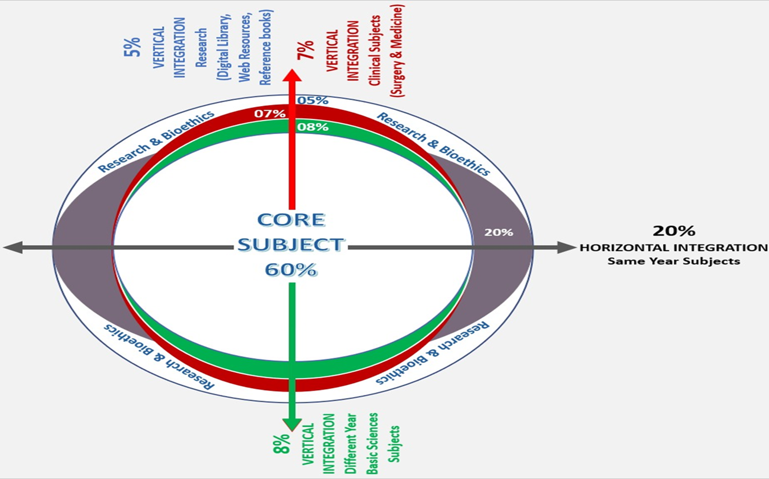
Prof Umar’s model of clinically oriented integrated Lecture Third year MBBS
Core subject | 72%
Horizontal integration ( Same year subjects) Anatomy, Biochemistry, Physiology | 11%
Vertical Integration (Basic sciences subjects of different years(Forensic Medicine, Pharmacology, Community medicine | 3%
Vertical Integration Clinical Subjects (Medicine, Surgery, Gynae/Obs etc) | 3%
Longitudinal/ ongoing integration ( Bioethics, Research, Artificial Intelligence, Family Medicine | 11%

Slide 5
Learning objectives
At the end of the session students should be able to
Define the informational care and its significance in healthcare delivery
Give a comprehensive explanation of seven steps of informational care regarding the three “Ds”
Provide informational care in clinical settings on the clinical issues

Slide 6
What is Informational care?
The process of providing individuals with relevant, evidence-based, and comprehensible information to enhance their understanding of health-related issues, encourage informed decision-making.
It promotes behaviors that improve physical and mental well-being.
It focuses on addressing cognitive and educational needs to empower individuals to take control of their health
Source: World Health Organization
Core Concept

Slide 7
What is Informational care in Health Settings?
It is the provision of information to patients using principles of communication regarding 3 D’s
The DISEASE
The DRUGS
The DOCTORS
Core Concept

Slide 8
Objectives of Informational Care
Fills the gap in patient’s knowledge and understanding.
Uses language that patient can understand
Must be tailored to the needs of the patient, stage of illness.
Meant to relieve the uncertainty and distress of the patient.
Questions that bother the patient the most must be addressed
Core Concept

Slide 9
Importance of informational care
Empowers patient to make informed decisions about their health
Build patients trust in healthcare workers
Enhances adherence to the treatment plan
Core Concept

Slide 10
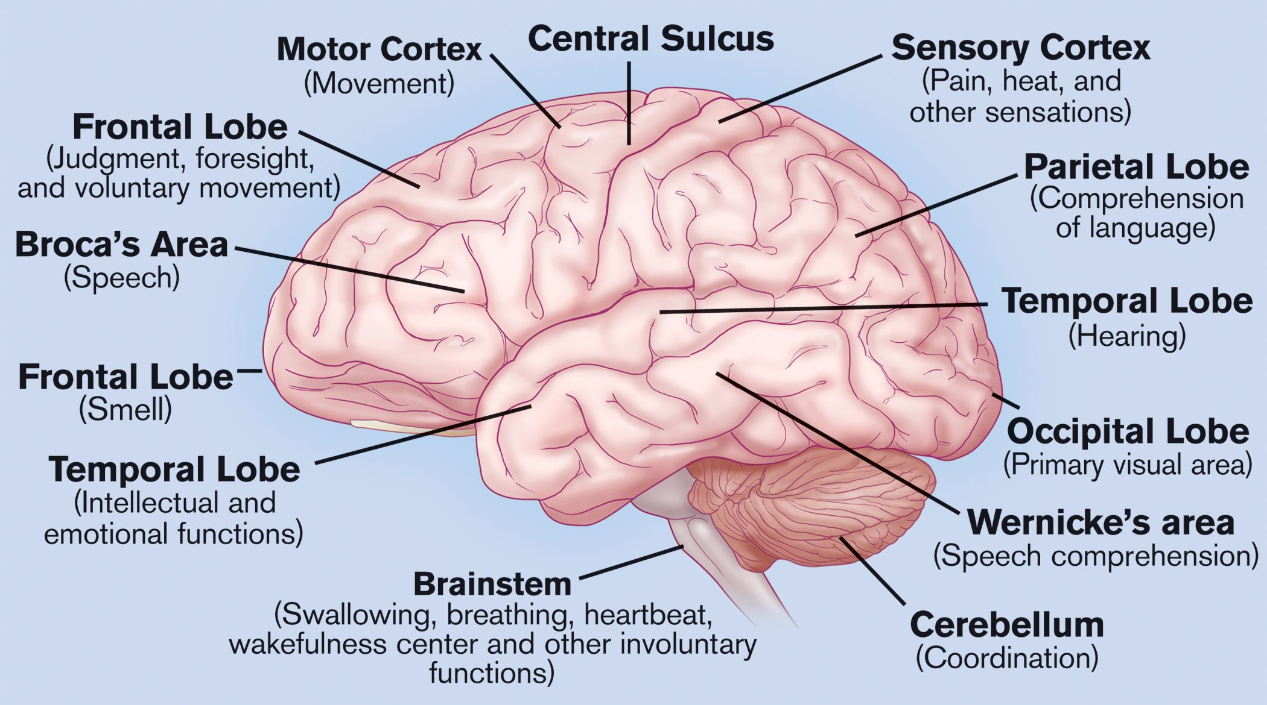
Parts of Brain involved
Horizontal Integration

Slide 11
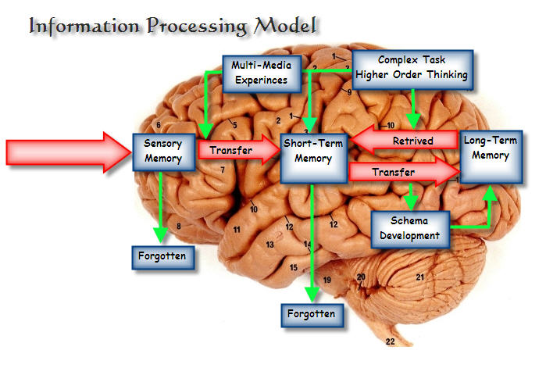
Information on information processing: An in depth look at cognition and information processing theory, by Jared Griffin, Wordpress.com 2011
Horizontal Integration

Slide 12
Scenario
A 35-year-old gentle man who has history of intravenous abuse for the past 5 years has been diagnosed as a case of HIV AIDS on detailed investigations and examination. He is also accompanied by his wife who is quite worried about her husband’s illness
How will you provide informational care?
Vertical integration

Slide 13
Seven Essentials of Informational Care
1. Must set aside time to give reasonable information to patient and family
2.Language should be understandable by the patient
Core Concept

Slide 14
3. IC must start with patients knowledge, understanding and expectations.
The doctor must clarify the myths and replace with evidence based information
Ap apni beemari ke baare me kya jante hain?
Core Concept

Slide 15
4. The task of giving information should be evidence based and without fear of causing negative reaction in patients
It should be done with compassion. Empathy and sensitivity
Vague statements building false hope SHOULD BE AVOIDED
Core Concept

Slide 16
5. Both aspects of the disease and treatment must be communicated
Information overload should be AVOIDED
Positive
Negative
Core Concept

Slide 17
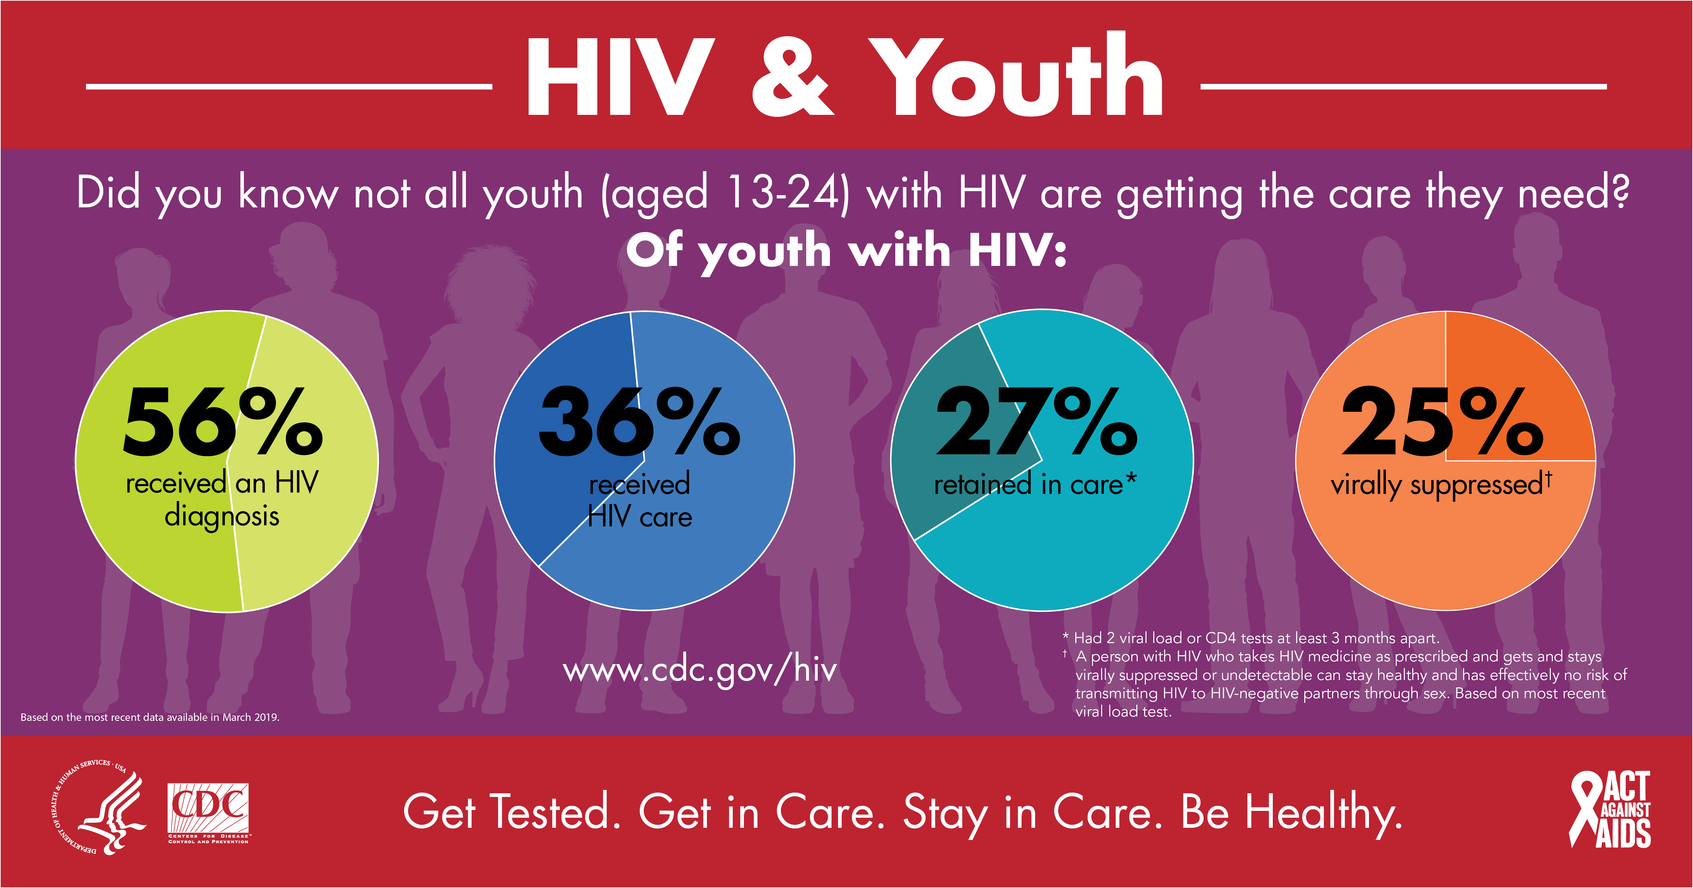
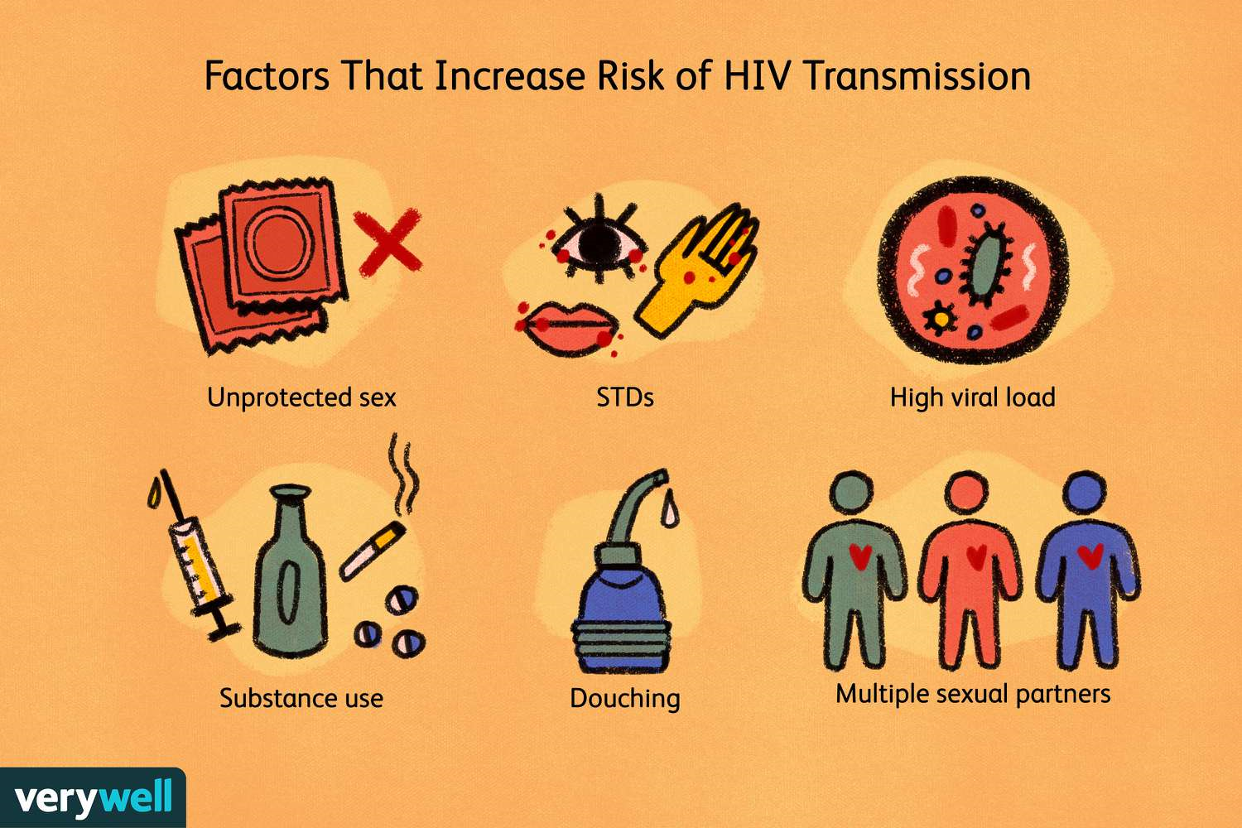
6. Use of simple figures, diagrams and sketches are often helpful to enhance patients understanding.
Most patients like to keep it at end of session.
Core Concept

Slide 18
7. The IC session ends with the patient summarizing his new understanding of the 3 Ds.
It helps to evaluate how much information has been retained
The doctor reassures any future concerns will be addressed
Core Concept

Slide 19
SEVEN QUESTIONS
A patient, needs answered in IC session
Core Concept

Slide 20
1 | What is wrong with me? | DIAGNOSIS
2 | Why have I developed this disease? | AETIOLOGY
3 | Is there any effective treatment to my problem? It it safe? Are there any dangerous side effects? | MANAGEMENT
4 | How long will I take to recover? | PROGNOSIS
5 | Is there a “Perhaz” ? | RESTRICTION
6 | Is there a risk of illness being spread to people AROUND me or passing it to offspring? | TRANSMISSION
7 | How will the illness and treatment influence my functioning? | FUNCTIONALITY
Core Concept

Slide 21
Effect of informational support on anxiety in family of care givers of patients with hemiplegic stroke : a quasi experimental study
Brain stroke causes physical and mental disabilities as well as dependence on family.
In such cases families suffer from anxiety due to unawareness of the associated consequences.
According to this study, informational support is effective in reducing anxiety in family caregivers.
https://pubmed.ncbi.nlm.nih.gov/32807435/by A Azizi · 2020
Longitudinal Integration

Slide 22
Autonomy
Autonomy is a practice that acknowledges patients have the right to exercise control over what happens to them regarding treatment.
Autonomy also requires informed consent, which involves communication between a patient and their healthcare provider that leads to an agreement or authorization for care, treatment, or services.
Longitudinal Integration

Slide 23
MCQs
You are a providing discharge instructions to a patient who has been hospitalized for heart failure. The patient has difficulty understanding the dietary restrictions related to sodium intake. How should you address this situation?
Provide the patient with a written handout about heart-healthy diets.
Repeat the instructions using medical terminology to reinforce understanding.
Use plain language and visual aids to explain the importance of limiting sodium intake.
Advise the patient to ask their primary care physician for clarification after discharge.
Answer: C

Slide 24
2. During a routine check-up, a patient expresses confusion about the prescribed medication and its potential side effects. What is the best response?
Provide the patient with a brief overview of the medication and encourage them to research it further.
Reassure the patient that the medication is safe and advise them to continue taking it as prescribed.
Explain the purpose of the medication, its potential side effects, and alternative treatment options using plain language.
Refer the patient to a pharmacist for detailed information about the medication.
Answer: C

Slide 25
3. What is an essential aspect of informational care during patient education sessions?
Avoid answering patient questions to maintain authority
Provide irrelevant information to confuse the patient.
Rush through the information to save time
Tailor the information to meet the patient's needs and preferences.
Answer: D

Slide 26
4. What is the primary goal of informational care in healthcare services?
A) To maximize profits for healthcare providers.
B) To provide accurate and understandable information to patients.
C) To minimize patient interactions with healthcare providers.
D) To prioritize speed and efficiency over patient understanding.
Answer: B

Slide 27
5. Why is it important for healthcare providers to engage in shared decision-making with patients?
It saves time for healthcare providers.
It empowers patients to make informed choices about their care.
It ensures that healthcare providers have full control over treatment decisions.
It eliminates the need for patient education.
Answer: B

Slide 28
References
Handbook of Behavioral sciences by Mowadat H.Rana, third edition

Slide 29
Thank You
ioprmu@gmail.com

