Slide 1


Slide 2
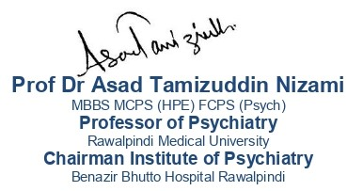
Communication Skills

Slide 3
Vision; The Dream/Tomorrow MOTTO
To impart evidence based research oriented medical education
To provide best possible patient care
To inculcate the values of mutual respect and ethical practice of medicine
Wisdom
Truth
Service

Slide 4
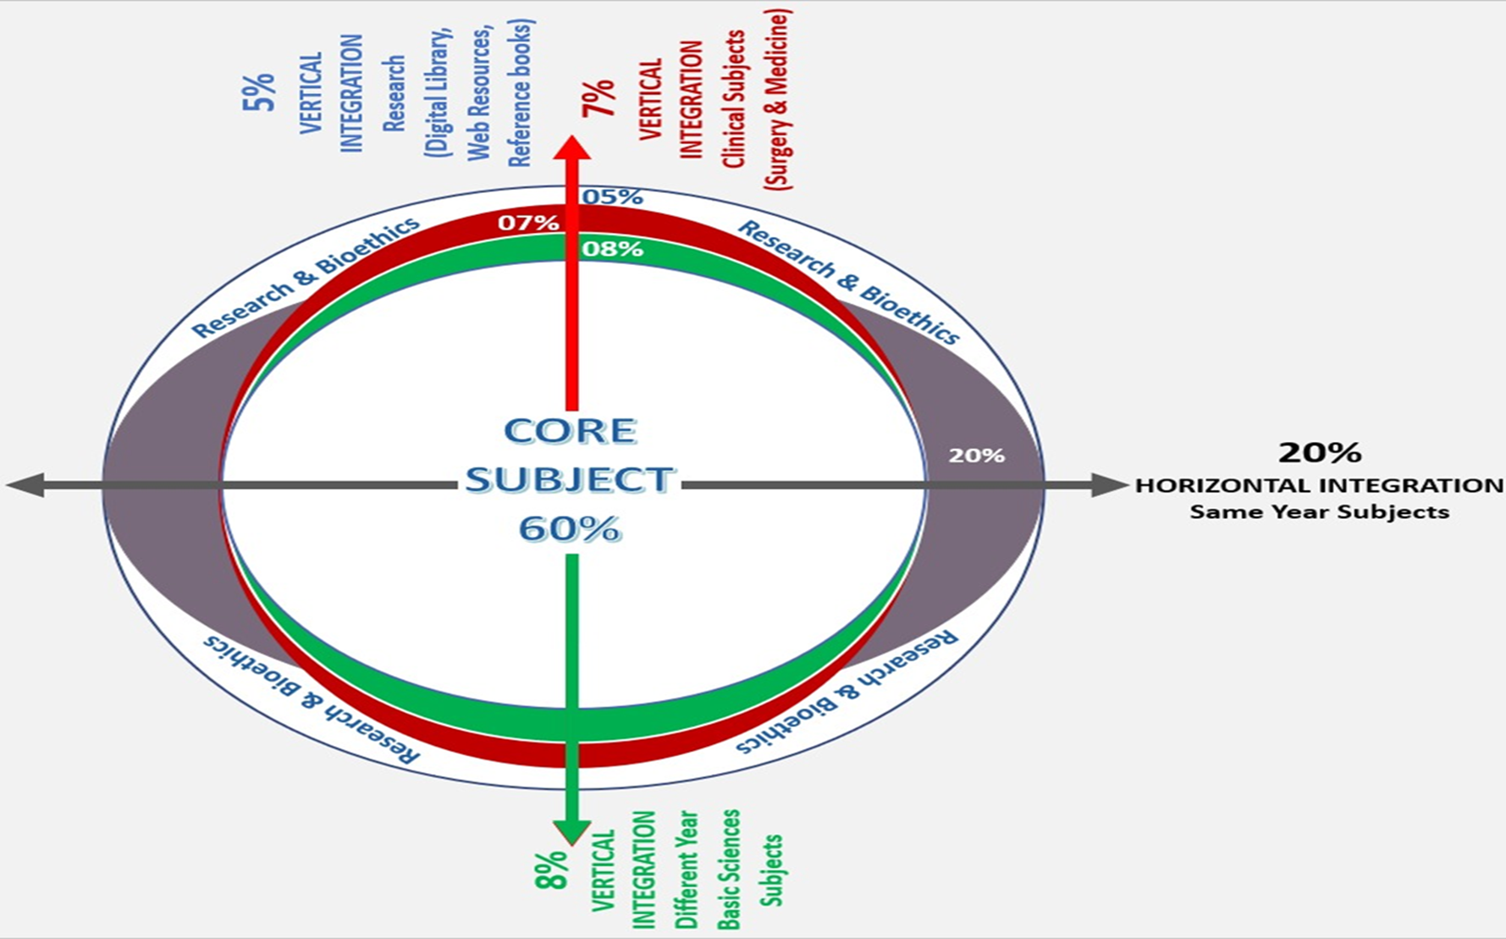
Prof Umar’s model of clinically oriented integrated Lecture Third year MBBS
Core subject | 75%
Horizontal integration ( Same year subjects) Anatomy, Biochemistry, Physiology | 13%
Vertical Integration (Basic sciences subjects of different years(Forensic Medicine, Pharmacology, Community medicine | 2%
Vertical Integration Clinical Subjects (Medicine, Surgery, Gynae/Obs etc) | 2%
Longitudinal/ ongoing integration ( Bioethics, Research, Artificial Intelligence, Family Medicine | 8%

Slide 5

LEARNING OBJECTIVES
At the end of the lecture, students will be able to
Define communication and its importance in medical settings
Describe verbal and non-verbal communication
Explain characteristics and components of effective communication.
Correlate and build core knowledge on the basis of latest research

Slide 6
What is Communication?
Communication is from a Latin word “Communicare” which means “to share”
It is the exchange of meaningful information through speech, visuals, signals, writing and behavior.
Transmission of information between individuals or group of individuals through use of verbal and non- verbal means
Core Concept

Slide 7
Communication Skills
Skills that include initiating and maintaining a conversation, taking verbal turns, understanding assumed or implied knowledge, alerting the receiver to the topic and changes in topic, and incorporating nonverbal communication into the interaction. (MacDonald & Gillette, 1984)
Core Concept

Slide 8
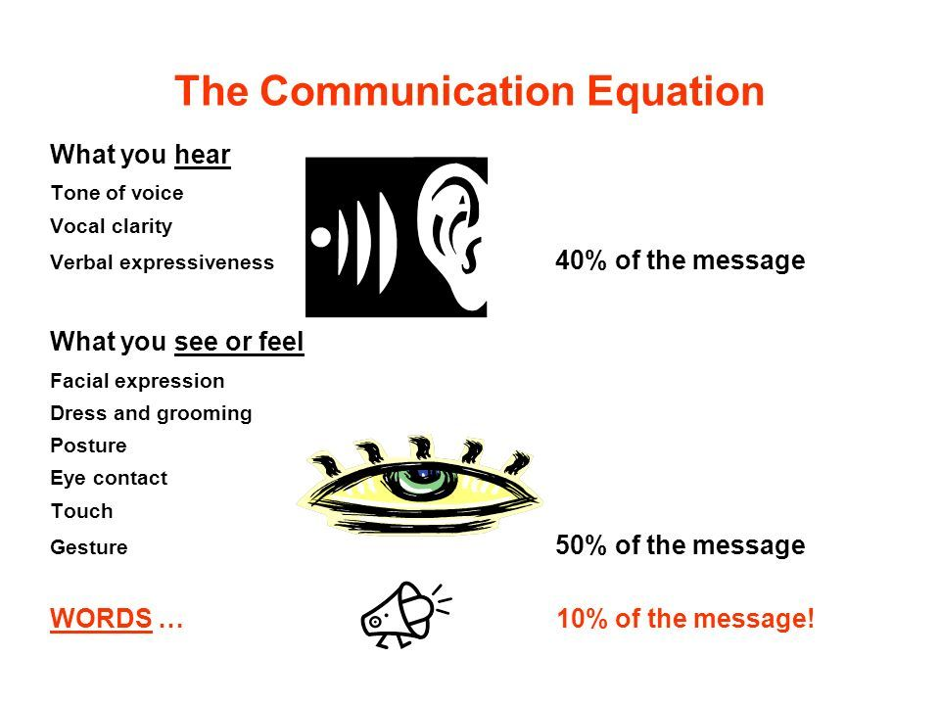
Core Concept

Slide 9
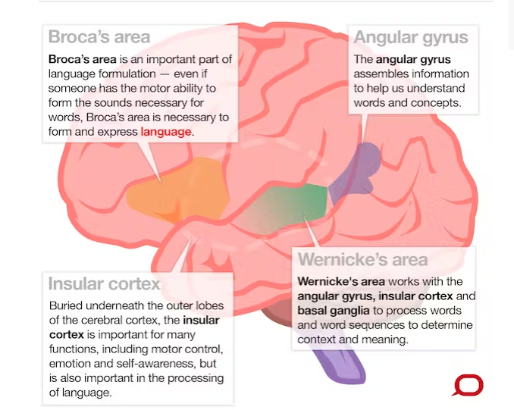
Anatomical Structures Involved In Communication
Horizontal Integration

Slide 10
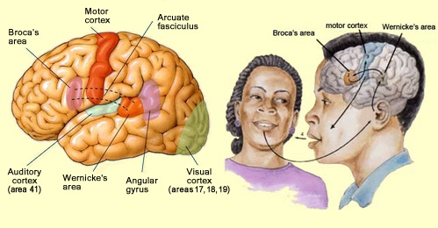
Areas of Brain
Horizontal Integration

Slide 11
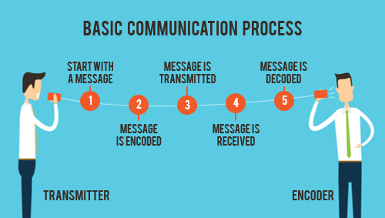
Communication Process
Horizontal Integration

Slide 12
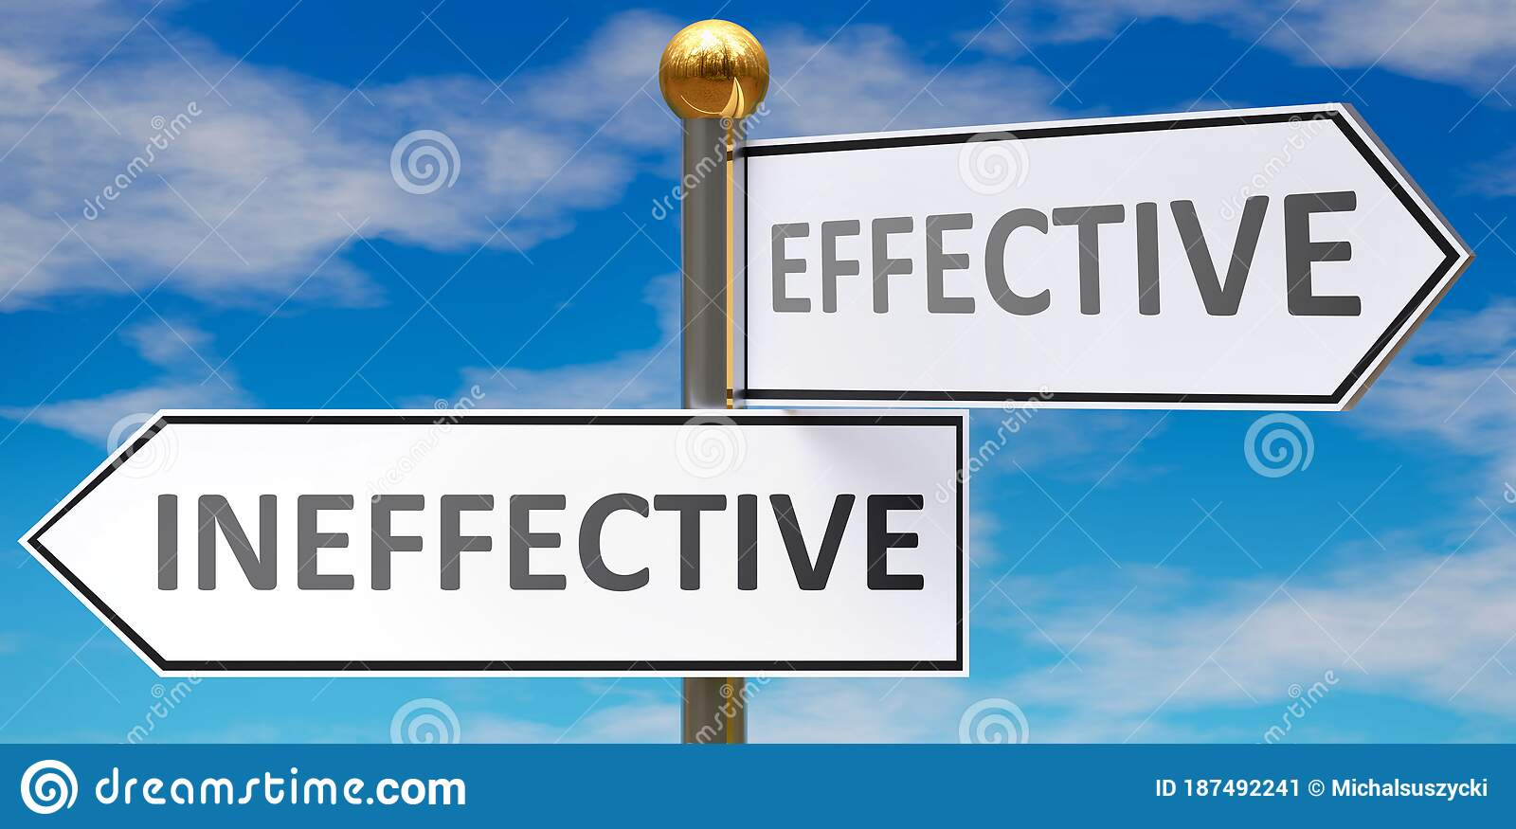
Effective communication is the basis of mutual understanding and trust.
Poor communication causes a lot of misunderstanding ethical and medicolegal problems.
Vertical integration

Slide 13
COMPONENTS OF GOOD COMMUNICATION SKILLS
Active listening
Pay attention
Show That You're Listening
Defer Judgment
Respond Appropriately
Open ended questions
Closed ended questions
Funneling
Paraphrasing
Selective Reflection
Empathy building
Check for understanding
Summarize
Core Concept

Slide 14
Characteristics of Effective Communication
Hearing | Listening | Active Listening
Physical process, natural, PASSIVE | Physical as well as a mental process; active learned skill. “We have two ears and one mouth so that we can listen twice as much as we speak | It involves a simultaneous focus on the linguistic and paralinguistic aspects of the speech and nonverbal communication
Core Concept

Slide 15
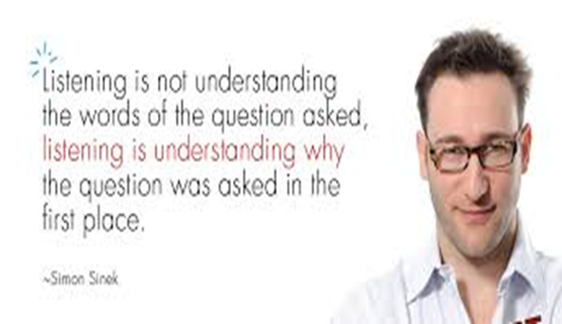
Active Listening
Verbal aspect - Involves the focus on the words of the speech
Paralinguistic aspect - features of the speech as the rate, rhythm, volume and fluency
Non verbal communication – the body language, gestures and the expressions during the conversation
Core Concept

Slide 16
Pay ttention
Show That You're Listening
Give the patient your undivided attention, and acknowledge the message.
Recognize that non-verbal communication also "speaks" loudly.
Look at the patient directly.
"Listen" to the patient’s body language.
Make sure that your posture is open and interested.
Encourage the patient to continue with small verbal comments like yes, and "uh huh."
Core Concept

Slide 17
Defer Judgment
Interrupting is a waste of time. It frustrates the speaker and limits full understanding
Allow the speaker to finish each point before asking questions.
Don't interrupt with counter arguments
Core Concept

Slide 18
Respond Appropriately
Be candid, open and honest in your response.
Assert your opinions respectfully.
Treat the other person in a way that you think you would want to be treated.
Core Concept

Slide 19
Open ended Questions
Encourage patients to talk
Exploration of a certain aspect
Clarifying the unclear areas and issues
Leading Questions – how, what, when, how come, anything else, and…..
Core Concept

Slide 20
Closed ended questions
Asked at the beginning of interview to clarify few things and inquire about demographics of the patient.
Gives time for both doctor and patient to be comfortable
Asked at the end to reach to a conclusion.
Core Concept

Slide 21
Funneling
Broader Area
Broader Area
Broader Area
Specific Area
Use of questions to guide the conversation from a broader area to a more specific area
The technique helps the interviewer to make the communication move from general statements to specific areas of clinical relevance
Core Concept

Slide 22
Paraphrasing
Process of repeating the last few words of the patient and summarizing what the patient has communicated so far, in your own words
Then ask him to validate if you have understood it correctly
Core Concept

Slide 23
Selective Reflection
It refers to bringing out the feelings attached to various symptoms and problems of the patient
e.g. “how do you feel when you start to feel fatigued only walking for a few minutes since you said you were an athlete once?”
“It sounds like….”
“It seems as if……”
“If I hear you correctly…..”
Core Concept

Slide 24
Empathy Building
Statements by the interviewer that make the patient understand that his feelings have been well understood, and that the doctor would have felt the same if he was in patient’s place
e.g.“ I understand how difficult it must be for you to live with your pain for such a long time”
Refrain from expressing sympathy instead
Core Concept

Slide 25
Check For Understanding and Summarize
From time to time during the session the doctor needs to summarize patient’s statements or ask the patient to comment on the summary, to ensure if he has understood the problem and its associated feelings correctly
At the end summarize what you have understood and discuss future plans accordingly.
Core Concept

Slide 26
FACTORS THAT IMPROVE COMMUNICATION
Use of minimal prompts
Sit squarely in relation to the patient
Open body position In relation to the patient
Lean slightly towards the client
Maintaining reasonable eye contact
Relaxed attentive health professional
Listen and respond to feelings
Note all paralinguistic and nonverbal cues
Core Concept

Slide 27
FACTORS THAT OBSTRUCT COMMUNICATION
Lack of exclusivity
Preoccupied or anxious health professionals
Uncomfortable seating
Lack of attention to non-verbal cues during active listening
Offensive remarks or judgement by the health profession
Frequent interruptions
Selective Listening
Day dreaming or dosing off during the conversation
Core Concept

Slide 28
Communication skills training for physicians improves health literacy and medical outcomes among patients with hypertension: a randomized controlled trial.
Seyedeh Belin Tavakoly Sany, Fatemeh Behzhad, Gordon Ferns and Nooshin Peyman
BMC Health Services Research (2020) 20:60
This trial was conducted in Iran on 240 hypertensive patients and 35 physicians. Physicians were given 3 sessions of Focus Group Discussion and 2 workshops.
This study concluded that the physician with high communication skills lead to improvement in their medical care.
Therefore, physician communication skills training appears to be an efficient way to clarify the needs of patients with limited health literacy and improve communication challenges between patients and their physicians.
Longitudinal Integration

Slide 29

The principle of confidentiality is the ethical obligation of physician to preserve the information gathered in association with patient care.
The patient needs to be able to trust the physicians, will protect the information shared in confidence.
It is worth emphasizing that, confidentiality can be breached in few cases, to other healthcare personnels for patient care, patient can harm oneself or others or required by law.
Confidentiality
Longitudinal Integration

Slide 30
Multiple Choice Questions
1. Which non-verbal cue will likely be missed by a doctor if he keeps checking his phone while attending his OPD patients?
  Tone of the patient’s speech
  The patient’s facial expressions
  Pauses in the patient’s speech
  The patient’s choice of words in describing the illness
Answer: B

Slide 31
2. Seeing an emaciated, bed-bound elderly patient silently crying in the medicine ward, a 3rd year medical student is moved. Which of the following is the best choice of words to make this patient feel better?
  “Pity you! You are in such a poor state!”
  “You should not cry, your illness will get even worse if you do.”
  “I understand that living with this illness must be very hard for you.”
  “I am so sorry for you, uncle… looking so weak, and bed-bound on top of that.”
Answer: C

Slide 32
3. “The patient allotted to me is so over talkative,” complained a 3rd year MBBS student to his teacher. “She keeps giving useless details and does not come to the point.”
Which technique should the teacher teach him to help him in taking history from such patients?
Funneling
Asking open-ended questions
Paraphrasing
Selective reflection
Answer: C

Slide 33
References
Handbook of Behavioral sciences by Mowadat H.Rana, Third edition
Seyedeh Belin Tavakoly Sany, Fatemeh Behzhad, Gordon Ferns and Nooshin Peyman., Communication skills training for physicians improves health literacy and medical outcomes among patients with hypertension: a randomized controlled trial. BMC Health Services Research (2020) 20:60

Slide 34
Thank You
ioprmu@gmail.com

