Slide 2
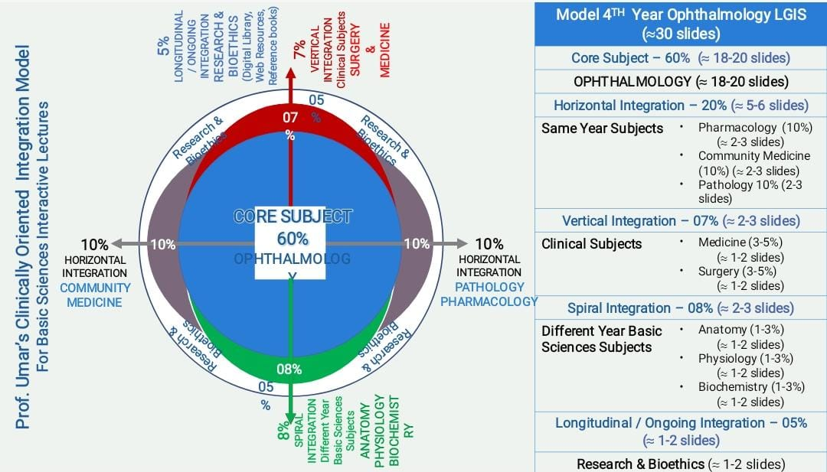
SEQUENCE OF LECTURE
VERTICAL INTEGRATION
HORIZONTAL INTEGRATION
CORE SUBJECT
EOLA (END OF LECTURE ASSESSMENT)
DIGITAL LIBRARY REFERENCES (RESEARCH, BIOETHICS, ARTIFICIAL INTELLIGENCE.)

Slide 3
LEARNING OBJECTIVES
AT THE END OF THIS SESSION, STUDENTS SHOULD BE ABLE TO
RECALL ANATOMY OF ORBIT.
ENLIST CAUSES OF PROPTOSIS
DESCRIBE CLINICAL FEATURES OF THYROID EYE DISEASE
DISCUSS MANAGEMENT OF THYROID EYE DISEASE
ENUMERATE DIFFERENT TYPES OF ORBITAL TUMORS.

Slide 4
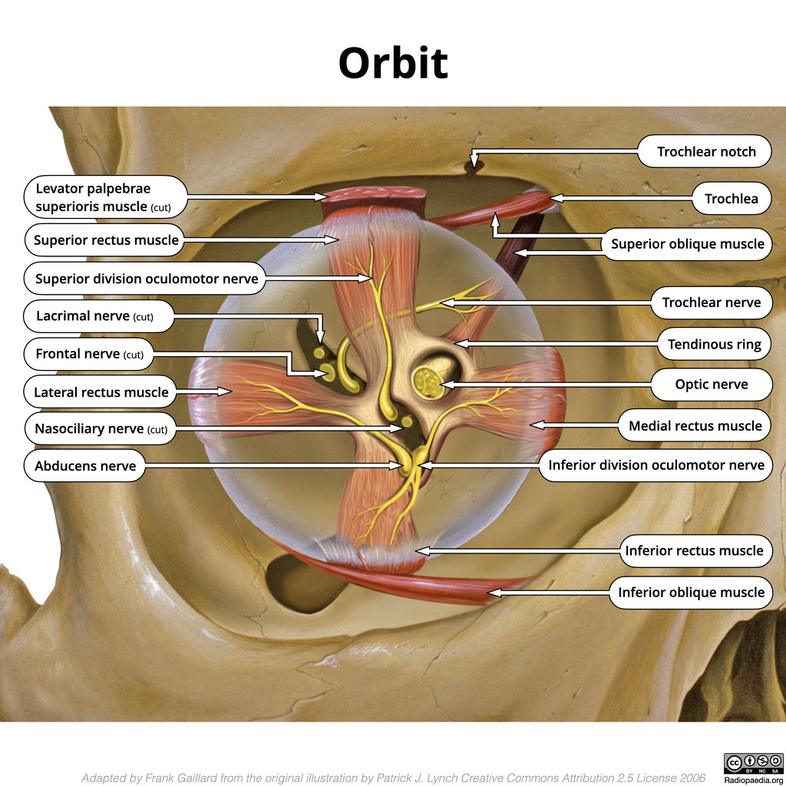
Anatomy of orbit
Vertical integration

Slide 5
Vertical integration

Slide 6
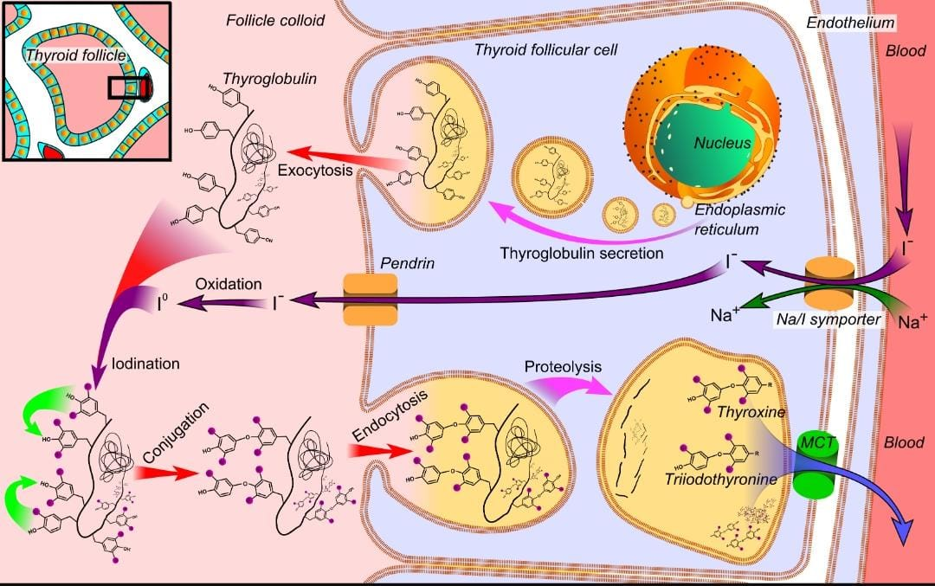

Slide 7
Vertical integration

Slide 8
Thyroid eye disease
HORIZONTAL INTEGRATION
Idiopathic
autoimmune inflammatory disorder
most common cause of unilateral and bilateral proptosis in adults.

Slide 9
Thyroid status
HORIZONTAL INTEGRATION
Hyperthroidism-- 90%
Hypothyroidism– 4%
Euthyroidism– 6%
TSH receptor antibodies—85-90%

Slide 10
Risk factors
HORIZONTAL INTEGRATION
Smoking
Female gender

Slide 12
HORIZONTAL INTEGRATION
PATHOGENESIS

Slide 13
Occular symptoms

Slide 14
Ocular signs
Core Subject

Slide 15
1. eyelid signs
Core Subject

Slide 16
Core Subject

Slide 17
2. Soft tissue signs
Core Subject
Periorbital swelling
Conjunctival hyperemia & chemosis
Keratoconjunctivitis sicca

Slide 18
3. pROPTOSIS
Core Subject
Most common presentation
Axial, bilateral/unilateral
Gradual/ sudden

Slide 19
Proptosis (abnormal protrusion of eye)
Core Subject

Slide 20
4. Restrictive myopathy
Core Subject
30-50% cases
Permanent
Initially edema then fibrosis
Inferior rectus is most commonly involved muscle
Remember ”IMSLO”

Slide 21
5. Optic neuropathy
Core Subject
5% cases
Compressive
Early stage manifest as Papilledema
optic atrophy in late stages

Slide 22
Investigations
Core Subject

Slide 23
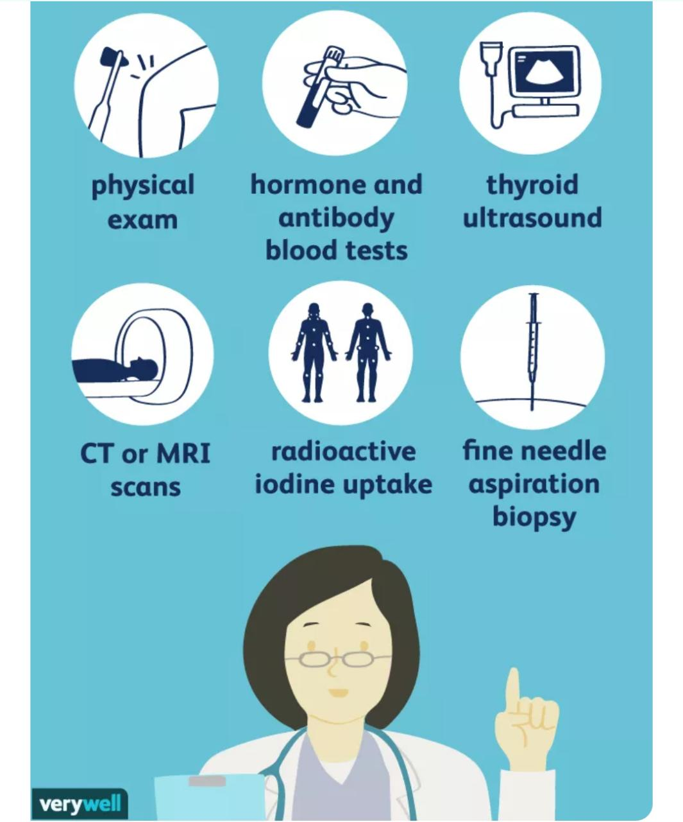
Core Subject

Slide 24
mri
Core Subject

Slide 25
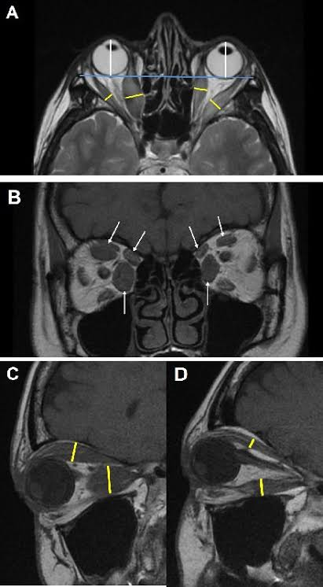
Core Subject

Slide 26
diagnosis
Core Subject
It is based on
systemic features of hyperthyroidism and ocular signs
Investigations

Slide 27
Treatment

Slide 28
Core Subject
I-

Slide 29
treatment of Ophthalmopathy
Core Subject
Mild cases
Lubricants
Topical anti inflammatory agents
Head elevation
Eyelid taping during sleep

Slide 30
Core Subject
Moderate to severe active disease:
Systemic steroids
Orbital steroids injections
Low dose fractionated radiotherapy
Combined therapy with irradiation

Slide 31
Core Subject
Surgery
Orbital decompression
Squint surgery
Eyelid surgery

Slide 32
Orbital tumors
Core Subject

Slide 33
Core Subject
1. Vascular tumors
Lymphangioma
Capillary heamangioma
Cavernous heamangioma

Slide 34
Core Subject
Lacrimal gland tumors
Pleomorphic lacrimal gland adenoma
Lacrimal gland carcinoma

Slide 35
Core Subject
2. Neural tumors
Optic nerve glioma
Optic nerve sheath meningioma
Plexiform neurofibroma

Slide 36
Core Subject
3. other tumors
Lymphoma
Rhabdomyosarcoma
Metastatic tumors

Slide 37
End of lecture assessment
Core Subject
An 11 year old female with no significant past medical history presented with symptoms suggestive of hyperthyroidism (weightloss, heat intolerance). She has also experienced a decline in grades at school. Family history is significant for thyroid disease in both grand mothers.
What is your diagnosis?
What investigations will you order?
Discuss different ophthalmic manifestations of the above disease.
Treatment options

Slide 38
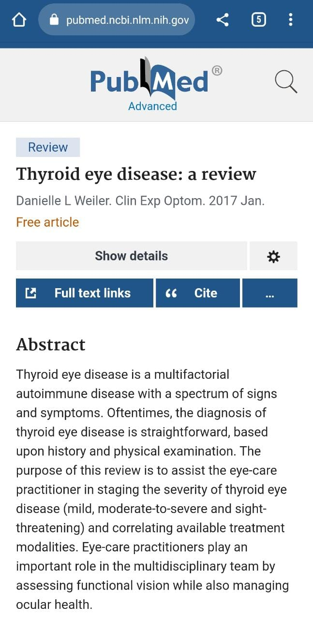
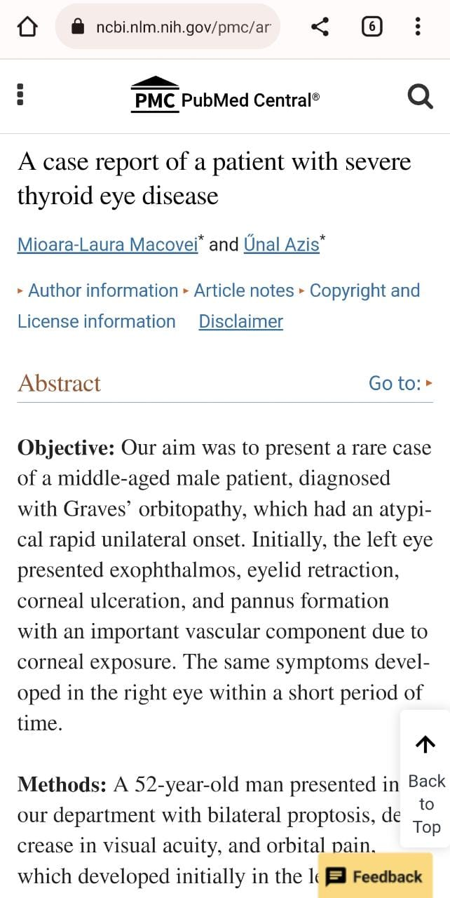
ETHICS AND RESEARCH
https://pubmed.ncbi.nlm.nih.gov/27701774/
https://www.ncbi.nlm.nih.gov/pmc/articles/PMC9289779/

Slide 39
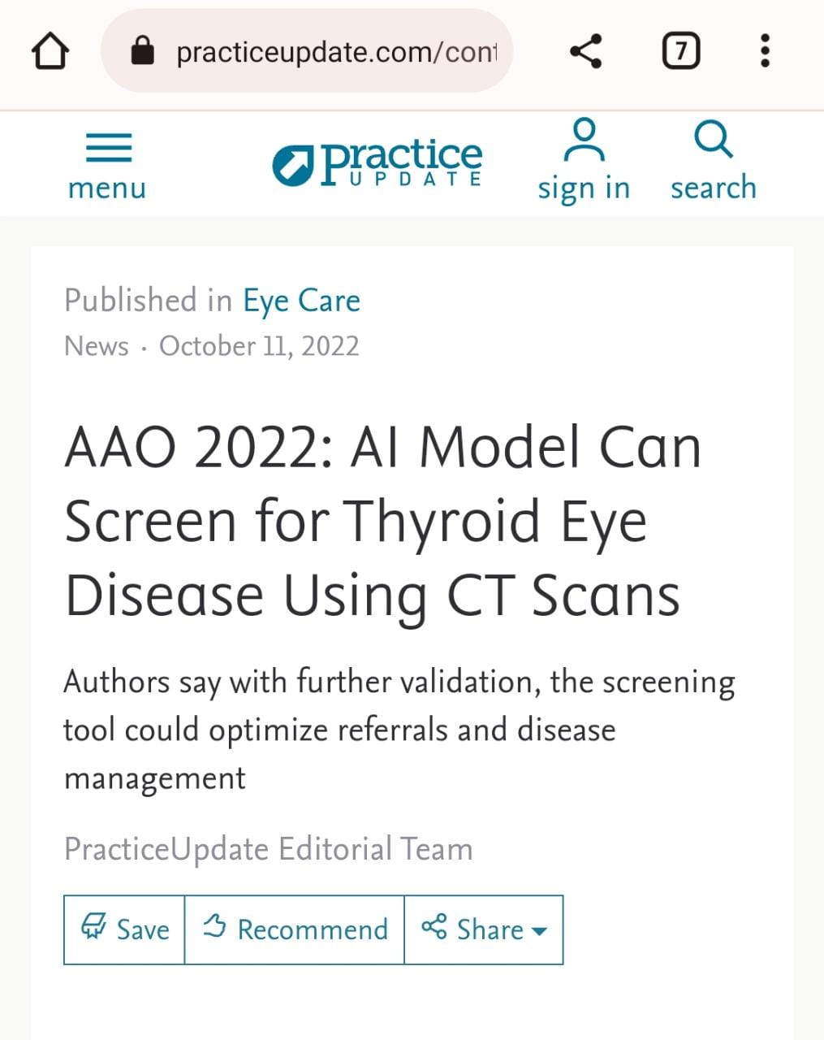
ARTIFICIAL INTELLIGENCE
https://www.practiceupdate.com/content/aao-2022-ai-model-can-screen-for-thyroid-eye-disease-using-ct-scans/143204/7/5/2#:~:text=10%2C%202022%20(HealthDay%20News),study%20presented%20at%20the%20annual

Slide 40
REFERENCES
KANSKI’S OPHTHALMOLOGY 8TH EDITION.
AMERICAN ACADEMY OF OPHTHALMOLOGY – BCSC 2015-2016

