Slide 1
Tuberculosis
Professor muhamad khurram
Head of department, Medical unit-2, hfh

Slide 2
University Motto, Vision, Values & Goals
Mission Statement
To impart evidence-based research-oriented health professional education
Best possible patient care
Mutual respect, ethical practice of healthcare and social accountability.
Vision and Values
Highly recognized and accredited centre of excellence in
Medical Education, using evidence-based training techniques for development of highly competent health professionals, who are lifelong experiential learner and are socially accountable.
Goals
The Undergraduate Integrated Learning Program is geared to provide you with quality medical education in an environment designed to:

Slide 3
Sequence OF LGIS
Learning objectives
What is Tuberculosis? (core concept= 70%)
Related pathology and pharmacology (horizontal integration 15%)
Related recent advances (vertical integration – 10%)
Research article related to topic (3%) and Ethics (3%)

Slide 4
Learning Objectives
Describe epidemiology and etiopathogenesis
Discuss clinical feature, and diagnostic plan
Outline complications
Outline of treatment.
Prevention
Future perspective.
Research for Medical Students/AI
MDM
Further reading
MCQs

Slide 5
Prof Umer Model of Integrated Lecture

Slide 6
Horizontal Integration
Horizontal integration in TB involves linking related disciplines such as pathology, pharmacology, and microbiology to enhance understanding and treatment strategies.
Key Aspects
Pathology: TB granuloma formation, caseous necrosis, and fibrosis.
Pharmacology: First-line and second-line anti-TB drugs, resistance mechanisms.
Microbiology: Mycobacterium tuberculosis structure, acid-fast characteristics, and virulence factors.
Purpose
Provides a multi-disciplinary approach to TB education and treatment.Helps integrate knowledge across medical fields for better diagnosis and management.

Slide 7
Vertical Integration
It focuses on linking basic sciences with clinical applications, particularly understanding the pathophysiology of TB.
Key Aspects
Inhalation & Infection: Mycobacterium tuberculosis enters the respiratory tract via aerosolized droplets.
Immune Response: Alveolar macrophages engulf the bacteria.Formation of granulomas to contain infection.
Latent vs. Active TB. Latent TB: Bacteria remain dormant, controlled by the immune system. Active TB: Reactivation due to immunosuppression (e.g., HIV, malnutrition).
Tissue Damage: Caseous necrosis, cavitation, and lung fibrosis leading to respiratory failure in severe cases.

Slide 8
Global TB Burden
WHO South-East Asia Region: 46% of new TB cases.
WHO African Region: 23% of new TB cases.
WHO Western Pacific Region: 18% of new TB cases.
Eastern Mediterranean: 8.1%
Americas: 3.1%
European Region: 2.3%
In 2022, 87% of new TB cases occurred in the 30 high TB burden countries.
Eight countries accounted for 68% of global TB cases:
India (27%)
Indonesia (10%)
China (7.1%)
Philippines (7.0%)
Pakistan (5.7%)
Nigeria (4.5%)
Bangladesh (3.6%)
Democratic Republic of the Congo (3.3%)

Slide 9
Epidemiology
Tuberculosis (TB) remains a global health threat, affecting all regions of the world. As of 2022, the WHO South-East Asian Region accounted for 46% of new TB cases, maintaining its position as the highest-burden region. This was followed by the WHO African Region (23%) and the WHO Western Pacific Region (18%). Notably, 87% of new TB cases occurred in the 30 high TB burden countries, with eight nations contributing 68% of global cases: India (27%), Indonesia (10%), China (7.1%), the Philippines (7.0%), Pakistan (5.7%), Nigeria (4.5%), Bangladesh (3.6%), and the Democratic Republic of the Congo (3.3%)

Slide 10
Global TB Statistics (2020–2024)
Metric | 2020 | 2021 | 2022 | 2023 | 2024 (Projections)
Global TB Cases | 10.0 million | 10.1 million | 10.6 million | 10.6 million | 10.8 million
Regional Distribution
- WHO South-East Asia (%) | 43% | 44% | 45% | 46% | 46%
- WHO Africa (%) | 25% | 24% | 23% | 23% | 23%
- WHO Western Pacific (%) | 18% | 18% | 18% | 18% | 18%
Top 8 High-Burden Countries | India, China, Indonesia, Philippines, Pakistan, Nigeria, Bangladesh, South Africa | Same as 2020 | India, Indonesia, China, Philippines, Pakistan, Nigeria, Bangladesh, D.R. Congo | Same as 2022 | Same as 2023

Slide 11
Pakistan
Pakistan-Specific Data
New TB Cases | ~525,000 | ~570,000 | ~610,000 | ~623,000 | ~640,000
Deaths | ~48,000 | ~49,000 | ~47,000 | ~47,000 | ~45,000
DR-TB | ~14,000 | ~14,500 | ~15,000 | ~15,000 | ~16,000

Slide 12
Pakistan ranks fifth globally in terms of absolute TB cases, reflecting persistent challenges such as delayed diagnosis, limited healthcare access, and high population density. In 2022, Pakistan reported approximately 623,000 new TB cases, with an estimated 47,000 deaths annually, underscoring the urgent need for enhanced prevention and treatment programs.

Slide 13
Mycobacterium Tuberculosis
Human is only a known reservoir.
Usually found in the lungs but can also live in any part of the body.
They may be obligate pathogen, facultative or opportunistic pathogens, or free living.
Usually infect the mono-nuclear phagocytes.
Can survive for weeks in the dust, on carpets or clothes, for months in sputum.
They are also found in soil and water.

Slide 14
MTB Characteristics
Straight or slightly curved thin rod-shaped bacilli.
Non-sporing, non-motile, non-capsulated bacteria.
Acid-fast bacilli, neither gram +ve nor gram –ve.
During acid-fast stain, they appear bright red to intensive purple with green/blue background.
They measure 0.5 µm x 3 µm.
Capable of intracellular growth.
Mycolic acid and Lipoarabinomannan (LAM)
ESX 1 secretion system
Phagosome maturation factors

Slide 15
Natural history
Inhalation of aerosolized droplets containing M.tuberculosis leads to deposition in the lungs, with one of the following possible outcomes
Immediate clearance of the organism
TB infection (previously termed latent TB) – TB infection refers to containment of viable organisms via host immunity, in the absence of signs or symptoms of illness.
Primary TB disease – Primary TB refers to immediate onset of TB disease following M.tuberculosis exposure in a previously naïve host
Reactivation TB disease – Reactivation TB disease refers to onset of symptomatic TB disease, years following a period of contained TB infection.

Slide 16
Primary TB
Noted in 1/3 of cases.
Symptoms include fever and chest pain. Retrosternal pain and dull interscapular pain have been ascribed to enlarged bronchial lymph nodes. The physical exam is generally normal.
CXR findings include hilar lymphadenopathy, pleural effusions and pulmonary infiltrates.

Slide 17
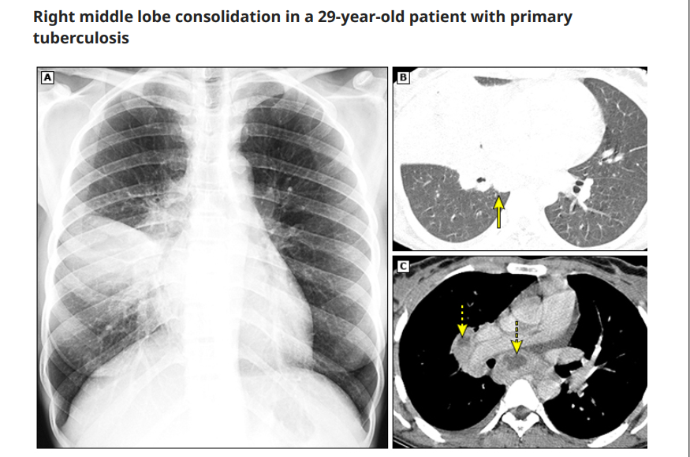

Slide 18
Reactivation TB
Refers to reactivation of a previously dormant focus seeded at the time of the primary infection.
Apical and posterior segments of the upper lobes are the sites most frequently involved.
Symptoms are insidious and may include cough, weight loss, fatigue, fever, night sweats, chest pain, dyspnea, and/or hemoptysis; these findings are observed less frequently among patients >60 years.
Exogenous reinfection in a previously infected person may present with similar findings.

Slide 19
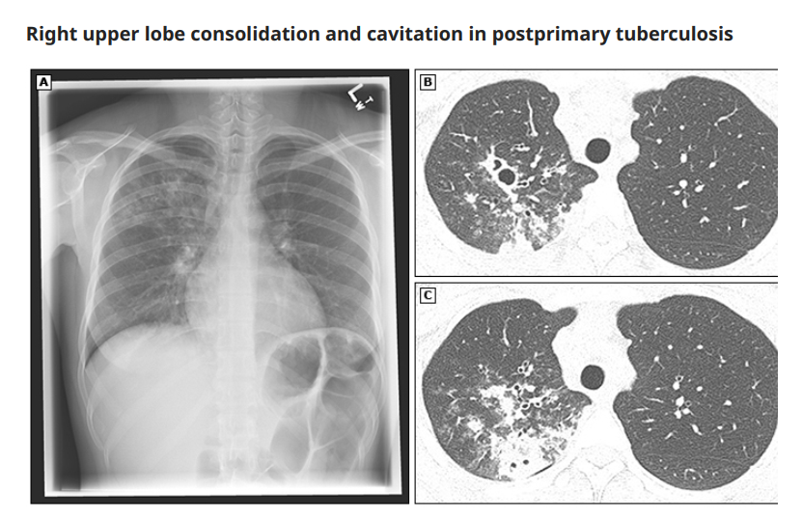

Slide 20
Endobronchial TB
It may develop via direct extension to the bronchi from an adjacent parenchymal focus (usually a cavity) or via spread of organisms to the bronchi via infected sputum.
It can occur in patients with primary TB or reactivation TB. Was more frequently prior ATT era.
Symptoms may be acute or chronic; a barking cough has been described in approximately two thirds of patients.

Slide 21
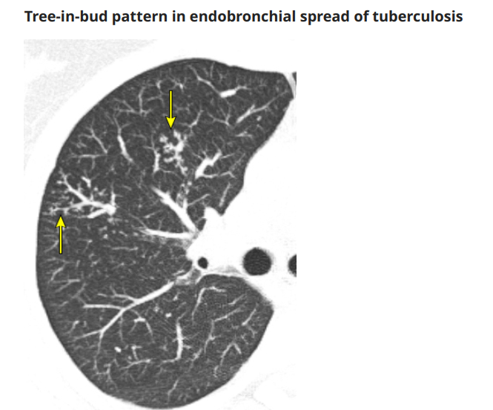

Slide 22
Lower Lung TB
Refers to disease involvement below the hila (including the perihilar regions) on chest imaging. 2 to 9% of adult cases.
Consolidation in lower lung TB tends to be more extensive and homogeneous than upper lobe TB and is associated with cavitation
Generally either subacute in onset (mean of 12 weeks) or chronic (up to 6 months).
Can be a manifestation of primary TB (with involvement of adjacent lymph nodes), reactivation TB (involving the superior segments of the lower lobes), or endobronchial TB.
Older adult patients and those with HIV, diabetes, renal or hepatic disease, those receiving corticosteroids, and those with underlying silicosis appear at highest risk for lower lobe TB. Many patients have no underlying medical illnesses.
This can lead to misdiagnosis as viral or bacterial pneumonia, bronchiectasis, or carcinoma.
Notes:
In reactivation TB, the upper lobes are the most common site of disease. Sometimes only the lower lobes are affected; this can lead to misdiagnosis as viral or bacterial pneumonia, bronchiectasis, or carcinoma. Lower lung TB refers to disease involvement below the hila (including the perihilar regions) on chest imaging [76]. The incidence in adults is 2 to 9 percent [27,76]. Consolidation in lower lung TB tends to be more extensive and homogeneous than upper lobe TB [77-79]. Cavitation may occur, and large cavities have been described. Symptoms in lower lobe TB are generally either subacute in onset (mean of 12 weeks) or chronic (up to 6 months). Lower lobe involvement can be a manifestation of primary TB (with involvement of adjacent lymph nodes), reactivation TB (involving the superior segments of the lower lobes), or endobronchial TB [77,78,80]. Endobronchial TB can affect the lower lung in both primary infection (especially when adjacent lymph nodes are involved) and reactivation disease (spread from upper lobe disease can secondarily infect the lower lobes) ( image 4). Older adult patients and those with HIV, diabetes, renal or hepatic disease, those receiving corticosteroids, and those with underlying silicosis appear at highest risk for lower lobe TB. However, many patients have no underlying medical illnesses. Studies in nursing homes suggest that lower lobe TB may be a manifestation of TB disease in an older, tuberculinnegative population with significant underlying diseases or anergy [80]. In some cases, the patients are suspected or known to have had previous TB but develop exogenous reinfection, perhaps due to a loss of demonstrable tissue hypersensitivity.

Slide 23
Tuberculoma
It is a well-circumscribed nodule or a mass consisting of caseous material encapsulated by multiple concentric layers of connective tissue without surrounding inflammation or spread.
Can occur in both primary and reactivation TB
Due to; 1) repeated extension of bronchopneumonic foci, subsequent necrosis, and re-encapsulation, 2) shrinkage of occluded cavities and fusion of small encapsulated densities [
Usually in upper lobes. Commonly single; multiple nodules can occur. <1 cm to >10 cm in diameter. May develope cavitation or calcification
Progressive, stationary, and regressive
Diagnosis ; airway cultures- often negative, Fine needle aspiration or lung biopsy
Majority reduced in size by ATT and this tendency may continue after completing treatment. May increase in size during treatment require careful observation or re-evaluation with further biopsies or resection
Notes:
A pulmonary tuberculoma is a well-circumscribed nodule or a mass. It consists of caseous material encapsulated by multiple concentric layers of connective tissue without surrounding inflammation or spread. Pulmonary tuberculomas can occur in both primary and reactivation TB and have been described in 6 to 9 percent of reactivation TB [21]. The proposed mechanism underlying the development of tuberculomas consists of repeated extension of bronchopneumonic foci, subsequent necrosis, and re-encapsulation. Other proposed mechanisms include shrinkage of occluded cavities and fusion of small encapsulated densities [81]. They are usually found in the upper lobes. A tuberculoma is one of the most common benign nodules and represents 5 to 24 percent of resected solitary pulmonary nodules [82]. They are usually a single nodule; multiple nodules can occur. The size ranges from <1 cm to >10 cm in diameter. The margins are usually smooth and sharp but may be irregular ( image 6); uncommonly, cavitation or calcification may be observed. The natural history of tuberculomas without antituberculous therapy has been classified into progressive, stationary, and regressive; a stationary course accounts for 30 to 50 percent of all patients. In one series including 45 patients, symptoms were present in nearly half of cases; the most frequent symptoms were sputum, cough, general weakness, and fatigue [83]. The diagnosis of tuberculoma can be difficult since airway cultures are often negative [79]. Fine needle aspiration or lung biopsy may be necessary for diagnosis. Tuberculomas may be accompanied by malignancy in rare cases. (See "Diagnostic evaluation of the incidental pulmonary nodule".) The majority of pulmonary tuberculomas are reduced in size by antituberculous treatment and this tendency may continue after completing treatment. In the early phase of treatment, a tuberculoma may increase in size and may require careful observation or re-evaluation with further biopsies or resection [83].

Slide 24
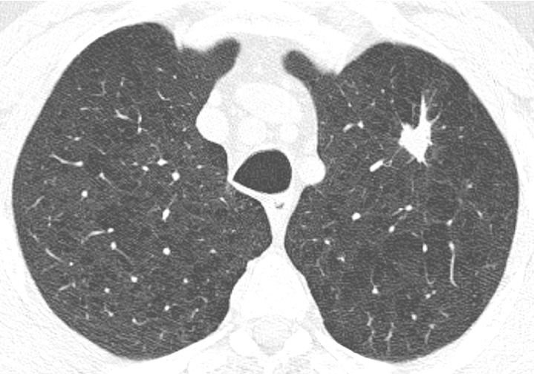
Notes:
A pulmonary tuberculoma is a well-circumscribed nodule or a mass. It consists of caseous material encapsulated by multiple concentric layers of connective tissue without surrounding inflammation or spread. Pulmonary tuberculomas can occur in both primary and reactivation TB and have been described in 6 to 9 percent of reactivation TB [21]. The proposed mechanism underlying the development of tuberculomas consists of repeated extension of bronchopneumonic foci, subsequent necrosis, and re-encapsulation. Other proposed mechanisms include shrinkage of occluded cavities and fusion of small encapsulated densities [81]. They are usually found in the upper lobes. A tuberculoma is one of the most common benign nodules and represents 5 to 24 percent of resected solitary pulmonary nodules [82]. They are usually a single nodule; multiple nodules can occur. The size ranges from <1 cm to >10 cm in diameter. The margins are usually smooth and sharp but may be irregular ( image 6); uncommonly, cavitation or calcification may be observed. The natural history of tuberculomas without antituberculous therapy has been classified into progressive, stationary, and regressive; a stationary course accounts for 30 to 50 percent of all patients. In one series including 45 patients, symptoms were present in nearly half of cases; the most frequent symptoms were sputum, cough, general weakness, and fatigue [83]. The diagnosis of tuberculoma can be difficult since airway cultures are often negative [79]. Fine needle aspiration or lung biopsy may be necessary for diagnosis. Tuberculomas may be accompanied by malignancy in rare cases. (See "Diagnostic evaluation of the incidental pulmonary nodule".) The majority of pulmonary tuberculomas are reduced in size by antituberculous treatment and this tendency may continue after completing treatment. In the early phase of treatment, a tuberculoma may increase in size and may require careful observation or re-evaluation with further biopsies or resection [83].

Slide 25
Complications of pulmonary TB
Hemoptysis
Pneumothorax
Bronchiectasis
Extensive pulmonary destruction (including pulmonary gangrene)
Chronic pulmonary aspergillosis
Acute respiratory distress syndrome, septic shock, malignancy, venous thromboembolism

Slide 26
Tuberculosis terminology
Tuberculosis terminology is inconsistent in the literature .
The following terms refer to the clinical state in which there is evidence of specific cell-mediated immunologic response following exposure to Mycobacterium tuberculosis-derived protein antigens in solution (eg, positive TST and/or IGRA), in the absence of signs or symptoms of illness: Tuberculosis infection (newer term) Latent tuberculosis infection (older term)
The following terms refer to presence of signs or symptoms reflecting illness due to M. tuberculosis: Tuberculosis disease (newer term) Active tuberculosis, Active tuberculosis disease, Active tuberculosis infection (older term)

Slide 27
When to suspect
DS TB; In patients with cough >2 to 3 weeks, fevers, night sweats, weight loss, lymphadenopathy + relevant epidemiologic factors (history of prior TB infection or disease, known or possible TB exposure, and/or past or present residence in or travel to an area where TB is endemic).
DR TB; prior TB treatment, progressive clinical and/or radiographic findings while on TB therapy, residence in or travel to a region with high
prevalence of drug-resistant TB, and/or exposure to an individual with known or suspected infectious drug-resistant TB.

Slide 28
TB Diagnosis
The diagnosis of pulmonary TB is definitively established by isolation of Mycobacterium tuberculosis from a bodily secretion (eg, culture of sputum, bronchoalveolar lavage, or pleural fluid) or tissue (pleural biopsy or lung biopsy).
Additional diagnostic tools include sputum acid-fast bacilli (AFB) smear and nucleic acid amplification (NAA) testing; in most cases when used appropriately a positive NAA test (with or without AFB smear positivity) is considered sufficient for diagnosis of TB

Slide 36
TB Infection screening
Montoux Test- TST
Comprises the intradermal injection of a purified protein derivative (PPD) from heat-killed cultures of M. tuberculosis, with measurement of the resultant induration 48–72 hours later.
PPD material comprises a heterogeneous mixture of TB antigens, which results in significant cross-reactivity with other M. tuberculosis complex strains – notably bacille Calmette-Guérin (BCG) and nontuberculous mycobacteria reducing specificity
Y Interferon release assay
Measure interferon-gamma production from whole blood or from circulating lymphocytes after in vitro overnight incubation in the presence of ESAT-6 and CFP-10.
TBST
MycoDot test is based on the detection of anti-mycobacterial antibodies in the serum samples of patients by employing plastic combs coated with lipoarabinomannan (LAM) antigen which is a highly immunogenic lipopolysaccharide presenting in the cell wall of all species of mycobacteria.
Notes:
early secretory antigenic 6 kDa (ESAT-6) protein and culture filtrate protein 10 (CFP-10), which are antigens that are found in M. tuberculosis but are not present in BCG or in most species of nontuberculous mycobacteria
TBST- Mycobacterium tuberculosis antigen-based skin test

Slide 37
TBIS Tests- Summary
Mycobacterium tuberculosis antigen-based skin tests (TBSTs) may be used to test for TB infection. Conditional recommendation for the intervention, very low certainty of the evidence
Either the tuberculin skin test (TST) or interferon-gamma release assays (IGRAs) can be used to test for TB infection. Strong recommendation, very low certainty of the evidence
Interferon-gamma release assays (IGRAs) (and the tuberculin skin test [TST]) should not be used in low- and middle-income countries (LMIC) for the diagnosis of pulmonary or extrapulmonary TB, or for the diagnostic work-up of adults (including people living with HIV) suspected of active TB in these settings. Strong recommendation

Slide 38
Conventional Treatment
2 Groups depending upon the degree of effectiveness and potential side effects
First Line: (Primary agents)
Most effective and have lowest toxicity. Isoniazid, Rifampicin, Ethambutol, Pyrazinamide, Streptomycin.
2nd Line
Less effective and most toxic. Amikacin, Kanamycin, Capreomycin, Viomycin, Kanamycin, Cycloserine, PAS, Ethionamide

Slide 39
TB Resistance
Multidrug-Resistant TB (MDR TB)
Multidrug-resistant TB (MDR TB) is caused by TB bacteria that are resistant to at least isoniazid and rifampin, the two most potent TB drugs. These drugs are used to treat all persons with TB disease.
TB experts should be consulted in the treatment of MDR TB.
Pre-Extensively Drug-resistant TB (pre-XDR TB)
Pre-Extensively Drug-resistant TB (pre-XDR TB) is a type of MDR TB caused by TB bacteria that are resistant to isoniazid, rifampin, and a fluroquinolone OR by TB bacteria that are resistant to isoniazid, rifampin, and a second-line injectable (amikacin, capreomycin, and kanamycin).
Extensively Drug-resistant TB (XDR TB)
Extensively drug-resistant TB (XDR TB) is a rare type of MDR TB caused by TB bacteria that are resistant to isoniazid and rifampin, a fluroquinolone, and a second-line injectable (amikacin, capreomycin, and kanamycin) OR by TB bacteria that are resistant to isoniazid, rifampin, a fluroquinolone, and bedaquiline or linezolid.

Slide 40
New Cases- 6 month regimen
Patients who have never received treatment for tuberculosis or taken it for less than one month.
New patients with pulmonary TB should receive a regimen containing 6 months of rifampicin: 2HRZE/4HR
Daily regimen is preferable

Slide 41
4 month regimen
People aged 12 years or older with drug-susceptible pulmonary TB may receive a 4-month regimen of isoniazid, rifapentine, moxifloxacin and pyrazinamide (2HPMZ/2HPM)- conditional recommendation, moderate certainty of evidence – new recommendation.
In children and adolescents between 3 months and 16 years of age with non-severe TB (without suspicion or evidence of MDR/RR-TB), a 4-month treatment regimen (2HRZ(E)/2HR) should be used- strong recommendation, moderate certainty of evidence

Slide 42
Steroids
In patients with TB meningitis, an initial adjuvant corticosteroid therapy with dexamethasone or prednisolone tapered over 6–8 weeks should be used (strong recommendation, moderate certainty of evidence).
In patients with TB pericarditis, an initial adjuvant corticosteroid therapy may be used (conditional recommendation, very low certainty of evidence)

Slide 43
Extrapulmonary TB
Pulmonary and extrapulmonary disease should be treated with the same regimens.
Note that some experts recommend 9–12 months of treatment for TB meningitis given the serious risk of disability and mortality, and 9 months of treatment for TB of bones or joints because of the difficulties of assessing treatment response.
Unless drug resistance is suspected, adjuvant corticosteroid treatment is recommended for TB meningitis and pericarditis.
In Tuberculous meningitis, Ethambutol should be replaced by Streptomycin

Slide 44
ATT Problems
Toxicity e.g. liver
Multiple therapy
Prolonged treatment
Drug interactions
Prevention
Early detection
Education and screening
Engineering controls
Personal hygiene and isolation of infected cases.

Slide 45
MDM
Future perspective – Research
Pulmonology and Infectious Disease Specialists
Nursing Care:
Social Work and Support Services
Public Health and Epidemiology
Clinical Trials: Ongoing research into new anti-TB drugs, shorter treatment regimens, and vaccines is crucial for advancing TB treatment and prevention.
Epidemiological Studies: Understanding the patterns of TB transmission, risk factors, and the impact of public health interventions is essential for controlling the disease.
Operational Research: Investigating the effectiveness of TB control programs, diagnostic strategies, and treatment adherence models helps optimize resource utilization and patient
Notes:
Multidisciplinary Management Components
Pulmonology and Infectious Disease Specialists: Expertise in managing drug-resistant TB, extrapulmonary TB, and TB in immunocompromised patients is essential.
Nursing Care: Nurses play a vital role in administering directly observed therapy (DOT), monitoring treatment progress, and providing patient education.
Social Work and Support Services: Addressing social determinants of health, providing support for patients facing financial, emotional, or social challenges, and ensuring access to care are important for successful TB management.
Public Health and Epidemiology: Collaboration with public health departments for contact tracing, outbreak investigation, and implementing TB control measures is crucial for preventing the spread of TB.
Integrating these components provides a multidimensional approach to TB management, encompassing early detection, evidence-based treatment, ongoing research, and comprehensive support from various healthcare disciplines to improve patient outcomes and control the spread of TB.
Research in Tuberculosis
Clinical Trials: Ongoing research into new anti-TB drugs, shorter treatment regimens, and vaccines is crucial for advancing TB treatment and prevention.
Epidemiological Studies: Understanding the patterns of TB transmission, risk factors, and the impact of public health interventions is essential for controlling the disease.
Operational Research: Investigating the effectiveness of TB control programs, diagnostic strategies, and treatment adherence models helps optimize resource utilization and patient

Slide 46
AI
Family Medicine
Diagnosis and Imaging
Predictive Models
Treatment Optimization
Early Detection and Management
Continuity of Care
Prevention and Public Health
Notes:
Artificial Intelligence (AI) in Tuberculosis Management
Diagnosis and Imaging: AI algorithms can analyze chest X-rays and CT scans to identify patterns indicative of TB, aiding in faster and more accurate diagnosis.
Predictive Models: AI can predict the likelihood of treatment success, drug resistance, and patient outcomes based on clinical data, genetic information, and treatment history.
Treatment Optimization: AI systems can assist in selecting appropriate drug regimens based on resistance patterns and patient-specific factors, improving treatment efficacy and reducing the risk of drug resistance.
Family Medicine's Role in Tuberculosis
Early Detection and Management: Primary care physicians play a key role in identifying symptoms of TB, initiating diagnostic tests, and starting treatment in collaboration with TB specialists.
Continuity of Care: Family practitioners monitor patients throughout the course of treatment, ensuring adherence to medication and managing side effects.
Prevention and Public Health: They are involved in TB screening programs, contact tracing, and vaccination efforts (e.g., BCG vaccine) to prevent the spread of TB in the community.

Slide 47
Recent Advances
1. New Drug Developments: Bedaquiline & Delamanid: Approved for multidrug-resistant TB (MDR-TB). Pretomanid: Used in combination therapy for extensively drug-resistant TB (XDR-TB).
2. Shorter Treatment Regimens:4-Month Regimen: Isoniazid, rifapentine, moxifloxacin, and pyrazinamide for drug-sensitive TB.
3. Vaccine Research: BCG Alternatives: M72/AS01E vaccine showing promise in clinical trials. mRNA TB Vaccines: Adapted from COVID-19 vaccine technology.
4. AI & Digital Tools in TB Detection: AI-Based X-ray Interpretation: Assists in rapid TB diagnosis in low-resource settings. Molecular Diagnostics: GeneXpert and Truenat for rapid TB detection.
5. Global TB Control Strategies: WHO's End TB Strategy aims to reduce TB deaths by 90% by 2035.Increased focus on latent TB treatment to prevent disease progression.

Slide 48
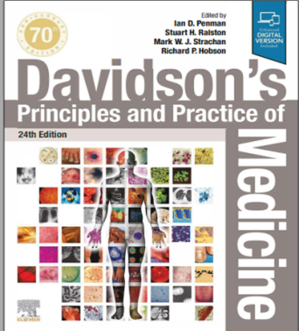
Resources/References
Article to go though/MCQs
WHO 2023
RMU Portal

Slide 49
