Slide 2
GIT Module LGIS PHYSIOLOGY)
2nd Year MBBS (2025)
Saliva & Mastication. Stages of Swallowing. Clinical Disorders of Swallowing & esophagus. Achalasia & Vomiting
Dr. Ali Zain
PGT physiology
Date: 00-00-0000

Slide 3
Table of contents
Sr # | Content | Slide #
1 | Motto, Vision | 5
2 | Professor Umar Model of Integrated Lecture | 4
3 | Bloom’s Taxonomy (Domains of learning) | 6
4 | Diagrammatic representation of Blooms taxonomy | 7
5 | Learning Objectives | 8
6 | Horizontal Integration | 9, 10, 12, 13
7 | Core Concept | 11, 14-32,
8 | Vertical Integration | -
9 | Biomedical Ethics (Lesson of the day) | 33
10 | Suggested research article | 34
11 | Promoting IT and Research culture (Digital library) | 31,32
12 | References of this lecture | 35

Slide 4
General Format for Large Group Interactive Session of Physiology:
S. No. Headings Domains/Type of Integration Ap roximate %
1. Title
Motor Functions of Stomach.
Physiology of regulation of gastric emptying
2.
Learning Objectives
Mentioned on the separate slide
Mentioned on the separate
slide
3.
Physiologic Anatomy (Histology)
Brain Storming/ Horizontal Integration
Interactive
15%
4.
Core Concepts of the Topic
Core concepts of Physiology
60%
5.
Concept explained through Animations
Core Concepts of Physiology
10%
6.
Topic with key
Interactive
5%
7.
Research article relevant to the topic with reference
Promotion of research culture
Use of Digital Library
Critical Thinking
Self-directed Learning
5%
8.
PM&DC Code of Ethics/Professionalism/Communicati on Skills with reference
Professional Ethics
Self-directed Learning
Interactive
5%

Slide 5
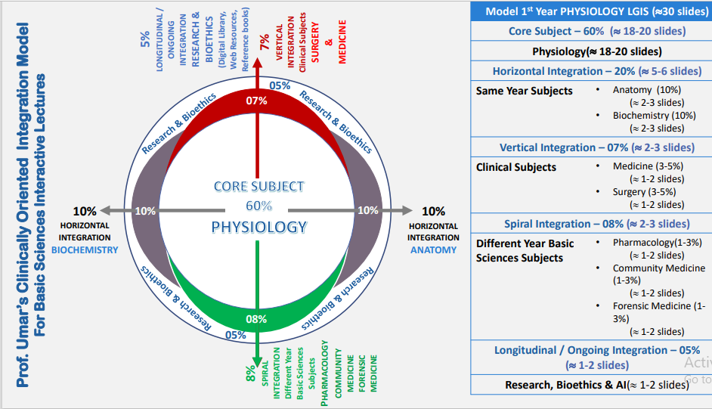
Physiology of Pancreas Pancreatic secretions
LGIS Physiology

Slide 6
Vision; The Dream/Tomorrow
To impart evidence-based research oriented medical education
To provide best possible patient care
To inculcate the values of mutual respect and ethical practice of medicine

Slide 7
BLOOM'S TAXONOMY : DOMAINS OF LEARNING
Sr. # | Domain of learning | Abbreviation | Levels of the domain | Meaning
1 | cognition | C | C1 | Recall / Remembering
2 |  |  | C2 | Understanding
3 |  |  | C3 | Applying / Problem solving
4 | Psychomotor | P | P1 | Imitation / copying
5 |  |  | P2 | Manipulation / Follows instructions
6 |  |  | P3 | Precision / Can perform accurately
7 | Attitude | A | A1 | Receiving / Learning
8 |  |  | A2 | Respond / Starts responding to the learned attitude
9 |  |  | A3 | Valuing / starts behaving according to the learned attitude

Slide 8
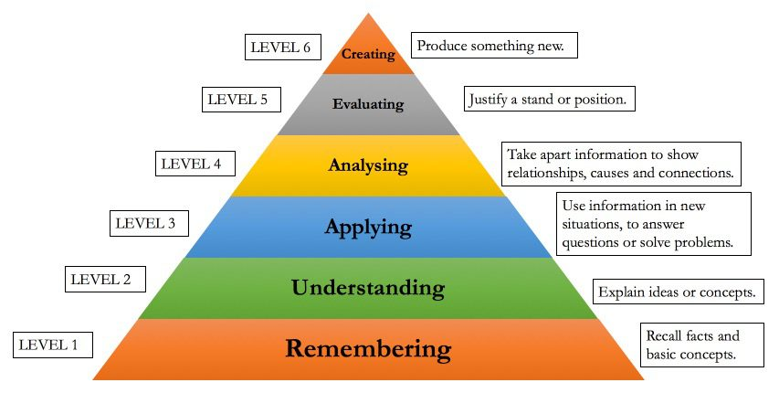
BLOOM'S TAXONOMY OF THE COGNITIVE DOMAIN

Slide 9
Learning objectives
1. Understand Secretion & composition of saliva Know the Nervous regulation of saliva | C1
2. Comprehend Mastication & its functions Know the Role of teeth & muscles in mastication Steps & nervous control center of chewing reflex Introduction of swallowing, stages of swallowing What is Primary & secondary peristalsis | C1
3. Know Physiological anatomy & functions of LES Receptive relaxation of stomach with nervous pathway Physiological anatomy & functions of distal esophagus | C2
4. Brief account of Clinical disorders of Swallowing (Achalasia, vomiting & nausea) | C1
Achalasia cardia, causes, effects & treatment Vomiting, stimuli & nervous pathway CTZ (Chemoreceptor Trigger Zone) Nausea, causes of nausea | C1

Slide 10
Horizontal integration (Anatomy )

Slide 11
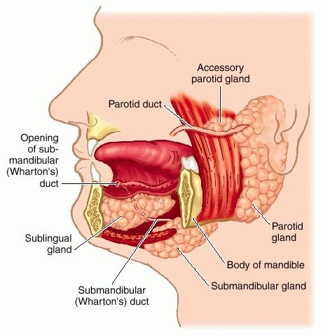
Physiological anatomy of stomach
Horizontal integration with Physiology

Slide 12
Core Concept

Slide 13
Secretion, Composition & Nervous Regulation of Saliva
Core concept
Secretion and Composition of Saliva (Introduction)
Daily average secretion of saliva: 1000 ml Range: 800 – 1500 ml
Principal glands of salivation: *parotid *submandibular *sublingual and *many tiny buccal glands

Slide 14
(Introduction) Saliva contains: 1. Serous secretion Ptyalin- an Alpha amylase (for digesting starches) 2. Mucus secretion Mucin- for lubricating and for surface protective properties
Core concept
Physiological role of Saliva
Flow of saliva washes away bacteria & food particles
Bactericidal factors: Thiocyanate ions & proteolytic enzymes
Contains antibodies: destroys bacteria & prevent caries

Slide 15
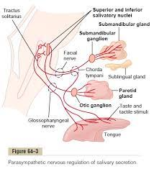
Nervous regulation of salivary secretion
Horizontal integration with Anatomy/Physiology

Slide 16
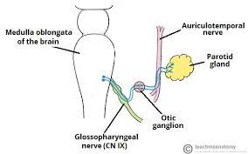
Nervous regulation of salivary secretion: Sympathetic and parasympathetic
Horizontal integration with Anatomy/Physiology

Slide 17
Types of glands
Core concept
Several different types of gland are found in the GI Tract:
Single cell mucous glands and goblet cells.
Pit glands. Invaginations of the epithelia into the submucosa. In the small intestine these are called Crypts of Lieberkuhn.
Deep tubular glands. These are found in the stomach - the gastric glands, and the upper duodenum - Brunners glands.
Complex glands, the salivary glands, the pancreas, and the liver. The salivary glands and the pancreas are compound acinous glands.

Slide 18
Basic mechanism of stimulation
Contact of food with epithelium stimulates secretions
functions of enteric nervous stimulus
Tactile stimulation
Chemical irritation
Distention of gut wall
Core concept

Slide 19
Core concept
Autonomic stimulation of secretions
Parasympathetic stimulation increases alimentary tract glandular secretions
Sympathetic stimulation has dual effect
If it is alone then it will increase secretion
If parasympathetic and hormonal factors are also there then sympathetic stimulation usually causes decrease in secretion rate

Slide 20
Functions of mucous
Core concept
It has adherent quality that make it adhere tightly to food or other particles
It coats the wall of gut and prevent actual contact between food n gut wall.
Mucous has low resistance to slippage
It causes fecal particles to adhere to one another to form feces that are then expelled from the body
It has strong resistance against git enzymes
Glycoprotein of mucous has amphoteric property which means the are capable of buffering both acids and bases to some extent

Slide 21
Composition of Saliva
Core concept
Aqueous fluids
Water, ions and enzymes
Parotid, submaxillary and sublingual glands
Mucus secretion (mucin)
Submaxillary and sublingual glands

Slide 22
Function of saliva for oral hygiene
Core concept
First the flow of saliva its self helps wash away the pathogenic bacteria as well as the food particles that provide their metabolic support.
Second saliva contains several factors that destroy bacteria e.g. thiocyanate ions, several proteolytic enzymes .
Third saliva often contains significant amount of protein anti-bodies that can destroy oral bacteria.
Therefore, in the absence of salivation the oral tissue become ulcerated and other wise infected and carries of teeth becomes extensive

Slide 23
Mastication and Swallowing
Mastication: (Introduction)
Processes involved in food preparation, including moving unchewed food onto the grinding surface of the teeth, chewing, it, and mixing it with saliva in preparation for swallowing.
Core concept

Slide 24
Muscles of mastication
Core concept

Slide 25
Action of muscles during masticatory movements
Core concept
Opening / Depressor jaw muscles
mylohyoid / digastric / inferior lateral pterygoid
Closing / elevator jaw muscles
medial pterygoid / superficial masseter / tempolaris

Slide 26
Nervous control of mastication
Core concept
Muscles of chewing are innervated by motor branches of fifth cranial nerves
Chewing process is controlled by nuclei in brain stem
Stimulation of reticular areas in the brain stem centers for taste can cause rhythmical chewing movements
Cerebral areas near sensory area for taste and smell,hypothalamus, amygdla can often cause chewing.

Slide 27
Chewing reflex
Core concept
The presence of bolus in mouth at first initiate chewing reflex
Inhibition of muscles of mastication which allow lower jaw to drop
this will initiate a STRETCH reflex of the jaw muscle that leads to rebound contraction.
This automaticity raises the jaw to causes closure of teeth
This will compresses the bolus again against the lining of he mouth, which inhibit jaw muscles
Allowing to rebound another time
Process is repeated again n again.

Slide 28
Significance of chewing
Core concept
Important for fruits and raw vegetables as they have indigestible cellulose membrane around them.
Digestive enzymes only act on the surface of food particles.
Grinding of food into fine particles prevents excoriation of git and ease in forward movement of food.

Slide 29
Swallowing (deglutition)
Core concept
Deglutition is the act of swallowing, through which a food or liquid bolus is transported from the mouth through the pharynx and esophagus into the stomach
Normal deglutition is a smooth coordinated process that involves a complex series of voluntary and involuntary neuromuscular contractions and typically is divided into three distinct phases.

Slide 30
Phases of deglutition
Core concept
Oral, (voluntary)
Pharyngeal (involuntary)
Esophageal (involuntary)

Slide 31
1. Oral phase
Core concept
swallow time from oral cavity to stomach is not more than 20 Total seconds
This phase requires intact dentition and is negatively affected by poor salivary gland function (lubrication), surgical defects, and neurological disorders

Slide 32
Core concept
The process begins with contractions of the tongue and striated muscles of mastication.
In the oral phase, a formed bolus is positioned in the middle of the tongue. The bolus is then pressed firmly against the tonsillar pillars, triggering the pharyngeal phase.
The cerebellum controls output for the motor nuclei of cranial nerves V (trigeminal), VII (facial), and XII (hypoglossal

Slide 33
Core concept
The oral preparatory phase refers to processing of the bolus to render it swallowable.
The oral propulsive phase refers to the propelling of food from the oral cavity into the oropharynx.

Slide 34
Core concept
The oral phase is affected by surgical defects resulting in weakness of the tongue or neurologic disability. These deficits can lead to leakage of oral contents before or after the swallow, resulting in leakage into the airway.
Common symptoms of Oral Phase:
Drooling
Oral retention
Difficulty in Chewing or inadequately chewed food

Slide 35
2. The pharyngeal phase of swallowing
Core concept
is the shortest but is the most complex.
In this phase the soft palate elevates closing off the nasopharynx and preventing Nasopharyngeal regurgitation

Slide 36
Horizontal integration with Anatomy/Physiology

Slide 37
2. Palatopharyngeal folds on each side of pharynx are pulled medially which then make it possible for food to pass into posterior pharynx
This stage lasts for less then one second, any large object is usually impeded too much to pass into the esophagus.
Vocal cords of the larynx are strongly approximated and the larynx is pulled upward and anteriorly by neck muscles. these actions combined with ligaments that prevent upward movement of epiglottis, causes closure of larynx by epiglottis
All these factors prevent passage of food into nose and trachea .
Core concept

Slide 38
Core concept
4. The upward movement of larynx also pulls up and enlarges the opening to the esophagus ,at the same time upper esophagus sphincter relaxes. thus food moves easily from posterior pharynx to esophagus.
The upward movement of larynx also lifts glottis out of the main stream of food flow ,so that food mainly passes on each side of it
5. Once larynx is raised palatopharyngeal sphincter relaxes, the entire pharyngeal wall contracts which propels food by peristalsis into esophagus.

Slide 39
Horizontal integration with Anatomy/Physiology

Slide 40
Nervous control of pharyngeal stage of swallowing
Horizontal integration with Anatomy/Physiology
Most sensitive tactile areas of the posterior mouth and pharynx for initiation of swallowing lies in a ring around the pharyngeal opening , with great sensitivity on tonsillar pillars
Impulses from these areas through the sensory part of trigeminal and glossopharyngeal nerves into the medulla oblongata either in or closely associated with the tractus solitarius..
The successive stages of swallowing process are then automatically initiated in orderly sequenced by neuronal areas of reticular substance of medulla oblongata and pons (swallowing center).

Slide 41
Horizontal integration with Anatomy/Physiology
Motor impulses from swallowing center to the pharynx and upper esophagus are transmitted by 5th,9th,10th and 12th cranial nerves and few superior cervical nerves.
In summary pharyngeal stage of swallowing is principally a reflex act.it is almost always initiated by voluntary movements of food into back of mouth which in turn excite involuntary pharyngeal receptors to elicit a reflex.

Slide 42
Effect of 2nd stage of swallowing on respiration
Core concept
Entire phase duration is less hen 6 second, there by interruption in respiration occurs just for fraction of usual respiratory cycle
The swallowing center usually inhibit the respiratory centers of medulla, halting in respiration at any point in this cycle favor swallowing.

Slide 43
Esophageal stage of swallowing
Core concept
Esophagus
Is a 25 cm muscular tube, it joins stomach with pharynx
Its upper 1/3 has skeletal muscles and it is controlled by skeletal impulses of glossopharyngeal and vagus nerves
Lower 2/3 has smooth muscles ,controlled by vagus nerve and its connection with esophageal myenteric plexus.
Primary function of esophagus is to conduct food rapidly from pharynx o stomach.

Slide 44
Peristalsis in esophagus
Core concept
It normally exhibits two types of peristalsis
Primary peristalsis
Secondary peristalsis
1. Primary peristalsis
Is simply continuation of peristaltic wave that begins in pharynx and spread into esophagus during 2nd stage of swallowing.
This wave passes all the way to stomach in about 8 to 10 seconds.
Effect of gravity

Slide 45
Core concept
2. Secondary peristalsis
It results from distention of esophagus itself by retained food
These waves continue until all the food has emptied into stomach
These waves are initiated partly by intrinsic neuronal circuits in myenteric plexus and partly by reflexes that begin in pharynx and then transmitted upward through vagal afferent fibers to medulla and back to esophagus through 9th and 10th nerve fibers.

Slide 46
Horizontal integration with Anatomy/Physiology

Slide 47
Receptive relaxation of stomach
When the esophageal peristaltic wave approaches toward the stomach ,a wave of relaxation ,transmitted through myenteric inhibitory neurons, precedes the peristalsis
Furthermore entire stomach and duodenum become relaxed as this wave reaches the lower end of the esophagus and thus prepared ahead of time to receive the food swallowed.
Core concept

Slide 48
Lower esophageal sphincter (gastroesophageal sphincter)
Core concept
3cm above its junction with stomach , circular muscles functions as a lower esophageal sphincter.
It normally remain in contracted state(tonically constricted) with an intraluminal pressure of 30mmhg.
When a peristaltic wave passes down the esophagus there is receptive relaxation of L.E.S ahead of peristaltic wave which allow early propulsion of food into stomach.
After passage of food it become constricted again

Slide 49
Horizontal integration with Anatomy/Physiology

Slide 50
Core concept
Tonic contraction of it helps to prevent significant reflux of stomach content into esophagus except under abnormal conditions.
It also prevents lower portion of esophagus from highly acidic n proteolytic secretion of stomach.

Slide 51
Vertical integration
Achalasia (Introduction)
It is a condition in which lower esophageal sphincter fails to relax during swallowing. So food can’t be transported from the esophagus to stomach

Slide 52
Causes
Core concept
There is a muscular ring at the point where the esophagus and stomach meet, called the lower esophageal sphincter. Normally, this muscle relaxes when you swallow. In people with achalasia, it does not relax as well. In addition, the normal muscle activity of the esophagus (peristalsis) is reduced.
This problem is caused by damage to the nerves of the esophagus.
Other problems can cause similar symptoms, such as cancer of the esophagus or upper stomach, and a parasite infection that causes Chagas disease.
Achalasia is rare. It may occur at any age, but is most common in middle-aged or older adults. The problem may be inherited in some people.

Slide 53
Symptoms
Vertical integration
Backflow (regurgitation) of food
Chest pain, which may increase after eating or may be felt in the back, neck, and arms
Cough
Difficulty swallowing liquids and solids
Heartburn
Unintentional weight loss

Slide 54
Examination and Tests
Vertical integration
Physical exam may show signs of anemia or malnutrition.
Tests include:
Esophageal manometry
Esophagogastroduodenoscopy
Upper GI x-ray & barium swallow

Slide 55
Treatment
Spiral integration
Stretching of lower end of esophagus by means of balloon inflated at lower end
Use of antispasmodic drugs
Myotomy by giving incision to esophageal muscles

Slide 56
Nausea (Introduction)
Core concept
Definition:
Nausea is a sensation of discomfort in the upper abdomen, accompanied by an urge to vomit.
Also known of as qualm, nausea may be a side effect associated with several medications or a symptom of disease or disorder.
Sometimes large, fatty or sugary meals may also lead to a feeling of nausea.

Slide 57
Causes of Nausea
Vertical integration
Alcohol, caffeine, excess sugar
Anxiety, depression and eating disorders such as anorexia and bulimia nervosa
Addison's disease
Appendicitis
Brain tumor
Hydrocephalus or "water on the brain"
Cancer and chemotherapy
Viral infections including chicken pox, influenza, stomach flu and norovirus
Chronic fatigue syndrome
Head injuries
Diabetes and associated gastroparesis
Crohn's disease, ulcerative colitis, irritable bowel syndrome
Gastroesophageal reflux disorder
Gastroenteritis or food poisoning

Slide 58
Vertical integration
Pancreatitis
Peptic ulcer
Ear disorders, dizziness, Meniere's disease, vertigo
Certain medications
Drugs of abuse
Heart attack or acute myocardial infarction
Electrolyte imbalance, mainly a rise in blood levels of potassium
Raised pressure within the skull
Meningitis or inflammation and infection of the membranes covering the brain
Kidney failure and kidney disorders
Migraine
Morning sickness associated with pregnancy
Premenstrual syndrome and menstruation
Pneumonia
Stress and sleep deprivation
Withdrawal syndrome
Liver disorders and hepatitis

Slide 59
Physiology of Vomiting
Core concept
Vomiting (Introduction)
Vomiting is the forceful expulsion of contents of the stomach and some times upper intestine
Regardless of cause, vomiting can have serious consequences, including acid-base derangements, volume and electrolyte depletion, malnutrition and aspiration pneumonia.

Slide 60
The Act of Vomiting
Core concept
Vomiting is usually experienced as the finale in a series of three events, which everyone reading this has experienced:
Nausea is an unpleasant and difficult to describe psychic experience in humans and probably animals. Physiologically, nausea is typically associated with decreased gastric motility and increased tone in the small intestine. Additionally, there is often reverse peristalsis in the proximal small intestine

Slide 61
The Act of Vomiting
Core concept
Retching ("dry heaves") refers to spasmodic respiratory movements conducted with a closed glottis. While this is occurring, the antrum of the stomach contracts and the fundus and cardia relax.

Slide 62
The Act of Vomiting
Core concept
Emesis or vomiting is when gastric and often small intestinal contents are propelled up to and out of the mouth. It results from a highly coordinated series of events that could be described as the following series of steps (don't practice these in public):
A deep breath is taken, the glottis is closed and the larynx is raised to open the upper esophageal sphincter. Also, the soft palate is elevated to close off the posterior nares.

Slide 63
The vomiting center of the brain
Core concept
Medulla has vomiting centers, both vagal and parasympathetic nerves are involved
The floor of the fourth ventricle contains an area called the chemoreceptor trigger zone (CTZ). It is also called the area postrena. When the CTZ is stimulated, vomiting may occur.

Slide 64
The vomiting center of the brain
Core concept
The CTZ contains receptors for dopamine, serotonin, opioids, acetylcholine and the neurotransmitter substance P. When stimulated, each of these receptors gives rise to pathways leading to vomiting and nausea. Present in high concentrations in the vomiting center, Substance P seems to be involved in the final common pathways that give rise to vomiting.
The CTZ lies outside the blood-brain barrier (BBB). Normally, the BBB controls substances that affect the brain. Medications and chemicals in the blood have selective access to the brain when protected by the BBB. As the CTZ, however, lies outside the BBB, drugs and medications are capable of stimulating this area to trigger vomiting. Medications that control or are used to treat vomiting may inhibit this area to prevent vomiting.

Slide 65
The process of vomiting
Core concept
Stimulation of the CTZ leading to activation of the motor, parasympathetic and sympathetic nervous system
Stimulation of the parasympathetic nervous system leading to increased salivation
Deep breathing preceding the actual vomiting to protect the lungs from aspiration

Slide 66
The process of vomiting
Core concept
Heaving or retching before the actual vomiting
Relaxation of the pyloric sphincter that guards the lower end of the stomach to bring up content from the gut
The pressure within the abdomen rises and the pressure within the chest or thorax is lowered. The abdominal muscles contract to expel the contents of the stomach
Activation of the sympathetic nervous system leads to sweating, palpitation and rapid heart rate

Slide 67
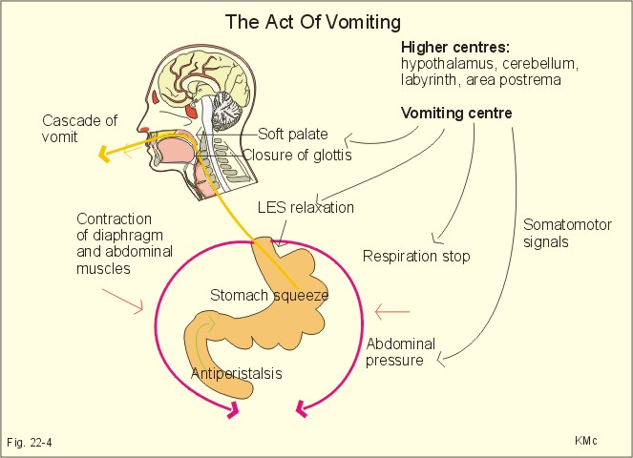

Slide 68
Control of vomiting

Slide 69
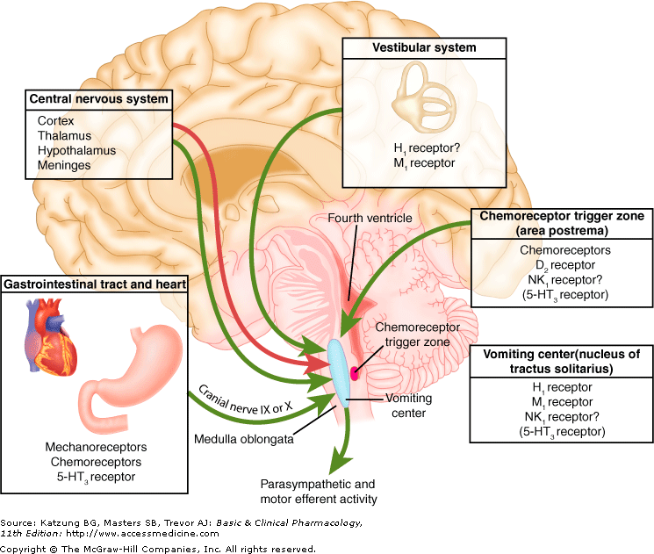

Slide 70
Brainstorming/Review
Brainstorming
Question & Answer

Slide 71
Brainstorming/Review
A woman comes to you. She has history of travel Sickness, which of the following drugs would help this patient?
Digitalis
Renatidine
Folic Acid
Diphenhydramine (Drug Acting on Vestibular Nuclei)
Morphine

Slide 72
Brainstorming/Review
The correct answer is D.
The motion stimulates Receptors in Vestibular Labrynth.

Slide 73
Vertical Integration

Slide 74
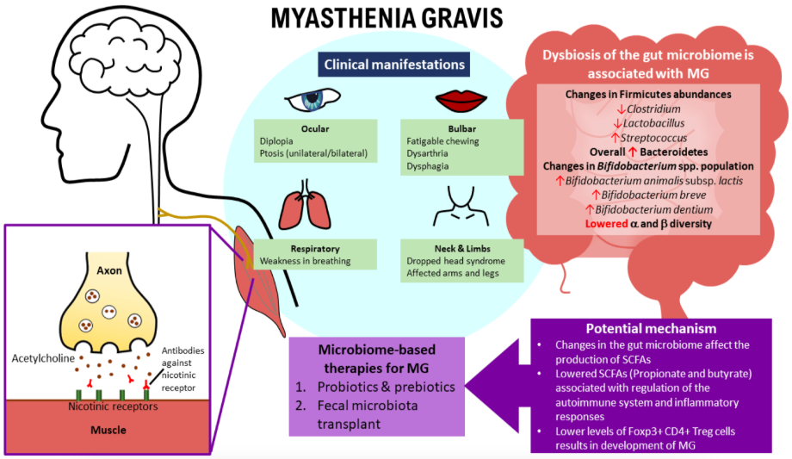
Vertical Integration

Slide 75
Understanding Biomedical Ethics
Biomedical Ethics

Slide 76
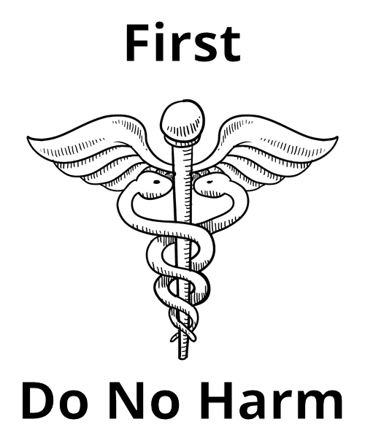
Bioethics
Non-maleficence
The principle of nonmaleficence holds that there is an obligation not to inflict harm on others. It is closely associated with the maxim primum non nocere (first do no harm).
Longitudinal bioethics Curriculum

Slide 77
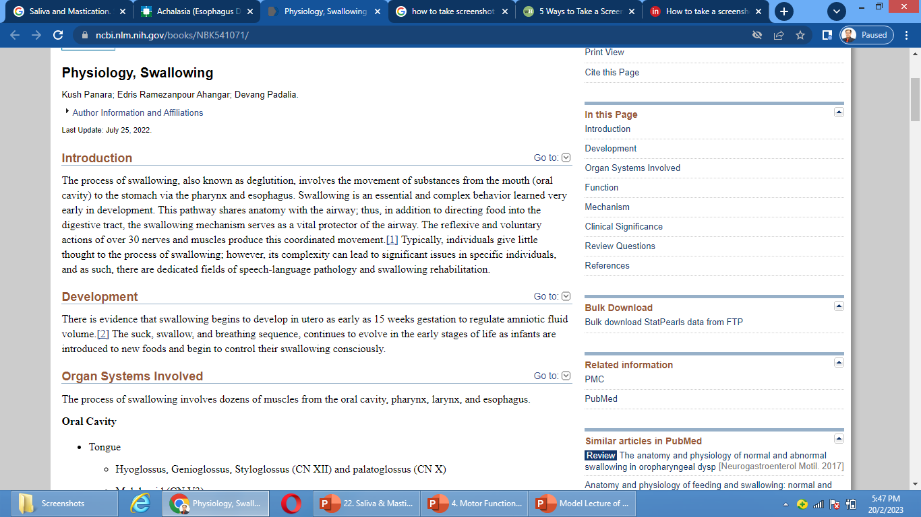
Research
Longitudinal Research Curriculum
https: www.ncbi.nlm.nih.gov/pmc/articles/PMC6850045/

Slide 78
How To Access Digital Library
Steps to Access HEC Digital Library:
Go to the website of HEC National Digital Library.
On Home Page, click on the INSTITUTES.
A page will appear showing the universities from Public and Private Sector and other Institutes which have access to HEC National Digital Library HNDL.
Select your desired Institute.
5. A page will appear showing the resources of the institution
6. Journals and Researches will appear
7. You can find a Journal by clicking on JOURNALS AND DATABASE and enter a keyword to search for your desired journal.

Slide 79
References
Guyton Text Book of Physiology
Share Wood Text Book of Physiology
Gagnon Text Book of Physiology
Silverthorne Text Book of Physiology
Person’s Text Book of Physiology
Essentials of Medical Physiology- by K Sembulingam and Prema Sembulingam 6th Edition.
Physiology by Linda S. Costanzo 6th Edition.

