Slide 2
THEME: Surgical Treatment Options Of Acid Peptic Diseases
To impart evidence-based research-oriented health
To impart evidence-based research-oriented health
To impart evidence-based research-oriented health
PROF. DR. Usman Qureshi
M.B.B.S F.C.P.S
HEAD OF THE DEPARTMENT
SURGERY UNIT–II, BBH
PROFESSOR OF SURGERY
RAWALPINDI MEDICAL UNIVERSITY

Slide 3
University Motto, Vision, Values & Goals
Mission Statement To impart evidence-based research-oriented health professional education .Best possible patient care Mutual respect, ethical practice of healthcare and social accountability. Vision and Values Highly recognized and accredited centre of excellence in Medical Education, using evidence-based training techniques for development of highly competent health professionals, who are lifelong experiential learner and are socially accountable. Goals The Undergraduate Integrated Learning Program is geared to provide you with quality medical education in an environment designed to:

Slide 4
PROF UMER MODEL OF INTEGRATED LECTURE

Slide 5
SEQUENCE OF LGIS
Learning objectives
1) Surgical Treatment Options Of Acid Peptic Diseases (core concept = 70%)
2) Principles of Surgical Treatment Options Of Acid Peptic Diseases (horizontal integration 10%)
3) Related clinical scenarios (vertical integration – 15%)
4) Research article related to topic (4%)
5) Ethics (1%)

Slide 6
LEARNING OBJECTIVES
At The End Of This Lecture Students Shall Be Able To Learn:
Brief Introduction about Acid Peptic Diseases
Different Causes and Risk Factors of Peptic Ulcer Disease
Indications For Peptic Ulcer Surgery
Surgical Options For Peptic Ulcer Disease
Clinical Menifestation and Surgical Treatment Of GERD

Slide 7
INTRODUCTION
The acid peptic diseases, also known as acid peptic disorders are a collection of diseases involving Excessive acid production in the stomach and nearby parts of the gastrointestinal tract.
The pathogenesis of these disorders involves an imbalance between acid secretion and gastric mucosal defenses.
Acid Peptic Disorders include Peptic Ulcer Disease and Gastroesophageal Reflux Disease.

Slide 10
Peptic Ulcer Disease
Peptic ulcers are defects in the gastric or duodenal mucosa that extend through the muscularis mucosae.
They develop and persist as a function of the acid-peptic activity in gastric juice.
Peptic ulcer disease (PUD) is associated with two major factors:
Helicobacter pylori (H. pylori) infection
Nonsteroidal anti-inflammatory drugs (NSAIDs).

Slide 11
Clinical Menifestation
Asymptomatic
Approximately 70 percent of peptic ulcers are asymptomatic.Patients with silent peptic ulcers may later present with ulcer-related complications such as hemorrhage or perforation.
Symptomatic
Upper Abdominal pain
Bloating
Abdominal Fullness
Nausea
Early Satiety

Slide 13
Risk Factors
Smoking
Alcohol
Foods
Citrus or acidic fruits
Chocolate, caffeine, and alcohol
Greasy, fatty, spicy, and fried foods
Garlic, onions, and mint flavourings
Psychological Factors
Stress
Depression

Slide 14
Pathophysiology
Most ulcers occur when the normal secretory, defense, or repair mechanisms of the stomach are disrupted by superimposed processes such as H. pylori infection and the ingestion of NSAIDs.
Gastric acid hypersecretion
Impaired duodenal bicarbonate secretion
The combination of increased gastric acid secretion and reduced duodenal bicarbonate secretion lowers the pH in the duodenum, which promotes the development of gastric metaplasia.

Slide 15
Pathophysiology

Slide 16
Pathophysiology H.Pylori

Slide 20
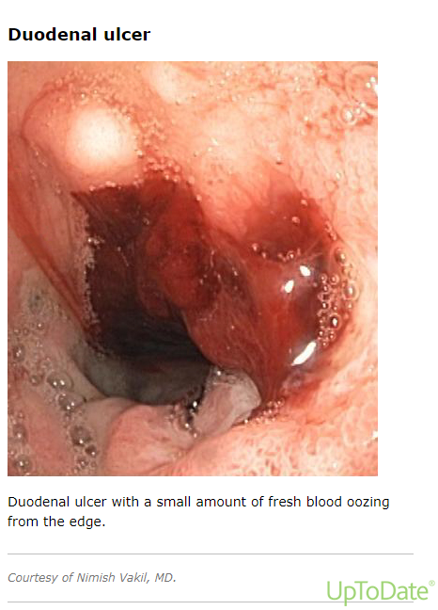

Slide 21
Investigations
Noninvasive
urea breath testing (UBT),
stool antigen testing
Serology
Invasive
Endoscopy and Biopsy
Biopsies Histopathology and C/S
Biopsy Urease Testing

Slide 22
INDICATIONS FOR PEPTIC ULCER SURGERY
Surgical management is reserved for peptic ulcer disease that is refractory to medical and/or endoscopic management, for suspicion of a malignancy within an ulcer, or for the management of complications of peptic ulcer disease ie,
Bleeding
Perforation
Obstruction

Slide 23
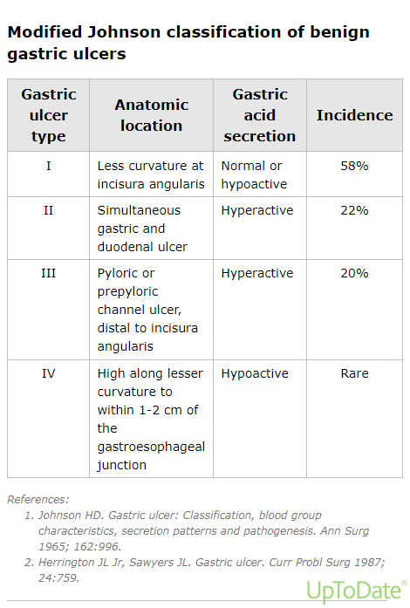

Slide 24
Gastric ulcer – Because gastric ulcers may harbor malignancy, the ulcer bed must be either extensively biopsied or excised.
Elective – For uncomplicated gastric ulcers the exact procedure(s) depend on the location of the ulcer and whether it is caused by hyperacidity.
Type 1 gastric ulcer – Distal gastrectomy
Type 2 gastric ulcer – Antrectomy plus vagotomy
Type 3 gastric ulcer – Antrectomy plus vagotomy
Type 4 gastric ulcer – Subtotal gastrectomy

Slide 25
Duodenal Ulcer
Perforation – For patients with a small perforated duodenal ulcer, closing the perforation with a piece of omentum (Graham patch).
For perforated ulcers close to the pylorus, truncal vagotomy with a pyloroplasty that incorporates the perforation is a reasonable alternative.
Large (>2 cm) or complex perforated duodenal ulcers may require specialized techniques to close and/or exclude
Various other procedures, such as jejunal serosal patch, Roux en-Y duodenojejunostomy, pyloric exclusion, and omental plugs, have been described for situations where primary closure is not feasible.

Slide 26
Surgical Options For Peptic Ulcer
Ulcer bed management
ligation of bleeding vessels
Placement and fixation of omentum within the ulcer bed to cover the defect and promote healing (ie, Graham patch).
Gastric drainage
Gastric drainage procedures divide or bypass the pyloric sphincter mechanism to facilitate gastric emptying and avoid gastric stasis

Slide 28
Pyloroplasty is a procedure that widens the opening between the antrum and duodenum to facilitate passage of gastric contents .
•The Heineke-Mikulicz pyloroplasty
•The Finney and Jaboulay pyloroplasties
Gastrojejunostomy which anastomoses the dependent portion of the stomach to the proximal jejunum, is typically reserved for patients with significant duodenal bulb scarring that precludes safe pyloroplasty.

Slide 30
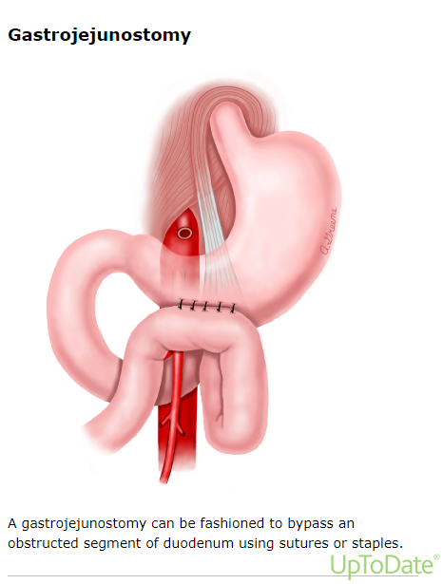

Slide 31
Definitive Ulcer Surgery
Vagotomy
It is a procedure that transects or removes a portion of the vagus nerves or branches of the vagus nerves to decrease gastric acid secretion.
Partial gastrectomy
(eg, antrectomy, subtotal gastrectomy)

Slide 32
Gastrointestinal reconstruction
Reconstruction is necessary following partial gastrectomy to reestablish gastrointestinal continuity.Following are the most common Reconstruction Techniques:
Billroth I
Billroth II
Roux-en-Y gastrojejunostomy

Slide 33
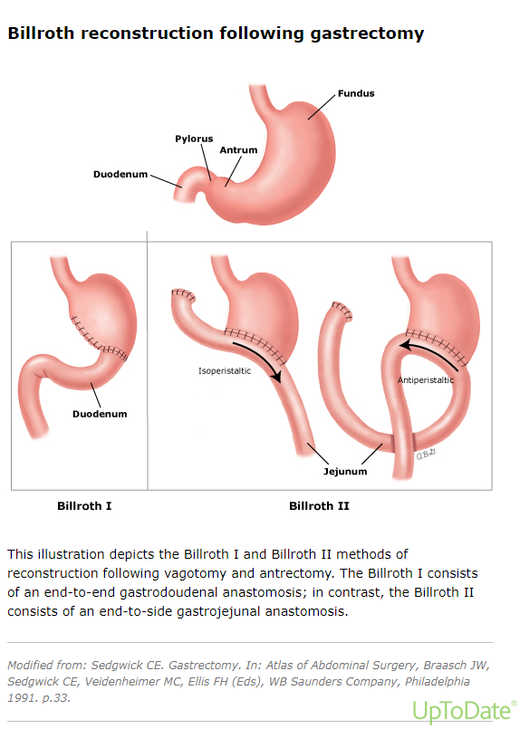

Slide 35
GERD
Gastroesophageal reflux disease (GERD) is defined as "a condition which develops when the reflux of stomach contents causes troublesome symptoms or complications“
It is manifested by a spectrum of nonspecific symptoms, including
heartburn
regurgitation
Dysphagia
Laryngitis
Adult-onset asthma
Aspiration pneumonia

Slide 36
INDICATIONS FOR SURGICAL MANAGEMENT
Antireflux procedures are most often performed to control gastrointestinal symptoms (eg, heartburn and regurgitation).
Gastrointestinal Symptoms
Failed medical management
Intolerance of or noncompliance with medical therapy
Complications of GERD
Volume regurgitation
Nongastrointestinal indications(chronic cough, hoarseness, laryngitis, wheezing, asthma, chronic bronchitis, aspiration)

Slide 38
Antireflux Surgical Procedures
Transoral incisionless fundoplication (TIF)
Magnetic sphincter augmentation (MSA)
Laparoscopic Hill gastropexy
Laparoscopic partial fundoplication
Laparoscopic Nissen (complete) fundoplication

Slide 40
Surgical approaches
Transabdominal fundoplication
Transthoracic fundoplication

Slide 41
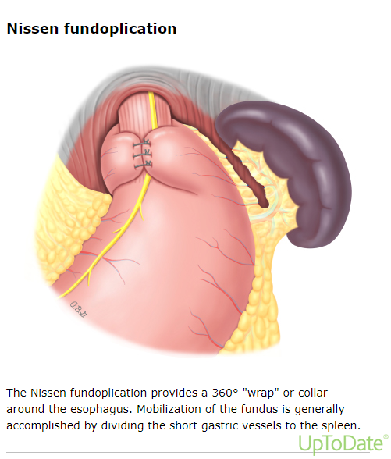

Slide 42
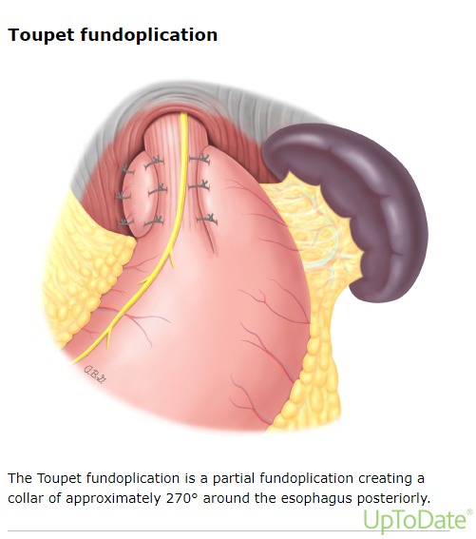

Slide 43
REFERENCES
Wang YR, Richter JE, Dempsey DT. Trends and outcomes of hospitalizations for peptic ulcer disease in the United States, 1993 to 2006. Ann Surg 2010; 251:51.
Sonnenberg A. Review article: historic changes of Helicobacter pylori-associated diseases. Aliment Pharmacol Ther 2013; 38:329.
Kavitt RT, Lipowska AM, Anyane-Yeboa A, Gralnek IM. Diagnosis and Treatment of Peptic Ulcer Disease. Am J Med 2019; 132:447.
Lanas A, Chan FKL. Peptic ulcer disease. Lancet 2017; 390:613.
Lau JY, Sung J, Hill C, et al. Systematic review of the epidemiology of complicated peptic ulcer disease: incidence, recurrence, risk factors and mortality. Digestion 2011; 84:102.
Towfigh S, Chandler C, Hines OJ, McFadden DW. Outcomes from peptic ulcer surgery have not benefited from advances in medical therapy. Am Surg 2002; 68:385.
Rockall TA. Management and outcome of patients undergoing surgery after acute upper gastrointestinal haemorrhage. Steering Group for the National Audit of Acute Upper Gastrointestinal Haemorrhage. J R Soc Med 1998; 91:518.

Slide 44
Any Question?
Thankyou

