Slide 1


Slide 2

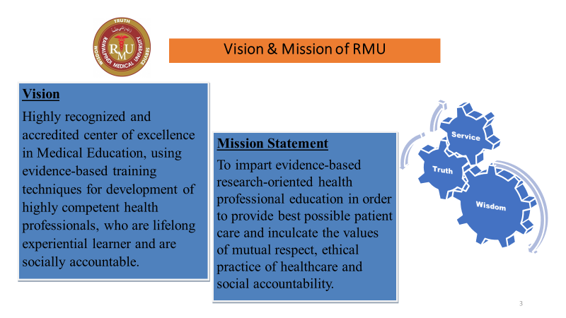
Vision & Mission of RMU:

Slide 3
Surface infections (AIDS, STIs, trachoma, Scabies)
Block II-eye

Slide 4
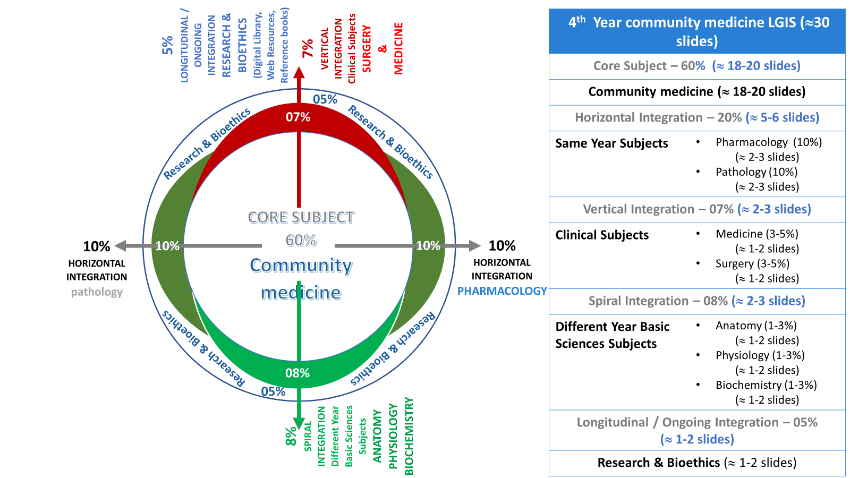
Prof Umar Model

Slide 5
Sequence of discussion
Sr. No | Headings | Approximate %
1. | Title of SGD
2. | Learning Objectives From Study Guide
3. | Core Concepts of the Topic | 70%
4. | Related Advanced Research Points | 05%
5. | Related Ethical Points | 10%
6. | Artificial Intelligence | 05%
7. | End Of Lecture Assessment | 10%

Slide 6
Learning Objectives
At the end of session students will be able to
Describe the epidemiology of surface infections
Identify the risk factors of surface infections
Recommend the preventive & control measures for surface infections
Appraise the working of Punjab AIDS Control Programme

Slide 7
Sexually transmitted diseases Problem Statement
Core concept
caused by bacterial, viral, protozoal , fungal agents and ectoparasites .
More than 1 million STIs are acquired every day.
Each year, there are 357 million new infections with 1 of 4 STIs
More than 500 million people are living with genital HSV (herpes)
Reference K.Park textbook of preventive and social medicine 25th edition page no. 348

Slide 8
Control of STDS
Core concept
Intervention strategies
Case Detection , Case holding & treatment ,Epidemiological treatment ,Personal prophylaxis ,Health education
Support components
STD clinics, laboratory services, PHC , information system , legislation , social welfare measures
Identify problem, establishing priority, setting objectives
Initial Planning
Monitoring and evaluation
Ongoing evaluation of disease trends

Slide 9
Acquired Immunodeficiency Syndrome---epidemiology
Agent : Human immuno-deficiency virus (HIV)
• Retrovirus
Two serological types: HIV-1 & HIV-2
• Pathogenecity of HIV-2 is lower
Mother to fetus transmission of HIV-2 is also
lower
Core concept

Slide 10
Mode of transmission
Core concept
Person to person un-protected sex; homosexual,
heterosexual & bisexual.
Contact of abraded skin with body secretions
like blood, semen or CSF
Use of HIV infected needles and syringes
transfusing infected blood

Slide 11
Stages of AIDS
Vertical integration
Stage 1 :Initial infection with virus and development of antibodies. (Flu like illness , asymptomatic)
Stage 2: Asymptomatic carrier state. ( lasts for 10 years , asymptomatic , antibodies detectable in blood)
Stage 3 :AIDS related complex mild symptoms , emergence of opportunistic infections and cancers.
Stage 4 : illnesses become more severe leading to an AIDS diagnosis.

Slide 12
Signs & Symptoms
Vertical integration
Major signs
Persistent diarrhea for more than 1 month
• Weight loss≥10% of body weight
Prolonged fever for more than 1 month
Minor signs
Persistent cough for more than 1 month
• Mouth ulcers/thrush.
• Abdominal pain, Eye problems.
• Skin lesions, greneralized lymphadenopathy

Slide 13
Prevention & Control of AIDS
Core concept
health Education
Prevention of blood borne HIV transmission
Antiretroviral treatment
Specific prophylaxis
Four ways to protect yourself : 1 Abstinence
2 Monogamous Relationship
3 Protected Sex
4 Sterile needles

Slide 14
Diagnosis
horizontal integration
ELISA/EIA (screening test)
Radio Immunoprecipitation Assay/Indirect
Fluorescent Antibody Assay (RIP/IFA)
Polymerase Chain Reaction (PCR)
• Western Blot (Confirmatory test)
Urine Western Blot Orasure

Slide 15
Family medicine
Pre test counselling : Transmission, Prevention , Risk Factors ,Voluntary & Confidential, Reportability of Positive Test Results
Post test counselling :
Clarifies test results
• Need for additional testing
• Promotion of safe behaviour
• Release of results

Slide 16
Ethics related AIDS
Autonomy : respect for persons and their right to make informed decisions about their lives, health, and health care.
Beneficence: caregivers act in the best interests of their patients

Slide 17
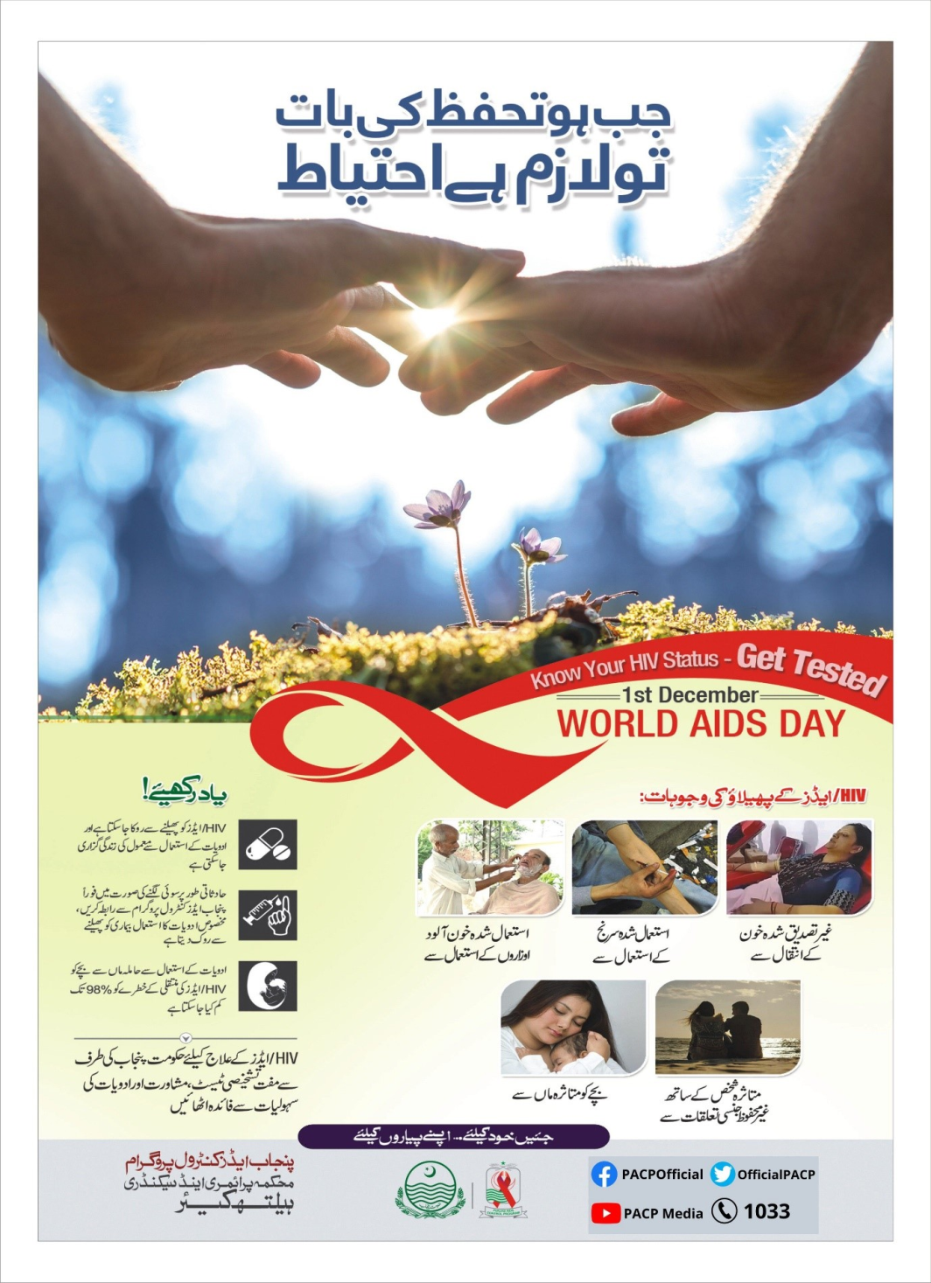
Punjab AIDS control programme
Core concept
State of the art Bio-Safety Level 3 laboratory
25 HIV treatment centers in 16 districts of Punjab
Biometric Registration of all patients for seamless service delivery
Lost to Follow-up mechanism that ensures no patient is left untreated
Provision of rashan packages to people living with HIV with collab
Reference
https://pshealthpunjab.gov.pk/home/verticalprogramaidsoration of APLHIV

Slide 18
Trachoma
horizontal integration
Trachoma is a chronic infectious disease of conjunctiva and cornea
caused by Chlamydia trachomatis
Types of trachoma:
1)Blinding trachoma.
2)Non- blinding trachoma

Slide 19
Problem Statement
Core concept
Trachoma is a major cause of preventable blindness in developing countries
About 1.9 million people currently suffer from visual impairment due to trachoma
200 million are at the risk infection
In 2021, 69 266 people received surgical treatment for advanced stage of the disease,
(source https://www.who.int/news-room/fact-sheets/detail/trachoma )

Slide 20
Epidemiologic determinants
Core concept
Agent factors: Causative agent:
a) Chlamydia trachomatis (serotypes A,B,C)
Host factors:
a) Age : More in infancy/childhood
b) Sex : In older age groups females are affected more
Environmental factors:
Direct sunlight, Dust , Smoke , Eye cosmetics , Low socio-economic status, unhygienic conditions, lack of sanitation

Slide 21
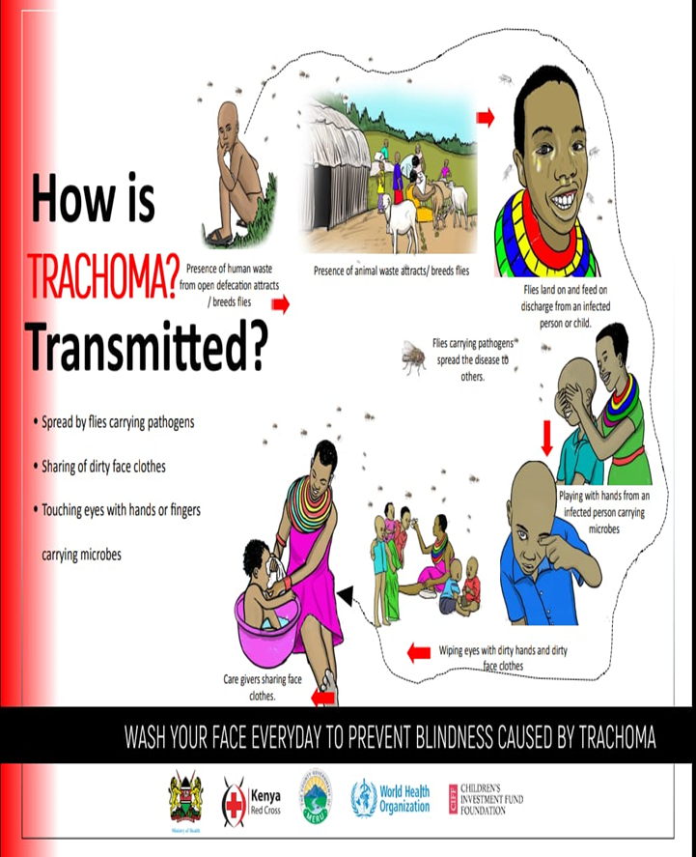
Mode of transmission
Core concept

Slide 22
Diagnosis
Horizontal integration
The cases must have at least two of the following criteria:
a) Follicles on upper tarsal conjunctiva.
b) Limbal follicles or their sequelae (Herbert’s Pit)
c) Typical conjunctival scarring (trichiasis, entropion)
d) Vascular Pannus most marked at superior limbus

Slide 23
Family medicine
Family medicine
Trachoma control programme requires the following elements:
a. Assessment of problem- Epidemiological surveys
b. Chemotherapy- Mass treatment or Selective treatment
c. Surgical correction
d. Surveillance-whole family
e. Health education
f. Evaluation- changes in age-specific rates of active trachoma, prevention of trichiasis and entropion

Slide 24

Scabies
Agent : SARCOPTES SCABIEI Epidemiological determinants:
All persons are susceptible
commonly occurs where cleanliness is lacking.
Spread:
Direct: Prolonged close contact
Indirect: Contact with soiled bed linen , clothing or other contaminated objects

Slide 25
Clinical features
Vertical intergation
Itching which is worse at night
involves more than 1 family member. Itchy red papules which can occur anywhere on the skin.
Diagnosis : skin scrapings of a lesion and demonstrating parasite under microscope.
Complications:
furunculosis , impetigo , pyoderma

Slide 26
Prevention & treatment
Core concept
Topical scabicides such as 5% permethrin , malathion , benzyl benzoate lotion , sulphur ointment .
Health education about proper cleanliness and body care and frequent change of underclothing and bedding .
Children who are infested should be excluded from school until disinfected

Slide 27
EOLA
1. A mother brought her three weeks old baby boy in eye opd . The baby was delivered at home . After few days of birth the baby got swelling of eye and mucopurulent discharge from left eye. The doctors suspect him a case of trachoma. In this case the most possible causative factor would be :
a)Premature rupture of membranes.
b)Prolonged labour
c)Untreated maternal chlamydial infection in pregnancy
d)Monsoon season at time of delivery
e)Preterm delivery of baby
Ans : c

Slide 28
EOLA
2. Post exposure prophylaxis of HIV/AIDS should be started within ?
a)21 hours
b)48 hours
c)72 hours
d)within 10 days
e) no specific time required
Ans : c

Slide 29
EOLA
A 22-year-old woman presented with complaint of severe nocturnal itching and rash on the hands, wrists, and axillae. She currently is residing at a shelter and states that several close contacts have described similar symptoms. Examination of her hands reveals burrows on the flexor surfaces and interdigital spaces. A clinical diagnosis of scabies is made . the best method to make a definitive diagnosis of scabies will:
a)Identification of burrows on skin examination
b)Identification of mites using a magnifying glass on skin examination
c)Performing a skin scraping from a burrow and identifying mites, eggs, or feces under the microscope
d)Performing a culture of a skin scraping from a burrow and isolating Sarcoptes scabiei in a culture specimen
Ans : c

Slide 30
Related Research
Research
https://www.jidc.org/index.php/journal/article/view/35298417
Abstract
Scabies is a contagious parasitic skin disease caused by Sarcoptes scabiei infestation which can be transmitted through direct or indirect contact. WHO classified scabies as a neglected tropical disease. The prevalence of scabies is high in certain countries ranging from 32.1% to 74%, especially in crowded conditions such as prisons, boarding schools, and orphanages. Mass treatment with permethrin cream or ivermectin can be given directly to patients. Prevention is conducted by providing medical treatment and breaking the chain of transmission. Source elimination and disinfection of fomites is very important. Participation of non-medical personnel such as teachers, cadres, and parents together with the local health workers (primary health care) is highly recommended. Using checklists or application can aid non-medical personnel to determine suspected cases, thus contributing to scabies elimination.

Slide 31
Learning resources
K.Park textbook of preventive and social medicine 25th edition page no. 348 & 361
Textbook Public Health & Community medicine by Mohammad Ilyas 7th edition page 584

Slide 32


