Slide 1
Kidney Stones, Diagnosis and Treatment
Renal Module
4th Year MBBS
Dr Kiran Fatima
Pathology Department
Rawalpindi Medical University

Slide 2

MOTTO OF RMU
Wisdom
Truth
Service

Slide 3
VISION OF RMU
THE DREAM/ TOMORROW
To impart evidence based research oriented medical education
To provide best possible patient care
To inculcate the values of mutual respect and ethical practice of medicine

Slide 4
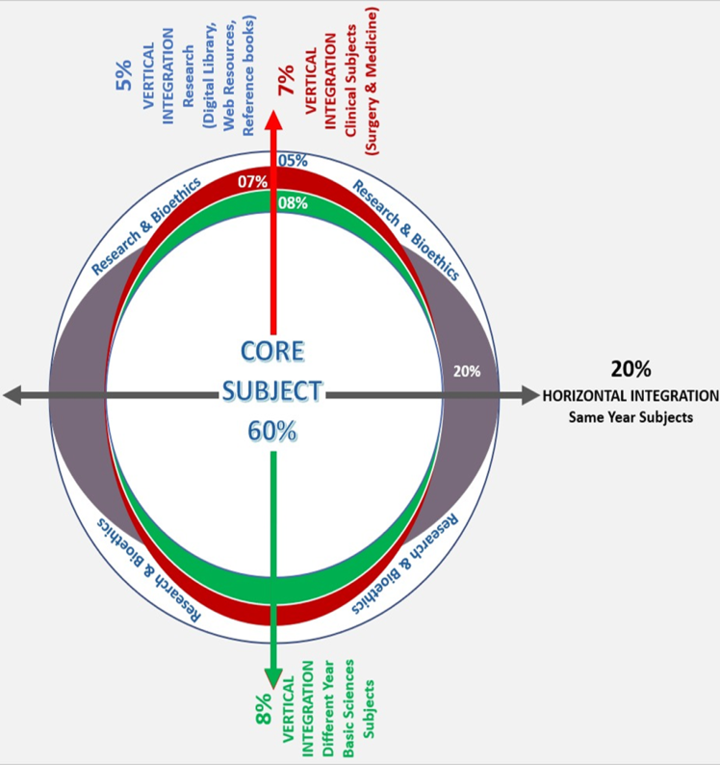
PROF UMAR’S LGIS MODEL

Slide 5
How to use HEC Digital Library
Steps to Access HEC Digital Library
Go to the website of HEC National Digital Library.
On Home Page, click on the INSTITUTES.
A page will appear showing the universities from Public and Private Sector and other Institutes which have access to HEC National Digital Library (HNDL).

Slide 6
4. Select your desired Institute.
5. A page will appear showing the resources of the institution
6. Journals and Researches will appear
7. You can find a Journal by clicking on JOURNALS AND DATABASE and enter a keyword to search for your desired journal.

Slide 7
Learning objectives:
At the end of this lecture we will be able to know that:
Types and risk factors for stone formation.
How patients with stone disease present in OPD / ER.
The investigations and definitive management for stone disease.

Slide 8
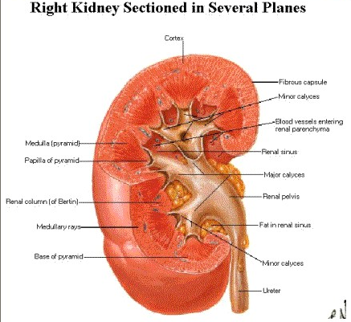
Spiral Anatomy

Slide 9
Risk factors
Core Content
Age
  Peek age incidence is between 20 to 40years
Sex
  Male Female ratio 3 : 1
Genetic
  25% of patients gives family history of stone disease.
  Familiar renal tubular acidosis
  Cystine uria
Climatic Condition
Geographical Location
Fluid Intake

Slide 10
Core Content
Diet
  High animal protein
  High salt intake
  Low Calcium diet
  Increase vitamin D
Occupation
  Laborers
  White collar jobs

Slide 11
Core Content
Urinary tract infections
  Urea splitting organisms
Immobility
Systemic disease
Anatomical abnormalities

Slide 12
Types of stones
Core Content
Oxalate
Struvite or Phosphate
Uric acid
Cystine
Xanthine

Slide 13
Core Content
Promotors
A) calcium
B) phosphate
C) oxalate
D) uric acid
Inhibitors
a) Citrate
b) Magnesium

Slide 14
Renal calculi
Core Content
Symptoms
  Pain
  Haematuria
  Infection
  Fever
  Renal failure
  Nausea & Vomiting

Slide 15
Signs
Core Content
Distress, Tachycardia, sweating
Tender costovertabral angle
Palpable kidney

Slide 16
Investigations
Core Content
Baseline
Urine R/E
USG
CT KUB
IVU
RFTs

Slide 17
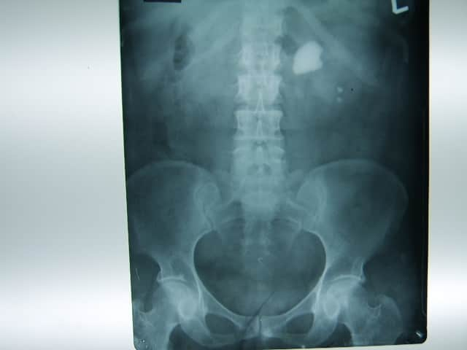

Slide 18
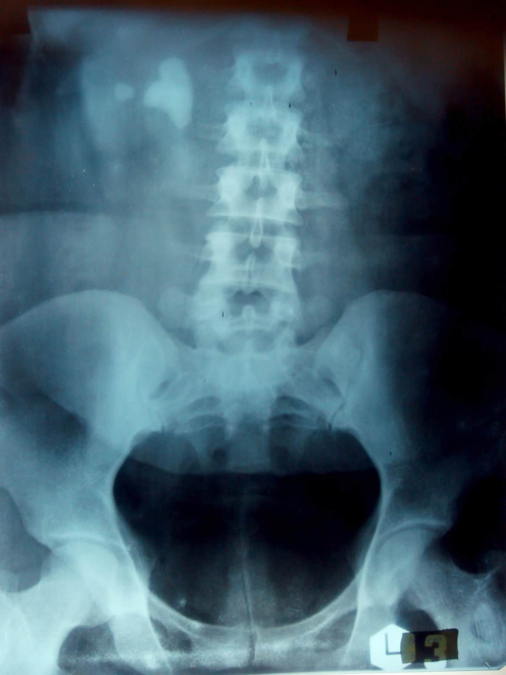

Slide 19
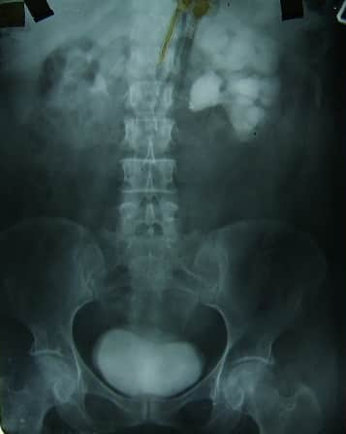

Slide 20
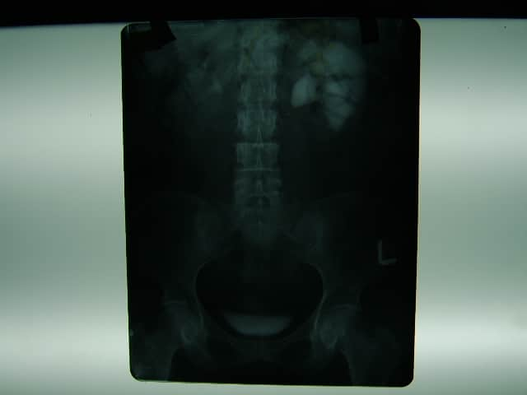

Slide 21
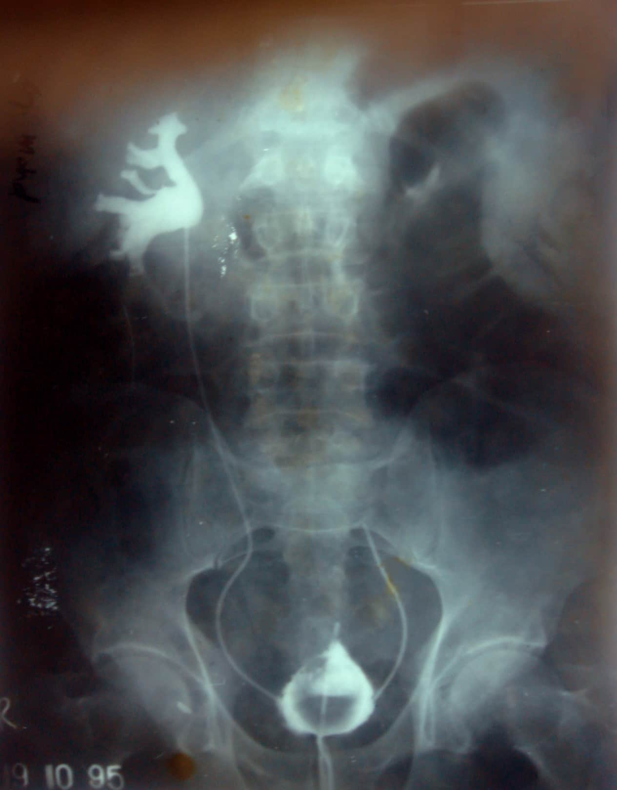

Slide 22
Treatment
Emergency
  Pain relief
  Control of infection
Definitive treatment

Slide 23
a) Surgery
Horizontal Integration
Pyelolithotomy
Nephrolithotomy
b) PCNL & Intracorporeal Lithotripsy
c) ESWL

Slide 24
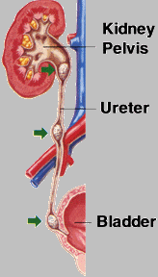
Ureteric calculi
Core Content
Points of impaction
  Ureteropelvic junction
  Crossing of iliac artery
  Vas deferens or broad ligament
  Intramural part
  Ureteric orifice

Slide 25
Signs & symptoms
Similar to renal calculi

Slide 26
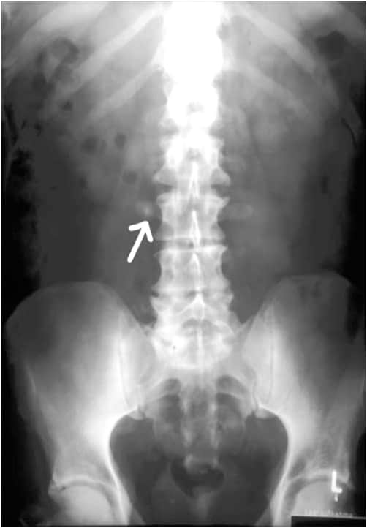

Slide 27
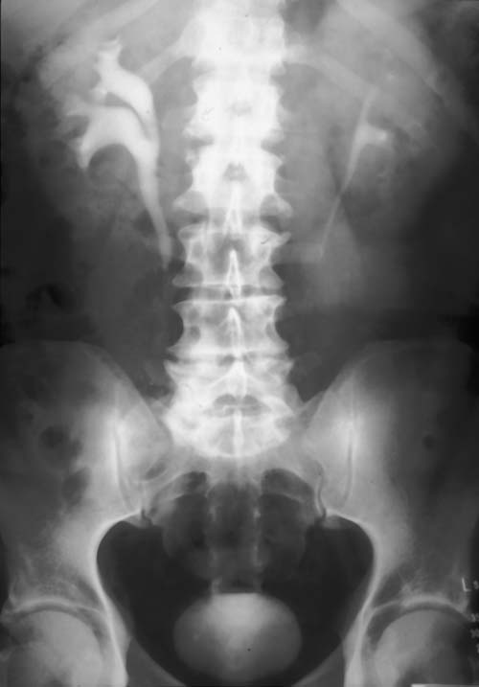

Slide 28
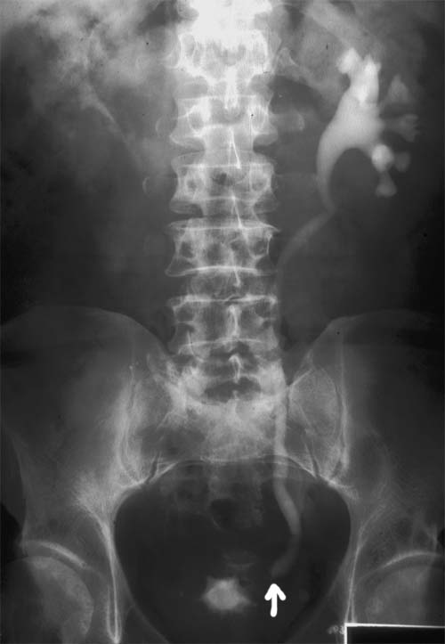

Slide 29
Investigations
Vertical integration
  Similar to Renal calculi
Treatment
Expectant
Relief of pain ,assessment of renal function & back pressure
Follow up
Ureterolithotomy
Endoscopic removal
ESWL

Slide 30
Research
https://pmc.ncbi.nlm.nih.gov/articles/PMC5585751/
Compositional analysis of various layers of upper urinary tract stones by infrared spectroscopy
Zhang He ^{1,*}, Zhang Jing ^{1,*}, Zheng Jing-Cun ¹, Hu Chuan-Yi ¹, Gao Fei ^{2,✉}
PMCID: PMC5585751 PMID: 28912866
Abstract
The objective of the present study was to determine the composition of various layers of upper urinary stones and assess the mechanisms of stone nucleation and aggregation. A total of 40 integrated urinary tract stones with a diameter of >0.8 cm were removed from the patients. All of the stones were cut in half perpendicularly to the longitudinal axis. Samples were selected from nuclear, internal and external layers of each stone. Fourier transform infrared spectroscopy (FT-IR) was adopted for qualitative and quantitative analysis of all of the fragments and compositional differences among nuclear, internal and external layers of various types of stone were subsequently investigated. A total of 25 cases of calcium oxalate (CaOx) stones and 10 cases of calcium phosphate (CaP) stones were identified to be mixed stones, while 5 uric acid (UA) calculi were pure stones (purity, >95%). In addition, the contents of CaOx and carbapatite (CA.AP) crystals in various layers of the mixed stones were found to be variable. In CaOx stones, the content of CA.AP in nuclear layers was significantly higher than that of the outer layers (32.0 vs. 6.8%; P<0.05), while the content of CaOx was lower in the inner than in the outer layers (57.6 vs. 86.6%; P<0.05). In CaP stones, the content of CA.AP in the nuclear layers was higher than that in the outer layers (74.0 vs. 47.3%; P<0.05), while the content of CaOx was lower in the inner than in the outer layers (7.0 vs. 40.0%; P<0.05). The UA stones showed no significant differences in their composition among different layers. In conclusion, FT-IR analysis of various layers of human upper urinary tract stones revealed that CaOx and CaP stones showed differences in composition between their core and surface, while all of the UA calculi were pure stones. The composition showed a marked variation among different layers of the stones, indicating that metabolism has an important role in different phases of the evolution of stones. The present study provided novel insight into the pathogenesis of urinary tract stones and may contribute to their prevention and treatment.

Slide 31
Family Medicine
A 35-year-old male presents to the emergency department with sudden, severe, colicky pain in his left flank radiating to his groin. He reports nausea and vomiting. He is visibly in distress and diaphoretic. His urine is tea-colored.
Question: What is the MOST likely diagnosis?
A) Pyelonephritis (kidney infection) B) Appendicitis C) Musculoskeletal strain D) Urolithiasis (kidney stone)
Correct Answer: D) Urolithiasis (kidney stone)

Slide 32
Take home message
Urinary tract stones (kidney stones) are hard deposits of minerals and salts that form inside the kidneys and can travel down the urinary tract, causing intense pain. Risk factors include dehydration, diet, and family history. Treatment varies depending on stone size and location, ranging from pain management to procedures like lithotripsy.

Slide 33


