Slide 2
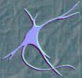
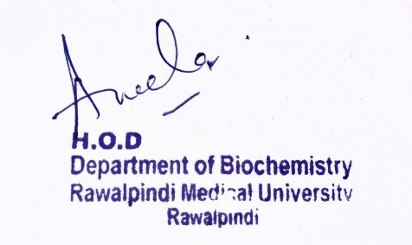
Special Senses Module 2nd Year MBBS (LGIS) Neurotransmitters
Presenter: Dr. Aneela Jamil Date: 26-02-25
(Assistant Professor)

Slide 3
Motto, Vision, Dream
To impart evidence based research oriented medical education
To provide best possible patient care
To inculcate the values of mutual respect and ethical practice of medicine
Wisdom
Truth
Service

Slide 4
Professor Umar Model of Integrated Lecture

Slide 5
Learning Objectives
At the end of this lecture students should be able to
Discuss classification of neurotransmitters
Describe the steps of neurotransmission
Explain synthesis and role of important neurotransmitters
Vertically integrate related disorders

Slide 6
Definition
Core Knowledge
A chemical substance released by one neuron that affects another neuron or an effector organ (e.g., muscle, gland, blood vessel)
OR
Chemical messenger that transmits signals from a neuron to a target cell across a synapse

Slide 7
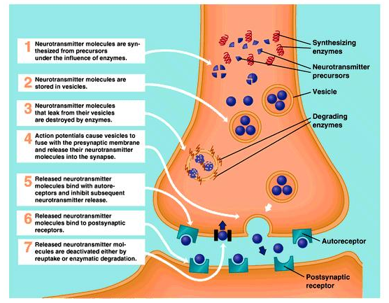
Core Knowledge

Slide 8
Classification based on chemical composition
Core Knowledge
Group | Example
Amines | Catecholamines
Amino acids | Glutamate, aspartate, glycine
Amino acid derivatives | GABA, histamine
Peptides | Endorphins, enkephalins
Others | Acetylcholine, adenosine, nitric oxide

Slide 9
Classification based on function
Core Knowledge
Group | Example
Excitatory | Glutamine, aspartate, histamine
Inhibitory | GABA, glycine
Excitatory & inhibitory (depends on type of receptor) | Acetylcholine, norepinephrine, dopamine

Slide 10
Fate of Neurotransmitters
Core Knowledge
At postsynaptic membrane
Enzymatic degradation
Reuptake mechanism - this is the most common fate

Slide 11
Mechanism of Action
Core Knowledge
Types of Receptors
Ionotropic receptor
Ligand binding to receptor is directly linked to opening or closing of ion channel
Metabotropic receptor
Ligand binding to receptor is indirectly linked to ion channel through second messenger system

Slide 12
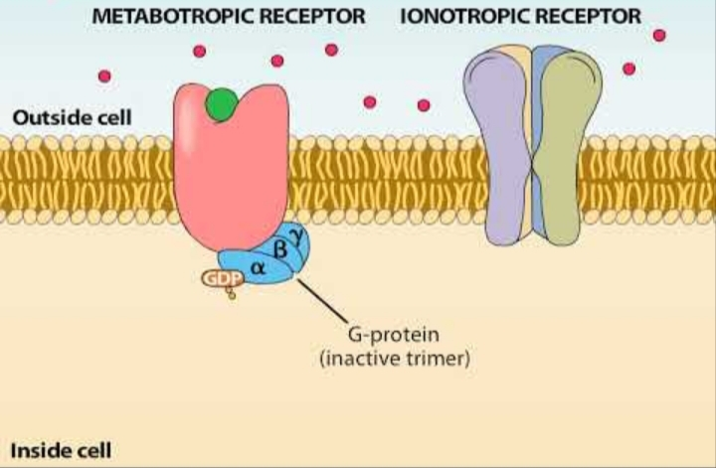
Core Knowledge

Slide 13
Acetylcholine
Core Knowledge
Synthesis:
from choline and acetyl CoA in presynaptic cholinergic neurons
enzyme is choline acetyl transferase

Slide 14
Core Knowledge

Slide 15
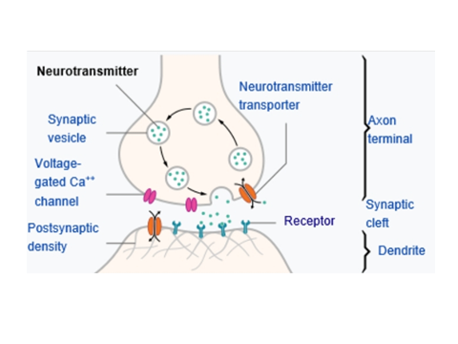
Core Knowledge
2. Release:
nerve impulse moves down to the presynaptic terminal → change in the membrane potential → opening of voltage gated calcium channels → Ca2 influx → synaptic vesicles fuse with the axonal membrane → exocytosis of Ach to synaptic cleft

Slide 16
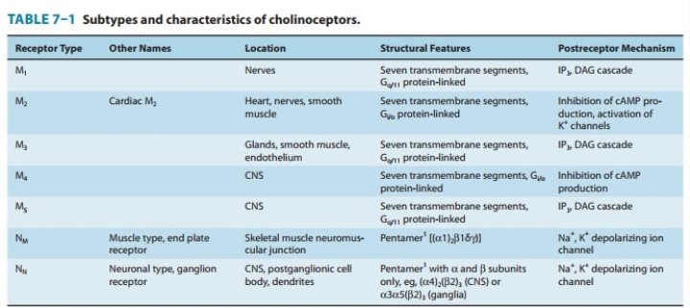
Core Knowledge

Slide 18
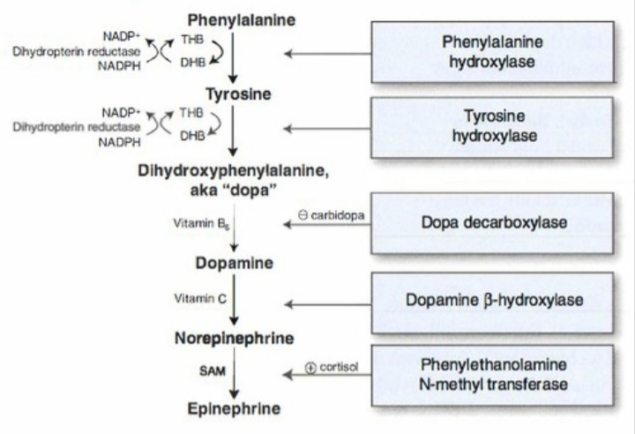
Core Knowledge
Catecholamines
Synthesis:

Slide 19
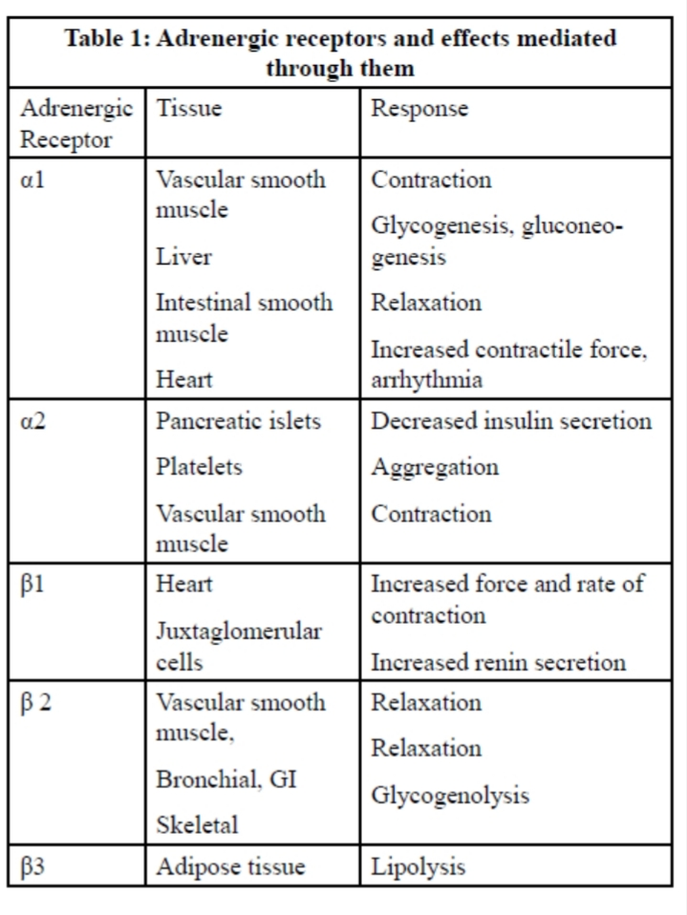

Slide 20
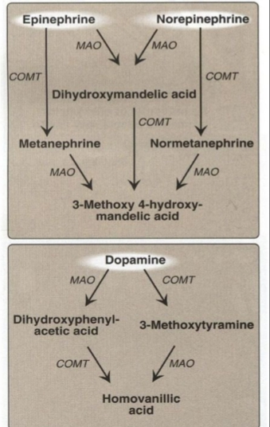
Core Knowledge
4. Deactivation:

Slide 21
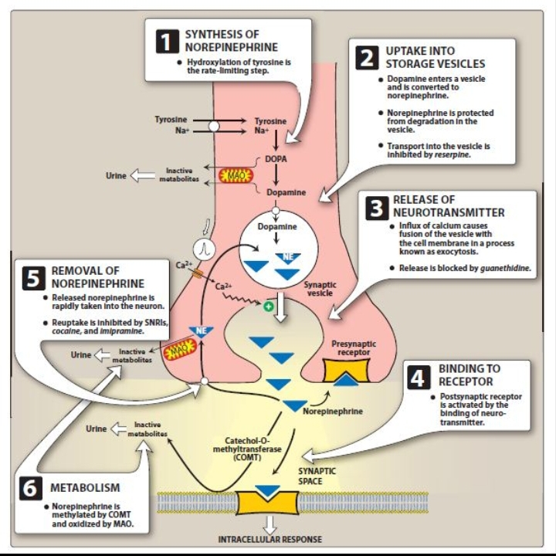
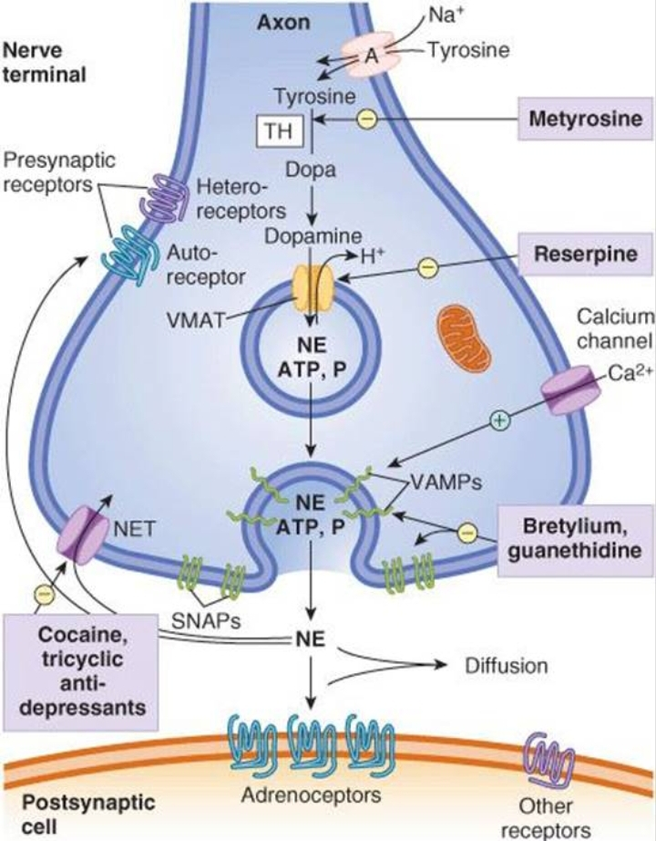

Slide 22
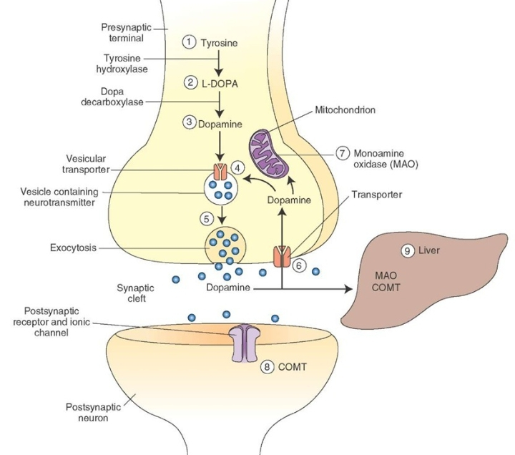
Serotonin
Core Knowledge

Slide 23
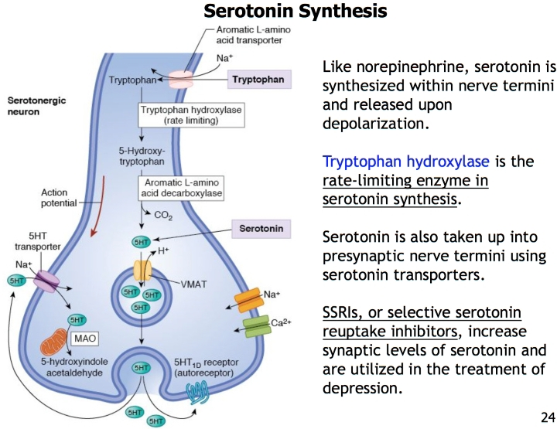
Core Knowledge
Synthesis, release, binding & degradation

Slide 24
Core Knowledge
Glutamate
Synthesis:
from glutamine by glutaminase enzyme
NOTE: precursor of GABA by glutamate decarboxylase enzyme

Slide 25
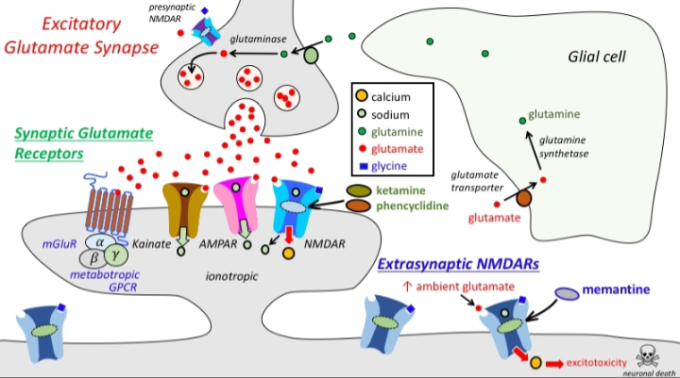
Core Knowledge
Binding to receptor:
metabotropic & ionotropic receptors (NMDA, APMA & kainate)

Slide 26
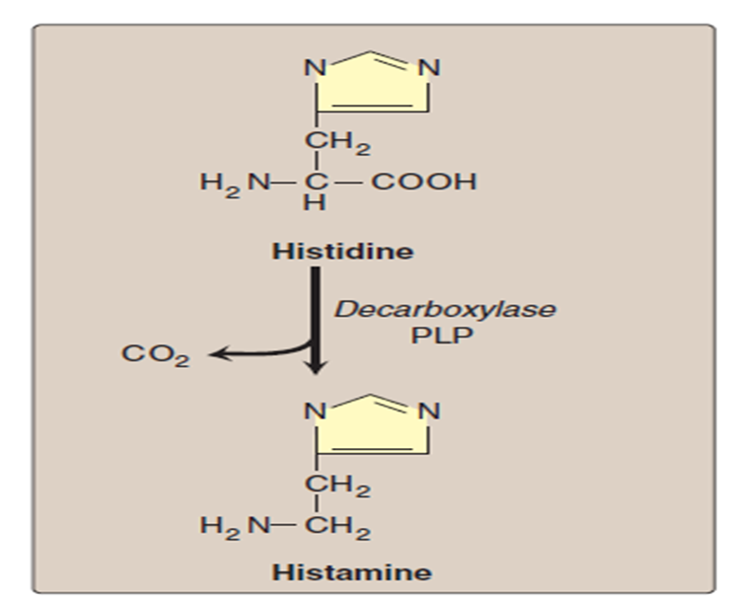
Core Knowledge
Histamine
Histidine, on decarboxylation, gives the corresponding amine → HISTAMINE

Slide 27
Core Knowledge
Nitric Oxide
Arginine is the substrate for the production of Nitric oxide (NO) by nitric oxide synthase

Slide 28
Core Knowledge
smooth muscle relaxation
vasodilation
regulation of blood flow and the blood pressure (inhibitors of NO synthesis raise blood pressure)
inhibitor of platelet aggregation and adhesion
neurotransmitter
mediates the bactericidal actions of macrophages
Functions of Nitric oxide

Slide 29
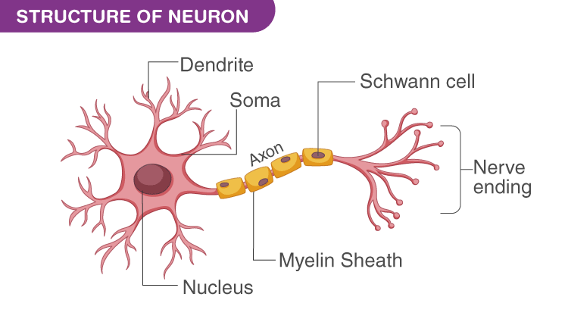
Anatomical & Physiological Aspects
Horizontal Integration

Slide 30
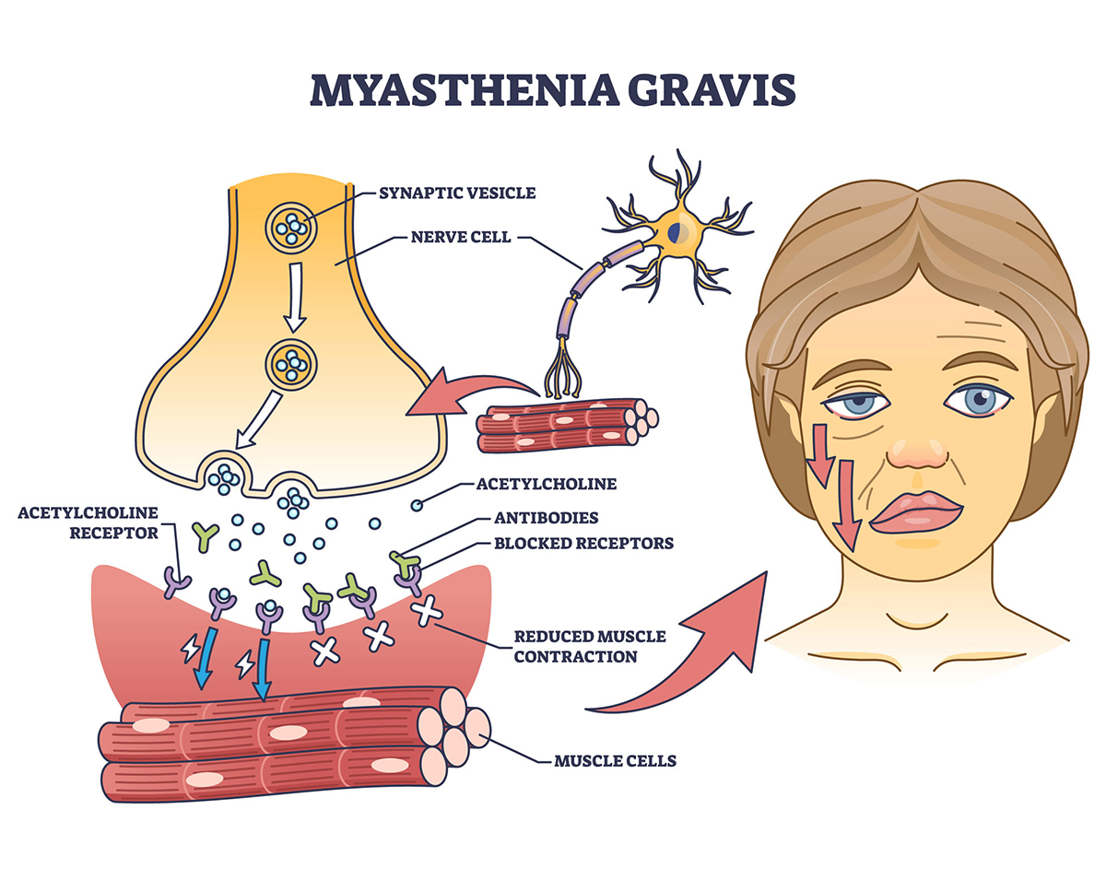
Vertical Integration
Acetylcholine

Slide 31
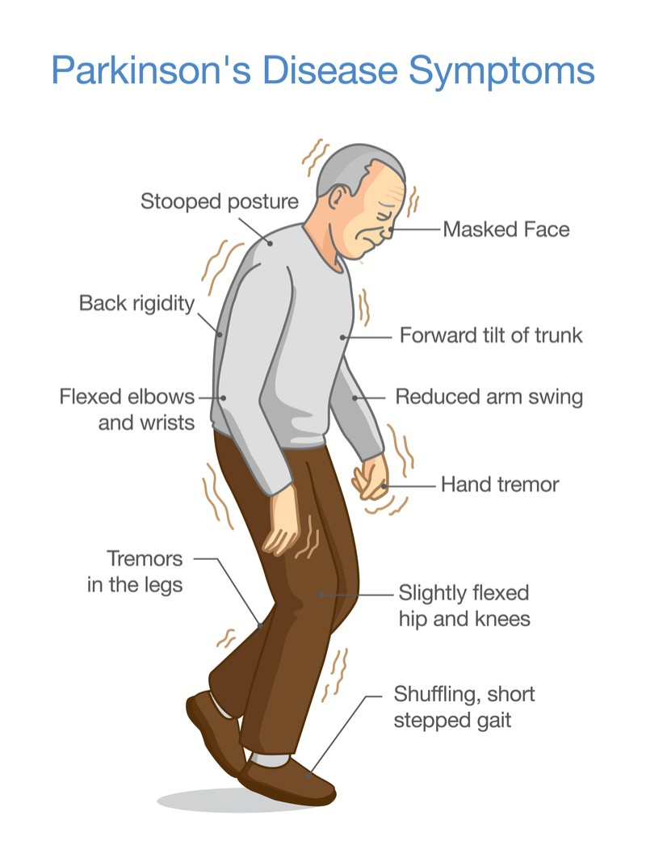
Vertical Integration
Dopamine

Slide 32
Family Medicine
Spiral Integration
Family Medicine plays important role in following manner:
Early Diagnosis
Education
Dietary Guidance
Monitoring
Refer to Specialists

Slide 33
Artificial Intelligence
Spiral Integration
Artificial Intelligence plays role in following aspects:
Utilizes extensive data from patient thereby enhancing prevention, diagnosis & treatment based on individual genetic profile

Slide 34
Suggested Research Article
Spiral Integration
Link: https://translationalneurodegeneration.biomedcentral.com/articles/10.1186/s40035-023-00378-6
Journal Name : BMC
Title: Role of dopamine in the pathophysiology of Parkinson’s disease
Author Name: Zhi Dong Zhou
Introduction
A pathological feature of Parkinson’s disease (PD) is the progressive loss of dopaminergic neurons and decreased dopamine (DA) content in the substantia nigra pars compacta in PD brains. DA is the neurotransmitter of dopaminergic neurons. Accumulating evidence suggests that DA interacts with environmental and genetic factors to contribute to PD pathophysiology. Disturbances of DA synthesis, storage, transportation and metabolism have been shown to promote neurodegeneration of dopaminergic neurons in various PD models. DA is unstable and can undergo oxidation and metabolism to produce multiple reactive and toxic by-products, including reactive oxygen species, DA quinones, and 3,4-dihydroxyphenylacetaldehyde. Here we summarize and highlight recent discoveries on DA-linked pathophysiologic pathways, and discuss the potential protective and therapeutic strategies to mitigate the complications associated with DA.

Slide 35
Bioethics
Spiral Integration
Appropriate information
Explain to patient or his family the genetic aspects of the condition
Counselling

Slide 36
How To Access Digital Library
Steps to Access HEC Digital Library
Go to the website of HEC National Digital Library
On Home Page, click on the INSTITUTES
A page will appear showing the universities from Public and Private Sector and other Institutes which have access to HEC National Digital Library HNDL
Select your desired Institute
A page will appear showing the resources of the institution
Journals and Researches will appear
You can find a Journal by clicking on JOURNALS AND DATABASE and enter a keyword to search for your desired journal

Slide 37
Learning Resources
Lippincott Illustrated Reviews Biochemistry, 8th Edition, Chapter 13, 21, page no. 380, 580-83
Google scholar
Google images

