Slide 1


Slide 2

GIT Module
Skill Lab /Physiology Practical
2nd year MBBS 2025
Physiology of Taste
Dr. Ali Zain
FCPS (PGR)
Dept. of Physiology
Dated: 00-00-0000

Slide 3
Table of Contents
Sr # | Content | Slide #
1 | Motto, Vision | 4
2 | Professor Umar Model of Integrated Lecture | 5
3 | Bloom’s Taxonomy(Domains of learning) | 6
4 | Diagrammatic Representation of Blooms Taxonomy | 7
5 | Learning Objectives | 8
6 | Horizontal Integration | 10,11
7 | Core Concept | 13 - 25
8 | Vertical Integration | 27
9 | Biomedical Ethics(lesson of the day) | 29,30
10 | Suggested Research Article | 32
11 | Brainstorming(SEQ relevant with lecture) | 33,34
12 | Promoting IT and research culture(Digital Library) | 35
13 | References of this lecture | 36

Slide 4
Motto Vision; The Dream/Tomorrow
To impart evidence based research oriented medical education
To provide best possible patient care
To inculcate the values of mutual respect and ethical practice of medicine
Wisdom
Truth
Service

Slide 5

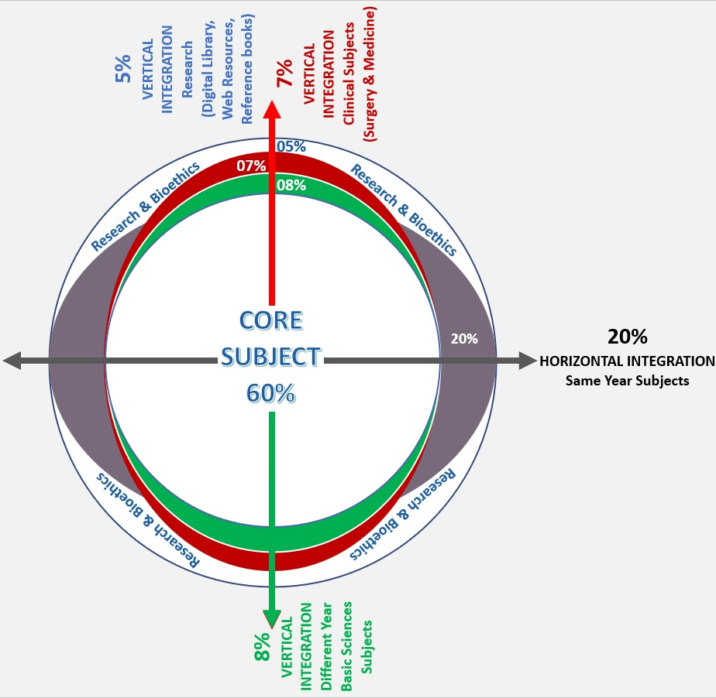
Professor Umar Model of Integrated Lecture
60%
CORE SUBJECT
20%
HORIZONTAL
INTEGRATION
Physiology
biochemistry
8%
VERTICAL INTEGRATION
Pathology
pharmacology
7%
VERTICAL INTEGRATION
Clinical integration
5%
VERTICAL INTEGRATION
Research, professionalism
Ethics
Digital library

Slide 6
Bloom's Taxonomy : Domains Of Learning
Sr. # | Domain of learning | Abbreviation | Levels of the domain | Meaning
1 | cognition | C | C1 | Recall / Remembering
2 |  |  | C2 | Understanding
3 |  |  | C3 | Applying / Problem solving
4 | Psychomotor | P | P1 | Imitation / copying
5 |  |  | P2 | Manipulation / Follows instructions
6 |  |  | P3 | Precision / Can perform accurately
7 | Attitude | A | A1 | Receiving / Learning
8 |  |  | A2 | Respond / Starts responding to the learned attitude
9 |  |  | A3 | Valuing / starts behaving according to the learned attitude

Slide 7
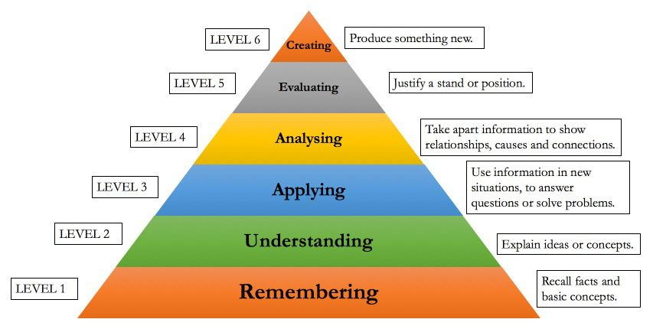
Bloom's Taxonomy Of The Cognitive Domain

Slide 8
Learning Objectives
Sr. # | Learning Objective | Domain of Learning
1 | To Describe properties of sense of taste. | C2
2 | To Illustrate various components playing role in taste sensation. | C3
3 | To Explain mechanism of taste sensation . | C2
4 | To Describe adaptation to taste. | C2
5 | To Illustrate clinical abnormalities related to taste. | C3

Slide 9
Core concept

Slide 10
Taste:
Separate undesirable or lethal foods from pleasant & nutritious food
Elicit physiological responses
  Involved in digestion & utilization of foods
Strongly tied to primitive emotional & behavioral functions of nervous systems
CORE CONCEPT

Slide 11
Sense of Taste (Gustation)
Function of taste buds
Contributions
  Sense of smell
  Texture of food
  Stimulation of pain endings-pepper
Importance
  Food selection
    Desires
    Metabolic need
CORE CONCEPT

Slide 12
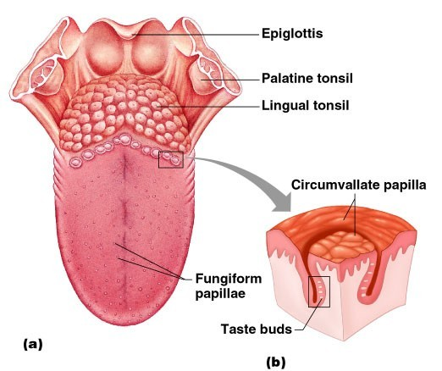
Taste Buds-Location
Circumvallate papillae-posterior tongue
  Large number
Fungiform papillae-anterior flat tongue
  Moderate numbers
Foliate papillae-in folds along lateral surfaces
  Moderate numbers
Additional taste buds
  Palate, tonsillar pillars, epiglottis,
Number of taste buds
  Adults-3000 to 10,000 taste buds
  Children-a few more
CORE CONCEPT

Slide 13
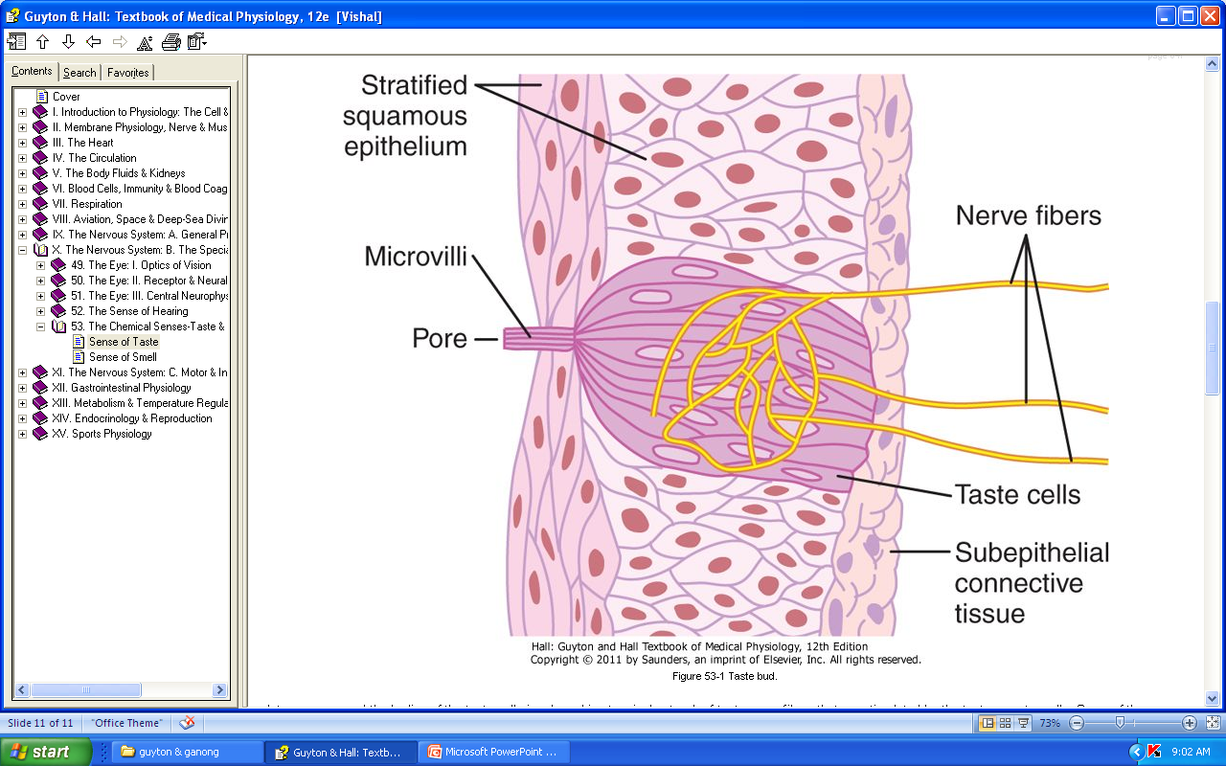
Taste Buds
Diameter-1/30 mm
Length-1/16 mm
Epithelial cells-50
  Supporting cells
  Taste cells
    Continually being replaced
    Mature cells-center
    Life span-10 days in lower mammals
    Outer tips arranged around taste pore
    Microvilli (taste hairs)-receptor surface
CORE CONCEPT/Histology integration
Reference from Google image

Slide 14
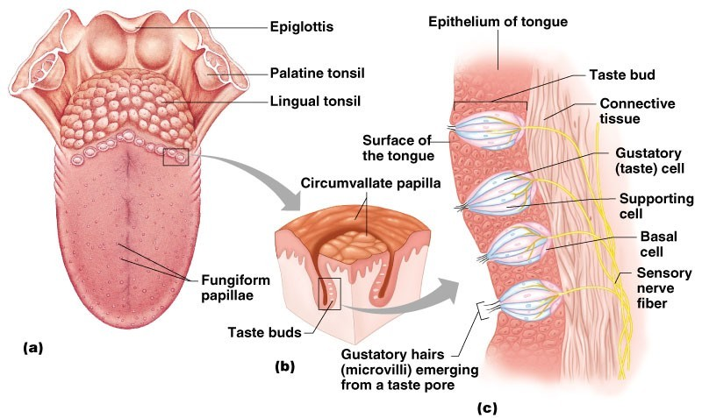
Structure of Taste Buds
Gustatory cells are the receptors
  Have gustatory hairs (long microvilli)
  Hairs are stimulated by chemicals dissolved in saliva
CORE CONCEPT

Slide 15
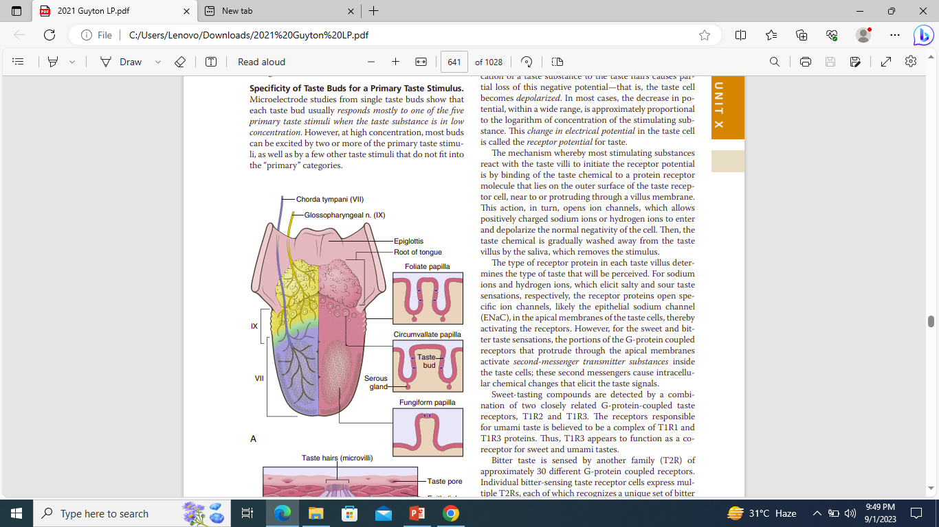
Distribution of taste buds on the papillae of tongue
Reference: Guyton & Hall textbook of medical physiology Pg#677
CORE CONCEPT/Histology integration

Slide 16
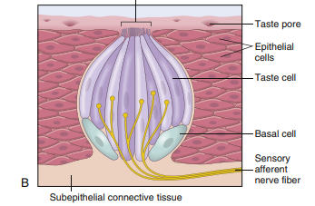
CORE CONCEPT
CORE CONCEPT/Histology integration
Structure of Taste Bud
Reference: Guyton & Hall textbook of medical physiology Pg#677

Slide 17
Taste-Primary(Elementary) Sensations
Sour Taste-Acids (H ion)
  Intensity - proportional to logarithm of H ion conc
Salty Taste-Na ion conc
  Quality - some salts elicit other taste sensations
  Cations
  Anions- lesser extent
CORE CONCEPT

Slide 18
Taste-Primary(Elementary) Sensations
Bitter Taste - organic substances
  Long-chain organic substances-nitrogen
  Alkaloids- quinine, caffeine, strychnine, & nicotine
  Saccharin-sweet ( bitter aftertaste)
  Bitter taste-rejection of food
    Deadly toxins in poisonous plants-alkaloids
      Intensely bitter taste
CORE CONCEPT

Slide 19
Taste-Primary(Elementary) Sensations
Sweet Taste
  Organic chemicals
    Sugars, glycols, alcohols, aldehydes, ketones, amides, esters
    Amino acids, small proteins
  Sulfonic acids, halogenated acids
  Inorganic salts of lead & beryllium
Sweet to bitter
  Slight changes in chemical structure
    Addition of a simple radical
CORE CONCEPT

Slide 20
Taste-Primary(Elementary) Sensations
Umami Taste (delicious)- l-glutamate
  Meat extracts & aging cheese
  Taste receptor-related to one of glutamate receptors expressed in neuronal synapses of brain
Fatty
  Long chain fatty acids
CORE CONCEPT

Slide 21
Taste Buds-Mechanism of Stimulation
Receptor Potential
  Proportional to logarithm of conc of stimulating substance
Salty & sour sensations
  Na & H ions-open specific ion channels in apical membrane.
Sweet & bitter sensations
  Second-messenger transmitter substances
    Intracellular chemical changes elicit taste signals
CORE CONCEPT

Slide 22
Generation of Nerve Impulses by Taste Bud
Adaptation
  First application of stimulus
    Rate of discharge of nerve fibers rises to a peak- fraction of a sec
    Adapts within next few sec back to a lower, steady level as long as taste stimulus remains
    Strong immediate signal
    Weaker continuous signal
CORE CONCEPT

Slide 23
Transmission of Taste Signals into CNS
Anterior 2/3
  Facial nerve
Back of tongue & posterior regions of mouth & throat
  Glossopharyngeal nerve
Base of tongue & parts of pharyngeal region
  Vagus nerve
Tractus solitarius
CORE CONCEPT

Slide 24
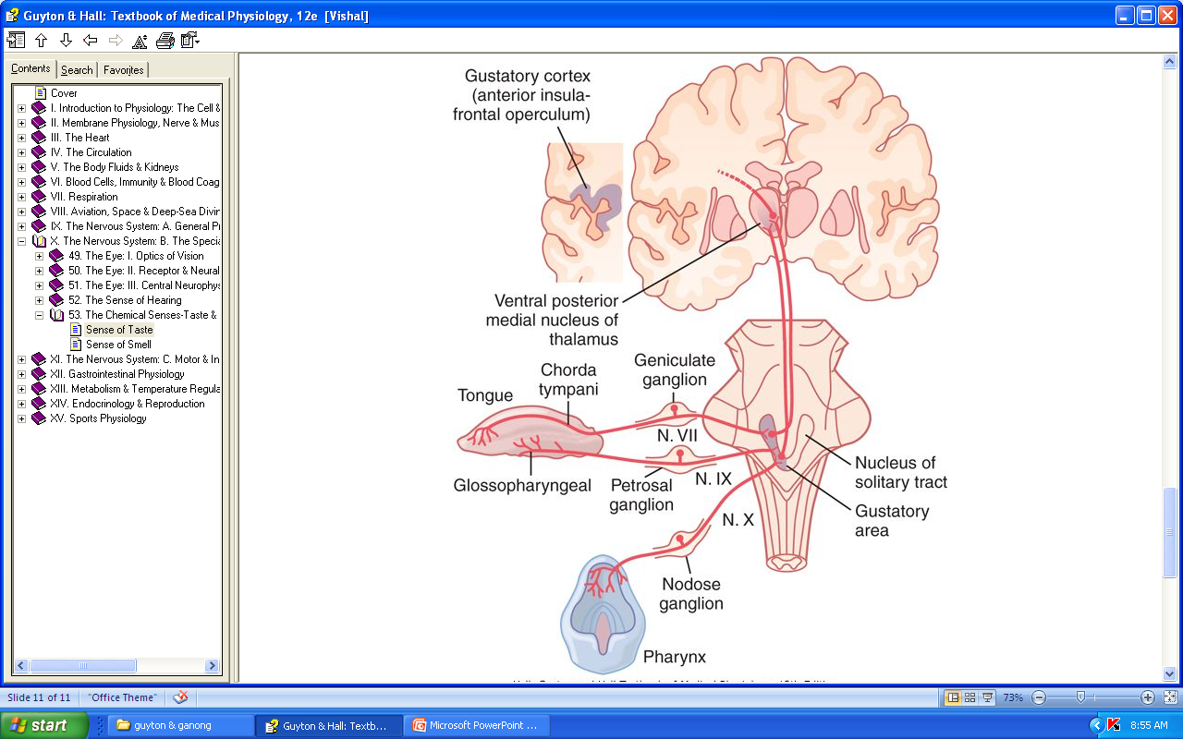
Transmission of Taste Signals into CNS
Transmission of taste signals into the CNS
Reference: Guyton & Hall textbook of medical physiology Pg#678
CORE CONCEPT

Slide 25
Apparatus:
The following material will be required:
Strong solutions of sucrose (10%), sodium chloride (15%) and weak solutions of acetic acid (1%), and quinine sulphate (0.1%) in drop bottles
A hand lens
Stool
Small cotton swabs or toothpicks and gauze
Five cards with sweet, salt, sour, umami and bitter printed on them.
CORE CONCEPT

Slide 26
Procedure:
Instruct the subject that he/she is to point to a card to indicate the taste felt by him/her.
Ask the subject to sit and protrude his tongue.
Examine and identify the areas which have large concentrations of papillae and taste buds by using hand lens.
Ask the subject to rinse (wash) his/her mouth and then dry it with gauze. Moisten a swab with a few drops of sugar solution, apply it to the tip of the tongue, and ask him to indicate, without withdrawing the tongue, the taste experienced by him.
CORE CONCEPT

Slide 27
Procedure:
5. Have him rinse his mouth; dry the tongue with gauze, and repeat the procedure with the salt solution. Repeat this procedure with all the four substances, one by one, on the sides, near the tip, the anterior 2/3rd and the posterior 1/3 of the dorsum of the tongue. Record the results.
CORE CONCEPT

Slide 28
(With Clinical and Para-clinical Sciences)
Spiral integration

Slide 29
Abnormalities in Taste Detection
Spiral integration with Family Medicine
Ageusia
  Absence of sense of taste
    Adverse side effect-cisplatin & captopril
    Deficiencies-vitamin B₃ or zinc
Hypogeusia
  Diminished taste sensitivity
    Damage to lingual or glossopharyngeal nerve
    Aging & tobacco abuse
Dysgeusia or parageusia
  Unpleasant perception of taste
  Metallic, salty, foul, or rancid taste

Slide 30
Brainstorming

Slide 31
Structured Essay Question
A 35-year male presented to medical outpatient department with complaints of fever, sore throat ,sneezing and cough.
What will be type of sensation that would be
lost in this patient?

Slide 32
Structured Essay Question
A 35-year male presented to medical outpatient department with complaints of fever, sore throat ,sneezing and cough.
What will be type of sensation that would be
lost in this patient?
KEY:
sense of smell & taste

Slide 33
Bioethics
(To promote biomedical ethics)

Slide 34

Justice(lesson of the day)
Justice in the context of medical ethics – is the principle that when weighing up if something is ethical or not, we have to think about whether it's compatible with the law, the patient's rights, and if it's fair and balanced.
Justice and fairness are used sometimes in place of each other.
Biomedical ethics

Slide 35
Suggested Research Article
(To promote research culture)

Slide 36
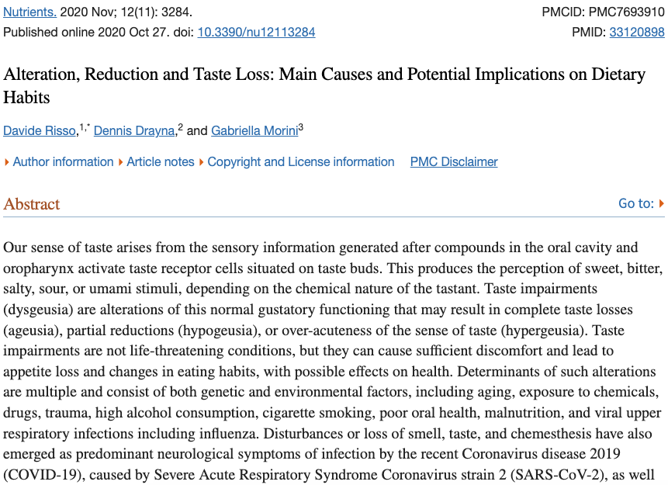
Suggested Research Article
https://www.ncbi.nlm.nih.gov/pmc/articles/PMC7693910/

Slide 37
Summary of the Article
Taste has a major role in individuals everyday lives, acting as a gatekeeper of food ingestion. On one hand, bitter, salty, and sour tastes are thought to have come about as a defensive and protective mechanism to prevent the ingestion of potentially toxic foods and to assure internal sodium or acid–base balance. On the other hand, sweet foods are naturally attractive and accepted since carbohydrates serve as the main energy source for animals. Lastly, umami senses amino acids in proteins, which naturally occur in meats, vegetables, and fermented products and are essential for humans.

Slide 38
How To Access Digital Library
Steps to Access HEC Digital Library
Go to the website of HEC National Digital Library.
On Home Page, click on the INSTITUTES.
A page will appear showing the universities from Public and Private Sector and other Institutes which have access to HEC National Digital Library HNDL.
Select your desired Institute.
5. A page will appear showing the resources of the institution
6. Journals and Researches will appear
7. You can find a Journal by clicking on JOURNALS AND DATABASE and enter a keyword to search for your desired journal.

Slide 39
References
Books
Guyton And Hall textbook of Medical Physiology 14th Edition
Ganong’s Review of Medical Physiology 25th Edition
Sherwood, 9th edition.
Silverthorn Physiology,6th edition
Vander’s Human Physiology,14th edition
Research:https://www.sciencedirect.com/science/article/pii/S1521661623000669
YouTube/ videolink:

Slide 40


