Slide 1
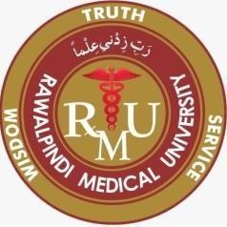
Sterilization and Disinfection Microbe Module 3rd year MBBS By : Kiran Fatima Pathology Department Rawalpindi Medical University

Slide 5
Levinson, W. Review of Medical Microbiology and Immunology. 15th ed. McGraw-Hill Education / Medical; 2020

Slide 6
Learning objectives
Define Sterilization and Disinfection
Protocol of Standard precautions
Personal protective equipment (PPE)
Donning and Doffing
Principles of sterilization & disinfection
Clinical use of Disinfectants & Sterilization
Types of agents for sterilization and disinfection

Slide 7
Study Questions
Define sterilization
Define disinfection
What are the various methods of disinfection?
What are the standard operating principles of autoclave?
What are the standard operating principles of hot air oven?

Slide 8
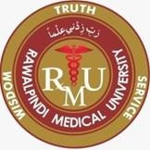
Definition
Core
Sterilization is killing or removal of all microorganisms including spores, which are highly resistant.
Disinfection is killing of many but not all microoganisms.
Mild disinfectants used on skin and other living tissue are antiseptics

Slide 9
Protocol of standard precautions
Important measures done (in addition to sterilization and disinfection) for the prevention of infection transmission are known as “standard precautions”
It includes:
Hand hygiene
Respiratory hygiene and cough etiquettes
Safe injection practices
Proper disposal of needles and sharps

Slide 10
Personal protective equipment
Core
It is specialized clothing or equipment worn by an employee for protection against infectious materials.
Includes face masks, safty goggles, gloves, gown, face shields, shoe covers

Slide 11
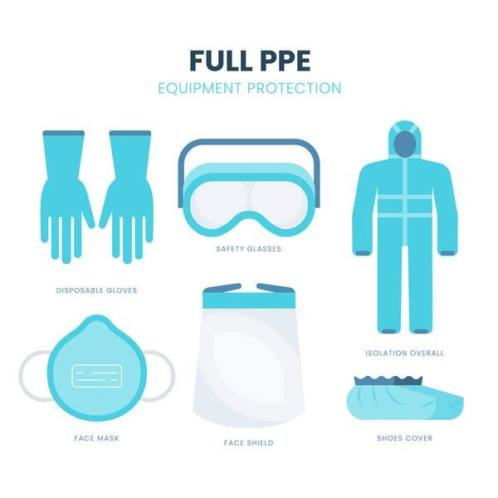
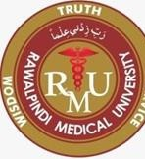
spiral
.

Slide 12
Donning sequence
Core
DONNING means to put on and use PPE properly to achieve the intended protection and minimize the risk of exposure.
SEQUENCE 1. Hand hygiene
Gown
Mask
Goggles
Gloves

Slide 13
Principles of sterilization & disinfection
Sterilization principle is to expose each item to direct steam contact at the required temperature and pressure for the specified time
Disinfection process that eliminates many or all pathogenic microorganisms, except bacterial spores, on inanimate objects

Slide 14
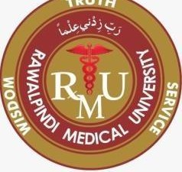
Clinical uses of disinfection
Clinical use for disinfection | Common agent
Surgeon’s hand prior to surgery | Chlorhexidine
Surgical site prior to surgery | Iodophor
Skin prior to venepuncture | 70% alcohol
Skin prior to blood culture sampling | Tincture iodine followed by 70% alcohol
Cleanse wound | Chlorhexidine
Air in operating room | Ultraviolet light
Floor in operating room | Lysol

Slide 15
Clinical uses of sterilization
Clinical use for Sterilization | Common agent
Heat sensitive material | Ethylene oxide / gluteraldehyde
Non-Heat sensitive material | Autoclave
Intravenous solutions | Filtration
Glassware in Medical laboratory | Autoclave

Slide 16
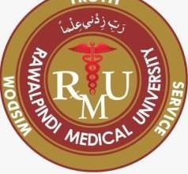
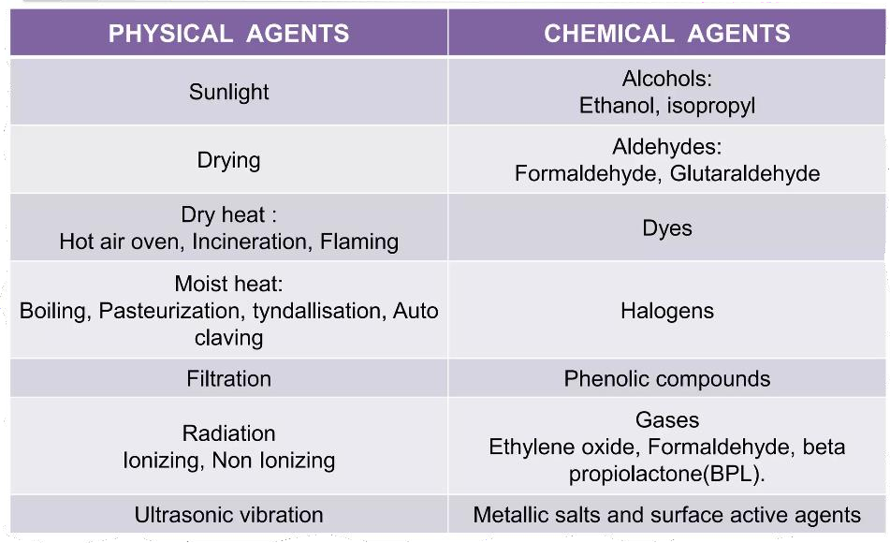
Types of disinfecting & sterilizing agents

Slide 17
Operational definitions
Hot air oven 180oC for 2 hrs
Pasteurization 62oC for 30min
Flash Pasteurization 72oC for 15 sec
Autoclaving 121oC at15 lb for 15min
Tyndallisation 100oC for 20 min (3 days)
UV light range 250-260 nm
Filtration Pore size of 0.22mm

Slide 18
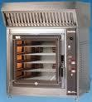
Sterilization by heat common methods Dry Heat
Dry Heat- kills microorganisms by destroying their oxidative processes.
Simplest method is exposing item to be sterilized to the naked flame e.g. Bunsen burner- for sterilizing bacteriological loops, knives, blades.
Hot air oven expose items to 160 °C for 1 hour.
Has electric element in chamber as source of heat plus a fan to circulate air for even distribution of heat in chamber. Oven without fan is dangerous. Used for items that are lacking water such as:
-Metals
-Glassware
-Ointment / Oils/ Waxes /Powder

Slide 19
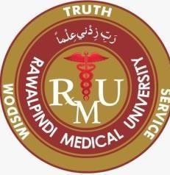
Advantages of Autoclave
Temp 121*C therefore spores killed.
Condensation of steam generates extra heat.
The condensation also allows the steam to penetrate rapidly into porous materials.
Note: for all invasive procedures at operating room or clinics, autoclavave equipments should be used.

Slide 20
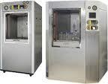
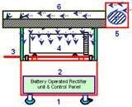
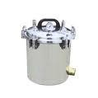

Slide 21
Moist Heat
Uses hot water. Moist heat kills microorganisms by
denaturating proteins.
Autoclaving – standard sterilization method in
hospitals.
The equipment is called Autoclave and it works under the same principle as the pressure cooker where water boils at increased atmosphere pressure i.e. because of increase pressure the boiling point of water is >100 °C.
The autoclave is a tough double walled chamber in which air is replaced by pure saturated steam under pressure.

Slide 22
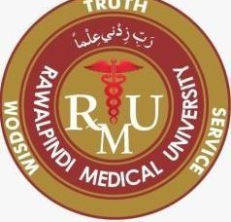
Moist heat: other applications
Pasteurization
Used heat at temperatures sufficient to inactivate harmful organism in milk. The temperatures of sterilization is not achieved .
Temperature may be 74°C, for 3-5 seconds. ( Flash methods or 62°C for 30 minutes.
( Conventional method ).
Boiling – quite common especially in domestic circumstances.

Slide 23
Hospital disinfection
Article
Floors, walls
Surfaces tables
Skin
Surgeons’ hands
Patient skin
Endoscopes
Thermometers
Disinfectant
Phenolics fluids 1-2% Hypochlorite, Alcohol
Chlorhexidine, Iodine alcohol
70% Alcohol, Iodine
Gluteraldehyde 2% (Cidex), subatmospheric steam
70% Alcohol

Slide 24
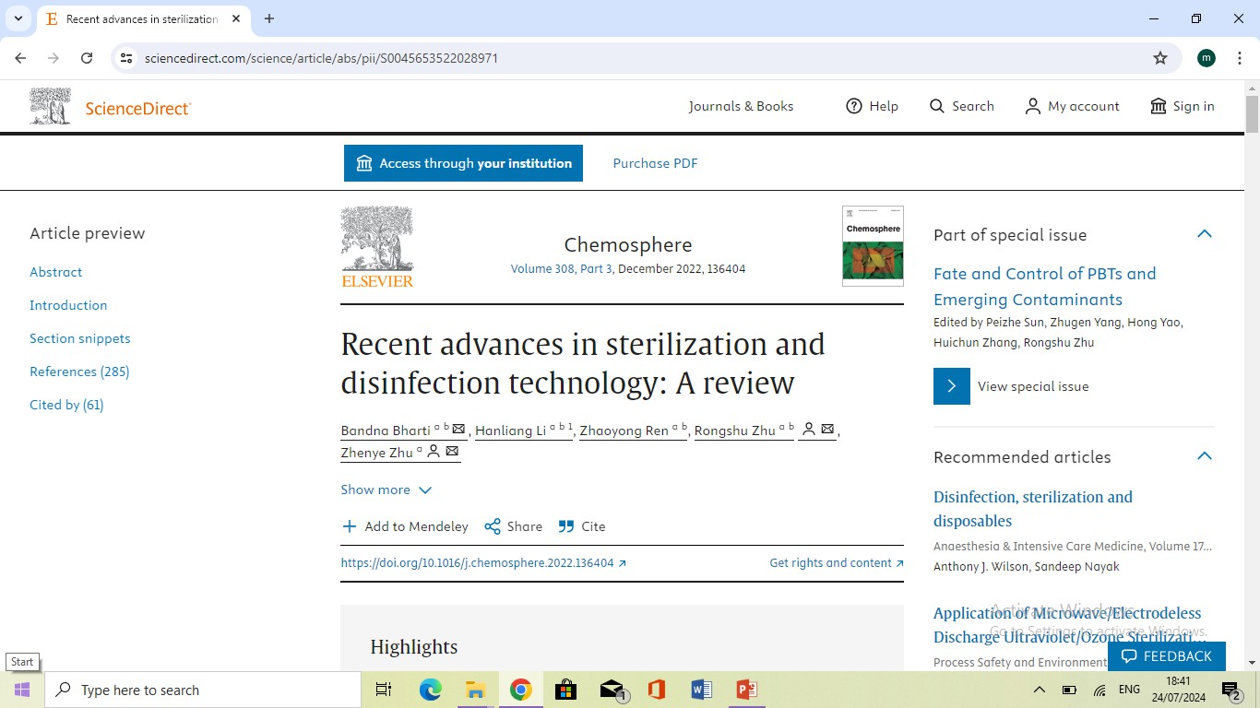
Research

