Slide 1
Staphylococcus aureus Microbe Module 3rd Year MBBS
BY:
Dr. Kiran Fatima
Pathology Department
Rawalpindi Medical University

Slide 2
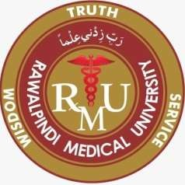
Motto of RMU

Slide 3
Vision of RMU
The Dream/ Tomorrow
◆ To impart evidence based research oriented medical education
◆ To provide best possible patient care
◆ To inculcate the values of mutual respect and ethical practice of medicine

Slide 4
Prof Umar’s LGIS model

Slide 5
Learning outcomes
At the end of the lecture the students should be able to:
Understand key characteristics of Staphylococcus species.
Identify pathogenic mechanisms and virulence factors. Recognize clinical manifestations.
Learn diagnostic methods and treatment options.
Discuss antibiotic resistance and prevention strategies.

Slide 6
Learning resources
◆ Textbooks:
◆ Robbins and cotran pathologic basis of disease.
◆ Jawetz, melnick, & adelberg's medical microbiology.

Slide 7
Introduction
Core content
Genus Staphylococcus:
Gram-positive cocci.
Grape-like clusters.
Catalase-positive.
Medically Important Species:
Staphylococcus aureus.
Staphylococcus epidermidis.
Staphylococcus saprophyticus.

Slide 8
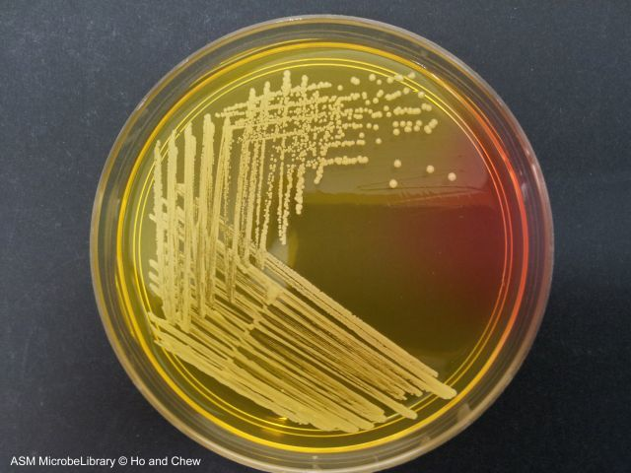
Spiral

Slide 9
Staphylococcus aureus:
Core content
Diseases produced by Staphylococcus aureus
is studied under 2 groups:
Infections
Intoxications

Slide 10
Intoxications:
Core content
Core
Pathology
Food poisoning
Toxic shock syndrome
Staphylococcal scalded skin syndrome

Slide 11
Definition
Core content
Core Pathology
◆ Toxic shock syndrome (TSS) is a toxin- mediated acute life-threatening illness, usually precipitated by infection with either Staphylococcus aureus or group A Streptococcus (GAS), also called Streptococcus pyogenes

Slide 12
Causes
Core content
Core Pathology
Use of tampons
Skin infections
Burns
After surgery.

Slide 13
Risk factors
Core content
Horizontal Integration
CM
Foreign bodies or packing (such as those use to stop nose bleed)
Post operative wound infections (fasciotomy, surgical debridement, laparotomy, amputation, or hysterectomy)
Vaginal postpartum infections
Streptococcal soft-tissue infection (bacterial cellulitis) & Recent influenza infection

Slide 14
Routes of infection
Horizontal Integration
CM
◆ Vagina.
◆ Cuts in wound.
◆ Nose.
◆ Nose(nasal packing)
◆ Surgical wounds.
◆ Skin wounds.

Slide 15
Pathophysiology
Core content
Colonization or infection with bacteria- production of toxins people who lack a protective antitoxin antibody
Toxins absorbed systemically
Production of cell mediator chemicals
{cytokines, such as interleukin 1 (IL-1) and tumor necrosis factor (TNF)} capable of mediating shock and tissue injury & systemic manifestations of TSS

Slide 16
Signs & symptoms
Core content
Vertical integration Family Medicine
Onset usually sudden with
High fever ,Watery diarrhea Nausea & vomiting, headache
Low blood pressure
Widespread skin rash
Dizziness , General ill feeling , Muscle ache , Confusion, Seizures
Peeling of the skin of palms & soles of feet
Organ failure (usually kidneys, liver)

Slide 17
Toxins involved in diseases
Core content
Core Pathology
Cytolytic toxins
Hemolysins
Alpha haemolysin Beta haemolysin
Gamma haemolysin Delta haemolysin
ii) Leucocidin (Panton-Valentine toxin)
Enterotoxin
Toxic shock syndrome toxin (TSST)
Exfoliative (epidermolytic toxin)

Slide 18
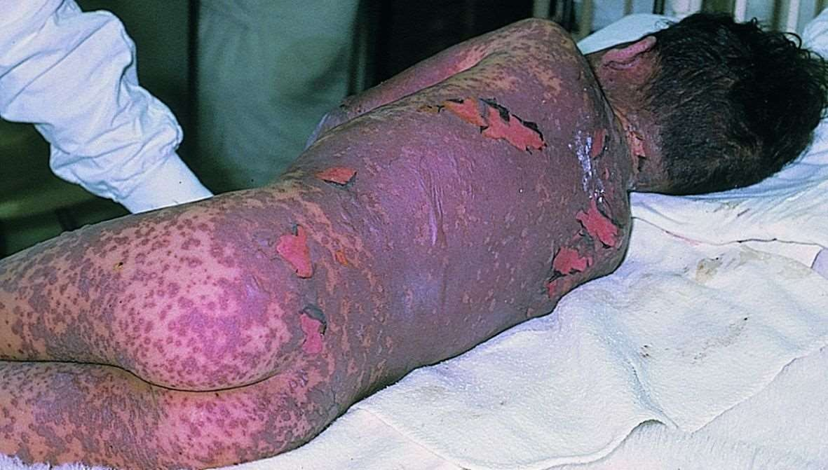
Core content
vertical
medicine
Staphylococcal Scalded Skin Syndrome (SSSS):
◆ Rapid invasion of the skin occurs in neonates because competing bacteria absence
◆ The skin becomes reddened and sloughs off rapidly, causing drastic fluid loss. May be fatal.
◆ strain of Staph.aureus which excretes exfoliatin (a pathogenic factor) invades the skin
◆ Treat with penicillin.

Slide 19
Core content
horizontal integration
Community Medicine
Staphylococcal Food Poisoning:
Factor is enterotoxin F. It grows in certain foods. (Cream filled and starchy.)
Potato salad-organism gets in easily by handling potatoes and eggs.
It is a food toxicity, not infectious disease.
It lasts 24 hours and the incubation period is two hours.

Slide 20
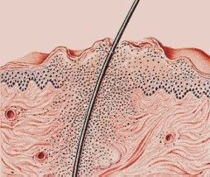
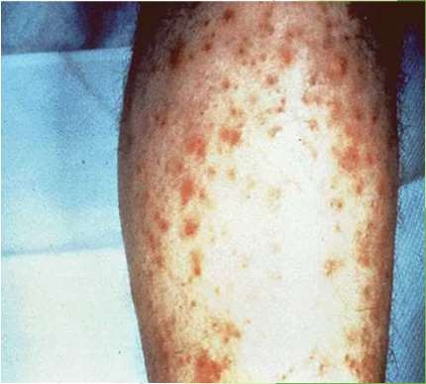
Common staphylococcal infections
Core content
Vertical integration Surgery/Dermatology
1) Skin and soft tissue: Folliculitis, furuncle (boil), carbuncle, stye, abscess, wound infections, impetigo, paronychia and less often cellulitis.

Slide 21
Common staphylococcal infections
Core content
◆ Musculoskeletal: Osteomyelitis, arthritis, bursitis, pyomyositis, osteomyelitis
◆ Respiratory: Tonsillitis, sinusitis, otitis externa, bronchopneumonia, lung abscess, empyema chest, rarely pneumonia
Central nervous system: Abscess, meningitis, intracranial thrombophlebitis.
Endovascular: Bacteremia, septicemia, pyemia, endocarditis.
Urinary: Urinary tract infection

Slide 22
Core content
Surgery
Septicemia:
S. aureus gains access to the blood. This may result from a cutaneous infection, contamination during surgery, or from the organism entering via a scratch on the skin.
Blood bacterimea is a chronic septicemia usually caused by Staphylococcus aureus.

Slide 23
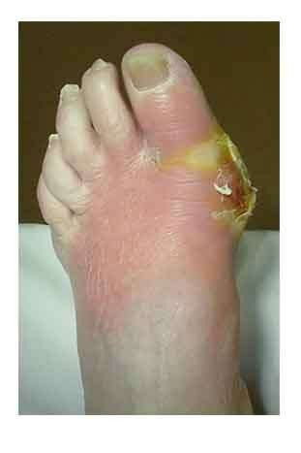
Vertical integration
surgery
Osteomyelitis: Staph. aureus gains access to bone and proliferates. It colonizes surface and deteriorates its. Becomes chronic. Can be surgically removed but surgery damages bone tissue. Treatment is penicillin.

Slide 24
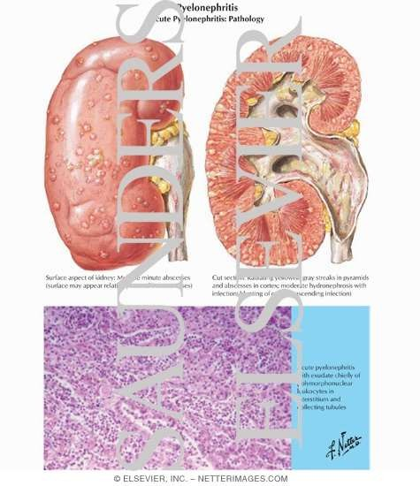
Vertical integration
Vertical integration
Nephro/Family Medicine
Pyelonephritis: Staph. aureus infection of the kidneys.
It ascends from bladder infection (cystitis) or hematogenous spread

Slide 25
Staphylococcus aureus lab diagnosis
Core
Pathology
Specimens collected: Depends on the type of infection.
◆ Suppurative lesion- Pus,
◆ Respiratory infection- Sputum,
◆ Bacteremia & septicemia- Blood,
◆ Food poisoning- Feces, vomit & the remains of suspected food,
◆ For the detection of carriers- Nasal swab

Slide 26
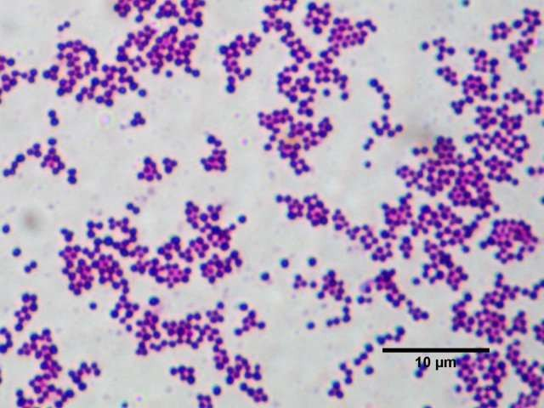
Methods of examination:
Core
Pathology
Direct microscopy
Culture
Biochemical reactions
Antibiotic sensitivity tests done as a guide to treatment.
Molecular methods

Slide 27
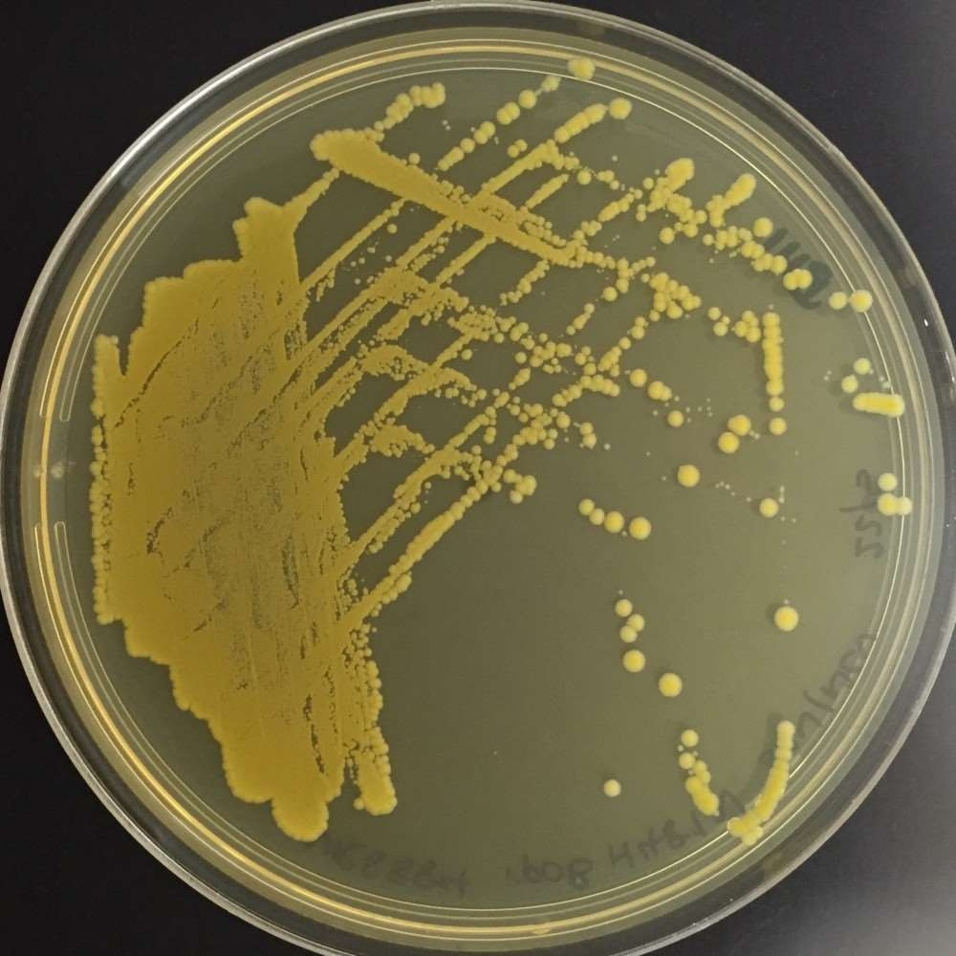
Colony morphology
Core
Pathology
◆ Staphylococci are Gram positive cocci,
◆ Occur in grape like clusters
◆ Coagulase positive: e.g- S. aureus
Coagulase negative: e.g- S. epidermidis,
S. saprophyticus
On nutrient agar- The colonies are large, circular, convex, smooth, shiny, opaque and easily emulsifiable.
Most strains produce golden yellow pigments

Slide 28
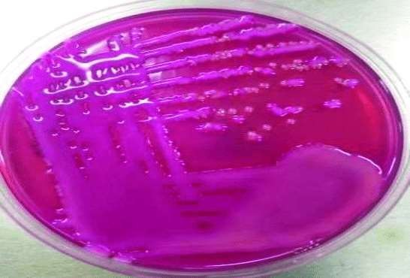
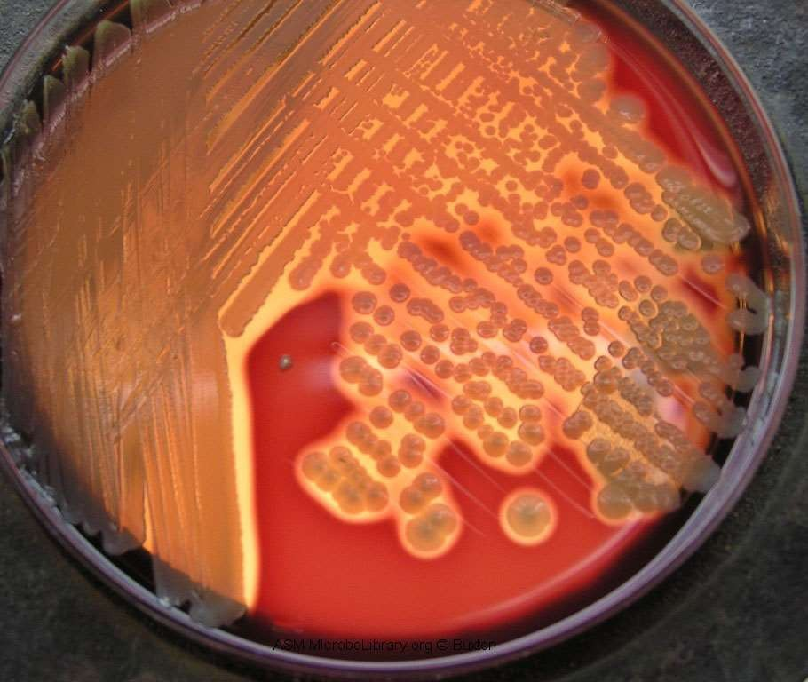
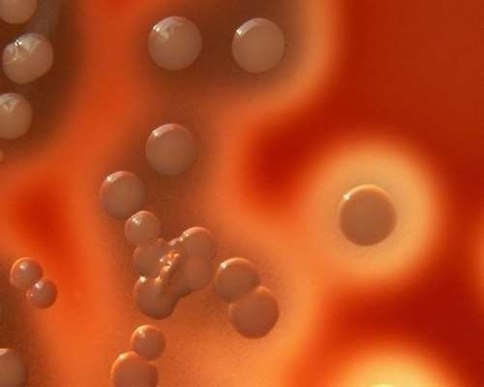
Colonies
Core content
Core
Pathology
On MacConkey’s agar- The colonies are small & pink in colour.
iii) On blood agar- Most strains produce β- haemolytic colonies

Slide 29
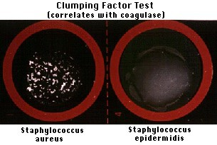
Coagulase test
Core
Pathology
Catalase and coagulase test- positive.
Reduces nitrate to nitrite.
Ferments mannitol anaerobically with acid
Urea hydrolysis test- positive.
Gelatin liquefaction test- positive.
Produces lipase, phosphatase, Thermostable nuclease
nly.

Slide 30
Molecular methods
Core
Pathology
1) PCR for mecA gene in MRSA.
Altered penicillin-binding protein (PBP2a).

Slide 31
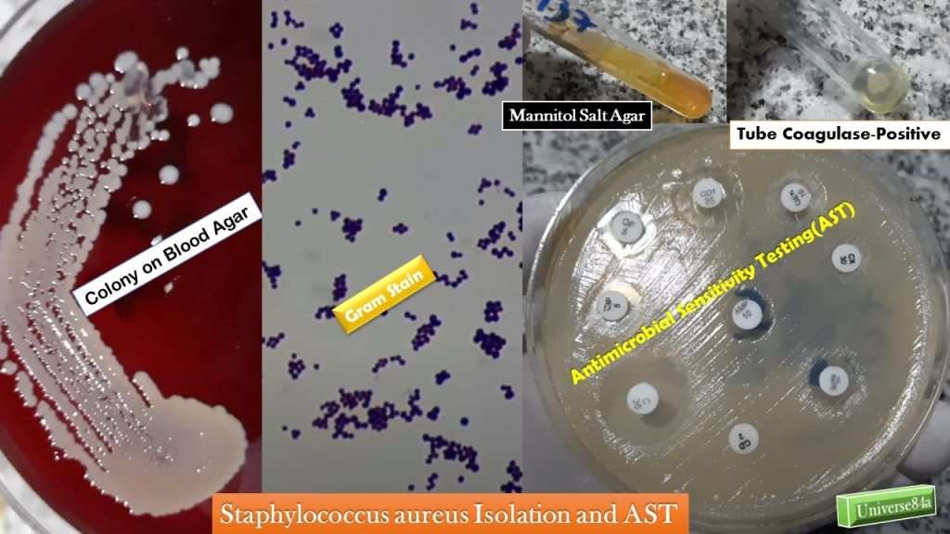

Slide 32
Treatment:
Vertical integration
Infectious disease/Family Medicine
◆ Drug resistance is common.
◆ Benzyl penicillin is the most effective antibiotic, if the strain is sensitive.
◆ Cloxacillin or Methicillin is used against beta-lactamase producing strains.
◆ Methicillin Resistant Staphylococcus aureus (MRSA) strains have become common.
◆ Vancomycin/Linezolid. is used in treatment of infections with MRSA strains.

Slide 33
Prevention
Horizontal Integration
CM
Hand hygiene.
Isolation & treatment of MRSA patients.
Detection of carriers among hospital staff, their isolation & treatment.
Avoid indiscriminate usage of antibiotics

Slide 34
Coagulase negative staphylococci
Core
Two species of staphylococci can cause human infections:
◆ Staphylococcus epidermidis
◆ Staphylococcus saprophyticus

Slide 35
Staphylococcus epidermidis
Core Pathology
It is a common cause of stitch abscesses. Staphylococcus epidermidis
It has predilection for growth on implanted foreign bodies such as artificial valves, shunts, intravascular catheters and prosthetic appliances leading to bacteremia.
In persons with structural abnormalities of urinary tract, it can cause cystitis.
Endocarditis may be caused, particularly in drug addicts.

Slide 36
Staphylococcus saprophyticus
Core
Pathology
It causes urinary tract infections, mostly in sexually active young women.
The infection is symptomatic and may involve the upper urinary tract also.
Men are infected much less often.
It is one of the few frequently isolated CoNS that is
resistant to Novobiocin.

Slide 37
Core content
Core
Pathology
Characters | S.aureus | S.epidermididis | S.saprophyticus
Coagulase | + | - | -
Novobiocin sensitivity | Sensitive | Sensitive | Resistant
Acid from mannitol fermentation anaerobically | + | - | -
Phosphatase | + | + | -

Slide 38
Summary
Toxic shock syndrome (TSS) is a toxin-mediated acute life- threatening illness, usually precipitated by infection with Staphylococcus aureus.
Common skin infections associated with S aureus are abcess, stye,carbuncle and impetigo
Staphylococci are Gram positive cocci, Occur in grape like clusters, Coagulase positive: e.g- S. aureus, Coagulase negative: e.g- S. epidermidis, S. saprophyticus
Diagnosed by Gram staining and culture on blood agar, positive catalase test and coagulase test.

Slide 39
Research
◆ Palavecino EL. Rapid Methods for Detection of MRSA in Clinical Specimens.
Methods Mol Biol. 2020;2069:29-45. doi: 10. 007/978-1-4939-9849-4_2. PMID: 31523763.
◆ several commercial rapid tests for detection of MRSA directly from nasal and wound swabs, from positive blood cultures, have been developed for use in clinical laboratories. Chromogenic agar plates and real-time PCR and other molecular tests are gaining popularity as MRSA screening tests because they have the advantage of a lower turnaround time than that of traditional culture and susceptibility testing and they are capable of detecting MRSA directly from nasal and wound swabs, allowing rapid identification of colonized or infected patients.

Slide 40
Biomedical ethics
Patients’ Rights
Confidentiality of the patients
Patient Safety
Conflict of Interests
Informed Consent
Dealing with the opposite sex
Beginning and end of life
Healthcare team ethics.

