Slide 2
Motto Vision; The Dream/Tomorrow
To impart evidence based research oriented medical education
To provide best possible patient care
To inculcate the values of mutual respect and ethical practice of medicine
Wisdom
Truth
Service

Slide 3
1st Year MBBS CVS- Module Small Group Discussion (SGD) Heteropolysaccharides
Dr. UZMA ZAFAR
Biochemistry Department
Updated Date 23-03-2023
Delivering Date-30-09-2024 to 05-10-2024

Slide 4
LEARNING OBJECTIVES
Definition and classification of polysaccharides
Structure and chemical properties of biologically important homo- and heteropolysaccharides
Biomedical importance of homo and heteropolysaccharides

Slide 5
Professor Umar Model of Integrated Lecture
60%
Core Subject
20%
Horizontal
Integration
Physiology
Anatomy
8%
Vertical Integration
Pathology
Pharmacology
7%
Vertical Integration
Clinical Integration
5%
Vertical Integration
Research, Professionalism
Ethics
Digital library

Slide 6
Horizontal Integration

Slide 7
Anatomical and physiological aspects
Chief importance of cellulose
In human nutrition it provides fiber and bulk to the food
This roughage serves to satisfy the appetite and stimulates intestinal peristalsis and prevents constipation
It is not digested in the human GIT due to lack of enzyme cellulase
Chief importance of glycogen
It maintains blood glucose level between meals
Serve as fuel in body
Horizontal integration

Slide 8
Anatomical and physiological aspects
Agar
Uses
Used as a laxative
Used in media for bacterial growth
Vegetable gums
Uses
In the preparation of confections
Pharmaceuticals
Also used as an adhesive
Horizontal integration

Slide 10
Heteropolysaccharides
Heteropolysaccharides are polymers composed of two or more than two sugar monomers linked by glycosidic bond.
HETEROPOLYSACCHARIDES
GAGs Gluco-conjugates Mucilages
Heparin * proteoglycans *Agar
Hyaluronic acid *glycoproteins *Vegetable gums
Keratan sulphate * Pectins
Dermatan sulphate
Heparan sulphate
Chondroitin sulphate
*hyaluronic acid is non sulfated
CORE CONCEPT

Slide 11
Structure OF GAGs
Repeating disaccharide units consist of amino sugar and acid sugar.
Acid Sugar: Uronic acid(D-glucuronic
acid and its C-5 epimer,
Iduronic acid)
Amino Sugar: N-acetylglucosamine
N-acetylgalactosamine
CORE CONCEPT

Slide 12
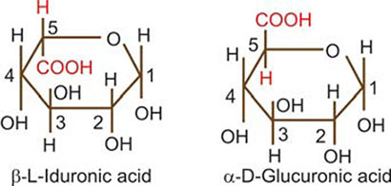
Structure OF GAGs
CORE CONCEPT

Slide 13
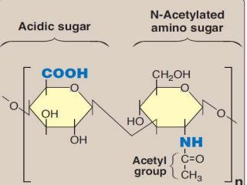
Structure OF GAGs
STRUCTURE OF GAGs
CORE CONCEPT

Slide 14
CORE CONCEPT

Slide 15
CHONDROITIN SULPHATE
Widely distributed in bone , cartilage and tendon
In cartilage it binds collagen and hold fibers in a tight strong network.
Role in compressibility of cartilage in weight bearing along with hyaluronic acid
Uses in the treatment of osteoarthritis.
2 types of chondroitin sulphate
Sulfated at C4 or C6
CORE CONCEPT

Slide 16
CORE CONCEPT

Slide 17
DERMATAN SULPHATE
Present in skin, blood vessel and heart valves
They not only are important structural substances but also bind to a variety of cytokines, growth factors, cell surface receptors, adhesion molecules, enzymes
Dermatan sulfate is thought to be involved in wound repair, regulation of blood coagulation and the response to infection
CORE CONCEPT

Slide 18
CORE CONCEPT

Slide 19
HYALURONIC ACID
Non-sulfated, non covalently attached to protein
Present in animal tissues as well as in bacteria
Found in synovial fluid joints, vitreous humor of the eye, umbilical cords, loose connective tissues and cartilage
CORE CONCEPT

Slide 20
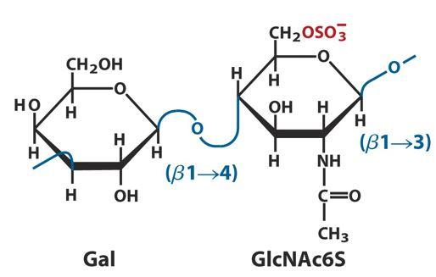
KERATAN SULPHATE
CORE CONCEPT

Slide 21
KERATAN SULFATES
Disaccharide unit
N-acetylglucoseamines with sulfate attach to the 6 position and galactose
KS I present in cornea
KS II present in connective tissue along with the chondroitin sulfate attached to hyaluronic acid
CORE CONCEPT

Slide 22
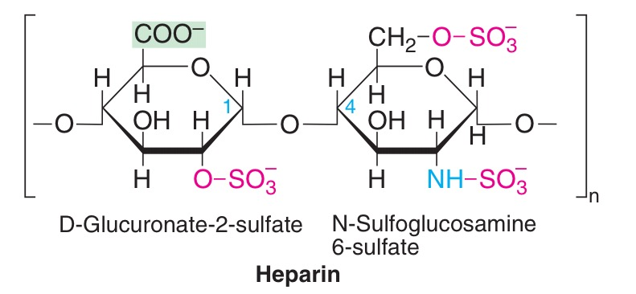
HEPARIN
CORE CONCEPT

Slide 23
HEPARIN
Intracellular GAG
Glucosamine and glucuronic acid or L-iduronic acid
Most of amino group are of GluN are N-sulfated but few are acetylated
90% IdUA present
Proteoglycan consists exclusively of serine and glycine.
Present in mast cell, liver, lung and skin
Serve as anti-cogulant
CORE CONCEPT

Slide 24
HEPARAN SULFATE
Same as heparin except some glucosamines are acetylated and there are few sulfate groups
Predominent uronic acid is GlUA
Extracellular GAG, found in basement membrane
Act as filtration barrier, repel negatively charge
Present on many cell surface (cell to cell interaction, regulate cell signaling)
CORE CONCEPT

Slide 25
PROTEOGLYCANS
Proteoglycans are proteins that covalently bound to GAG’s called core protein except hyaluronic acid.
The amount of carbohydrates(95%) in proteoglycan is much greater than is found in glycoprotein.
There are 30 proteoglycan present on cell membrane or in extracellular matrix.
CORE CONCEPT

Slide 26
FUNCTIONS OF PROTEOGLYCANS
Found in every tissue of body specially in the ECM or ground substance.
Proteoglycans criss-crossed by collagen and elastin giving strength to the ECM.
They act as tissues organizers.
They are the major component of cartilage.
Role in cell migration.
Act as anticoagulant.
Maintain the shape of eye and corneal
transparency.
CORE CONCEPT

Slide 27
Vertical Integration

Slide 28
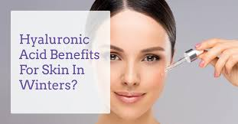
Hyaluronic acid benefits for skin
Hyaluronic acid
Treating dry eyes
It's also used in moisturizing creams, lotions, ointments and serums
It makes your skin flexible Hyaluronic acid helps skin stretch and flex and reduces skin wrinkles and lines

Slide 29
Mucopolysaccharidoses
It is lysosomal storage disease
Deficiency or absence of lysosomal hydrases
Accumulation of the unhydrolyzed substrate within the lysosomes

Slide 30
Family Medicine
Family Medicine plays important role in following manner:
Diagnosis
Education
Dietary Guidance
Monitoring
Refer to Specialists

Slide 31
Artificial Intelligence
Artificial Intelligence plays role in following aspects:
Personalized Nutrition
Diagnostic Tools
Food Recommendations
Drug Development

Slide 32
Bioethics
Here are some ethical considerations related to this case
Informed Consent
Access to healthcare
Family and care giver support
Resource Allocation
Spiral Integration

Slide 33
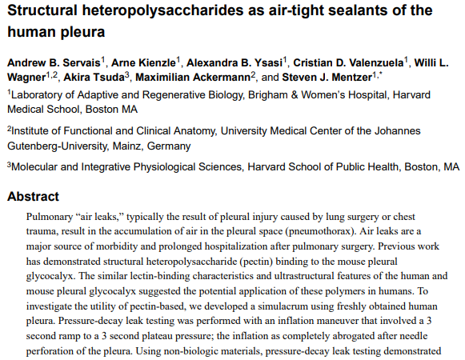
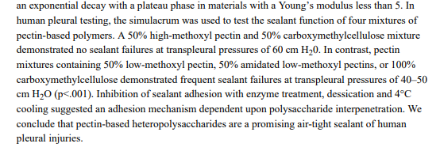
Suggested research articles
https://www.ncbi.nlm.nih.gov/pmc/articles/PMC6408304
/

Slide 35
Assessment

Slide 36
MCQS
1. Which of the following is an example of a heteropolysaccharide?
A) Starch
B) Cellulose
C) Hyaluronic acid
D) Glycogen
E) Inulin

Slide 37
MCQS
2. Heteropolysaccharides are made up of:
A) Only glucose units
B) Two or more different types of monosaccharides
C) Only amino acids
D) Only fructose units
E) Repeating glucose and galactose units

Slide 38
MCQS
3. Which of the following heteropolysaccharides is a major component of the extracellular matrix?
A) Chondroitin sulfate
B) Glycogen
C) Amylose
D) Inulin
E) Dextran

Slide 39
MCQS
4. The repeating disaccharide unit in hyaluronic acid consists of:
A) Glucose and mannose
B) Glucuronic acid and N-acetylglucosamine
C) Galactose and mannose
D) Glucose and galactose
E) Fructose and mannose

Slide 40
MCQS
5. Which of the following heteropolysaccharides plays a role in anticoagulation?
A) Glycogen
B) Heparin
C) Amylopectin
D) Chitin
E) Keratan sulfate

Slide 41
MCQS KEY
1. C
2. B
3. A
4. B
5. B

