Slide 2
Motto Vision; The Dream/Tomorrow
To impart evidence based research oriented medical education
To provide best possible patient care
To inculcate the values of mutual respect and ethical practice of medicine

Slide 3
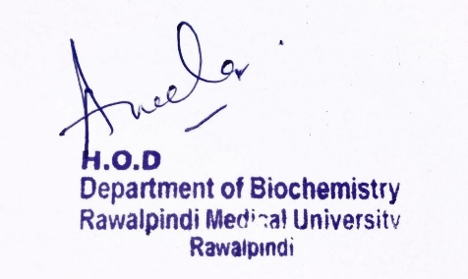
1st Year MBBS Foundation Module Small Group Discussion – SGD Physicochemical Properties Of Cell
Foundation Module 1st Year MBBS(SGD) Physicochemical properties of Cell
Presenter: Dr Nayab Ramzan Date: 08-02-25
Deptt of Biochemistry
RMU

Slide 4
Professor Umar Model of Integrated Lecture

Slide 5
Learning Objectives
At the end of the session, students will be
able to:
Define osmosis, osmotic & oncotic pressures, surface tension, and Emulsification
Discuss Biochemical Applications of Osmotic/Oncotic pressure Surface Tension and Emulsification and methods to measure them.
Practice the principles of bioethics & apply strategic use of A.I in the related clinical condition.
Read relevant research articles related to the Core Knowledge.

Slide 6
Osmosis
Core Knowledge
Definition
Osmosis
derived from Greek word meaning “push”
Osmosis
The process by which a Solvent (water) passes from a dilute solution to a more concentrated solution when both are separated by a Semi Permeable Membrane (this membrane allows water to diffuse but not the solute)

Slide 7
Types of Semipermeable Membranes
Core Knowledge
Semipermeable Membrane
Natural
Artificial
Peritoneum
Cellophane
Collodion
Urinary Bladder
Gelatinous Ppt of Cu. Fe. Cyanide

Slide 8
Core Knowledge

Slide 9
Osmotic Pressure & Hydrostatic Pressure
Core Knowledge
OSMOTIC PRESSURE is defined as:
“The equivalent of excess of pressure which must be applied to the concentrated solution in order to prevent the passage of the solvent into it through a semi permeable membrane separating the two i.e. solution and solvent.”
HYDROSTATIC PRESSURE (Pressure of any fluid enclosed in a space)
It forces fluid out of the solution.
Osmotic pressure draws fluid back into the solution.
In order to counteract and stop the osmotic inflow into the solution, it equals the difference between the hydrostatic pressure on both sides.

Slide 10
Unit of Osmotic Pressure
Core Knowledge
Osmole is the unit of osmotic pressure.
1 Osmole equals to 22.4 atmospheres or 17024 mm Hg, this unit is too large for use in biology so milliosmole i.e. 1/1000 of osmole or about 17mm Hg is used is used for biological fluids.
OP of Plasma is 280- 300 milliosmole/litre .
Methods to Measure Osmotic Pressure
Pfeffer’s method
Freezing point determination method

Slide 11
Oncotic Pressure
Core Knowledge
Chief colloids of plasma - Plasma Proteins form a colloidal solution.
Oncotic Pressure OR Colloid Osmotic Pressure - osmotic pressure exerted by plasma proteins, notably Albumin, in a blood vessel’s plasma.
25-30 mm Hg - negligible compared to that of plasma crystalloids (about 5000 mm Hg).
The main force that usually tends to pull water into the circulatory system & opposing force to Hydrostatic pressure

Slide 12
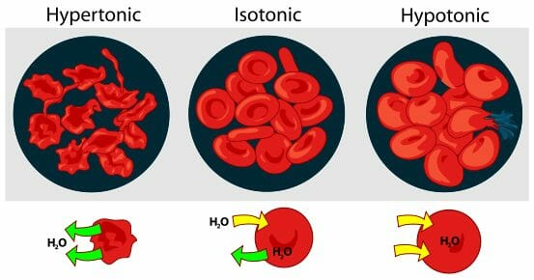
Importance of Osmotic Pressure
Core Knowledge
Iso – Osmotic/Isotonic (0.9% NaCl)
Hypertonic
(greater than 0.9% NaCl)
Hypotonic
(less than 0.9% NaCl)

Slide 13
Surface Tension
Core Knowledge
Definition
“The tension of the surface film of a liquid caused by attraction of the particles in the surface layer by the bulk of the liquid, which tends to minimize surface area”.

Slide 14
Measurement Of Surface Tension
Core Knowledge
Surface Tension may be measured by the following methods:
Drop weight method
Drop Method
Capillary rise method
Du Nouy’s Torsion Balance Method

Slide 15
Surface Tension
Core Knowledge
Factors Affecting Surface Tension
Surface tension decreases with increase of Temperature.
Most Salts increase surface tension. The increase being almost proportional to concentration, Bile Salts Are an Exception which lower the surface tension.
Alkalies increase surface tension but ammonia lowers it as do the strong mineral acids.
Organic substances dissolved in a liquid usually lower surface tension.

Slide 16
Emulsion
Core Knowledge
Definition
A colloidal dispersion in which both the Disperse Phase (solute) and the Dispersion Medium (solvent) are liquids but not miscible
It is a Stable Dispersion of one liquid in another Immiscible liquid

Slide 17
Emulsification
Core Knowledge
Substances that lower the surface tension of water include Bile Salts etc
The tendency of water molecules to coalesce is decreased by the surface Tension lowering agents, thus the emulsion becomes Stable.
Since Bile Salts cause the greatest decrease in surface tension, they are the Best Emulsifying Agents.

Slide 18
Importance of Osmotic Pressure
Horizontal Integration
When the blood is diluted by drinking water, the osmotic pressure is lowered and more water passes from blood to tissues due to increased diffusion pressure which is inversely related to osmotic pressure.
Osmoregulation

Slide 19
Importance of Osmotic Pressure
Horizontal Integration
At the same time diffusion pressure of water passing through kidneys is also increased and more dilute urine is excreted.
This continues until the concentration of water in blood and tissues is returned to normal limits.

Slide 20
Physiological Aspect

Slide 21
Importance of Osmotic Pressure
Vertical Integration
1. Fluid balance and blood volume
Fluid balance of different compartments of the body is maintained due to osmosis.
Osmosis significantly contributes to the regulation of the blood volume and urine excretion.
Marked decrease in concentration of plasma proteins results in water leakage into the tissues - Edema.

Slide 22
Importance of Oncotic Pressure
Vertical Integration
2. Red blood cells and fragility
When RBC,s are suspended in an Isotonic (0.9% NaCl) solution , the cell volume remains unchanged and they are Intact.
In Hypertonic solution (eg 1.5% NaCl) water flows out of RBC and the cytoplasm shrinks, a phenomenon known as Crenation.
On the other hand, when the RBC are kept in a Hypotonic solution (eg 0.4% NaCl), the cells bulge due to entry of water in them which often causes Rupture of plasma membrane of RBC (Hemolysis).

Slide 23
Applications of Osmotic/Oncotic Pressure
Vertical Integration
Osmotic Fragility Test for RBCs is employed in lab for diagnostic purposes.
Increased fragility of RBC is observed in Haemolytic Jaundice
Decreased fragility is seen in certain Anaemias.
Osmotic Fragility test
Transfusion
Action of Purgatives
Osmotic Diuresis
Edema due to Hypoalbuminaemia
Cerebral Edema
Irrigation of Wounds

Slide 24
Applications of Surface Tension
Vertical Integration
Digestion and Absorption of fat
Hay’s Sulphur Test
Surfactants and Lung Function
Surface Tension and Absorption
Lipoprotein Complex Membranes

Slide 25
Kwashiorkar
Vertical Integration
Edematous Malnutrition
Caused by a Lack Of Protein in diet of infants & children.
Occurs in countries where good food is not readily available
Patients have an Extremely Emaciated appearance in all body parts except ankles, feet & belly which swell due to Fluid Retention.

Slide 26
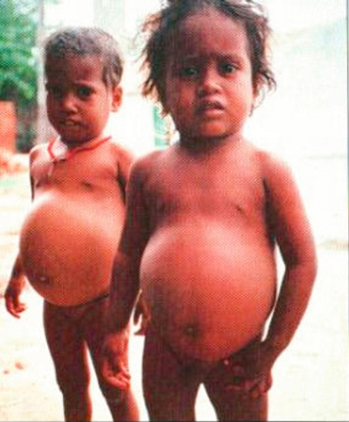
Family Medicine
Management of Kwashiorkar
Role of family Medicine in patients with Kwashiorkar (Edematous Malnutrition):
Diagnosis & Monitoring– Clinical assessment, Proper investigations - Serum Total Proteins/Albumin, Anemia - Close follow-up
Education & Dietary Guidance –
Condition of Protein Energy Malnutrition in
infants & children, Education of Parents esp Mother
Regular Diet - Initially light digestible,
gradual increase according to patient response ,
approx. 150 kcal/day, High Protein diet,
Seasonal Fruits & Vegetables.
Refer to Specialists – Urgent referral of Serious patients with severe signs & symptoms to Paediatrician

Slide 27
Spiral Integration
Artificial Intelligence
Role of AI in Management of Kwashiorkar
Artificial Intelligence plays role in Kwashiorkar following aspects:
Personalized Nutrition – Diet Optimization, Dietary Pattern Assessment
Diagnostic Tools –AI may be able to judge a child’s nutrition status through photographs→ Diagnosis
Food Recommendations – Diet Planning & Advancement, Food Image Recognition by Robots
Prediction of Risk Factors - Region of famine, Underlying Infections/Diseases, Pre-existing Immunity

Slide 28
Spiral Integration
Ethical Considerations
Bioethics
Catering Social concerns of Kwashiorkar patients – Occurs in areas of Famine, inadequate availability of good quality food. Dignified Economic support of patient & family
Responsibility, Persistence, Patience & Loyalty by Healthcare Professionals is required to treat Malnourished infants & children as response to treatment is very slow & gradual
Avoiding multiple Unnecessary Needle Pricks in patients undergoing Blood Tests of serum Proteins & Hb– (Non-maleficence)
All the Precautions of handling syringes & drawing blood from a patient be followed strictly to avoid blood-borne Diseases & Infections of Malnourished patients – (Beneficence)

Slide 29
Spiral Integration
Research Article
Suggested Research Article
Link: https://www.researchgate.net/publication/370591814_Control_of_Enzyme_Reactivity_in_Response_to_Osmotic_Pressure_Modulation_Mimicking_Dynamic_Assembly_of_Intracellular_Organelles
Journal Name: Advanced Materials
Title: Control of Enzyme Reactivity in Response to Osmotic Pressure Modulation Mimicking Dynamic Assembly of Intracellular Organelles
Author Names:
Clemence Schvartzman
Hang Zhao
Emmanuel Emmanuel Ibarboure
Vusala Ibrahimova
Abstract:
In response to variations in osmotic stress, esp hypertonicity associated with biological dysregulations, cells have developed complex mechanisms to release their excess water, thus avoiding their bursting and death. When water is expelled, cells shrink and concentrate their internal bio(macro)molecular content, inducing the formation of membraneless organelles following a liquid-liquid phase separation (LLPS) mechanism. To mimic this intrinsic property of cells, functional thermo-responsive elastin-like polypeptide (ELP) biomacromolecular conjugates are herein encapsulated into self-assembled lipid vesicles using a microfluidic system, together with polyethylene glycol (PEG) to mimic cells' interior crowded microenvironment. By inducing a hypertonic shock onto the vesicles, expelled water induces a local increase of concentration and a concomitant decrease of the cloud point temperature (Tcp ) of ELP bioconjugates that phase separate and form coacervates mimicking cellular stress-induced membraneless organelle assemblies. Horseradish peroxidase (HRP), as a model enzyme, is bioconjugated to ELPs and is locally confined in coacervates as a response to osmotic stress. This consequently increases local HRP and substrate concentrations and accelerates the kinetics of the enzymatic reaction. These results illustrate a unique way to fine-tune enzymatic reactions dynamically as a response to a physiological change in isothermal conditions. This article is protected by copyright. All rights reserved.

Slide 30
How To Access Digital Library
Steps to Access HEC Digital Library
Go to the website of HEC National Digital Library.
On Home Page, click on the INSTITUTES.
A page will appear showing the universities from Public and Private Sector and other Institutes which have access to HEC National Digital Library HNDL.
Select your desired Institute.
A page will appear showing the resources of the institution
Journals and Researches will appear
You can find a Journal by clicking on JOURNALS AND DATABASE and enter a keyword to search for your desired journal.

Slide 31
Learning Resources
Essentials of Medical Biochemistry, by Mushtaq Ahmed, Vol1, chapter 2, page 24-55, Ninth edition.
Guyton and Hall Textbook of Medical Physiology by John E. Hall, Michael E. Hall. Fourteenth edition.
Harper’s Illustrated Biochemistry 32nd Edition
Google Scholar
Google Images

