Slide 1


Slide 2

Foundation Module
First Year MBBS
Functional Organization of Human Body and Cell
Supervised by Prof. Samia Sarwar Chairperson Physiology Presenter :Dr. (FCPS PHY)
Dated : 00-00-2025
Physiology Department

Slide 3

Motto, Vision, Dream
To impart evidence based research oriented medical education
To provide best possible patient care
To inculcate the values of mutual respect and ethical practice of medicine
Wisdom
Truth
Service

Slide 4
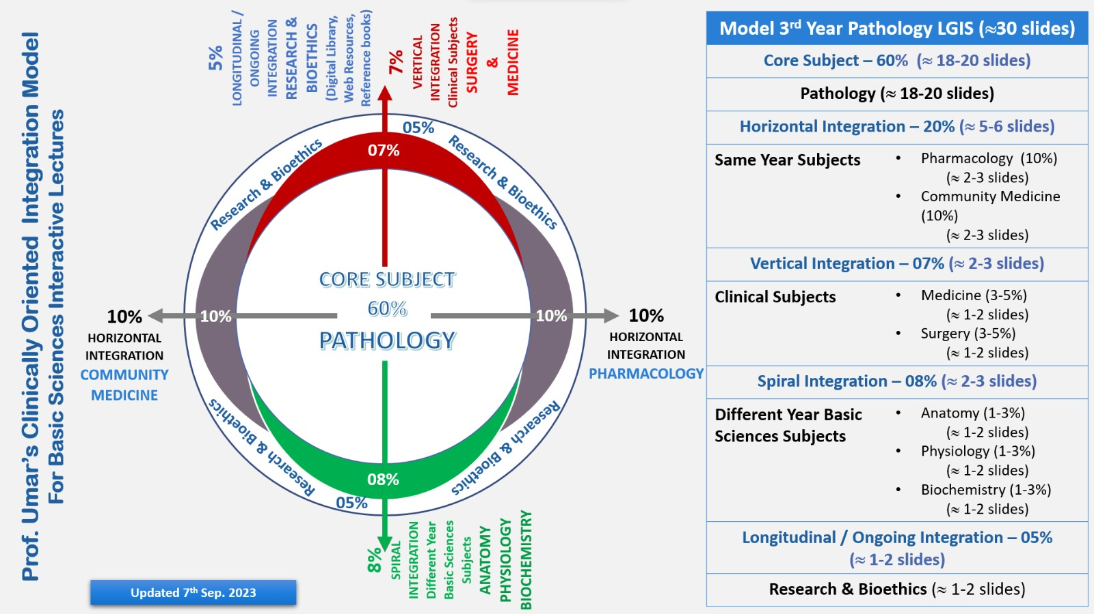
Professor Umar Model of Integrated Lecture

Slide 5
Learning Objectives
At the end of this session students should be able to
To understand different levels of organization of human body
To recall human body composition
To explain body fluid compartments
To understand cell structure and its constituents

Slide 6
Interactive Session

Slide 7
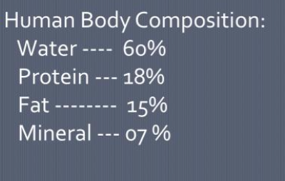
Horizontal Integration with Biochemistry

Slide 8
Body Fluid Compartments
Core Concept
Human body
50-70%fluid
(42L)
Extracellular fluid 1/3rd
(14L)
Plasma
Interstitial fluid
Intracellular fluid 2/3rd
^{(28L)}

Slide 9
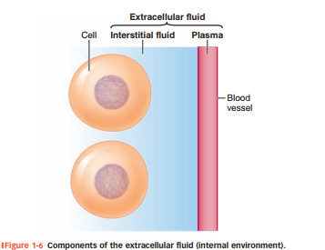
Core Concept
Reference: Sherwood Human Physiology 9th edition pg#9

Slide 10
Difference between Extracellular and Intracellular Fluid
Core Concept
Extracellular fluid Found outside the cells 1/3rd of total body fluid Major cation is sodium Major anion is chloride | Intracellular fluid Found inside the cells 2/3rd of total body fluid Major cation is potassium Major anion is phosphate

Slide 11
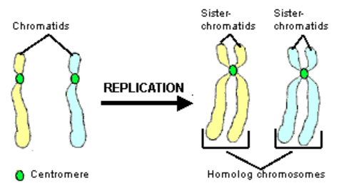
The Cell
Core Concept
The basic living unit of the body is the cell.
Each tissue or organ is an aggregate of many different cells held together by intercellular supporting structures.

Slide 12
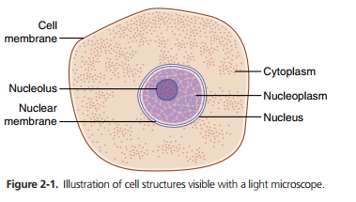
Core Concept
Electro positively charged small molecules that lead to the formation of large number of proteins present in chromosomes.
Organized in vast numbers of small, bobbin like cores.
Reference: Guyton and Hall Textbook of Physiology fourteenth Edition page no. 13

Slide 13
Cell Structure
Core Concept
It includes :
Cell membrane
Cytoplasm
Cytosol
Organelles

Slide 14
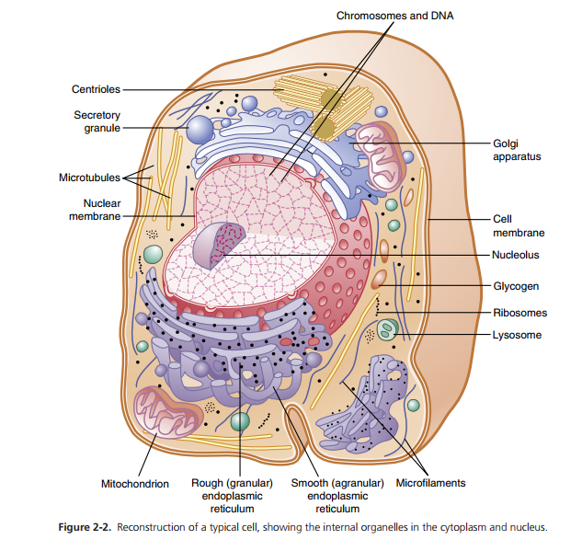
Cell Cycle
‘Cell cycle is the period of time between the birth of a cell and its own division to produce two daughter cells’
Reference: Guyton and Hall Textbook of Physiology fourteenth Edition page no. 14

Slide 15
Levels of Organization in the Human Body
Core Concept
Chemical level
Cellular level
Tissue level
Organ level
Body system
Organism level

Slide 16
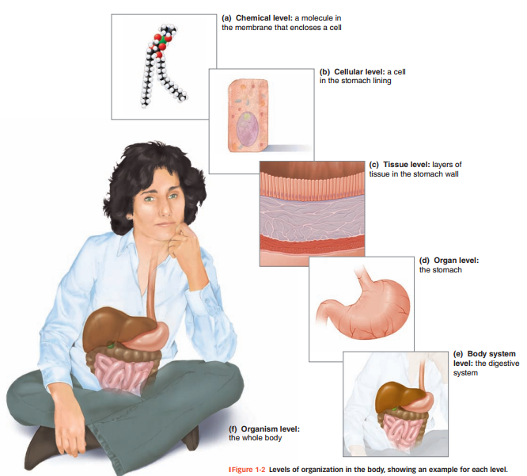
Core Concept
TOTAL BODY WATER 60%BW
ECF 20%BW
ICF40%BW(Body weight)
PLASMA 5%BW
Or 25% of ECF
IF 15%BW
Or 75% of ECF
Reference: Sherwood Human Physiology 9th edition pg#4

Slide 17
Vertical Integration

Slide 18
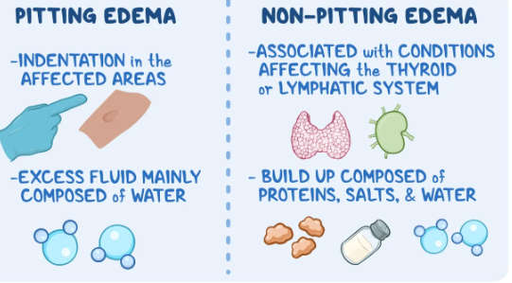
Edema
Vertical Integration
The process by which cells divide into two daughter cells with the
same genetic material are:
  Mitosis
  Meiosis
  Meiosis I
  Meiosis II
  Karyokinesis
  Cytokinesis

Slide 19
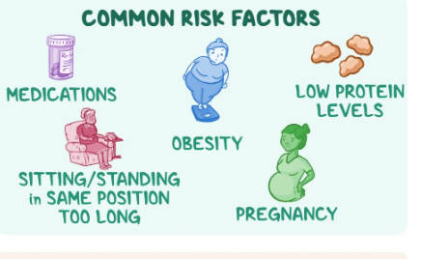
Edema
Vertical Integration
Intracellular component of the body water accounts for about 40% of body weight and the extracellular component for about 20%.
Approximately 25% of the extracellular component is in the vascular system (plasma = 5% of body weight) and 75% outside the blood vessels (interstitial fluid = 15% of body weight).
The total blood volume is about 8% of body weight.
Flow between these compartments is tightly regulated.

Slide 20
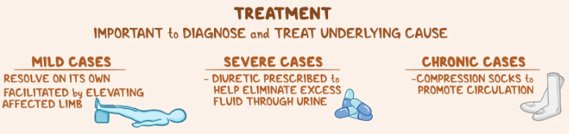
Edema
Vertical Integration
‘A type of cell division in which parent cell divides into two daughter cells and each of two daughter cells receive a chromosomal karyotype identical to parent cells’

Slide 21
Spiral Integration

Slide 22

Autonomy
Spiral Integration/Ethics
Autonomy means that the patients are able to make independent decisions. This means that doctors & nurses should be sure patients have all of the needed information that is required to make a decision about their medical care and are educated. They do not influence the patient's choice.
The Right of Self-Determination or Autonomy would include the right to refuse treatment, the right to participate in research or refuse it. To exercise this right would require Informed Consent.

Slide 23
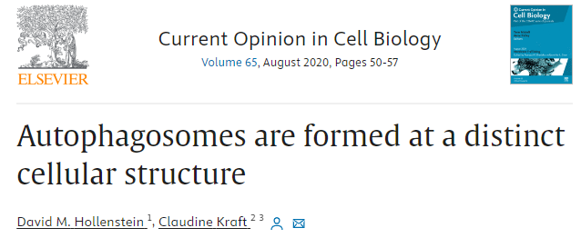
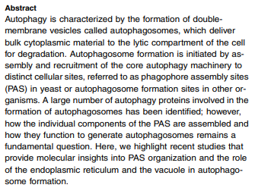
Suggested Research Article
Spiral Integration/ Research
Reference:https://www.sciencedirect.com/science/article/pii/S0955067420

Slide 24
How To Access Digital Library
Promoting IT & Research Culture
Steps to Access HEC Digital Library
Go to the website of HEC National Digital Library.
On Home Page, click on the INSTITUTES.
A page will appear showing the universities from Public and Private Sector and other Institutes which have access to HEC National Digital Library HNDL.
Select your desired Institute.
5. A page will appear showing the resources of the institution
6. Journals and Researches will appear
7. You can find a Journal by clicking on JOURNALS AND DATABASE and enter a keyword to search for your desired journal. Link:https://www.topstudyworld.com/2020/05/access-hec-digital-library.html?m=1

Slide 25
Brainstorming

Slide 26
Structured Essay Question Related To Topic
Brainstorming
Q No.1: A 27 years female , primigravida had delivered a baby 1 week ago. After delivery Regression of uterus is function of which organelle?

Slide 27
Answer
Brainstorming
Lysosomes

Slide 28
Structured Essay Question Related To Topic
Brainstorming
Q: A 27 years female has delivered a baby 1 week ago. After delivery Regression of uterus is function of which organelle?

Slide 29
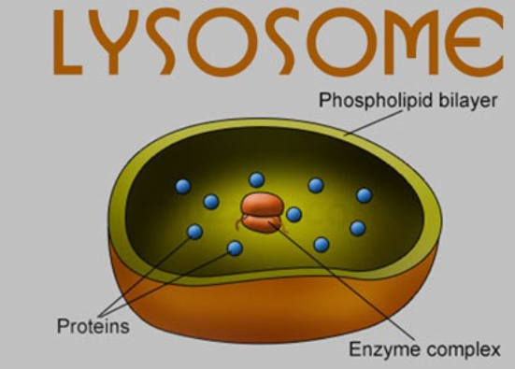
Brainstorming

Slide 30
References
References
Guyton and Hall Textbook of Medical Physiology 14th Edition
Ganong’s Review of Medical Physiology 25th Edition
Sherwood, 9th edition.
Silverthorn Physiology, 6th edition
Vander’s Human Physiology, 14th edition

Slide 31


