Slide 2
Foundation Module First Year MBBS
Cellular Control Mechanism, Cell Cycle & Apoptosis
Supervised by Prof. Samia Sarwar Chairperson Physiology Presenter :Dr. (FCPS PHY)
Dated : 00-00-2025
Physiology Department

Slide 3
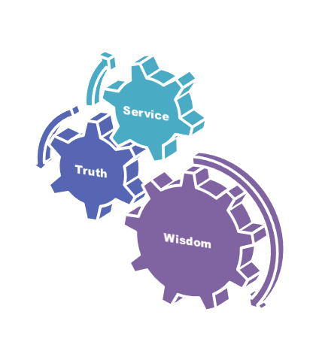
Motto, Vision, Dream
To impart evidence based research oriented medical education
To provide best possible patient care
To inculcate the values of mutual respect and ethical practice of medicine
Wisdom
Truth
Service

Slide 4
Professor Umar Model of Integrated Lecture

Slide 5
Learning Objectives
To understand control of cell growth and cell reproduction
To explain replication of chromosomes and cell cycle
To understand programmed cell death/apoptosis

Slide 6
Interactive Session

Slide 7
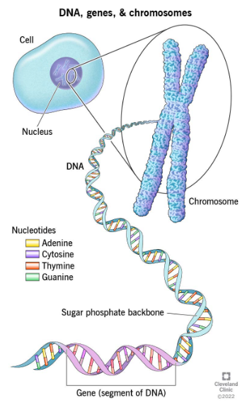
HUMAN PHYSIOLOGY
Horizontal Integration with Biochemistry
Human physiology explains the specific characteristics and mechanisms of the human body that make it a living being.
3Ps
Physiology, purpose, process

Slide 8
Control of Cell Growth
Core Concept
Growth of the cells is controlled by three ways:
Growth factors from other parts of the body e.g. pancreatic growth
Availability of space for growth e.g. cell growth in tissue culture
Negative feedback effect e.g. own secretions in tissue culture

Slide 9
Cell Reproduction
Core Concept
Reproduction and growth of different types
of cells:
Do not reproduce for many years e.g. smooth muscle cells
Reproduce only during fetal life e.g. neurons
Reproduce all the time e.g. blood-forming cells

Slide 10
Cell Reproduction
Core Concept
Regeneration of the organs occurred by rapid division of the cells until appropriate numbers again available e.g. liver transplantation.

Slide 11
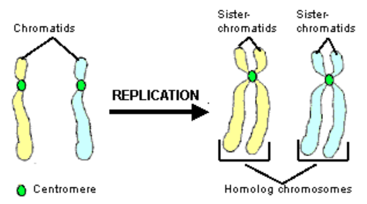
Replication of Chromosomes
Core Concept
Number of chromosomes in human cell is 46
Number of pairs is 23
Genes also exist in pairs
Replication occurs after few minutes of replication of DNA.

Slide 12
Histones
Core Concept
Electro positively charged small molecules that lead to the formation of large number of proteins present in chromosomes.
Organized in vast numbers of small, bobbin like cores.

Slide 13
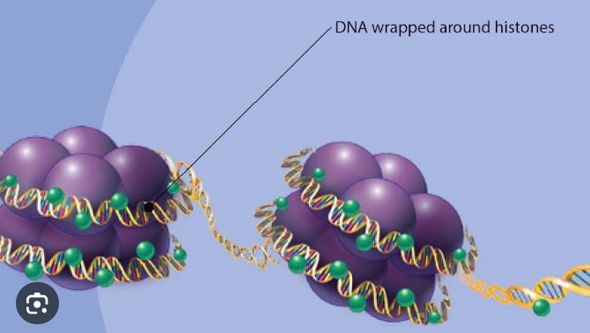
Functions of Histones
Core Concept
Regulates DNA activity.
Decondense by regulatory proteins.

Slide 14
Cell Cycle
Core Concept
‘Cell cycle is the period of time between the birth of a cell and its own division to produce two daughter cells’

Slide 15
Core Concept
Reference: Silverthorn Physiology 6th Edition A-22 appendix C

Slide 16
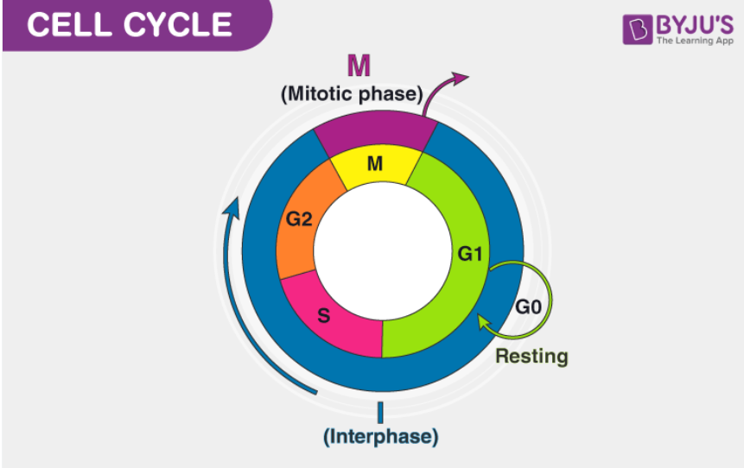
Core Concept
TOTAL BODY WATER 60%BW
ECF 20%BW
ICF40%BW(Body weight)
PLASMA 5%BW
Or 25% of ECF
IF 15%BW
Or 75% of ECF

Slide 17
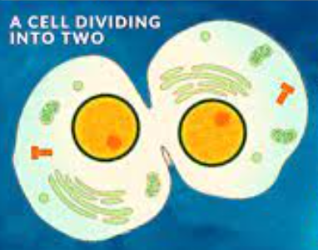
Cell Division
Core Concept
The process by which cells divide into two daughter cells with the
same genetic material are:
Mitosis
Meiosis
Meiosis I
Meiosis II
Karyokinesis
Cytokinesis

Slide 18
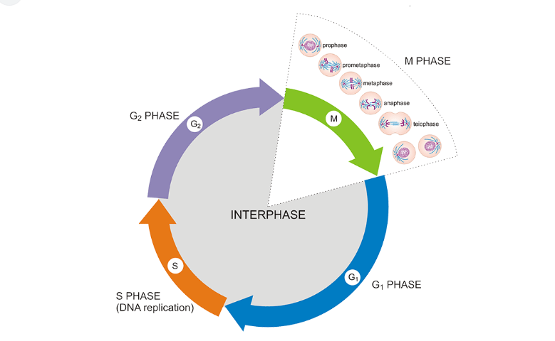
Interphase
Core Concept
Intracellular component of the body water accounts for about 40% of body weight and the extracellular component for about 20%.
Approximately 25% of the extracellular component is in the vascular system (plasma = 5% of body weight) and 75% outside the blood vessels (interstitial fluid = 15% of body weight).
The total blood volume is about 8% of body weight.
Flow between these compartments is tightly regulated.

Slide 19
Mitosis
Core Concept
‘A type of cell division in which parent cell divides into two daughter cells and each of two daughter cells receive a chromosomal karyotype identical to parent cells’

Slide 20
Core Concept
Reference :Guyton and Hall Textbook of Medical physiology page no.41

Slide 21
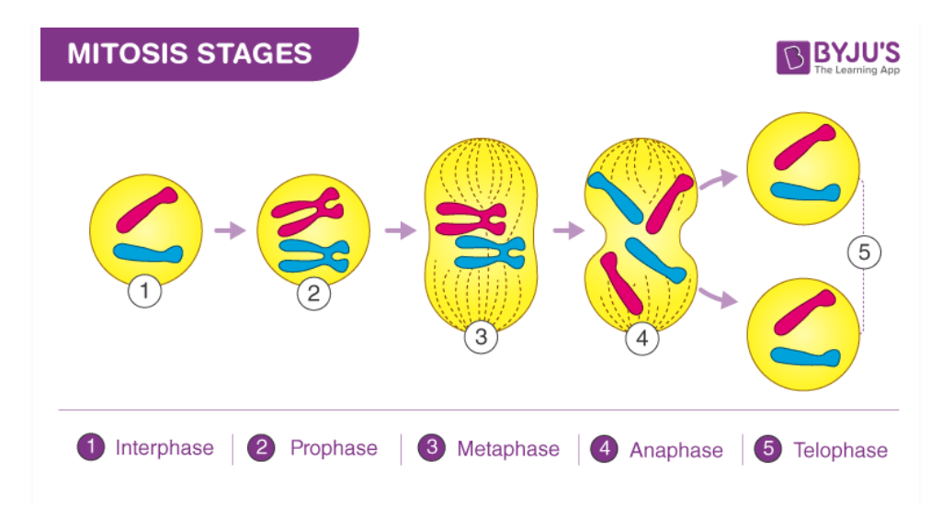
Phases of Mitosis
Core Concept
Prophase
Metaphase
Anaphase
Telophase

Slide 22
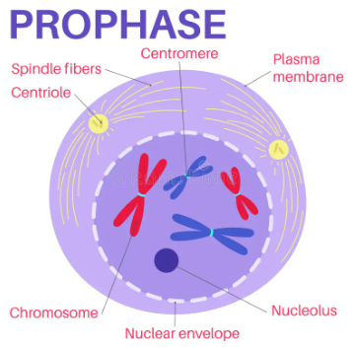
Prophase
Core Concept
Chromosomes becomes visible
Centriolar migration
Assembling of microtubules
Formation of asters

Slide 23
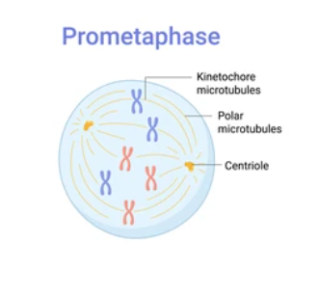
Prometaphase - Metaphase
Core Concept
Spindle microtubules extend into the central region

Slide 24
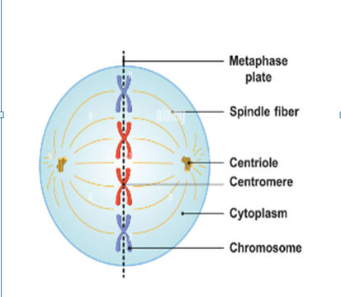
Metaphase
Core Concept
Equatorial plate and chromosomal alignment
Centromeres lie in single transverse plane
Chromosomes acquire two groups of kinetochore microtubules which exert pull on chromosomes

Slide 25
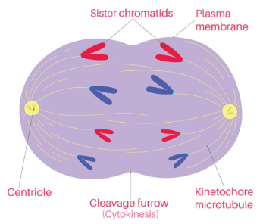
Anaphase
Core Concept
Separation of sister chromatids due to split in centromeres
Chromosomes clustered at spindle poles
Formation of cleavage furrow starts

Slide 26
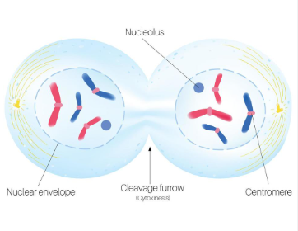
Telophase
Core Concept
Cleavage furrow gradually deepens.
Bundles of spindle microtubules still connecting daughter cells.
Formation of nuclear envelope and reappearance of nucleoli occurs.
Uncoiling of chromosomes.

Slide 27
Meiosis
Core Concept
Special type of cell division in germ cells
Two successive cell divisions
Meiosis I
Meiosis II
Four daughter cells
Haploid chromosomes + genetic variation

Slide 28
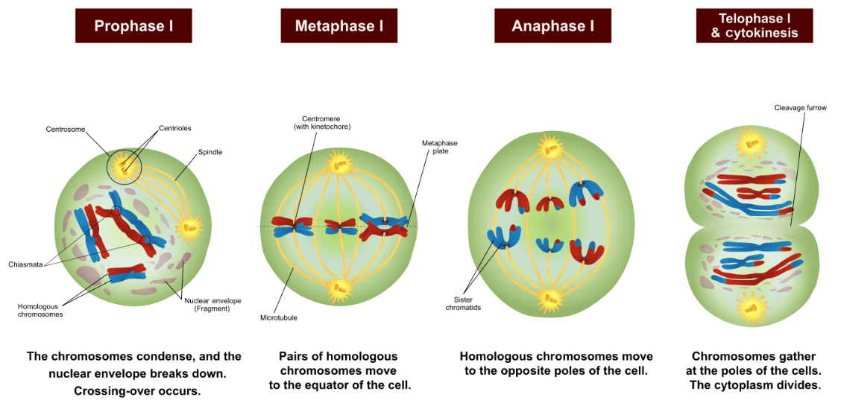
Phases of Meiosis I
Core Concept

Slide 29
Prophase I
Core Concept
Prophase I
Laptotene
Zygotene
Pachytene
Diplotene
Diakinesis

Slide 30
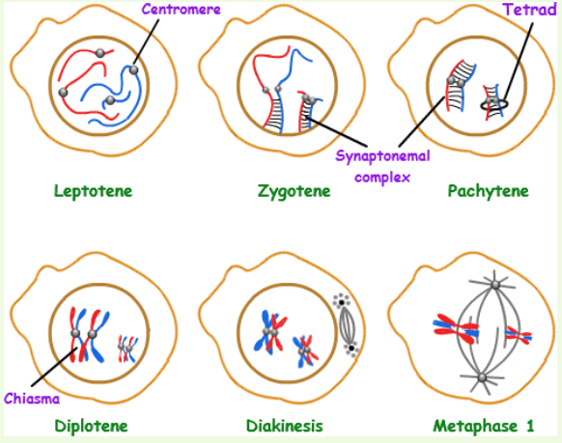
Phases of Prophase I
Core Concept

Slide 31
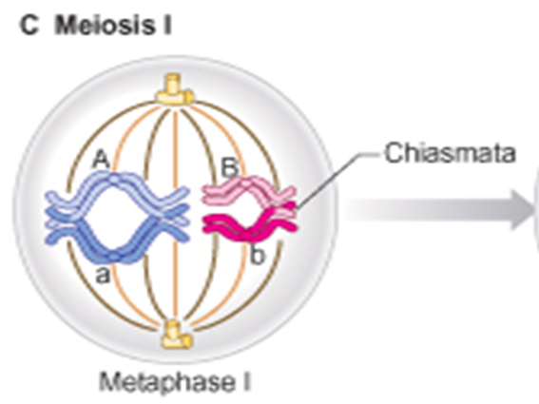
Metaphase I
Core Concept
Bodies attach to the spindle microtubules are bivalents, not single chromosomes
Homologous pairs lie parallel to the equatorial plate, with one on either side.

Slide 32
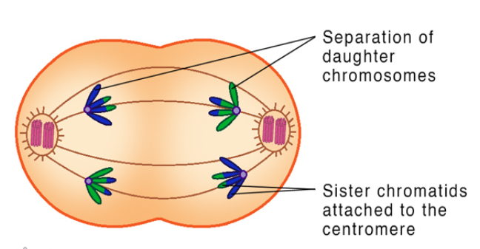
Anaphase I
Core Concept
Homologous pair completely separates from each other & move to opposite poles of spindles
No division of centromeres occurs & whole chromosome move to opposite poles
Positioning of bivalent pairs is random.

Slide 33
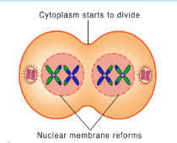
Telophase I
Core Concept
Assortment of maternal and paternal chromosomes in each Telophase nucleus is also random.
Nuclei reconstructed & Cytokinesis divide parent cell into two daughter cells

Slide 34
Meiosis II
Core Concept
Meiosis II is more like mitosis - commences after a short interval
No DNA synthesis occurs.
Unlike mitosis, the separating chromatids are genetically different.
Cytoplasmic division also occurs

Slide 35
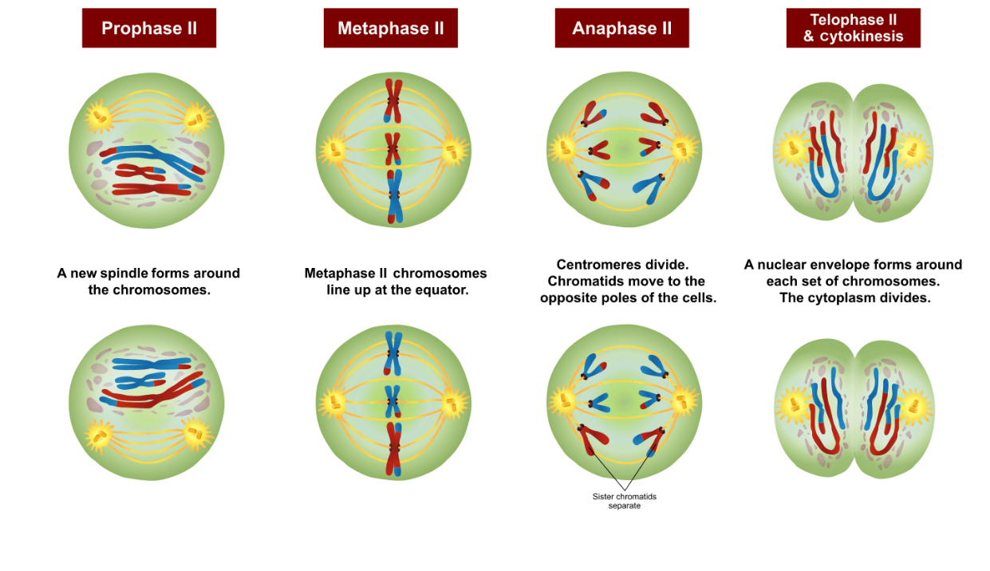
Phases of Meiosis II
Core Concept

Slide 36
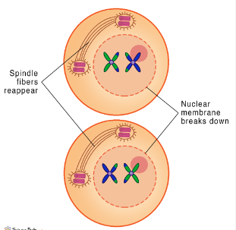
Prophase II
Core Concept
Disappearance of the nucleoli and the nuclear envelope
Shortening and thickening of the chromatids
Centrioles move to the polar regions and arrange spindle fibers for the second meiotic division

Slide 37
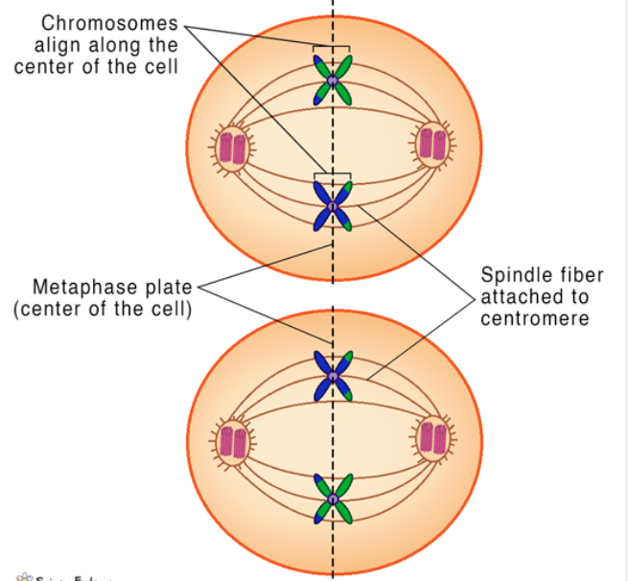
Metaphase II
Core Concept
Two kinetochore attach to spindle fibers from the centrioles at each pole.

Slide 38
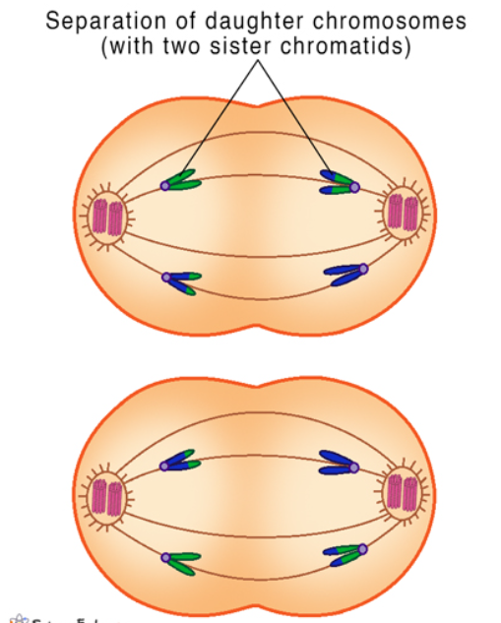
Anaphase II
Core Concept
Centromeres are cleaved
Sister chromatids pulled apart
The sister chromatids are now called sister chromosomes

Slide 39
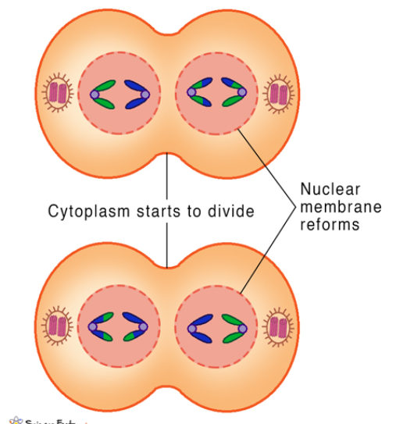
Telophase II
Core Concept
Uncoiling and lengthening of the chromosomes
Spindle disappear
Nuclear envelopes reform and cell wall formation
Four daughter cells formed, each with a haploid set of chromosomes.

Slide 40
Karyokinesis vs. Cytokinesis
Core Concept
Karyokinesis:
Division of cell nucleus.
Cytokinesis:
Division of a cell bringing about separation into two daughter cells

Slide 41
Core Concept

Slide 42
Apoptosis
Core Concept
The process of programmed cell death.
The death of cells which occurs as a normal and controlled part of an organism’s growth or development.

Slide 43
Mechanism of Apoptosis
Core Concept
Initiated by activation of family of proteases, called caspases.
Caspases are formed and stored in proactive form known as procaspases.
Once activated , cleave and activate other procaspases, triggering a cascade that breaks down protein within a cell.

Slide 44
Steps of Apoptosis
Core Concept
Major steps:
Cell shrinks
Cell fragments
Cytoskeleton collapses
Nuclear envelope disassembles
Cells release apoptotic bodies
Macrophages phagocytose apoptotic bodies

Slide 45
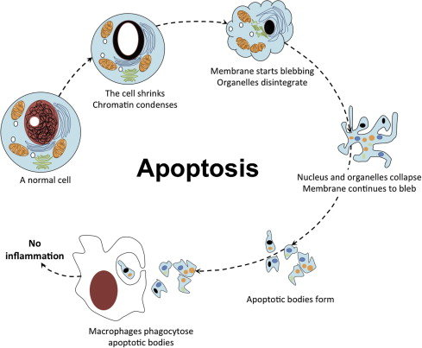
Core Concept

Slide 46
Vertical Integration

Slide 47
Apoptosis in Relation to Breast tissue
Vertical Integration with General Surgery
Apoptosis is involved in the remodelling of breast tissue during pregnancy and lactation.
The balance of cell survival and death is critical for the functional changes in the breast during these periods.

Slide 48
Breast Cancer
Vertical Integration with General Surgery
Dysregulation of apoptosis is a hallmark of cancer.
In breast cancer, a disruption in the balance between cell survival and apoptosis.

Slide 49
Spiral Integration

Slide 50
Spiral Integration
A 45 years lady has been diagnosed with advanced breast cancer. The oncologist proposes an aggressive treatment plan that involves a combination of chemotherapy and radiation therapy.
The treatment aims to induce apoptosis, and preventing the further spread of the disease.

Slide 51
Bioethical considerations
Vertical Integration with Biomedical Ethics
Includes:
Impact on healthy cells
Quality of life
Balance between potential benefits and risks.

Slide 52
Ethical Issue
Vertical Integration with Biomedical Ethics
Apoptosis is not entirely selective because normal cells may also undergo apoptosis e.g. hair loss, nausea, and weakened immune function.
Ensuring informed consent
Affecting her ability to work
Expensive treatments

Slide 53
Consideration
Vertical Integration with Biomedical Ethics
How much collateral damage to healthy cells is ethically acceptable?
Are there alternative treatments that could minimize the impact on normal cells?
How much emphasis should be placed on extending life versus maintaining a certain quality of life?
How much information is ethically necessary?

Slide 54
Autonomy
Vertical Integration with Biomedical Ethics
The patients are able to make independent decisions.
Patients should have all the needed information that is required to make a decision about their medical care and are educated.
Doctors do not influence the patient's choice.
The right to refuse treatment, the right to participate in research or refuse it.
To exercise this right would require
Informed Consent.

Slide 55
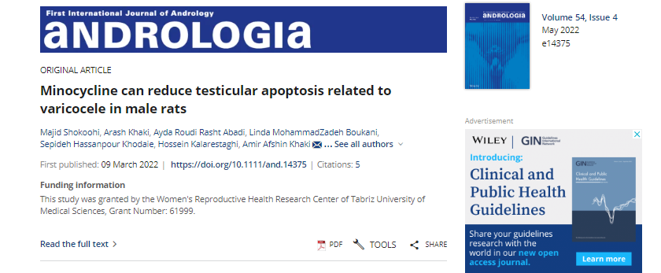
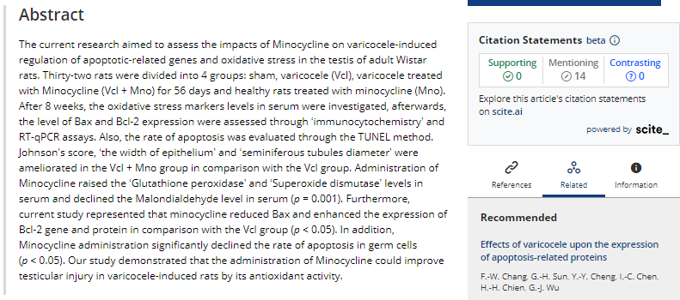
Suggested Research Article
Vertical Integration with Research
Reference: https://onlinelibrary.wiley.com/doi/abs/10.1111/and.14375

Slide 56
How To Access Digital Library
Promoting IT & Research Culture
Steps to Access HEC Digital Library
Go to the website of HEC National Digital Library.
On Home Page, click on the INSTITUTES.
A page will appear showing the universities from Public and Private Sector and other Institutes which have access to HEC National Digital Library HNDL.
Select your desired Institute.
5. A page will appear showing the resources of the institution
6. Journals and Researches will appear
7. You can find a Journal by clicking on JOURNALS AND DATABASE and enter a keyword to search for your desired journal. Link:https://www.topstudyworld.com/2020/05/access-hec-digital-library.html?m=1

Slide 57
Brainstorming

Slide 58
Structured Essay Question Related To Topic
Brainstorming
Q: A 27 years female has delivered a baby 1 week ago. After delivery Regression of uterus is function of which organelle?

Slide 59
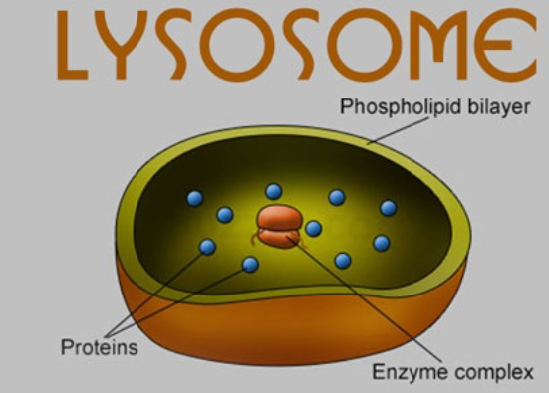
Brainstorming

Slide 60
References
References
1. Books:
Guyton and Hall Textbook Of Medical Physiology fourteenth edition page no. 41-43,45
Ganong’s Review of Medical Physiology page no.5
Silverthorn Physiology 6th Edition A22
Google images.
2. Medical Journal articles:
Reference: Minocycline can reduce testicular apoptosis related to Varicocele in male rats
Published in: First International Journal of Andrology

Slide 61
Summary
Summary
Core knowledge:
Control of cell growth, cell cycle and apoptosis
Horizontal Integration:
Embryology and Biochemistry
Vertical Integration:
Gynaecology : Example of Breast tissue (apoptosis after pregnancy and lactation)
Research:
Minocycline can reduce testicular apoptosis related to varicocele in
male rats
Biomedical Ethics:
Example of Breast cancer (impact on quality of life, potential risks and benefits)
Autonomy
The patients are able to make independent decisions
Family Medicine:
Genetic Counselling

