Slide 2
1st Year MBBS Foundation Module Small Group Discussion (SGD) Cell Membrane
Presenter: Dr. Uzma Zafar Date: 24-01-25
(Demonstrator)

Slide 3
Motto, Vision, Dream
To impart evidence based research oriented medical education
To provide best possible patient care
To inculcate the values of mutual respect and ethical practice of medicine
Wisdom
Truth
Service

Slide 4
Professor Umar Model of Integrated Lecture

Slide 5
Learning Objectives
At the end of this session students should be able to
Explain composition and structure of cell membrane
Describe the Fluid mosaic model
Understand the functions of cell membrane

Slide 6
Cell Membrane
Core Knowledge
A thin semi permeable membrane defining the boundary of a cell separating it from the external environment.

Slide 7
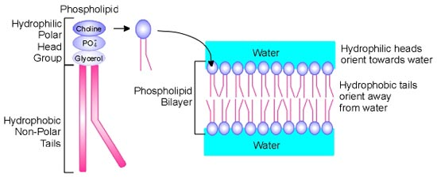
Composition of Cell Membrane Lipids
Core Knowledge
Basic structural components of cell membrane.
Have a “polar” or ionic head ( hydrophilic) & the other end is “non-polar” tail ( hydrophobic)

Slide 8
Composition of Cell Membrane Lipids
Core Knowledge

Slide 9
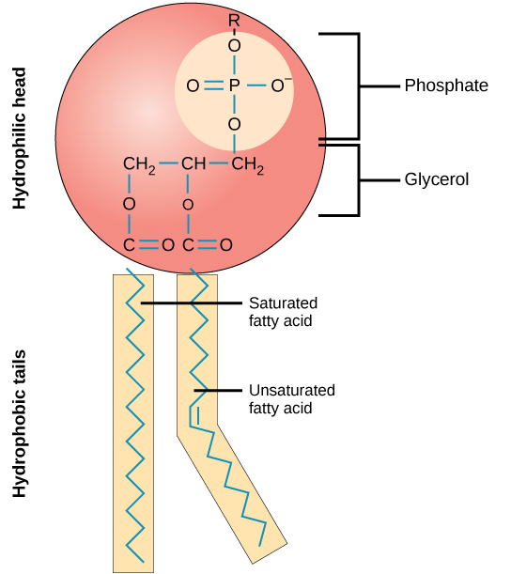
Composition of Cell Membrane Phospholipids
Core Knowledge
Most common lipids present in cell membrane.
Consist of a glycerol backbone fatty acids (combined with ester link) and a phosphorylated alcohol.

Slide 10
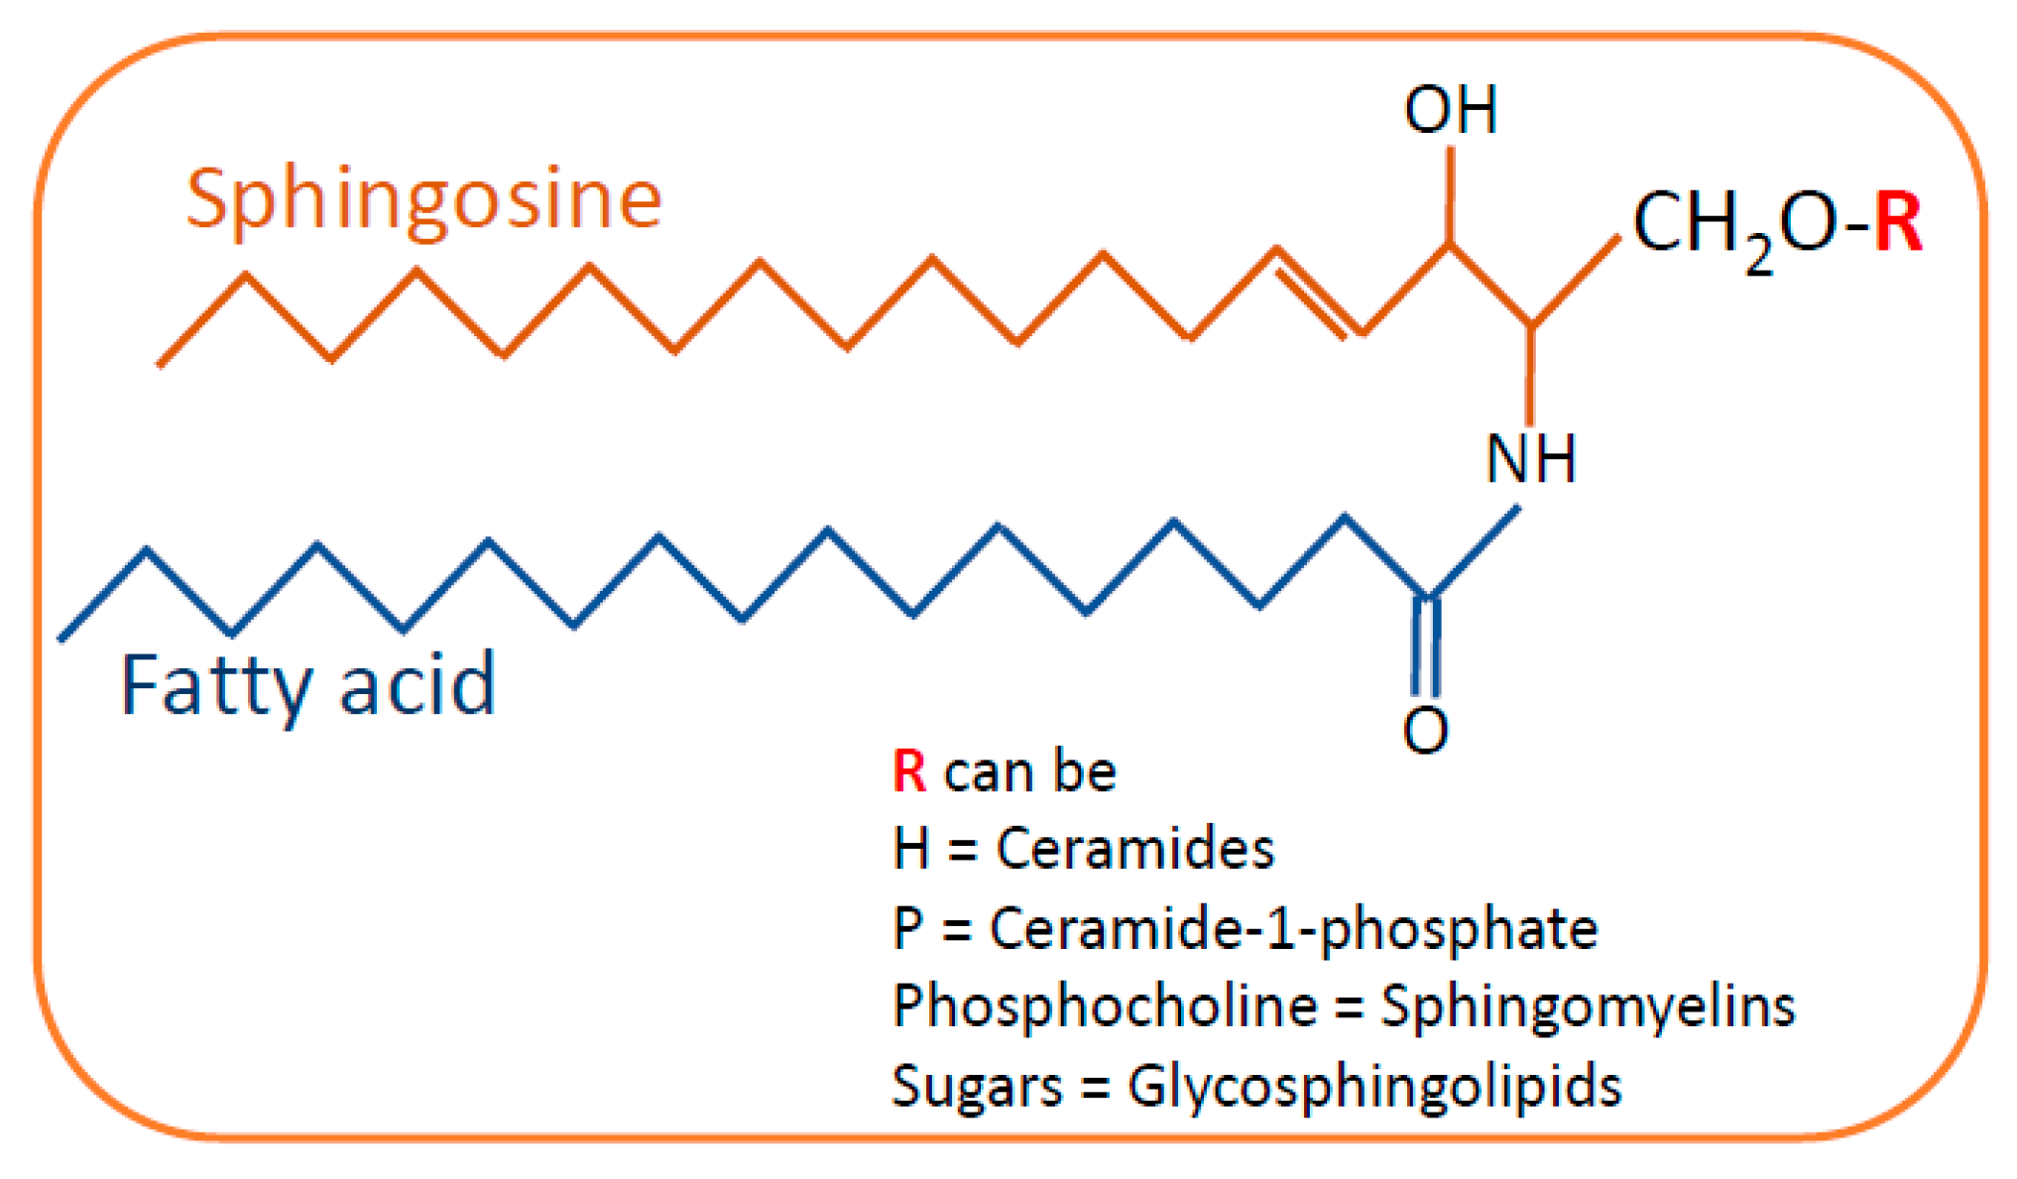
Composition of Cell Membrane Sphingolipids
Core Knowledge
Sphingolipids are a second type of lipid found in cell membranes, particularly nerve cells and brain tissues.
They do not contain glycerol, but retain the two alcohols with the middle position occupied by an amine.

Slide 11
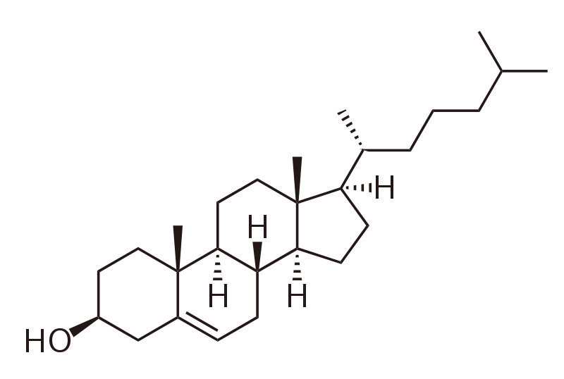
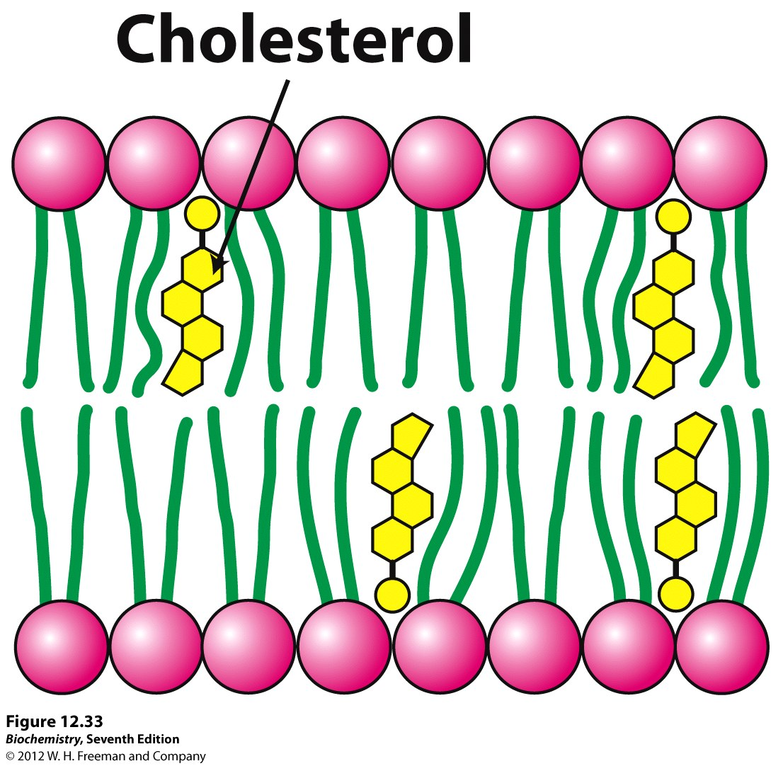
Composition of Cell Membrane Sterols
Core Knowledge
Cholesterol —most common sterol in cell membrane.
Combines with phospholipids of membrane with its hydroxyl group i.e. hydrophilic polar head at aqueous interface & remainder buried in hydrophobic leaflets.
Helps to regulate fluidity of animal membrane.

Slide 12
Composition of Cell Membrane Proteins
Core Knowledge
1) Integral Proteins
Integral membrane proteins are permanently embedded within the plasma membrane. They have a range of important functions. Such as channeling or transporting molecules across the membrane.
2) Peripheral proteins
These proteins attach to integral membrane proteins, or penetrate the peripheral regions of the lipid bilayer.

Slide 13
Composition of Cell Membrane Proteins
Core Knowledge
3) Transmembrane proteins
Transmembrane proteins are firmly inserted into the phospholipid bilayer. Spanning the entire width of the membrane, they may protrude from both sides of the cell.
They can serve as receptors for hormones, neurotransmitters, tissue, specific antigens, growth factor etc.

Slide 14
Composition of Cell Membrane Proteins
Core Knowledge

Slide 15
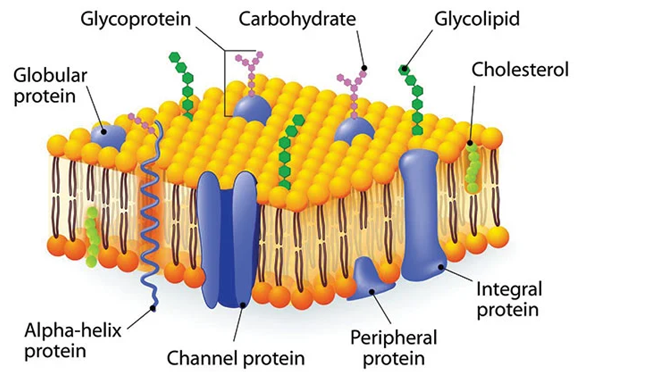
Composition of Cell Membrane Carbohydrates
Core Knowledge
It is present in the form of Glycoproteins & Glycolipids.
Cell recognition and cell protection are two important roles of carbohydrates.

Slide 16
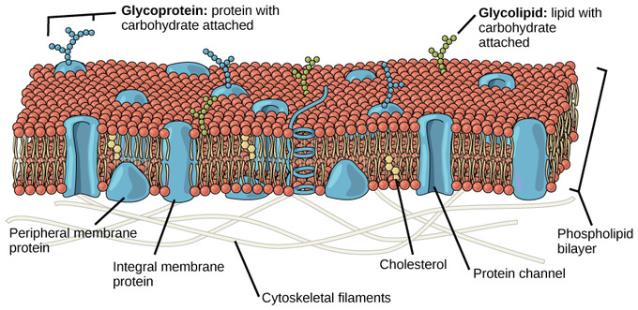
Fluid Mosaic Model
Core Knowledge
Fluid Mosaic Model describes the structure of plasma membrane as a mosaic of components- primarily, cholesterol, carbohydrates, proteins and phospholipids.

Slide 17
Key points of Fluid Mosaic Model
Core Knowledge
1) The main component of the membrane is composed of phospholipid molecules.
2) Integral proteins, the second major component of membrane are integrated completely into the membrane structure with their hydrophobic regions interacting with the hydrophobic region of the phospholipid bilayer.
3) Carbohydrates, the third major component of plasma membranes, are found on the exterior surface of cells- bound either to proteins (as glycoproteins ) or to lipids (as glycolipids).

Slide 18
Anatomy of Cell Membrane

Slide 19
Physiology of Cell Membrane
Keeps the cell intact
Acts as a protective barrier
Regulates transport in and out of the cell
Cell membranes are selectively permeable
Allows cell recognition
Provides anchoring sites for filaments of cytoskeleton
Provides binding sites for enzymes

Slide 20
Physiology of
In some tissues, collagen may be dispersed as a gel that gives support
Provide great strength, as in tendons
In the Cornea transmit light
Collagen of Bone resist mechanical shear

Slide 21
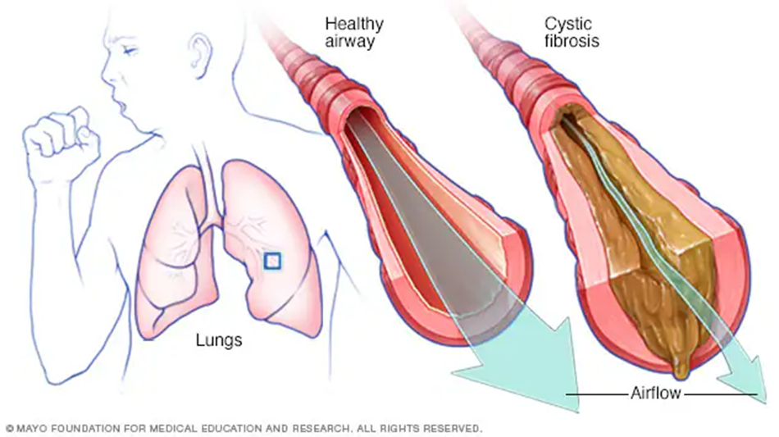
Cystic Fibrosis
Vertical Integration
CF is a recessive genetic disorder. It is characterized by chronic bacterial infection of airways in sinuses, fat maldigestion due to pancreatic exocrine insufficiency.
It is due to mutation in the gene encoding the CFTR’ a transmembrane protein.

Slide 22
Family Medicine
Spiral Integration
Family Physician helps the patients in the following manner:
1) After diagnosing, he educates the patient and the family
2) Gives the dietary guidance
3) Monitors the patient’s general health and symptoms
4) Refers to specialists

Slide 23
Ethical Consideration
Spiral Integration
Here are some ethical considerations related to cystic fibrosis (CF):
Informed Consent
Access to healthcare
Privacy on genetic information needs to be addressed
The development and use of germ-line gene therapy (GLGT)

Slide 24
Role of AI in Managing
Spiral Integration
Artificial Intelligence plays role in following aspects:
Data acquired from the entire CF population is used to make ML (Machine Learning) tools. ML model is used to predict clinical trajectories for CF. Clinical analysis of model outputs can be used to prescribe precise medication
AI can also be used to prescribe personalized food recommendations and help with drug development.

Slide 25
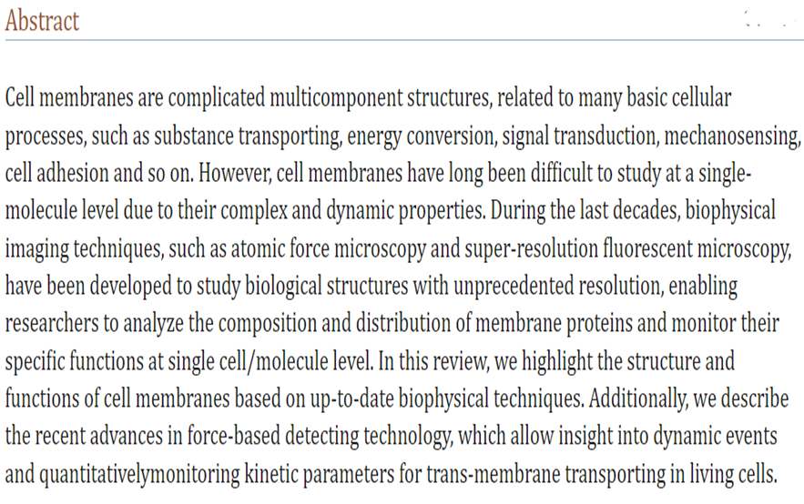
Suggested Research Article
Link:
https://www.ncbi.nlm.nih.gov/pmc/articles/PMC10233388/
Journal: Biophys Rep
Title:
Studying structure and functions of cell membranes by single molecule biophysical techniques
Author:
Qingrong Zhang et al.

Slide 26
How To Access Digital Library
Steps to Access HEC Digital Library
Go to the website of HEC National Digital Library.
On Home Page, click on the INSTITUTES.
A page will appear showing the universities from Public and Private Sector and other Institutes which have access to HEC National Digital Library HNDL.
Select your desired Institute.
A page will appear showing the resources of the institution
6. Journals and Researches will appear
7. You can find a Journal by clicking on JOURNALS AND DATABASE and enter a keyword to search for your desired journal.

Slide 27
Learning Resources
Harper's Illustrated Biochemistry 32nd edition, chapter no. 40
Google Scholar
Google Images

Slide 28
THANK YOU

