Slide 1
SCREENING-II (Interpretation of screening tests)
Block II-ophthalmology( Eye)

Slide 3
Vision & Mission of RMU
Wisdom
Truth
Service
Vision
Highly recognized and accredited center of excellence in Medical Education, using evidence-based training techniques for development of highly competent health professionals, who are lifelong experiential learner and are socially accountable.
Mission Statement
To impart evidence-based research-oriented health professional education in order to provide best possible patient care and inculcate the values of mutual respect, ethical practice of healthcare and social accountability.

Slide 4
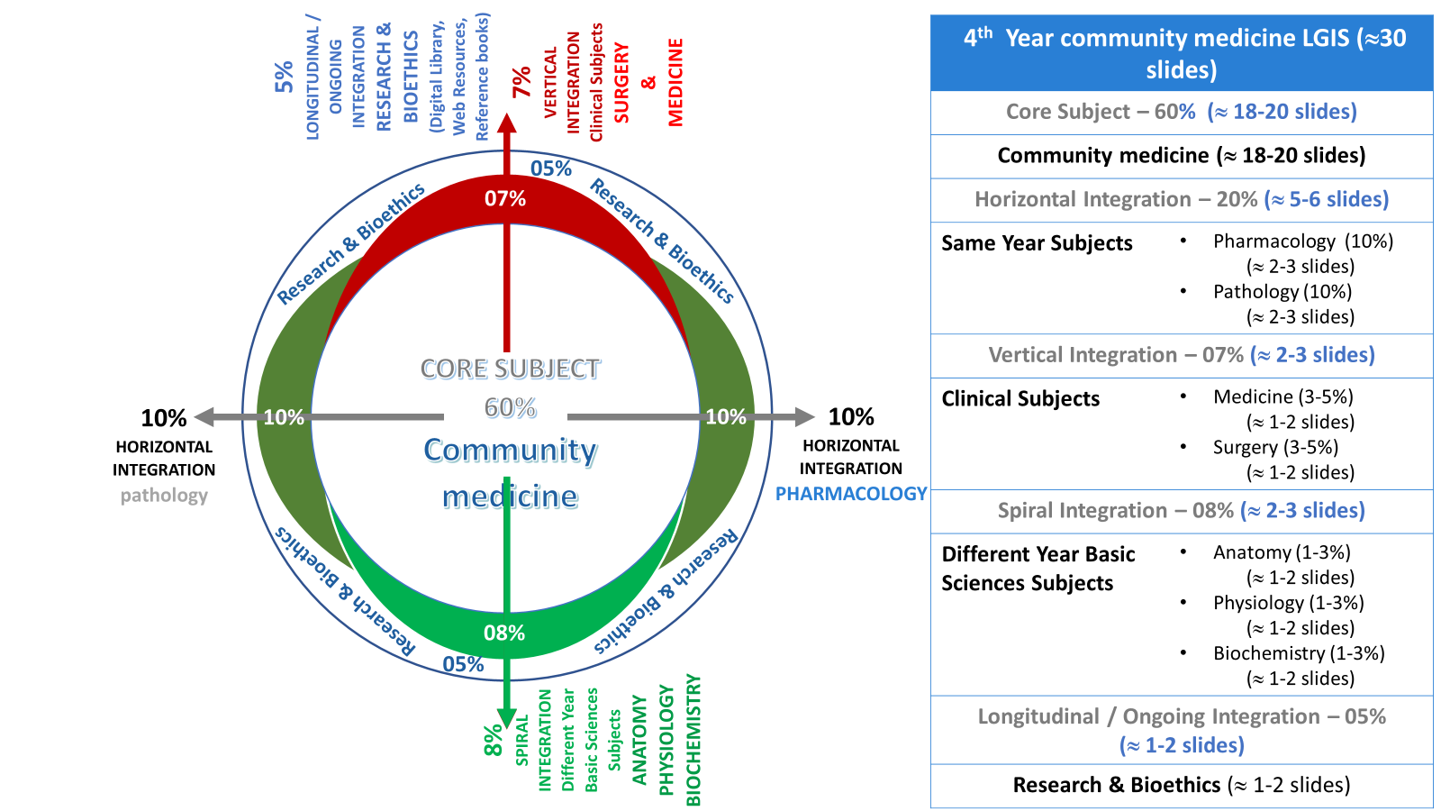
Prof Umar model

Slide 5
Sequence Of Lecture
Learning objectives ( 1 slide)
Core Subject ( 15 slide)
EOLA (End of lecture assessment 1 slides)
Digital Library reference ( 3 slide)
( Research , Bioethics, artificial intelligence)

Slide 6
Learning objectives
Calculate and interpret sensitivity & specificity of screening test from given data
Calculate and interpret Positive predictive value& Neg. predictive value of screening test from given data
Explain yield of screening tests
Discuss measures used to evaluate screening tests & program
Discuss problems of borderline with emphasis on cut-off point decision.

Slide 7
Core Subject

Slide 8
Predictive Value
Performance of test depends upon
Sensitivity & specificity
Predictive value (diagnostic power of the test)
The predictive accuracy depends upon sensitivity, specificity and disease prevalence.
There are two types of predictive values:
Positive Predictive Value (PPV)
Negative Predictive Value ( NPV)

Slide 9
Positive Predictive Value (PPV)
the probability that subjects with a positive screening test truly have the disease in question
more prevalent a disease is in a given population, the more accurate will be the predictive value of a positive screening test

Slide 10
Negative Predictive Value (NPV)
the probability that subjects with a negative screening test truly will not have the disease in question
As prevalence decreases, NPV increases

Slide 11
Confused about sensitivity & PPV???
Sensitivity: “I know my patient has the dis-ease. What is the chance that the test will show that my patient has it?”
PPV: “I just got a positive test result back on my patient. What is the chance that my patient has the disease?”

Slide 12
Example 1
Imagine we have a sample population of 100 people, 50 healthy and the other patients. If the test was positive for 75 people of this population, the PPV and NPV of test are as follows:

Slide 13
Interpretation of PPV & NPV
PPV: 50/75 = 0.66 or 66.6%.
Interpretation: in this population, 66.6% of people whose test result is positive, have the disease.
NPV: 25/25 = 100%.
Interpretation: in this population, 100% of the people whose test result is negative, are healthy

Slide 14
Example 2
In a study out of a total population of 80 cirrhotic patients, 21 (26%) had opaque ascites fluid appearance. 15 people out of the 21 had spontaneous bacterial peritonitis (SBP).
Question: calculate sensitivity, specificity, accuracy, PPV, and NPV of opaque ascites fluid in prediction of SBP if the total number of SBP patients was 40 cases (50%).

Slide 15
Calculations

Slide 16
Calculations (Contd)
Sensitivity: 15/40 = 37.5%
Specificity: 34/40 = 85%
Accuracy: (15 + 34) / 80 = 61.2%
PPV: 15/21= 71.4%
NPV: 34/59 = 57.6%

Slide 17
Yield of Screening test
the amount of previously unrecognized disease that is diagnosed as a result of screening effort.
It Depends upon
Sensitivity
Specificity
Prevalence of disease
Participation of the individual in the detection programme
Calculated by
Prevalence of disease
Positive predictive value

Slide 18
Evaluation of screening tests
The following measures are used to evaluate a screening
test:
(a) Sensitivity = a/ (a + c) x 100
(b) Specificity = d/(b + d) x 100
(c) Predictive value of a positive test = a/(a + b) x 100
(d) Predictive value of a negative test = d/(c + d) x 100
(e) Percentage of false-negatives = c/ (a + c) x 100
(f) Percentage of false-positive = b/(b + d) x 100

Slide 19
Evaluation of screening program
Randomized control trials
Uncontrolled trials
Other methods:
Case control studies
Comparison in trends between areas with different degree of screening coverage

Slide 20
Problem of Borderline
In the screening of the disease, a prior decision is made about the cut off point
The following factors are taken into consideration :
Disease Prevalence: high prevalence its screening level is set at lowest level, increase sensitivity
The Disease: If the disease is lethal and early detection markedly improves prognosis, a greater degree of sensitivity, Even at the expense of specificity is desired.

Slide 21
Problem of Borderline
Bimodal distribution
Shades area ( A&B) mixture of false positive and false negative
Level E cut off point between normal and diseased e.g tuberculin test
Unimodal distribution
If screening level set at:
Point A or C Good sensitivity, poor specificity
Point B or D Poor sensitivity, Good specificity
e.g blood pressure, blood sugar and serum cholesterol

Slide 22
Cut off point decision
Disease prevalence:
if prevalence is high screening level is set at a lower level which will increase sensitivity
Nature of disease:
Lethal disease (cervical cancer, breast cancer): greater sensitivity is desired
High specificity is desired when false positive errors must be avoided like diabetes.

Slide 23
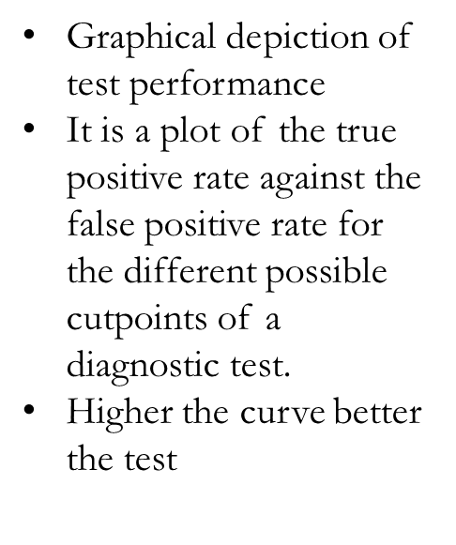
Receiver operating characteristic curve ROC Curve

Slide 24
research
https://www.sciencedirect.com/science/article/abs/pii/0021968186901268
Abstract
The case-control approach has been proposed for the evaluation of the efficacy of screening for cancer. It provides information at the level of the individual subject and allows direct estimation of the relative risk of not being screened.

Slide 25
Ethical aspects of screening
Principle | Potential harm
Beneficence | large benefits at population level for those who can be offered early treatment but not every case will benefit
Non-malfecence | Psychological harm from false positives Preventable death resulting from false-negative test
Justice | A challenge to ensure equality in uptake into care pathways among deprived and affluent populations
Autonomy | Communicating risk to patients is difficult, and questionable whether people who partake in a screening programme truly understand the consequences of their participation

Slide 26
Artificial intelligence: Machine learning approach for screening large database and drug discovery
Highlights
ML can be applied for virtual screening for analysing the structural characteristics.
To develop safe, effective, affordably treatments AI based tool can be used.
In-vivo relevant drug characteristics need to be properly taken into account in future AI drug development methods.
Future challenges and direction in machine-learning-based drug discovery.
https://www.sciencedirect.com/science/article/abs/pii/S0166354223002188

Slide 27
End of lecture assessment MCQ
Q- The probability of a persons having the disease when the test is positive:
Sensitivity
Specificity
Positive predictive value
Negative predictive value
False positives

Slide 28
Suggested reading
The 25th edition K.Park "Textbook o f Preventive and Social Medicine" chapter: screening

