Slide 1
Concept Of Screening
Block II-Ophthalmology(EYE)

Slide 3
Vision & Mission of RMU
Wisdom
Truth
Service
Vision
Highly recognized and accredited center of excellence in Medical Education, using evidence-based training techniques for development of highly competent health professionals, who are lifelong experiential learner and are socially accountable.
Mission Statement
To impart evidence-based research-oriented health professional education in order to provide best possible patient care and inculcate the values of mutual respect, ethical practice of healthcare and social accountability.

Slide 4
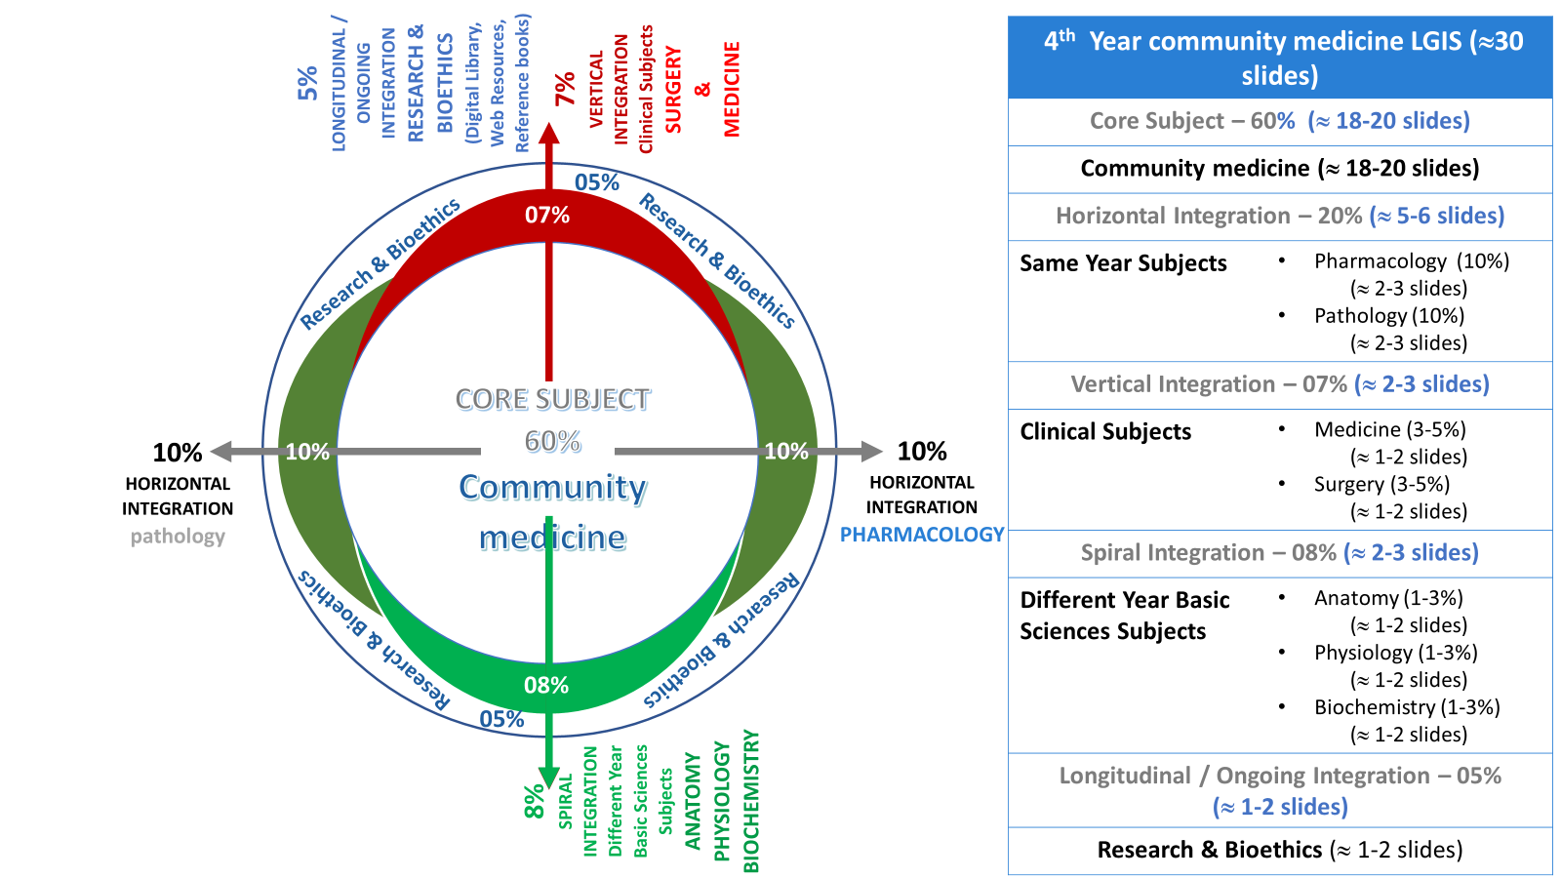
Prof Umar model

Slide 5
Sequence Of Session
Statement of learning outcomes (01 slide)
Order & Components of the session
Core subject ( contains throughout relevant clinical contents) ( 22 slides)
Vertical integration( 02 slide)
Research pertinent to enhance understanding o the subjects (01 slides)
Bioethics : pertinent discussion (01 slides)
End o the session relevant assessments ( 01 slides)
Suggested additional readings ( 01 slide)

Slide 6
Learning objectives
Explain Iceberg phenomenon of diseases with examples
Discuss aims and objectives of screening
Enlist Criteria for screening of diseases & screening tests
Comprehend uses & types of screening with examples
State differences between screening test and diagnostic tests.
Describe rationale of screening tests with reference to natural history of disease and critical point.
Construct2x2table from given data.
Explain measures of validity of screening tests.

Slide 7
SCREENING
Core Content
The process of search of unrecognized disease by rapidly applied tests, examinations and other procedures to apparently healthy individuals.”

Slide 8
Can you guess??????
Core Content

Slide 9
Iceberg Phenomenon of disease
Core Content

Slide 10
Aims & objectives of screening
Core Content
Screening is carried out for;
Earlier diagnosis
Subsequent treatment
Favorably alters the natural history of the disease in a significant proportion of those who are identified as "positive“
The screening test has only two outcomes: positive or negative.

Slide 11
Criteria for screening a disease
Core Content
1. An important health problem with high prevalence
2. Recognizable latent or early symptomatic stage
3. Adequately understood natural history of the disease
4. Availability of a reliable , accurate test that can detect the disease prior to onset of signs and symptom
5. Available facilities for confirmation of the diagnosis
6. Availability of effective treatment

Slide 12
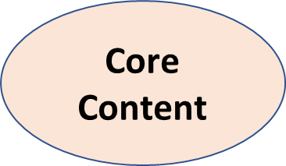
Criteria for screening a Disease (Contd.)
7. Agreed on policy concerning whom to treat as patient (e.g lower ranges of BP, borderline Diabetes)
8. Good evidence of reducing the mortality & morbidity by early detection & treatment.
9. Expected benefits higher than the risks & costs.

Slide 13
Criteria for screening tests
Acceptability
Repeatability (observer and biological variation)
Validity
Widely applicable
Simple
Rapid
Safe
Inexpensive
Non-invasive

Slide 14
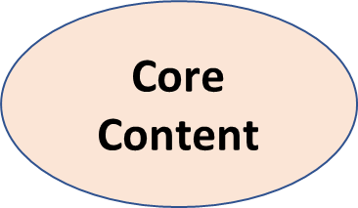
Uses of Screening

Slide 15
Types of Screening
Mass screening
High-risk or selective screening
Multiphasic screening

Slide 16
Mass screening
simply means the screening of a whole Population, or a sub-group
offered to all, irrespective of the particular risk individual may run of contracting the disease in question
e.g. , tuberculosis, mammography in women aged 40-year, Visual defects in school children, Newborn screening program
Very expensive and not useful preventive measure

Slide 17
High-risk or selective screening
Most economical and productive
For example, help in detection of additional or new cases in;
screening for cancer cervix in lower socioeconomic status people
screening for diabetes, hypertension, breast cancer, heart diseases etc. for other members of the family and close relatives

Slide 18
Multiphasic screening
Two or more screening tests in combination to many people at one time
include health questionnaire, clinical examination and a range of measurements and investigations.
For example;
Chemical and hematological tests on blood and urine specimens.
Lung function assessment, audiometry and measurement of visual acuity

Slide 19
Screening test versus Diagnostic test
Vertical integration

Slide 20
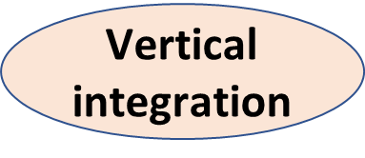
Screening test versus Diagnostic test (Contd.)

Slide 21
Rationale for screening test

Slide 22
Critical Point
“A point in the natural history of diseases before which treatment is more effective or less difficult to administer or cure is possible but not after that point”.
A theoretical concept
Must be well before the stage of usual diagnosis

Slide 23
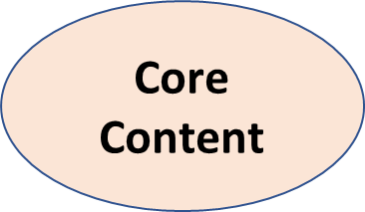
Construction of 2 by 2 table

Slide 24
Validity Of Screening Tests
“To what extent a test accurately measures which it purports to measure”.
expresses the ability of a test to separate those who have the disease from those who do not .
For example, glycosuria is a useful screening test for diabetes, but a more valid or accurate test is the glucose tolerance test
Two components are measured .
Sensitivity
Specificity

Slide 25
Sensitivity
the ability of a test to identify correctly all those who have the disease-- (True positive)
Interpretation:
A 90 per cent sensitivity means that 90 per cent of the diseased people screened by the test will give a "true-positive" result and the remaining 10 per cent a "false-negative" result

Slide 26
Specificity
the ability of a test to identify correctly those who do not have the disease--- "true-negatives"
Interpretation:
A 90 per cent specificity means that 90 per cent of the non-diseased persons will give "true-negative" result, 10 per cent of non-diseased people screened by the test will be wrongly classified as "diseased" when they are not ( false positive).

Slide 27
Research
https://www.ncbi.nlm.nih.gov/pmc/articles/PMC9345258/
ASSESSMENT OF EFFICACY/EFFECTIVENESS OF SCREENING
For a screening test to prove effective, it must not merely diagnose more cases of the disease of interest or diagnose cases earlier, but ultimately improve the outcome. For instance, screening for breast cancer using mammography must not merely diagnose more breast cancers or diagnose them at an early stage when treatment is possible, but it should reduce deaths due to breast cancer.Ideally, the assessment of the value of a screening program requires a randomized controlled trial.

Slide 28
Ethical aspects of screening
Principle | Potential harm
Beneficence | . may have large benefits at population level for those who can be offered early treatment but not every case will benefit
Non-maleficence | Psychological harm from false positives in the interval before diagnostic testing Preventable death resulting from false-negative test Unwarranted reassurance from false-negative
Justice | A challenge to ensure equality in uptake and linkage into care pathways among deprived and affluent populations
Autonomy | Communicating risk to patients is notoriously difficult

Slide 29
Artificial intelligence: Machine learning approach for screening large database and drug discovery
Highlights
ML can be applied for virtual screening for analysing the structural characteristics.
To develop safe, effective, affordably treatments AI based tool can be used.
In-vivo relevant drug characteristics need to be properly taken into account in future AI drug development methods.
Future challenges and direction in machine-learning-based drug discovery.
https://www.sciencedirect.com/science/article/abs/pii/S0166354223002188

Slide 30
EOLA
The extent to which a test measures what it was originally designed to measure is described as:
Sensitivity
Specificity
Validity
Reliability
True-positive value

Slide 31
Learning resources
The 25th edition K.Park "Textbook o f Preventive and Social Medicine"

