Slide 1
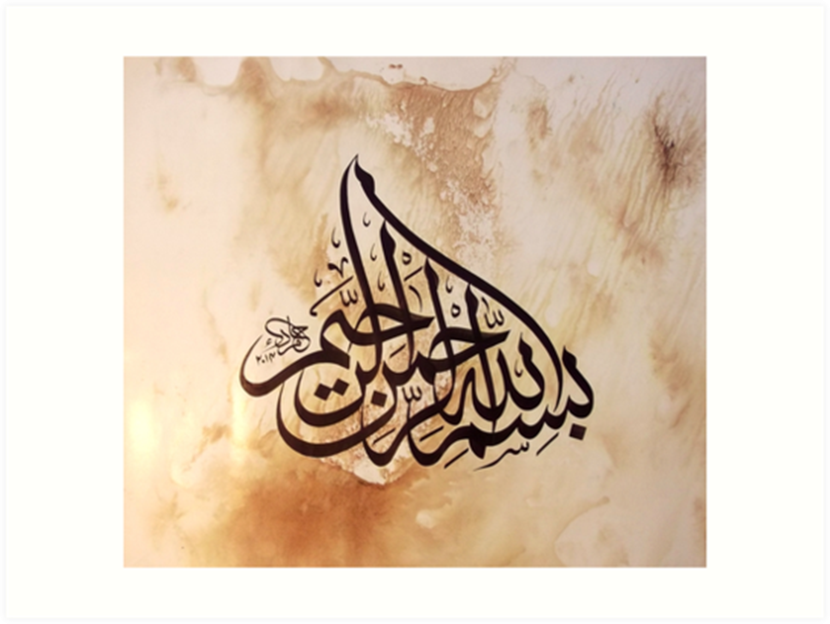

Slide 2
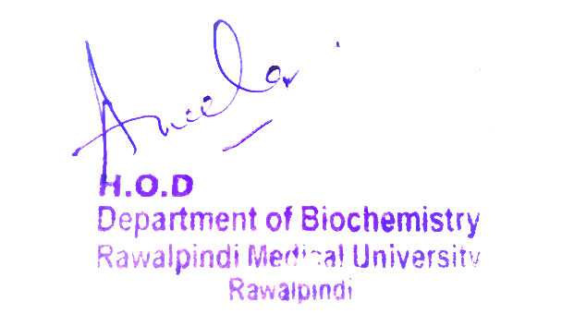
Musculoskeletal System (MSK-I) Module First Year MBBS(CBL) Rickets
Presenter: Dr. Romessa Naeem Date: 24-01-25
(Demonstrator)

Slide 3
Motto, Vision, Dream
To impart evidence based research oriented medical education
To provide best possible patient care
To inculcate the values of mutual respect and ethical practice of medicine
Wisdom
Truth
Service

Slide 4
Professor Umar Model of Integrated Lecture

Slide 5
Learning Objectives
At the end of this session students should be able to
Describe Vitamin D with respect to its synthesis, sources and RDA .
Explain Regulation , Biochemical Functions of Vitamin D and disorders associated with it.

Slide 6
Interactive Session
A 5 years girl was brought to the OPD of DHQ hospital with complains of not being able to walk properly. She was breast fed with history of delayed dentition and insufficient sunlight exposure. Her mother stated that she started to walk at the age of two and a half year.
On examination she was below the 5th percentile for both height and weight with prominent costochondral junctions widened wrists and bowed legs. Her lab investigation showed raised serum alkaline phosphates and parathyroid hormone with low vitamin D. she was diagnosed to have Rickets

Slide 7
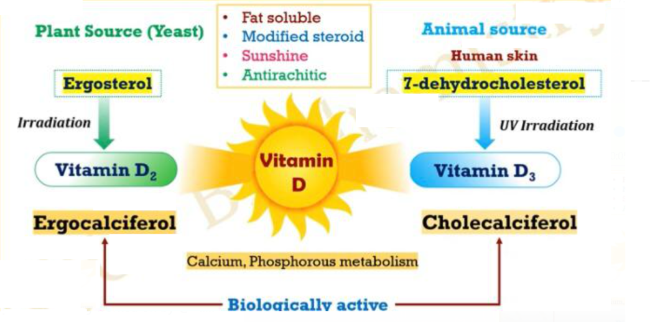
Vitamin D
Core Knowledge

Slide 8
Vitamin D : Chemistry
Core Knowledge

Slide 9
Vitamin D : Sources
Core Knowledge

Slide 10
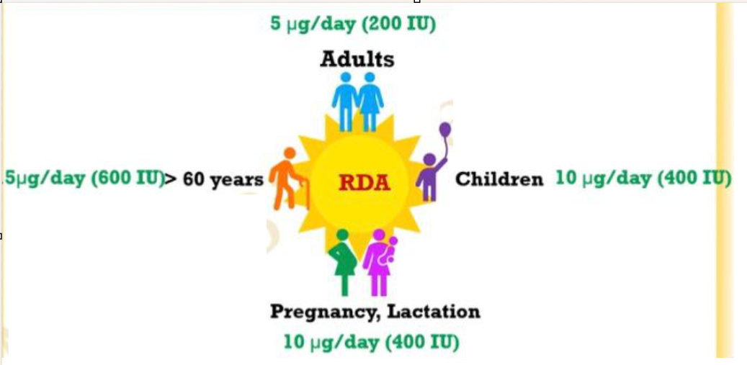
Vitamin : RDA
Core Knowledge

Slide 11
Vitamin D :Absorption and Transport
Core Knowledge

Slide 12
Calcitriol Synthesis
Core Knowledge

Slide 13
Vitamin D Biochemical Functions
Core Knowledge

Slide 14
Calcium and phosphorous homeostasis
Core Knowledge

Slide 15
Effect of Calcitriol on Intestine
Core Knowledge

Slide 16
Effect of Calcitriol on Bones
Core Knowledge

Slide 17
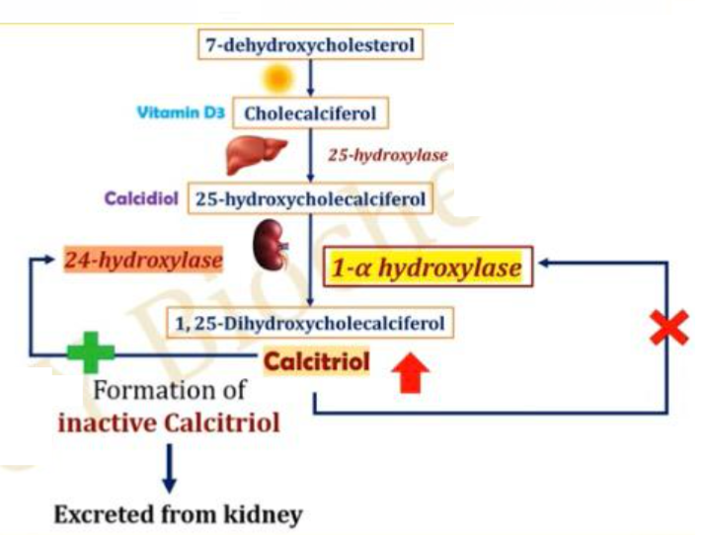
Regulation By Calcitriol
Core Knowledge

Slide 18
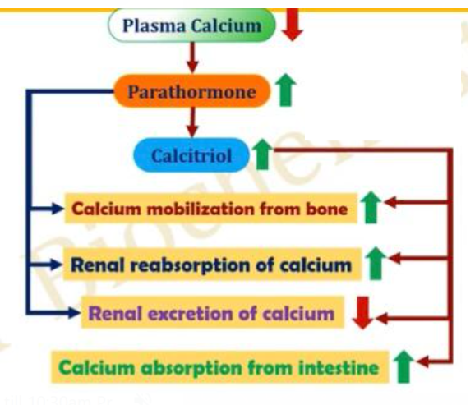
Regulation by Calcium and PTH
Core Knowledge

Slide 19
Vitamin D Deficiency Causes
Core Knowledge

Slide 20
Anatomy of Bone

Slide 21
Physiology of Bone
Storage of Minerals
Support
Protection
Movement
Blood cell production
Endocrine Functions
Regulation of acid base balance

Slide 22
Hypervitaminosis

Slide 23
Rickets

Slide 24
Rickets

Slide 25
Management of Rickets
Spiral Integration
Family Medicine plays important role in following manner:
Diagnosis
Education and Guidance of parents and caregivers about importance of Vitamin D supplementation.
Monitoring and Follow-up
Refer to Specialists

Slide 26
Ethical Consideration
Spiral Integration
Informed consent
Research ethics
Access to health care
Privacy & Confidentiality

Slide 27
Role of AI in Managing Rickets
Spiral Integration
Artificial Intelligence plays role in following aspects:
AI algorithms assist in diagnosis of rickets
Personalized treatment
Predictive analysis
Counselling through AI chatbots
Research and data analysis

Slide 28
Suggested Research Article
1 Introduction
Rickets is a skeletal disease characterized by deficient mineralization of growth plates and bone matrix (osteomalacia) associated with low concentrations of calcium and/or phosphate in the blood. Rickets includes a heterogeneous group of acquired and inherited diseases. Nutritional rickets is the most common form of rickets globally. On the other hand, the development of molecular genetic techniques increased identification of the inherited forms of rickets. The primary method for diagnosing rickets involves examining the patient’s medical history, conducting biochemical tests, and performing radiologic examinations. Genetic analyses are particularly important in cases where patients are suspected to have a genetic form of rickets despite the absence of a family history of the disease. Treatment and management of rickets should be targeted on the pathogenesis and both are strictly connected with the diagnosis.
The aim of this document is to provide practical guidance to specialists and healthcare professionals about the main criteria for diagnosis, treatment, and management of patients with rickets.
Link
:https://www.frontiersin.org/
Journal Name:
Front. Endocrinol
Title:
diagnosis, treatment, and management of rickets: a position statement from the Bone and Mineral Metabolism Group of the Italian Society of Pediatric Endocrinology and Diabetology
Author Name:
Giampiero I. Baroncelli^{1†}

Slide 29
How To Access Digital Library
Steps to Access HEC Digital Library
Go to the website of HEC National Digital Library.
On Home Page, click on the INSTITUTES.
A page will appear showing the universities from Public and Private Sector and other Institutes which have access to HEC National Digital Library HNDL.
Select your desired Institute.
A page will appear showing the resources of the institution
6. Journals and Researches will appear
7. You can find a Journal by clicking on JOURNALS AND DATABASE and enter a keyword to search for your desired journal.

Slide 30
Learning Resources
Lippincott Illustrated Reviews Biochemistry, 8th Edition, Chapter 28 page no. 437-439
Google scholar
Google images

Slide 31
THANK YOU

