Slide 1


Slide 2

Retinal Vascular Occlusion Disorders & Hypertensive Retinopathy

Slide 3
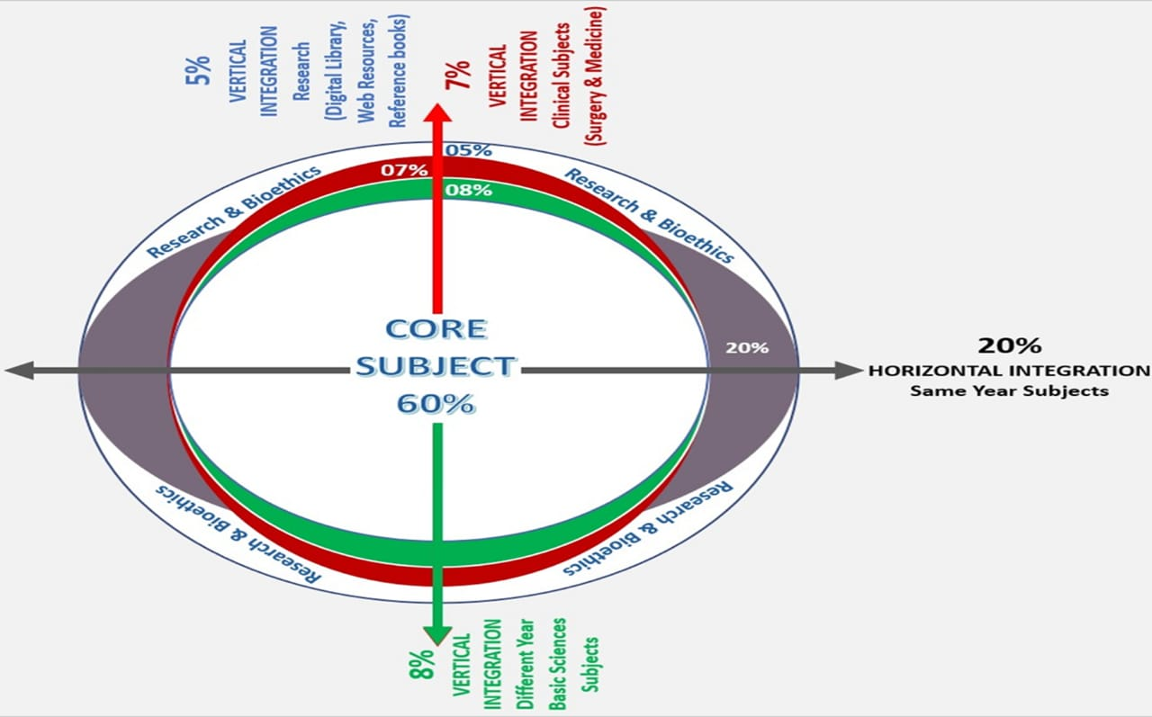
Sequence of Lecture
Learning Objectives
Vertical Integration
Core Subject
End of Lecture Assessment
Digital Library References
(Research, Bioethics, Artificial intelligence)

Slide 4
Learning Objectives
At the end of this session, students should be able to
Recall anatomy of Retina
Distinguishes the symptoms and signs of retinal vascular disorders
Predicts the prognosis
Construct the treatment plan Of CRVO, BRVO, CRAO, BRAO.

Slide 5
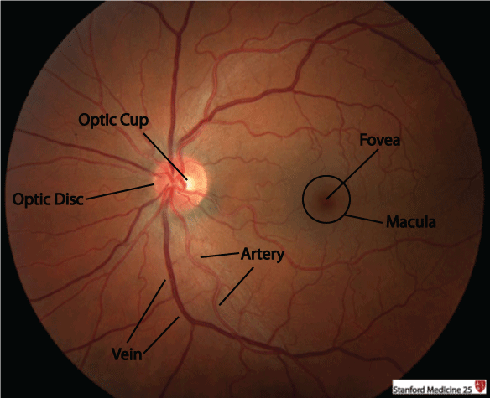
Vertical Integration
Anatomy

Slide 6
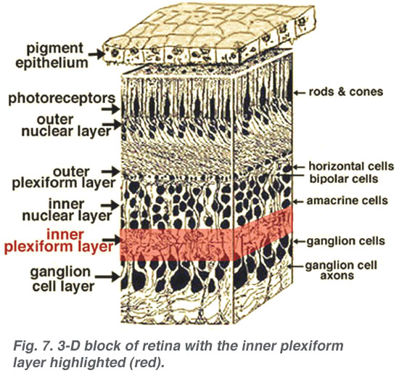

Slide 7
Retinal Venous Occlusion
Central Retinal Vein Occlusion
Non-ischemic CRVO
Ischemic CRVO
Branch Retinal Vein Occlusion
Quadrant Vein Occlusion
Hemiretinal Vein Occlusion
Impending CRVO

Slide 8
Branch Retinal Vein Occlusion

Slide 9
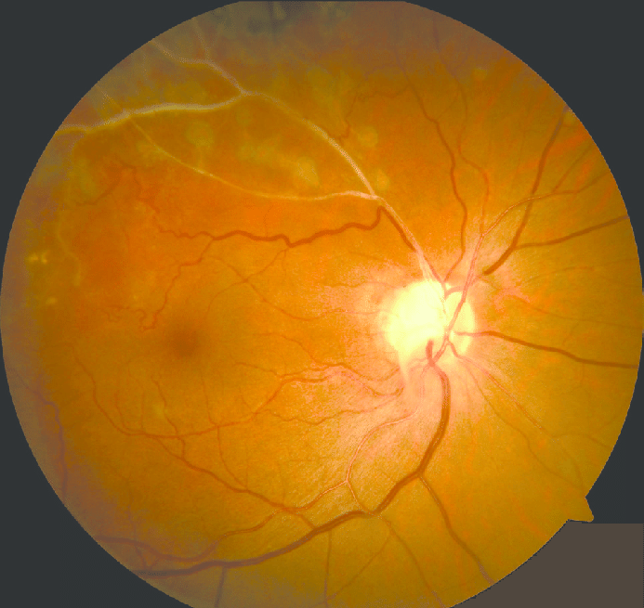

Slide 10
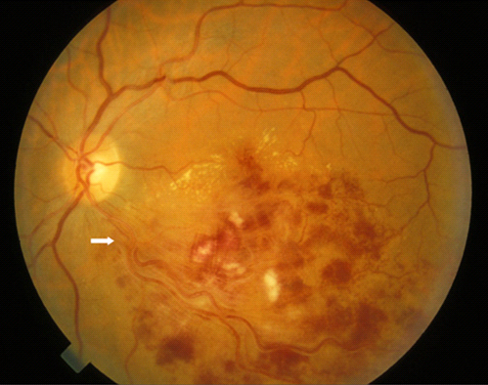

Slide 11
Treatment
Patient Education
Observation with review at 3 months then 3-6 monthly for 2 years.
Micropulse Laser
Intravitreal Anti-VEGF agents
Intravitreal Dexamethasone implant
Intravitreal triamcinolone

Slide 12
Central Retinal Vein Occlusion

Slide 13
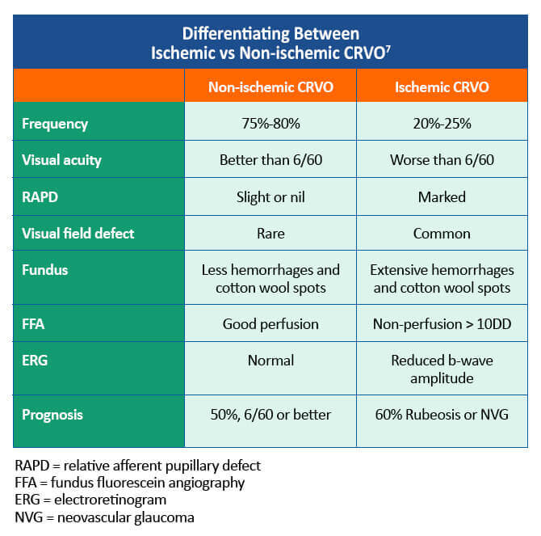

Slide 14
Non-Ischemic Central Retinal Vein Occlusion

Slide 15
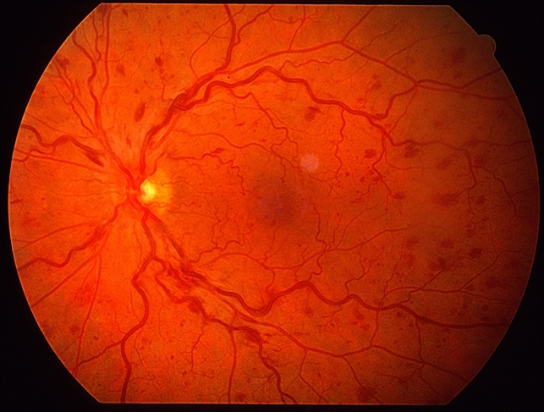

Slide 16
Ischemic Central Retinal Vein Occlusion

Slide 17
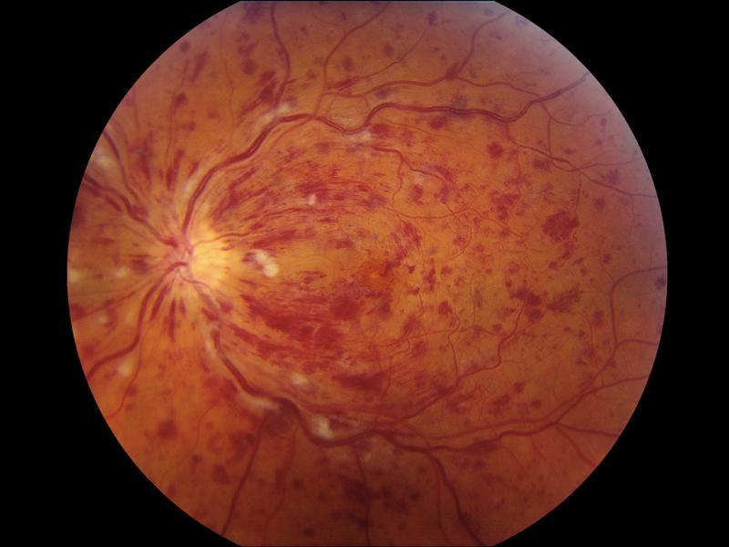

Slide 18
Treatment
Patient Education
Observation with review monthly for 6 months in ischemic CRVO for 2 years while for non ischemic CRVO 3 monthly review for 2 years.
Panretinal Photocagulation
Intravitreal Anti-VEGF agents
Intravitreal Dexamethasone implant
Intravitreal triamcinolone
Antiplatelet Therapy
Treat underline systemic disease
Vitrectomy and endolaser

Slide 19
Retinal Artery Occlusion
Branch Retinal Artery Occlusion
Central Retinal Artery Occlusion

Slide 20
Branch Retinal Artery Occlusion

Slide 21
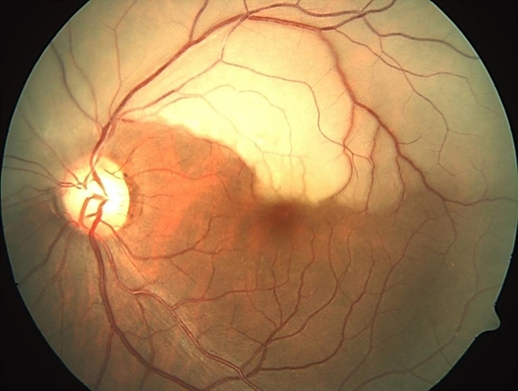

Slide 22
Central Retinal Artery Occlusion

Slide 23
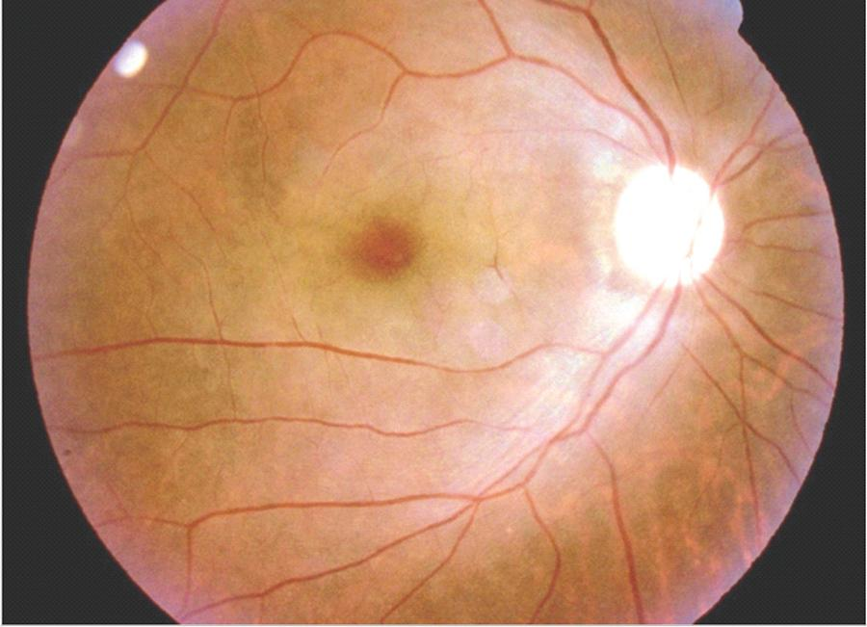

Slide 24
Treatment
Its an acute emergency
Treatment should be given in less than 24-48 hours after presentation.
Adoption of a supine posture
Ocular massage
Anterior chamber paracentesis
Sublingual isosorbide dinitrate
Rebreathing into a paper bag
Hyperosmotic agents lie Mannitol

Slide 25
Topical 1% timolol
Intravenous Acetazolamide 5oomg
Transluminal Nd:YAG laser embolysis/ embolectomy
Thrombolysis
Systemic management

Slide 26
End of lecture assessment (eola)
A 62-year-old male presents to the emergency department with sudden painless loss of vision in his right eye. On examination, the affected eye shows a cherry-red spot at the fovea, along with a pale retina and a relative afferent pupillary defect. Ophthalmoscopy reveals a "boxcarring" appearance of retinal arteries. What is the most likely diagnosis?
A) Central retinal vein occlusion
B) Retinal detachment
C) Branched Retinal Vein Occlusion
D) Central retinal artery occlusion
E) Ocular ischemic syndrome

Slide 27
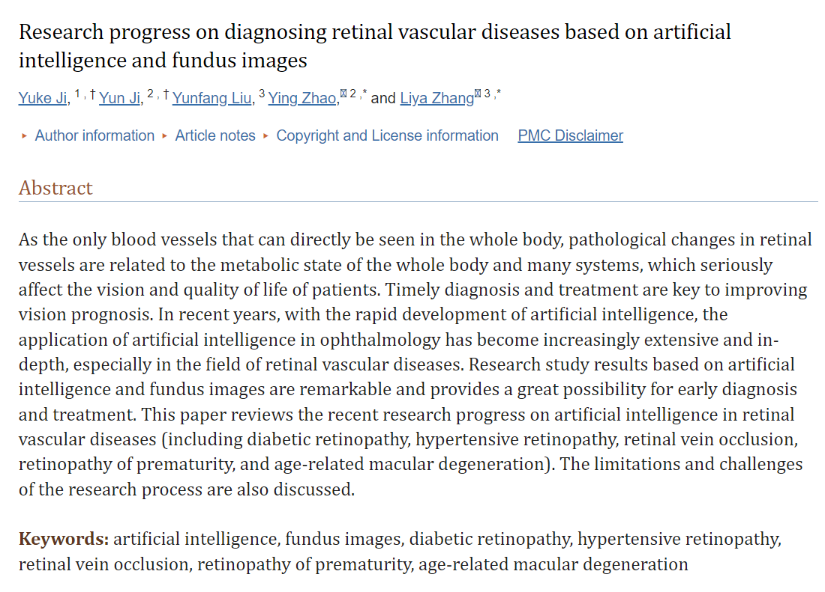
Artificial Intelligence
https://www.ncbi.nlm.nih.gov/pmc/articles/PMC10086262/

Slide 28
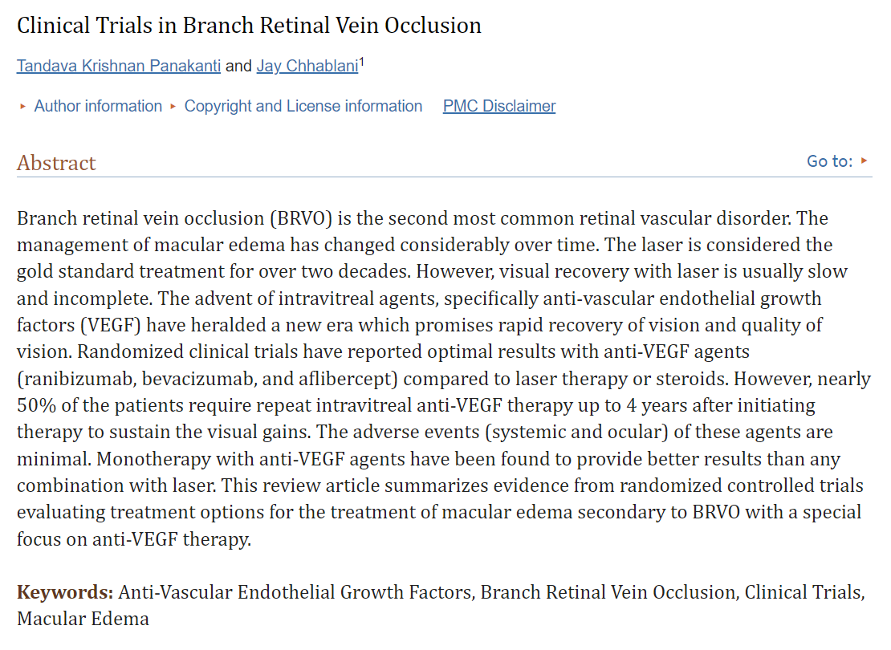
Research article
https://www.ncbi.nlm.nih.gov/pmc/articles/PMC4759902/

Slide 29


