Slide 1


Slide 2

Retinal Detachment

Slide 3

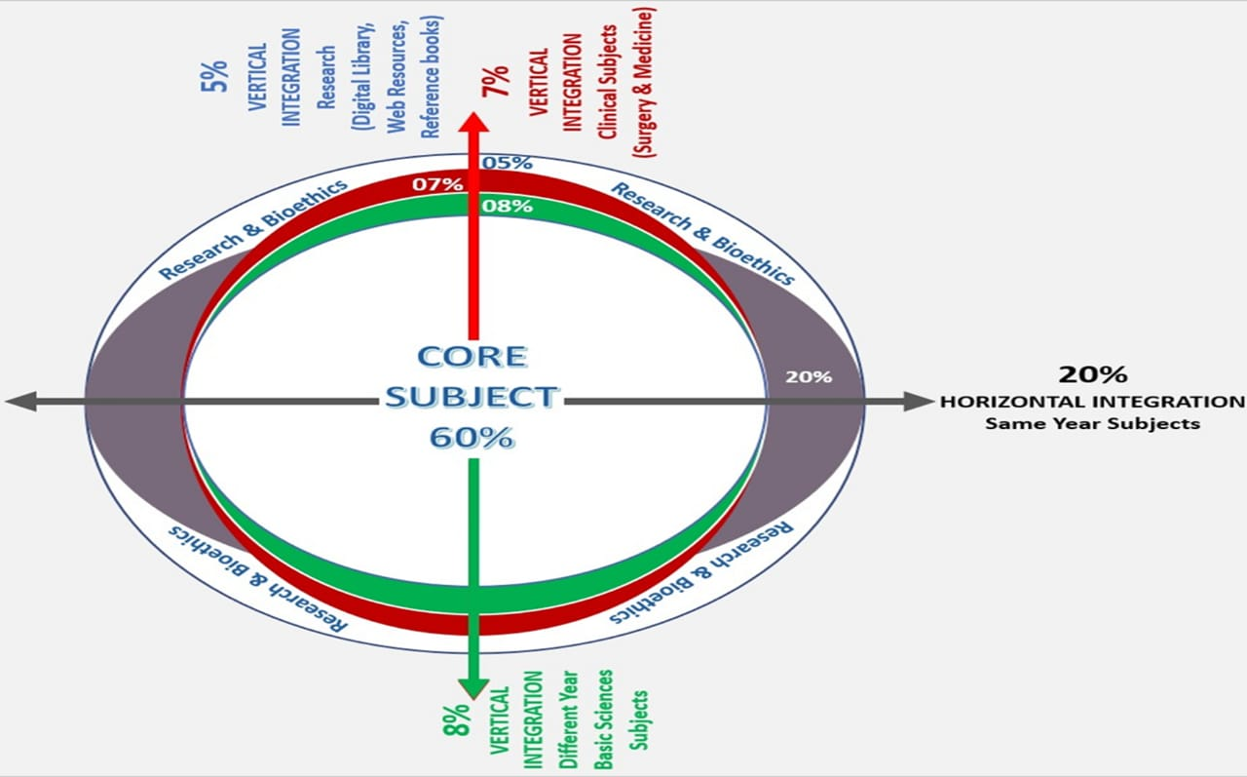
Sequence of Lecture
Learning Objectives
Vertical Integration
Core Subject
End of Lecture Assessment
Digital Library References
(Research, Bioethics, Artificial intelligence)

Slide 4
Learning Objectives
At the end of this session, students should be able to
Recall anatomy of Retina.
Define Retinal Detachment and its types
Explain the signs and symptoms of retinal detachment
Discuss Treatment Options

Slide 5
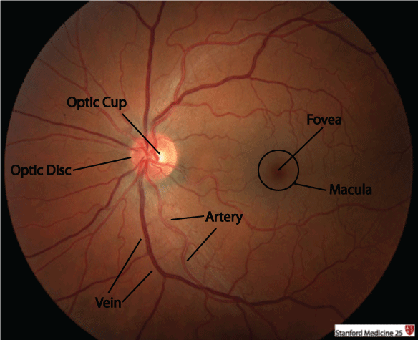
Vertical Integration
Anatomy

Slide 6
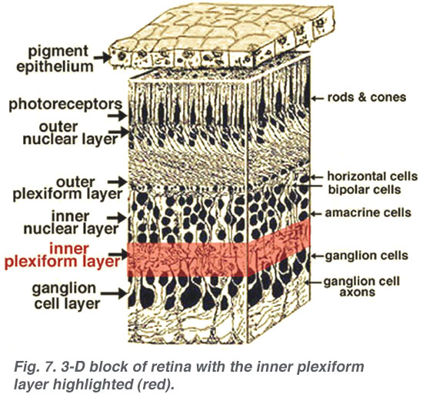

Slide 7
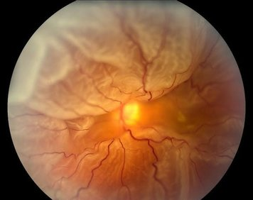
Retinal Detachment
Separation of the Neurosensory Retina from the Retinal Pigment Epithelium resulting in accumulation of subretinal fluid in potential space

Slide 8
Types
Retinal Detachment
Rhegmatogenous RD
Tractional RD
Exudative RD
Combined RRD+ERD
Subclinical RD

Slide 9
Rhegmatogenous Retinal Detachment

Slide 10
Pathogenesis
Presence of retinal break in concert with vitreoretinal traction that allows accumulation of liquefied vitreous under neurosensory retina.
40% in myopic eyes.

Slide 11
Symptoms
Flashing lights
Floaters
Acute posterior vitreous detachment
Curtain like relative peripheral visual defect
Symptoms may not be present on waking in the morning

Slide 12
Signs
Relative afferent pupillary defect
IOP is lowered
Iritis
RD has a convex, slightly opaque and corrugated appearance in fresh RD
Subretinal fluid
Good mobility of retina on B Scan
Retinal thinning, intraretinal cysts, subretinal demarcation lines in long standing detachment
Proliferative vitreoretinopathy

Slide 13
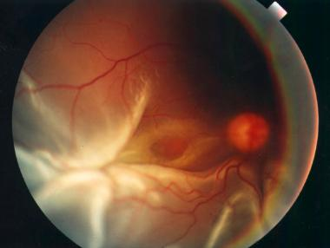

Slide 14
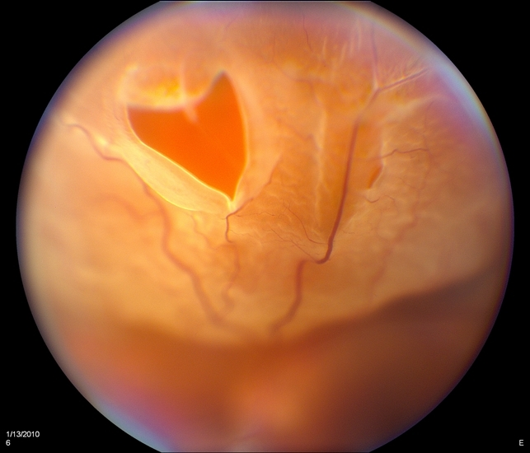

Slide 15
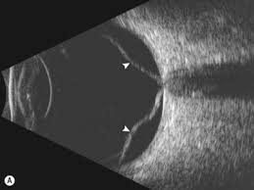
B Scan

Slide 16
Treatment
Pars Plana Vitrectomy
Silicon Oil
Gas Tamponade
Endo-Laser

Slide 17
End of lecture Assessment (EOLA)
A 53yrs old man, banker, with high myopia presents in eye opd with complaint of sudden loss of vision. He gave history of floaters and flashes in right eye from one week and curtain like effect from yesterday. Patient has no pain, diplopia, metamorphosia or other symptoms. On examination his visual acuity is CF at 2 feet in right eye and 6/36 in left eye. RAPD +ve in left eye.
What is your diagnosis ?

Slide 18

Artificial Intelligence

Slide 19
Research article
Pars plana vitrectomy, scleral buckle, and pneumatic retinopexy for the management of rhegmatogenous retinal detachment: a meta-analysis
https://doi.org/10.1016/j.survophthal.2021.05.008
Conclusion:
PPV is associated with a slower visual recovery, but similar final vision and primary reattachment rate, relative to SB.
In the overall analysis combined PPV + SB did not improve visual acuity or reattachment rates relative to PPV alone, and the incidence of complications was similar.
There is no difference between PR and SB for primary reattachment rates, but final visual acuity may be better, and there may be a reduced progression of cataract following PR

Slide 20


