Slide 1

DIABETIC RETINOPATHY

Slide 2
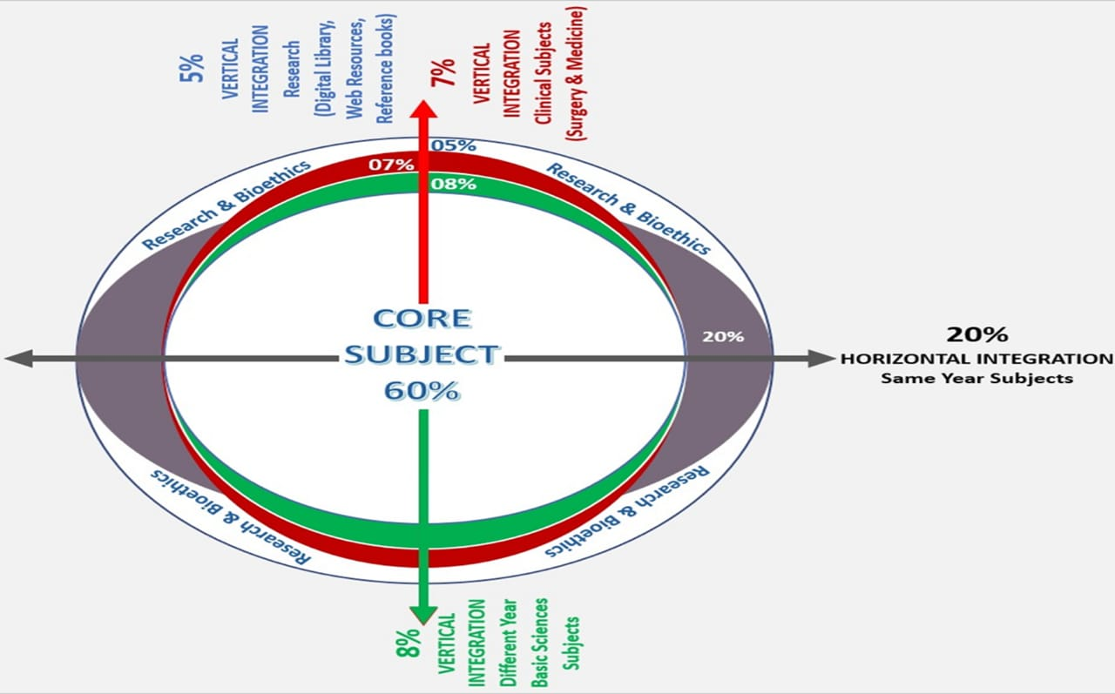
Sequence of Lecture
Learning Objectives
Vertical Integration
Core Subject
End of Lecture Assessment
Digital Library References
(Research, Bioethics, Artificial intelligence)

Slide 3
Learning objectives
At the end of the session, students should be able to:
Know the anatomy of retina
Understand pathophysiology of Diabetic retinopathy
Differentiate DR from other vascular disorders
Classify and know the management of different stages of DR

Slide 4
Vertical integration
Anatomy Of Retina
Embryologcially,It is derived from neuroectoderm.
Structurally, It has 10 distinct layers:
Inner limiting membrane
Nerve fiber layer
Ganglion cell layer
Inner plexiform layer
Inner nuclear layer
Outer plexiform layer
Outer nuclear layer
External limiting membrane
Inner segment/outer segment layer (Rods & Cones)
Retinal pigment epithelium (RPE)

Slide 5
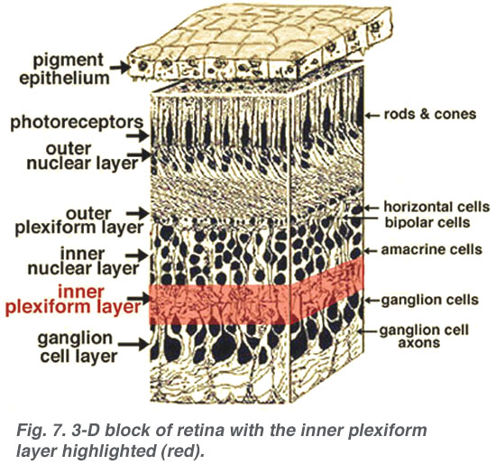

Slide 6
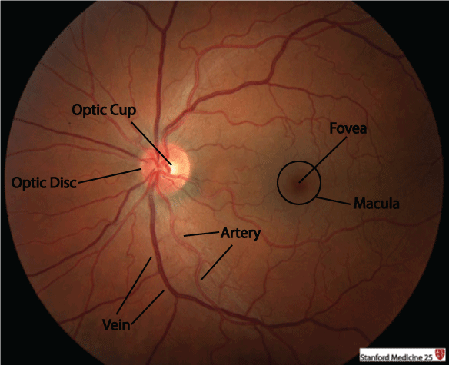

Slide 7
Vertical integration
Physiology - Retinal Circulation
Arterial System:
Central Retinal Artery- end artery
Short Posterior ciliary arteries
Venous System:
Central Retinal Vein

Slide 8
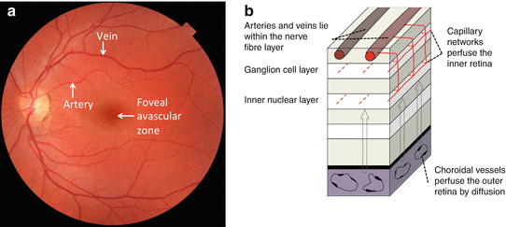

Slide 9
DIABETIC RETINOPATHY
Microangiopathy in which small blood vessels are particularly vulnerable to damage from High blood glucose levels.
More common in type 1 diabetes than type 2 diabetes.

Slide 10
Risk Factors
Duration of diabetes
Poor control of diabetes
Pregnancy
Hypertension
Nephropathy
Hyperlipidemia
Smkoing
Obesity
Anaemia

Slide 11
Examination
Visual acuity
Slit Lamp examination
IOP
Fundoscopy
ETDRS

Slide 12
Signs

Slide 13
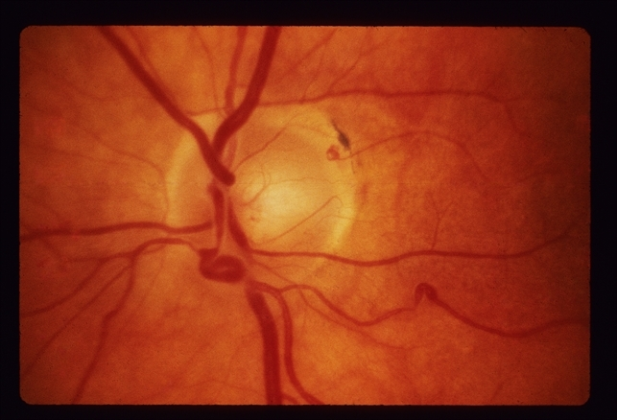
Microaneurysms

Slide 14
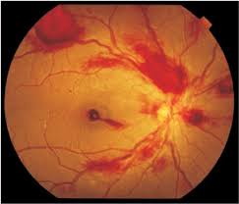
Retinal Haemorrhages

Slide 15
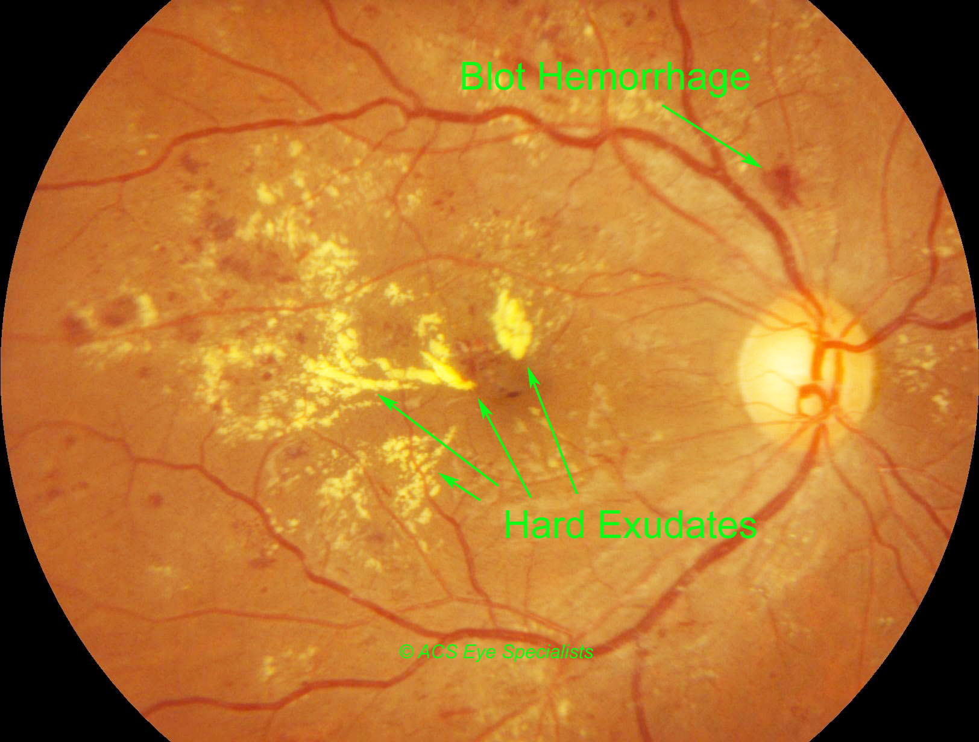
Exudates

Slide 16
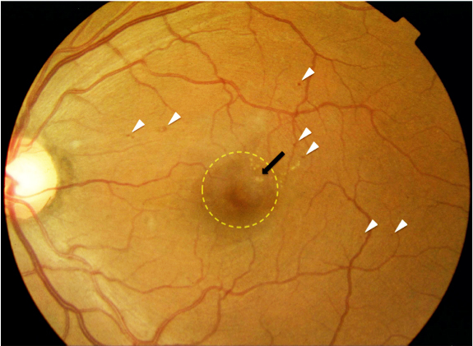
Diabetic Macular Oedema(DMO)

Slide 17
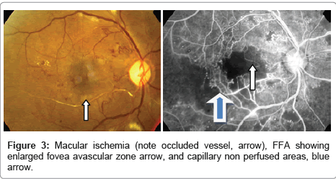
Ischemic Maculopathy

Slide 18
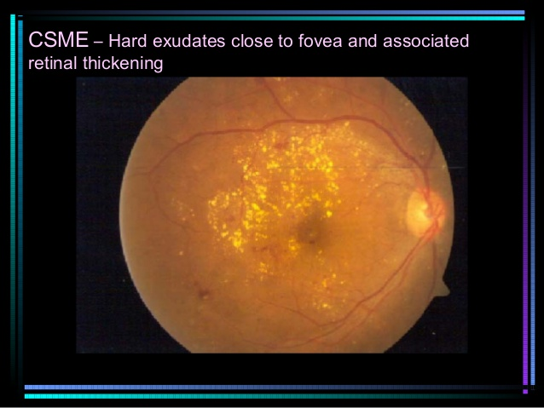
Clinically Significant Macular Oedema

Slide 19
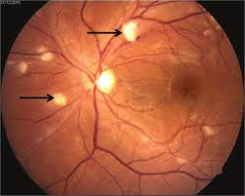
Cotton Wool Spots

Slide 20
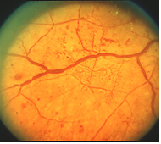
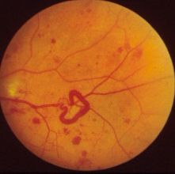
Venous Chnages

Slide 21
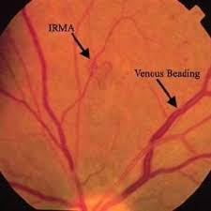
Intra-retinal Microvascular Abnormalities (IRMA)

Slide 22
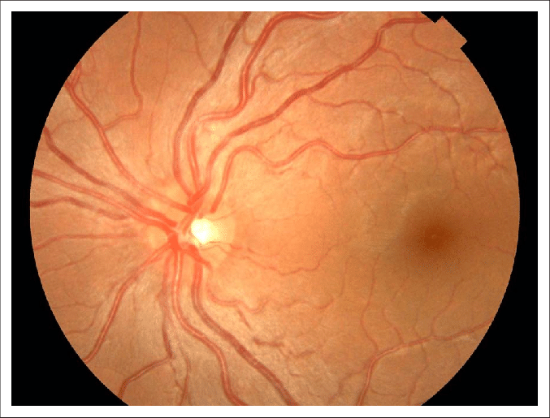
Arterial Changes

Slide 23
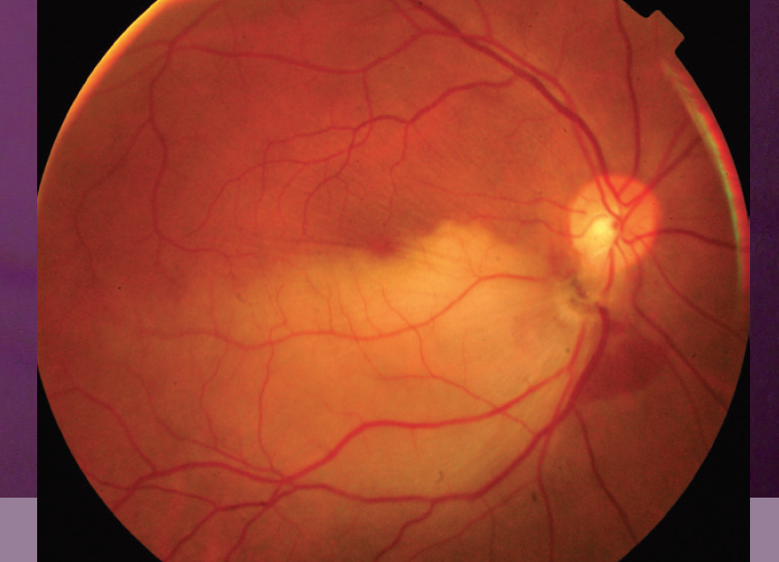

Slide 24
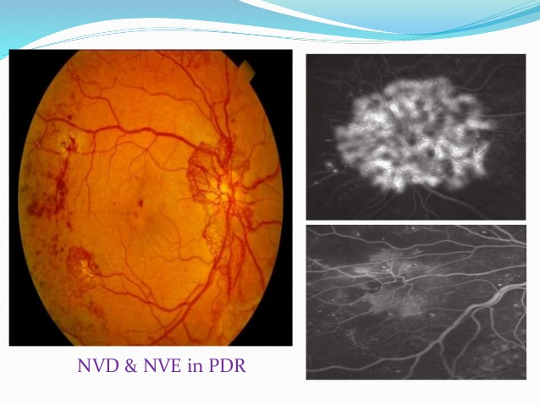
New Vessels Elsewhere/Disc/Iris (NVE/NVD/NVI)

Slide 25
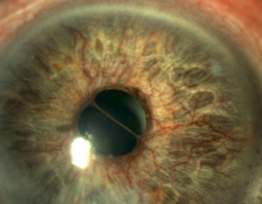

Slide 26
Classification

Slide 27
Descriptivve Classification
Background diabetic retinopathy.
Diabetic maculopathy
Preproliferative diabetic retinopathy
Proliferative diabetic retinopathy
Advanced diabetic eye disease

Slide 28
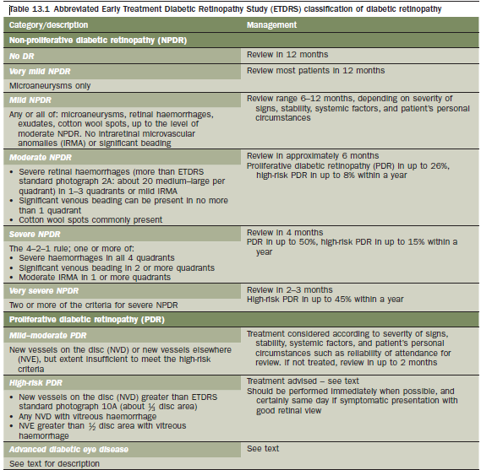
ETDRS Classification

Slide 29
Management

Slide 30
Investigations
Visual acuity
Slit lamp examination
Fundoscopy
Fundus fluorescein angiography (FFA)
Optical Coherence Tomography (OCT)

Slide 31
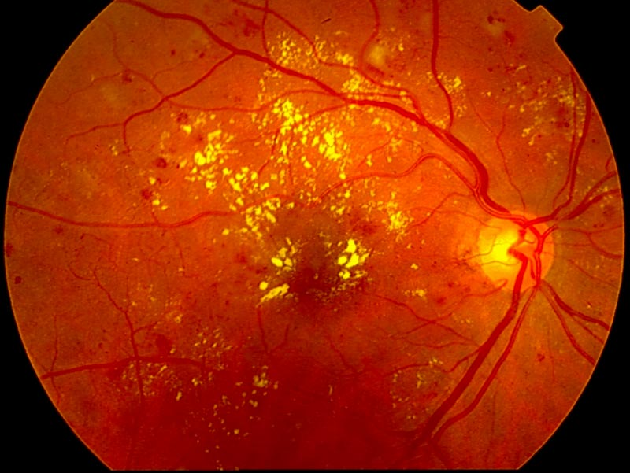

Slide 32
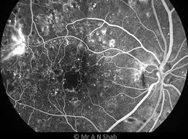

Slide 33
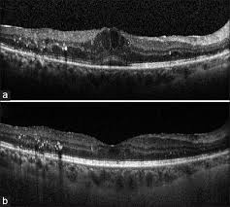

Slide 34
Treatment
Patient education
Diabetic control
Controlled risk factors
Fenofibrate 200mg daily
Cessation of smoking
Address anaemia, renal failure
Diode or argon laser photocoagulation
Intravitreal Anti-VEGF agents
Pars plana vitrectomy

Slide 35
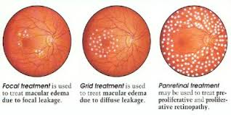

Slide 36
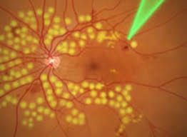

Slide 37
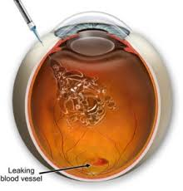

Slide 38
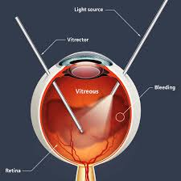

Slide 39
End of lecture assessment
A 55-year-old female with a history of poorly controlled type 2 diabetes mellitus presents for a routine eye examination. On dilated fundus examination, numerous dot and blot hemorrhages, microaneurysms, and cotton-wool spots are noted scattered throughout the retina. Additionally, there are areas of intraretinal microvascular abnormalities (IRMA). What is the most likely diagnosis?
A) Central serous chorioretinopathy
B) Branch retinal vein occlusion
C) Diabetic macular edema
D) Proliferative diabetic retinopathy
E) Hypertensive retinopathy

Slide 40
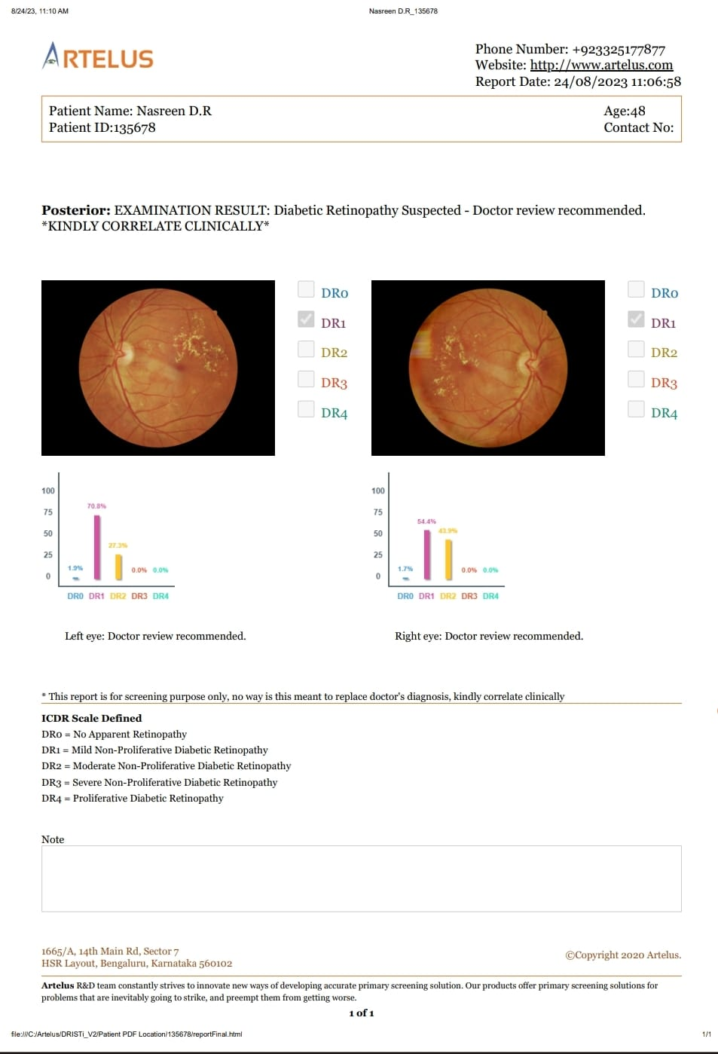
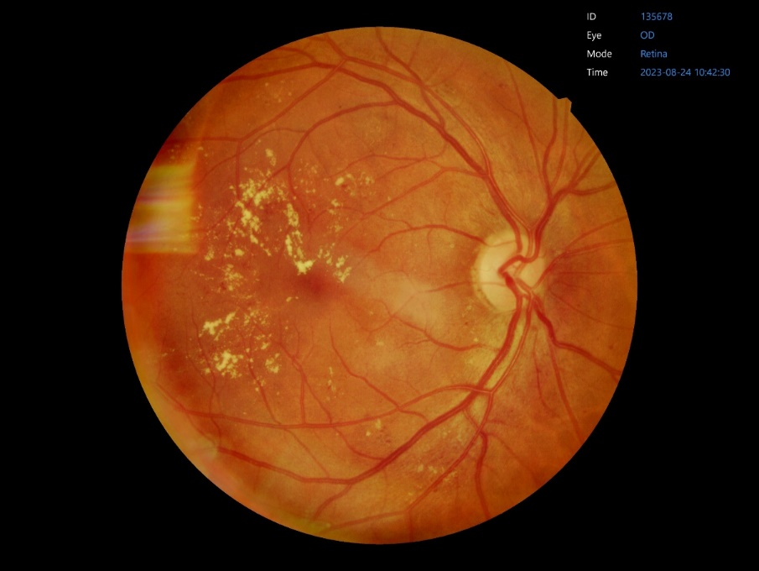
Artificial intelligence (RMU Project)
The Efficacy of Artificial Intelligence in Grading the severity of Diabetic Retinopathy.
A.I Generated Report

Slide 41
Research article
https://www.aao.org/eyenet/article/drcr-net-five-year-outcomes-for-protocol-t
DRCR.net Protocol T
Compares three anti-VEGF agents for macular edema (Bevacizumab, Ranibizumab and Aflibercept)
Conclusion
In summary, Protocol T demonstrated that all three anti-VEGF agents are highly effective treatments for center-involving DME, with significant improvements in vision and reductions in macular edema on OCT at one year that were sustained through two years with fewer injections and lasers than in the first year

