Slide 2
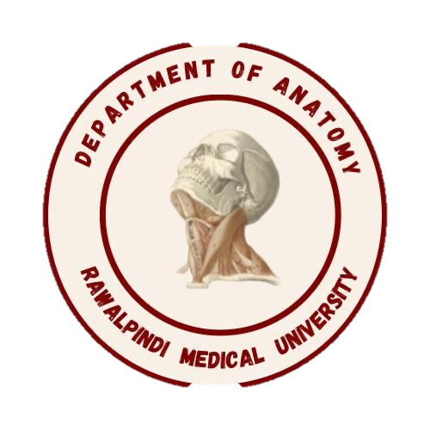
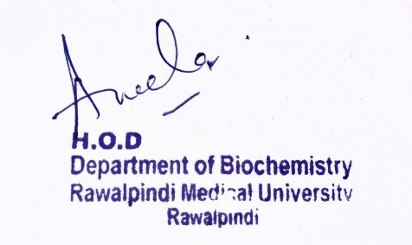
Respiratory Module 1st Year MBBS (LGIS) Oxidative Phosphorylation
Presenter: Dr. Aneela Jamil Date: 24-02-25
(Assistant Professor)

Slide 3
Motto, Vision, Dream
To impart evidence based research oriented medical education
To provide best possible patient care
To inculcate the values of mutual respect and ethical practice of medicine
Wisdom
Truth
Service

Slide 4
Professor Umar Model of Integrated Lecture

Slide 5
Learning Objectives
At the end of this lecture students should be able to
Explain Chemiosmotic hypothesis
Understand uncouplers
Vertically integrate related disorder

Slide 6
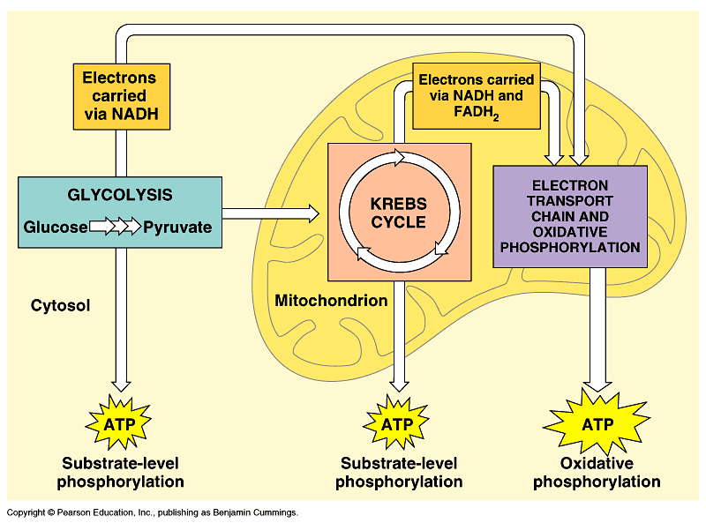
Core Knowledge

Slide 7
Core Knowledge
Notes:
Pumping H+ across membrane … what is energy to fuel that?
Can’t be ATP! that would cost you what you want to make!
Its like cutting off your leg to buy a new pair of shoes. :-(
Flow of electrons powers pumping of H⁺
O₂ is 2 oxygen atoms both looking for electrons

Slide 8
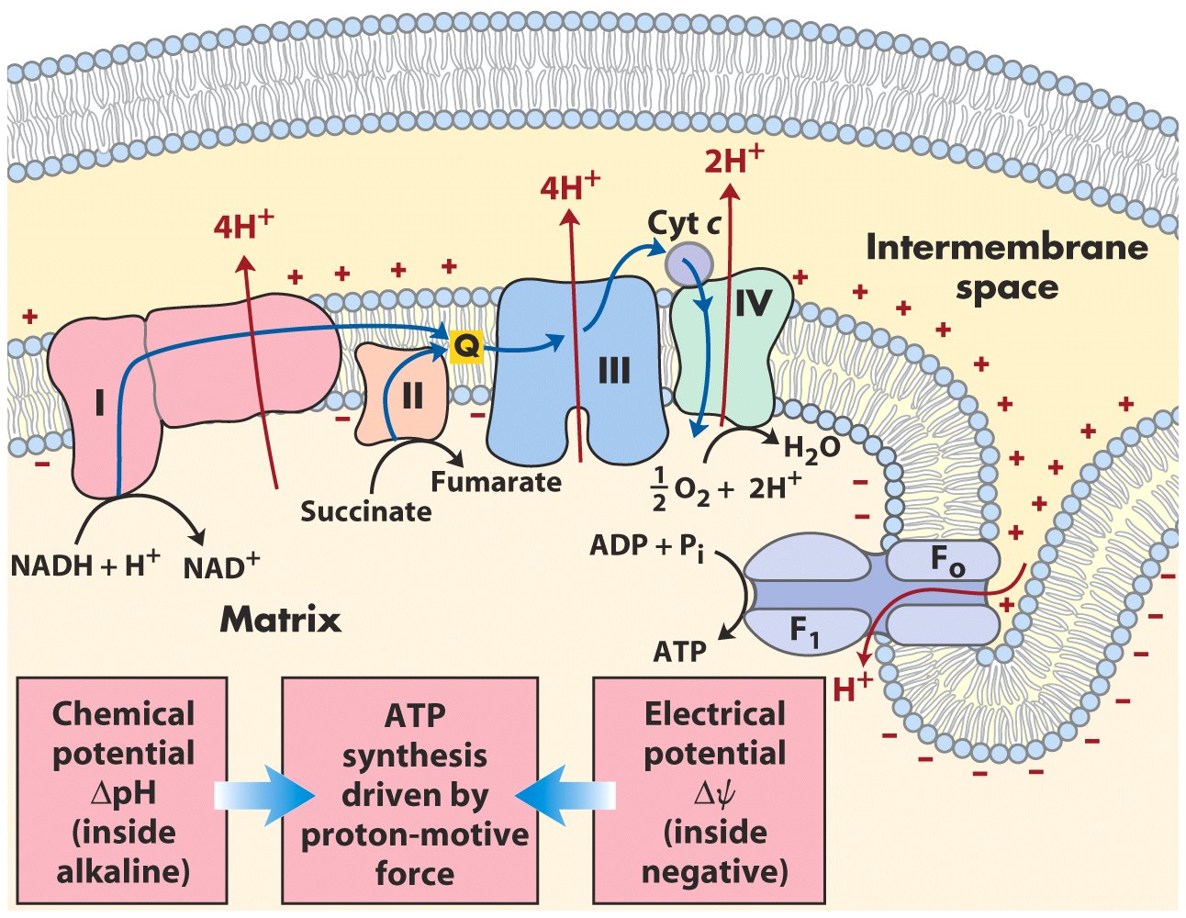
Core Knowledge
Chemiosmotic Theory

Slide 9
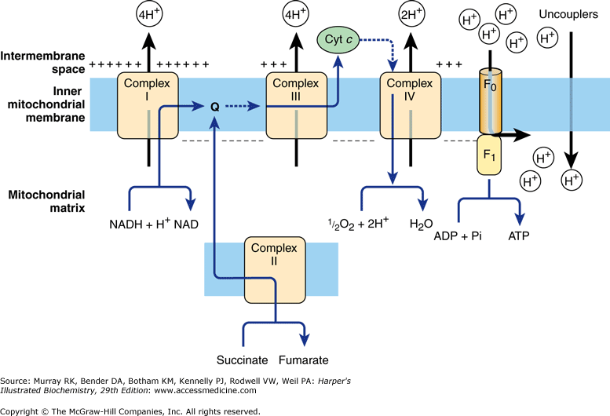
Core Knowledge

Slide 10
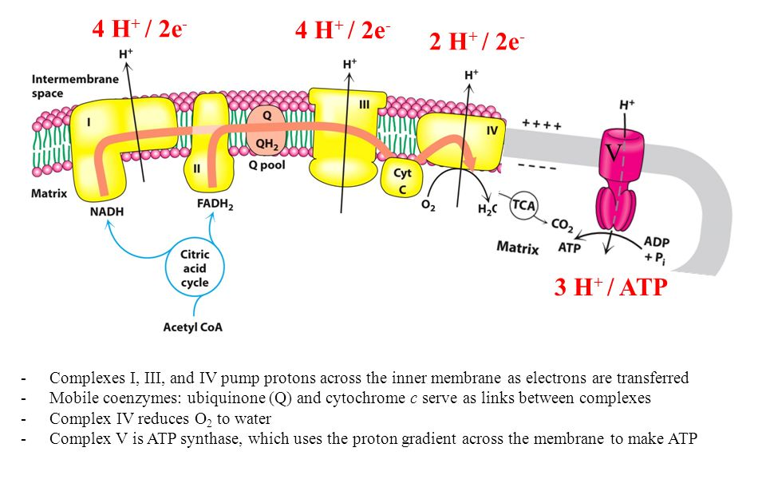
Core Knowledge

Slide 11
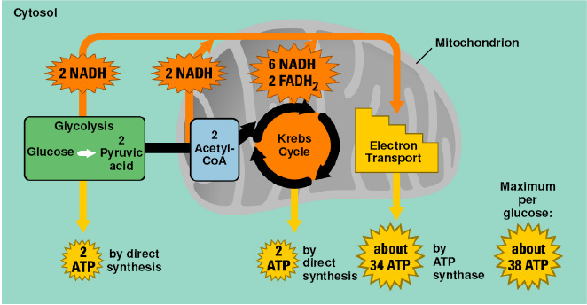
Core Knowledge

Slide 12
Core Knowledge

Slide 13
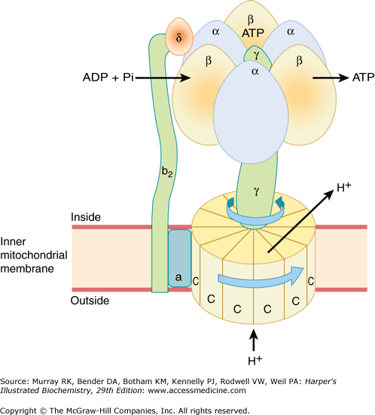
Core Knowledge

Slide 14
Core Knowledge
Each β subunit has a different conformation
β-ADP
β-ATP
β-empty

Slide 15
Core Knowledge
ADP and Pi bind
Conformation changes back to initial state so that cycle continues
Conformation changes, ATP formation; energy provided by proton movement
Conformation changes; ATP dissociates; energy provided by proton movement

Slide 16
Uncouplers
Core Knowledge
Natural
Thermogenin
Thyroxin when increased
Oligomycin
Synthetic
2,4-dinitrophenol
Dinitrocresol
Ionophores (valinomycin)
Aspirin

Slide 17
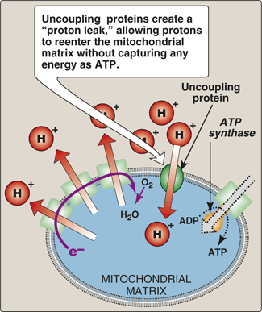
Core Knowledge

Slide 18
Core Knowledge

Slide 19
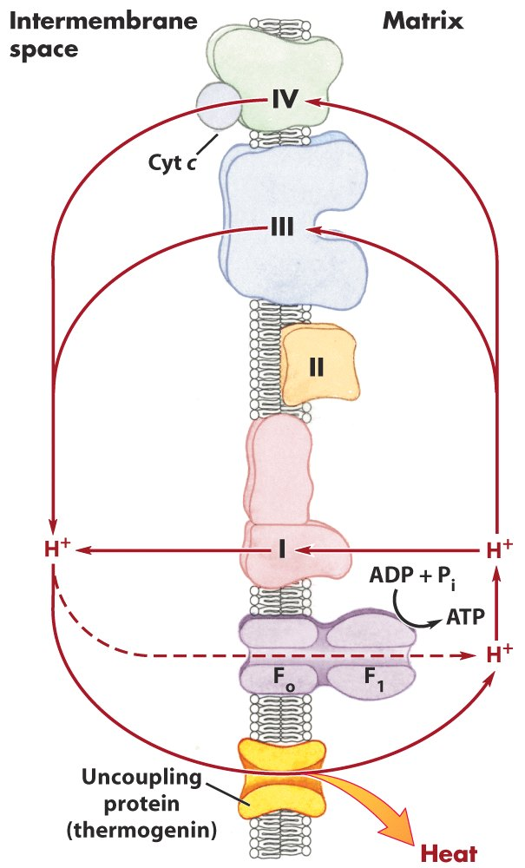
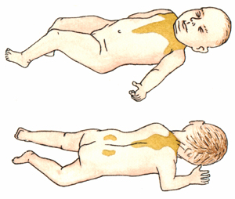
Core Knowledge
Protects newborn from cold

Slide 20
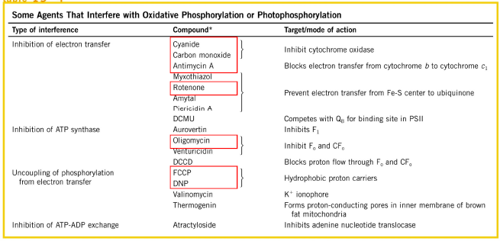
Core Knowledge

Slide 21
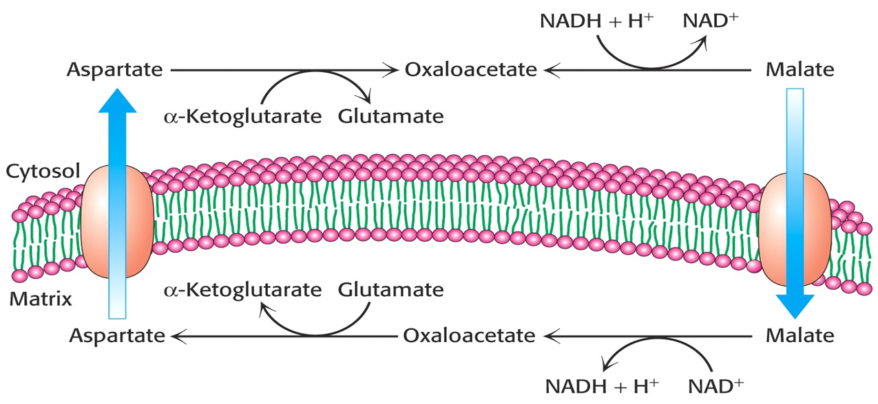
Core Knowledge

Slide 22
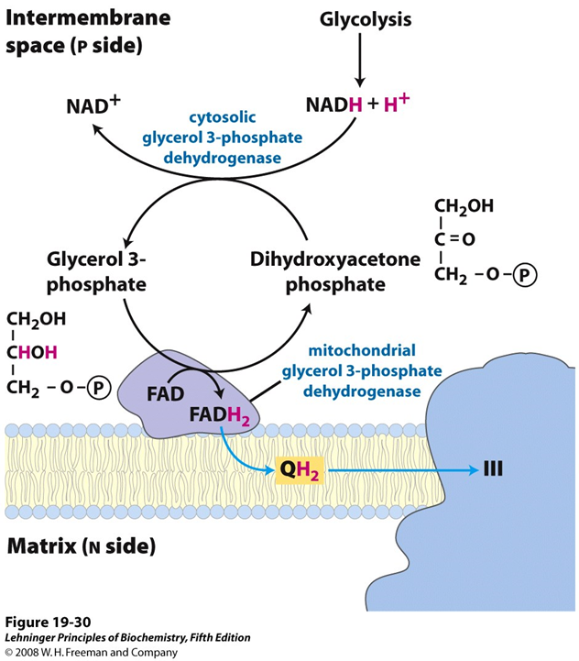
Core Knowledge

Slide 23
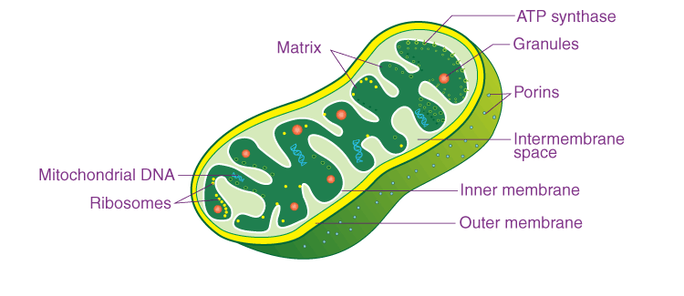
Anatomical Aspects
Horizontal Integration

Slide 24
Horizontal Integration
Physiological Aspects
Functions of Mitochondria
Power house of cell (ATP production)
Site of different metabolic pathways

Slide 25
Vertical Integration
Mutations in mtDNA are responsible for several diseases, including some cases of mitochondrial myopathies and Leber hereditary optic neuropathy

Slide 26
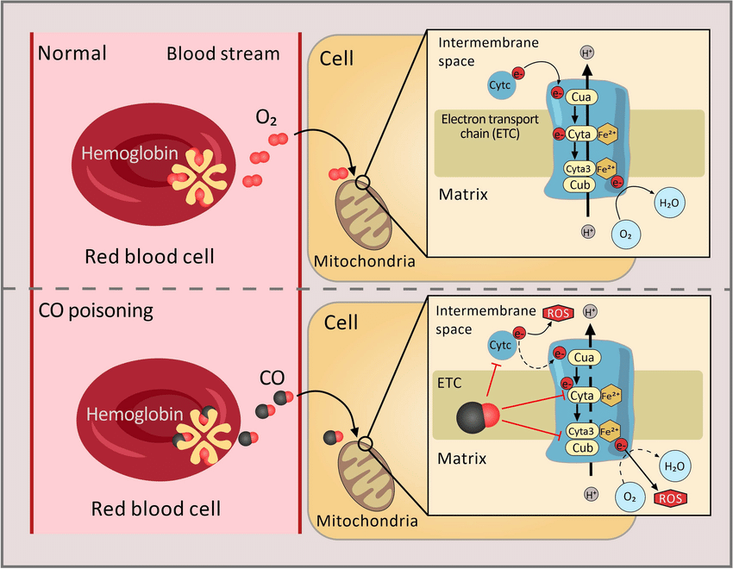
Vertical Integration

Slide 27
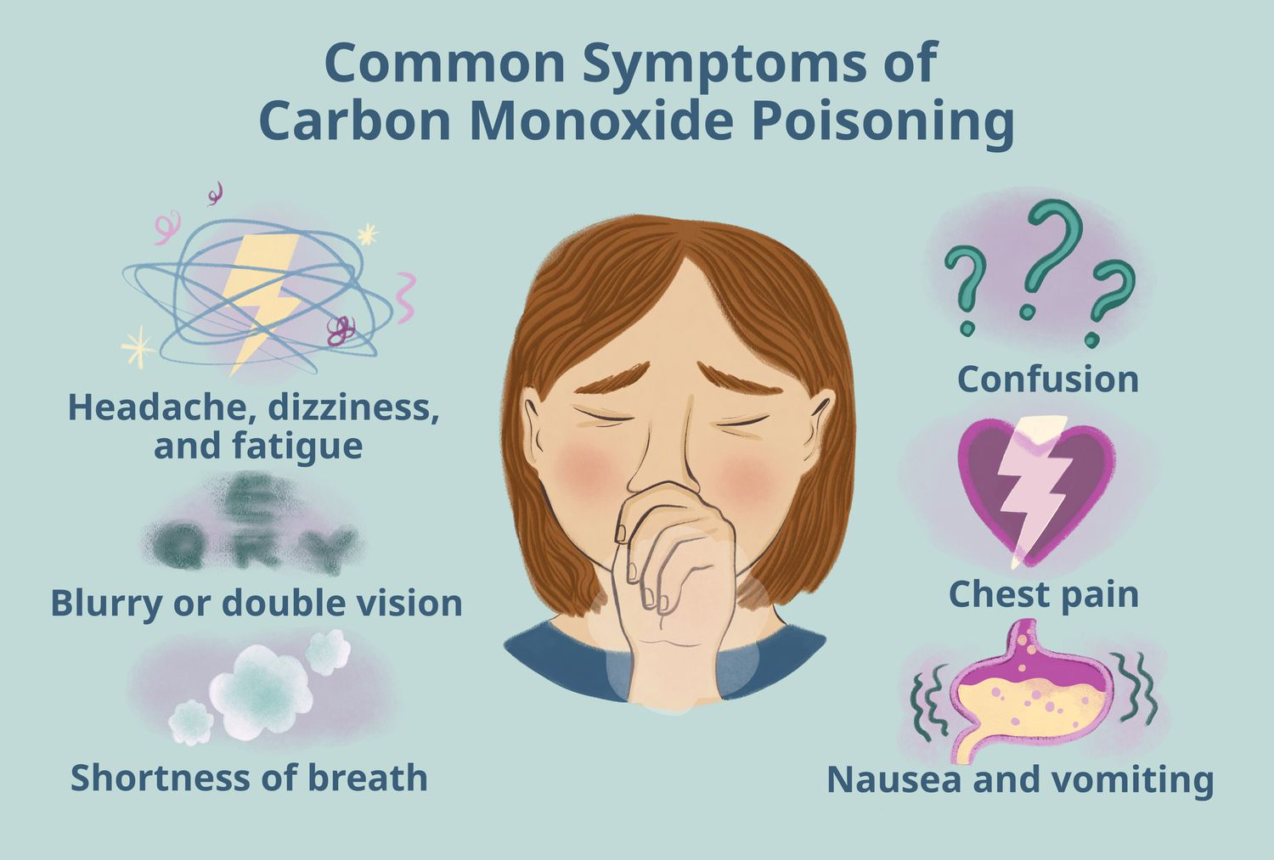
Vertical Integration

Slide 28
Family Medicine
Spiral Integration
Family Medicine plays important role in following manner:
Early Diagnosis
Education
Dietary Guidance
Monitoring
Refer to Specialists

Slide 29
Artificial Intelligence
Spiral Integration
Artificial Intelligence plays role in following aspects:
Decoding DNA sequences to
pinpoint genetic variations
identify genetic abnormalities
Utilizes extensive data from patient thereby enhancing prevention, diagnosis & treatment based on individual genetic profiles

Slide 30
Suggested Research Article
,
,
Spiral Integration
Link: https://www.sciencedirect.com/science/article/pii/S0074774202530038
Journal Name : International Review of Neurobiology
Title: Oxidative phosphorylation: Structure, function, and intermediary metabolism
Author Name: Simon J.R
Abstract
The inner mitochondrial membrane is the site of the electron-transport chain (ETC), and is where the process of oxidative phosphorylation (OXPHOS) occurs that facilitates ATP synthesis. In view of the key role the ETC plays in energy metabolism, damage to one or more of the respiratory-chain complexes could lead to an impairment of cellular ATP formation. However, each of the complexes of the ETC appears to exert varying degrees of control over respiration. In vitro studies suggest that substantial loss of activity of an individual complex may be required before ATP synthesis is compromised. However, the degree of control a particular complex exerts over respiration may differ between cell types. The chapter presents descriptions of the predominant metabolic pathways located to mitochondria that are responsible for NADH and FADH₂ generation. The optimal mitochondrial function is essential for cell survival. There is an increasing body of evidence to suggest that mitochondrial dysfunction occurs in a number of neurodegenerative disorders.

Slide 31
Bioethics
Spiral Integration
Appropriate information
Explain to patient or his family the genetic aspects of the condition
Counselling

Slide 32
How To Access Digital Library
Steps to Access HEC Digital Library
Go to the website of HEC National Digital Library
On Home Page, click on the INSTITUTES
A page will appear showing the universities from Public and Private Sector and other Institutes which have access to HEC National Digital Library HNDL
Select your desired Institute
A page will appear showing the resources of the institution
Journals and Researches will appear
You can find a Journal by clicking on JOURNALS AND DATABASE and enter a keyword to search for your desired journal

Slide 33
Learning Resources
Lippincott Illustrated Review, Biochemistry (Eighth edition, chapter 06)
Google scholar
Google images

