Slide 1
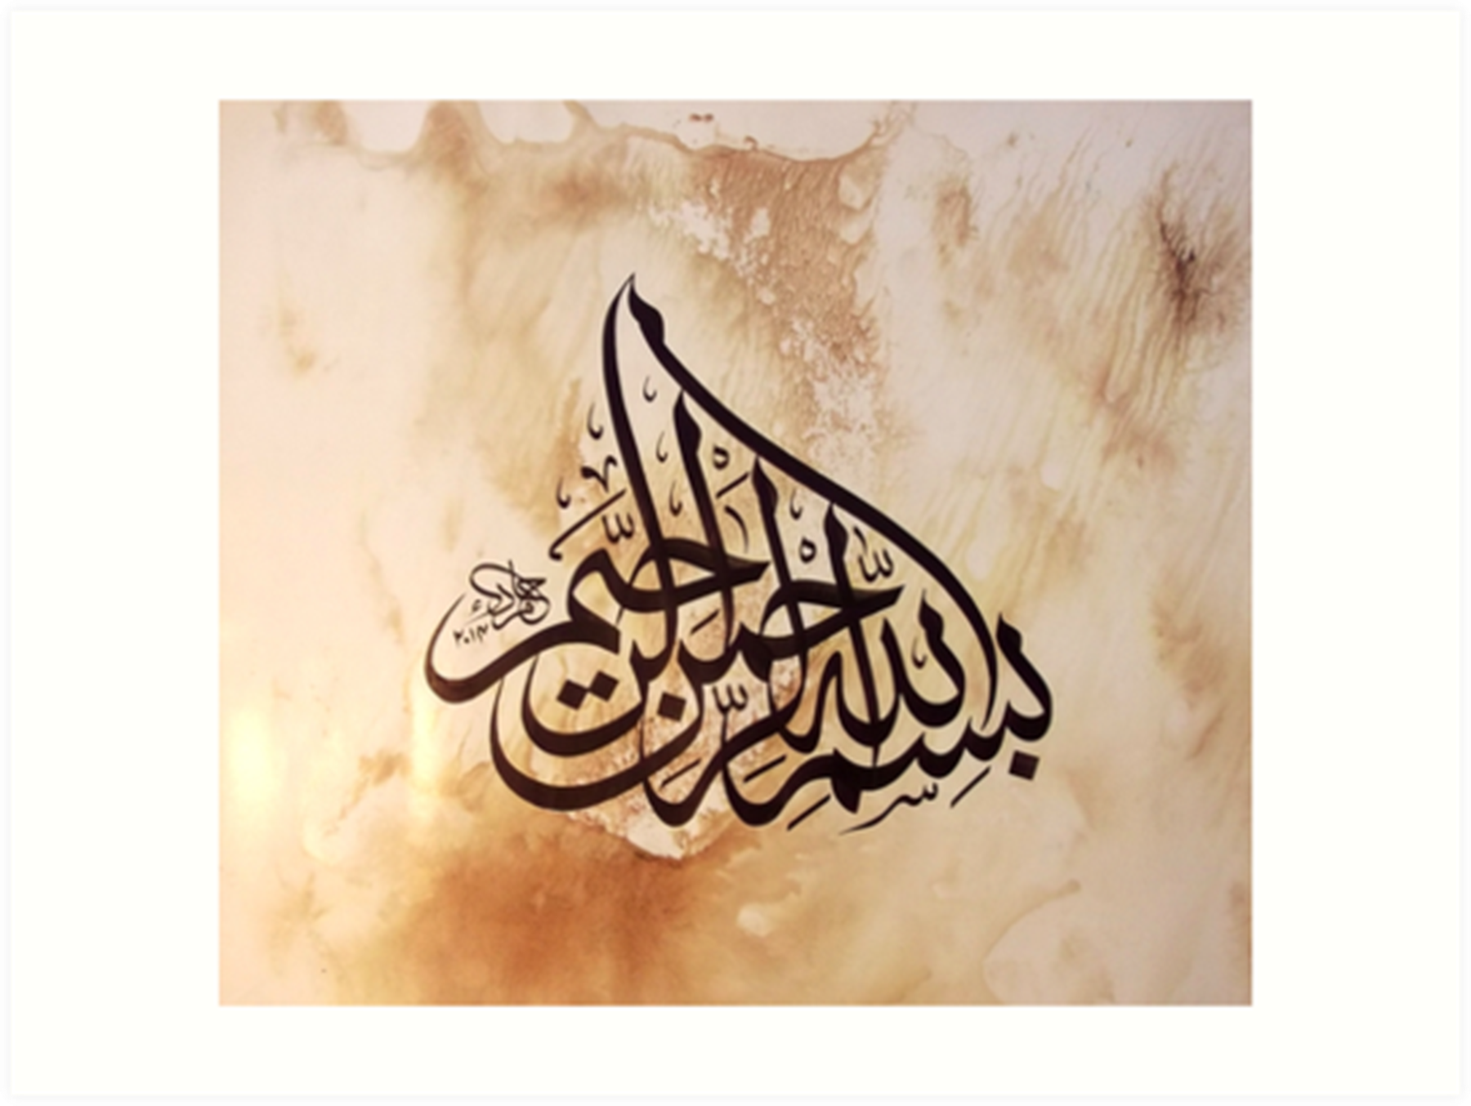

Slide 2
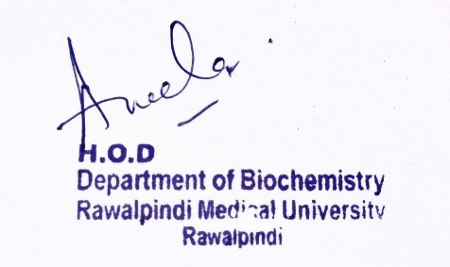
Respiratory Module 1st Year MBBS (LGIS) Electron Transport Chain
Presenter: Dr. Aneela Jamil Date: 24-02-25
(Assistant Professor)

Slide 3
Motto, Vision, Dream
To impart evidence based research oriented medical education
To provide best possible patient care
To inculcate the values of mutual respect and ethical practice of medicine
Wisdom
Truth
Service

Slide 4
Professor Umar Model of Integrated Lecture

Slide 5
Learning Objectives
At the end of this lecture students should be able to
Understand complexes of electron transport chain
Discuss the flow of electrons across electron transport chain
Vertically integrate related disorder

Slide 6
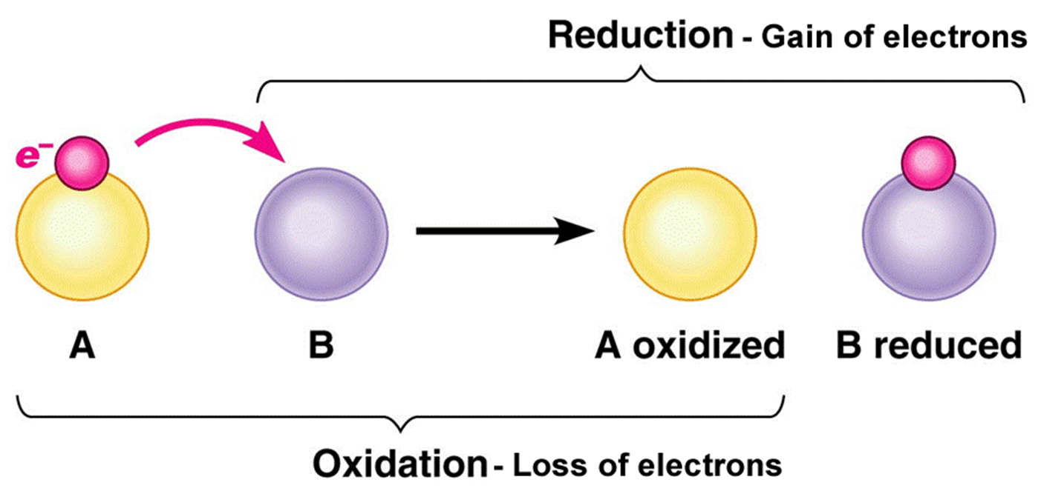
Core Knowledge

Slide 7
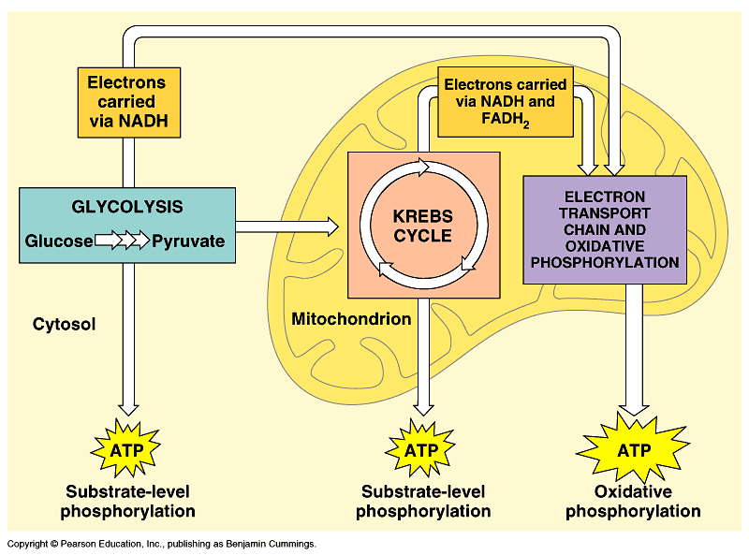
Core Knowledge

Slide 8
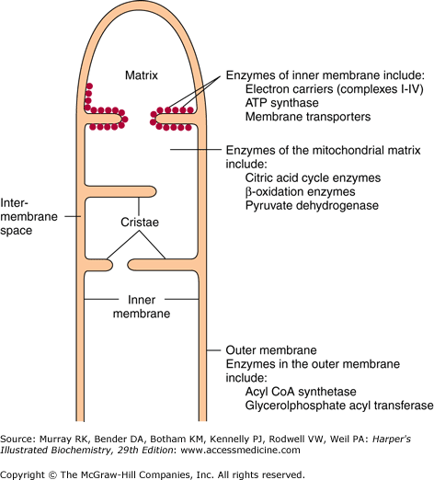
Core Knowledge

Slide 9
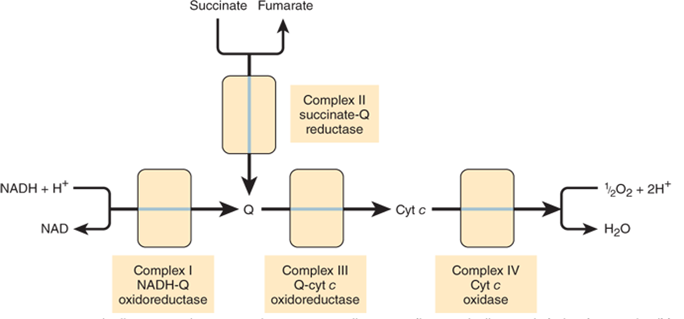
Core Knowledge
4 protein complexes
complex I
complex II
complex III
complex IV
2 mobile electron carriers
coenzyme Q & cytochrome C

Slide 10
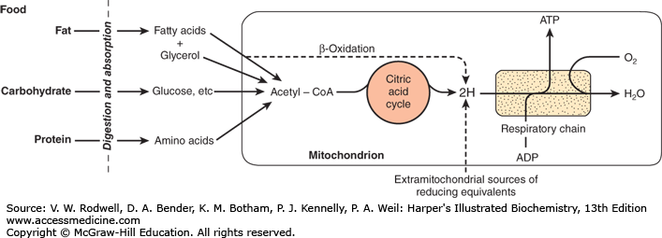
Core Knowledge

Slide 11
Core Knowledge

Slide 12
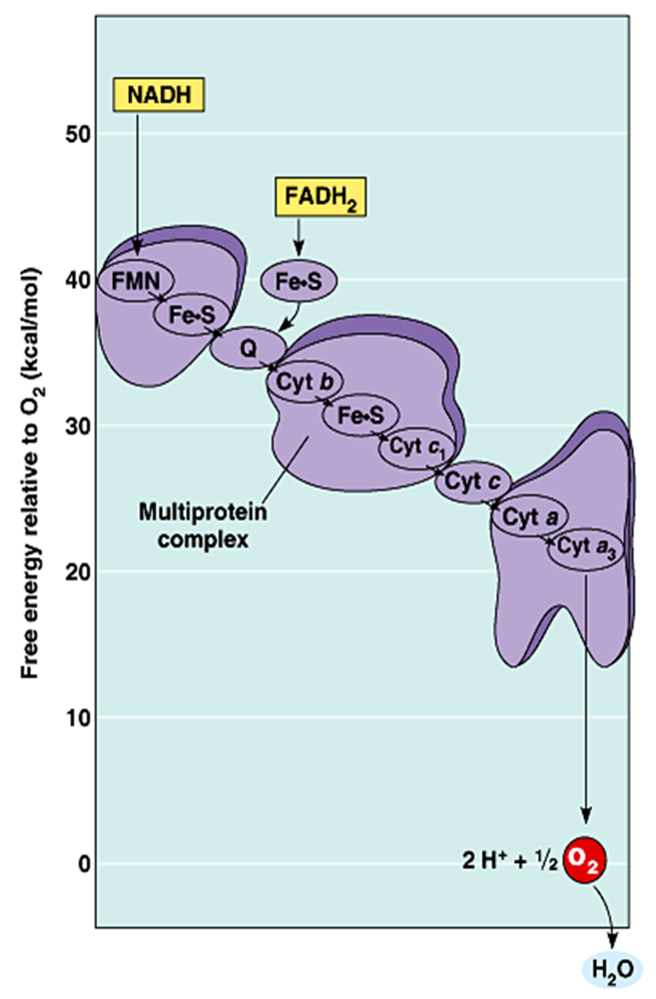
Core Knowledge
Redox Potential

Slide 13
Core Knowledge
Formation of NADH

Slide 14
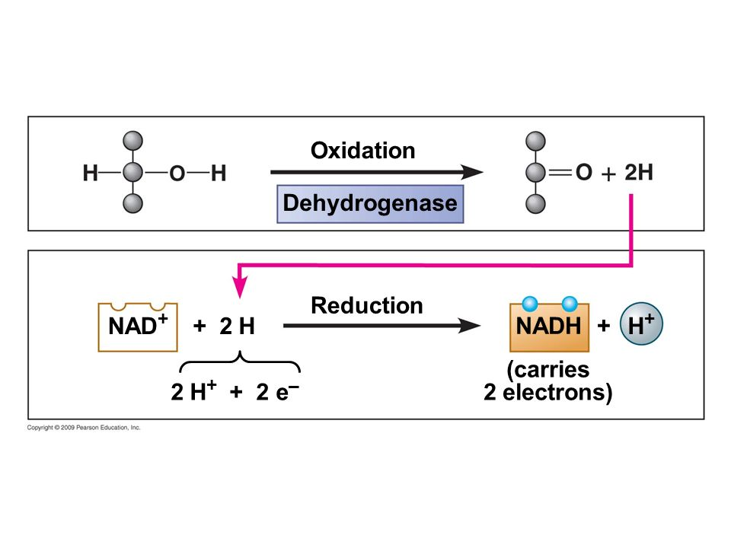
Core Knowledge

Slide 15
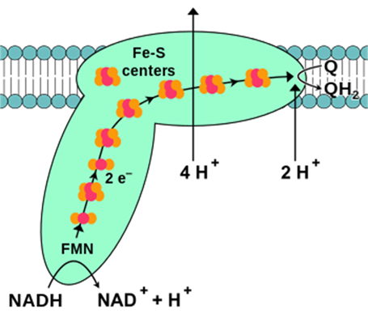
Core Knowledge
Complex I (NADH Dehydrogenase)
Complex I has
a tightly bound flavin mono nucleotide
six iron–sulfur centers
Electrons are transferred to
FMN to produce FMNH2
iron-sulfur centers
coenzyme Q

Slide 16
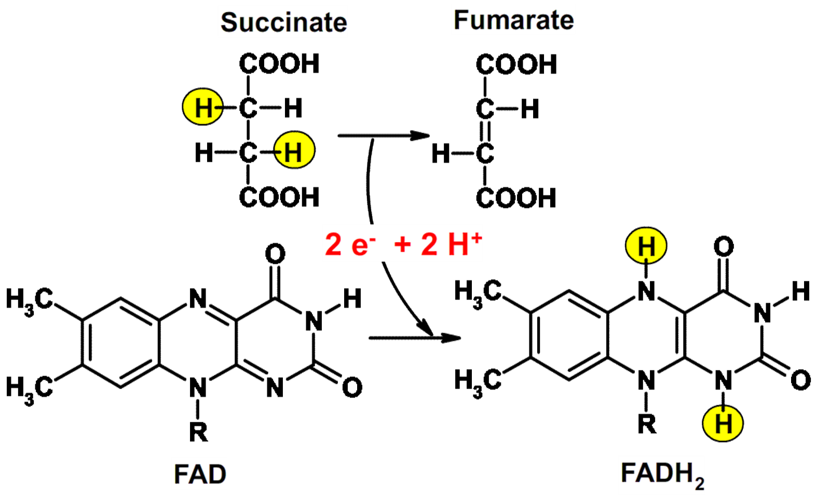
Core Knowledge
Formation of FADH2

Slide 17
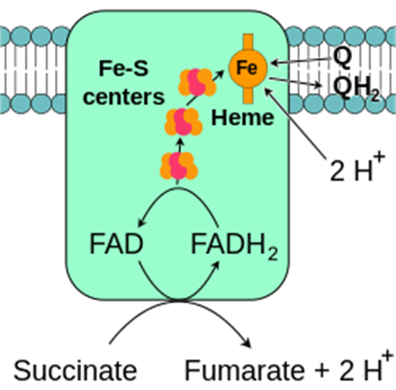
Core Knowledge
Complex II (Succinate Dehydrogenase)
Complex II has
tightly bound flavin adenine dinucleotide
iron-sulfur centers
Electrons are transferred to
iron-sulfur centers
coenzyme Q

Slide 18
Core Knowledge
Coenzyme Q
Quinone derivative
Mobile electron carrier
Can accept hydrogen atoms both from FMNH₂ (Complex I) and from FADH₂ (Complex II)
Transfers electrons to Complex III
Links flavoproteins to the cytochromes

Slide 19
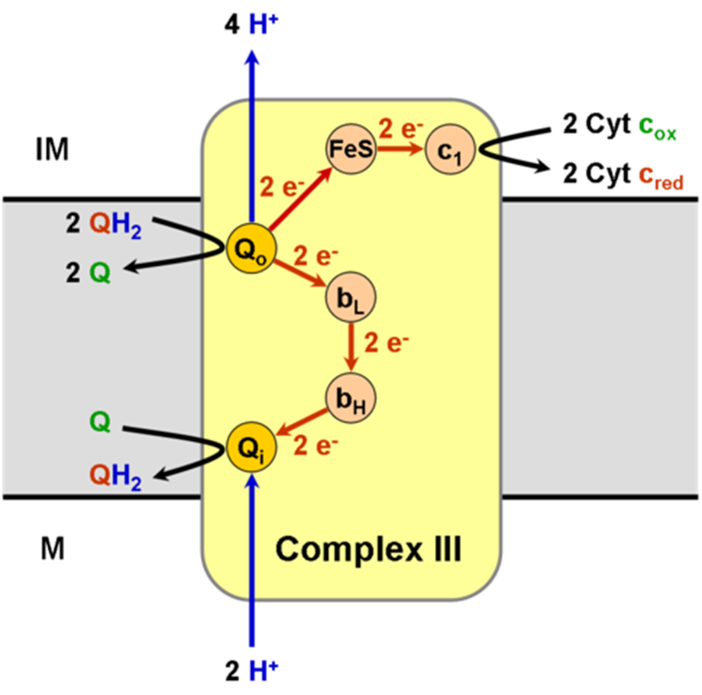
Core Knowledge
Complex III (Cytochrome bc1 Oxidoreductase)
Complex III has
cytochrome b
cytochrome c1
iron-sulfur center
Electrons are transferred to
cytochrome b
iron-sulfur center
cytochrome c1
cytochrome C

Slide 20
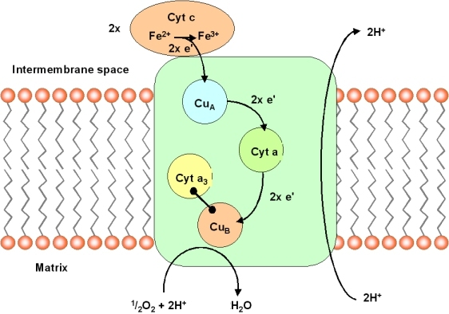
Core Knowledge
Complex IV(Cytochrome Oxidase)
Complex IV has
Cu_{A ,} Cu_{B}
cytochrome a
cytochrome a₃
Electrons are transferred to
Cu_{A}
cytochrome a
cytochrome a₃
Cu_{B}
oxygen

Slide 21
Core Knowledge

Slide 22
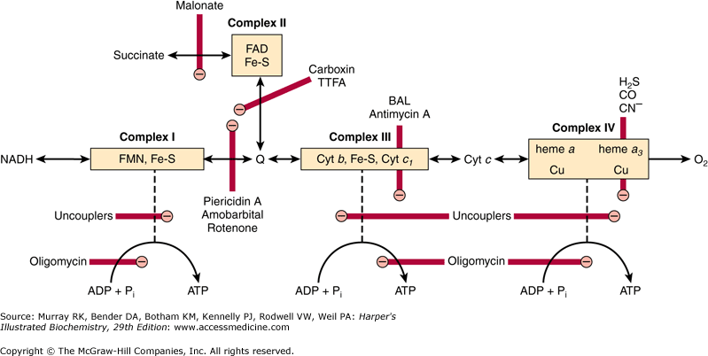
Core Knowledge

Slide 23
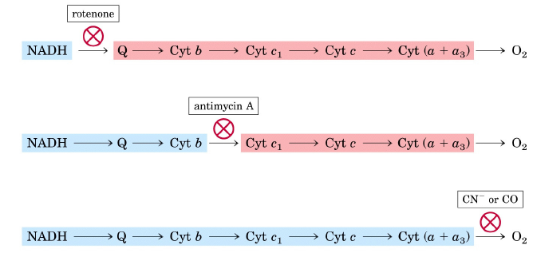
Core Knowledge

Slide 24
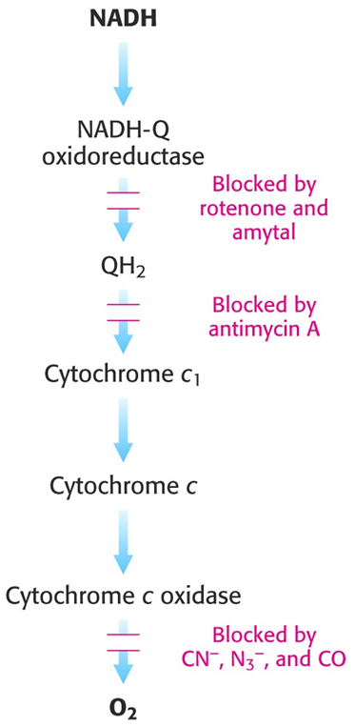
Core Knowledge

Slide 25
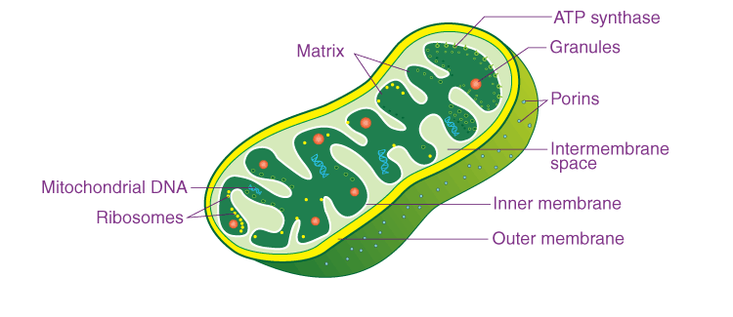
Anatomical Aspects
Horizontal Integration

Slide 26
Horizontal Integration
Physiological Aspects
Functions of Mitochondria
Power house of cell (ATP production)
Site of different metabolic pathways

Slide 27
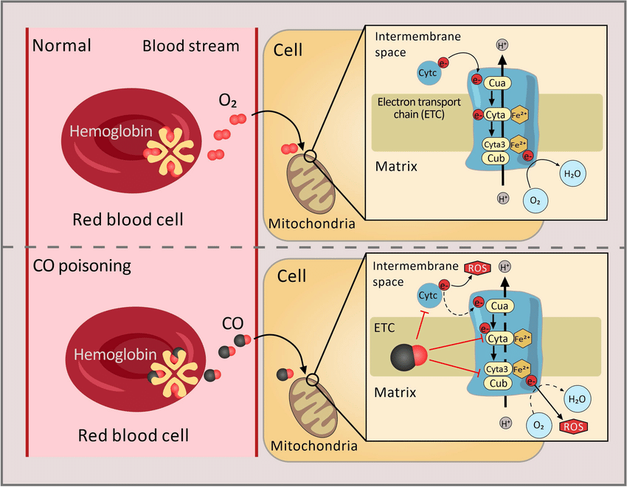
Vertical Integration

Slide 28
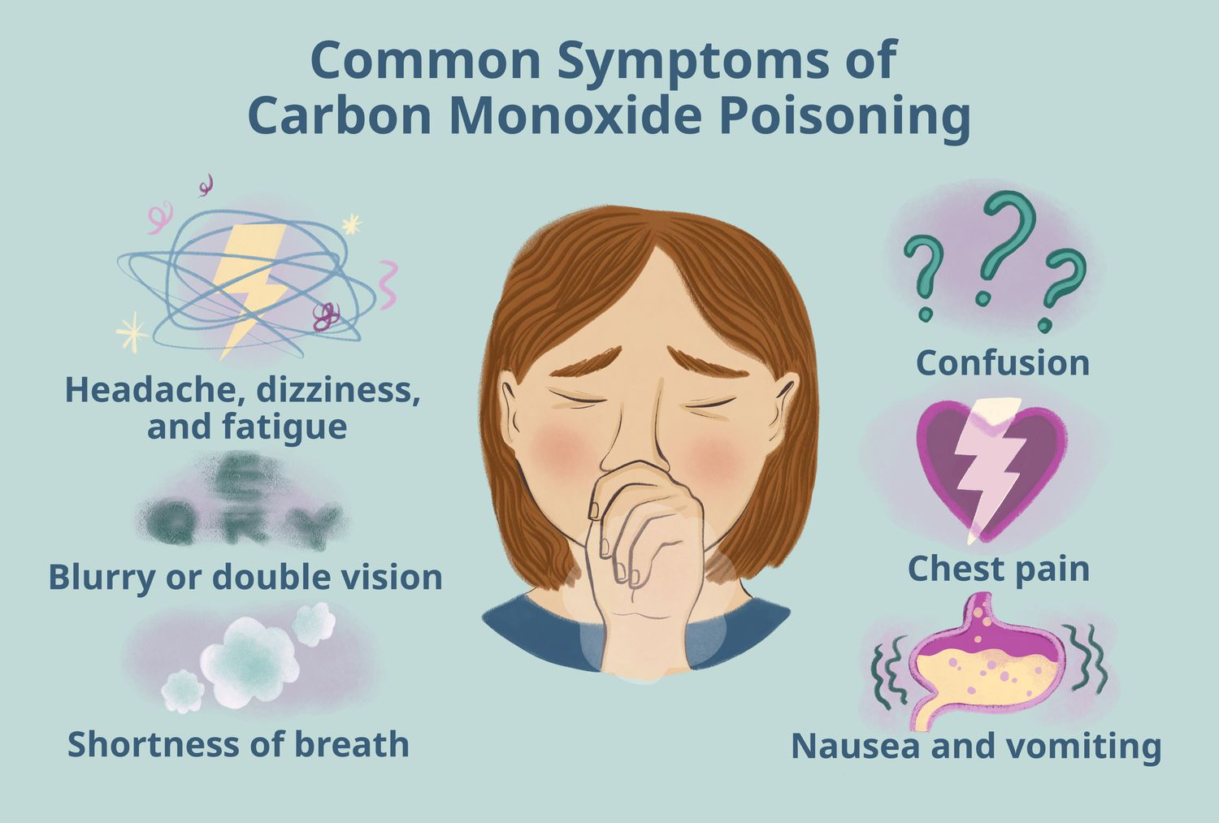
Vertical Integration

Slide 29
Family Medicine
Spiral Integration
Family Medicine plays important role in following manner:
Early Diagnosis
Education
Dietary Guidance
Monitoring
Refer to Specialists

Slide 30
Artificial Intelligence
Spiral Integration
Artificial Intelligence plays role in following aspects:
Decoding DNA sequences to
pinpoint genetic variations
identify genetic abnormalities
Utilizes extensive data from patient thereby enhancing prevention, diagnosis & treatment based on individual genetic profiles

Slide 31
Suggested Research Article
Spiral Integration
Link: https://faseb.onlinelibrary.wiley.com/doi/10.1096/fj.202101161R
Journal Name : FASEB
Title: The role of the electron transport chain in immunity
Author Name: Maureen Yin
Abstract
The electron transport chain (ETC) couples oxidative phosphorylation (OXPHOS) with ATP synthase to drive the generation of ATP. In immune cells, research surrounding the ETC has drifted away from bioenergetics since the discovery of cytochrome c (Cyt c) release as a signal for programmed cell death. Complex I has been shown to generate reactive oxygen species (ROS), with key roles identified in inflammatory macrophages and T helper 17 cells (T_{H}17) cells. Complex II is the site of reverse electron transport (RET) in inflammatory macrophages and is also responsible for regulating fumarate levels linking to epigenetic changes. Complex III also produces ROS which activate hypoxia-inducible factor 1-alpha (HIF-1α) and can participate in regulatory T cell (T_{reg}) function. Complex IV is required for T cell activation and differentiation and the proper development of T_{reg} subsets.

Slide 32
Bioethics
Spiral Integration
Appropriate information
Explain to patient or his family the genetic aspects of the condition
Counselling

Slide 33
How To Access Digital Library
Steps to Access HEC Digital Library
Go to the website of HEC National Digital Library
On Home Page, click on the INSTITUTES
A page will appear showing the universities from Public and Private Sector and other Institutes which have access to HEC National Digital Library HNDL
Select your desired Institute
A page will appear showing the resources of the institution
Journals and Researches will appear
You can find a Journal by clicking on JOURNALS AND DATABASE and enter a keyword to search for your desired journal

Slide 34
Learning Resources
Lippincott Illustrated Review, Biochemistry (Eighth edition, chapter 06)
Google scholar
Google images

