Slide 2
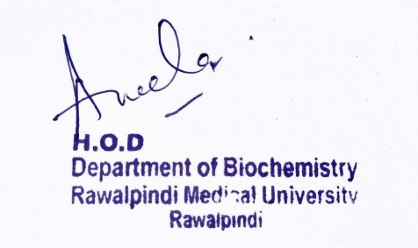
Reproduction Module 2nd Year MBBS (LGIS) Regulation of Gene Expression
Presenter: Dr. Aneela Jamil Date: 26-02-25
(Assistant Professor)

Slide 3
Motto, Vision, Dream
To impart evidence based research oriented medical education
To provide best possible patient care
To inculcate the values of mutual respect and ethical practice of medicine
Wisdom
Truth
Service

Slide 4
Professor Umar Model of Integrated Lecture

Slide 5
Learning Objectives
At the end of this lecture students should be able to
Explain Lac and Try operon
Explain eukaryotic gene expression
Describe RNAi and its applications

Slide 6
Overview
Core Knowledge

Slide 7
Gene expression
Core Knowledge
Regulation of gene expression: includes a wide range of mechanisms that are used by cells to increase or decrease the production of specific gene products (protein or RNA)
Primary site of regulation in prokaryotes and eukaryotes is TRANSCRIPTION
In eukaryotes: posttranscriptional and posttranslational modifications play an important role as well

Slide 8
Classification of genes with respect to their expression
Core Knowledge
Constitutive (house keeping) genes:
Are expressed at a fixed rate, irrespective of the cell condition
Regulatory genes:
Are expressed only as needed
Their amount may increase or decrease with respect to their basal level in different conditions

Slide 9
Types of regulation of gene
Core Knowledge

Slide 10
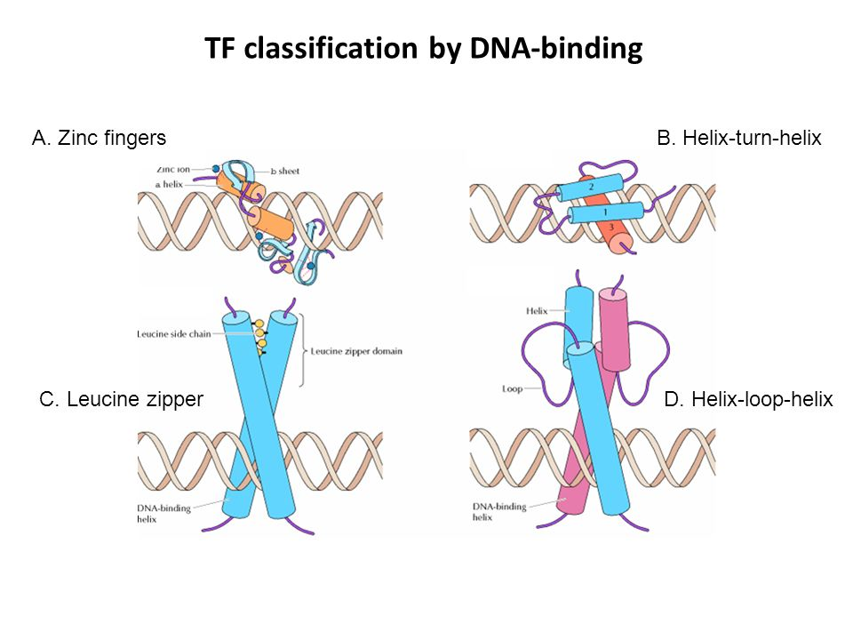
Regulatory Sequences
Core Knowledge
cis-acting, trans-acting
Activate or Repress
Interaction/binding takes place with the help of structural motifs (zinc finger, leucine finger, helix-turn-helix)

Slide 11
Operon
Core Knowledge
An operon is a cluster of genes that are transcribed together
To give a single mRNA
Which encodes multiple proteins
Such polycistronic mRNA is typically found in prokaryotes

Slide 12
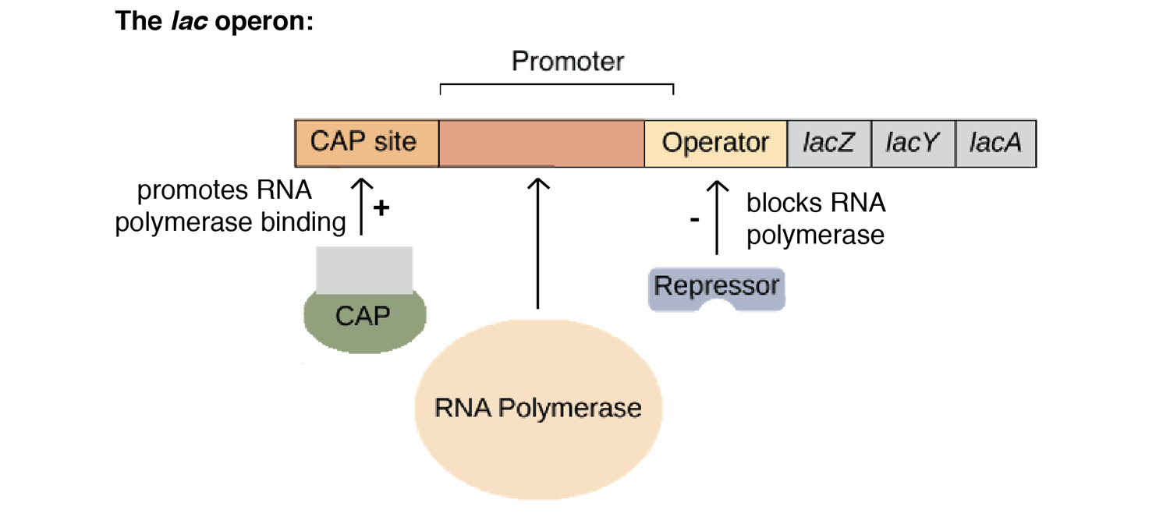
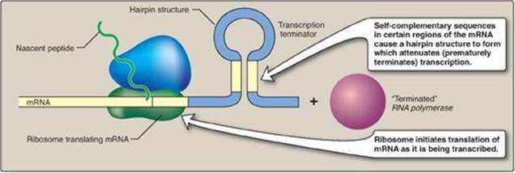
Core Knowledge
Lactose
Operon
Tryptophan
Operon

Slide 13
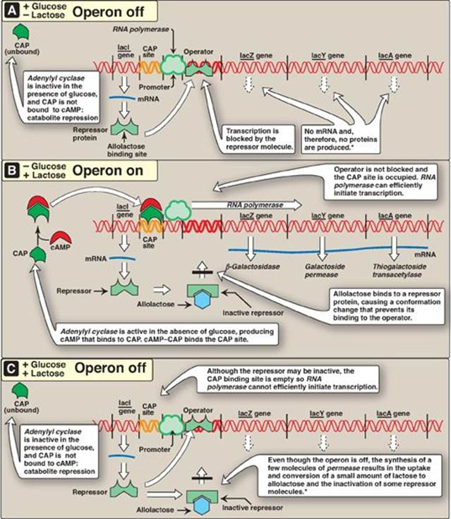
Core Knowledge
Lactose
Operon
Operon
Uninduced

Slide 14
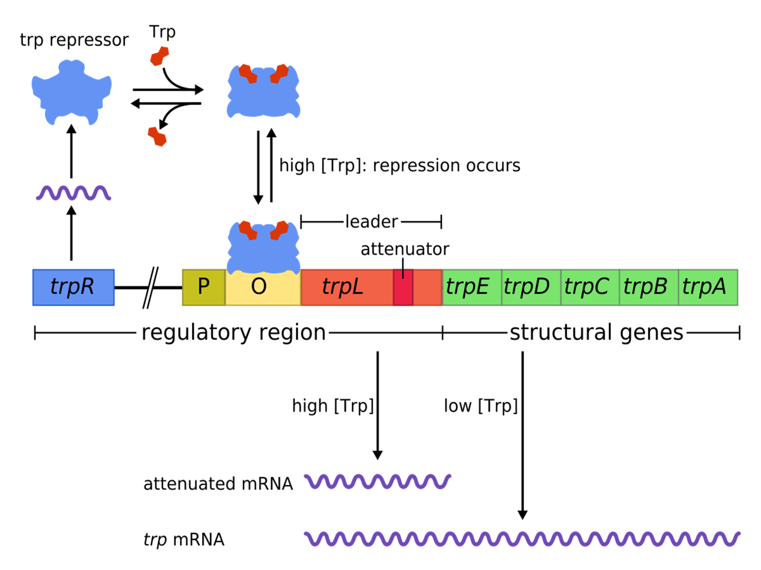
Tryptophan Operon
Core Knowledge

Slide 15
Core Knowledge
Regulation by Processing
of mRNA
Eukaryotic mRNA undergoes multiple changes before it is exported into the cytosol
Capping at 5′-end
Polyadenylation at 3′-end
Splicing

Slide 16
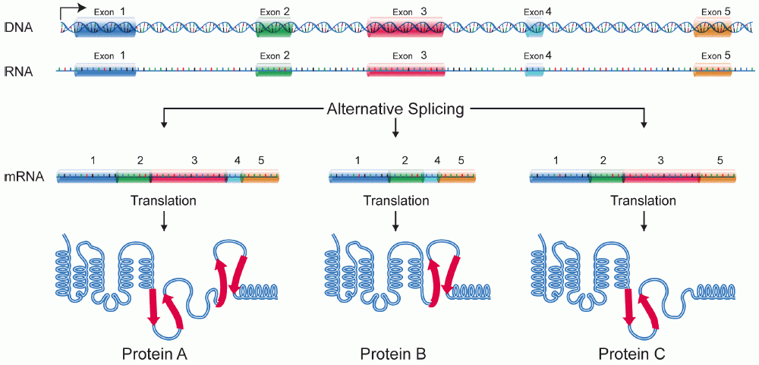
Core Knowledge
Alternate Splicing

Slide 17
Core Knowledge
Alternative polyadenylation

Slide 18
Core Knowledge
mRNA Editing

Slide 19
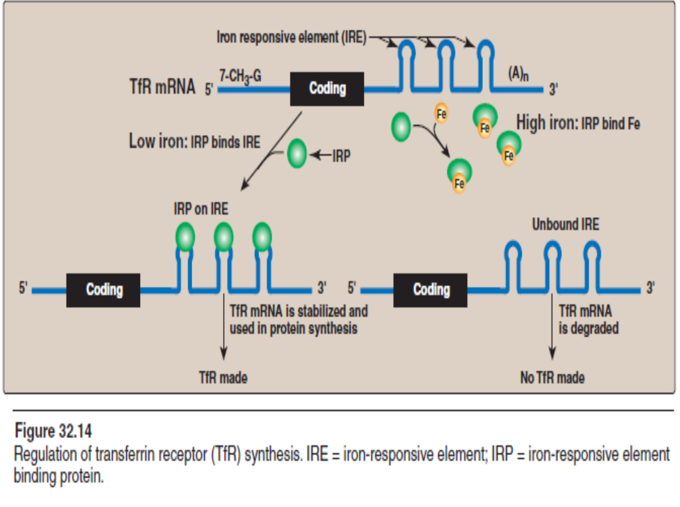
Core Knowledge
mRNA stability
Iron metabolism:

Slide 20
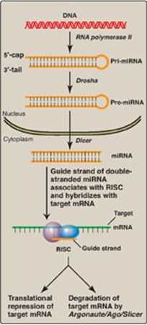
Core Knowledge
RNA
Interference
(RNAi)

Slide 21
Core Knowledge
Regulation through DNA modification
Gene expression in eukaryotes is also influenced by
Access to DNA
Amount of DNA
Arrangement of DNA
Mobile DNA elements

Slide 22
Core Knowledge
Access to DNA

Slide 23
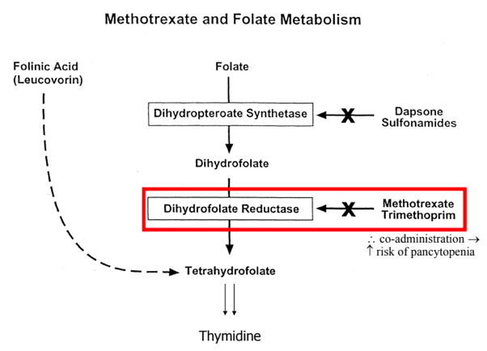
Core Knowledge
Amount of DNA

Slide 24
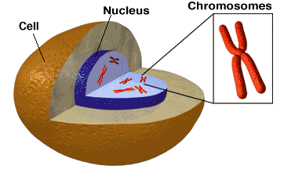
Anatomical & Physiological Aspects
Horizontal Integration

Slide 25
Horizontal Integration
Physiological Aspects
Cell division and cell cycle
Control house of cell

Slide 26
Applications of RNAi
Vertical Integration
The first clinical trial of RNAi-based therapy in patients with age-related macular degeneration (AMD)
AMD is triggered by overproduction of vascular endothelial growth factor (VEGF)
↑VEGF leads to the sprouting of excess blood vessels behind the retina
The blood vessels leak→ entirely destroying vision (“wet” macular degeneration)
siRNA drug—a short dsRNA that specifically targets the mRNA of VEGF and promotes its degradation—is injected into the eye
(siRNA)
(VEGF)

Slide 27
Family Medicine
Spiral Integration
Family Medicine plays important role in following manner:
Early Diagnosis
Education
Dietary Guidance
Monitoring
Refer to Specialists

Slide 28
Artificial Intelligence
Spiral Integration
Artificial Intelligence plays role in following aspects:
Utilizes extensive data from patient thereby enhancing prevention, diagnosis & treatment based on individual genetic profile
Food recommendations

Slide 29
Suggested Research Article
.
Spiral Integration
.
Link: https://pmc.ncbi.nlm.nih.gov/articles/PMC309050/
Journal Name: Microbiology and Molecular Biology Reviews
Title: RNA Interference: Biology, Mechanism, and Applications
Author Name: Oluwafemi Ojo
Introduction
Double-stranded RNA-mediated interference (RNAi) is a simple and rapid method of silencing gene expression in a range of organisms. The silencing of a gene is a consequence of degradation of RNA into short RNAs that activate ribonucleases to target homologous mRNA. The resulting phenotypes either are identical to those of genetic null mutants or resemble an allelic series of mutants. Specific gene silencing has been shown to be related to two ancient processes, suppression in plants and quelling in fungi, and has also been associated with regulatory processes such as transposon silencing, antiviral defense mechanisms, gene regulation, and chromosomal modification.

Slide 30
Bioethics
Spiral Integration
Appropriate information
Explain to patient or his family the genetic aspects of the condition
Counselling

Slide 31
How To Access Digital Library
Steps to Access HEC Digital Library
Go to the website of HEC National Digital Library
On Home Page, click on the INSTITUTES
A page will appear showing the universities from Public and Private Sector and other Institutes which have access to HEC National Digital Library HNDL
Select your desired Institute
A page will appear showing the resources of the institution
Journals and Researches will appear
You can find a Journal by clicking on JOURNALS AND DATABASE and enter a keyword to search for your desired journal

Slide 32
Learning Resources
Lippincott Illustrated Reviews Biochemistry, 8th Edition, Chapter 33, pages 465-480
Google scholar
Google images

