Slide 1
Cystic Diseases Of Kidney Renal Module 4th Year MBBS
Dr. Kiran Fatima
Pathology Department
Rawalpindi Medical University

Slide 3
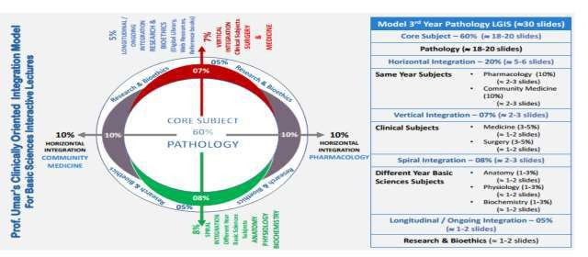

Slide 4
Mission Statement
To impart evidence based research oriented health professional education in order to provide best possible patient care and inculcate the values of mutual respect, ethical practice of healthcare and social accountability.
Vision and Values
Highly recognized and accredited centre of excellence in Medical Education, using evidence-based training techniques for development of highly competent health professionals, who are lifelong experiential learner and are socially accountable.

Slide 5
LEARNING OBJECTIVES
Classify renal cystic diseases
Correlate the etiology with pathogenesis of simple renal cysts
Describes the morphology of simple renal cysts
Correlate the clinical features with pathogenesis of ADPKD
Correlate the pathogenesis with morphology of ARPKD
Correlate the pathogenesis with morphology of nephronophthisis.

Slide 6
How to use HEC Digital Library
Steps to Access HEC Digital Library
Go to the website of HEC National Digital Library.
On Home Page, click on the INSTITUTES.
A page will appear showing the universities from Public and Private Sector and other Institutes which have access to HEC National Digital Library (HNDL).

Slide 7
Select your desired Institute.
A page will appear showing the resources of the institution
Journals and Researches will appear
You can find a Journal by clicking on JOURNALS AND DATABASE and enter a keyword to search for your desired journal.

Slide 8
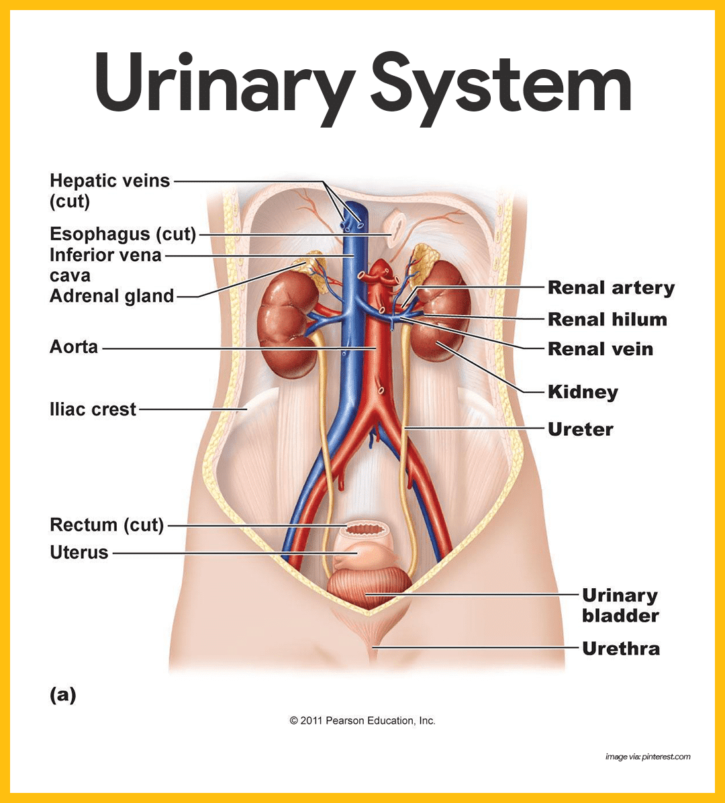
Spiral Anatomy

Slide 9
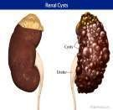
Classifications of renal cystic
Pathology core
diseases
Simple renal cysts
Polycystic kidney diseases
Autosomal dominant (adult) polycystic kidney disease (ADPKD)
Autosomal recessive (childhood) polycystic kidney disease (ARPKD)
Medullary diseases with cysts

Slide 10
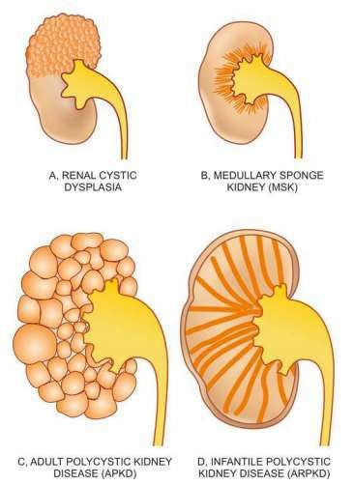
Pathology
core

Slide 11
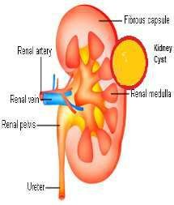
1. Simple renal cysts
Pathology
core
Definition:
Renal cysts are sacs of fluid that form in the kidneys. They are usually characterized as “simple” cysts, meaning they have a thin wall and contain water-like fluid.
Incidence:
Simple renal cysts are most common
Usually seen in the elderly.
50% of individuals over 50 years of age have single or multiple cysts.

Slide 12
Predisposing factors of SRC
Pathology core
Dialysis-associated acquired simple cysts occur in both the cortex and medulla, ultimately responsible for causing hematuria.
Occasionally, renal adenomas or even papillary adenocarcinomas arise in the walls of these cysts.

Slide 13
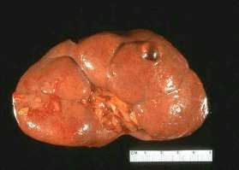
Morphology
Pathology
core
Gross apparence:
Size: they are 1-5 cm in diameter (large 10 cm) surface: they are translucent and lined by gray, glistering smooth membrane which is filled with clear fluid.
Microscopic findings:
These membranes are lined by cuboidal epithelium, which at times may be completely atrophic.

Slide 14
2- Polycystic kidney diseases
Pathology
core
Types of polycystic kidney diseases
Autosomal dominant (adult) polycystic kidney disease(adpkd)
Autosomal recessive (childhood) polycystic kidney disease(arpkd)

Slide 15
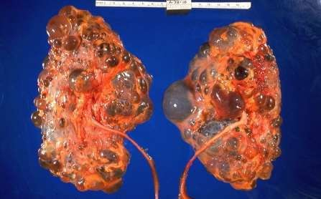
I- Autosomal dominant
(ADULT)
Pathology core
It is characterized by multiple expanding cysts affecting both kidneys that ultimately destroy the intervening parenchyma.
One allele inherited other gets defected by somatic mutation
Needs both alleles to be defective
Bilateral

Slide 16
Pathogenesis (ADPKD)
Pathology core
Mutations in PKD genes result in abnormal polycystin protein formation.
PKD 1 gene mutation = polycystin 1 protein
PKD 2 gene mutation = polycystin 2 protein
The PKD2 mutations have a slower disease progression as compared with patients with PKD1 mutations.

Slide 17
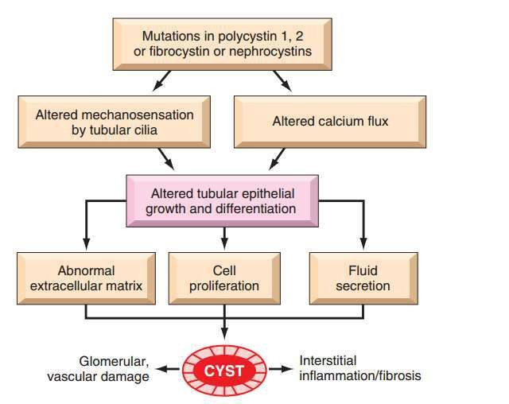
Pathology
core

Slide 18
Pathogenesis
Pathology
core
(ADPKD)
Abnormal polycystin protein result in abnormal calcium influx, abnormal cell polarity, (orientation) cell proliferation, cell-cell and cell matrix interaction.
This results in cyst formation

Slide 19
Clinical features
Pathology
vertical
Small cysts start to develop in adolescence.
Usually produce symptoms after fourth decade of life.
The most common presenting complaint is flank pain or a heavy, dragging sensation.
Palpable abdominal mass.
Hypertension and urinary infection (75%).
Subarachnoid hemorrhage (10% to 30%) .
Hematuria
End-stage kidney disease occurs at about age 50.
Renal failure are treated by renal transplantation.

Slide 20
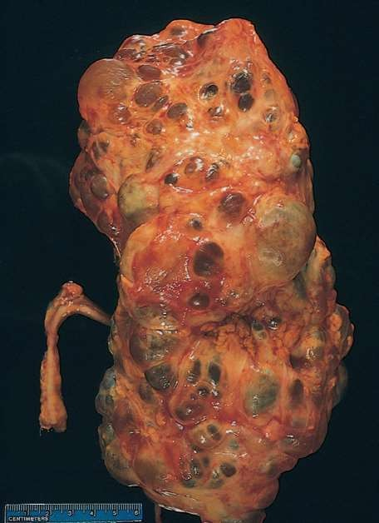
Morphology (ADPKD)
Pathology
core
Gross apparence:
Cystic masses are of various sizes (up to 3 or 4 cm in diameter).
Weight is up to 4 kg for each kidney and are palpable abdominally as masses extending into the pelvis.
These are filled with fluid, which may be clear, turbid, or hemorrhagic

Slide 21
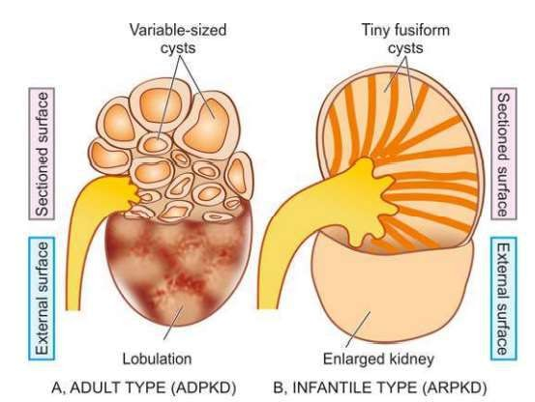
Pathology
core

Slide 22
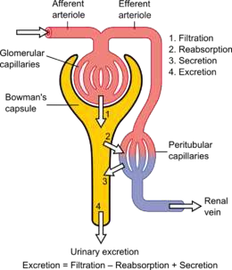
Morphology (ADPKD)
Pathology
core
Microscopic findings:
Cysts may arise at any level of the nephron [from tubules
to collecting ducts, and have a variable, often atrophic, lining]. Occasionally, Bowman’s capsules are involved in the cyst formation.

Slide 23
II- Autosomal recessive (childhood) polycystic kidney disease (ARPKD)
Pathology core
It is a rare autosomal recessive disorder
It is genetically distinct from adult polycystic kidney disease.
compound heterozygotes
Commonly involve perinatal, neonatal ages
While in infantile, and juvenile ages, associated hepatic lesions are also seen.
Extrarenal congenital anomalies

Slide 24
Pathogenesis
Pathology
( ARPKD )
core
Mutations in the PKHD1 gene:
It is present on short arm of chromosome 6 (6p).
Encodes for membrane receptor proteins called fibrocystin
Fibrocystin is found in cilia of tubular epithelial cells, but its function remains unknown.

Slide 25
Morphology ( ARPKD )
Pathology core
Gross apparence:
Usually bilateral renal involvement.
Smooth external appearance. Numerous small cysts in the cortex and medulla give the kidney a spongelike appearance, dilated, elongated channels at right angles to the cortical surface. Liver and other organs also involved by cysts
Congenital hepatic fibrosis
Microscopic findings:
The cysts have a uniform lining of cuboidal cells,
Reflecting their origin from the collecting tubules.

Slide 26
3. Medullary diseases with cysts
Pathology core
Two major types of cystic disease affecting the medulla:
I-
II-
Medullary spongy kidney Nephronophthisis

Slide 27
I. Medullary spongy kidney
Pathology
core
Medullary spongy kidney
It is usually autosomal dominant
Affects ages between 20-40 years
Gross
papillary ducts in the medulla are dilated,
Microscopy: small cysts lined by cuboidal epithelium or occasionally by transitional epithelium.
No cortical scarring.

Slide 28
II. Nephronophthisis
Pathology
core
The most common genetic cause of ESRD in children and young adults
Three variants
(1) sporadic, nonfamilial;
(2) familial juvenile nephronophthisis (most common); autosomal recessive
(3) renal-retinal dysplasia
Genetics
Mutations in various gene loci, that encode for nephrocystins,

Slide 29
Morphology
Pathology
core
Gross Appearance:
small contracted kidneys
granular surfaces
cysts at the corticomedullary junction

Slide 30
Morphology
Pathology
core
Microscopic findings:
Numerous small cysts lined by flattened or cuboidal epithelium,
surrounded by either inflammatory cells or fibrous tissue.
Widespread cortical atrophy and thickening of the tubular basement membranes
Interstitial fibrosis.
Glomeruli are preserved.

Slide 31
Multicystic renal dysplasia
Pathology
core
sporadic
unilateral or bilateral
The kidney is usually enlarged, extremely irregular, and multicystic
The cysts vary in size from several millimeters to centimeters in diameter.
Most cases are associated with ureteropelvic obstruction, ureteral agenesis or atresia, and other anomalies of the lower urinary tract.

Slide 32
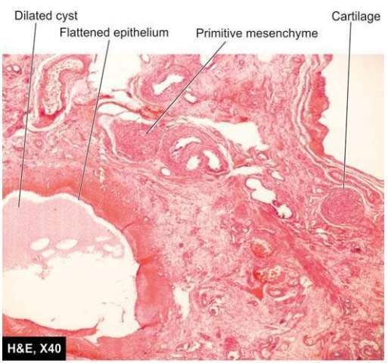
Multicystic renal dysplasia
Pathology
core
Cysts lined by flattened epithelium.
Islands of undifferentiated mesenchyme, often with cartilage, and immature collecting ducts
may mimic a neoplasm
Outcome depends upon uni/bi laterality

Slide 33
Summary
Pathology
core
Adult polycystic kidney disease is a disease of autosomal dominant inheritance caused by mutations in the genes encoding polycystin-1 or -2.
Childhood polycystic kidney disease is a disease of autosomal recessive inheritance caused by mutations in the gene encoding fibrocystin. It is less common than the adult.
Nephronophthisis–medullary cystic disease complex is a disease of autosomal recessive inheritance, it is associated with mutations in several genes that encode epithelial cell proteins called nephrocystins

Slide 34
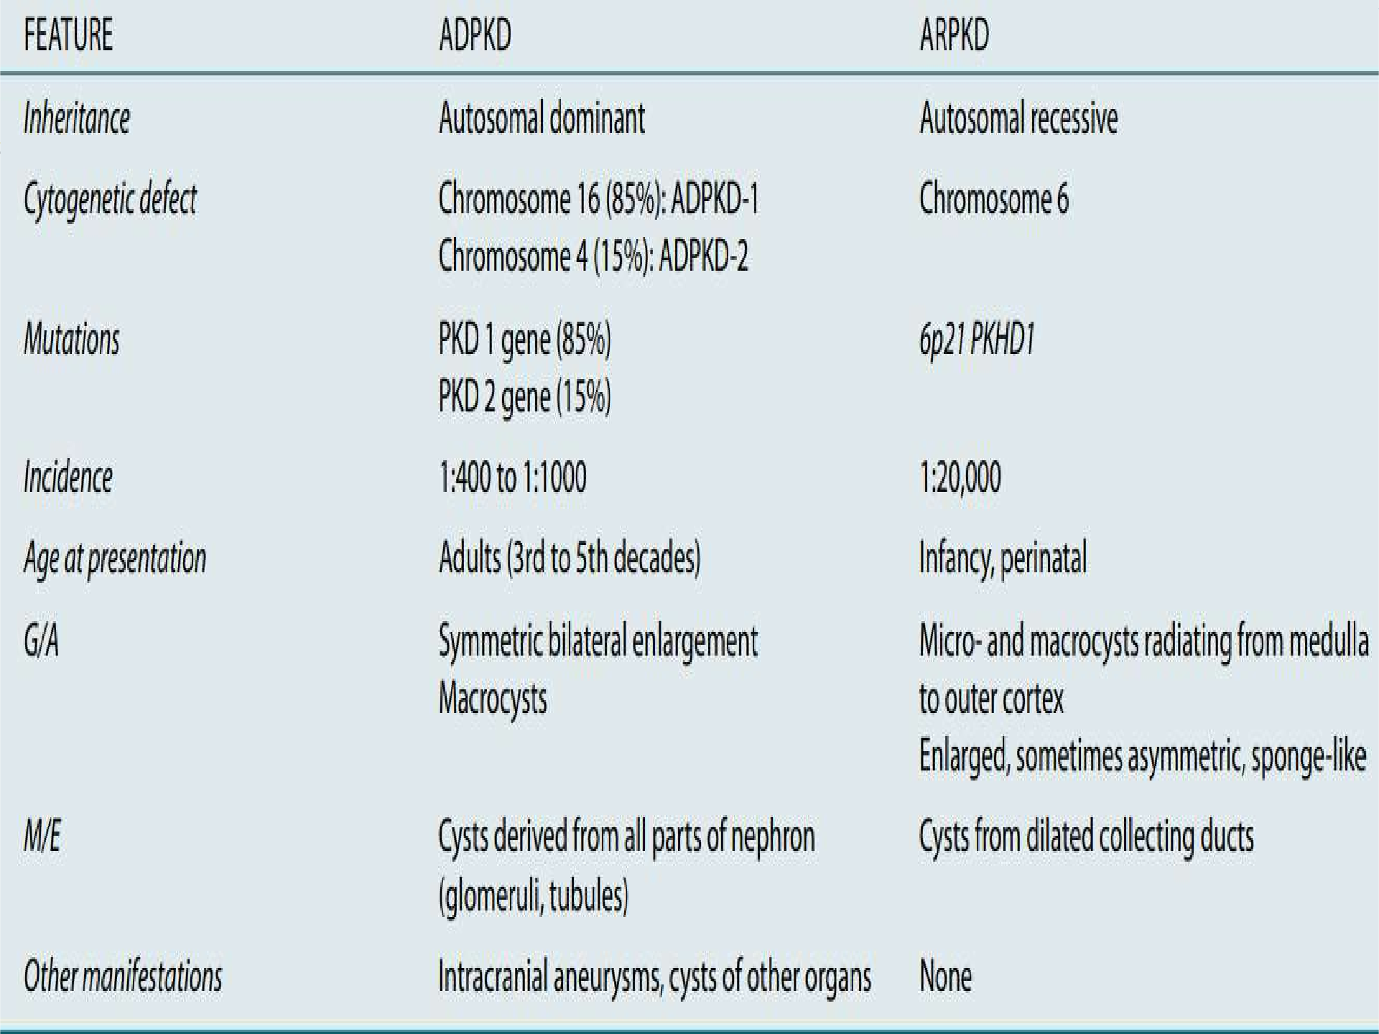
Pathology
core

Slide 35
Take home message
Renal disease refers to conditions that impair kidney function, including acute kidney
injury (AKI) and chronic kidney disease (CKD).
Glomerular diseases, such as nephrotic and nephritic syndromes, result from damage to the glomeruli and lead to proteinuria, hematuria, and other systemic complications.
Early diagnosis and management of renal disease are crucial to prevent progression to end-stage renal disease (ESRD), requiring dialysis or kidney transplantation.

Slide 36
Family medicine
A 45-year-old male with a history of poorly controlled hypertension presents with fatigue, swelling in his legs, and decreased urine output over the past few weeks. Laboratory tests reveal elevated serum creatinine and blood urea nitrogen (BUN), and a urine dipstick shows significant proteinuria. A renal biopsy shows sclerosed glomeruli with interstitial fibrosis.
What is the most likely diagnosis?
A. Acute Pyelonephritis
Diabetic Nephropathy
Focal Segmental Glomerulosclerosis (FSGS)
IgA Nephropathy
Acute Tubular Necrosis (ATN)
Correct Answer: C. Focal Segmental Glomerulosclerosis (FSGS)

Slide 37
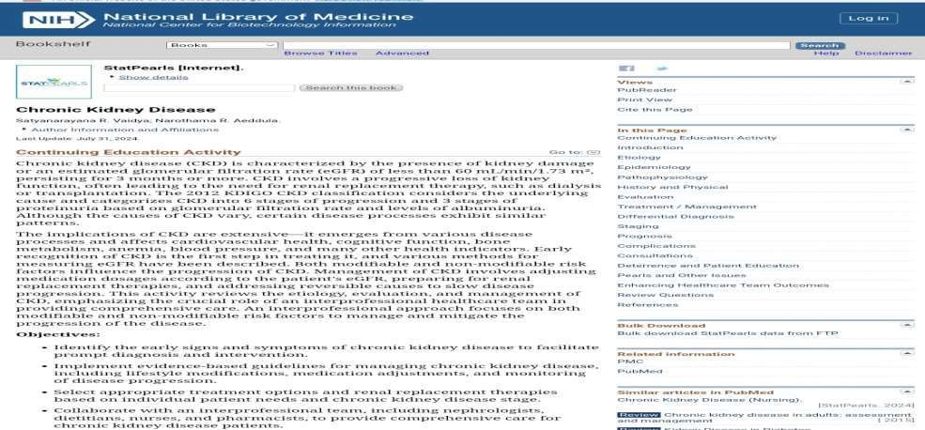
Longitudinal
Research
https://www.ncbi.nlm.nih.gov/books/NBK535404/

