Slide 2
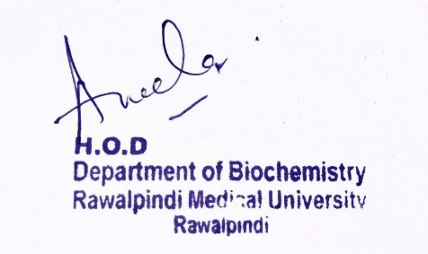
Renal Module 2nd Year MBBS (LGIS) Acid Base Imbalance I
Presenter: Dr. Aneela Jamil Date: 27-01-25
(Assistant Professor)

Slide 3
Motto, Vision, Dream
To impart evidence based research oriented medical education
To provide best possible patient care
To inculcate the values of mutual respect and ethical practice of medicine
Wisdom
Truth
Service

Slide 4
Professor Umar Model of Integrated Lecture

Slide 5
Learning Objectives
At the end of this lecture students should be able to
Explain the causes and compensation of Metabolic acidosis and alkalosis
Understand the Anion gap

Slide 6
Core Knowledge
Parameter | Normal Range
pH | 7.35-7.45
HCO₃ | 22-26 mmol/L
pCO₂ | 35-45 mmHg
HCO₃/H₂CO₃ | 20:1

Slide 7
Core Knowledge
Disorders of Acid Base Balance
ACIDOSIS: “pH of blood is LESS than 7.35”
ALKALOSIS: “pH of blood is MORE than 7.45”

Slide 8
Core Knowledge
pH?
<7.35
>7.45
Acidosis
Alkalosis
Metabolic
Respiratory
Metabolic
Respiratory

Slide 9
Core Knowledge
Acid base disturbances produced by the change in arterial pCO2 are called Respiratory disturbances
Acid base disturbances produced by the change in HCO3 conc. are called Metabolic disturbances

Slide 10
Core Knowledge
Metabolic acidosis
Metabolic alkalosis
Respiratory acidosis
Respiratory alkalosis

Slide 11
Core Knowledge
Uncompensated
Partially compensated
Fully compensated

Slide 12
Metabolic Acidosis
Core Knowledge
“Accumulation of non-volatile acids within the body”
Primary bicarbonate deficit
Low pH (< 7.35)
Decrease ratio of HCO3: H2CO3

Slide 13
Core Knowledge
Causes
Lactic Acidosis
Diabetic ketoacidosis
Uremic acidosis
Diarrhea
Intake of substances producing acids
Adrenal insufficiency

Slide 14
Core Knowledge
Respiratory compensation
Hyperventilation (Kussmaul respiration)
pCO2 falls
Renal compensation
Increased excretion of acid
Conservation of bicarbonate
Ammonia excretion

Slide 15
Metabolic Alkalosis
Core Knowledge
“A condition primarily associated with increase in the plasma bicarbonate concentration”
Primary alkali excess
Increase plasma pH (> 7.45)
Increase ratio of HCO3: H2CO3

Slide 16
Causes
Core Knowledge
Vomiting
Diuretics
Excessive intake of alkali
Hyperaldosteronism

Slide 17
Core Knowledge
Respiratory compensation
Hypoventilation
pCO2 increases
Renal compensation
Conservation of hydrogen ions
Loss of bicarbonate

Slide 18
Serum Anion Gap (AG)
Core Knowledge
Unmeasured anions constitute the Anion gap
Normal anion gap = 12 + 4 mEq/L
[Na+ + K+] - [Cl-+HCO3-] = 0
But:
=[142 + 4] - [105 + 25]
=146 – 130 = 16 mEq/L

Slide 19
Core Knowledge
mostly only sodium is taken as major cation:
=[142] - [105 + 25]
=142 – 130 = 12 mEq/

Slide 20
Core Knowledge

Slide 21
Core Knowledge
Significance of anion gap:
Helps to find cause of metabolic acidosis
If chloride ion is increased→ hyperchloremic metabolic acidosis with normal anion gap
If unmeasured anion is increased → normochloremic metabolic acidosis with high anion gap

Slide 22
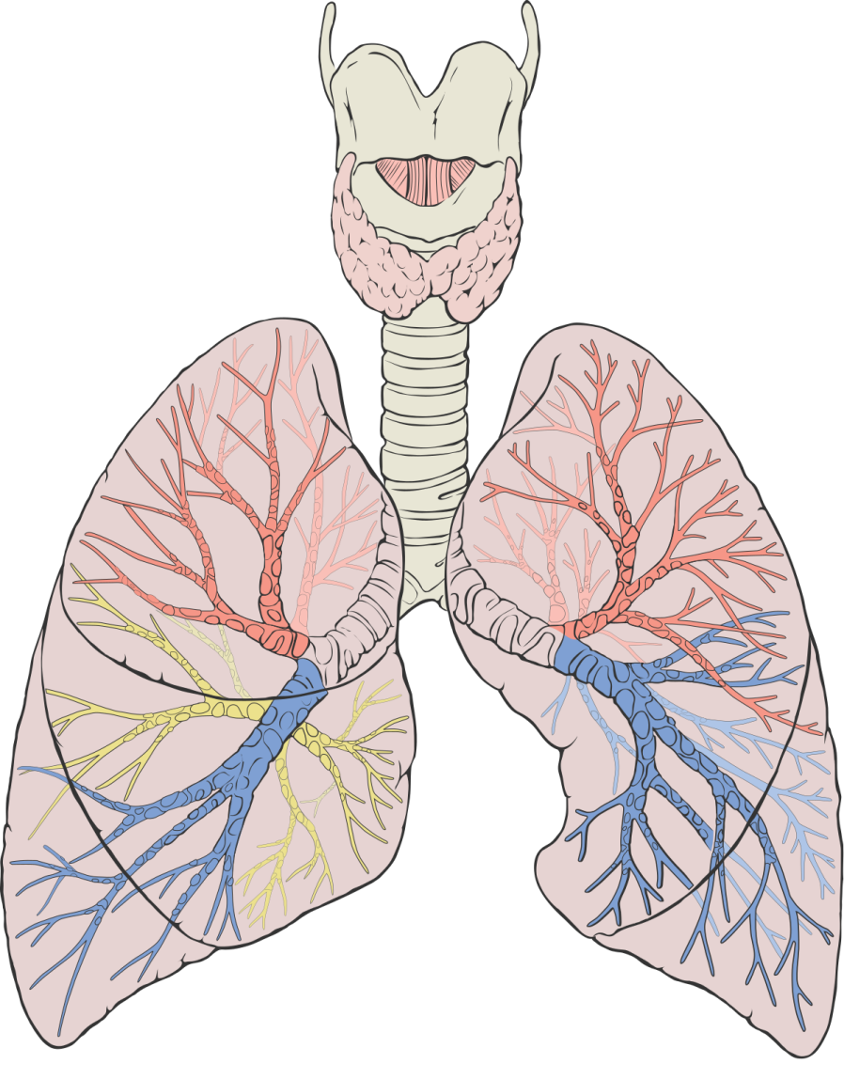
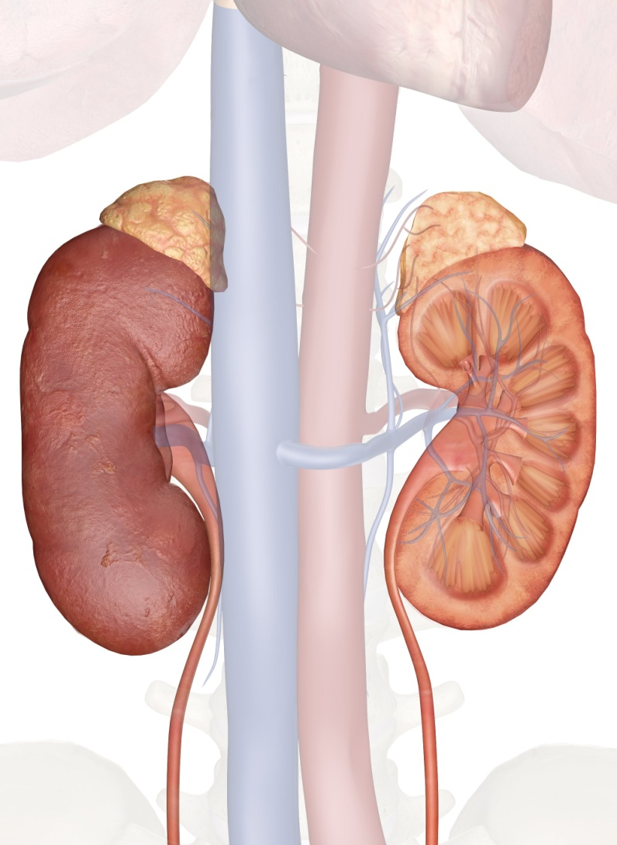
Anatomical & Physiological Aspects
Horizontal Integration

Slide 23
Horizontal Integration
Physiological aspects of Lungs & Kidneys
Regulation of acid-base equilibrium
Control of partial pressure of carbon dioxide and bicarbonate concentration
Control of blood pressure and fluid homeostasis

Slide 24
METABOLIC ACIDOSIS
pH | HCO₃⁻ | PCO₂ | Status
Vertical Integration
↓ | ↓↓ | N
Uncompensated
↓ | ↓↓ | ↓
Partially compensated
N | ↓↓ | ↓
Fully Compensated
METABOLIC ALKALOSIS
pH | HCO₃⁻ | PCO₂ | Status
↑ | ↑↑ | N
Uncompensated
↑ | ↑↑ | ↑
Partially compensated
N | ↑↑ | ↑
Fully Compensated

Slide 25
Vertical Integration
Normal anion gap metabolic acidosis | High anion gap metabolic acidosis
GI bicarbonate loss (diarrhoea, colostomy, ileostomy) | Lactic acidosis (shock, seizures, tissue hypoxia)
Renal bicarbonate loss (renal tubular acidosis) | Ketoacidosis (diabetes, chronic alcoholism, fasting)
Ingestions (acetazolamide, MgSO4) | Toxins metabolized to acids (methanol, salicylates)

Slide 26
Family Medicine
Spiral Integration
Family Medicine plays important role in following manner:
Early Diagnosis
Education
Dietary Guidance
Monitoring
Refer to Specialists

Slide 27
Artificial Intelligence
Spiral Integration
Artificial Intelligence plays role in following aspects:
Utilizes extensive data from patient thereby enhancing prevention, diagnosis & treatment based on individual genetic profile

Slide 28
Suggested Research Article
Spiral Integration
Link: https://www.sciencedirect.com/science/article/pii/S2590059521000194
Journal Name : Kidney Medicine
Title: Metabolic Acidosis in CKD: A Review of Recent Finding
Author Name: Michal L. Melamed
Introduction
Metabolic acidosis is fairly common in patients with chronic kidney disease (CKD). The prevalence of metabolic acidosis increases with worsening kidney function and is observed in ∼40% of those with stage 4 CKD. For the past 2 decades, clinical practice guidelines have suggested treatment of metabolic acidosis to counterbalance adverse effects of metabolic acidosis on bone and muscle. Studies in animal models of CKD also demonstrated that metabolic acidosis causes kidney fibrosis. During the past decade, results from observational studies identified associations between metabolic acidosis and adverse kidney outcomes, and results from interventional studies support the hypothesis that treating metabolic acidosis with sodium bicarbonate preserves kidney function.

Slide 29
Bioethics
Spiral Integration
Appropriate information
Explain to patient or his family the genetic aspects of the condition
Counselling

Slide 30
How To Access Digital Library
Steps to Access HEC Digital Library
Go to the website of HEC National Digital Library
On Home Page, click on the INSTITUTES
A page will appear showing the universities from Public and Private Sector and other Institutes which have access to HEC National Digital Library HNDL
Select your desired Institute
A page will appear showing the resources of the institution
Journals and Researches will appear
You can find a Journal by clicking on JOURNALS AND DATABASE and enter a keyword to search for your desired journal

Slide 31
Learning Resources
Textbook of Biochemistry, Mushtaq
Google scholar
Google images

