Slide 1
Renal Cell Carcinoma
DR.ASMARA ASRAR
Assistant Professor of Nephrology
Nephrology Department

Slide 2
MOTTO AND VISION
Mission Statement
To impart evidence-based research-oriented health professional education
Best possible patient care Mutual respect, ethical practice of healthcare and social accountability.
Vision and Values
Highly recognized and accredited centre of excellence in Medical Education, using evidence-based training techniques for development of highly competent health professionals, who are lifelong experiential learner and are socially accountable.
Goals
The Undergraduate Integrated Learning Program is geared to provide you with quality medical education in an
environment designed to:

Slide 3
Learning Objectives
Epidemology
Risk Factor
Pathology
Diagnosis
Staging
Management

Slide 4
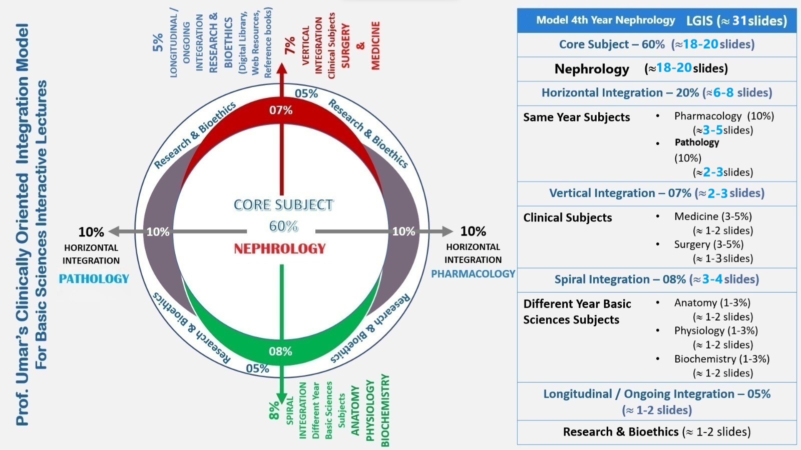

Slide 5
Epidemiology
Male predominance (M:F 1.5:1).
Most common in sixth to eighth decades; peak incidence in sixth decade
Metastatic disease in 30% at diagnosis, and eventually in 50% (lung, liver, bone, distant LN, adrenal, brain, opposite kidney, soft tissue)
Most sporadic RCCs are unilateral and unifocal

Slide 6
Stage at diagnosis is the most important prognostic factor
Predominant histologic type: adenocarcinoma arising from tubular epithelium
Adenocarcinoma subtypes:
clear cell (75–85%)
chromophilic/ papillary (10–15%)
chromophobe (5–10%)
oncocytic (rare)
Sarcomatoid (1–6%; poor prognosis)

Slide 7
Papillary (chromophilic) renal cell carcinoma extending into the collecting system

Slide 8
Risk factors
Tobacco , urban environmental toxins (cadmium/ asbestos/ petrols), obesity, high dietary fat intake, acquired cystic renal disease from renal failure
Association with von Hippel-Lindau disease:
autosomal dominant
loss of 3p
>70% chance developing RCC (almost all clear cell histology) risk of developing multiple other benign and malignant tumors (retinal angiomas, CNS hemangioblastomas, pheochromocytoma , pancreatic cancer)

Slide 9
Familial Renal Cell Carcinoma Syndromes

Slide 10
Pathology
Round to ovoid
Circumscribed by a pseudo capsule of compressed
parenchyma and fibrous tissue
Nuclear features can be highly variable

Slide 11
Fuhrman's Classification System for Nuclear Grade

Slide 12
Diagnosis
Common signs and symptoms:
hematuria (80%)
flank pain (45%)
flank mass (15%)
classic triad of prior three only present in 10%
normocytic/normochromic anemia, fever, weight loss
Less common signs and symptoms:
hepatic dysfunction without mets
Polycythemia
hypercalcemia (occurs in 25% of patients with RCC mets)

Slide 13
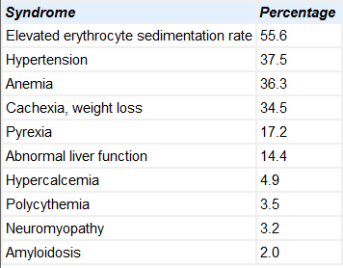
Paraneoplastic syndromes in 20% of patients with RCC

Slide 14
Diagnosis
Labs: CBC, LFT, BUN/Cr, LDH, urinalysis
Imaging:
CT abdomen
MRI abdomen if CT suggests IVC involvement
Metastatic evaluation:
Chest X ray
Bone scan or MRI brain only if clinically indicated

Slide 15
CT scan shows right renal tumor with perinephric stranding suggesting invasion of the perinephric fat

Slide 16
Contrast inferior venacavogram in patient with a right renal tumor shows involvement of the subdiaphragmatic vena cava

Slide 17
PET: equivocal findings on conventional imaging
Percutaneous renal biopsy or aspiration: limited role

Slide 18
Staging AJCC 7th Edition

Slide 21
Prognostic Factors For RCC

Slide 22
Management
Stage I-III
Nephrectomy
Open radical nephrectomy, but laparoscopic gaining popularity
Nephron sparing surgery via partial nephrectomy, if possible (open or laparoscopic)
Possible to spare adrenal gland in ~75% cases
No role for adjuvant chemo/immunotherapy

Slide 23
No widely accepted role for neoadjuvant or adjuvant radiotherapy.
Retrospective data suggest possible utility in select cases:
Positive surgical margins
Locally advanced disease with perinephric fat invasion and adrenal invasion (IVC/renal vein extension alone does not increase local recurrence significantly)
LN+
Unresectable (pre-op RT)

Slide 24
Stage IV
Cytoreductive nephrectomy: improved survival with
nephrectomy followed by interferon alpha vs.
interferon alpha alone

Slide 25
Systemic therapy
Immunotherapy (IL-2, interferon alpha, or combination)
High dose IL-2 only FDA approved treatment for
Biologic agents show promise in recent trials
Bevacizumab
Sorafenib or sunitinib
Temsirolimus
Consider chemo (gemcitabine ± 5-FU or capecitabine)
Focal palliation of metastases
RT alone
Metastasectomy
Combination of both

Slide 26
How to use HEC Digital Library
Steps to Access HEC Digital Library
Go to the website of HEC National Digital Library.
On Home Page, click on the INSTITUTES.
A page will appear showing the universities from Public and Private Sector and other Institutes which have access to HEC National Digital Library(HNDL).
4. Select your desired Institute
A page will appear showing the resources of the institution
6. Journals and Researches will appear
7. You can find a Journal by clicking on JOURNALS AND DATABASE and enter a keyword to search for your desired journal.

Slide 27
Question 1
What is the most common histological subtype of Renal Cell Carcinoma (RCC)?
A) Papillary RCC
B) Chromophobe RCC
C) Clear Cell RCC
D) Collecting Duct RCC

Slide 28
Question 2
A 50-year-old male presents with a 6-cm solid renal mass. What is the recommended treatment for this patient?
A) Partial nephrectomy
B) Radical nephrectomy
C) Ablative therapy (e.g., RFA or cryoablation)
D) Systemic therapy with tyrosine kinase inhibitors

Slide 29
Answers
Answer 1: C) Clear Cell RCC
Answer 2: B) Radical nephrectomy

Slide 30
References
1. Christiansen CF, Johansen MB, Langeberg WJ, et al. Incidence of acute kidney injury in cancer patients: a danish population-based cohort study. Eur J Intern Med. 2011;22(4):399–406.
2. Salahudeen AK, Bonventre JV. Onconephrology: the latest frontier in the war against kidney disease. J Am Soc Nephrol. 2013;24(1):26–30.
3. Janus N, Launay-Vacher V, Byloos E, et al. Cancer and renal insufciency results of the BIRMA study. Br J Cancer. 2010;103(12):1815–1821

Slide 31
THANKYOU

