Slide 1
RADIOLOGY OF ENT , HEAD AND NECK

Slide 2
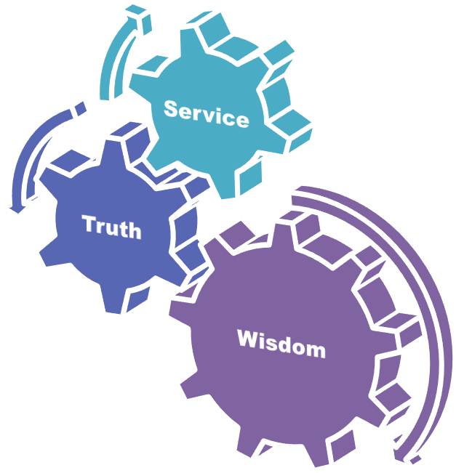
University Motto, Vision, Values & Goals
Mission Statement To impart evidence-based research-oriented health professional education Best possible patient care Mutual respect, ethical practice of healthcare and social accountability. Vision and Values Highly recognized and accredited centre of excellence in Medical Education, using evidence-based training techniques for development of highly competent health professionals, who are lifelong experiential learner and are socially accountable. Goals The Undergraduate Integrated Learning Program is geared to provide you with quality medical education in an environment designed to:

Slide 3
Sequence of LGIS
Learning objectives
How to diagnose different ENT , Head and neck diseases on radiology (core concept = 60%)
Anatomy, physiology, biochemistry (spiral integration 8%)
Pathology and community medicine (horizontal integration 20%)
Related clinical medical surgical (vertical integration – 7%)
Research, family medicine, bioethics, artificial intelligence (5%)

Slide 4
Learning Objectives
At the end of lecture students shall be able to
Visualize different diseases
Diagnose diseases on the basis of radiology

Slide 5
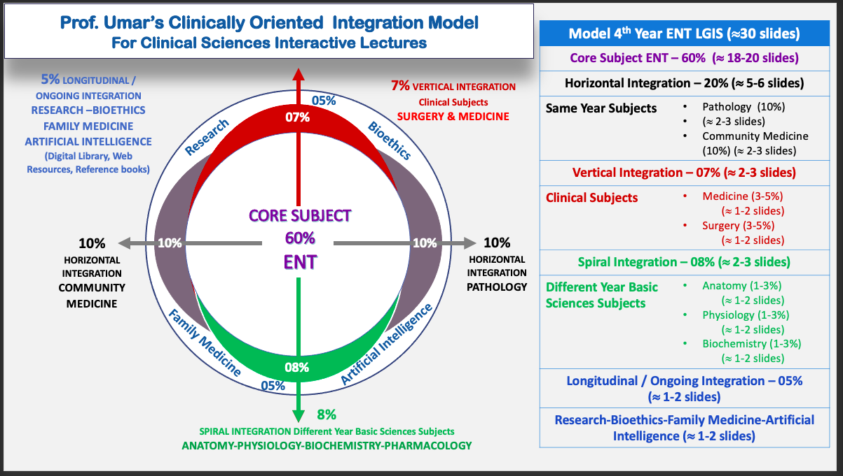
Prof Umar Model Of Integrated Lecture

Slide 6
Areas in ENT, Head &Neck to look for in Radiology
Nose, nasal cavity and PNS
Nasopharynx and it’s roof
Soft palate
Base of skull
Mastoid , ear , temporal bone
Base of tongue, valleculae, epiglottis
Hyoid bone, thyroid cartilage, cricoid cartilage
Subglottic space, aryepiglottic folds
Prevertebral soft tissue , pretracheal soft tissue , cervical spine

Slide 7
Types of radiological views used
Lateral view neck
AP view neck
Soft tissue lateral view nasopharynx
Axial , coronal , saggital views

Slide 8
Normal anatomy of sinuses on CT A, cribriform plate; B, lamina papyracea; C, inferior orbital nerve; D, temporalis muscle; E, hard palate; F, inferior turbinate; G, middle turbinate

Slide 9
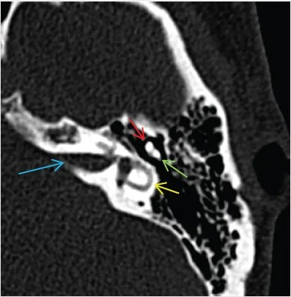
CORE SUBJECT
Normal anatomy of the middle/inner ear on CT. Red arrow, head of malleus; green arrow, short process of incus; blue arrow, internal auditory canal; yellow arrow, lateral semi-circular canal

Slide 10
X-ray head and neck

Slide 11
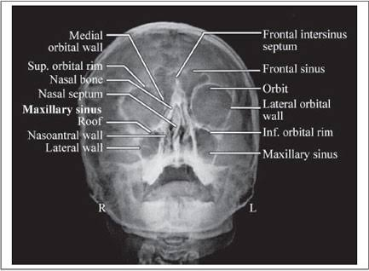
Normal X-ray Nose and PNS
Spiral integration

Slide 12
Acute frontal and maxillary sinusitis
Horizontal integration

Slide 13
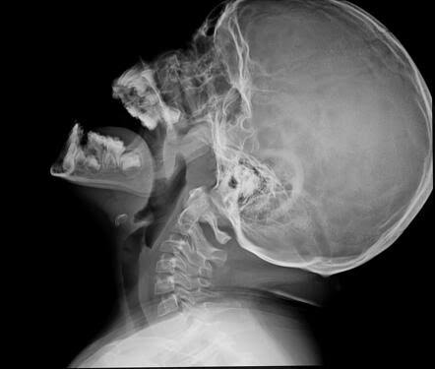
X-ray adenoids hypertrophy
X-ray neck lateral view soft tissue, with mouth open, neck extended

Slide 14
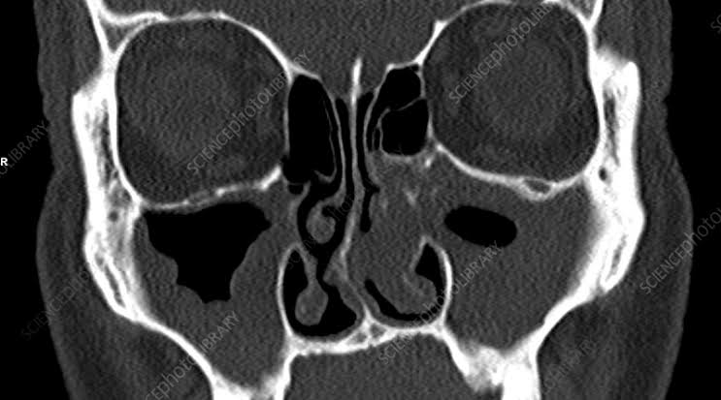
Nasal polyp left side CT scan coronal view
Horizontal integration

Slide 15
CT scan Axial view showing juvenile nasopharyngeal angiofibroma
Horizontal integration

Slide 16
CT scan temporal bone showing acute mastoiditis
Horizontal integration

Slide 17
Barium swallow , esophageal web in plummer Vinson syndrome
CORE SUBJECT

Slide 18
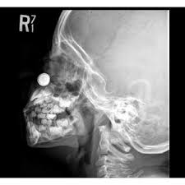
Foreign body nose
Core Subject

Slide 19
Foreign body ear (Eustachian tube)
Horizontal integration

Slide 20
Foreign body esophagus

Slide 21
Foreign body Bronchus

Slide 22
Tracheal Stenosis

Slide 23
Retropharyngeal abscess
Spiral Integration
Pre vertebral soft tissue swelling

Slide 24
Fungal rhinosinusitis

Slide 25
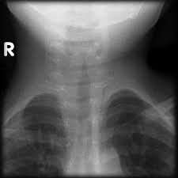
Croup steeple sign

Slide 26
Acute epiglottitis thumb printing sign
Vertical Integration

Slide 27
Research
https://www.google.com/url?sa=t&source=web&rct=j&opi=89978449&url=https://jamanetwork.com/journals/jamaotolaryngology/fullarticle/608162&ved=2ahUKEwjauuur-9mEAxUu9bsIHXBACCkQFnoECB0QAQ&usg=AOvVaw3ndfxAooUCLRyfDqKgSK6s

Slide 28
Artificial Intelligence
Longitudinal Integration
Role of AI in ENT radiology is imaging analysis, automated diagnosis, surgical planning, treatment recommendations, monitoring, and prognosticatio

Slide 29
REFERENCES
SCOTT BROWN OTOLARYNGOLOGY 8th edition
Disease of ENT Saleem Iqbal Bhutta
PL Dhingra, 7th edition

