Slide 2
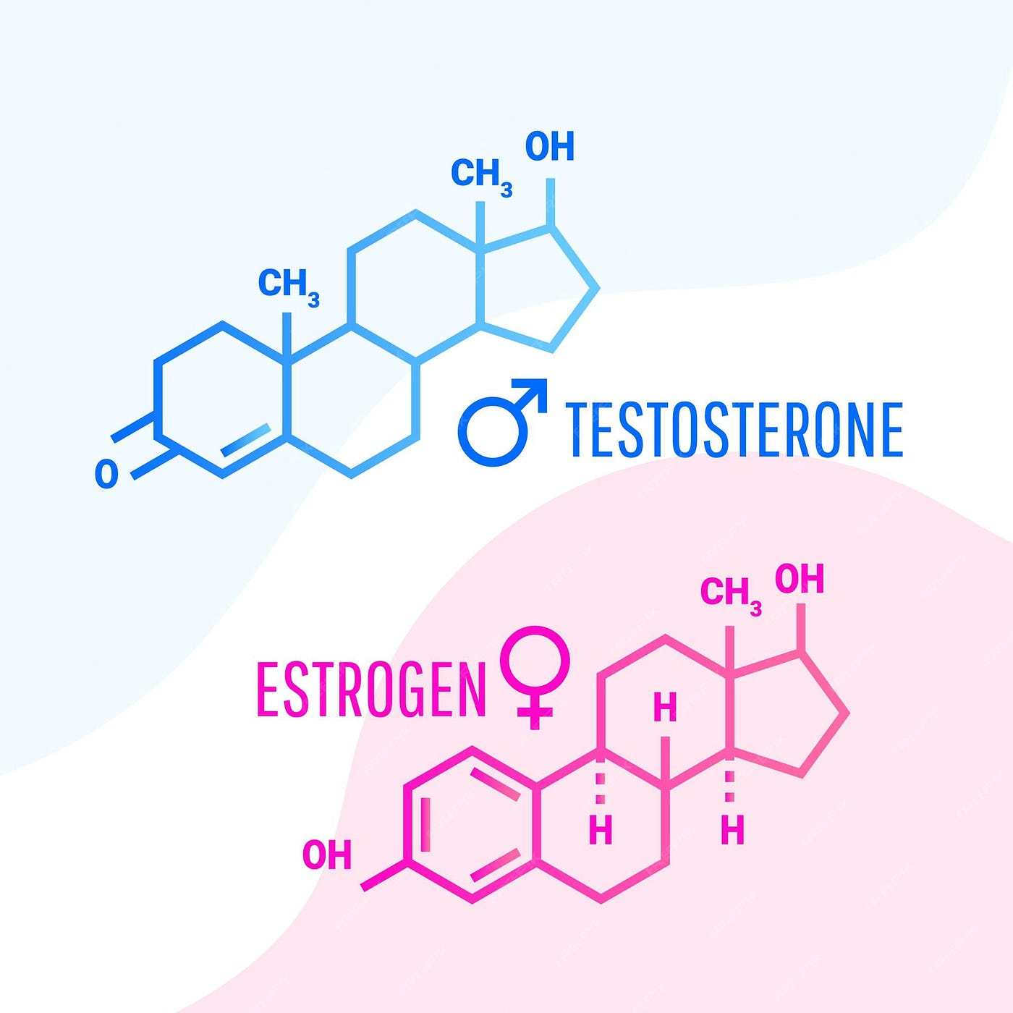
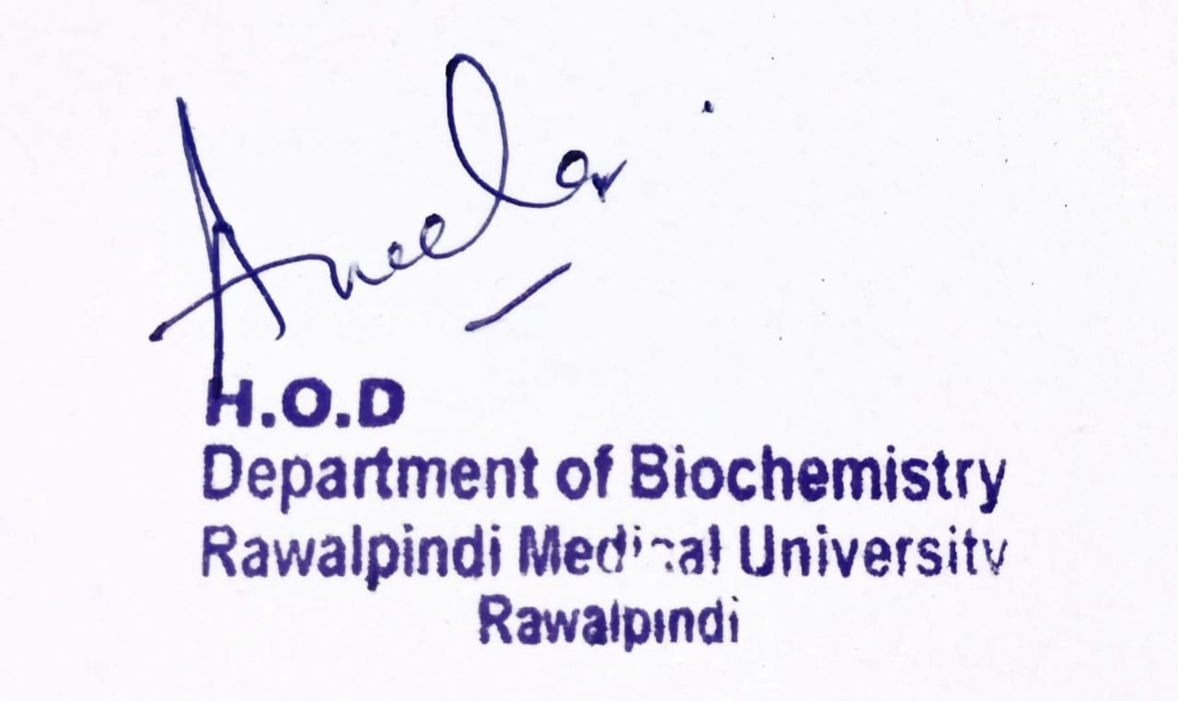
Reproduction Module 2nd Year MBBS (SGD) Reproductive Hormones
Presenter: Dr. Sana Latif Date: 25-02-25
(Senior Demonstrator)

Slide 3
Motto, Vision, Dream
To impart evidence based research oriented medical education
To provide best possible patient care
To inculcate the values of mutual respect and ethical practice of medicine
Wisdom
Truth
Service

Slide 4
Professor Umar Model of Integrated Lecture

Slide 5
Learning Objectives
Biochemical aspects of Male and Female Reproductive Hormones.
Outline of the Reproductive Anatomy.
Mechanism of Regulation of Reproductive Hormones.
Clinical Implications of Hormone imbalances.
Management of related disorder.
Role Of AI and Bioethics in Reproductive Endocrine Imbalance

Slide 6
Interactive Session
A female XYZ, unmarried, age 25 years, comes to the OPD asking for information about how to manage the hair growth and acne on her face.
She explains that she has polycystic ovary syndrome and started taking the combined oral contraceptive pill three months ago. She is worried that although the treatment has helped with most of her symptoms (her periods are more regular and less painful), the acne on her face and the hair on her chin are still present. The patient confirms there is no family history of cardiovascular disease and she has recently joined a running club to help her maintain a fit and healthy lifestyle.

Slide 7
Main Hormones of the Reproductive System
Core Knowledge
MALE
Testosterone
Dihydrotestosterone (DHT)
Androgens:
Androstenedione
DHEA
Follicle Stimulating Hormone
Luteinizing Hormone
Inhibin
FEMALE
Estrogen
Progesterone

Slide 8
Testosterone
Core Knowledge
Male Reproductive Hormones
Production: Leydig cells of the testes.
Regulation: Hypothalamic-Pituitary-Gonadal (HPG) axis.
Enzyme:17β-Hydroxysteroid dehydrogenase (17β-HSD).
Functions
Primary Sexual Characteristics (Fetal Life)
Secondary Sexual Characteristics (Puberty)
Spermatogenesis i.e production and maturation of sperm.
Anabolism : protein synthesis and muscle growth.
Behavioral Effects: Influences libido and aggression.

Slide 9
Dihydrotestosterone (DHT)
Core Knowledge
Male Reproductive Hormones
More potent than testosterone.
Production: Prostate, skin, liver
Regulation: Hypothalamic-Pituitary-Gonadal (HPG) axis.
Enzyme: 5 α Reductase
Functions
Development of the prostate.
Formation of external genitalia during fetal development.
Secondary sexual characteristics: facial/body hair, and sebaceous gland activity

Slide 10
Estrogen
Core Knowledge
Female Reproductive Hormones
Most potent form: Estradiol
Production: Granulosa Cell of the Ovary, Adrenal Gland, Adipose Tissue.
Regulation: Hypothalamic-Pituitary-Ovarian (HPO) axis.
Enzyme:17β-HSD, P450 aromatase
Functions
development of female secondary sexual characteristics
regulation of the menstrual cycle, and maintenance of the reproductive tissues.
systemic effects on bone density, cardiovascular health, and skin integrity.

Slide 11
Progesterone
Core Knowledge
Female Reproductive Hormones
Production: corpus luteum in the ovaries and the placenta during pregnancy
Regulation: Hypothalamic-Pituitary-Ovarian (HPO) axis.
Enzyme: 3 β- Hydroxysteroid dehydrogenase
Functions
to prepare the endometrium for implantation and maintain pregnancy.
Regulation of menstrual cycle by inhibiting LH and FSH release, thus preventing further ovulation during the luteal phase.
The development of mammary glands for lactation.
Uterine smooth muscle relaxation for preventing preterm labor.

Slide 12
Androgens: Androstenedione and DHEA
Core Knowledge
Common Reproductive Hormones
Androstenedione:
Produced in the adrenal glands and gonads.
Intermediate in the biosynthesis of testosterone and estrogen.
DHEA:
Produced mainly by the adrenal cortex.
Functions as a precursor to male and female sex hormones.
Levels peak in early adulthood and decline with age.
Role in Puberty:
Contributes to the growth spurt and development of secondary sexual characteristics.

Slide 13
Anatomy of the Male And Female Reproductive System
Horizontal Integration

Slide 14
Hypothalamic-Pituitary-Gonadal Axis
Horizontal Integration
Physiology
The Regulator of Testosterone Level
Hypothalamus:
Releases Gonadotropin-Releasing Hormone (GnRH) in a pulsatile manner.
Pituitary Gland:
Releases Luteinizing Hormone (LH) and Follicle-Stimulating Hormone (FSH) in response to GnRH.
Testes:
LH: Stimulates Leydig cells to produce testosterone.
FSH: Supports Sertoli cells and spermatogenesis.
Negative Feedback:
Inhibition of GnRH and LH secretion.
Positive Feedback:
Conversion of testosterone to estradiol by the enzyme aromatase.

Slide 15
Hypothalamic-Pituitary-Ovarian Axis
Horizontal Integration
Physiology
Hypothalamus:
Releases Gonadotropin-Releasing Hormone (GnRH) in a pulsatile manner.
Pituitary Gland:
Releases Luteinizing Hormone (LH) and Follicle-Stimulating Hormone (FSH) in response to GnRH.
Ovaries:
LH: Triggers ovulation (LH Surge),
Production of Progesterone by Corpus Luteum
FSH: Follicular Growth, Production of Estrogen
Negative Feedback:
Estrogen and progesterone exert negative feedback on the hypothalamus and pituitary to regulate the secretion of GnRH, FSH, and LH, maintaining hormonal balance.

Slide 16
Clinical Correlation Male Hormonal Imbalances and Treatment
Vertical Integration
Hypogonadism:
Causes: Klinefelter syndrome, testicular injury, pituitary disorders.
Symptoms: Reduced libido, erectile dysfunction, infertility, decreased muscle mass, fatigue.
Treatment: Testosterone replacement therapy (TRT).
Hypergonadism:
Causes: Androgen-secreting tumors, anabolic steroid use.
Symptoms: Early puberty in boys, aggressive behavior, increased muscle mass.
Treatment: Address underlying cause, potential use of anti-androgens.
Androgen Insensitivity Syndrome:
Description: Genetic condition where individuals have male XY chromosomes but develop female characteristics due to androgen receptor dysfunction.
Management: Psychological support, hormone therapy.
Benign Prostatic Hyperplasia (BPH):
Description: Enlargement of the prostate gland, common in older men.
Symptoms: Urinary frequency, urgency, weak stream.
Treatment: 5-alpha-reductase inhibitors, alpha-blockers, surgery.

Slide 17
Clinical Correlation Female Hormonal Imbalances and Treatment
Vertical Integration
Polycystic Ovary Syndrome (PCOS):
Hormonal imbalances, including elevated levels of androgens.
Clinical features include irregular menstrual cycles, hirsutism, acne, weight gain, and infertility.
Hormonal therapies for PCOS include combined oral contraceptives, anti-androgens, metformin, and clomiphene citrate.
Amenorrhea:
Amenorrhea is the absence of menstrual periods and can be primary or secondary.
Causes include hormonal imbalances, hypothalamic dysfunction, pituitary disorders, PCOS, or thyroid dysfunction.
Hormonal therapies depend on the underlying cause and may include hormone replacement therapy (HRT) in menopause-related cases.
Premature Ovarian Failure (POF):
ovaries stop functioning before the age of 40, leading to decreased estrogen production.
Clinical features include irregular or absent menstrual periods, hot flashes, vaginal dryness, and infertility.
Hormone replacement therapy (HRT) and combined oral contraceptives for symptoms management.
Hormonal Therapies and Their Uses:
Hormone Replacement therapy (HRT)
Contraceptive hormonal therapy includes various forms such as combined oral contraceptives, progestin-only pills, patches, injectables, and hormonal IUDs.
treatment of endocrine disorders like hypothyroidism, hyperthyroidism, adrenal insufficiency, and diabetes mellitus.

Slide 18
Management of PCOS
Spiral Integration
Family Medicine
Family Medicine plays important role in following manner:
Diagnosis
Education
Dietary Guidance
Monitoring
Refer to Specialists

Slide 19
Management of PCOS
Spiral Integration
Family Medicine
Since she has only been taking the pill for three months and has seen an improvement in her symptoms, she does not need to go to her GP for referral to a dermatologist. To see the full benefit of the pill, up to six months of treatment is needed; therefore, she should be reassured that it might take another three months for the full effects of treatment to be achieved. She should also be advised to maintain a balanced diet and continue with her running club.
The patient can be advised to buy over-the-counter benzoyl peroxide as a 5% gel or as a 10% wash for her acne. For better efficacy, she should apply it to her face using a cleanser and sun protection moisturizer rather than applying to individual lesions. The treatment can be completed for six weeks and be assessed thereafter. Johanna should also be advised that non-comedogenic make up is available.
If after six months of treatment, Miss XYZ still has acne and facial hair, she should be referred to her Dermatologist/Endocrinologist for a prescription. However, it is important to advise her that a common side effect of facial hirsutism cream is acne; therefore, hair removal may be a good option for this patient. Laser removal of facial hair may also be considered.

Slide 20
Role Of AI in Management
Spiral Integration
Artificial Intelligence
Artificial Intelligence plays role in following aspects:
Personalized Nutrition
Diagnostic Tools
Food Recommendations
Drug Development

Slide 21
Ethical Consideration
Spiral Integration
Bioethics
Informed Consent:
Ensuring that individuals fully understand the risks and benefits of hormone treatments, particularly when used for purposes such as fertility treatments or gender transition.
Equity and Access:
Ethical concerns arise when certain groups face barriers to accessing reproductive health care or when treatments are unaffordable.
Reproductive Rights:
Balancing the rights of individuals to make decisions about their own reproductive health with societal concerns about the potential consequences of certain hormone therapies, such as the implications for future generations or the environment.
Risk and Safety:
Assessing the risks and benefits of hormone therapies, including potential long-term health effects, and ensuring that patients are adequately informed about these risks. the responsibility of healthcare providers and researchers is to minimize risks and prioritize patient safety.

Slide 22
Quantifying The Variability In The Assessment Of Reproductive Hormone Levels.
Spiral Integration
Research Article
Ali Abbara ¹, Sophie Adams ², Maria Phylactou ¹, Chioma Izzi-Engbeaya ¹, Edouard G Mills ¹, Layla Thurston ¹, Kanyada Koysombat ¹, Simon Hanassab ³, Thomas Heinis ⁴, Tricia M-M Tan ⁵, Krasimira Tsaneva-Atanasova ⁶, Alexander N Comninos ¹, Margaritis Voliotis ⁶, Waljit S Dhillo ⁷
Fertil Steril. 2024 Feb;121(2):334-345. doi:10.1016/j.fertnstert.2023.11.010. Epub 2023 Nov 15.
To quantify how representative a single measure of reproductive hormone level is of the daily hormonal profile using data from detailed hormonal sampling in the saline placebo-treated arm conducted over several hours.
The initial morning value of reproductive hormone levels was typically higher than the mean value throughout the day (percentage decrease from initial morning measure to daily mean: luteinizing hormone level 18.4%, follicle-stimulating hormone level 9.7%, testosterone level 9.2%, and estradiol level 2.1%). Luteinizing hormone level was the most variable (CV 28%), followed by sex-steroid hormone levels (testosterone level 12% and estradiol level 13%), whereas follicle-stimulating hormone level was the least variable reproductive hormone (CV 8%). In healthy men, testosterone levels fell between 9:00 am and 5:00 pm by 14.9% (95% confidence interval 4.2, 25.5%), although morning levels correlated with (and could be predicted from) late afternoon levels in the same individual (r² = 0.53, P<.0001). Testosterone levels were reduced more after a mixed meal (by 34.3%) than during ad libitum feeding (9.5%), after an oral glucose load (6.0%), or an intravenous glucose load (7.4%).
Conclusion: Quantification of the variability of a single measure of reproductive hormone levels informs the reliability of reproductive hormone assessment.

Slide 23
How To Access Digital Library
Steps to Access HEC Digital Library
Go to the website of HEC National Digital Library
On Home Page, click on the INSTITUTES
A page will appear showing the universities from Public and Private Sector and other Institutes which have access to HEC National Digital Library HNDL
Select your desired Institute
A page will appear showing the resources of the institution
Journals and Researches will appear
You can find a Journal by clicking on JOURNALS AND DATABASE and enter a keyword to search for your desired journal

Slide 24
Learning Resources
Textbook of Biochemistry, Lippincott 8th edition, chapter no.28 , pages no. 432-436
Google scholar
Google images

